Slide 1
Annual District Utility Meetings 2013
Accommodation and Coordination
Bryan Bradley
Utility Engineer
Office of Traffic and Safety
Iowa Department of Transportation
Bryan.Bradley@iowa.gov
1

Slide 2
Purpose of this Powerpoint
What's new in Utilities at the DOT
Hit a bunch of topics
Promote understanding cooperation
2

Slide 3
Utility Accommodation and Coordination (Central Office in Ames)
Utilities Section
Permits & Utility Relocation (Policy)
Utility Relocation Agreements
In the Traffic and Safety Office
Group consists of
Bryan Bradley Utility Engineer/Administrator
Jeff McCollough Utility Relocation/Permits
Stephanie Anderson Agreements Secretary
3

Slide 4
Utility Accommodation and Coordination ( 6 Districts)
Assistant District Engineer
Responsible for construction projects
District Utility Coordinators (DUC)
5 Districts have 1 full time pos. 6th shares the pos.
Coordinates with utilities on construction projects
Permits-Engineering Operations Technician (EOT)
2 or 3 per district
Administers Access and Utilities permits including:
Utility Accommodation Permits
Application to Perform Work Within State Highway Right-of-Way
4

Slide 5
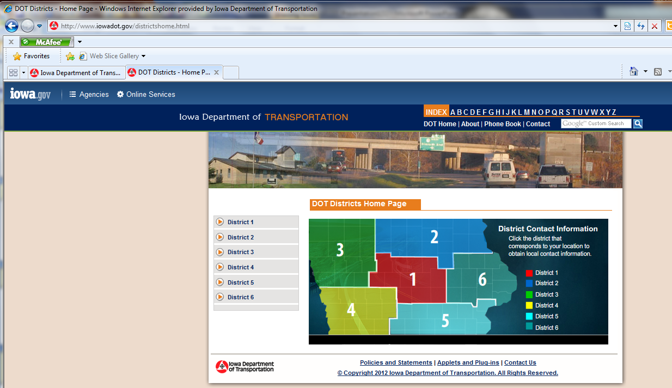
http://www.iowadot.gov/districtshome.html
OR see the districts contacts power point in the CD

Slide 6
Utility Accommodation and Coordination (IADOT)
Central Office
Policy
Agreements
Plan Submittal
District
Initial notification
Conduct meetings
Coordinate movement
Permits
Working on cohesiveness and standardization
6

Slide 7
Utility Accommodation and Coordination (IADOT)
Changes
We are implementing program of
Utility dates U00 through U07
Follow the Point 25 process for most projects.
End Results
Fewer plans sent out, only when it needed (working with survey, soils)
Plans sent on schedule fit to our design and letting dates.
Increased ability to modify plans.
7

Slide 8
Utility Accommodation and Coordination (IADOT)
We are really working across districts and the state to improve the process.
Will gladly listen to your concerns and suggestions bryan.bradley@iowa.gov
As we go forward you will know that all communications are important if we send them. Please reply.
8

Slide 9
Utility Accommodation and Coordination
Operational Planning Meeting (OPM)
Preliminary meeting with utilities
Get all involved in design, can change design
Before final design complete
Utility Coordination Meeting UCM
Promote cooperation, utilities work together
Understand utility issues
Present new information as project develops
9

Slide 10
Agreements
Utility on private property or easement
Through central office
Need estimate
Need work plan (drawings)
Need easement documents
Final amount within 125% of Estimate
10

Slide 11
Agreements
Central office writes them up
Pre-Audit, Certificate of Completion
Final Audit, Disclaimer of Interest in Realty
Final Payment of Retainage (10%)
Discussion or questions on Agreements?
11

Slide 12
ADA REQUIREMENTS FOR SIDEWALKS
CHECK OUT THE CD
Law since 1990
Pressure being applied by Feds
12

Slide 14
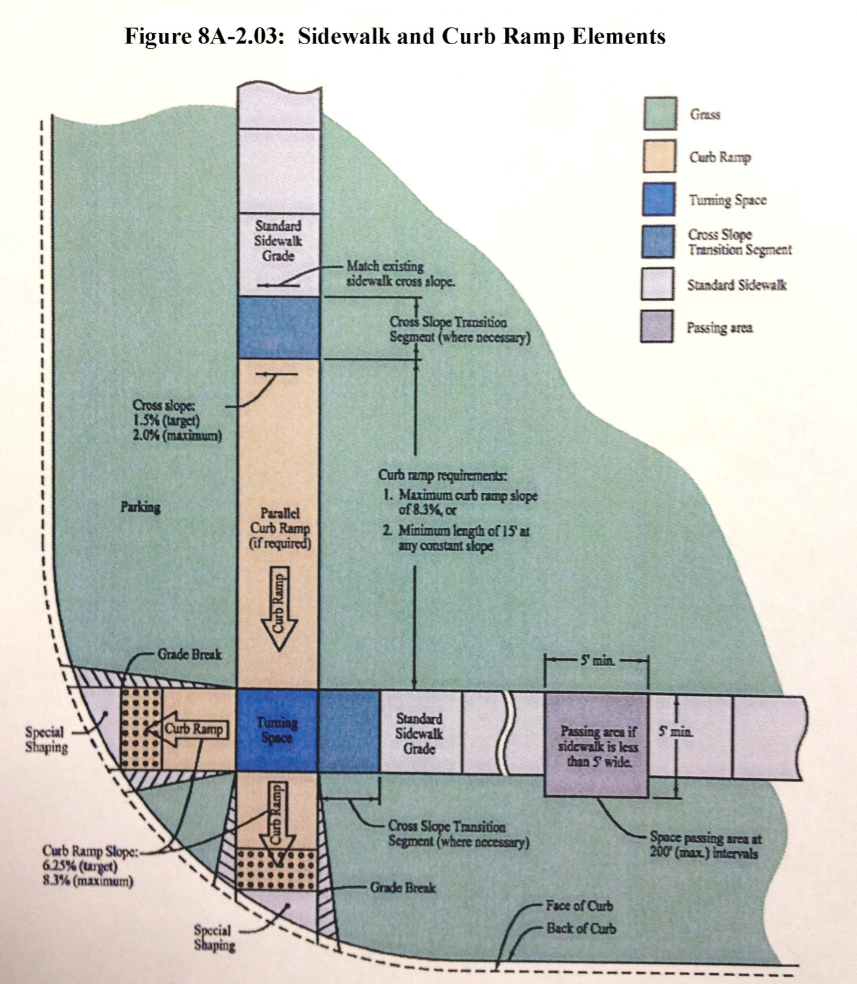
(From SUDAS)

Slide 15
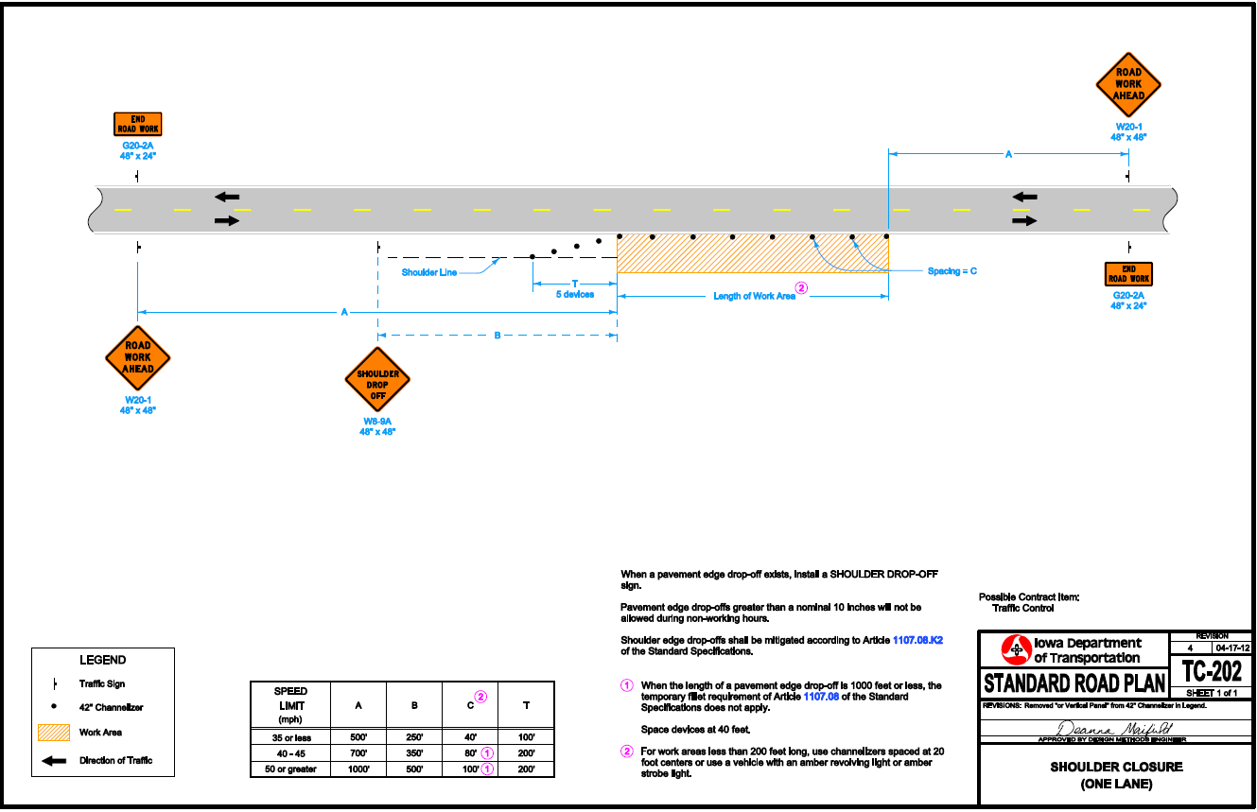
Temporary Traffic Control
CHECK OUT THE CD/HANDOUT
It is in the policy it is not optional
15

Slide 16
Other issues
Utilities are Liable for Contractors work/TTC/plans
Check out the Policy Page 34
Please work with contractors to follow Policy and the permits.
Work times(1/2 hour after/before sun up/down)
16

Slide 17
Other issues
Abandonments
Becoming more of an issue every day.
Check out the Policy Page 34
DOT needs to be notified
Permitting Issues
Check out the CD again (checklist)
Have people who fill them out go through list.
17

Slide 18
conclusions
Comments/suggestions????
Bryan Bradley
Utility Engineer
Office of Traffic and Safety
Iowa Department of Transportation
Bryan.Bradley@iowa.gov
515-239-1014

