Slide 1
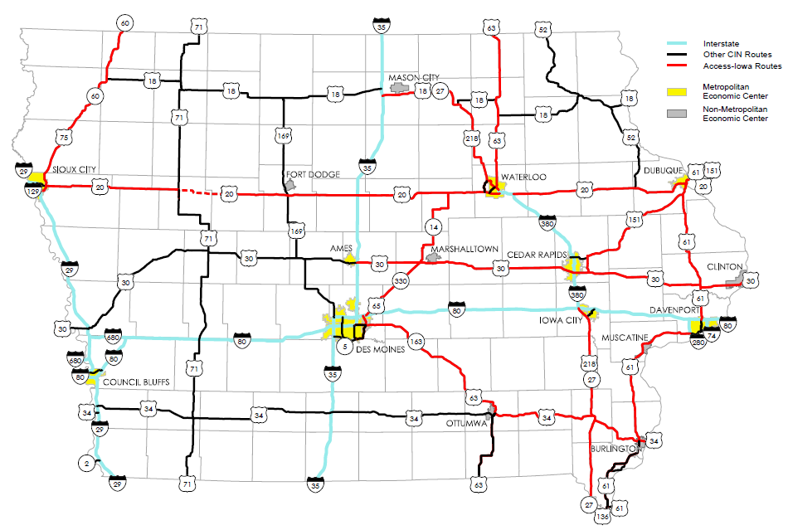
TIME-21 Accelerated Development of Key CIN Corridors
Improvement changes FY 2009 to FY 2016
March 13, 2012
Sac, Calhoun, Webster US 20
Awarded/Spent $177 M
Programmed $ 39 M
Total Cost $216 M
Length: 46 miles
Completion 2013
Bremer US 63
Awarded/Spent $45 M
Programmed $ 1 M
Total Cost $46 M
Length: 16.3 miles
Completion 2012
Webster, Humboldt US 169
Total Cost: $14 M
Length: 13 miles
Completion 2011
Woodbury US 20
Total Cost: $107 M
Programmed 2013-2019
Length: 11.5 miles
Story, Marshall US 30
Total Cost: $21 M
Length: 14.8 miles
Completion 2011
US 30 Tama/Toledo Bypass
Total Cost: $59 M
Length: 7.5 miles
Completion 2011
Louisa US 61
Total Cost: $30 M
Programmed 2014-2017
Length: 4.1 miles
Mills US 34
Awarded/Spent $53 M
Programmed $32 M
Total Cost $85 M
Length: 4.9 miles
Completion 2013
US 61 Fort Madison Bypass
Awarded/Spent $ 81 M
Programmed $ 1 M
Total Cost $ 82 M
Length: 9 miles
Completion 2011
Indicates Accelerated Development of Key CIN Corridors in TIME-21 Study
Indicates remaining TIME-21 Accelerated Development of Key CIN Corridors to be programmed after FY 2016
38

