Slide 1
Accessing Project Plans Electronically
FTP(File Transfer Protocol)
Site Instructions
Notes:
In the past the IDOT would send either paper copies or CD’s of the project plans out to the utility companies. Now the office of Traffic and Safety will be sending an E-Mail with a link referencing the location of the project plans on our ftp site.

Slide 2
FTP Site Instructions
DOT will E-Mail link for project :
  FTP://utilities:8898NN38@165.206.203.34
Copy link into Windows Explorer / NOT Internet Explorer
Getting to Windows Explorer
  Left click mouse / start button / my computer / paste into address bar / Go
  Right click mouse/ explorer / paste into address bar / Go
Notes:
Read from slide.

Slide 3

Windows Explorer
Not Internet Explorer
Notes:
Read from slide.

Slide 4
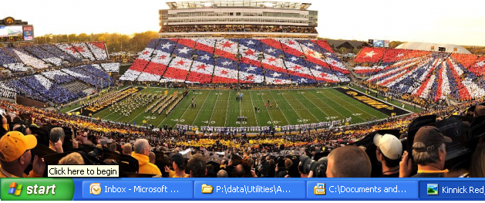
Left Click Start Button
Notes:
Left click start button.

Slide 5
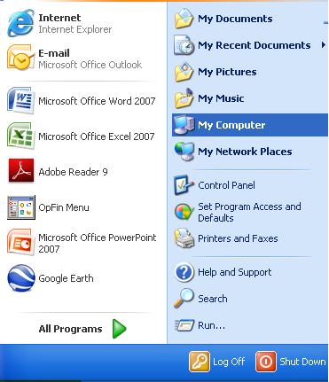
Left Click My Computer Button
Notes:
Left click my computer button.

Slide 6
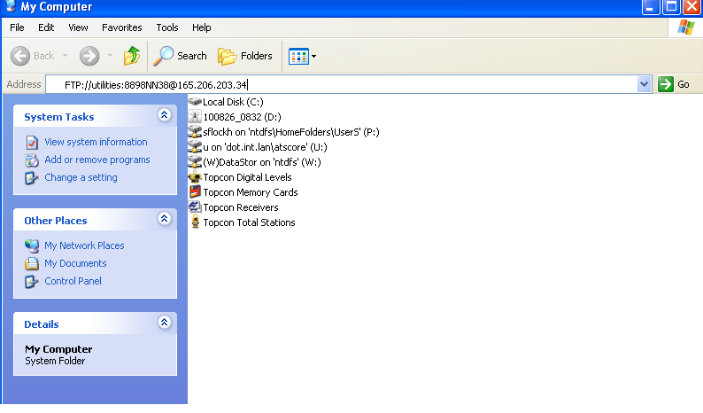
Paste Link Into Address Bar / Click Go
Notes:
Paste link into address bar / click go.

Slide 7
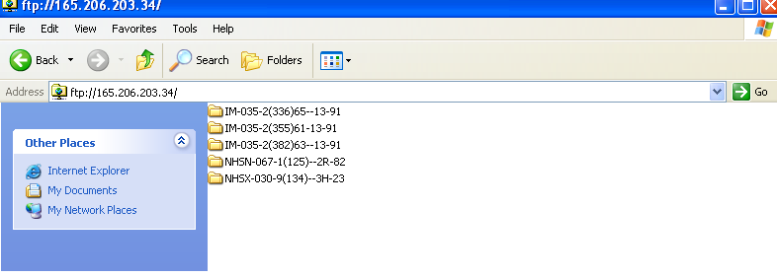
Select Project
Notes:
Select project, open folder and file save as plans to your computer.

Slide 8
Right Click Start Button
Notes:
Right click start button.

Slide 9
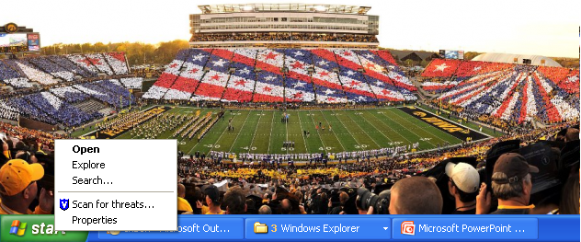
Right Click Explore
Notes:
Right click on Explorer.

Slide 10
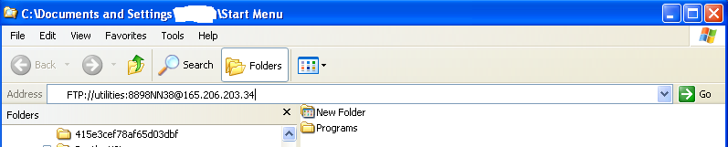
Paste Link Into Address Bar / Click Go
Notes:
Paste the link into the address bar.

Slide 11
Select Project
Notes:
Select project, open folder and file save as the project plans to your computer.

