Slide 1
IOWA DOT CONTACTS
District contacts in several formats including links for electronic formats.
  District Utility Coordinators (coordination)
  District Personnel (other)
  Engineering Operations Technicians (permits)

Slide 2
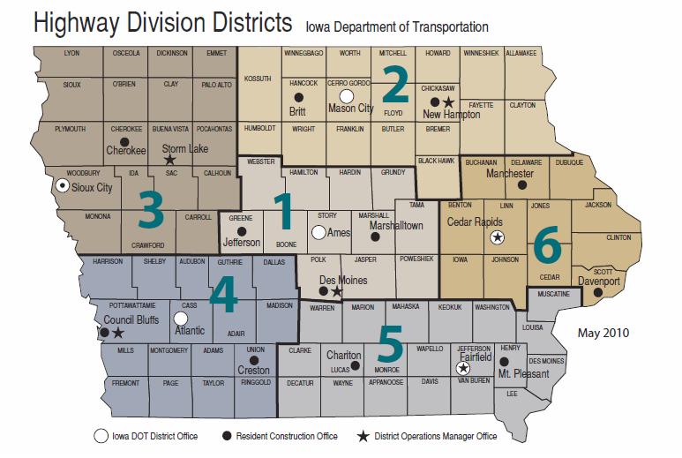
Notes:
Highway Division District location Map

Slide 3
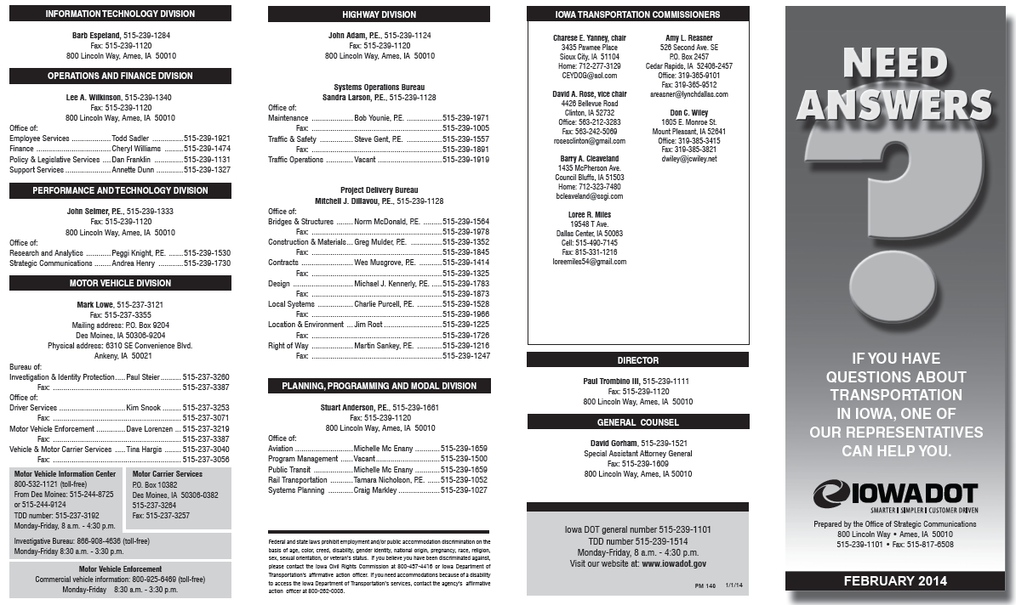
http://www.iowadot.gov/pdf_files/need_answers.pdf

Slide 4
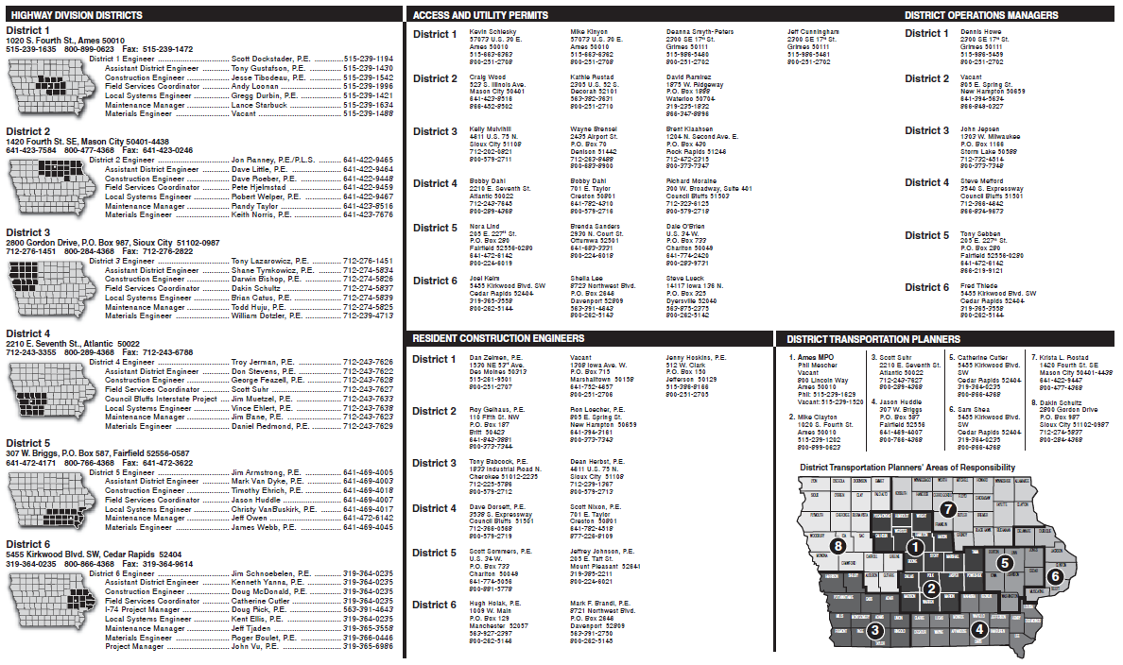
http://www.iowadot.gov/pdf_files/need_answers.pdf

Slide 5
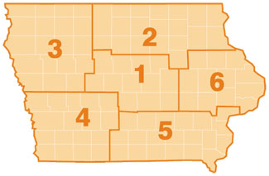
District Utility Coordinators
Doug Manley
712-274-5828
Dean Wiebke and Pete Hjelmstad
641-422-9449 and 641-422-9459
Steve Flockhart
319-364-0235
Jerry Lavine
515-986-5476
Eric Keiner
712-250-0537
Bonnie Clancy
641-469-4013

Slide 6
EOT Area of Responsibility
To find the EOT responsibility maps go the the permit site and click on maps at the bottom of the page.
http://www.iowadot.gov/district1/permits.htm
http://www.iowadot.gov/district2/permits.htm
http://www.iowadot.gov/district3/permits.htm
http://www.iowadot.gov/district4/permits.htm
http://www.iowadot.gov/district5/permits.htm
http://www.iowadot.gov/district6/permits.htm

Slide 7
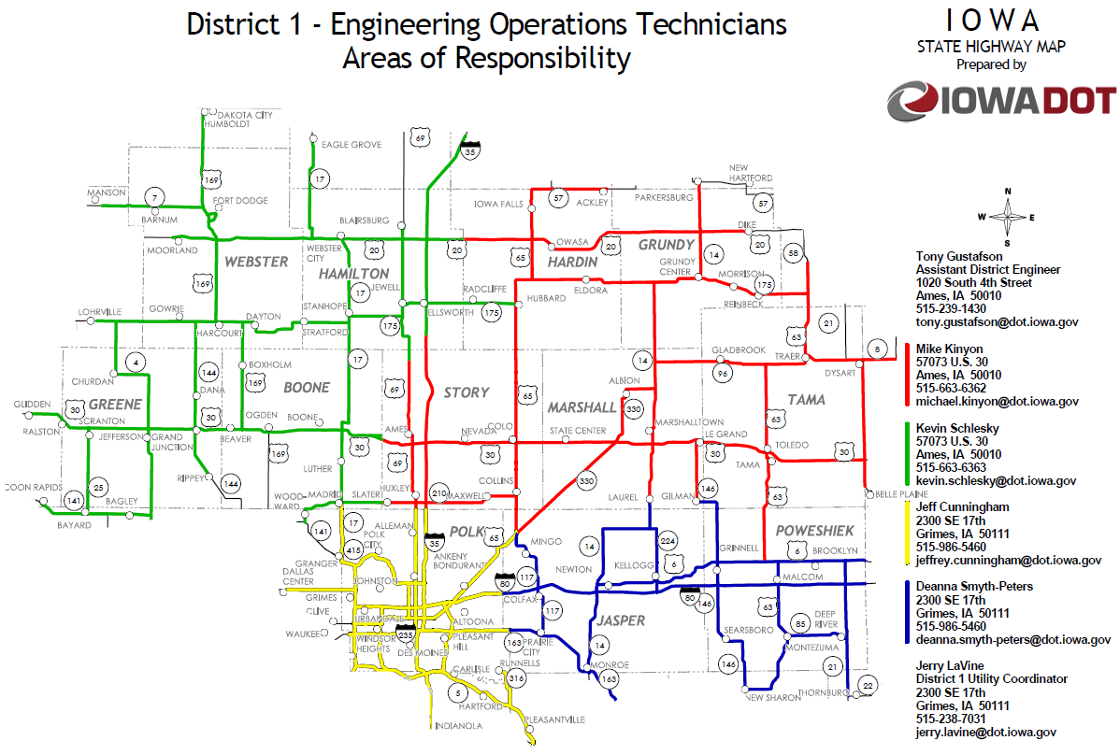
February 2014

Slide 8
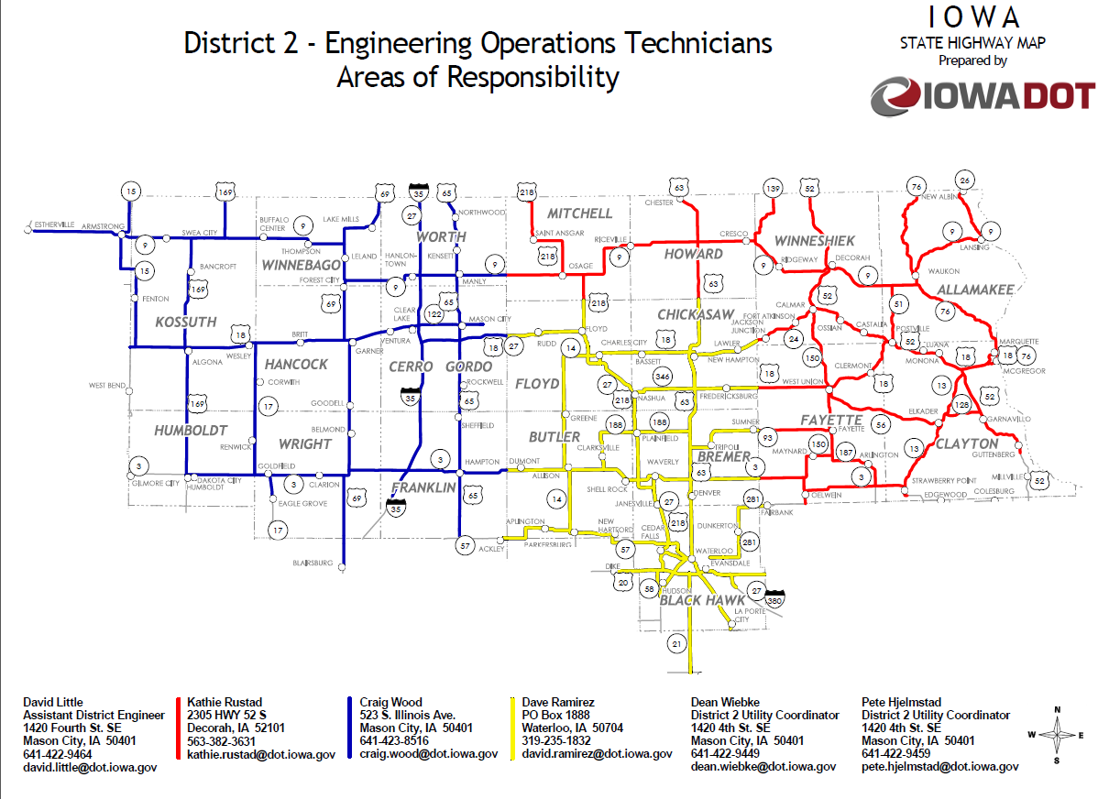
February 2014

Slide 9
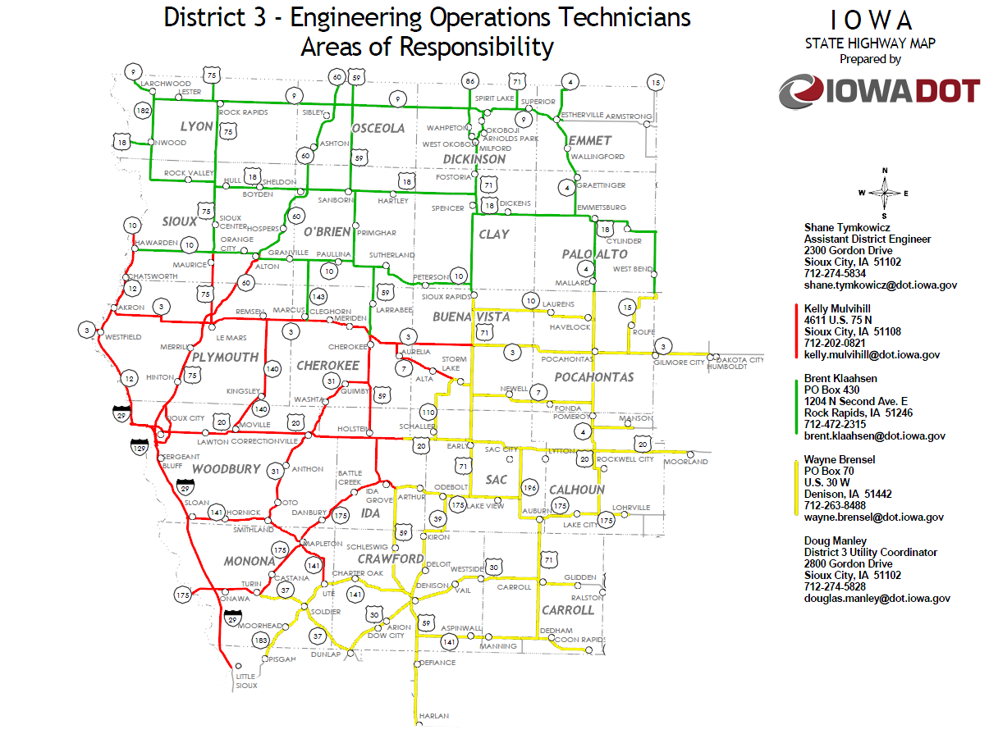
February 2014

Slide 10
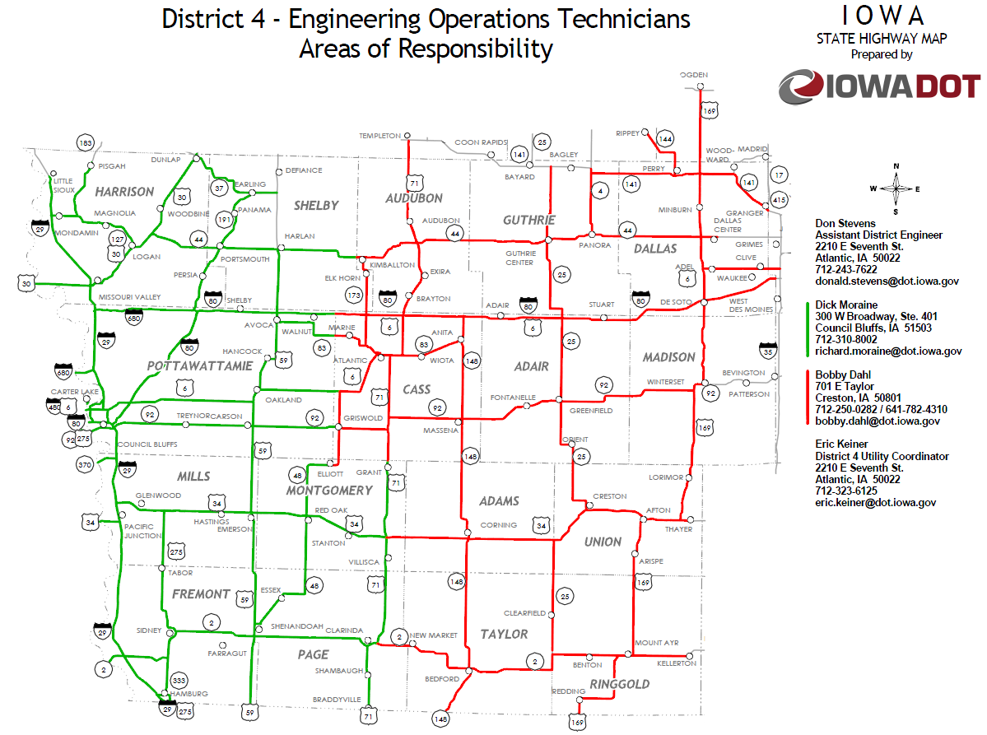
February 2014

Slide 11
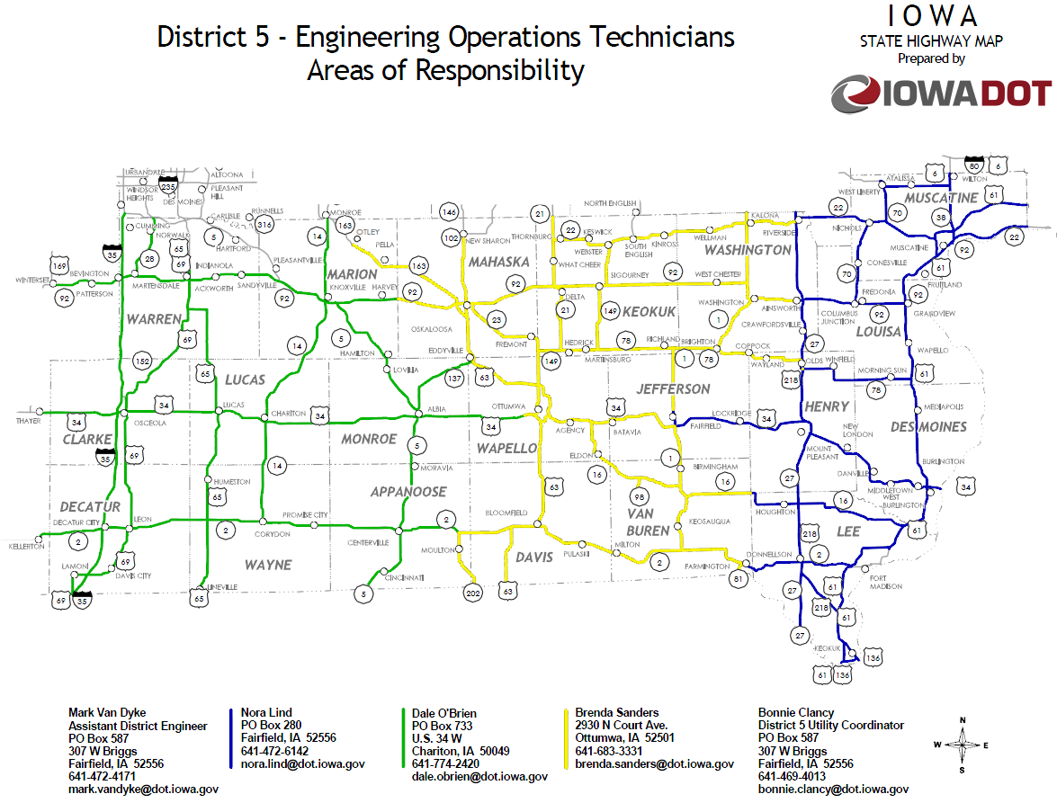
February 2014

Slide 12
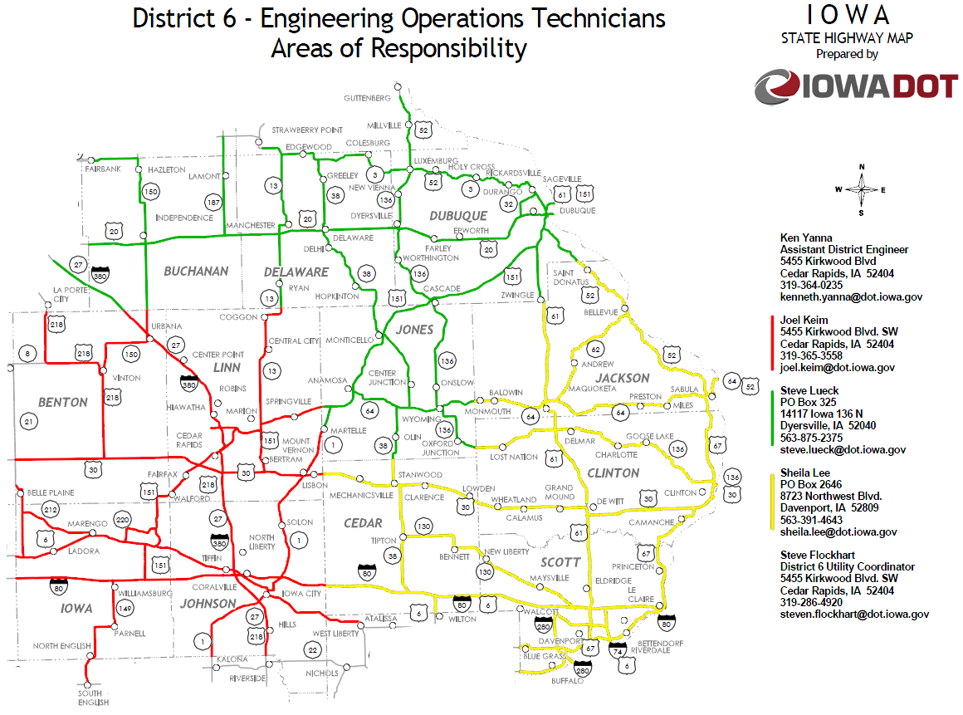
February 2014

