Slide 1
Plan Reading

Slide 3
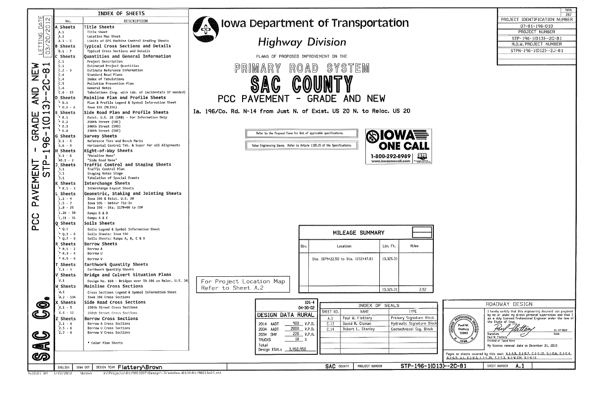
General project description and location

Slide 4
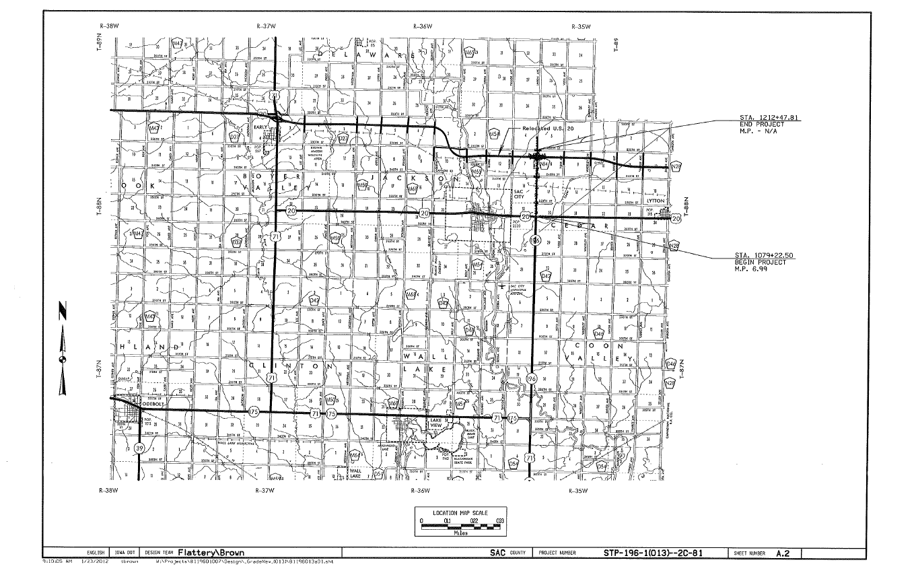
Page showing location on a map

Slide 5
General project description and location

Slide 6
General project description and location

Slide 7
Stationing
General project description and location

Slide 8
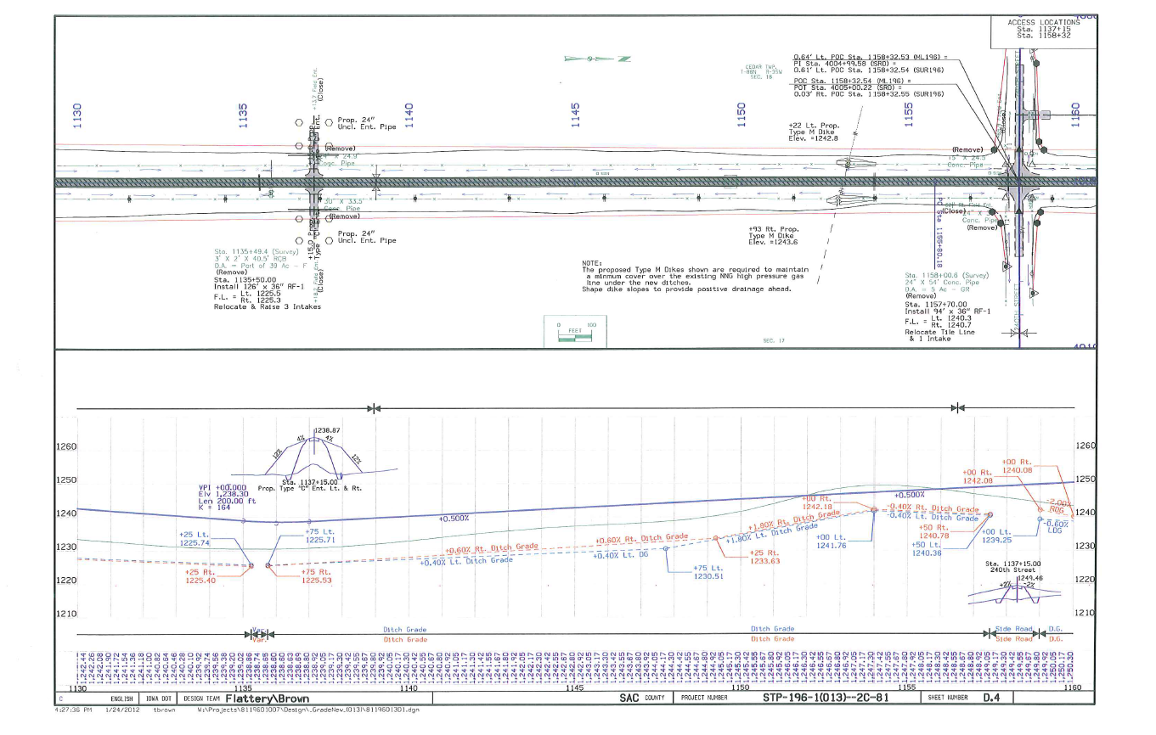
General project description and location

Slide 9
Centerline
Mainline
Route
Every 25’
10’
Proposed Solid Line
Existing Dash Line

