Slide 1
Annual District Utility Meetings 2015
Accommodation and Coordination
Bryan Bradley
State Utility Engineer
Office of Traffic and Safety
Iowa Department of Transportation
bryan.bradley@iowa.gov
1

Slide 2
Purpose of this Powerpoint
What's new in Utilities at the DOT
Hit a bunch of topics
Promote understanding cooperation
2

Slide 3
BUY AMERICA
Still important even in 2015 – BUY AMERICA
Extended to some utility relocations Jan.1, 2014
See the DVD or FTP Site Buy America folder for details.
Affects many relocations due to Highway projects, including all that are reimbursable and all due to an Interstate project.
Products that are 90% by weight Steel or Iron must meet requirements, as well as precast concrete products.
This must be considered early in the process.
3

Slide 4
LANE RESTRICTION NOTIFICATION
Notification of width or height restrictions on Iowa primary highways is ALWAYS required.
Utilities may not obstruct primary highways without prior consent of the Iowa DOT, except in emergency situations.
See the document: 511 Utility Notifications of Restrictions.
Minimum 48 hours advanced notification, prefer 10 days.
For wide load routing, some loads getting stuck when restrictions were unknown.
4

Slide 5
Utility Accommodation and Coordination (Central Office in Ames)
Utilities Section
Permits & Utility Relocation (Policy)
Utility Relocation Agreements
In the Traffic and Safety Office
Group consists of
Bryan Bradley Utility Engineer/Administrator
Jeff McCollough Utility Relocation/Permits
Stephanie Anderson Agreements Secretary
5

Slide 6
Utility Accommodation and Coordination ( 6 Districts)
Assistant District Engineer
Responsible for construction projects
District Utility Coordinators (DUC)
5 Districts have 1 full time pos. 6th shares the pos.
Coordinates with utilities on construction projects
Permits-Engineering Operations Technician (EOT)
2 or 3 per district
Administers Access and Utilities permits including:
Utility Accommodation Permits
Application to Perform Work Within State Highway Right-of-Way
6

Slide 7
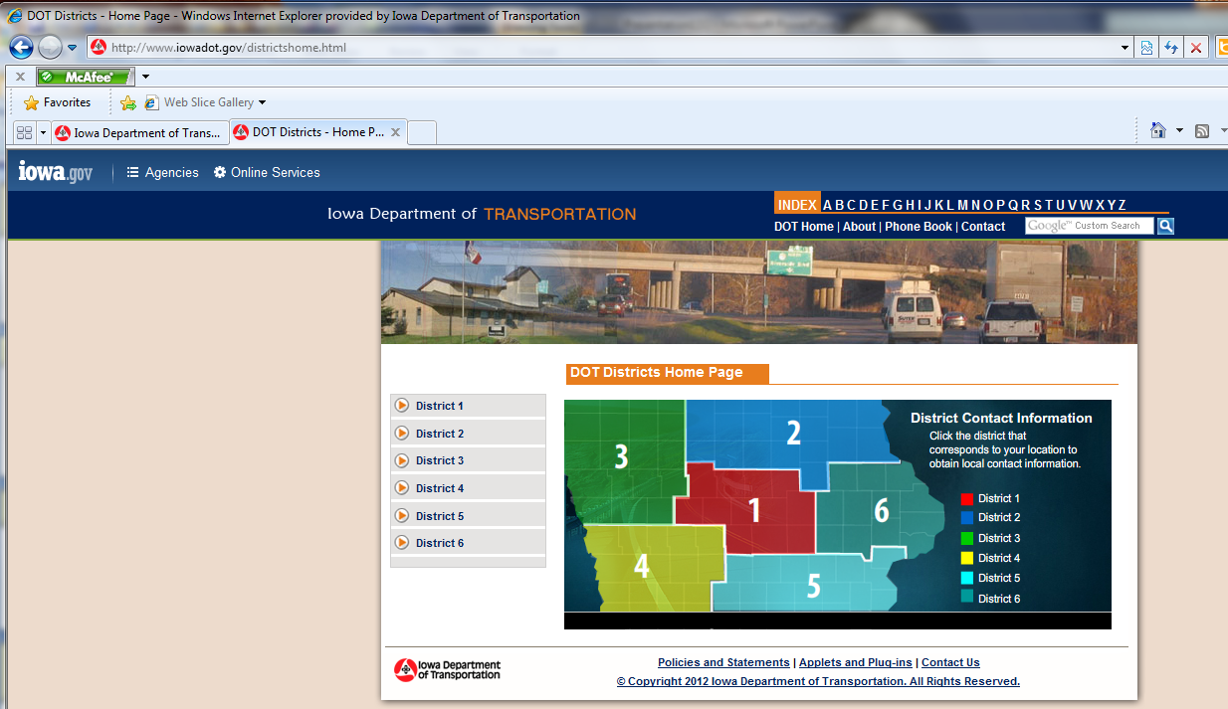
http://www.iowadot.gov/districtshome.html
OR see the districts contacts power point on the DVD

Slide 8
Utility Accommodation and Coordination (IADOT)
Central Office
Policy
Agreements
Plan Submittal
District
Initial notification
Conduct meetings
Coordinate movement
Permits
Working on cohesiveness and standardization
8

Slide 9
Utility Accommodation and Coordination (IADOT)
Changes
We are implementing program of
Utility dates U00 through U07
Follow the Point 25 process for most projects.
End Results
Fewer plans sent out, only when it needed
Plans sent on schedule fit to our design and letting dates.
Increased ability to modify plans.
9

Slide 10
Utility Accommodation and Coordination (IADOT)
We are really working across districts and the state to improve the process.
Will gladly listen to your concerns and suggestions bryan.bradley@iowa.gov
As we go forward you will know that all communications are important if we send them. Please reply.
10

Slide 11
Utility Accommodation and Coordination
Operational Planning Meeting (OPM)
Preliminary meeting with utilities
Get all involved in design, can change design
Before final design complete
Utility Coordination Meeting UCM
Promote cooperation, utilities work together
Understand utility issues
Present new information as project develops
11

Slide 12
Agreements
Utility on private property or easement
Through central office
Need estimate
Need work plan (drawings)
Need easement documents
Final amount within 125% of Estimate
12

Slide 13
Agreements
Central office writes them up
Pre-Audit, Certificate of Completion
Final Audit, Disclaimer of Interest in Realty
Final Payment of Retainage (10%)
Discussion or questions on Agreements?
13

Slide 14
ADA REQUIREMENTS FOR SIDEWALKS
CHECK OUT THE DVD or FTP site
Law since 1990
Can be serious consequences if fail to comply. It is being watched.
14

Slide 15
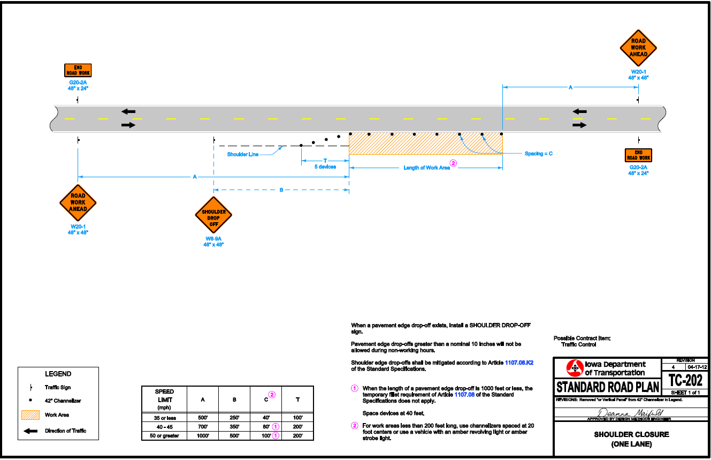
Temporary Traffic Control
CHECK OUT THE DVD or FTP site
It is in the policy it is not optional
15

Slide 16
Other issues
Utilities are Liable for Contractors work/TTC/plans
Check out the Policy Page 34
Please work with contractors to follow Policy and the permits.
Work times(Do not start before ½ hour after sun up and stop at least ½ hour before sun down)
16

Slide 17
Other issues
Abandonments
Becoming more of an issue every day.
Check out the Policy Page 34
DOT needs to be notified
Permitting Issues
Check out the DVD or FTP site again (checklist)
Have people who fill them out go through list.
17

Slide 18
conclusions
Comments/suggestions????
Bryan Bradley
Utility Engineer
Office of Traffic and Safety
Iowa Department of Transportation
Bryan.Bradley@iowa.gov
515-239-1014

