Slide 1
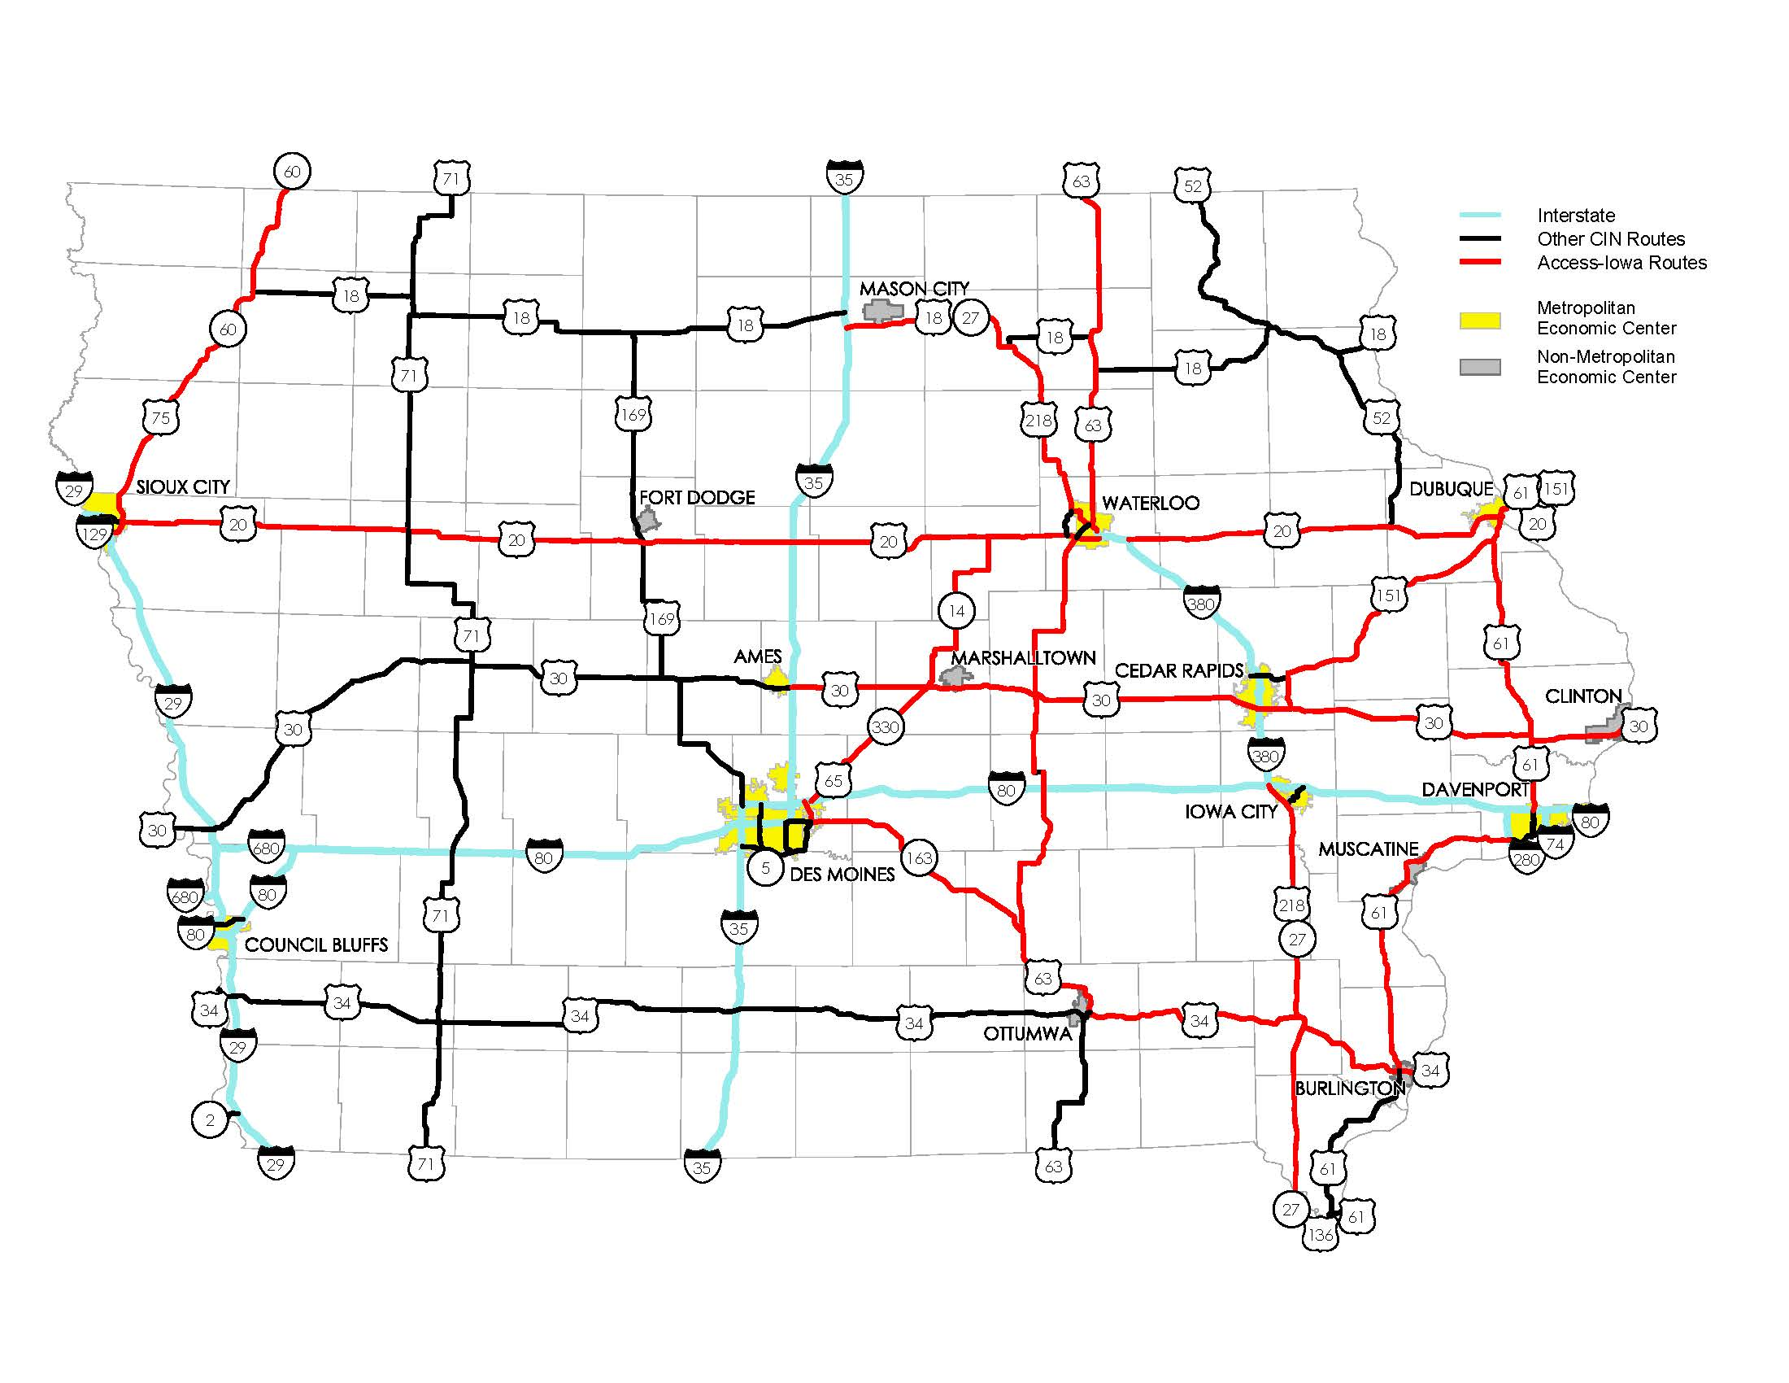
TIME-21 Accelerated Development of Key CIN Corridors
Improvement changes FY 2009 to FY 2019
March 11, 2014
Sac, Calhoun, Webster US 20 US 71 to Moorland
Total Cost $209 M
Length: 46 miles
Completion 2013
Webster, Humboldt US 169
Total Cost: $14 M
Length: 13 miles
Completion 2011
Bremer US 63
Total Cost $45 M
Length: 16.3 miles
Completion 2012
US 30 Tama/Toledo Bypass
Total Cost: $56 M
Length: 7.5 miles
Completion 2011
US 30 Mount Vernon/Lisbon Bypass
Total Cost: $95 M
Length: 6.0 miles
Programmed 2013-2020
Woodbury US 20
Moville to Correctionville
Awarded/Spent $4 M
Programmed $104 M
Total Cost $108 M
Length: 11.5 miles
Completion 2018
Story, Marshall US 30
Total Cost: $21 M
Length: 14.8 miles
Completion 2011
Benton US 30
Total Cost: $118 M
Length: 13.9 miles
Programmed 2013-2021
Louisa US 61
Total Cost: $52 M
Programmed 2013-2017
Length: 6.0 miles
Mills US 34
Awarded/Spent $76 M
Programmed $1 M
Total Cost $77 M
Length: 4.9 miles
Completion 2014
US 61 Fort Madison Bypass
Total Cost $ 82 M
Length: 9 miles
Completion 2011
Indicates Accelerated Development of Key CIN Corridors in TIME-21 Study
Indicates remaining TIME-21 Accelerated Development of Key CIN Corridors to be programmed after FY 2018
Programmed amounts include current cost estimate updates

