Slide 1
Plan Reading

Slide 2
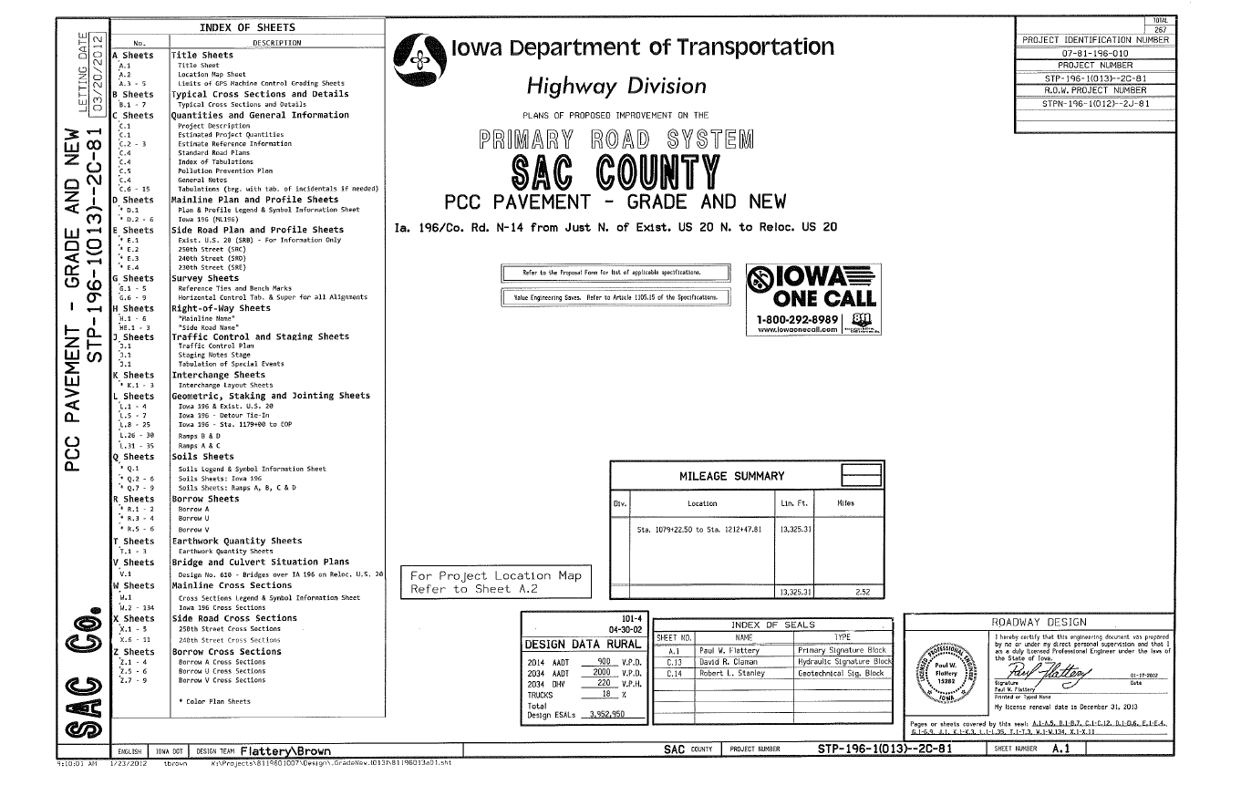

Slide 3
General project description and location

Slide 4
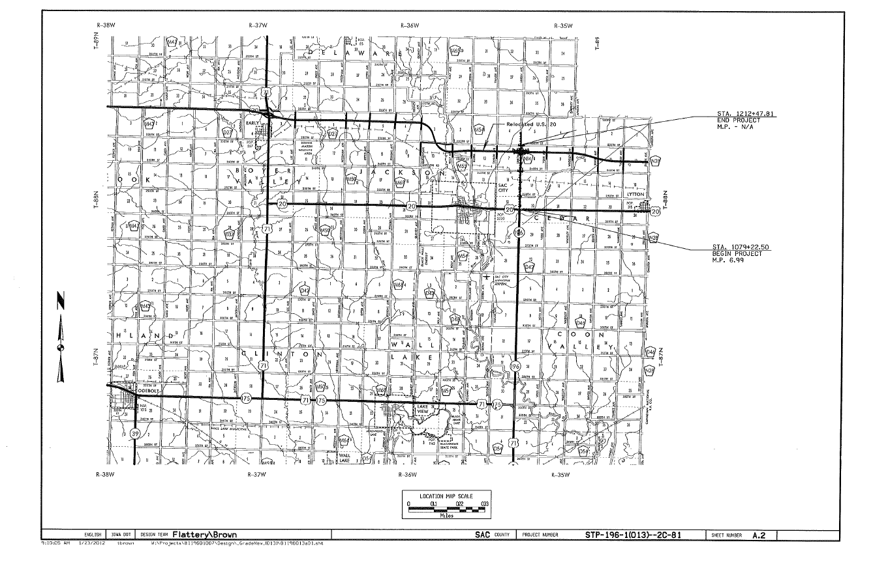
Page showing location on a map

Slide 5
General project description and location

Slide 6
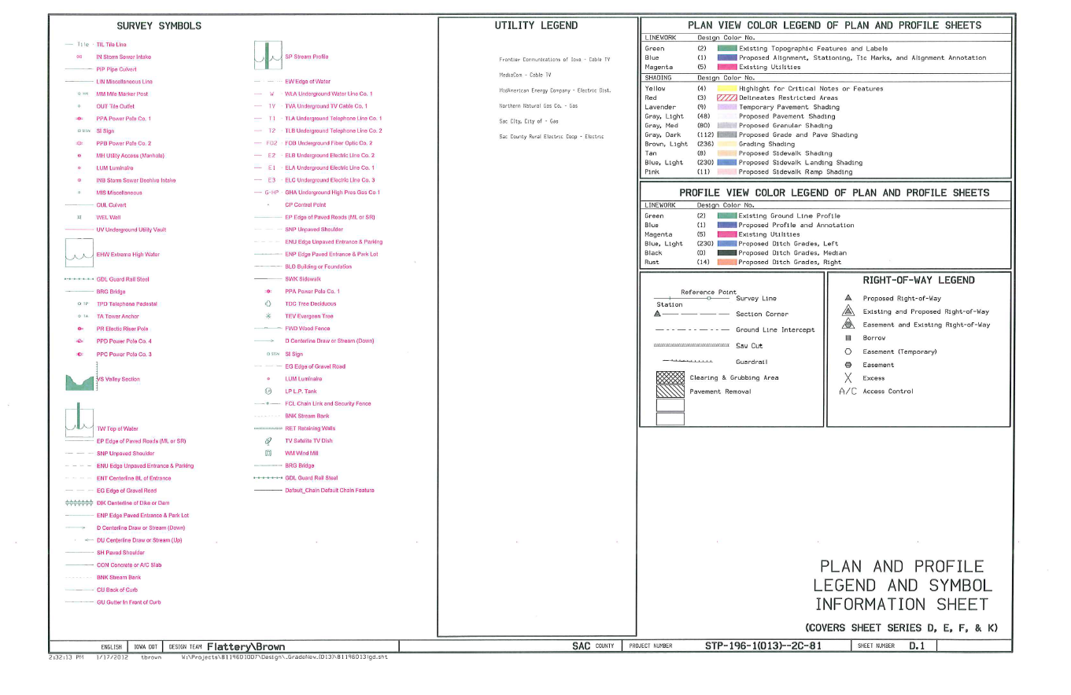
General project description and location

Slide 7
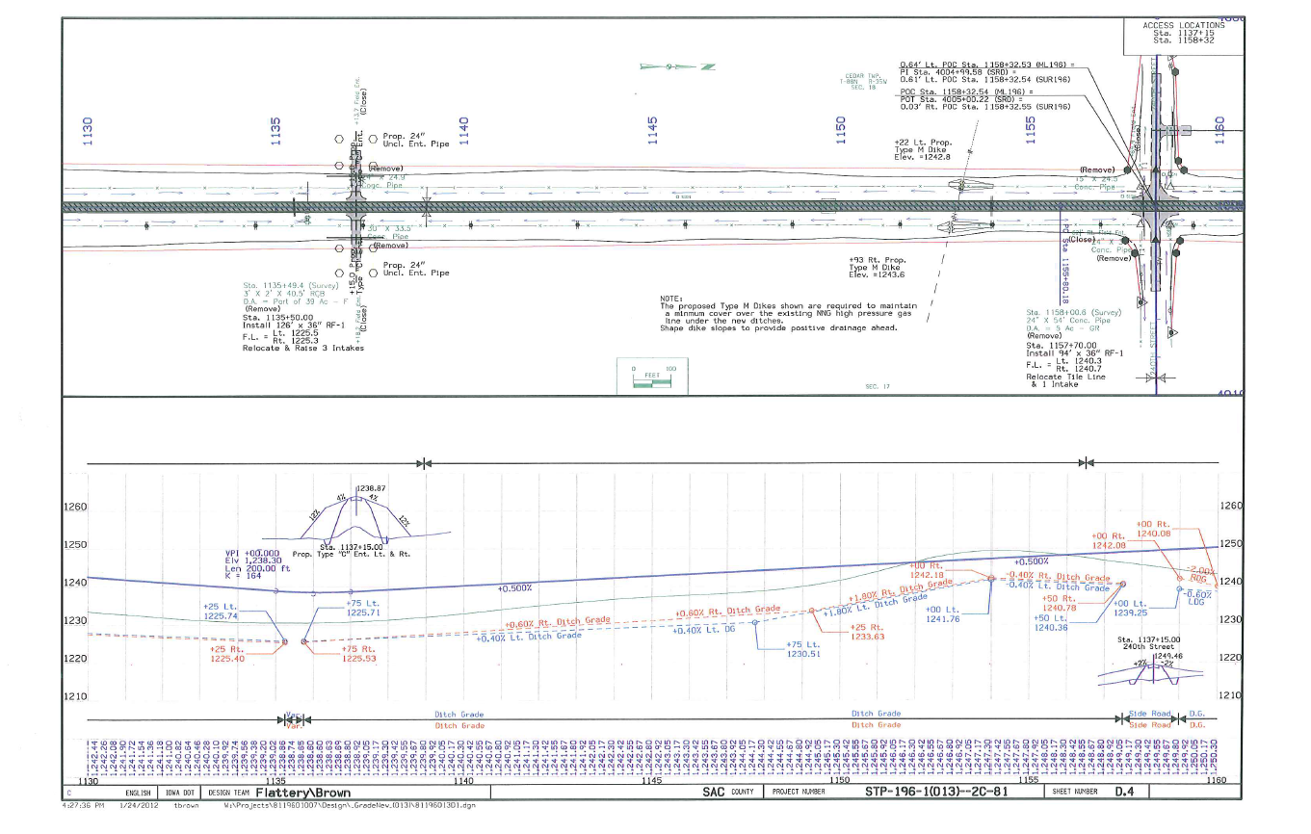
Stationing
General project description and location

Slide 8
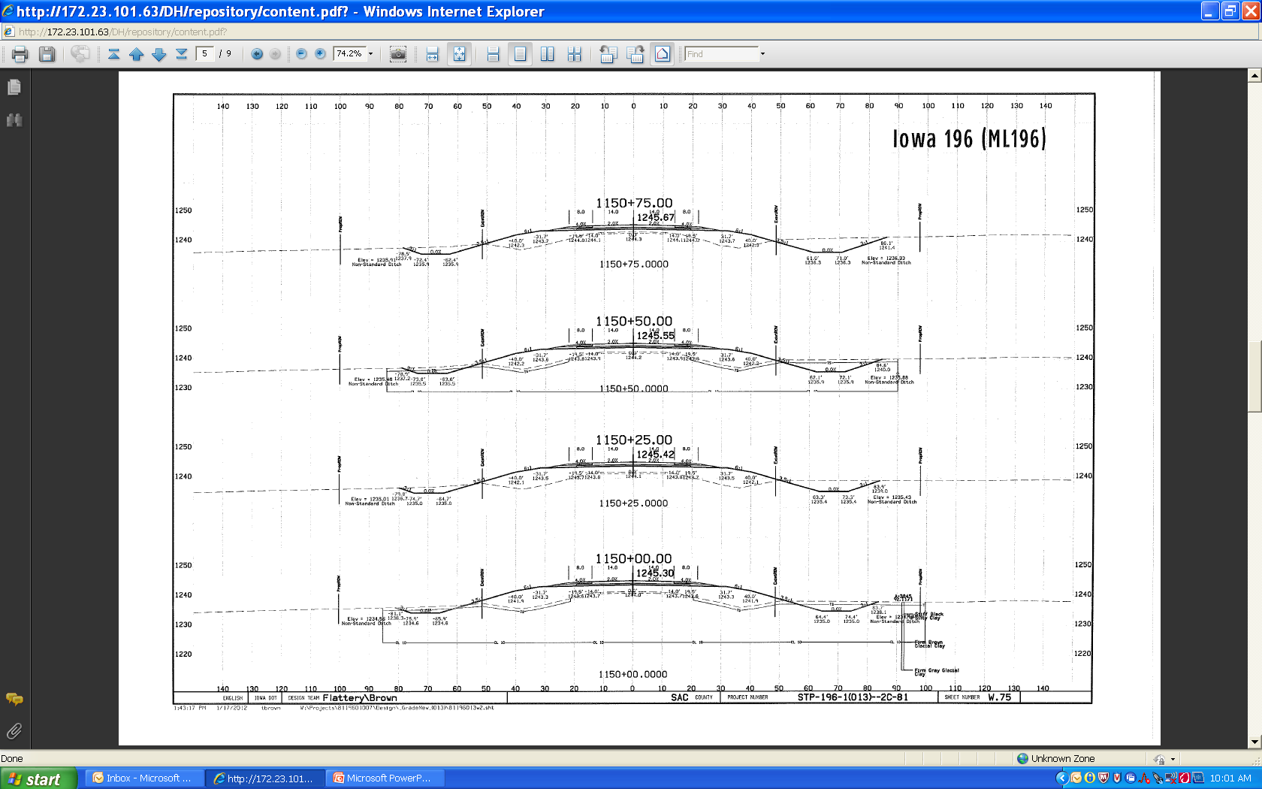
General project description and location

Slide 9
Centerline
Mainline
Route
Every 25’
10’
Proposed Solid Line
Existing Dash Line

Slide 10
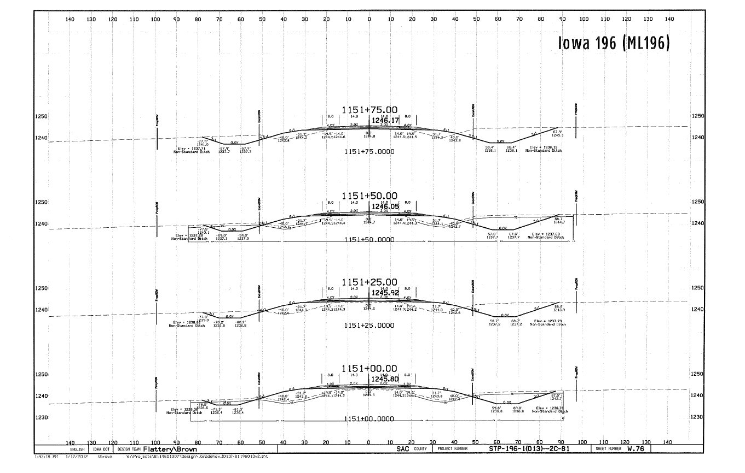

Slide 11
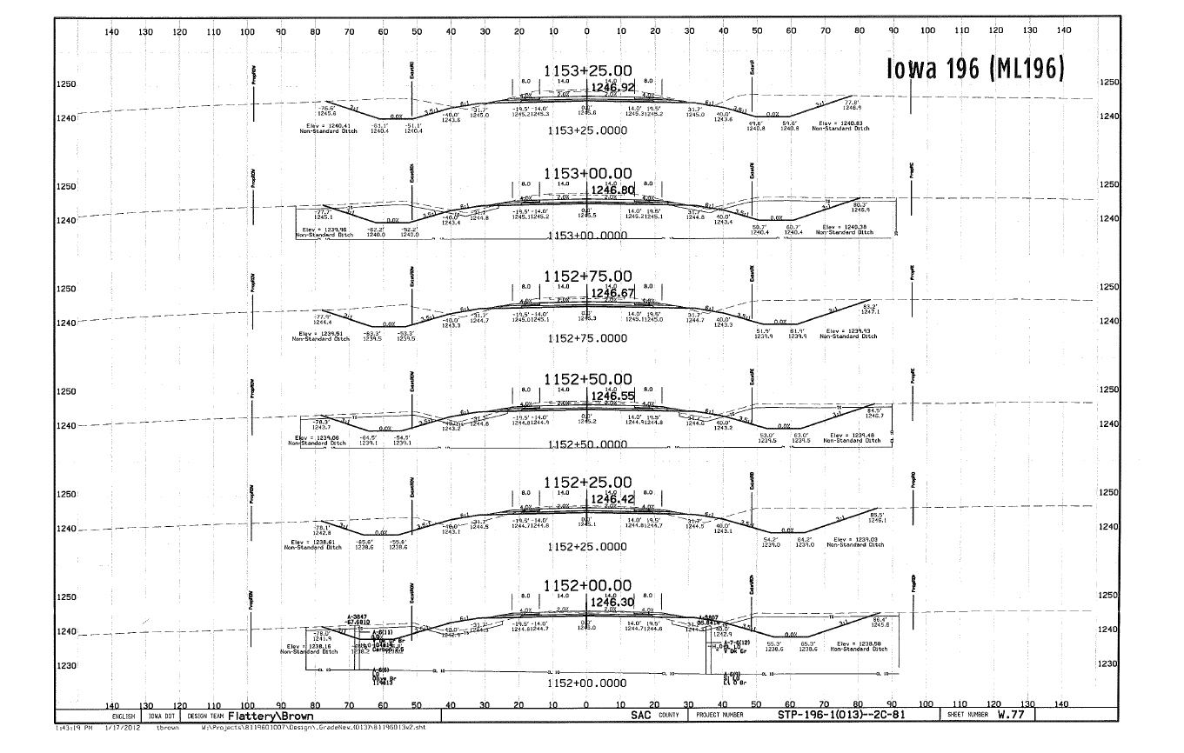

Slide 12
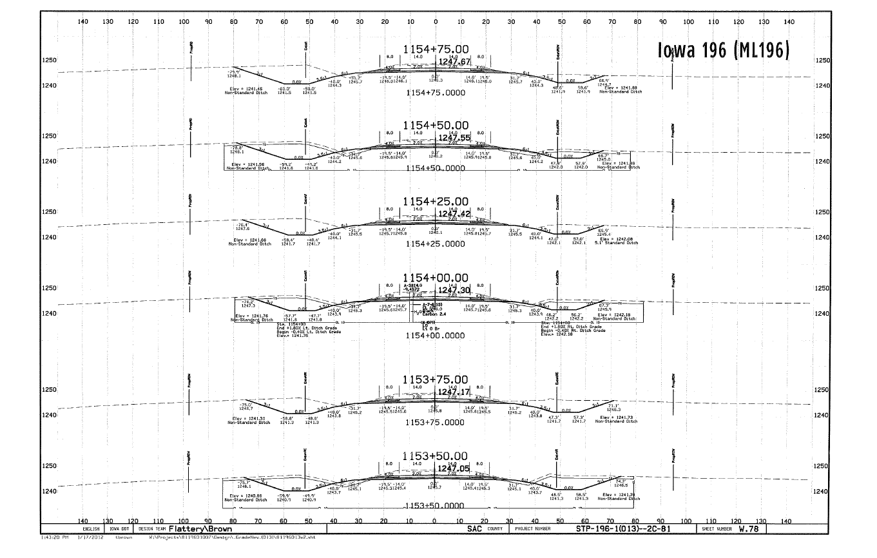

Slide 13
