Slide 1
Utility Coordination
Afternoon session
Utility Coordination changes
Process changes, ways to improve
Electronic communications
Improvement in the process

Slide 2
Utility Coordination
IOWA DOT Process
Point 25 process per Iowa Administrative Code (IAC)
Project Scheduling System (PSS)
Utility Coordination List (UCL) (Matrix)
Integrated with the Electronic Permitting System (EPS)

Slide 3
Utility Coordination
IOWA DOT Process

Slide 4
Utility Coordination
IOWA DOT Process current
U02 event first official required contact with Utility (IAC)
Plans typically considered 30% complete
Just after field review and our D02 event
Problem is horizontal alignment is difficult to change, preliminary cross sections already done
We don’t have a lot to share earlier than that but we do have something

Slide 5
Utility Coordination
IOWA DOT Process
U00 event aligns with our Concept Event D00
Plans typically considered 0% complete
We have the project approved
We have a highway and a proposed start and end point, general Idea of what we are going to do
We don’t have a lot to share but we do have something- proposed concept

Slide 6
Utility Coordination
IOWA DOT Process – proposed/new U00
DOT Actions
Preform One Call to get utilities in the area
Update PSS with utilities and contacts
Concept is sent to utilities in the area
Utility Actions
Enter basic information through the Web portal

Slide 7
Utility Coordination
IOWA DOT Process – proposed/new U00
Utilities also asked to share site plans
Any additional information that would help with design.
Information gathered will be included in the final concept in a utility section
Final Concepts will be sent to the Utilities

Slide 8
Utility Coordination
IOWA DOT Process – proposed/new U00
Utilities also asked to share site plans
Any additional information that would help with design.
Information gathered will be included in the final concept in a utility section
Final Concepts will be sent to the Utilities

Slide 9
Utility Coordination
IOWA DOT Process – proposed/new U01
Extra step if Major utilities discovered in U00 phase
Collect detailed information for design to use
Finishes 2 months after U00

Slide 10
Utility Coordination
IOWA DOT Process – U02
First Official Plan Submittal to Utilities.
30% plans
Horizontal and vertical alignment basic cross sections
Sent to Utilities with expectation that they will enter information in the Utility Coordination List

Slide 11
Utility Coordination
IOWA DOT Process – U03
First Official Plan Submittal to Utilities.
60% plans – Need Lines and ROW
Horizontal and vertical alignment cross sections finalized
Sent to Utilities with expectation that they will enter information in the Utility Coordination List

Slide 12
Utility Coordination
IOWA DOT Process – U04
First Official Plan Submittal to Utilities.
90% plans
Sent to Utilities with expectation that they will enter information in the Utility Coordination List

Slide 13
Utility Coordination
Development of the UCM with UCL
Internals have been developed
Working on updating the Utility contacts
Whole system
Web Portal for input will be similar to the EPS

Slide 14
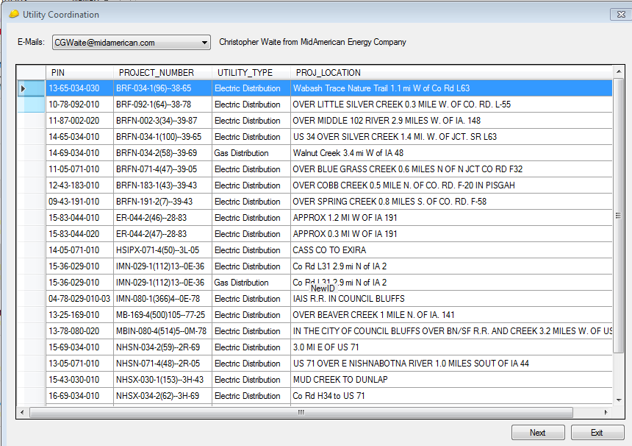
Utility Coordination

Slide 15
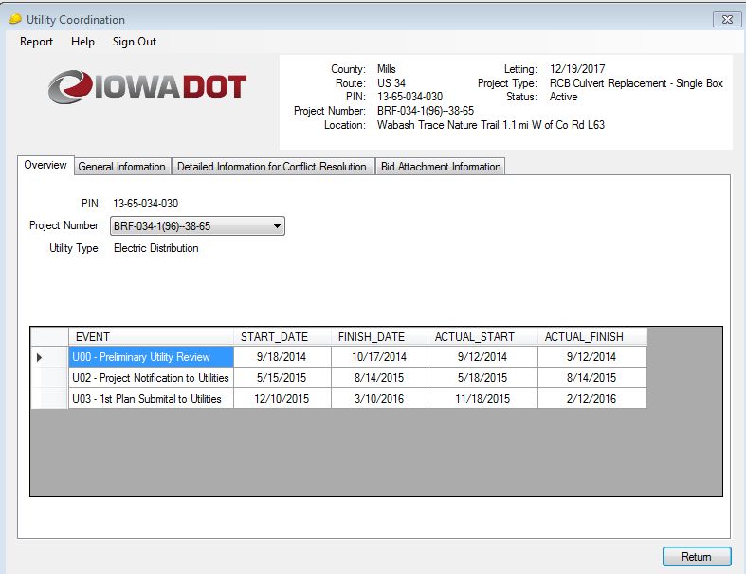
Utility Coordination

Slide 16
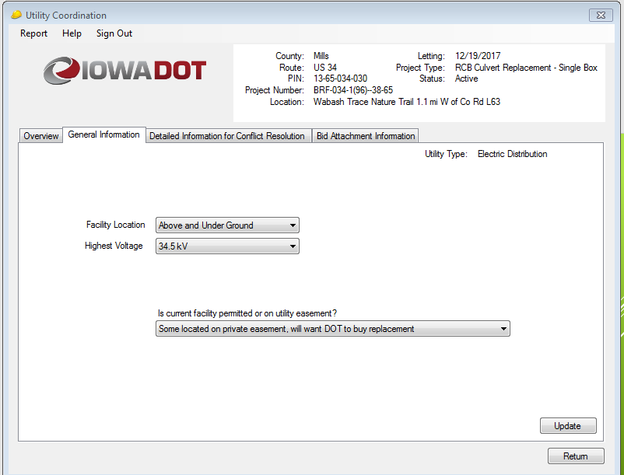
Utility Coordination

Slide 17
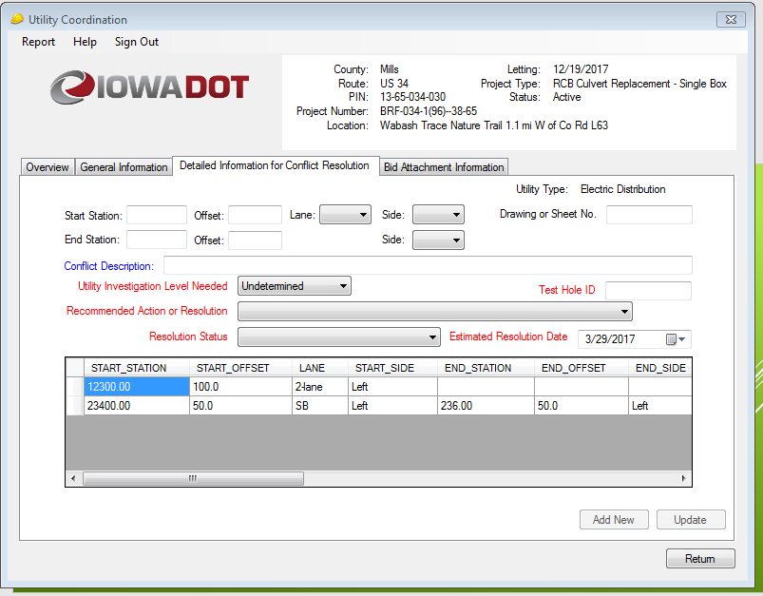
Utility Coordination

Slide 18
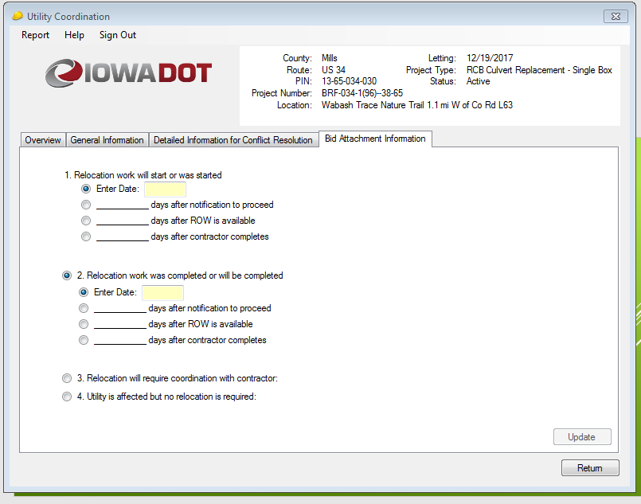
Utility Coordination

Slide 19
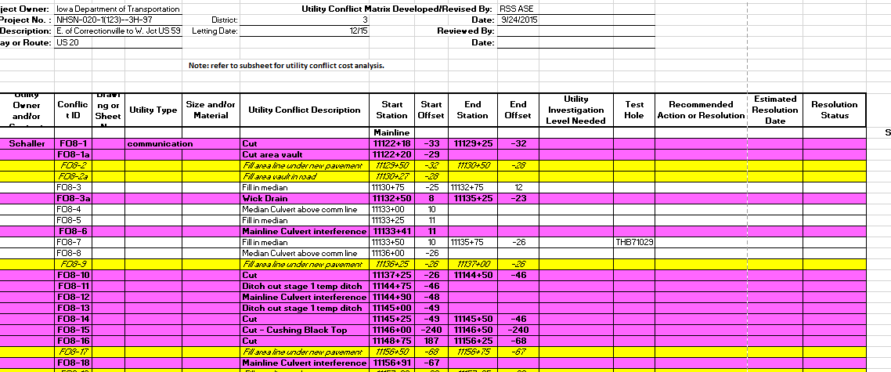
Utility Coordination
IOWA DOT Process – U07

Slide 20
Utility Coordination
IOWA DOT Process – U07

Slide 21
Utility Coordination
Iterative process

Slide 22
Utility Coordination
IOWA DOT Process

