Slide 1
Annual Utility/Iowa DOT 2017 MeETING
Welcome to the future of Utility Permitting and Utility/DOT Project coordination in Iowa.

Slide 2
Annual Utility/Iowa DOT 2017 MeETING
Welcome
Utility Company Employees
Consultants for Utility Companies
District Employees of the DOT
Central Office Employees of the DOT
People listening in and watching on Adobe Connect
Housekeeping

Slide 3
Annual Utility/Iowa DOT 2017 MeETING
Challenge:
Improve the Accommodation of Utilities in the DOT ROW
Maintain Safety
Maintain Utility Access
Maintain Roadway Function
Minimize Cost to Taxpayers and Ratepayers
Today:
Improve the Permitting Process (Accommodation)
Improve the Relocation Process – Due to DOT Projects

Slide 4
Annual Utility/Iowa DOT 2017 MeETING
To Address Challenge:
Move Forward Today with this general schedule
10:00 to 12:00 Electronic Permitting Process
Our Plans for implementation but we are looking for suggestions
Fill out sheets on the table (Several this morning)
12:00 – 1:00 Lunch
1:00 to 3:00? Electronic Utility Coordination
Utility Coordination Process
Utility Conflict Matrix
Discussion

Slide 5
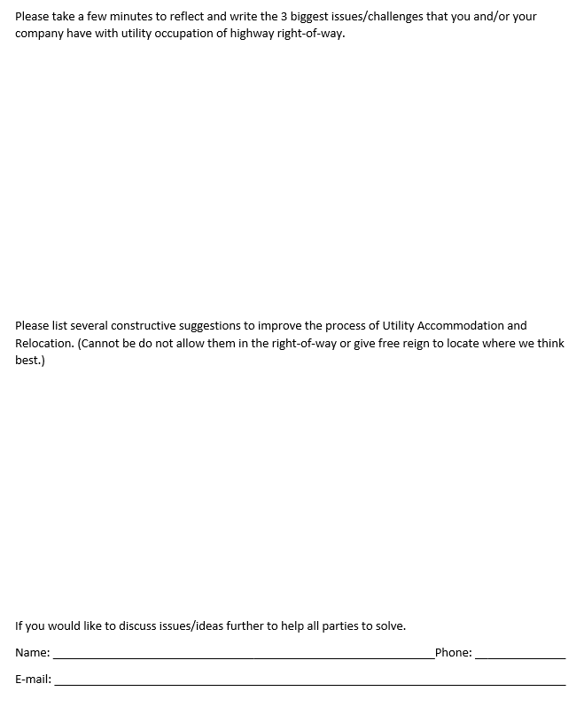
Annual Utility/Iowa DOT 2017 MeETING
Please fill some comments in the untitled request for comment sheets this morning. I hope to be able to use them to prompt some conversations this afternoon. Please get them to Steph before you eat your lunch.
These are for DOT and Non-DOT people.

Slide 6
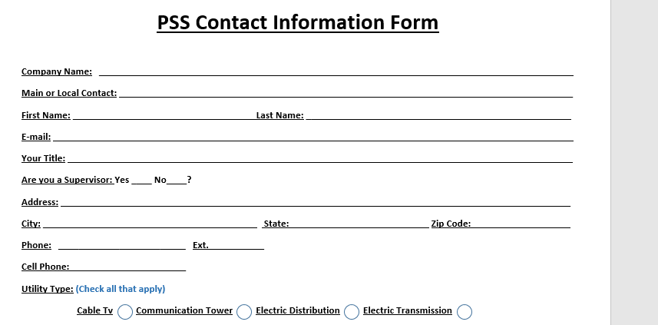
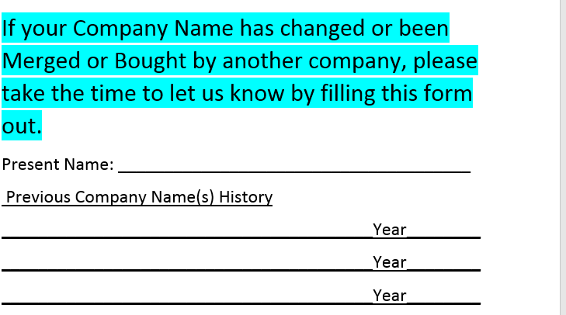
Annual Utility/Iowa DOT 2017 MeETING
Please complete the PSS Contact Information Form. We are updating our database and you guys will be a good start for this process in 2017.
With our change in database we need to create family trees for utilities. Please go back as far as you know. And if you have several companies in your background try to include them all. If you don’t know the year put down your best guess with a ?
Unless you are a municipal utility please fill one out even if you have kept the same name since inception.
Please get them to Steph before lunch as well. We may have someone come around in a while to pick these up.

Slide 7
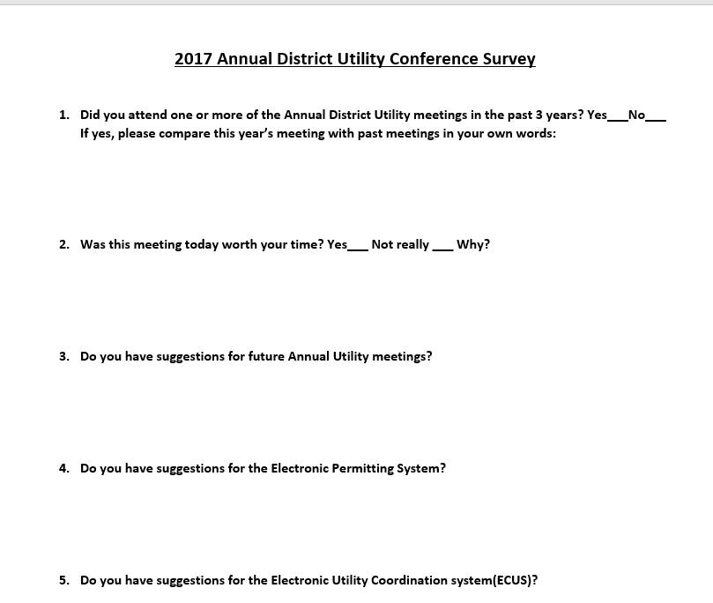
Annual Utility/Iowa DOT 2017 MeETING
Please complete the conference survey out at the end of the day. If you are DOT please put that at the top of the page.
These are for DOT and Non-DOT people.

Slide 8
Annual Utility/Iowa DOT 2017 MeETING
Improve the Accommodation of Utilities in the DOT ROW
Maintain Safety
Maintain Utility Access
Maintain Roadway Function
Minimize Cost to Taxpayers
and Ratepayers
Introductions:
Thought about having everyone introduce themselves, right now but I’m going to mix it up since you don’t need to know who is who right now. With the role reversal game we will play later it is better if you don’t know until you can see the name tag.
It will be nice to see names with faces later though so if you haven’t filled out a name tag AND placed it on your person yet please raise your hand.
So we have around 150 people here from more than60 different companies. DOT people from every corner of the state. Why are we here?

Slide 9
permitting Process in Other states
Permitting is often topic at AASHTO subcommittee annual meetings and during Technical Council conference calls.
Iowa is joining the minority of states that have an electronic permitting process for ROW accommodation by Utilities, still < ½.
Off the shelf versus in house
We developed the system in house and EPS is part of a permitting system that includes, Accesses, Highway signing, Highway Beautification, etc.
It is a long process to put all of the pieces together.

Slide 10
permitting Process in Iowa
Paper process that is often submitted electronically at this time.
Can be difficult to know what is expected/needed/optional.
DOT is planning to be going live with the Electronic Permitting Process for utilities on May 1st, 2017.
Want to be able to make changes after receive input today.

Slide 11

permitting Process in Iowa
WHY ELECTRONIC?
Guides through needed information
Easy to attach documents
Records communications
Helps Utilities and Contractors Track
Others can monitor/help more easily
Can start and stop input data
Map location picks Township, Range etc.
automates request for DOT as-built plan based on map
Helps with consistency between permittees and permitters
Submits to city or county electronically if you want

Slide 12
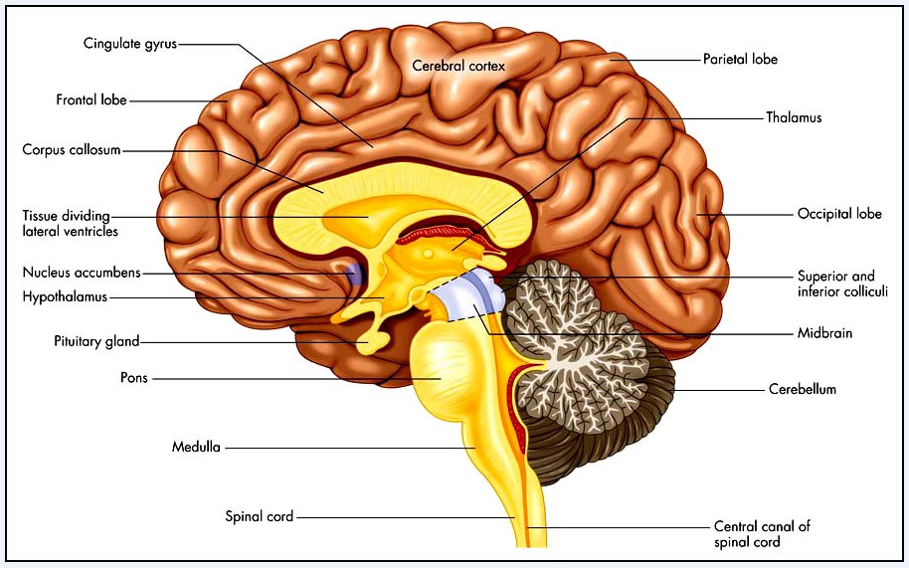
Big Brain

Slide 13
ARRANGING MEETING TODAY
Stephanie aka Steph Anderson
Thank you!
Happy Birthday Monday!

Slide 14
permitting Process in Iowa
Permitting development Team:
Steve Lueck
Brenda Sanders
Kelly Mulvihill
Deb Corwin (IT)
Rohan Prabhu (IT)
Jeff McCollough

Slide 15
permitting Process in Iowa
New System:
Web portal to get you in and then guides you through the process
Collect basic information and then get the details
First things first
Enterprise A & A – Doorway
Authentication and Authorization

Slide 16
permitting Process in Iowa
2 WARNINGS:
Enterprise A & A is beyond DOT control:
20 minutes of inactivity, A&A logs you off.
Working on a solution, Use Save Buttons
Firefox does not presently work.
It will lock up
Use Internet Explorer
We are working on a solution

Slide 17
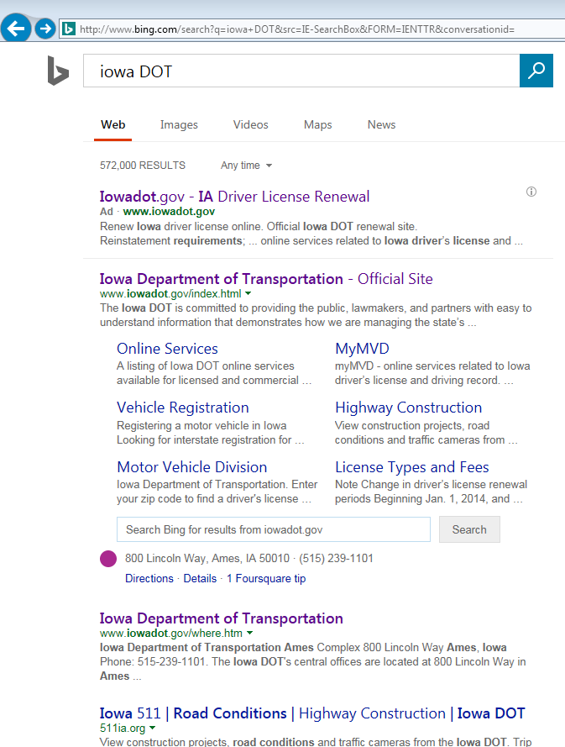
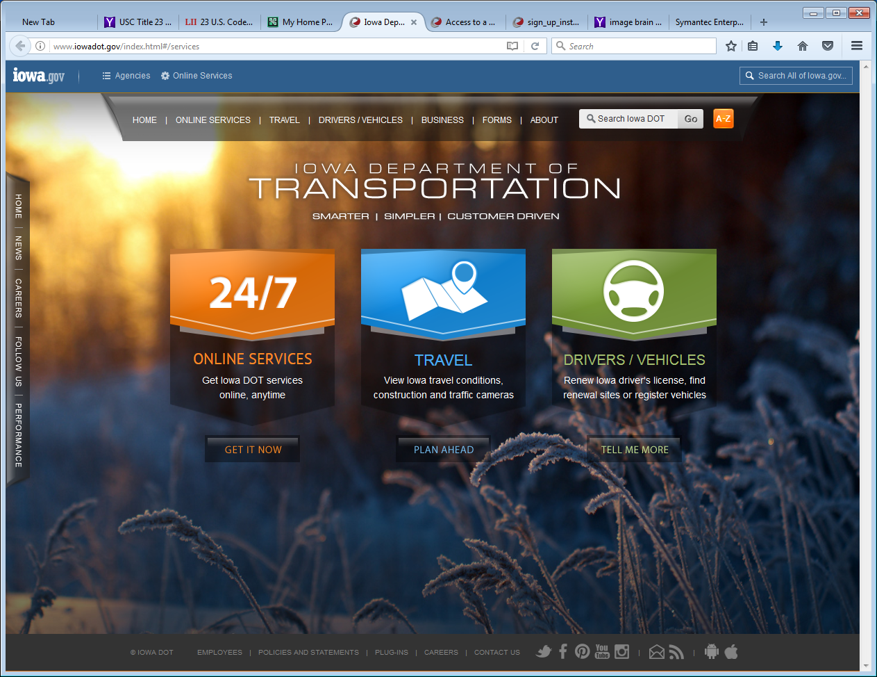
http://www.iowadot.gov/index.html#services
How to find?
Search for Iowa DOT

Slide 18
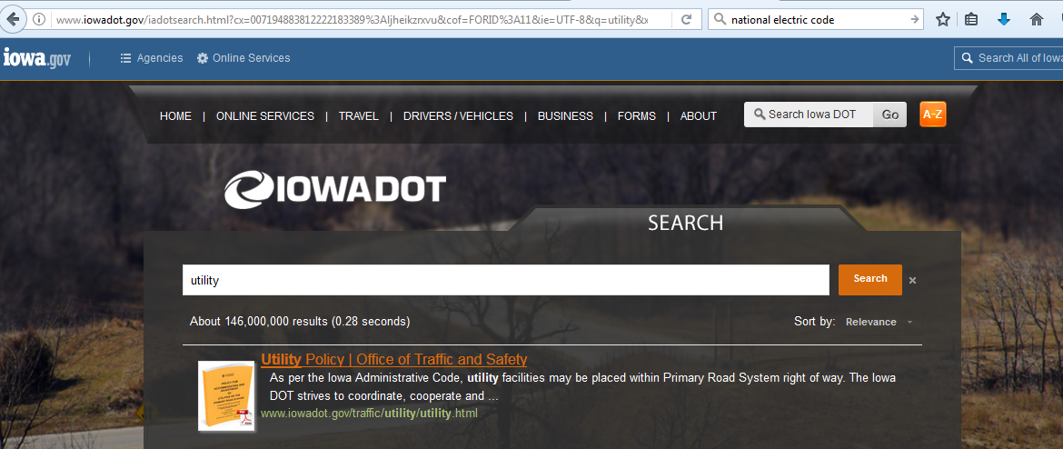
http://www.iowadot.gov/index.html#services
Key Word Search
Utility
Utilities
Utility permits
accommodation
Skip the Next Slide

Slide 19
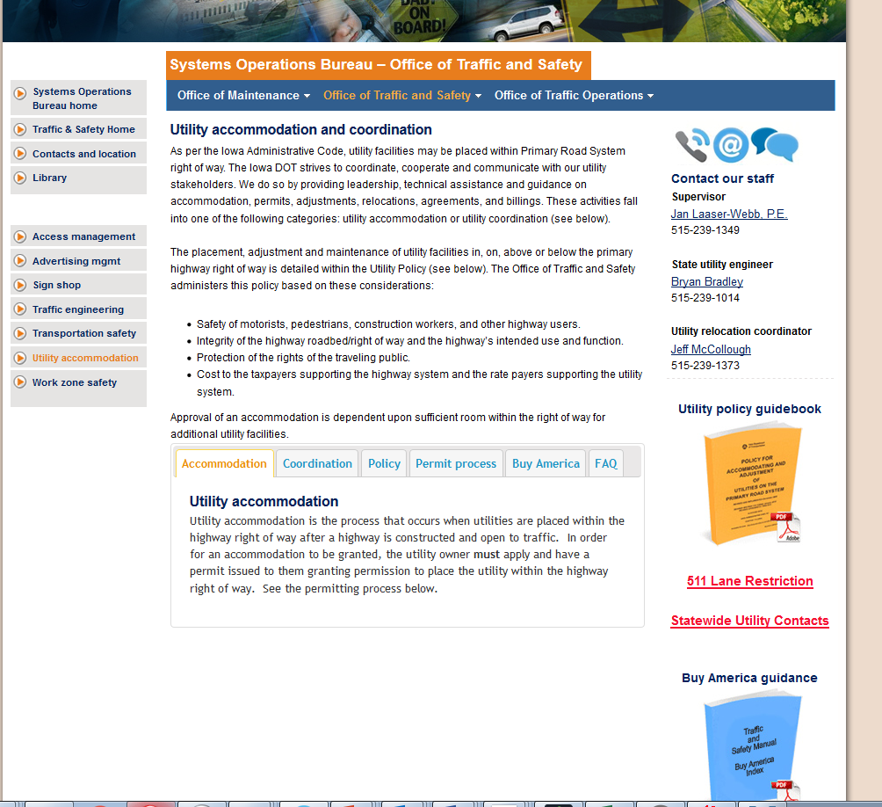
Jump to Permit Page

Slide 20
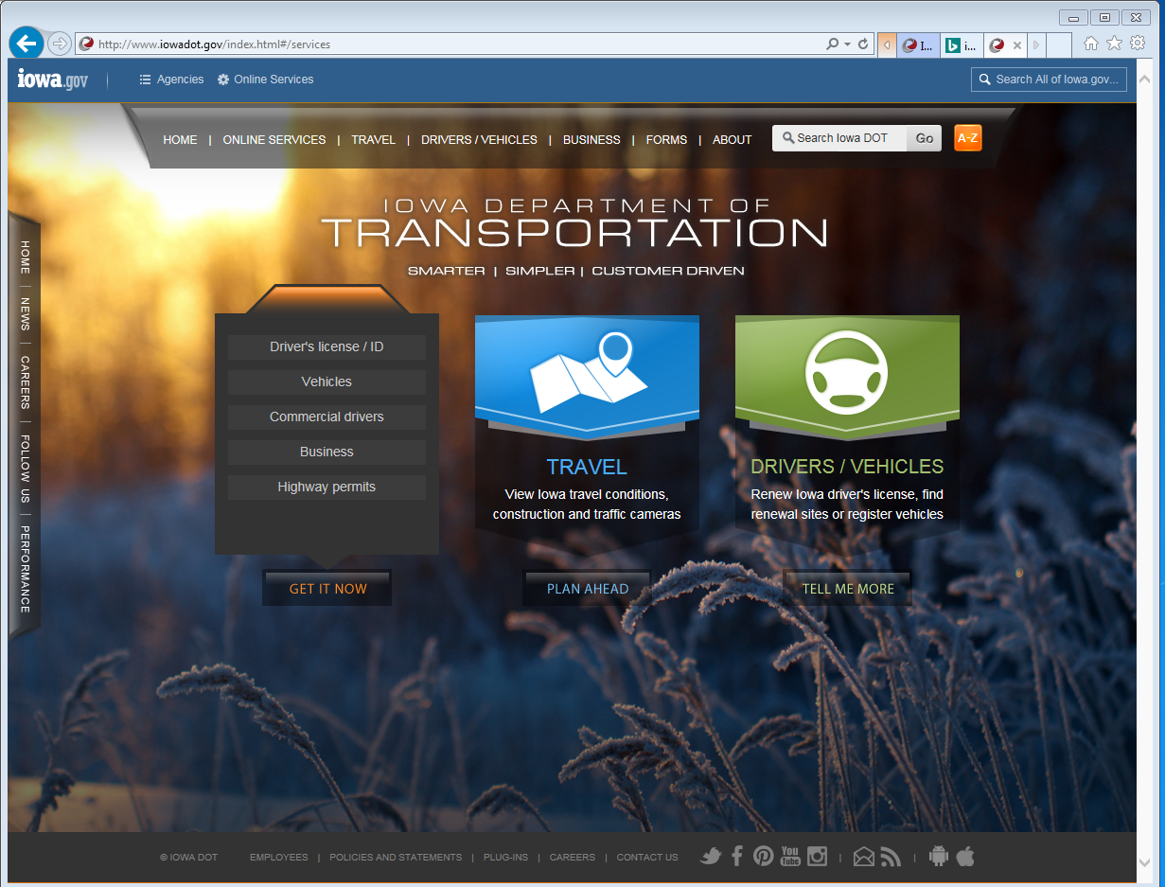
http://www.iowadot.gov/index.html#services
Choose the Highway permits tab.
It opens up a new amazing world at your fingertips.
Dramatic music……..
Increasing volume…….

Slide 21
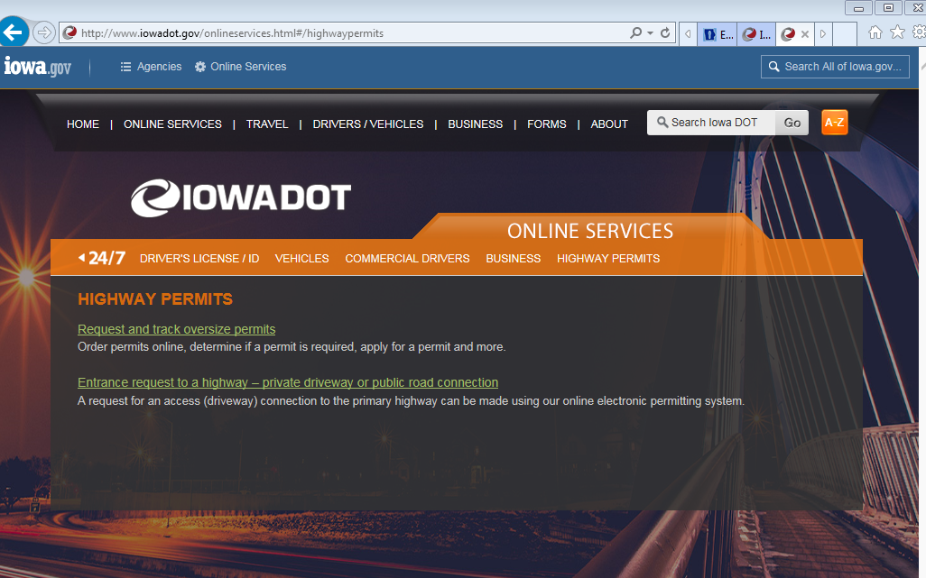
http://www.iowadot.gov/onlineservices.html#/highwaypermits

Slide 22
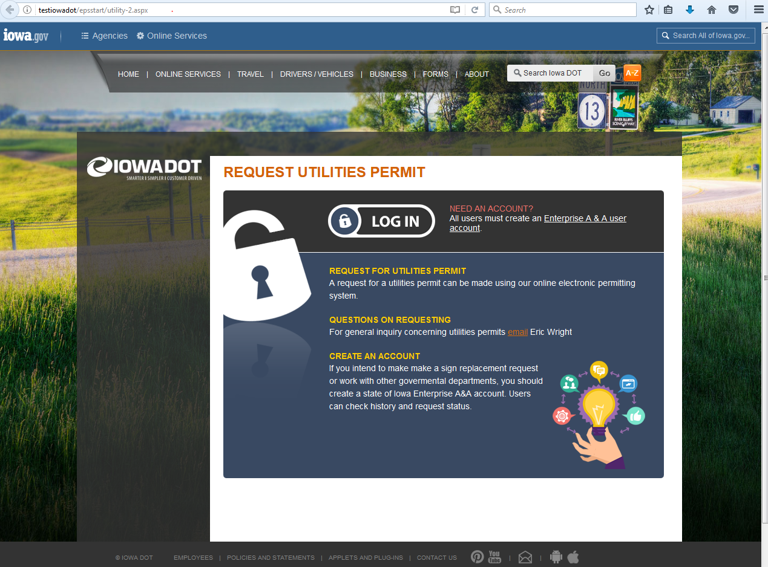
https://secure.iowadot.gov/epsstart/up.aspx
Log in screen
First Time Create Account

Slide 23
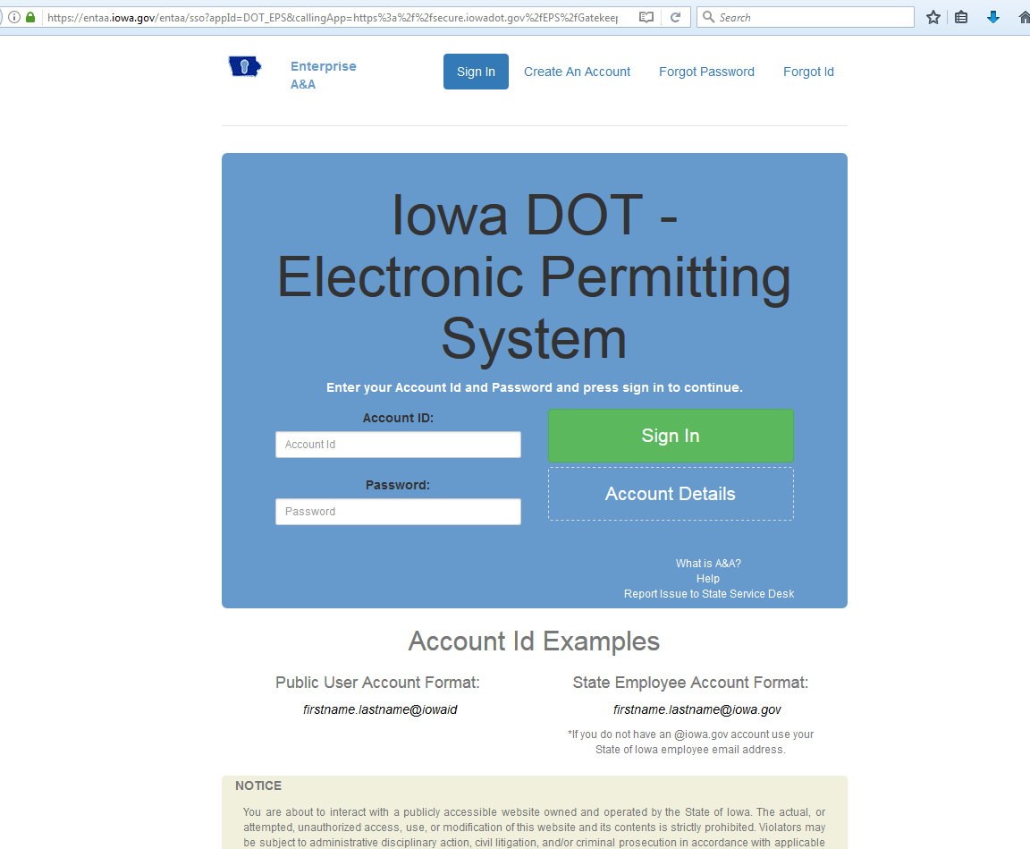
Creating an account in Enterprise A & A
Create an Account
For Help in creating account, logging in etc.

Slide 24
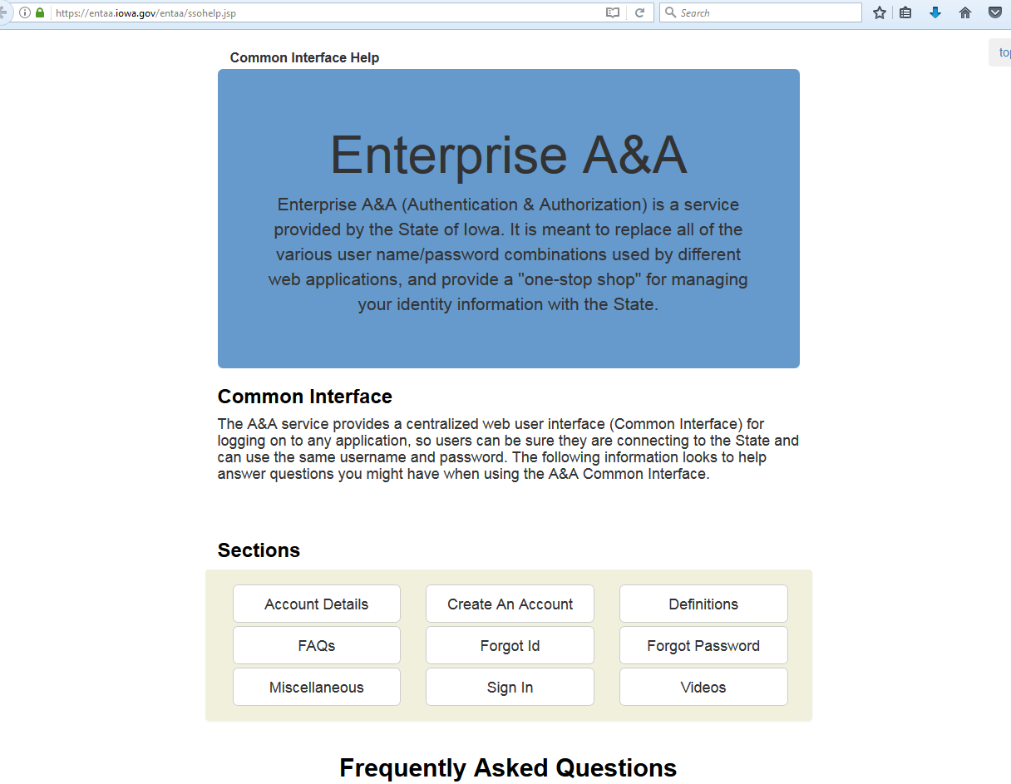
Creating an account in Enterprise A & A
Very Helpful tutorial
Goes to the Create an Account Section abb. Where the following slides came from.

Slide 25
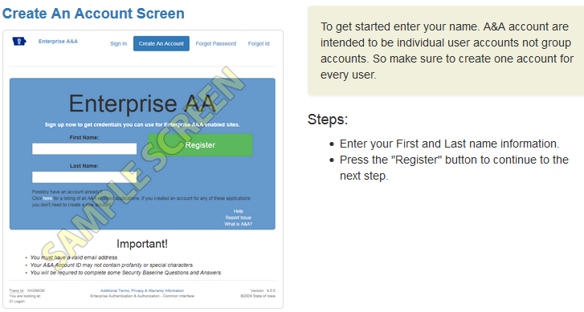
Creating an account in Enterprise A & A

Slide 26
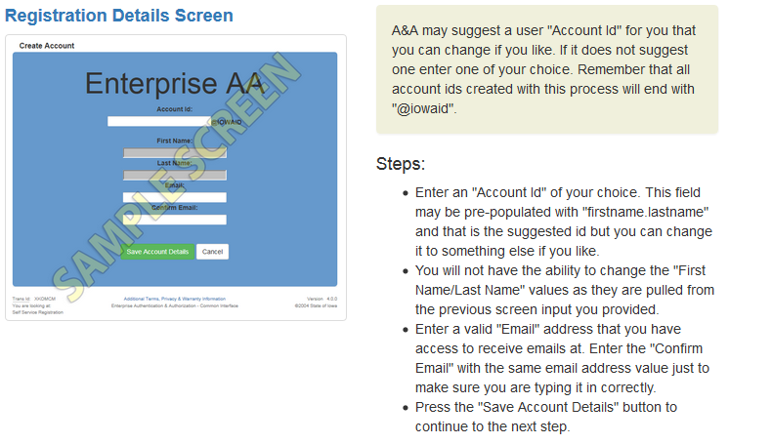
Creating an account in Enterprise A & A
This Email is used in the next step so it should be a regular email for you

Slide 27
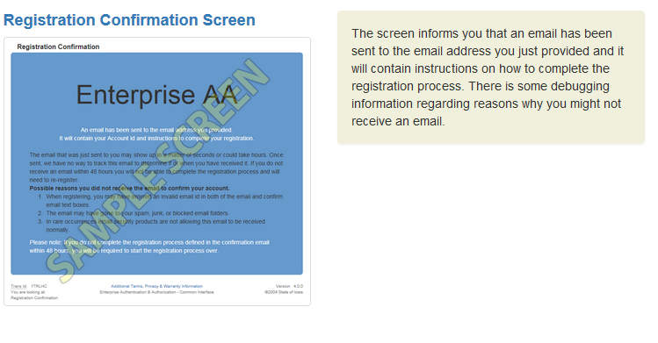
Creating an account in Enterprise A & A

Slide 28
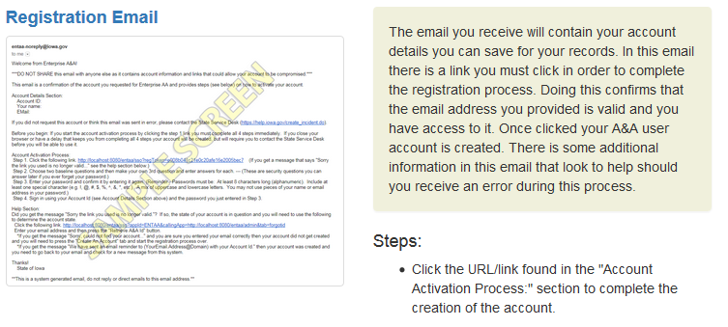
Creating an account in Enterprise A & A

Slide 29
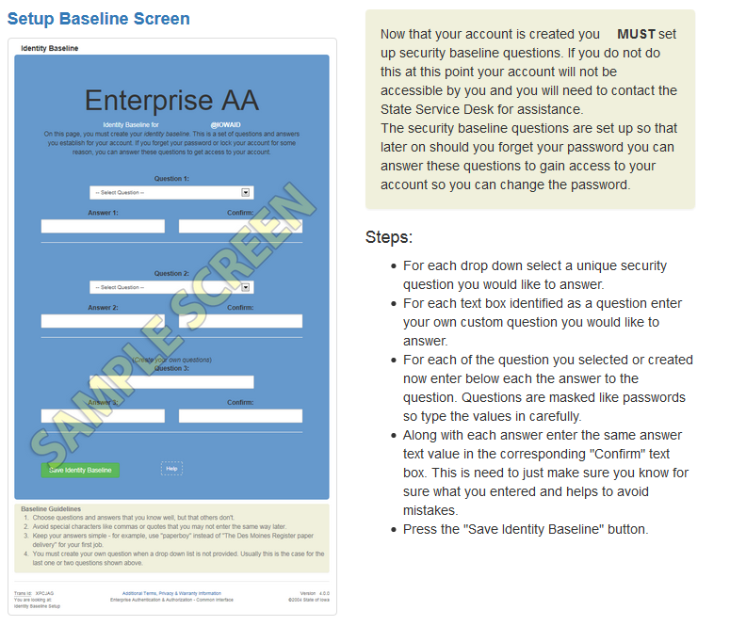
Creating an account in Enterprise A & A

Slide 30
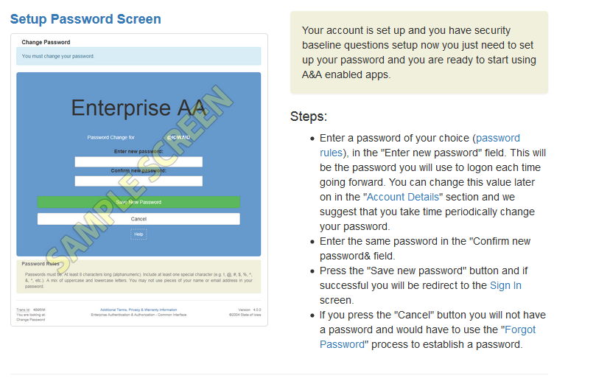
Creating an account in Enterprise A & A

Slide 31
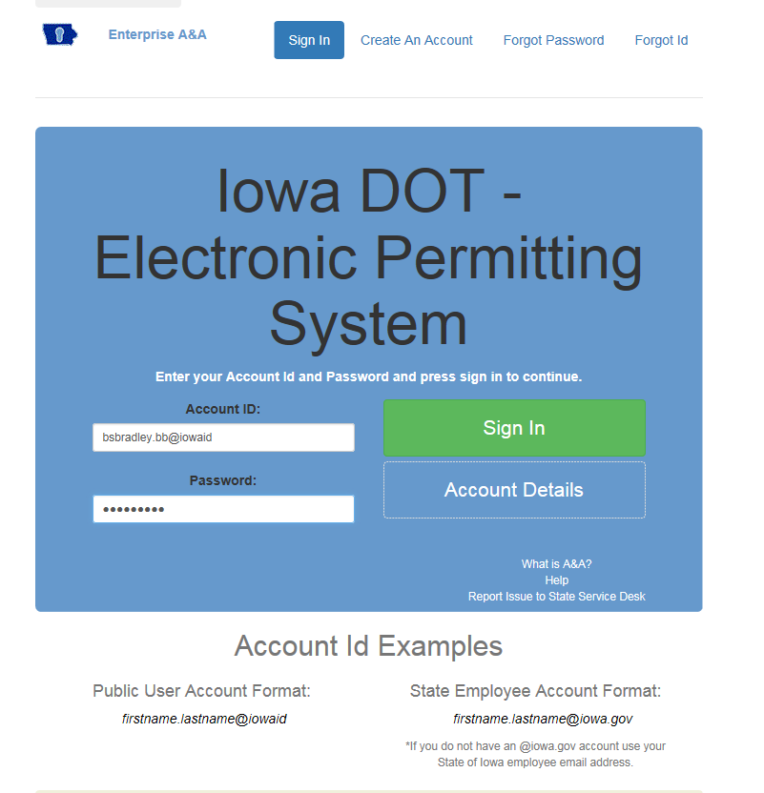
Getting into the EPS
Password: The Password is case-sensitive: "Secret1!" is NOT the same as "secret1!". Your Account ID and matching password are required to use your account.
In general, your password should be:
Between 8 and 12 letters (a-z, A-Z), numbers (0-9) or symbols (!, @, #, $) long.
Something others cannot easily guess (e.g., pieces of your name).
Something you can easily remember.
Independent of a specific website or purpose.
PASSWORD:
Minimum 8 characters
1 UPPER CASE
1 lower case
1 special symbol
The Account ID is what you entered with the @iowaid after your original username

Slide 32
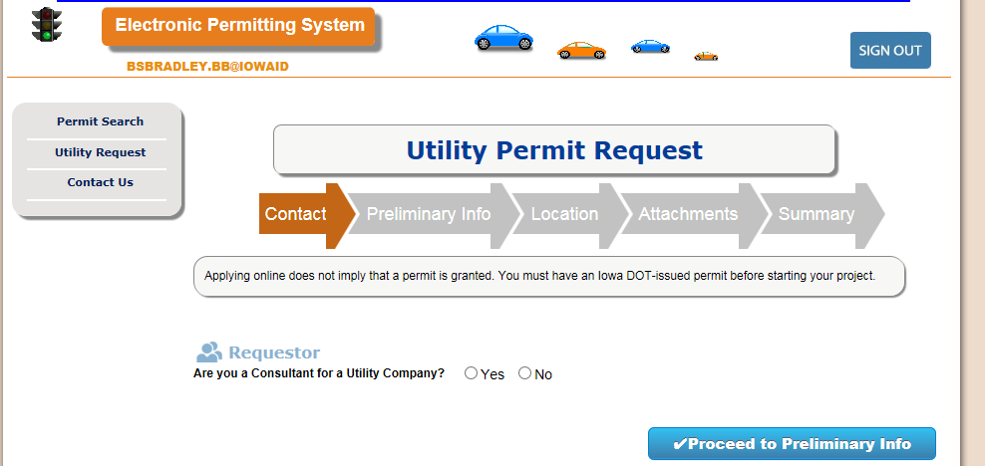
EPS
Knows who you are
All Permits easily searchable
New Request

Slide 33
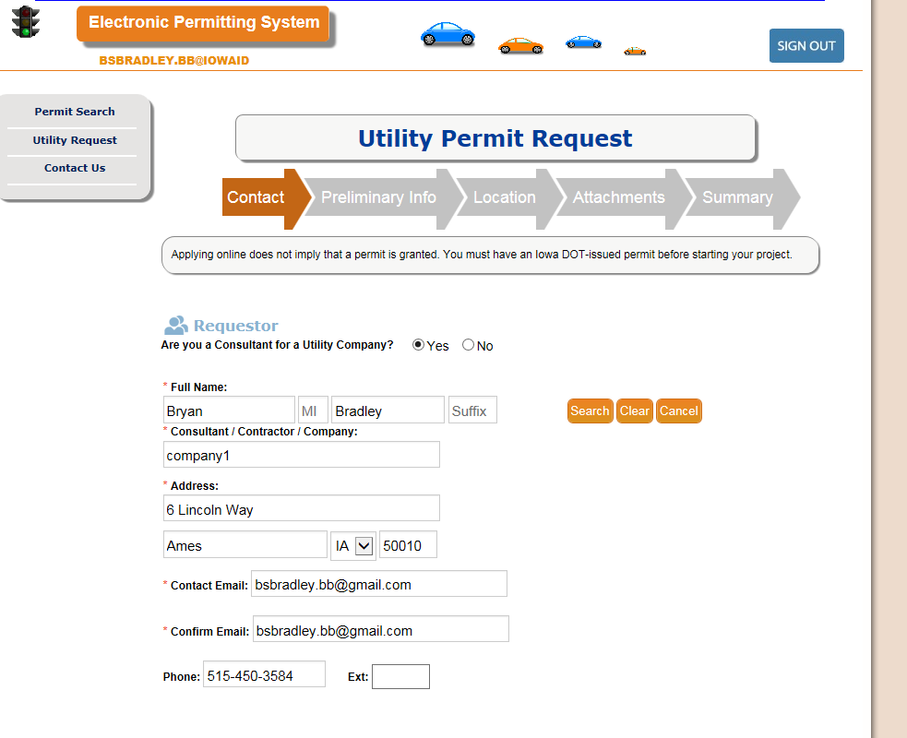
EPS
Two phases
Preliminary – Initiate the request
Much is autofill after the first time in

Slide 34
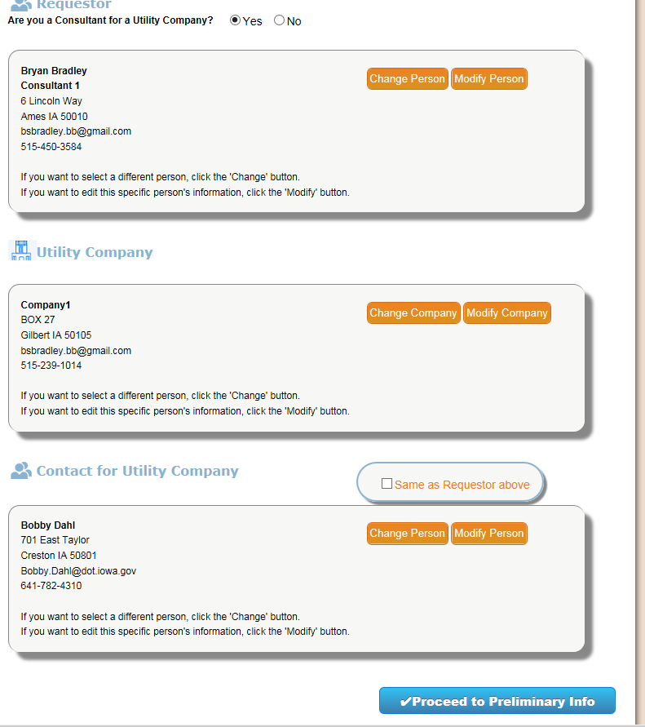
EPS
In this example I am a consultant working for Company Consultant 1
I am working for Utility Company1
The contact for the Utility Company (Company1) is Bobby Dahl
Of course you may be a Utility Employee working for a Utility and the Utility Contact

Slide 35
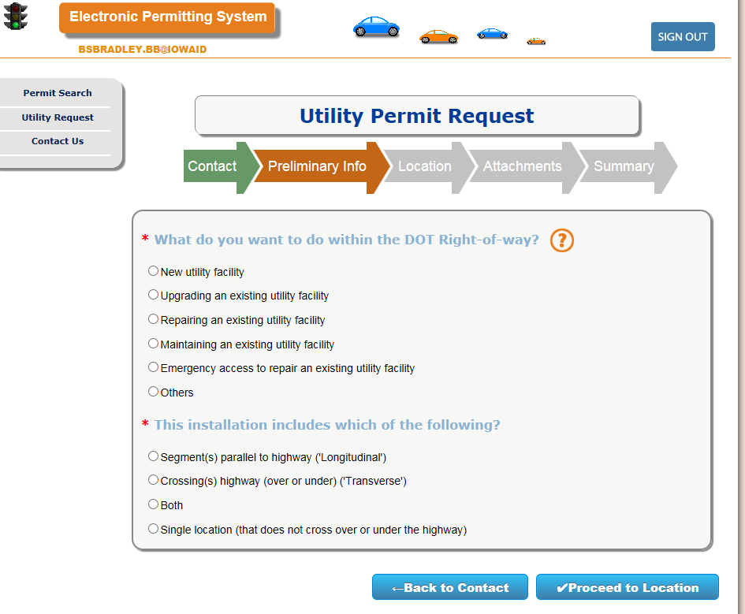
EPS

Slide 36
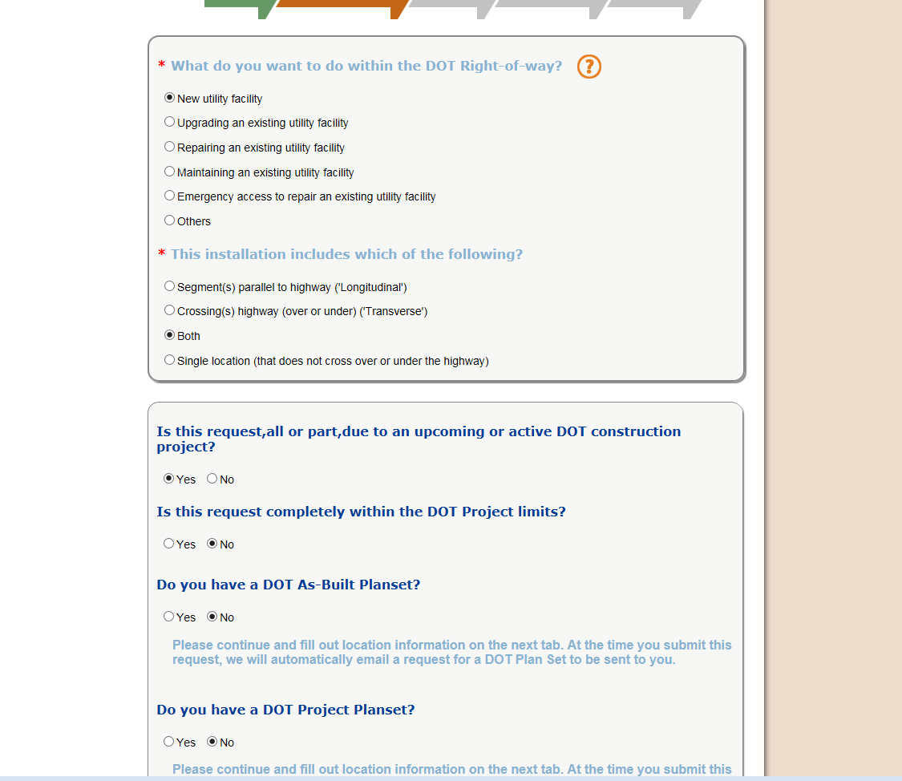
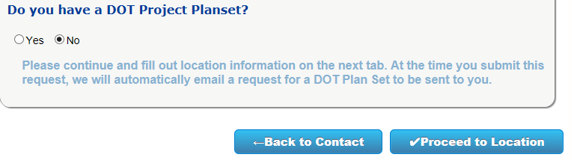
EPS

Slide 37
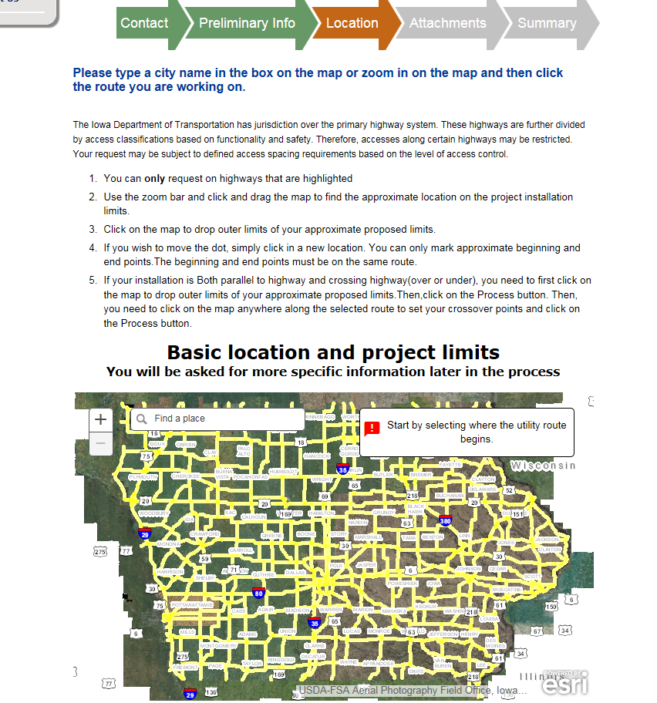
EPS

Slide 38
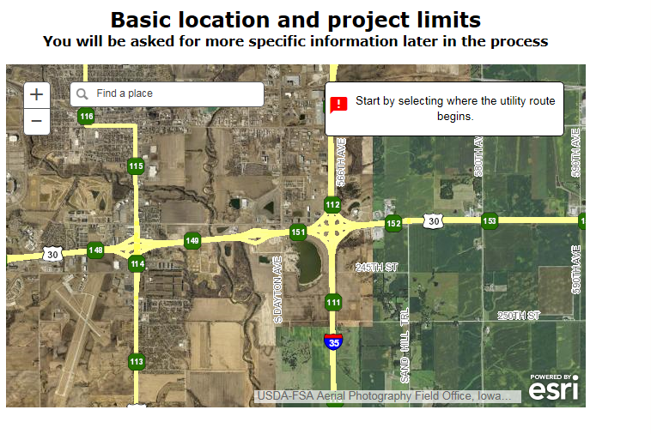
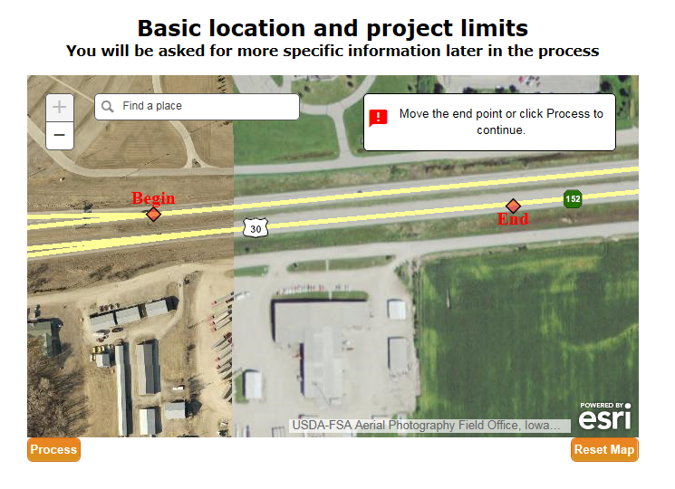
EPS

Slide 39
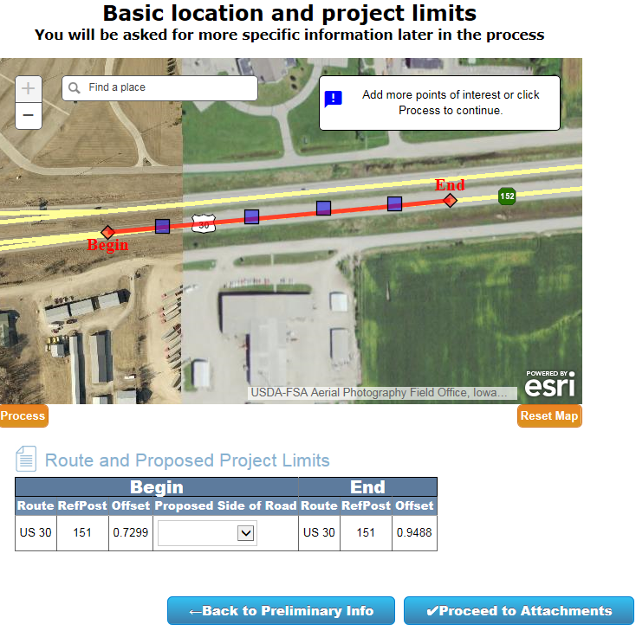
EPS

Slide 40
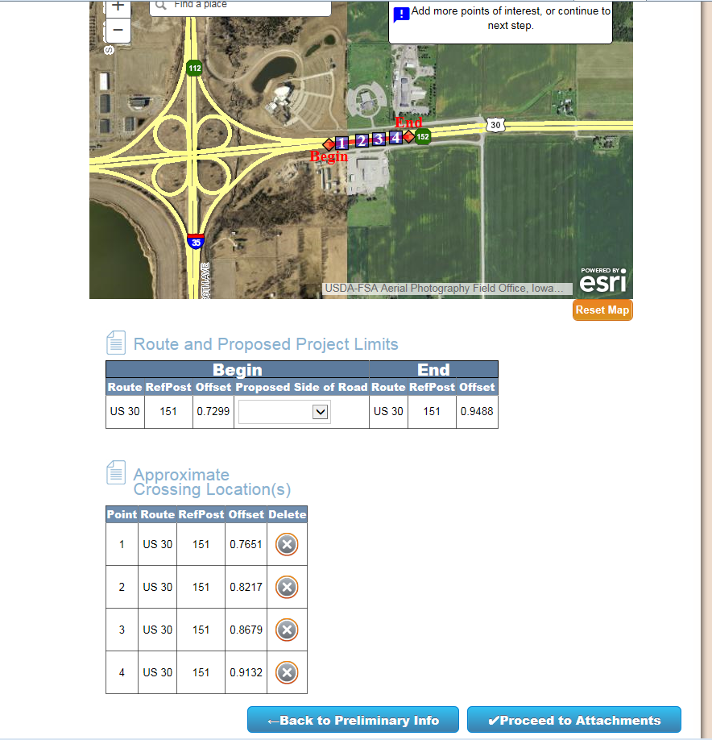
EPS

Slide 41
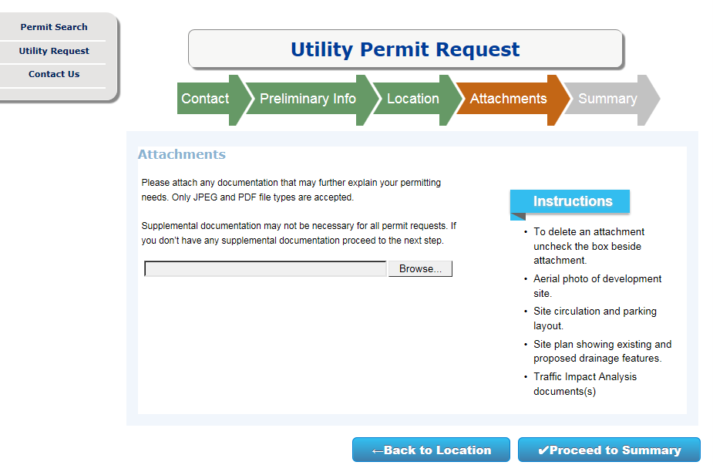
EPS

Slide 42
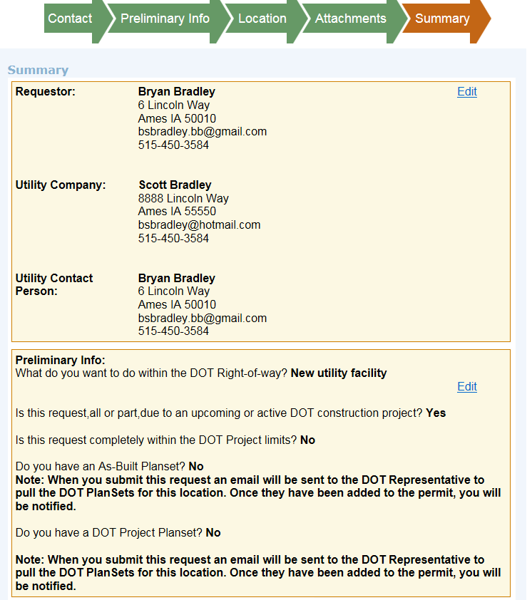
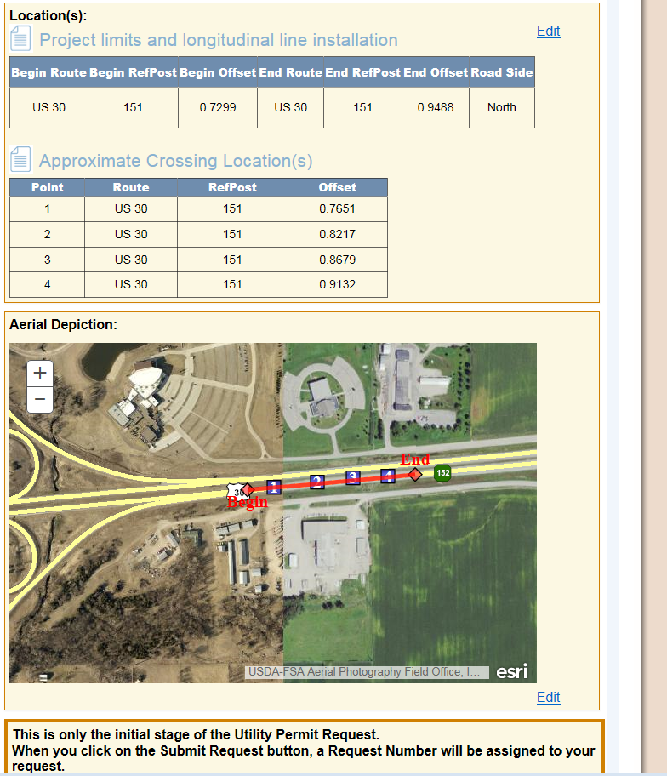

EPS

Slide 43
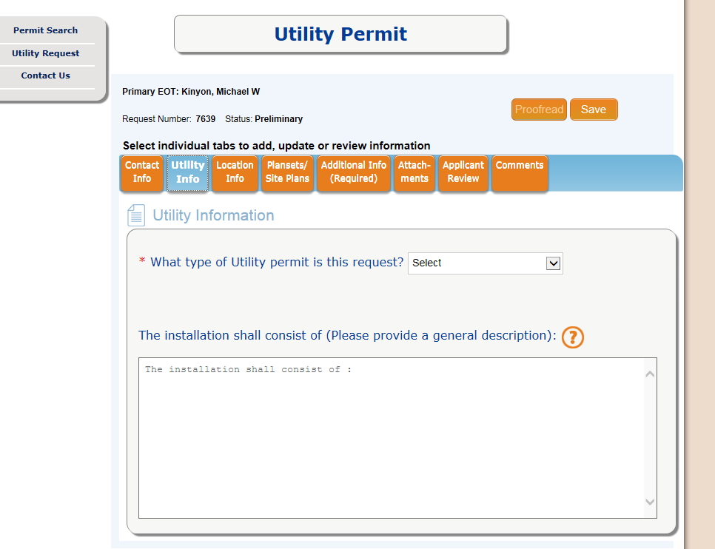
After the initial information is gathered including plan availability and location the permit application process has been initiated.
May have to wait until plans available and attached by DOT
If you have DOT as-builts and/or project plans then you can go directly here.

Slide 44
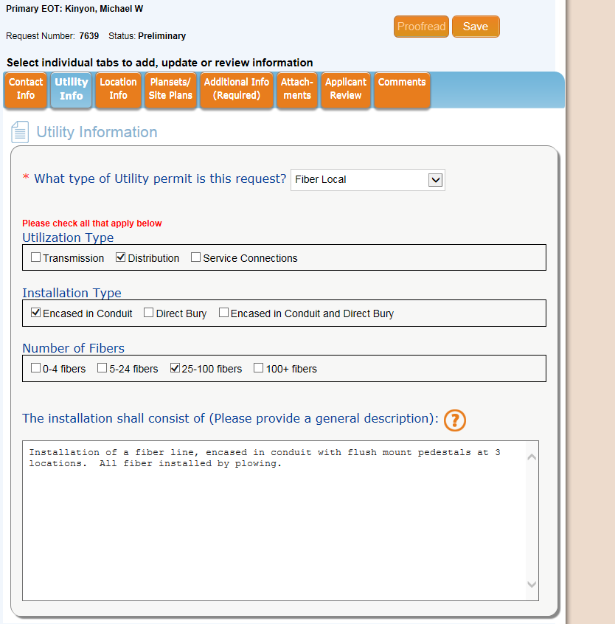
EPS
After Utility Information Tab complete next tab at the top

Slide 45
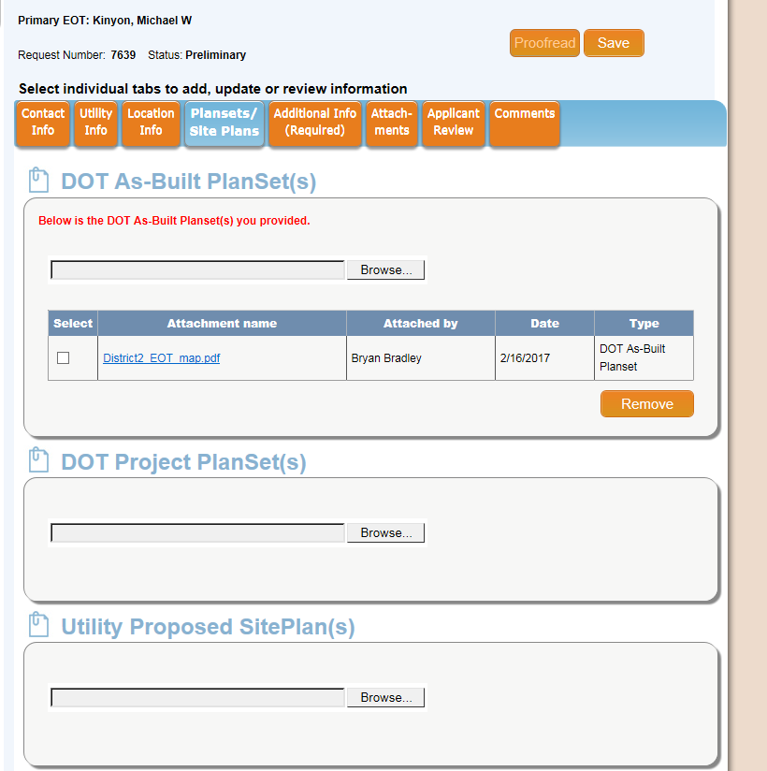
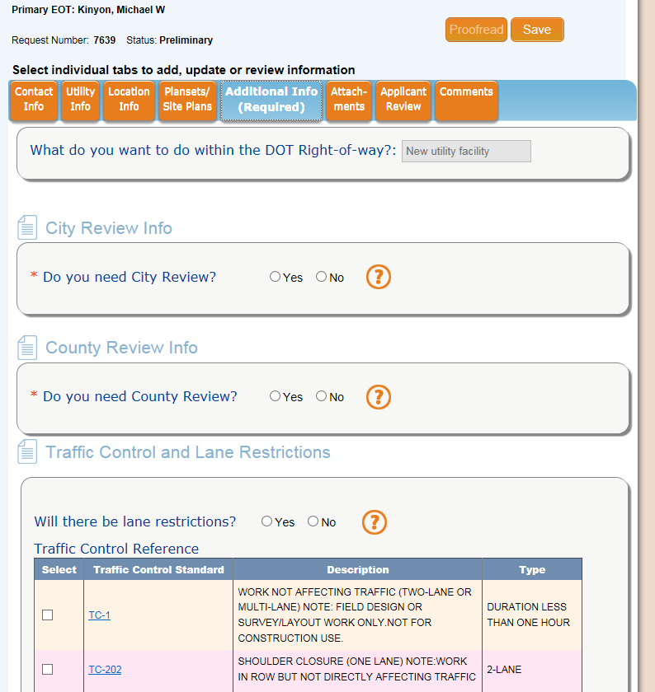
EPS
Discuss tabs

Slide 46
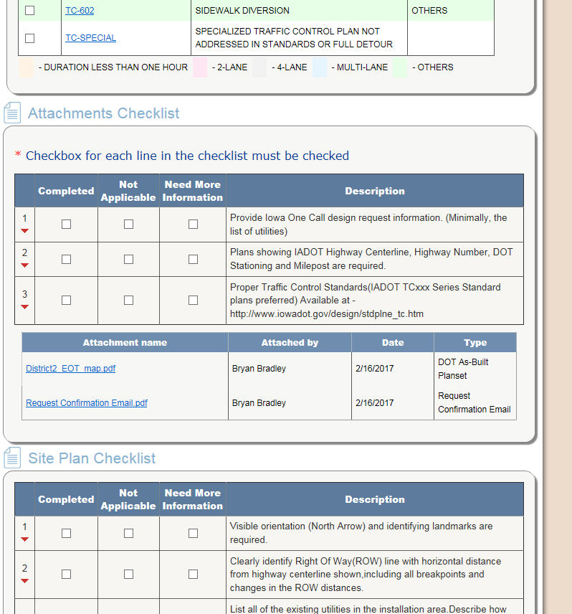
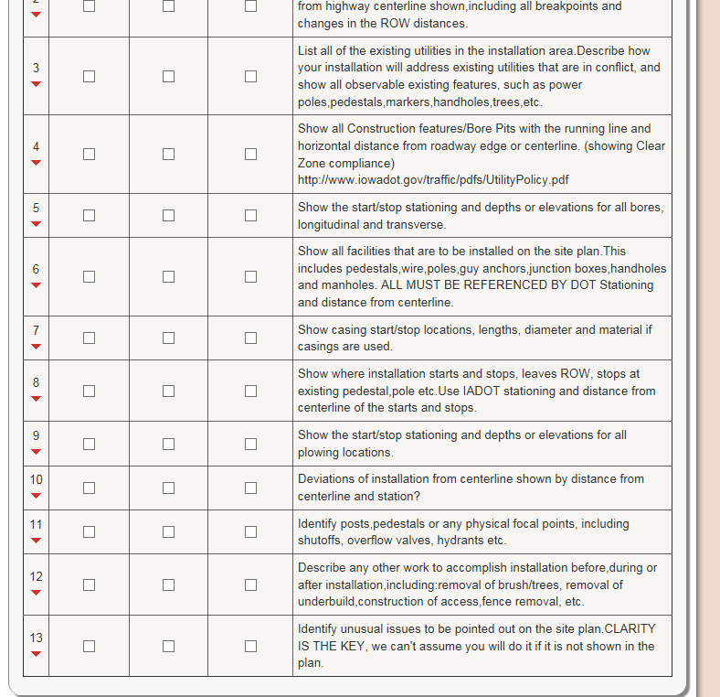
EPS

Slide 47
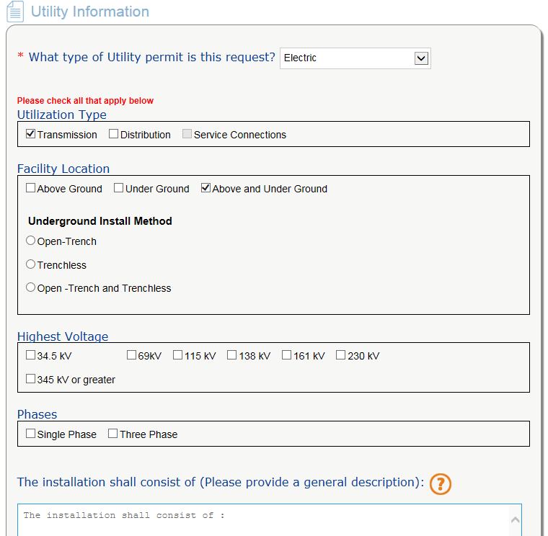
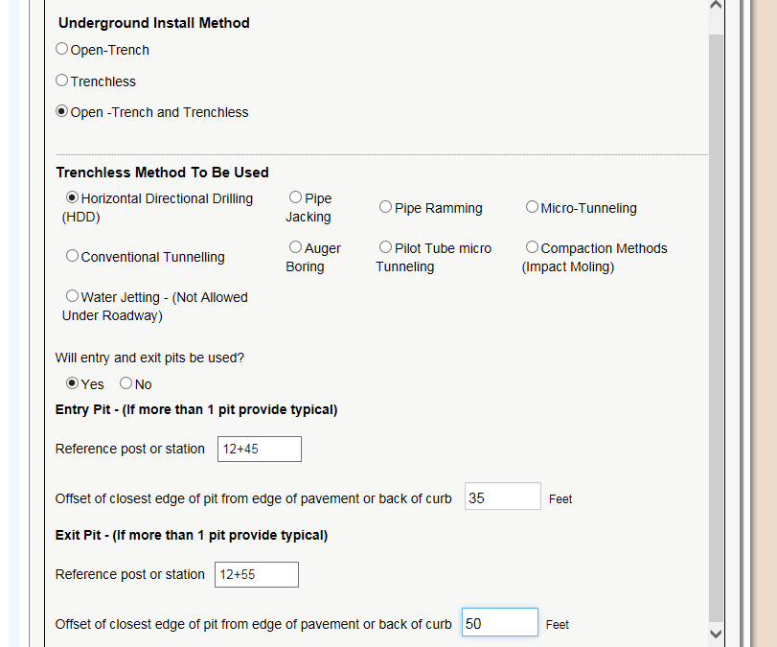
EPS - Electric

Slide 48
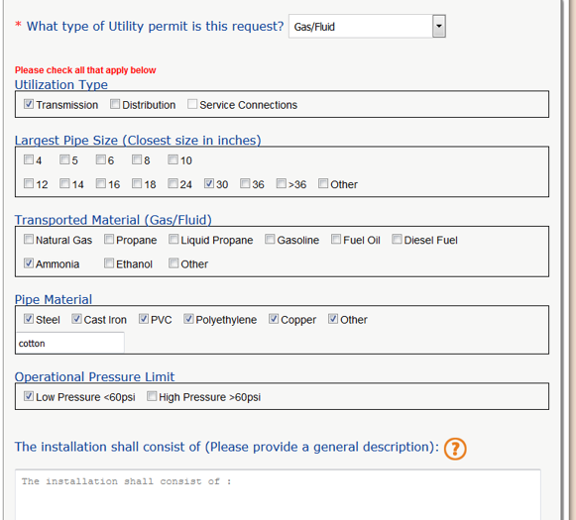
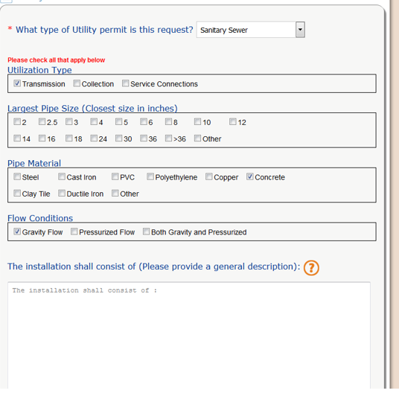
EPS – Gas/Fluid, Sanitary Sewer

Slide 49
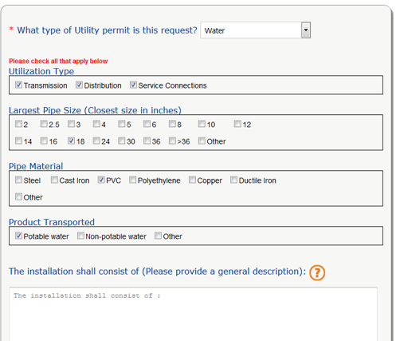
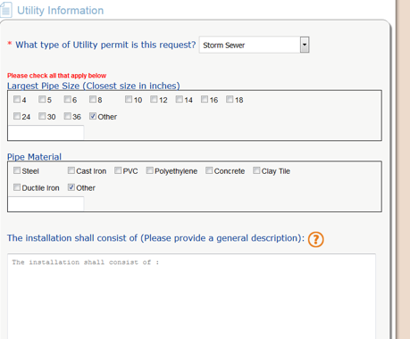
EPS Water, Storm Sewer

Slide 50
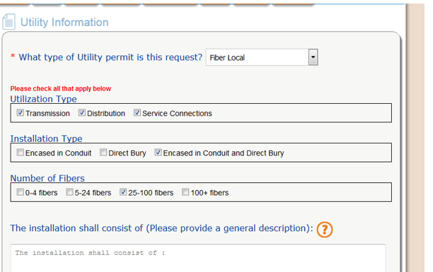
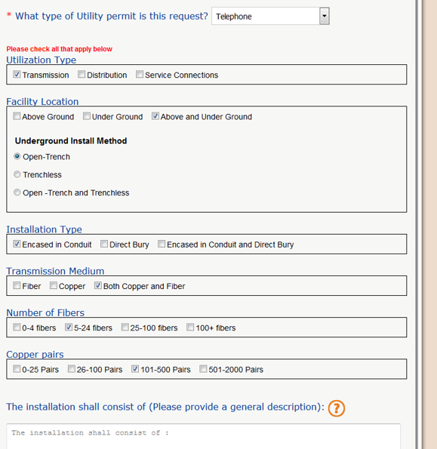
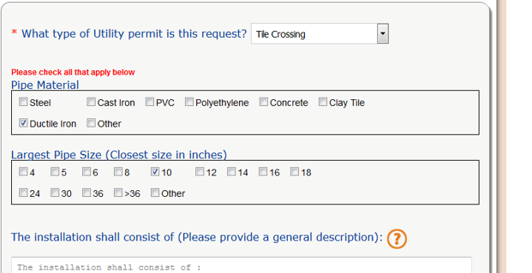
EPS Telephone, Fiber Local, Tile

Slide 51


EPS
Add applicant review

Slide 52


EPS Emails generated
at different steps

Slide 53


The Check Sheet

Slide 54


GAS/FLUID DISTRIBUTION

Slide 55

GAS/FLUID TRANSMISSION

Slide 56


ELECTRIC TRANSMISSION

Slide 57


ELECTRIC DISTRIBUTION

Slide 58

FIBER LOCAL

Slide 59

FIBER LONG DISTANCE

Slide 60

WATER

Slide 61

SANITARY SEWER

Slide 62

CABLE TV

Slide 63


TELEPHONE

Slide 64
EPS
Comments
Questions
Concerns
Suggestions.
Filled out Yet?
Contact Info
Family Tree
Questions
Comments on the Layouts

Slide 65
National Trends, issues, permitting accommodation
X,Y,Z location and data retention
Dakota Access Pipeline
Small Cell, Distributed Antenna System (DAS)
Mobilitie - Sprint
Iowa Permitting
Some states Leasing WA, OR, VA, GA

Slide 66
Annual Utility/Iowa DOT 2017 MeETING
Introductions:
Okay so we are getting close to lunch so I wanted to allow everyone to put names and faces together.
So If you work for the DOT please stand up.
Now Sit, now stand, now sit. They can be trained!
District DOTers - 1 through 6
Introduce yourself as I request each district to do so. State your position

Slide 73


Slide 74
Annual Utility/Iowa DOT 2017 MeETING
Introductions:
Utilities people please stand up, okay sit down, No sorry stand up.
Please stand up and state your name and company/city
I do want to encourage the Utilities to introduce themselves to the DOT people that you have been or will be working with at lunch, afternoon break or after the afternoon session is complete.

Slide 75
Annual Utility/Iowa DOT 2017 MeETING
More Introductions:
Central Office
Utility Section, IT, Others
Utilities and Consultants – Stop by and say Hi!
Lunch
After - afternoon session

Slide 76
EPS
Utility Information complete next tab at the top

