Slide 1
IOWA DOT CONTACTS
District contacts in several formats including links for electronic formats.
District Utility Coordinators (coordination)
District Personnel (other)
Engineering Operations Technicians (permits)

Slide 2
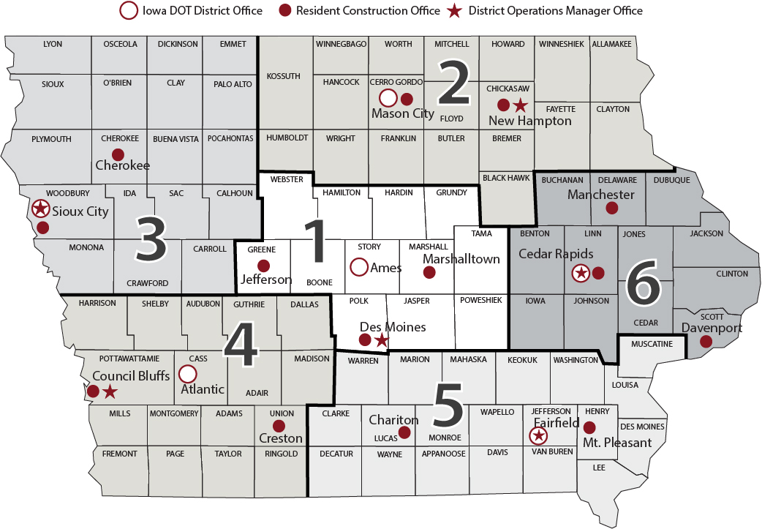
Notes:
Highway Division District location Map

Slide 3
http://www.iowadot.gov/pdf_files/need_answers.pdf

Slide 4
http://www.iowadot.gov/pdf_files/need_answers.pdf

Slide 5
District Utility Coordinators

Slide 6
EOT Area of Responsibility
To find the EOT responsibility maps go the the permit site and click on maps at the bottom of the page.
http://www.iowadot.gov/district1/permits.htm
http://www.iowadot.gov/district2/permits.htm
http://www.iowadot.gov/district3/permits.htm
http://www.iowadot.gov/district4/permits.htm
http://www.iowadot.gov/district5/permits.htm
http://www.iowadot.gov/district6/permits.htm

Slide 7
March 2017

Slide 8
March 2017

Slide 9
March 2017

Slide 10
March 2017

Slide 11
March 2017

Slide 12
March 2016

