Slide 1
IOWA DOT CONTACTS
District contacts in several formats including links for electronic formats.
https://iowadot.gov/districts/district-contacts
Ctrl+Click to follow the link above
District Personnel (Other)
District Utility Coordinators
Engineering Operations Technicians (permits)
District Maintenance Shop Supervisors

Slide 2
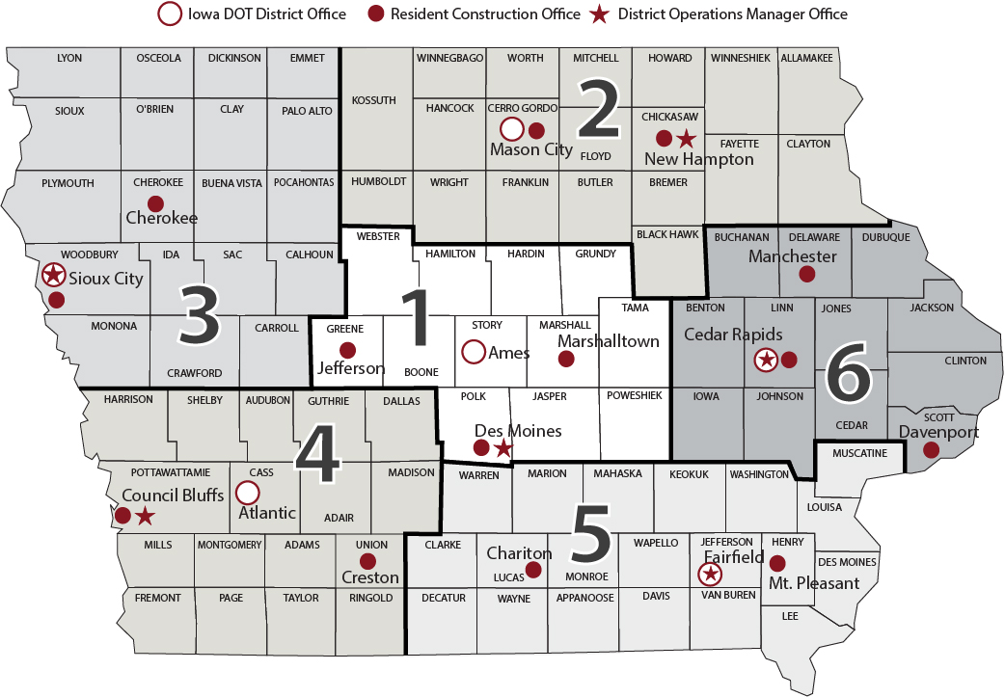
Notes:
Highway Division District location Map

Slide 3
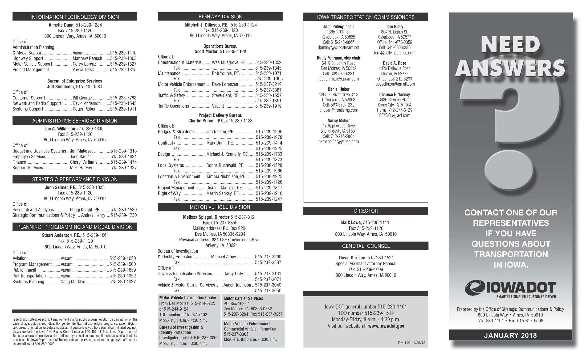
http://www.iowadot.gov/pdf_files/need_answers.pdf

Slide 4
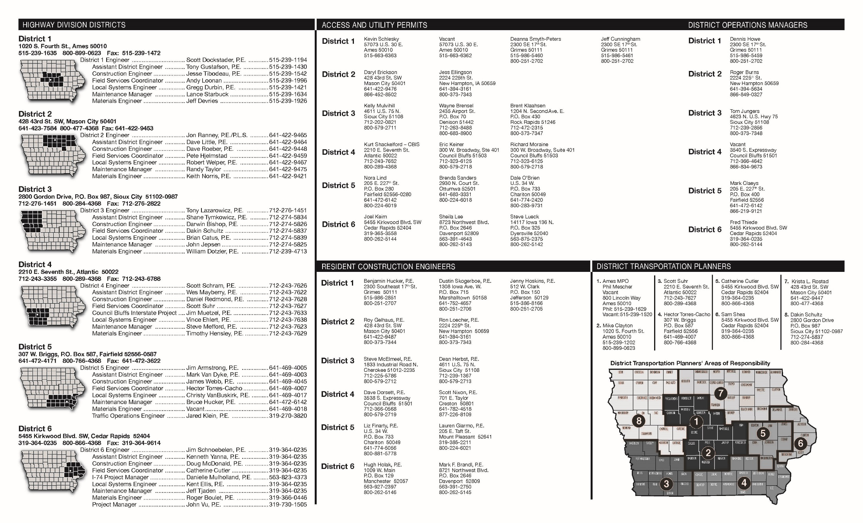
http://www.iowadot.gov/pdf_files/need_answers.pdf

Slide 5
District Utility Coordinators

Slide 6
EOT Area of Responsibility
To find the most up to date Engineering Operations Tech (EOT) responsibility maps and contact information on our website for the permitting.
Please Ctrl+Click on the link below.
https://iowadot.gov/districts/permits

Slide 7
https://iowadot.gov/districts/images/district1_eot_map.pdf
Ctrl+Click for most current online map

Slide 8
https://iowadot.gov/districts/images/district2_eot_map.pdf
Ctrl+Click for most current online map

Slide 9
https://iowadot.gov/districts/images/district3_eot_map.pdf
Ctrl+Click for most current online map

Slide 10
https://iowadot.gov/districts/images/district4_eot_map.pdf
Ctrl+Click for most current online map

Slide 11
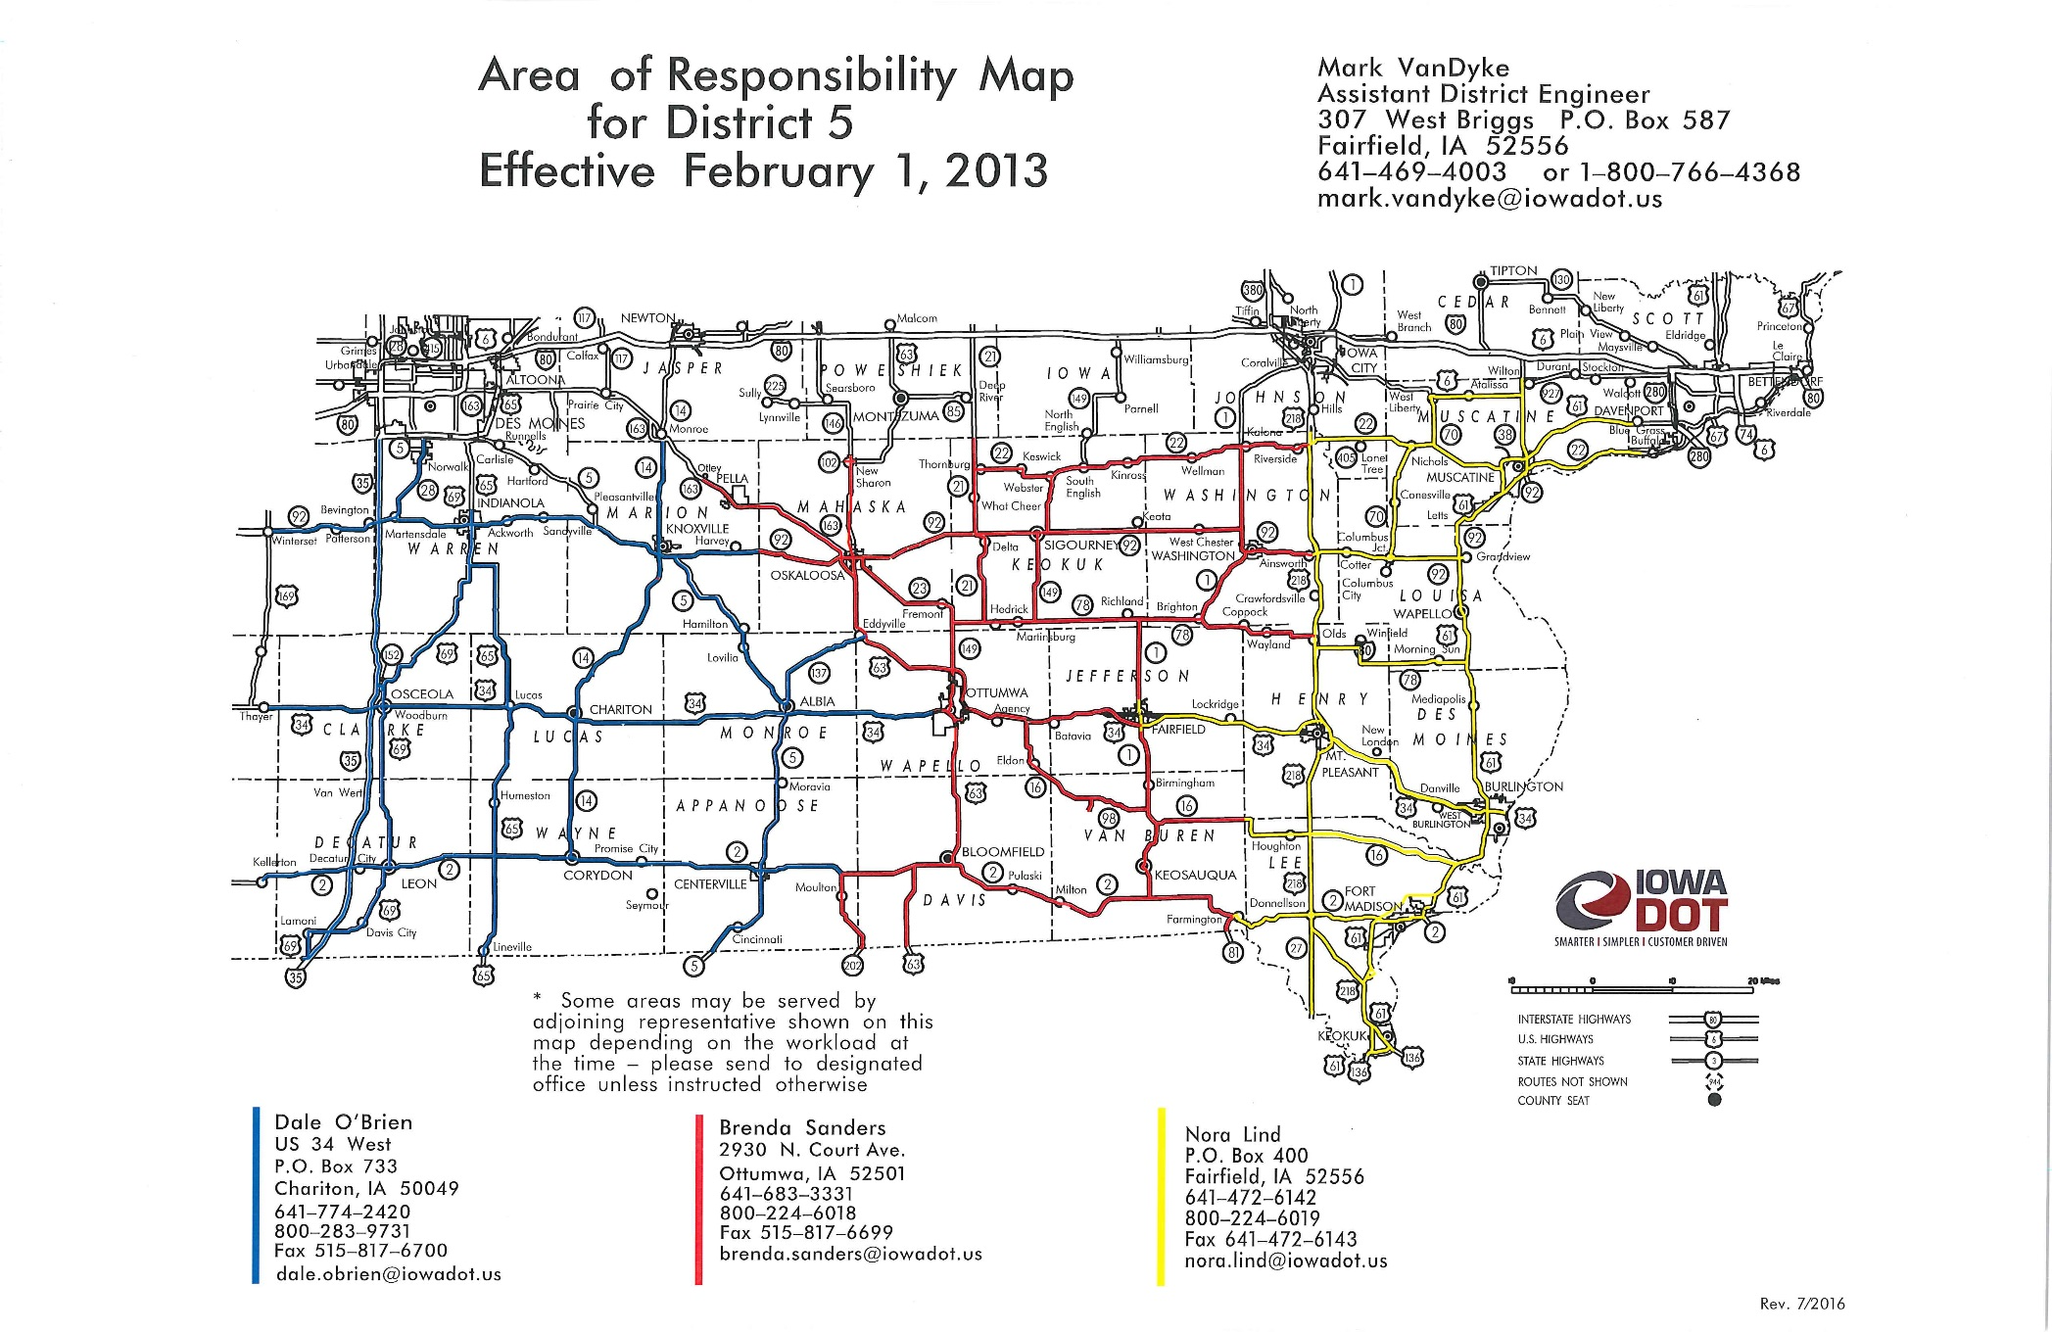
https://iowadot.gov/districts/images/district5_eot_map.pdf
Ctrl+Click for most current online map

Slide 12
https://iowadot.gov/districts/images/district6_eot_map.pdf
Ctrl+Click for most current online map

Slide 13
https://iowadot.gov/districts/pdf/DistrictMapD1.pdf
Ctrl+Click for most current online map

Slide 14
District 1 Maintenance Garage Contacts (Ctrl+Click on City for the most current Area Responsibility Map)
Altoona Polk County Teresa Salak 405 1st Avenue North Altoona, IA 50009 515-967-4246
Ames Story County Jim Van Sickle 57073 US Hwy 30 Ames, IA 50010 515-663-6367
Boone Story County Jeff Vander Zwaag 615 Snedden Drive Boone, IA 50036 515-432-5411
Des Moines North Polk County Eric Lack 1530 NE 53rd Ave. Des Moines, IA 50313 515-265-1614
Fort Dodge Webster County Ryan Sundine 2088 230th St Fort Dodge, IA 50501 515-955-8571
Grimes Polk County Jim Scott 2310 SE 17th St Grimes, IA 50111 515-986-5465
Grinnell Poweshiek County Moe Mohamed 902 Ogan Grinnell, IA 50112 641-236-3014
Grundy Center Grundy County Mark Stephens 1205 A. Ave. Grundy Center, IA 50638 319-824-5259
Iowa Falls Hardin County Brad Fleming 1035 Industrial Park Rd Iowa Falls, IA 50126 641-648-3135
Jefferson Greene County Jeff Vander Zwaag 610 N. Pinet Jefferson, IA 50129 515-386-2176
Malcom Poweshiek County Moe Mohamed 1206 420th Ave. Malcom, IA 50157 641-528-3775
Marshalltown Marshall County Mark Stephens 1308 Iowa Ave W. Marshalltown, IA 50158 641-753-7783
Newton Jasper County Nancy Woody 2300 W. 19th St S. Newton, IA 50208 641-792-7783
Tama Tama County Moe Mohamed 3277 L. Ave. Tama, IA 52339 641-484-2402
Williams Hamilton County Brad Fleming 2110 Vail Ave.
Williams, IA 50271 515-854-2217

Slide 15
https://iowadot.gov/districts/pdf/DistrictMapD2.pdf
Ctrl+Click for most current online map

Slide 16
District 2 Maintenance Garage Contacts (Ctrl+Click on City for Area Responsibility Map)
Algona Kossuth County Scott Loge Supervisor 2107 100th Ave. Algona, IA 50511 515-295-5218
Allison Butler County Russell Frisch Supervisor 12 Pfaltzgraff Allison, IA 50602 319-267-2550
Charles City Floyd County Jeremy Weber Supervisor 600 18th St. Charles City, IA 50616 641-228-4165
Clarion Wright County Ron Reichter Supervisor 1010 Central Ave. W. Iowa 3 W. Clarion, IA 50525 515-532-2626
Decorah Winneshiek County Joel Monroe Supervisor 2305 U.S. 52 S. Decorah, IA 52101 563-382-4565
Elkader Clayton County Gabriel Zittergruen Supervisor 22347 Iowa 128 Elkader, IA 52043 563-880-0098
Garner Hancock County Scott Loge Supervisor 280 U.S. 18 E. Garner, IA 50438 641-923-2305
Hanlontown Worth County Pete Andera Supervisor 763 Iowa 9 Hanlontown, IA 50444 641-896-3100
Latimer Franklin County Ron Reichter Supervisor 1773 Heather Ave. Latimer, IA 50452 641-579-6466
Mason City Cerro Gordo County Pete Andera Supervisor 480 43rd St. SW Mason City, IA 50401 641-423-9441
New Hampton Chickasaw County Jeremy Weber Supervisor 2220 225th St. New Hampton, IA 50659 641-394-2541
Osage Mitchell County Jeremy Weber Supervisor 1945 Iowa 9 Osage, IA 50461 641-732-3637
Swea City Kossuth County Scott Loge Supervisor 806 Hwy. 9 Swea City, IA 50590 515-272-4295
Waterloo Black Hawk County Barry Thede Supervisor 1875 W. Ridgeway Ave. P.O. Box 1888 Waterloo, IA 50704 319-233-3055
Waukon Allamakee County Joel Monroe Supervisor 1380 9th St SW Waukon, IA 52172 563-568-3773
Waverly Bremer County Russell Frisch Supervisor 3001 E. Bremer Ave. Waverly, IA 50677 319-352-1045
West Union Fayette County Gabriel Zittergruen Supervisor 11562 210th St. Iowa 150 S. West Union, IA 52175 563-880-0098

Slide 17
https://iowadot.gov/districts/pdf/DistrictMapD3.pdf
Ctrl+Click for most current online map

Slide 18
District 3 Maintenance Garage Contacts (Ctrl+Click on City for Area Responsibility Map)
Pocahontas Pocahontas County Nate Westphal Supervisor 405 N.W. Seventh St. Pocahontas, IA 50574 Ph: 712-335-4590
Rock Rapids Lyon County Lance Schlumbohm Supervisor 1204 N. Second Ave. P.O. Box 430 Rock Rapids, IA 51246 Ph: 712-472-3719
Rockwell City Calhoun County Nate Westphal Supervisor 2770 Norridge Ave. P.O. Box 226 Rockwell City, IA 50579 Ph: 712-297-8222
Sac City Sac County Nate Westphal Supervisor 2903 W. Main St. P.O. Box 302 Sac City, IA 50583 Ph: 712-662-7674
Sioux City - Hamilton Woodbury County Todd Cogdill Supervisor 200 Hamilton Blvd. Sioux City, IA 51103 Ph: 712-252-1836
Sioux City - Leeds Woodbury County Todd Cogdill Supervisor 4623 U.S. 75 N. Sioux City, IA 51108 Ph: 712-239-2856
Sloan Woodbury County Ron Gleiser Supervisor 3250 Dallas Ave. P.O. Box 53 Sloan, IA 51055 Ph: 712-428-3300
Spencer Clay County Doug Williams Supervisor 1107 11th Ave. S.W. Spencer, IA 51301 Ph: 712-262-1645
Spirit Lake Dickinson County Doug Williams Supervisor 3001 N. 18th St. Spirit Lake, IA 51360 Ph: 712-336-2112
Storm Lake Buena Vista County Doug Williams Supervisor 1301 W. Milwaukee P.O. Box 1166 Storm Lake, IA 50588 Ph: 712-732-5670
Alton Sioux County Troy Clouse Supervisor 805 Second Ave. P.O. Box 407 Alton, IA 51003 Ph: 712-756-8814
Ashton Osceola County Lance Schlumbohm Supervisor 2374 Iowa 60 Blvd. Ashton, IA 51232 Ph: 712-724-6211
Carroll Carroll County Nate Westphal Supervisor 19382 190th St. P.O. Box 475 Carroll, IA 51401 Ph: 712-792-2894
Cherokee Cherokee County Doug Williams Supervisor 1805 Industrial Road Cherokee, IA 51012 Ph: 712-225-2522
Correctionville Woodbury County Troy Clouse Supervisor 4244 U.S. 20 E. RR 2 Box 95A Correctionville, IA 51016 Ph: 712-372-4762
Denison Crawford County Ron Gleiser Supervisor 2435 Airport Road P.O. Box 70 Denison, IA 51442 Ph: 712-263-4792
Emmetsburg Palo Alto County Doug Williams Supervisor 1405 Adams St. Emmetsburg, IA 50536 Ph: 712-852-4886
Ida Grove Ida County Ron Gleiser Supervisor 2387 Keystone Ave. Box 122 Ida Grove, IA 51445 Ph: 712-364-2027
LeMars Plymouth County Troy Clouse Supervisor 1080 Lincoln St. N.E. P.O. Box 531 LeMars, IA 51031 Ph: 712-546-6401
Onawa Monona County Ron Gleiser Supervisor 1800 Iowa 175 W. P.O. Box 458 Onawa, IA 51040 Ph: 712-423-2040

Slide 19
https://iowadot.gov/districts/pdf/DistrictMapD4.pdf
Ctrl+Click for most current online map

Slide 20
District 4 Maintenance Shop Contacts (Ctrl+Click on City for Area Responsibility Map)
Creston Union County Kurt Reason Supervisor 405 S. Chestnut Creston, IA 50801 641-782-4310
DeSoto Dallas County Pete Wonders Supervisor 3354 Overton Circle Adel, IA 50003 515-834-2368
Greenfield Adair County Kurt Reason Supervisor 2313 Iowa 92 Greenfield, IA 50849 641-743-8324
Missouri Valley Harrison County Todd Frank Supervisor 2308 U.S. 30 Missouri Valley, IA 51555 712-642-2178
Adair Adair County Shawn Havick Supervisor 300 Hillcrest Adair, IA 50002 641-742-3216
Atlantic Cass County Shawn Havick Supervisor 502 Ash St Atlantic, IA 50022 712-243-3114
Avoca Pottawattamie County Dave Brisbois Supervisor 1110 N. Chestnut Avoca, IA 51521 712-343-2655
Clarinda Page County Jason Sallach Supervisor 1150 E. State St Clarinda, IA 51632 712-542-1476
Corning Adams County Kurt Reason Supervisor 2004 200th St. Corning, IA 50841 641-322-4335
Council Bluffs (south) Pottawattamie County Tony Arrick Supervisor 3540 S. Expressway Council Bluffs, IA 51501 712-366-0332
Council Bluffs (north) Pottawattamie County Tony Arrick Supervisor 2501 N. 25th St. Council Bluffs, IA 51501 712-322-7543
Mount Ayr Ringgold County Kurt Reason Supervisor 700 S. Henderson Dr. Mount Ayr, IA 50854 641-464-2340
Neola Pottawattamie County Todd Frank Supervisor 30420 Tomahawk Ave. Neola, IA 51559 712-485-2591
Oakland Pottawattamie County Dave Brisbois Supervisor 18818 U.S. 59 Oakland, IA 51560 712-482-3190
Pacific Junction Mills County Mike Miller Supervisor 21112 Kane Ave. Pacific Junction, IA 51561 712-622-8140
Perry Dallas County Pete Wonders Supervisor 14455 N Ave. U.S. 169 Bouton, IA 50039 515-676-2233
Red Oak Montgomery County Jason Sallach Supervisor 1903 N. Broadway Ave. Red Oak, IA 51566 712-623-2450
Sidney Fremont County Mike Miller Supervisor 1305 Filmore P.O. Box 730 Sidney, IA 51652 712-374-2515

Slide 21
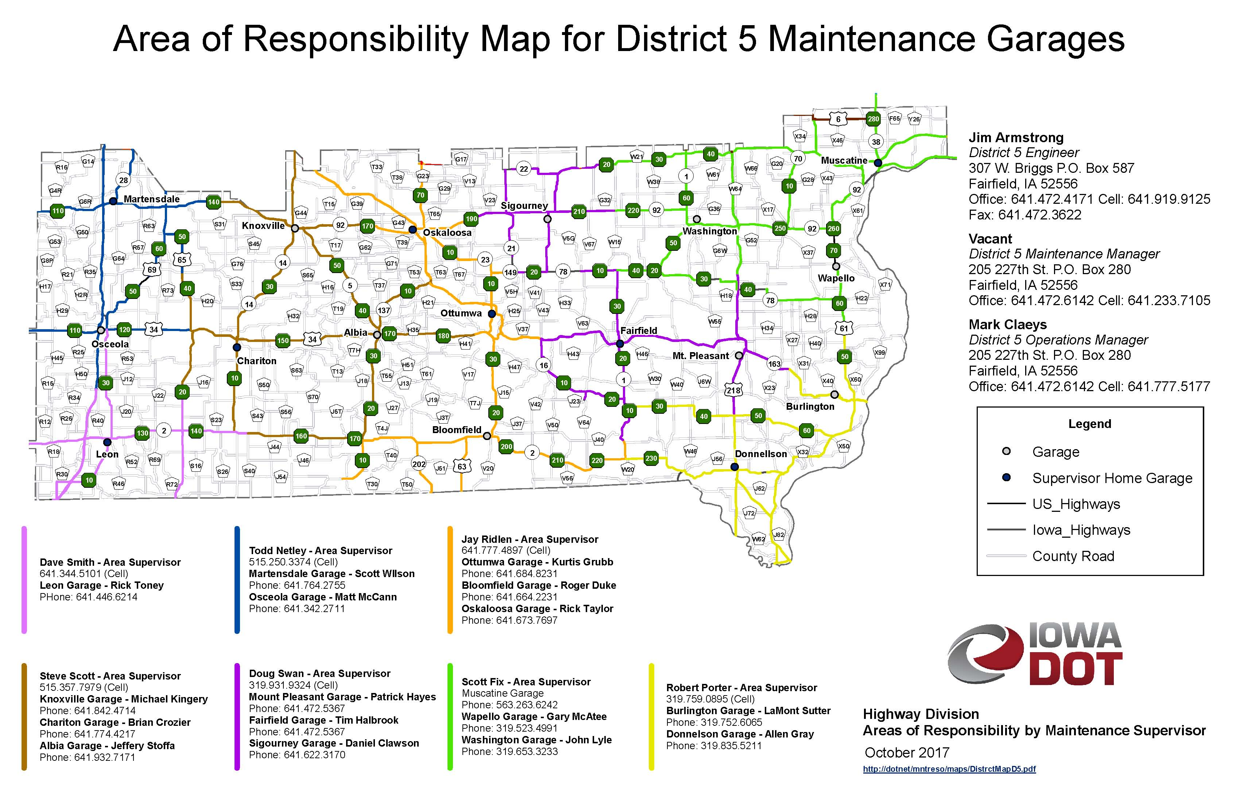
https://iowadot.gov/districts/pdf/D5_DistrictMap.pdf
Ctrl+Click for most current online map

Slide 22
District 5 Maintenance Shop Contacts (Ctrl+Click on City for Area Responsibility Map)
Leon Decatur County Dave Smith Supervisor 1504 S.W. Lorraine St. Leon, IA 50144 641-446-6214
Martensdale Warren County Todd Netley Supervisor 795 Iowa 92 W. Martensdale, IA 50160 641-764-2755
Mount Pleasant Henry County Doug Swan Supervisor 906 E. Harvest Drive Mount Pleasant, IA 52641 319-385-8641
Muscatine Muscatine County Scott Fix Supervisor 417 Lake Park Blvd. Muscatine, IA 52761 563-263-6242
Albia Monroe County Steve Scott Supervisor 1501 S. C St. Albia, IA 52531 641-932-7171
Bloomfield Davis County Jay Ridlen Supervisor 20836 Iowa 2 Bloomfield, IA 52537 641-664-2231
Centerville Appanoose County Dave Smith Supervisor 23619 Iowa 5 S. Centerville, IA 55604 641-856-2670
Chariton Lucas County Steve Scott Supervisor 45842 Iowa 14 Chariton, IA 50049 641-774-4217
Donnellson Lee County Bob Porter Supervisor 900 Park St. Donnellson, IA 52625 319-835-5211
Fairfield Jefferson County Doug Swan Supervisor 207 E. 227th St Fairfield, IA 52556 641-472-5367
Knoxville Marion County Steve Scott Supervisor 300 W. Newblod Drive Knoxville, IA 50138 641-842-4714
Osceola Clarke County Todd Netley Supervisor 1410 Jeffries Drive Osceola, IA 50213 641-342-2711
Oskaloosa Mahaska County Jay Ridlen Supervisor 1970 Iowa 92 W. Oskaloosa, IA 52501 641-673-7697
Ottumwa Wapello County Jay Ridlen Supervisor 2930 N. Court Rd. Ottumwa, IA 52501 641-684-8231
Sigourney Keokuk County Doug Swan Supervisor 23301 Hwy 149 Sigourney, IA 52591 641-622-3170
Wapello Louisa County Scott Fix Supervisor 101 Surrey Drive Wapello, IA 52653 319-523-4991
Washington Washington County Scott Fix Supervisor E. 11 St. and N. 12 Ave. Washington, IA 52353 319-653-3233
West Burlington Des Moines County Bob Porter Supervisor 617 N. Beaverdale Rd. West Burlington, IA 52655 319-752-6065

Slide 23
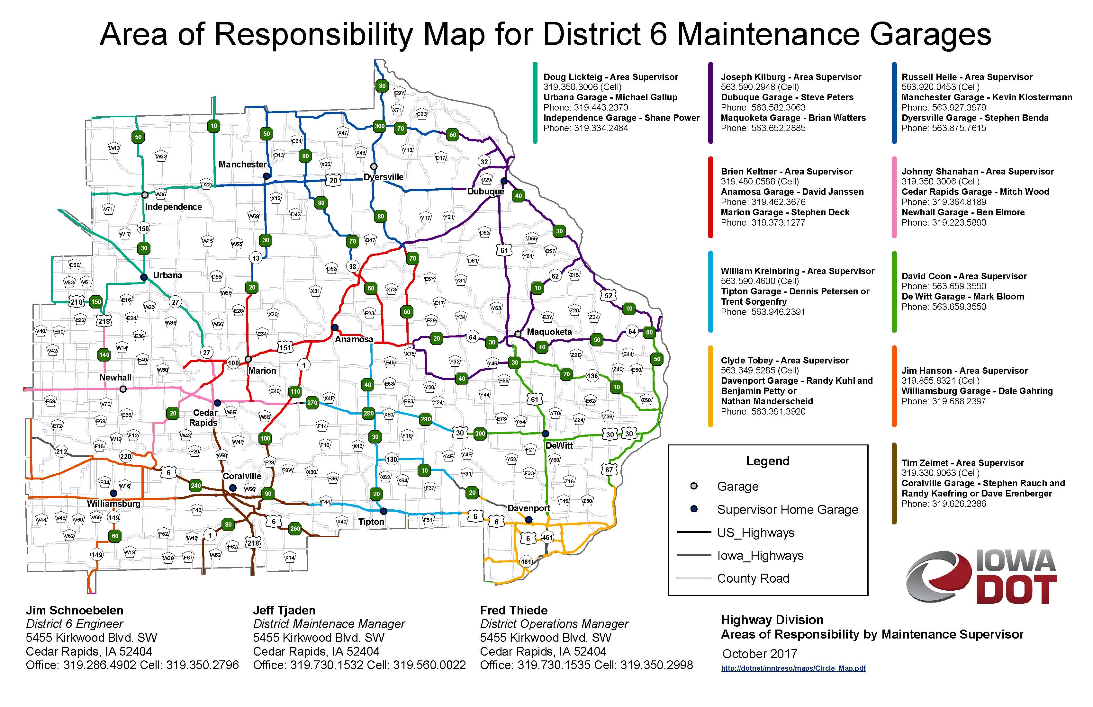
https://iowadot.gov/districts/pdf/DistrictMapD6.pdf
Ctrl+Click for most current online map

Slide 24
District 6 Maintenance Shop Contacts (Ctrl+Click on City for Area Responsibility Map)
Anamosa Jones County Brien Keltner Supervisor 2040 Iowa 64 E. P.O. Box 545 Anamosa, IA 52205 319-462-3676
Cedar Rapids Linn County Johnny Shanahan Supervisor 5455 Kirkwood Blvd. S.W. Cedar Rapids, IA 52404 319-364-8189
Coralville Johnson County Tim Zeimet Supervisor 2600 Coral Ridge Ave. Coralville, IA 52241 319-626-2386
Davenport Scott County Clyde Tobey Supervisor 8721 N.W. Blvd. P.O. Box 2646 Davenport, IA 52809 563-391-3920
DeWitt Clinton County Dave Coon Supervisor 801 Westwood Dr. DeWitt, IA 52742 563-659-3550
Dubuque Dubuque County Joe Kilburg Supervisor 11000 US 61 S. P.O. Box 738 Dubuque, IA 52004 563-582-3063
Dyersville Dubuque County Russ Helle Supervisor 14117 Route 136 N. P.O. Box 325 Dyersville, IA 52040 563-875-7615
Independence Buchanan County Doug Lickteig Supervisor 2001 240th St. Independence, IA 50644 319-334-2484
Manchester Delaware County Russ Helle Supervisor 1105 W. Main P.O. Box 129 Manchester, IA 52057 563-927-3979
Maquoketa Jackson County Joe Kilburg Supervisor 2983 Iowa 62 Maquoketa, IA 52060 563-652-2885
Marion Linn County Brien Keltner Supervisor 5801 Linn Aire Ave. Marion, IA 52303 319-373-1277
Newhall Benton County Johnny Shanahan Supervisor 7318 27th Ave. Watkins, IA 52354 319-223-5890
Tipton Cedar County Bill Kreinbring Supervisor 2092 Moscow Co. Rd. X-54
Tipton, IA 52772 563-946-2391
Urbana Benton County Doug Lickteig Supervisor 5397 31st Ave. Urbana, IA 52345 319-443-2370
Williamsburg Iowa County Jim Hanson Supervisor 2507 210th St. Williamsburg, IA 52361 319-668-2397

