Slide 1
Utility program
Iowa Department of Transportation

Slide 2
Administration & Coordination
Central Office
District offices
Field offices

Slide 3
www.menti.com
Code 57 11 68

Slide 4
Accommodation & Coordination

Slide 5
Central Office – Right of Way Bureau
Program Administrator – Deanne Popp
Program Leader - Policy Administrator
Utility Reimbursement Agreements
Utility Reimbursements
Initiatives
UTILITY RELOCATION COORDINATOR – JEFF MCCOLLOGH
Accommodation Specialist
Project Scheduling
Project Plan Submittals

Slide 6
Engineering Operations Technicians
Utility Accommodation Permit Review
Project Coordination Assistance
Utility Work Plan Review
Other permits

Slide 12
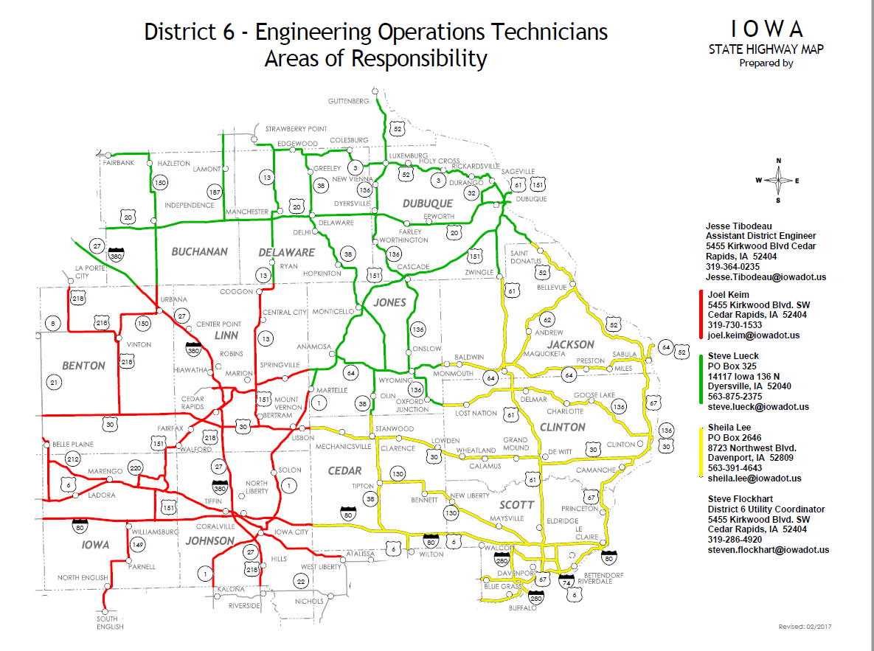

Slide 13
District Utility Coordinators
District 1 – Jerry Lavine
District 2 – Tracy Meise
District 3 – Kelly Mulvihill
District 4 – Kurtis Shackelford
District 5 – Bonnie Clancy
District 6 – Steve Flockhart (FT DUC)
Project Coordination
Utility Work Plan Review
Utility Accommodation Permit Review
Utility Reimbursement Agreement Review

Slide 15
Utility Accommodation and Coordination
Communication
is KEY
Annual 5-year Construction Program
Share with all Utilities
DOT Annual Meeting
Regular correspondence (written or verbal)
Local City Meetings Monthly, Bi-Monthly, Quarterly Meetings
Easy way to present information and get Utility input
Best coordinators know the utility contacts in their areas and communicate regularly

Slide 16
Iowa Administrative Code 761-115 (306A)
Utility Accommodation (Utility Permits)
Primary and Interstate Roads
Utility Adjustments for highway projects Chapter 115.25 - (Point 25 Projects)
All projects except
Accelerated schedules
No anticipated utility adjustments

Slide 17
Point25 Process (Overview)
IAC 761-115.25 = Point 25 Process
Only for state highway improvement projects
Requires multiple notifications and responses
If all Notifications submittals are met:
Non-responsive utility can be held liable for project delay damages
Utility and Contractor settle directly
State is provider of evidence
State cannot take on liability of either party

Slide 18
UTILITY EVENT OVERVIEW U Event (00)
Utility Research / Identification
Completed for All projects where utility conflicts are anticipated Prerequisites: Final Concept Completion
Previous utility permits
Previous utility Reimbursement agreements
Field examinations (Concept Reviews)
Existing utility maps
Iowa One Call (Design Request)
Identifies underground utilities with-in project limits

Slide 19
UTILITY EVENT OVERVIEW U Event (02)
Project Notification to Utility Companies
Required on all Point 25 Projects
Prerequisites: Completed D02 (Field Exam Plans / General project layout Only / anticipated new ROW lines not determined, proposed new cross sections not available
Request maps or plans from utility companies on existing facility locations (90 days to reply)
Request notification if utility is currently located in private easement (Reimbursable Relocation Agreement)
Goal is for the event to be early enough in the process to allow for modifications to the design to avoid major utility relocations ( HP gas, OH Electrical Transmission lines, major communication duct banks)

Slide 20
UTILITY EVENT OVERVIEW U Event (03)
1st Project Plan Submittal to Utility Companies
Required on all Point 25 Projects
Prerequisites: Completed Preliminary Design (D05) and new proposed ROW layout (R01)
Requires all impacted utilities to submit a relocation plan (90 days to reply)
What is an acceptable relocation plan?
Relocation must be shown on project plans and cross section sheets

Slide 21
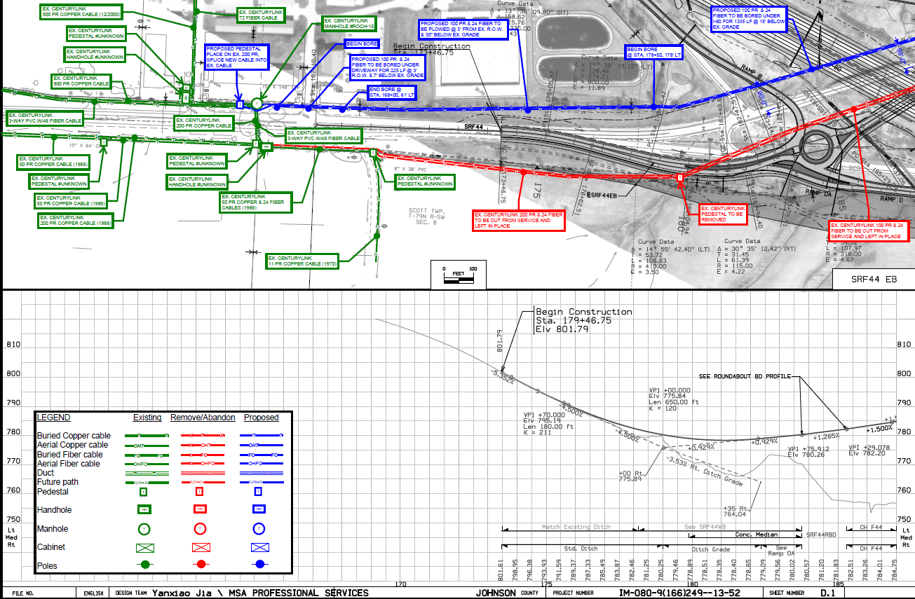

Slide 22
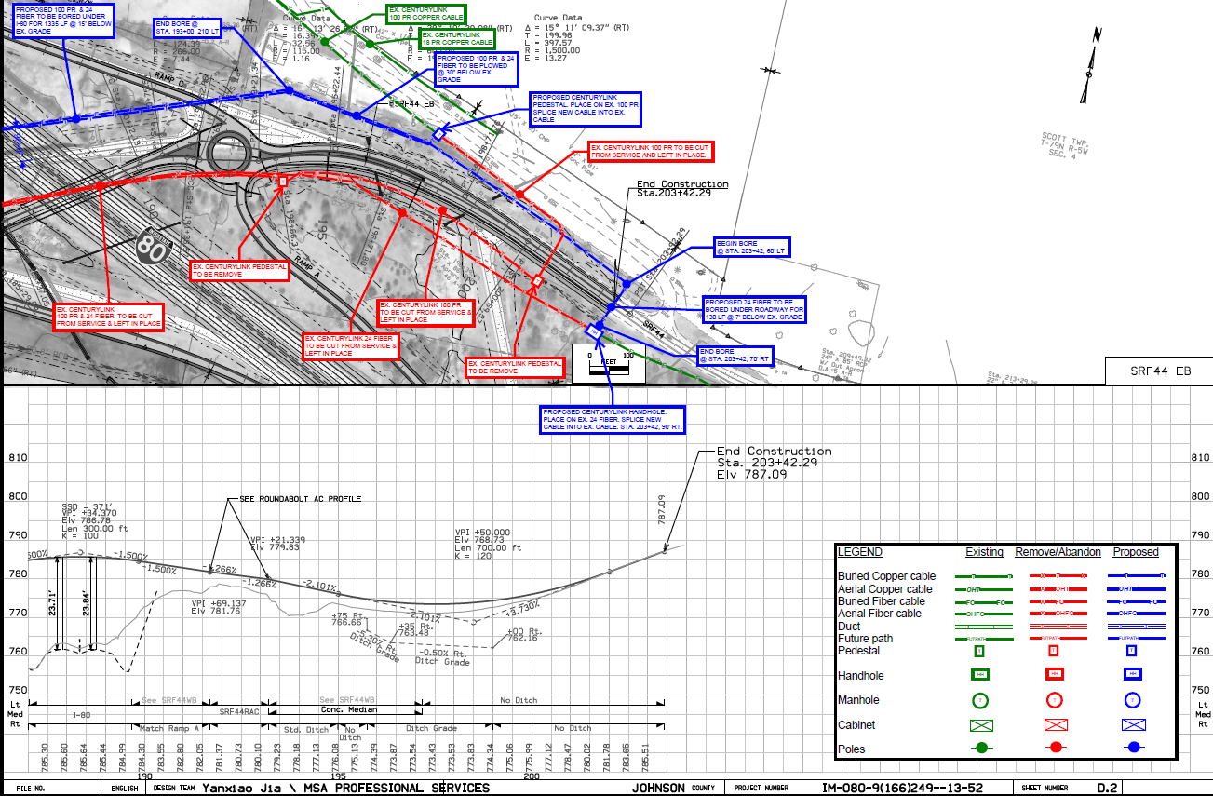

Slide 23
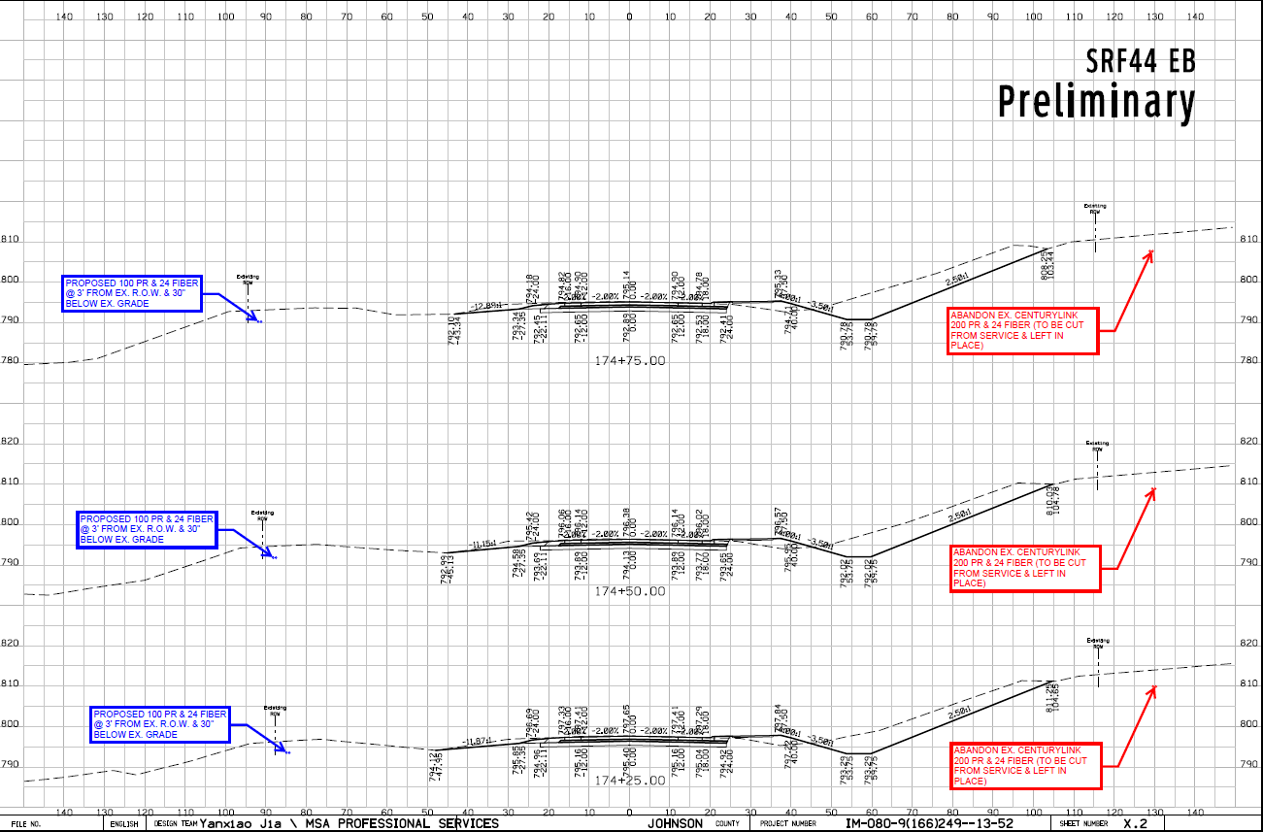

Slide 24
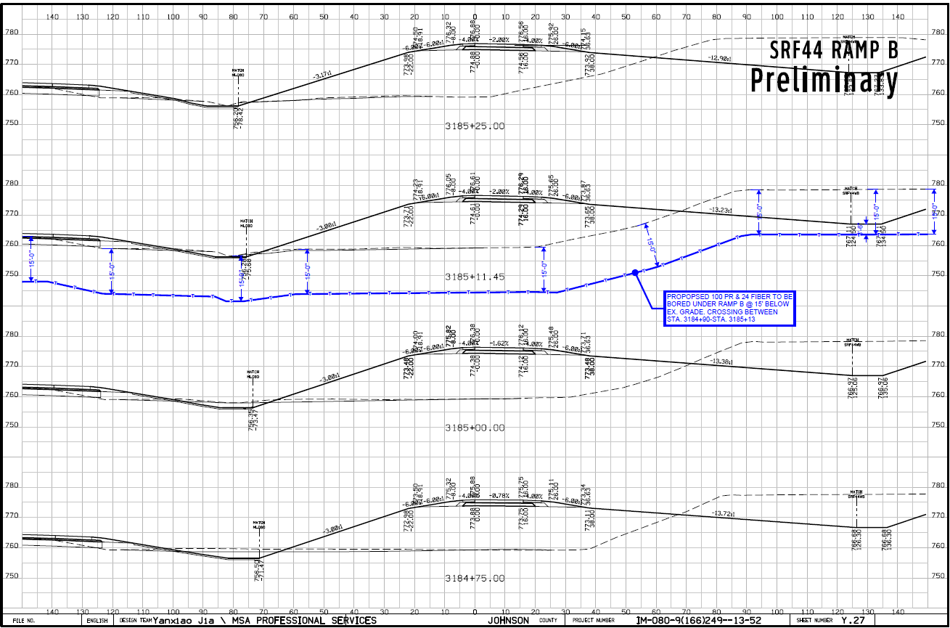

Slide 25
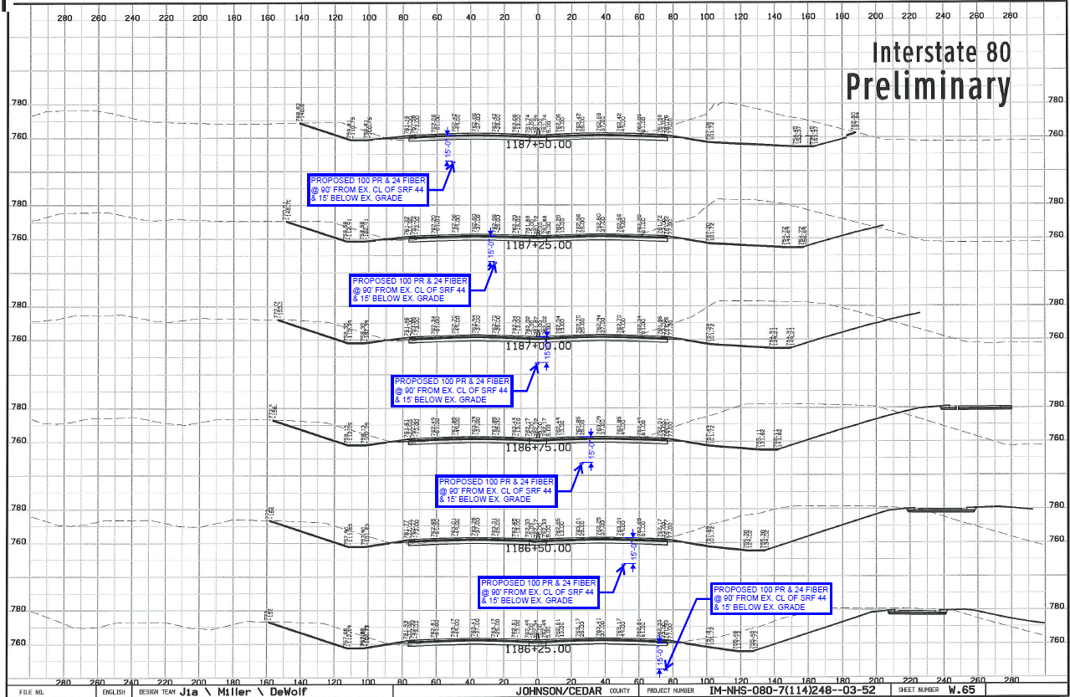

Slide 26
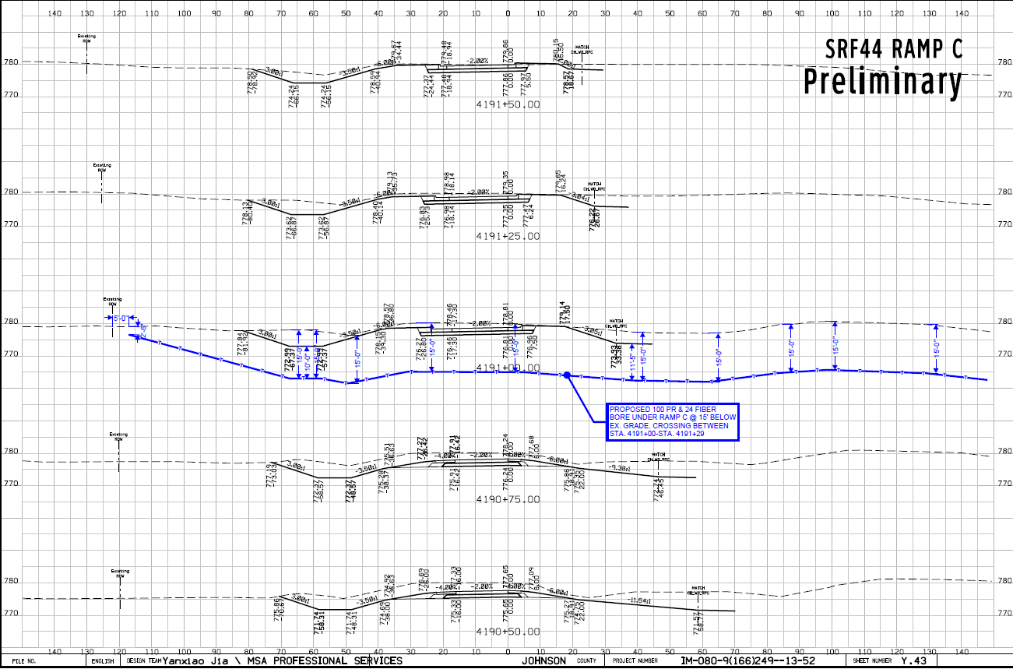

Slide 27
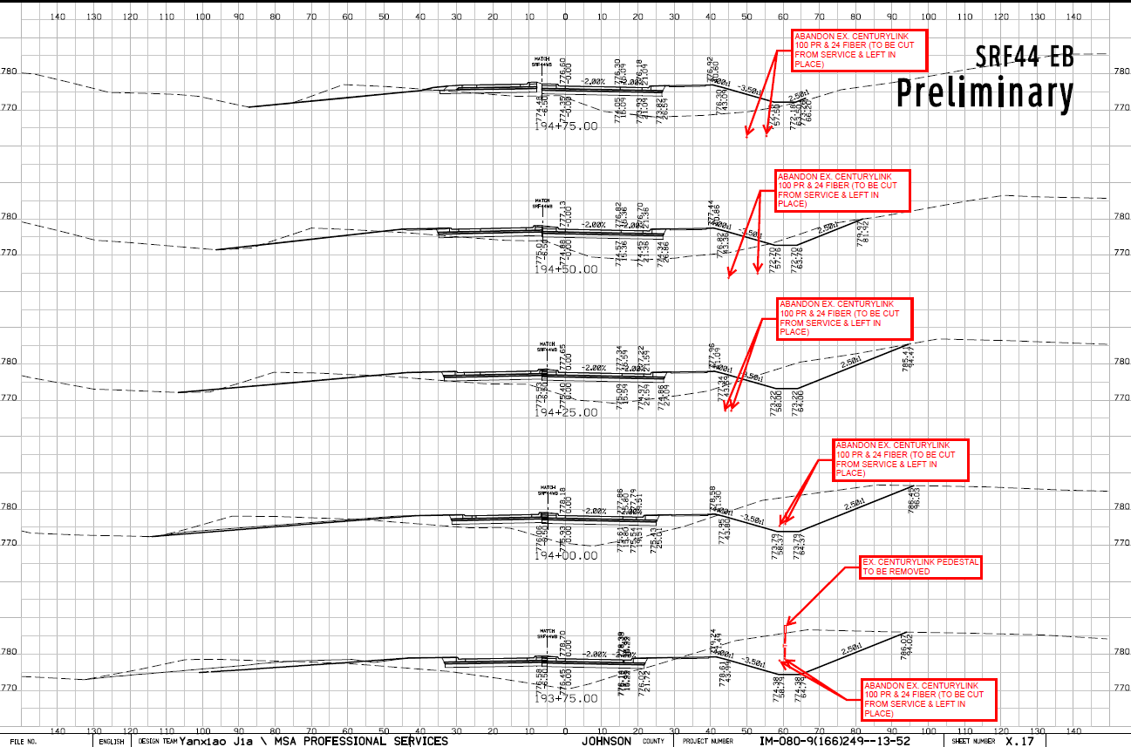

Slide 28
UTILITY EVENT OVERVIEW U Event (04)
2nd Project Plan Submittal to Utility Companies
Required on all Point 25 Projects
Prerequisites: Completed Design (D05) and ROW layout (R01)
Requires all impacted utilities to resubmit their relocation plans if any project design changes occurred after the U03 submittal (60 days to reply)

Slide 29
UTILITY EVENT OVERVIEW U Event (05)
Utility Reimbursement Agreement
Handled through the ROW Bureau – Utilities Section
Available when a private utility is NOT located with-in public ROW
Utility owned is located private easement
Prerequisites:
Private easement documentation
Proposed relocation plan shown on IADOT project plan sheets and cross sections
Itemized relocation cost estimate

Slide 30
UTILITY EVENT OVERVIEW U Event (06)
Required on all Point 25 Projects
Prerequisites:
All New ROW purchases are completed or have a clearly defined possession date
Final utility relocation work plan approval
Reimbursement agreement executed (if applicable)
Utility Accommodation Permit Issued by EOT
If coordination with contractor is required then the notice to proceed may be contingent upon the contractors schedule

Slide 31
UTILITY EVENT OVERVIEW U Event (07)
Utility Bid Attachment
Required on all Point 25 Projects (Recommended for Non-Point 25 projects)
Provides a verbal explanation of conflict locations and resolution
Provides an anticipated start and completion date for each utility companies relocation
Provides utility company contact name , phone #, email address
UBA is sent to office of contracts prior to letting and is included in the project proposal bid documents
UBA is for the use of the bidding contractors so they are aware of the utilities relocation plan and timeline, or if a particular utility has been non-responsive

Slide 32
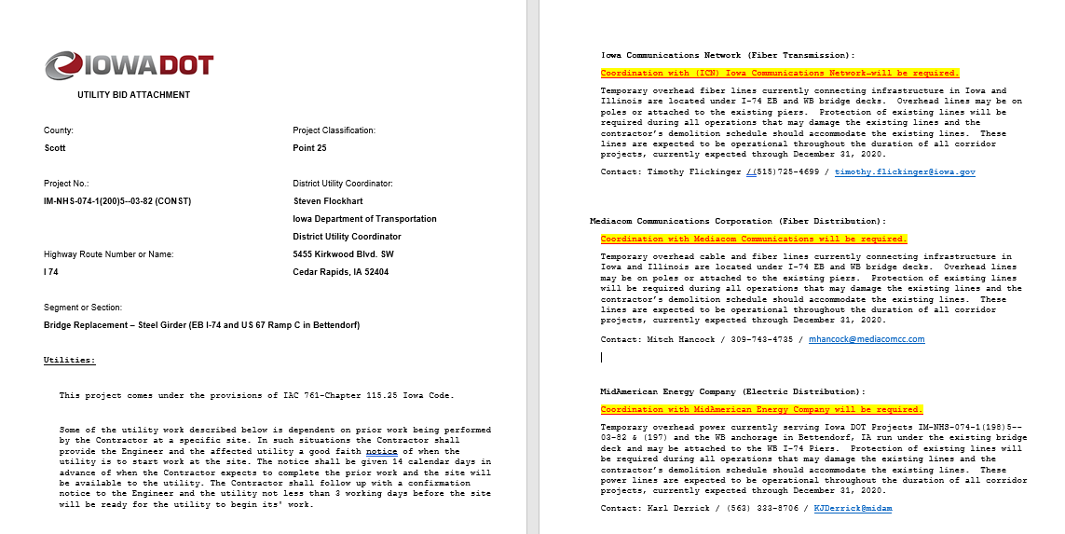

Slide 33
Questions?
Thank you!

