Slide 1

HIGHWAY PLAN READING
For Utility owners, designers, and contractors.
Deanne Popp, CPM Utility Program Administrator
800 Lincoln Way 515-239-1014
Ames, Iowa 50100 deanne.popp@iowadot.us
Notes:
Welcome to the Iowa DOT’s Highway Plan Reading short course. This course has been designed specifically for utility owners, designers, and contractors as an aid to understanding the pertinent information contained in DOT highway project plans and where it is located.

Slide 2

Course Objectives
Become familiar with plan features important to utilities:
  Title Sheets
  Plan and Profile Sheets
  Right of Way Sheets
  Typical Sections
  Cross Sections
Learn how to locate plan features in the field

Slide 3

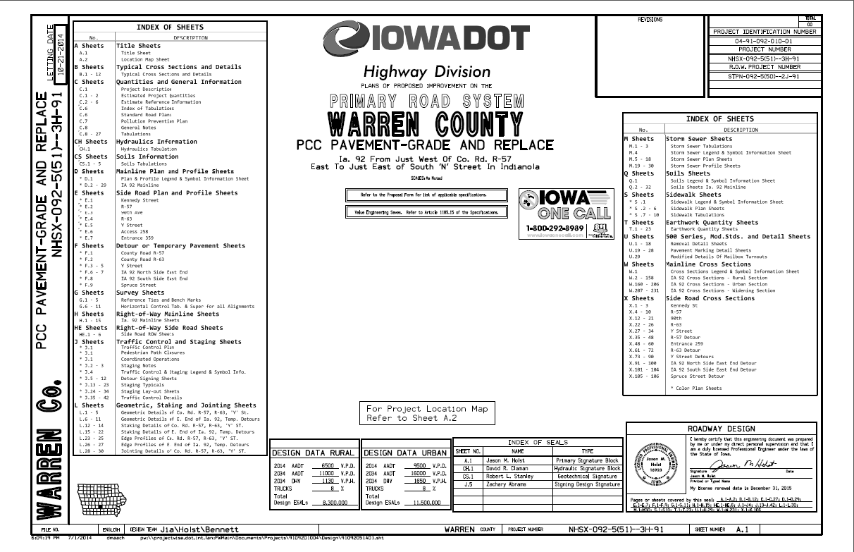
Title Sheet
Sheet A.1
Notes:
Point out to participants:
Copies of plan sheets used in presentation are provided
Sheet number in lower left corner of slide corresponds to plan sheet being used

Slide 4

Title Sheet: Project Number
Sheet A.1
Notes:
The project number is so important that it is shown in 3 places on the title sheet.
The location at the bottom right of the sheet is where it is shown on every other sheet in the plan set.
For easy project location, the county is listed three times as well. Can you find all three?
In a way, the county is listed 3 more times as it is the last 2 digits in the project number.
Also prominently displayed is the type of project: in this case, twice and it is PCC Pavement – Grade and Replace.

Slide 5
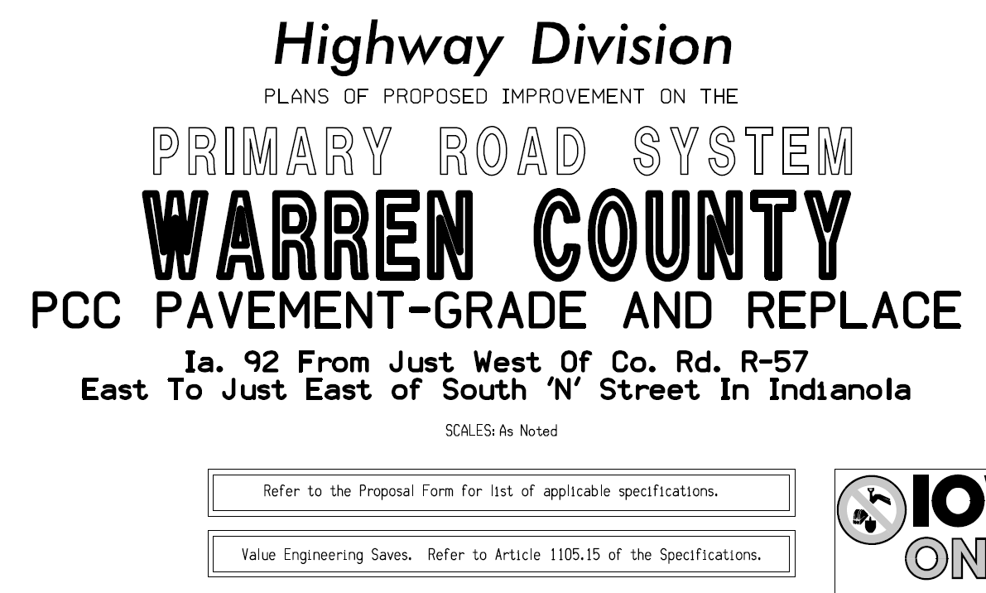
Title Sheet: Project Description
Sheet A.1
Notes:
Front and center – where the project is located.
Big letters - COUNTY
- TYPE OF PROJECT
- Description of the project limits

Slide 6
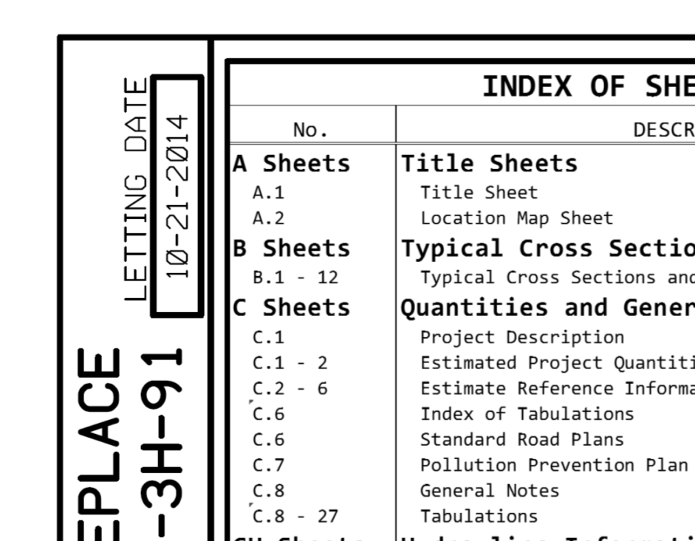
Title Sheet: Letting Date
The typical project development life cycle is 5-6 years.
Watching letting dates will let you how soon construction is slated to begin.
Target: relocation work complete 3 to 6 months prior to the letting date.
Sheet A.1
Notes:
Letting date reflects our best laid plans.
The letting dates may move but we try to keep them in the same fiscal year.
These may easily be out there several years with our early plan submittals.
The letting date is when the DOT accepts the _________.
Factoid:
The DOT operates on a fiscal year that runs July 1 to June 30 so we are in fiscal year 2016 and have been for over 8 months.

Slide 7
Title Sheet: Sheet Numbers & Index
Approx. 4 mile project and 656 sheets!
Sheet A.1
Notes:
Index makes it look like there are hundreds of sheets.
There are 656 sheets in this set of plans!
Only a fraction of the 656 pages are utility critical.
So as you are flipping through the pages, lets start to limit the sheets we want to look at.

Slide 8
Title Sheet: Index of Sheets
A sheets: Title/Map sheets
B sheets: Typical Cross Sections and Details
C sheets: Quantities and General Information
CH sheets: Hydraulics Information
CS sheets: Soils Information
D sheets: Mainline Plan and Profile sheets
E sheets: Side Road Plan and Profile sheets
F sheets: Detour or Temporary Pavement sheets
G sheets: Survey sheets
H sheets: Right-of-Way Mainline sheets
HE sheets: Right-of-Way Side Roads sheets
J sheets: Traffic Control and Staging sheets
K sheets: Interchange sheets
L sheets: Geometric, Staking & Jointing sheets
M sheets: Storm Sewer sheets
N sheets: Traffic Signal sheets
P sheets: Lighting Layout sheets
Q sheets: Soils sheets
S sheets: Sidewalk sheets
T sheets: Earthwork Quantity sheets
U sheets: 500 Series, Mod. Stds. & Detail sheets
V sheets: Bridge, Culvert & Retaining Walls
W sheets: Mainline Cross Sections
X sheets: Side Road Cross Sections
Y sheets: Ramp Cross Sections
Notes:
During review, emphasis should be placed on those sections which are in bold as the others hold less utility-important information.
By the end of this presentation, you will see a specific order to examine the sheets you need.

Slide 9
Title Sheet: Index of Sheets
Utilities should focus their review on:
“A” sheets: Title/Map
“D” (mainline) & “E” (side roads) sheets: Plan and Profile
“H” (mainline) & “HE” (side road) sheets: Right-of-Way
“W,” “X,” & “Y” sheets: Cross Sections
“B” sheets: Typical Sections
“M” sheets: Storm Sewer
“V” sheets: Bridge, Culvert & Retaining Walls
“K” sheets: Interchange sheets (if applicable)
Notes:
Now, hundreds of sheets are pared down significantly.
A:
D & E:
H & HE:
W, X, & Y:
B:
M:
V:
K:
So, lets get back to the A sheets

Slide 10
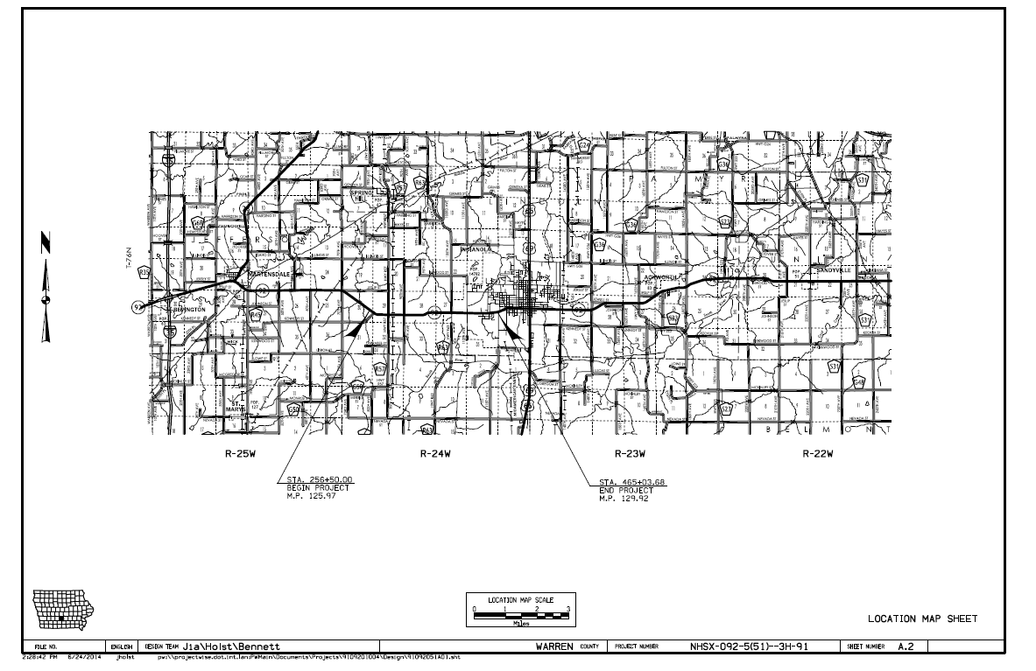
Location Map Sheet
Project location always noted on location map
Project begin & end noted with station and milepost.
Sheet A.2
Notes:
The second A-sheet, which happens to be named A.2, shows the location of the project with beginning and ending stations and mileposts.

Slide 11
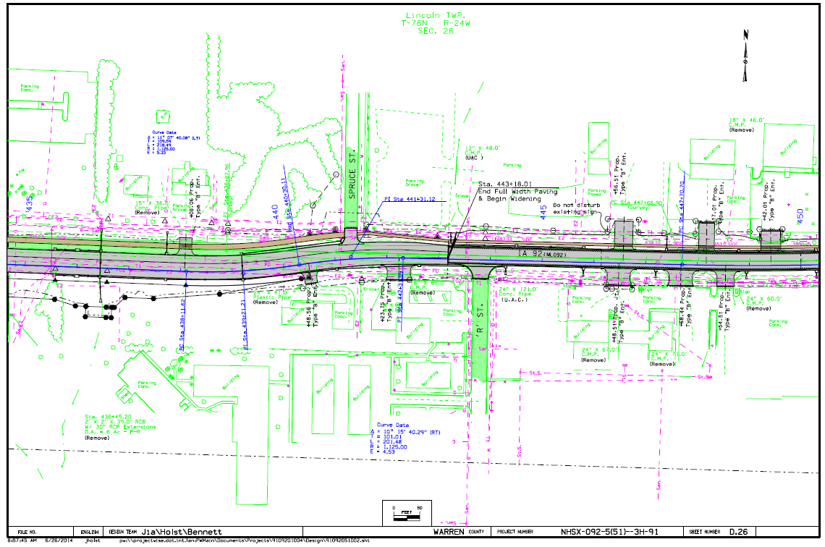
Scales
Scale bar allows accurate scaling independent of print size.
Included on all plan sheets
Sheet D.26
Notes:
Since we don’t know what size of paper the plans will be printed on, we include a scale bar on every drawing sheet so that you can convert distances on the sheet to real-world dimensions.

Slide 12
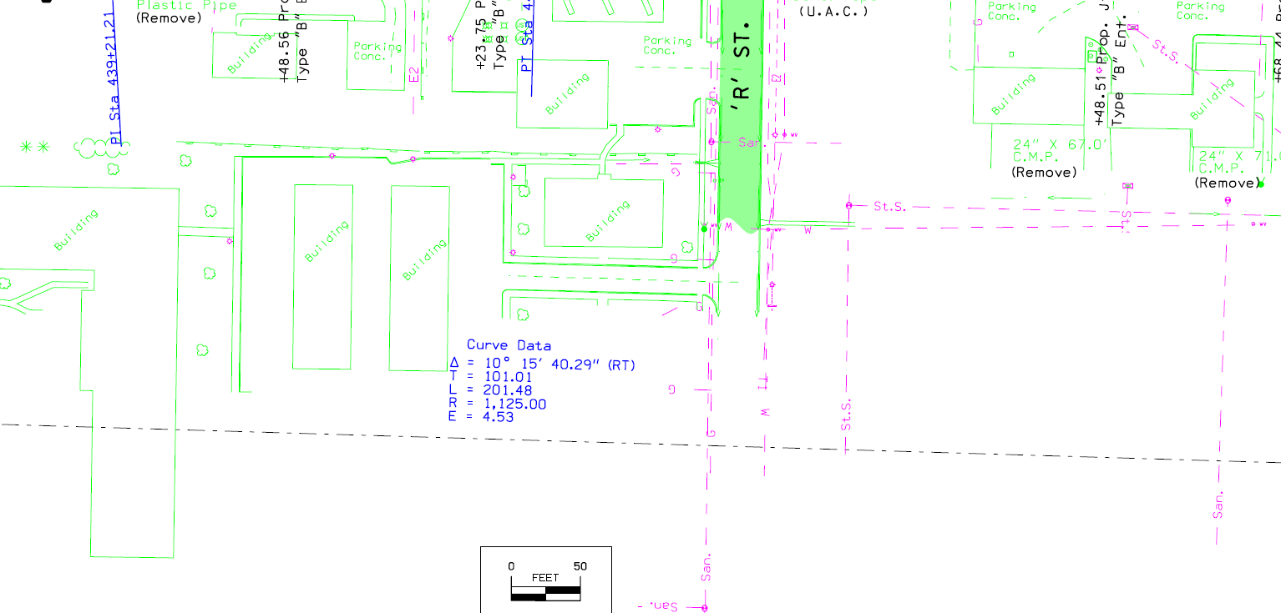
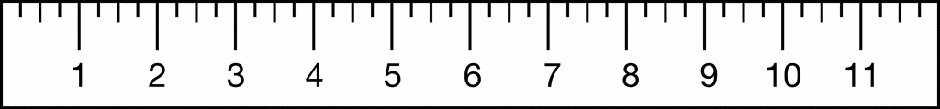
Scales
How wide is ‘R’ Street?
1” (Ruler Measure)
1” (Ruler Measure) = ~28’ (Plan Dimension)
Sheet D.26

Slide 13

Three Views
F02
Plan
F02
F01
F01
F01
Profile
(Cross) Section
(and Typical Sections)
F02
F02
F02
Notes:
Plan view: overhead view from airplane
Profile view: side view
Section view: cut through perpendicular (90 degrees) to roadway
Two utilities are shown:
FO1 is mostly parallel to the road – we call this a longitudinal installation
F02 is mostly perpendicular or crossing the roadway – we call this a transverse installation

Slide 14
Plan View
Plan
(D, E, & K sheets)
Notes:
D – Mainline plan sheets
E – Side Roads plan sheets
K – Interchange plan sheets

Slide 15
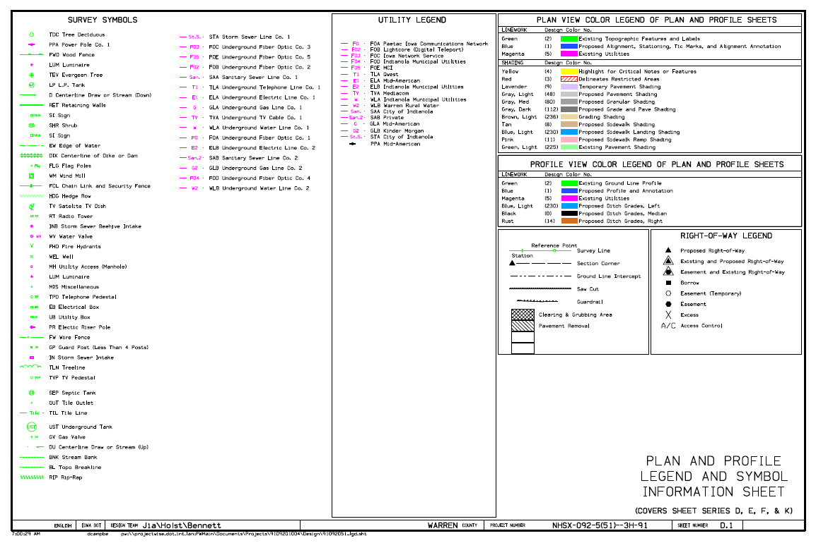
Plan View
Plan Sheet Legend
Utility line types
NOTE:
Most existing utility features are in pink
Existing features (picked up by survey) are in green
Always see Sheet D.1 for complete legend of abbreviations and symbols.
Sheet D.1
Notes:
How many Fiber Optic lines are shown in the utility legend (in pink)?
The symbols legend is always on sheet D.1
These apply for all the D, E, F, & K sheets.
Before we move on to the plan sheets, look at the Right of Way legend – it will make perfect sense very soon.

Slide 16
Plan View
Plan Sheet
Always see Sheet D.1 for complete legend of abbreviations and symbols.
Sheet D.26
Notes:
Look at sheet D.26
This is a transition for this particular road, from a 3-lane rural section with ditches on the left to an urban section with curb and gutter on the right.

Slide 17
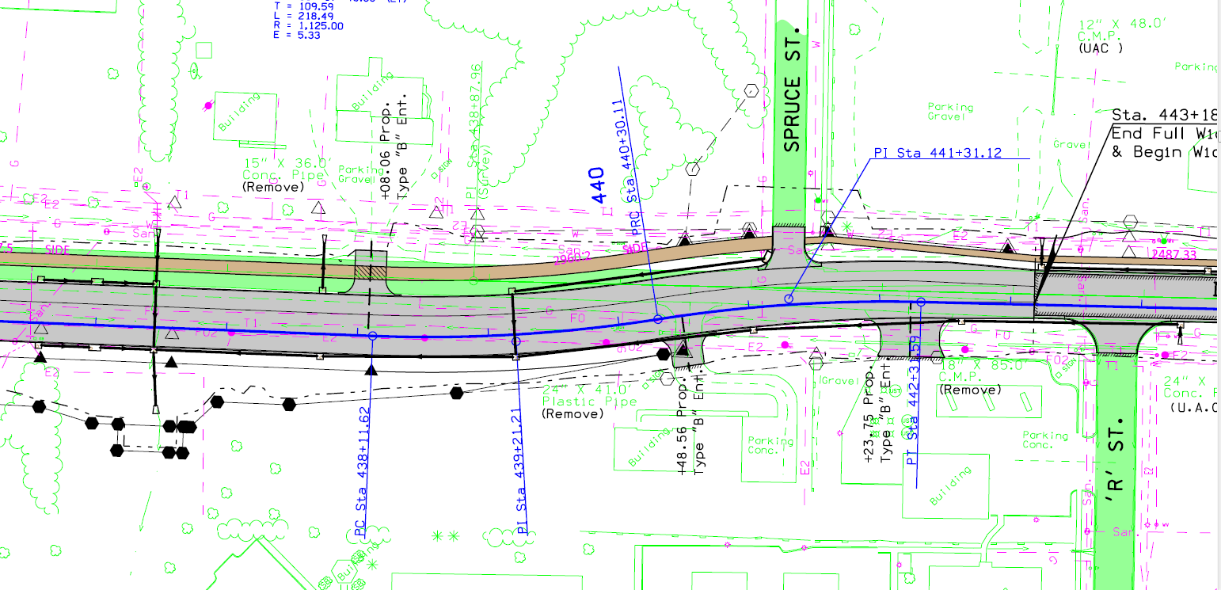
Plan View
ROW & Need Lines
ROW and Easement information can also be found on the “H-sheets.”
Existing Right-of-Way
(Open triangles at corners)
Existing and Proposed Right-of-Way
(Shaded triangle with open triangle around it)
Construction Limits (Need Line)
(Black double skip-dash line)
Proposed Right of Way
(Black line with shaded
triangles at corners)
Permanent Easement
(Black line with shaded hexagons at corners)
Temporary Easement
(Black dashed line with
open hexagons at corners)
Always see Sheet D.1 for complete legend of abbreviations and symbols.
Sheet D.26
Notes:
Look at sheet D.26
Go over R.O.W. – easements
Temporary easements – driveway construction
Permanent easements – for drainage
-Utilities use of easements – not shown on this sheet but we did have some for electric transmission west of here.
Discuss need line – edge of construction (either fill or cut to this limit)
Outside is considered safe zone.
In side it may be safe if it is fill or minor cut – we will have to wait until the cross sections to see what is going on here.

Slide 18
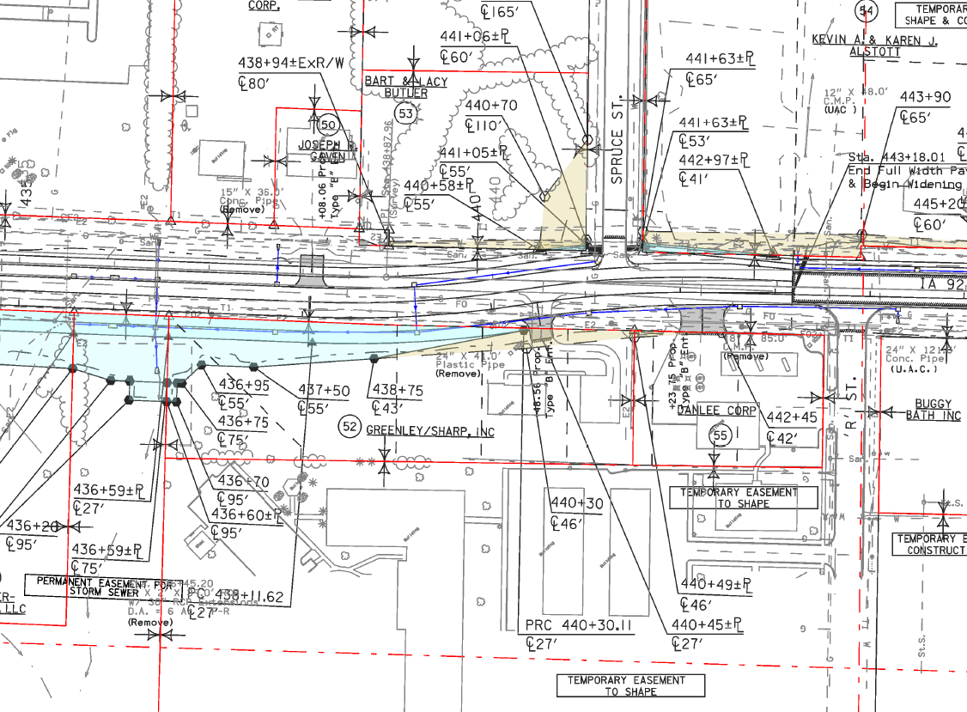
Plan View (H-sheets)
ROW (H-sheets)
Existing Property & ROW Lines
(Red lines with open triangles at intersections)
Temporary Easement
(Tan shading & black dashed line
With open hexagons at corners)
Easement Notes
(Explains reason for easements)
Permanent Easement
(Cyan shading & black line with shaded hexagons at corners)
The “H-sheets” are another place to see ROW, easements, etc.
Sheet H.13
Notes:
Turn to sheet H.13
New ROW is much clearer on the H-sheets with the shading.
Try to make ROW lines straight outside of need lines
Sometimes odd shapes happen – such as permanent easement for storm sewer
It would seem like all the temporary easements in tan would be fairly small, but sometimes we shape for snow borrows that can be quite large.

Slide 19
Plan View
Drainage
NOTE: Existing pipe information is placed as close to the pipe symbol as possible to avoid other plan information.
Proposed Storm Sewer Intake/Junction Box
(in black)
Pipe Abbreviations:
R.C.P.: Reinforced Concrete Pipe
C.M.P.: Corrugated Metal Pipe
Plastic: Corrugated HDPE Pipe
Existing Pipe Info.
(in Green)
(“Remove” note indicates proposed removal of pipe. “UAC” note indicates Use As Constructed.)
Proposed Pipe
Outlet Apron
Proposed Storm Sewer
(Arrow indicates flow direction; see M sheets for add’l info.)
Drainage Arrows
(Black indicates proposed;
green indicates existing.)
Always see Sheet D.1 for complete legend of abbreviations and symbols.
Sheet D.26
Notes:
Pipes:
Information as close to pipe as possible without cluttering plan sheets
Point out green drainage arrows
3 primary pipe culvert classifications
Utilities:
-Ask how many utilities they can find: T1, E2, G1, FO, FO2, W, San, St. Sewer – Answer: 8
-Utilities shown picked up by IaDOT preliminiary survey based on above ground and OneCall flagging

Slide 20
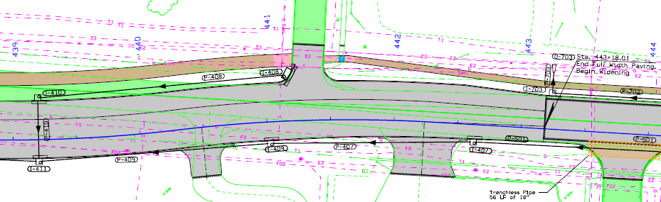
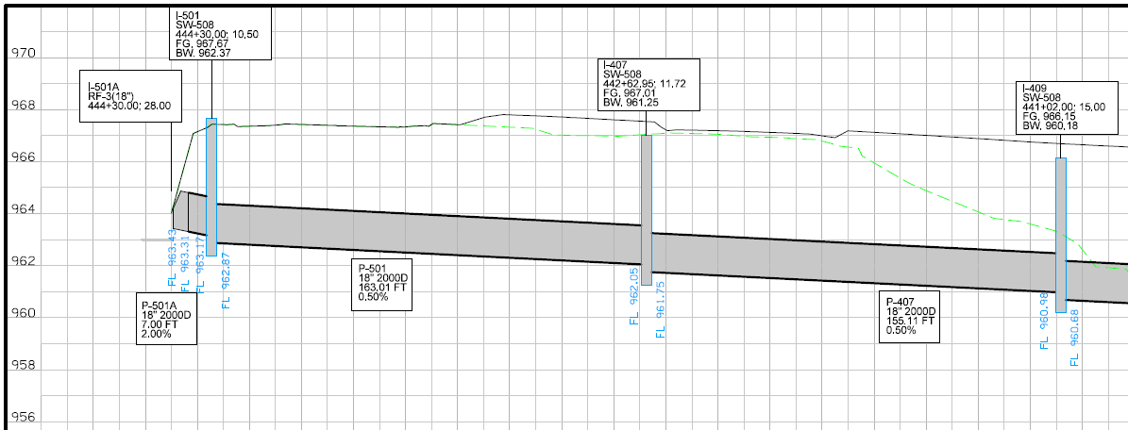
Plan View
Drainage
NOTE: Storm sewer plan view and profile view are not located on the same or adjacent sheets.
P-407
Sheet M.14 (Plan View) & M.27 (Profile View)

Slide 21
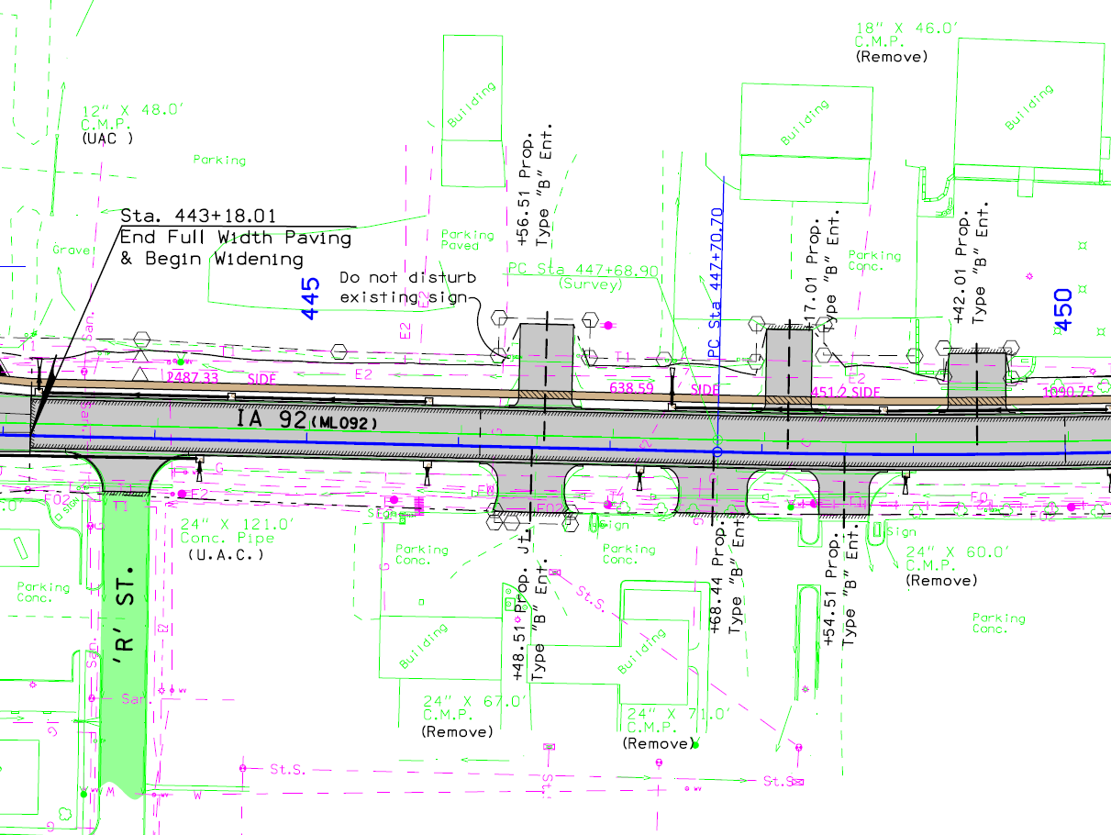
Plan View
Stationing
Proposed Baseline Stationing
(Blue)
Existing Centerline
(Green)
Proposed Baseline
(Blue)
Always see Sheet D.1 for complete legend of abbreviations and symbols.
Sheet D.26
Notes:
Time to get to a subject everyone loves – STATIONING
DOT projects are measured in stationing (we’ll learn why on the next slide)
How does stationing show on the plans?
500 ft. numbers
Green and blue tick marks do not line up the same due to slight changes in road length between projects.
NOTE: this project utilized a “Baseline” that was not located in the center of the roadway rather than a “Centerline,” which is located in the center of the roadway. Most projects use a centerline, but as in this job, sometimes a baseline is used in certain sections to ease in constructability for the contractor. You can determine if the blue line shown is a centerline or baseline by looking at the Typical Sections (B-sheets) and finding the typical that applies to the area you are looking at. We’ll get into the Typicals in a few more slides…

Slide 22
Centerline Stationing
What is Stationing?
A station is a longitudinal measurement method used to provide location along highway and other longitudinal projects.
The measurement is taken horizontally (i.e. does not follow ground contour) along the highway project centerline.
1 STA. = 100 Feet
East-west roads, stationing typically begins on the west county line.
North-south roads, stationing typically begins on the south county line.
Stationing typically resets to 0+00 when crossing a county line.
STA. 445+00 = 44,500’ from station 0+00
Notes:
Longitudinal location – typically used on longitudinal-type projects (highways, railroads, pipelines, etc.)
One station is 100’ long
Stations are measured horizontally – they do not follow the contour (ups and downs) of the roadway

Slide 23
Centerline Stationing
How does stationing work?
Stationing
Example: This point is at
Sta. 451+00 - 50’ Lt.
(Left of centerline)
Labeled every 500’ on rural scales
Labeled every 100’ on urban scales
445
450
Left Side
Ahead
100’
Right Side
Back
500’
Example: This point is at
Sta. 451+25 - 100’ Rt.
(Right of centerline)
Notes:
Who uses stationing? The DOT’s do!
Since the DOT’s do, Utilities needs to also to be able.
To be able to communicate with DOT we need to know where things are in relation to the stationing and the offset from centerline.
How do you know if it is a left offset or right offset? Look in the direction of increasing station…Right on right.

Slide 24
Where can I find Stationing for a Highway?
Physically on 2-Lane Roads:
  The right side of the roadway when looking in the same direction as stationing.
Physically on 4-Lane Roads:
  In similar locations as outlined previously on the outside edges in both directions.
DOT Project Plans:
  Obtain project plans from DOT Document Services in Ames: Desi.Asklof@dot.iowa.gov or (515) 239-1808

Slide 25
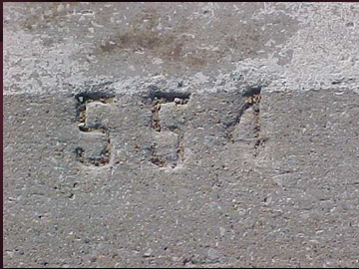
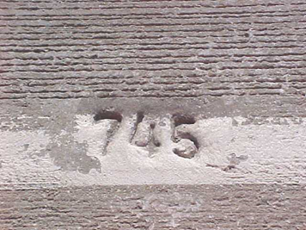
How do I find stationing in the field?
Stationing
About 1 foot in from the outside edge of the road every 100 ft. stamped in the pavement on PCC (concrete) roadways.
Notes:
PCC = Portland Cement Concrete

Slide 26
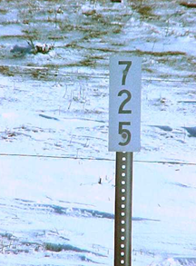
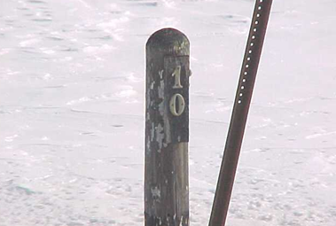
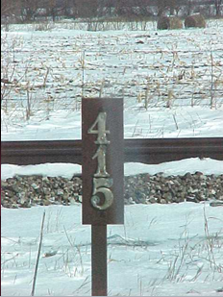
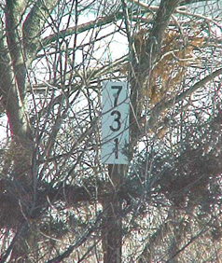
How do I find stationing in the field?
Stationing
Every 500 ft. on HMA (Asphalt) surfaced roadways.
Notes:
Can markers always be found? NO!
Sometimes farmers remove them
Not a priority for replacement
If you can’t find stationing, check with the EOT.

Slide 27
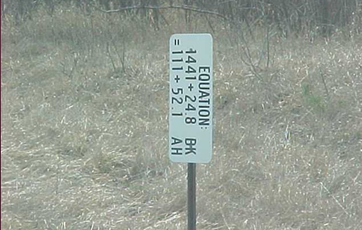
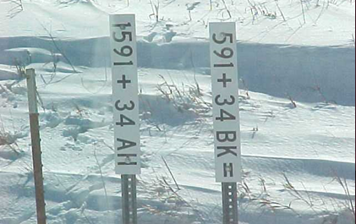
Station Equations
Stationing
What happens when stationing changes along a road? A station equation is created.
Common reasons include:
shortening or lengthening of a highway line due to highway realignment
4-lane highway where one lane is longer than another due to alignment.
1410
1410
Ahead
115
Left Side
1411+24.8
111+52.1
Right Side
Back
Notes:
Drill down for the sign on the left.

Slide 28
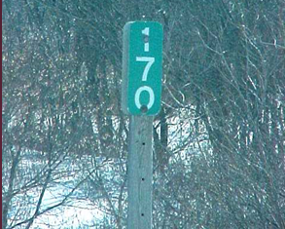
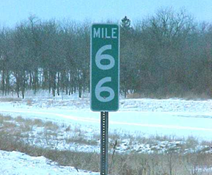
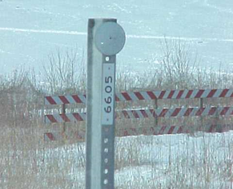
What Is A Milepost?
Mileage is measured along the centerline profile from the start of the highway.
NOTE: Mileposts may be up to 50’ ahead or back from their “correct” location when field conditions warrant, which is why they are called “reference posts.”
East-west roads, mileposts typically begin on the west end of the route in the state.
North-south roads, mileposts typically begin on the south end of the route in the state.
Mileposts are continuous throughout the length of the route across the state.
Notes:
Mileposts follow the contour, so a mile on anything other than a flat road will be less than 52+80 stations.

Slide 29
Profile View
Profile
(D, E, & K sheets)
Notes:
Each profile sheet aligns with a plan sheet
Sometimes both plan and profile are on the same sheet (like E.2)
And sometimes they are on separate matching sheets (like D.26 and D.27) and lay out together (same stations)

Slide 30

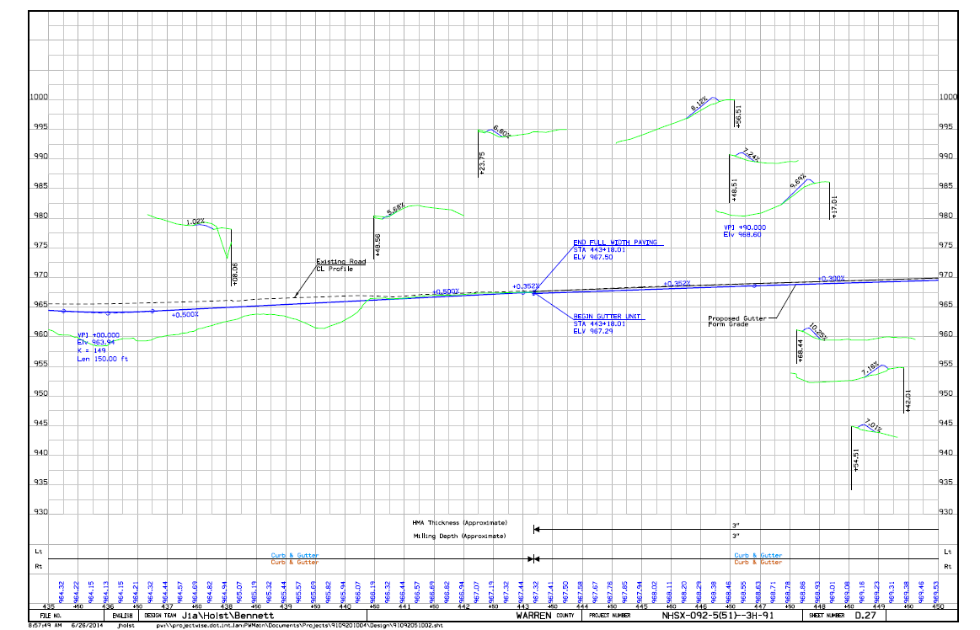
Profile View
Profile Sheet
Profile sheets have elevations labeled
(in feet) along the left and right edges.
Profile sheets have corresponding centerline stationing
as shown in the plan view or plan sheet.
Always see Sheet D.1 for complete legend of profile line colors.
Sheet D.27

Slide 31
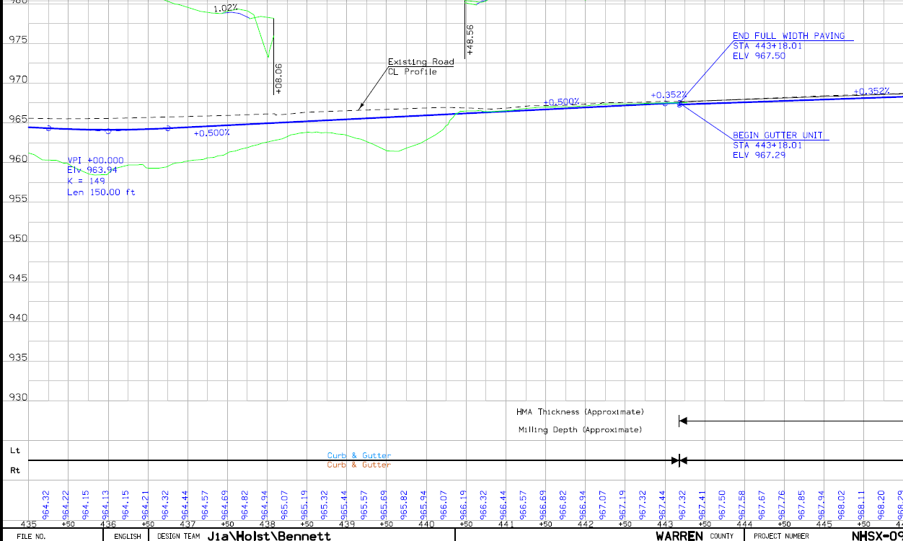
Profile View
Profile Sheet
964.94’
962.50’
Fill = 2.44’
2.44’
What is the cut or fill
at STA. 438+00?
Profile @
New Project
Center Line
(Blue line)
Existing Ground @
New Project Center
Line (Green line)
Elev. 962.50
Profile Elevation
@ Sta. 438+00
= 964.94’
“Profile” is
also called:
“Grade-Line” or
“Profile Grade Line”
Elevations
(in feet)
438+00
Centerline
Stationing
Always see Sheet D.1 for complete legend of profile line colors.
Sheet D.27

Slide 32
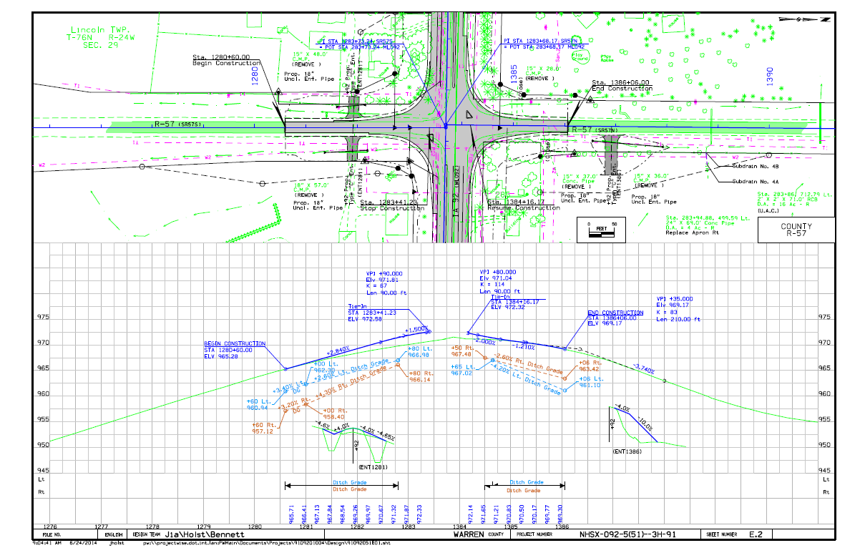
Profile View
Profile Sheet
Sometimes the plan view and profile view are included on the same sheet.
Sheet E.2
Notes:
E sheets are typically side roads or other roads receiving improvements as part of the project that are not the main highway route.
This one has plan and profile on the same page.
Ditch grades (slopes) and elevations are shown in light blue/tan if the ditch grade is different than the profile grade of the roadway.

Slide 33
Section Views
Typical Section
(B sheets)

Slide 34
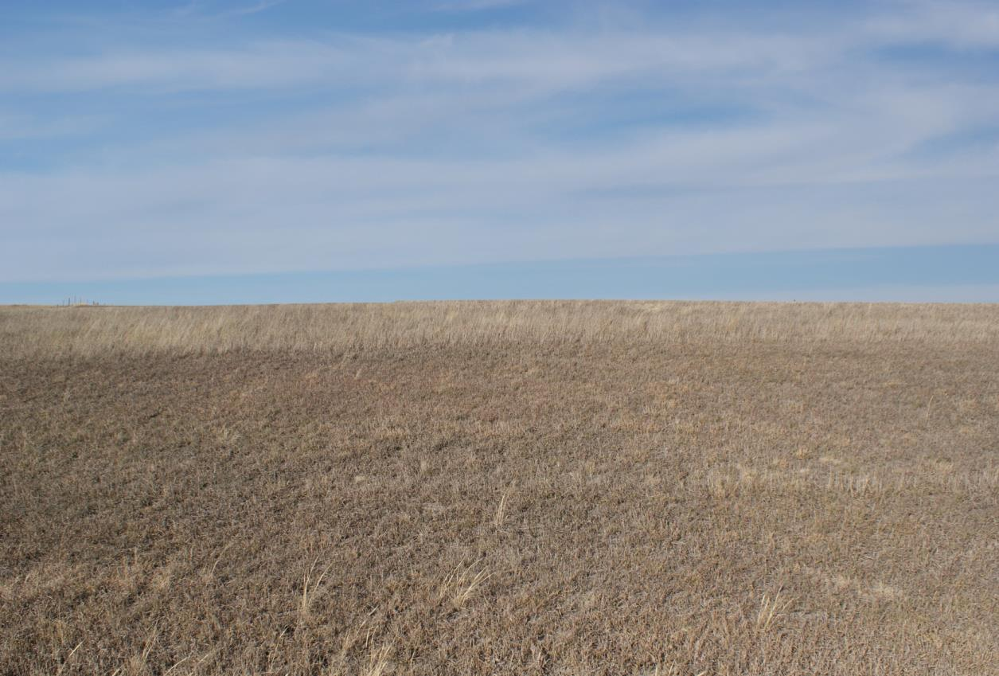
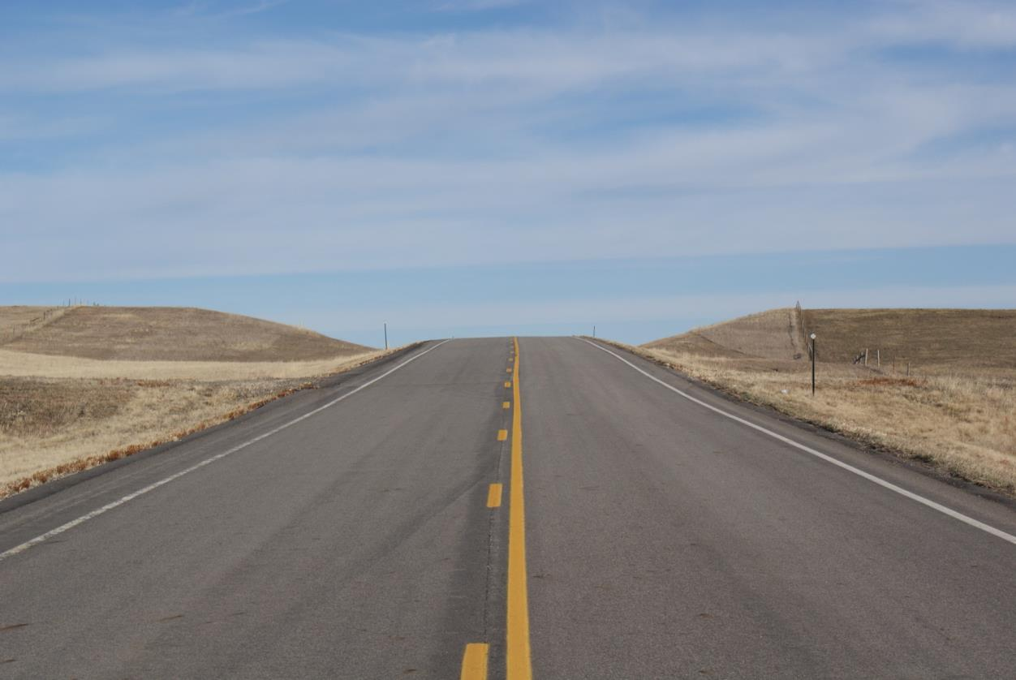
Typical Sections
Typical Section Sheet
Project Center line
Typical Section
Image courtesy of South Dakota Department of Transportation.

Slide 35
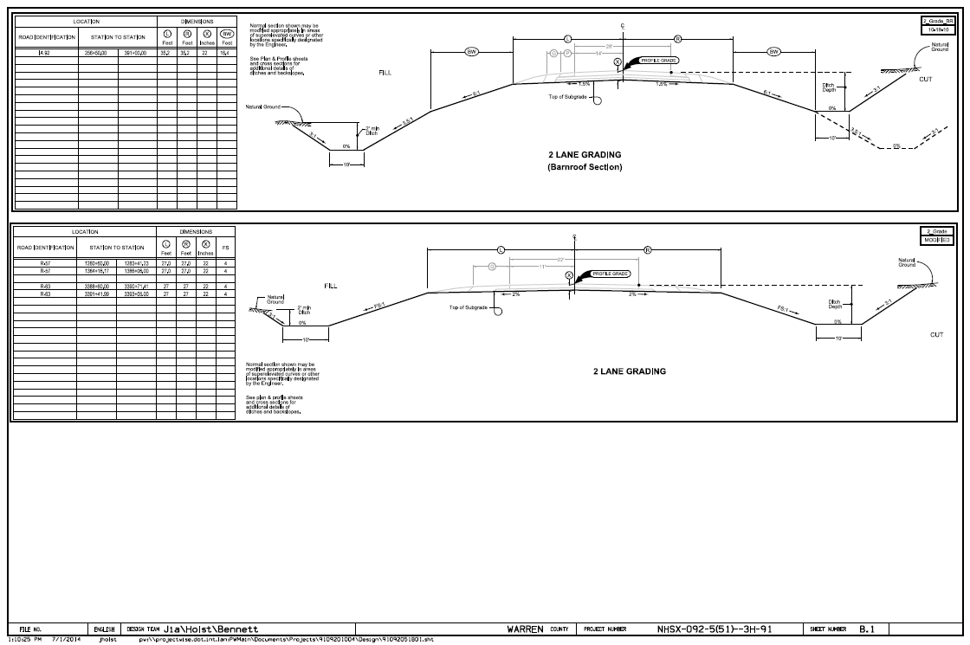
Typical Sections
Typical Section Sheet
Typical Section for Grading.
Sheet B.1
Notes:
Typical Sections are not as helpful for investigating potential conflicts at specific locations, but are useful for gaining a general idea of what type of grading and paving improvements will be occurring on a specific section of the project.
The top typical is a barnroof-type section that has a variable foreslope whereas the bottom typical has a standard section with uniform foreslopes.

Slide 36
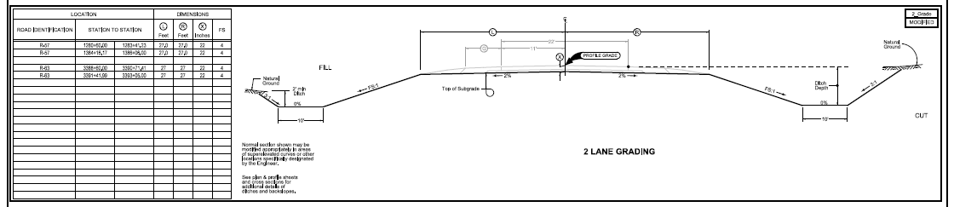
Typical Sections
Typical Section Sheet
Left Side
C
Right Side
L
Foreslope
Foreslope
Shoulder
Break Point
Ditch
Backslope
Fill
Section
Cut
Section
NOTE:
Longitudinal utility installations are NOT allowed in the foreslope or ditch bottom.
The table shows areas where this typical section applies (station ranges) and also provides values for dimensions shown on section.
Typical Section for Grading.
Sheet B.1

Slide 37
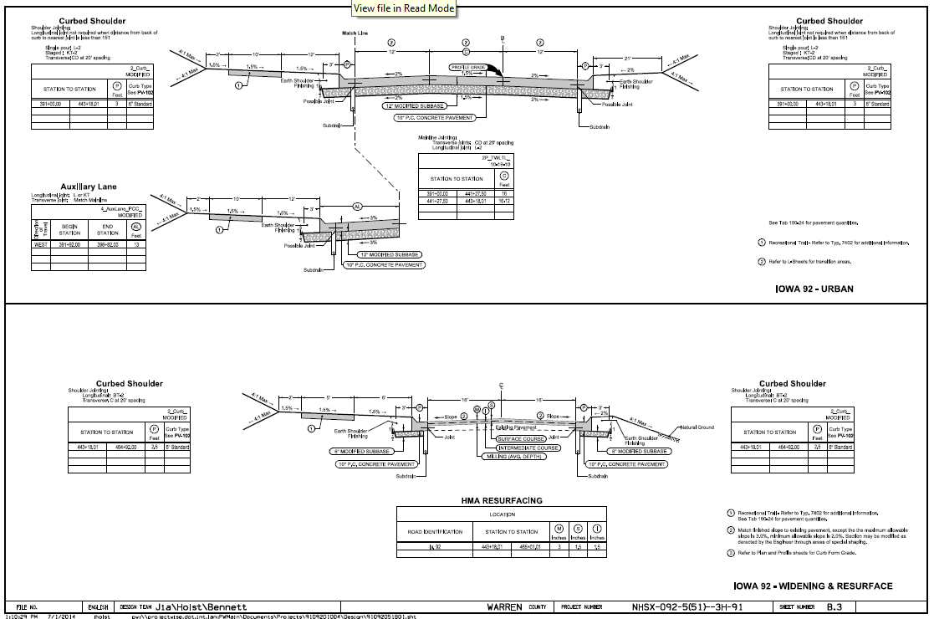
Typical Sections
Typical Section Sheet
Note the presence of sub-drains!
Subdrains are typically constructed
42” deep and are outlet into the ditch
(through the foreslope) every 500’.
This is where you can also see if a Centerline (CL) or a Baseline (BL) is used on each section of the project.
Typical Section for Paving.
Sheet B.3
Notes:
This is a paving typical and shows the paving or resurfacing to be completed.
Utilities may not think this is important, but if you notice, this typical shows if subdrains will be constructed with the project or lanes will be added in certain locations (based upon the tables).
Theoretically, subdrains and utilities should not conflict, but this problem has occurred many times.

Slide 38
Slope Ratio
3:1 Slope
H:V Slope
Slope
1
Vertical
1
2
3
3 Horizontal
The first number is the number of feet the slope must go horizontally to raise one foot vertically.
NOTE: this is different than the mathematical slope of V:H!
Notes:
Most of the world thinks of slope as “rise over run,” but in roadway plans, we typically show slope as “run over rise.”
Typical foreslopes:
Recoverable 6:1 or greater
Transversable (but not recoverable) 3:1 to 6:1
Both count as clear zone as long as there are no fixed objects within the clear zone distance
Typical backslopes: typically 3:1 for ease/safety of maintenance operations.

Slide 39
Section Views
Cross Section
(W, X, & Y sheets)
Notes:
Cross sections are one of the most important sheets in the plans, along with the D/E/K and H/HE sheets.

Slide 40
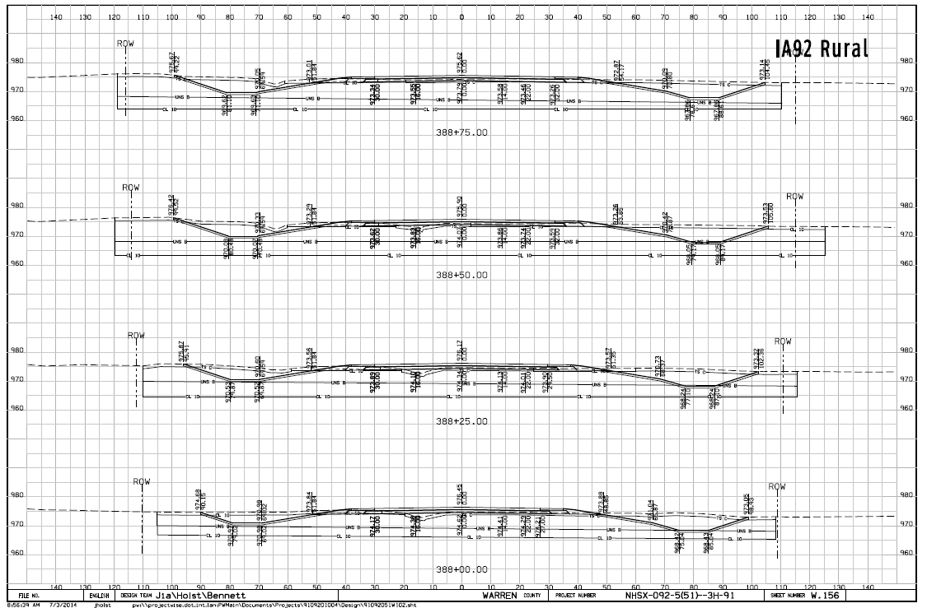
Cross Sections
Cross Section Sheet
Cross section frequency: 50’ (rural) or 25’ (urban)
(stationing is shown at the lower center of each cross section)
Sheet W.156
Notes:
Elevations appear along the left and right sides for each section.
Cross sections are typically cut every 50’ on rural projects and every 25’ on urban projects.
Now, let’s zoom in on one cross section and explore what is shown!

Slide 41
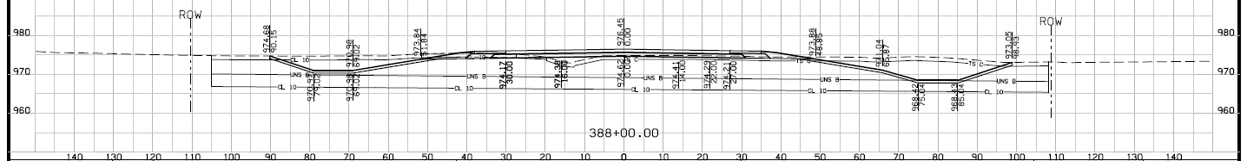
Cross Sections
Cross Section Sheet
Existing Ground
(Dashed Line)
Proposed Final Grade
(Solid Line)
90.15’ Lt. – Distance from CL to tie into existing ground.
Elevations
Top of New Pavement Elev.
@ Sta. 388+00 = 976.45’
Top of New Grade (soil)
Elevation: 974.62
Offset from CL
Centerline
STA. 388+00
0’ offset = Design Center Line
(middle of the new road)
Left Side I Right Side
Sheet W.156
Notes:
Let’s look at the cross section at STA. 388+00.00
This is a grade and pave project, so the numbers above the lines are the final pavement/topsoil elevations. The numbers below the lines refer to the top of the subgrade grading.
Topsoil replacement: take note that in the foreslope, backslope, and ditch bottom areas, we excavate an additional six inches below the finished grade in order to be able to place 6 inches of topsoil back in its place. Therefore, in those areas, the lower line and lower elevations are most critical for calculating utility cover.
Large scrapers and bulldozers are often used to remove the soil initially and replace the topsoil when grading is complete. Due to their size and weight, they exert a significant amount of pressure on the soil and can affect underground facilities several feet deeper than the elevation shown. Take this into consideration when reviewing plans!

Slide 42
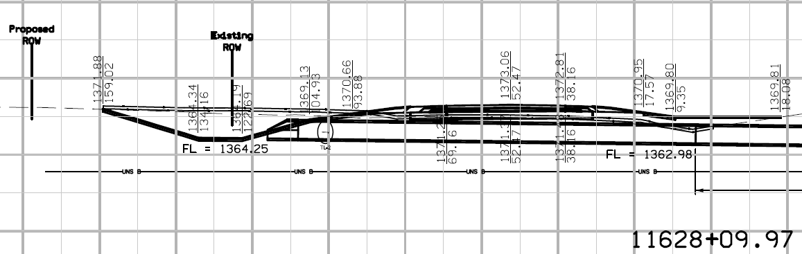

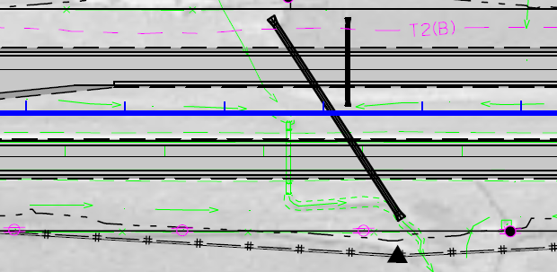
Cross Sections
Cross Section Sheet
Skewed Culvert
1380
1360
1340
11630
11625
Sheet W.52
Notes:
Let’s look at sheet W.52, which is the last sheet in your packet.
You may notice that this sheet is from a US 20 plan set, as the Indianola project we have been using did not have any examples of cross sections cut at skewed culverts.
A skewed culvert means the culvert is not perpendicular (or square) with the centerline of the road.
This culvert is skewed 33 degrees Right Ahead. Let’s dive into what that means…
“Right Ahead” means that when looking in the direction if increasing station, the end of the culvert on the right side is forward of the centerline location.
The angle between the culvert and the centerline is 33 degrees.
That is where the notation of “Skew 33 degrees Right Ahead” comes from.

Slide 43
Cross Sections
Cross Section Sheet
How do I know if I have to relocated based upon the cross section?
OK
NO-GO Zone
(Longitudinal utilities not allowed in this area)
OK
Maybe
Maybe
OK:
As close to the R.O.W. in this area is the preferred area for longitudinal utility installations.
This area is past the need line and should not be affected by the project
(with the possible exception of sign foundations, noise walls, etc.).
Maybe:
This area is generally not allowed, but if an existing installation is located in this area
the DOT may allow it to remain depending upon depth.
NO-GO Zone:
Longitudinal utility installations are NOT allowed in this area,
except in extremely rare circumstances.
Sheet W.156
Notes:
Note: this applies to longitudinal utility installations.
What if you have a transverse installation in this area?
Can you tell where the old ditch was? Answer: about 15’ LT of new CL.

Slide 44
Electronic Plans
PDF plans posted to Utilities FTP site for all projects
  Link to FTP site sent with project notifications (U02, U03, U04)
Microstation design files (.dgn) are available upon request
  Contact the District Utility Coordinator to request these files
  The Iowa DOT does not provide AutoCAD files (.dwg) but Microstation files can often be converted to AutoCAD (.dwg) by others.
Notes:
PDF files are typically sent via a link to an FTP site. If plans are very small, sometimes they can be an attachment to an email.

Slide 45
Review
Look at title sheet (A.1) to determine project scope.
Look at map sheet (A.2) to determine project location.
If your installation may be impacted, go to the Plan and Profile sheets (D sheets) to find your utility installation on the plan sheets.
  Check to see if your facilities are inside the “need line.”
  Check to see if the R.O.W. is changing in the area where your facility is located.
  If it appears your facilities may be impacted, go to the impacted locations in the cross sections to see extent of grading work.
  If no “D sheets” in plan, check “B sheet” typical sections for extent of work.
    Typically this occurs on jobs with minimal or no grading work.
    If it is an urban job, check for “S sheets” to determine any sidewalk upgrades which would impact above-ground facilities (poles, pedestals, handholds, etc.).

Slide 46
Questions?
Bryan Bradley, P.E. State Utility Engineer
800 Lincoln Way 515-239-1014
Ames, Iowa 50100 bryan.bradley@dot.iowa.gov

Slide 47
Knowledge Check

Slide 48
Knowledge Check
12’
3’
4:1
?
What is the vertical distance on a 4:1 slope
with a horizontal distance of 12’ ?

Slide 49
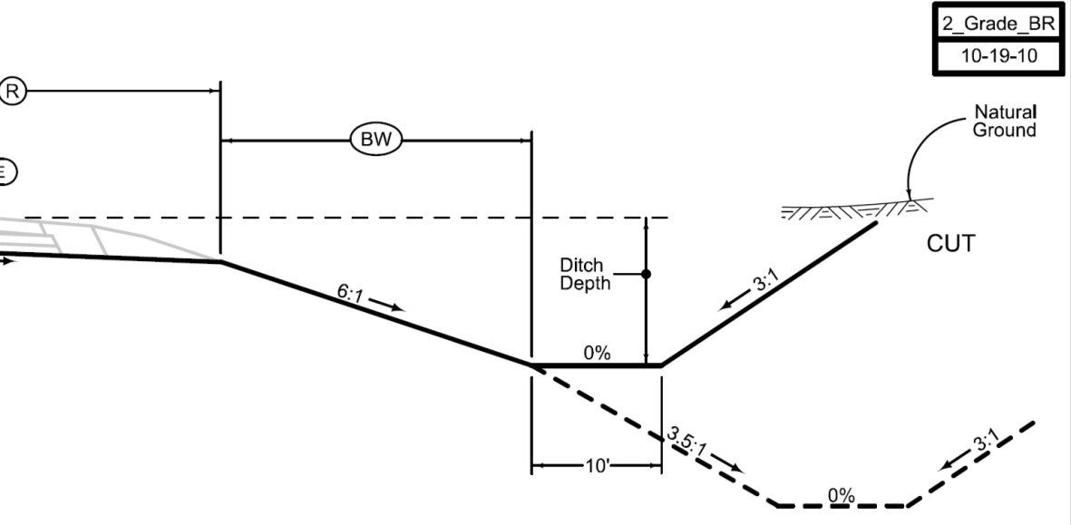
Knowledge Check
What drawing is being shown?
Typical Section
The backslope is what ratio?
A – 6:1 B – 3:1 C – 3.5:1
B – 3:1
How wide is the ditch bottom?
10’

Slide 50
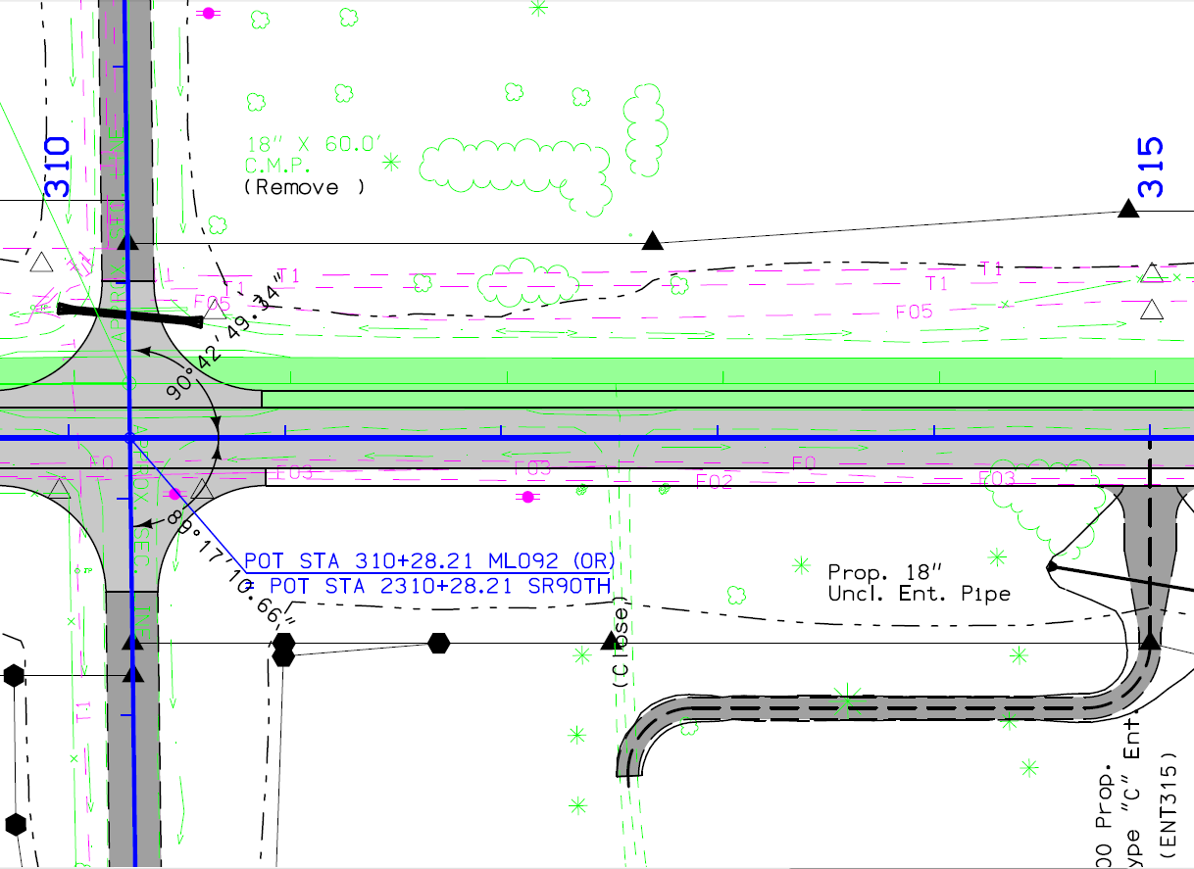
Knowledge Check
What side of centerline is power pole line?
Right
Sheet D.8

Slide 51
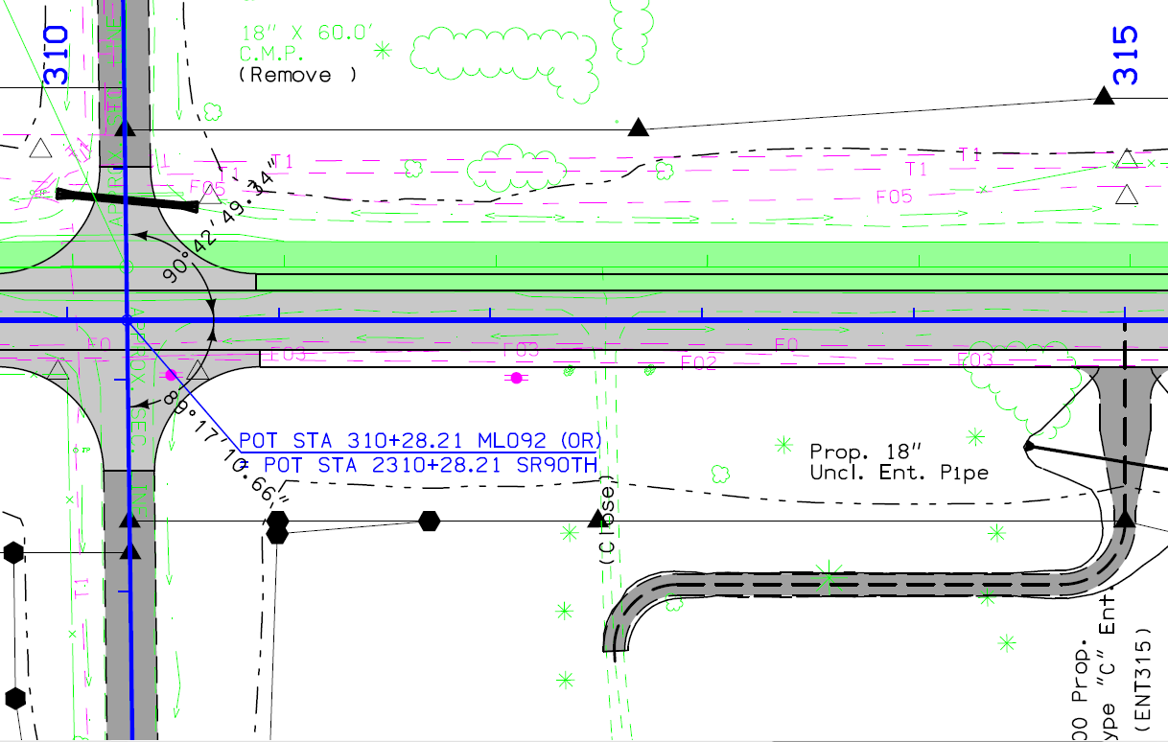
Knowledge Check
Will the utilities on the left side be impacted in this area?
Most likely!
How do you know?
They are in side the “need line!”
Where should you look to know for sure?
Cross sections!
Sheet D.8
Notes:
Note: Section on left side of road is in cut – deepening existing ditch.

Slide 52
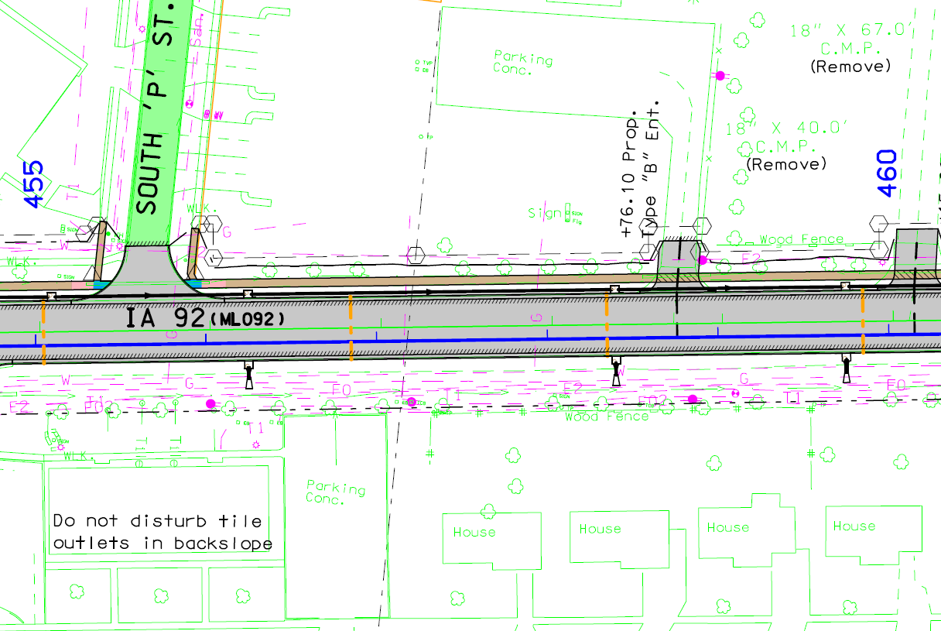
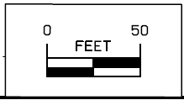
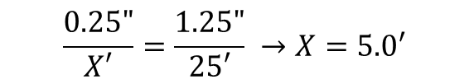
Knowledge Check
At what station does the gas line cross the proposed centerline?
0.25” (Ruler Measure)
$$\frac{0.25"}{X′}=\frac{1.25"}{25′} →X=5.0′$$
STA. 458+00 – 5.0’ =
STA 457+95
1.25” (Ruler Measure) = 25’ (Plan Dimension)
Sheet D.28

Slide 53
Questions?
Deanne Popp, CPM Utility Program Administrator
800 Lincoln Way 515-239-1014
Ames, Iowa 50100 deanne.popp@iowadot.us
Special Thanks to:
Ben Hucker District 6 TEI
Brenda Sanders District 5 EOT

