Slide 1
UTILITY PERMITS
IOWA DEPARTMENT OF TRANSPORTATION
UTILITY ACCOMMODATION PERMIT

Slide 2
WHEN ARE PERMITS REQUIRED?
Any time you plan to locate facilities within the highway right of way
New installations
Upgrades
overhead changed to underground

Slide 3
MAINTENANCE
Covered under original permit and requires 48 hour notification, unless it’s an emergency repair
Exact same size, location, and install methods
Pole replacement as long as…
facility is not being upgraded
Pole is placed within 1 foot of original location

Slide 4
When more than one permit is needed
Each non-continuous installation requires a separate permit
Transverse crossings – not connected to new longitudinal lines between them
Installs that begin on one highway and continue onto another highway
Two (or more) different utility types (i.e. fiber optic & telephone)
Even if they’re installed in the same location at the same time

Slide 5
Single permit
Installs that cross city limits or county lines
Attach copies of each county’s approval
Installs that cross DOT District lines or EOT jurisdictions
With some exceptions…

Slide 6
When to submit
Not less than 30 days prior to expected installation or work
DOT has 30 days to return the permit – provided that…
All impertinent and required information is supplied
Correct and accurate format
With all attachments
With all required prior approvals
FHWA approvals are acquired after submission to DOT
Are allowed to exceed the 30 day timeframe

Slide 7
Allow More lead time for…
Large installs
Complicated installs

Slide 8
Permit delays…why?
Sent to the wrong DOT office
Incorrect format
Inaccurate or missing information
Traffic control plans
Insufficient # copies of site plans/attachments

Slide 9
Where to submit permits
EOT assigned to the territory
Refer to EOT maps – keep them handy!
Take copies with you today

Slide 10
Who is the Applicant?
Company permanently responsible for the facilities once installed
Installers or the Utility Company’s contractor would be considered that Utility Company’s subcontractor ~ they are NOT the applicant.
Applicant’s signature MUST be an authorized representative of the Utility Company (the Applicant).
Private contractors are NOT allowed to sign as the Utility Company’s representative unless they are under a contract specifying that they are an officially authorized representative of the Utility Company.

Slide 11
Applicant information
Must be filled out in completion
Contact information is important
Phone number
Someone who can answer questions that may arise from the permit

Slide 12
Describe the installation
Boring
Digging
Open trenching
Pole installation
Materials used and specifics on encasement

Slide 13
Work site location
Section, Township, Range
(Sec 32, T76N R13W)
Highway and general location
More specific location information
Stations
Mileposts
Side of highway
Should reflect required information on your Site Plan

Slide 14
What is a station?
Unit of measure for highway construction and other road work
True horizontal distance regardless of terrain
1 Station = 100 true horizontal feet
1 Metric Station = 100 true horizontal meters (328.08 feet)

Slide 15
Stamped or posted
PCC Concrete – stamped in pavement
Approximately 1 foot in from the outside edge every 100 feet (or 20 meters)
ACC (Asphalt) – post mounted
Every 500 feet (100 meters)
Along the ROW / fence line or in the foreslope

Slide 16
Stamped or posted
2-Lane Roads
Right side of the highway
Running in the same direction as stationing
4-Lane Roads
Similar locations as previously described
Outside edges in both directions

Slide 17
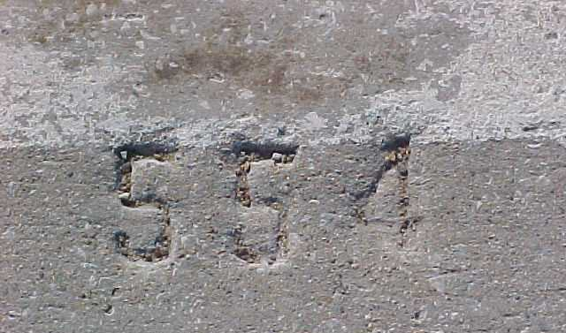
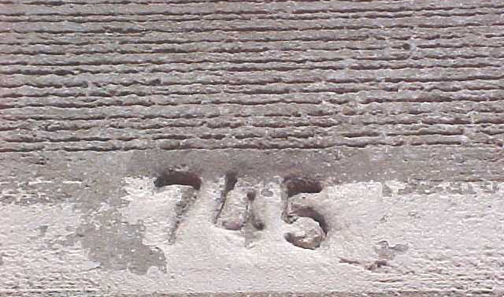
Pcc stationing

Slide 18
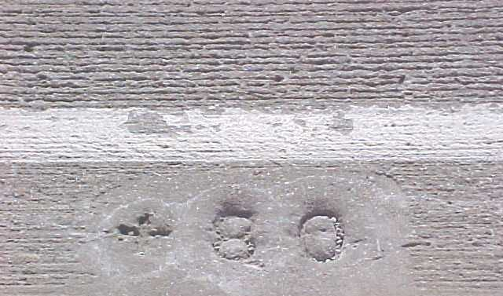
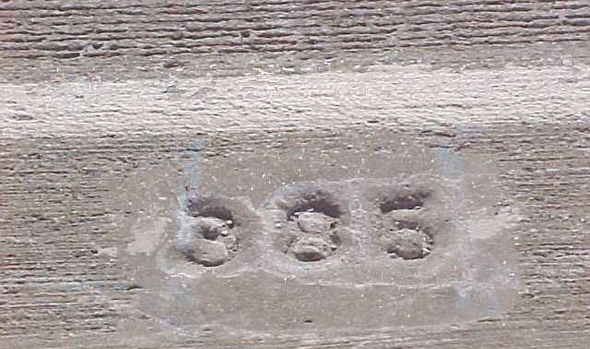
Pcc metric stationing

Slide 19
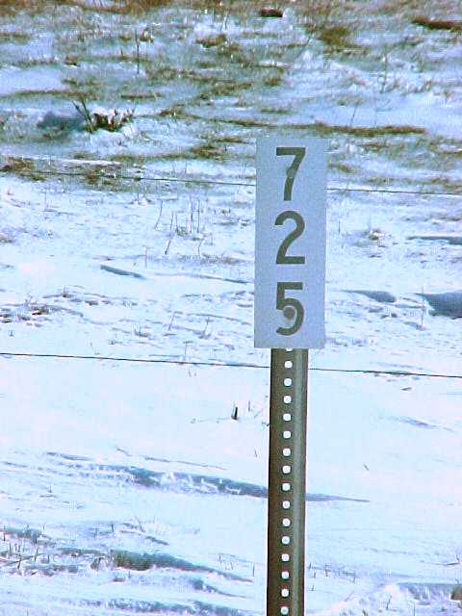
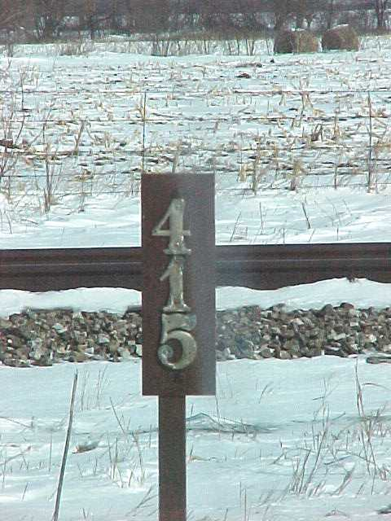
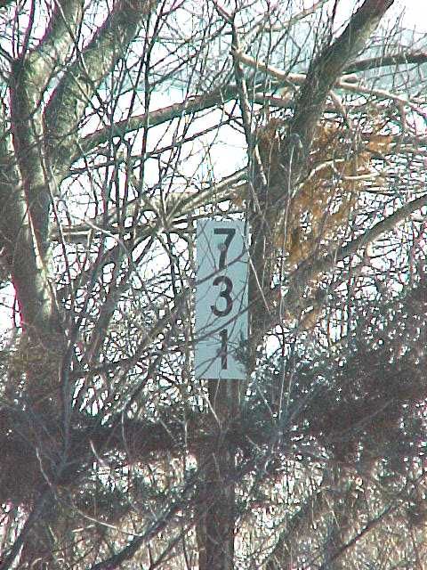
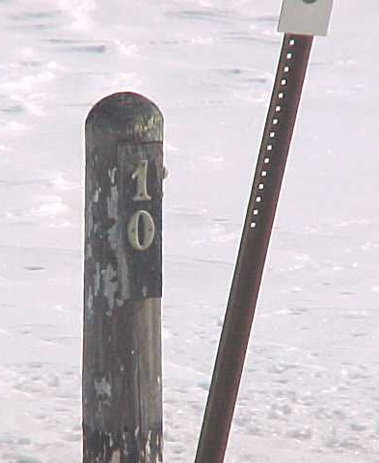
Acc stationing (500 ft. marker)

Slide 20
Station numbers can change
Equations
A location where one series of stationing ends and a new series begins
Signified by a Back Station point = Ahead Station point
Example:
(Equation 32+33.7 Back = 3299+65.3 Ahead)

Slide 21
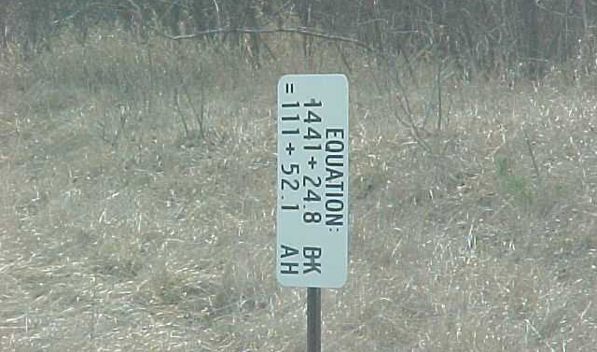
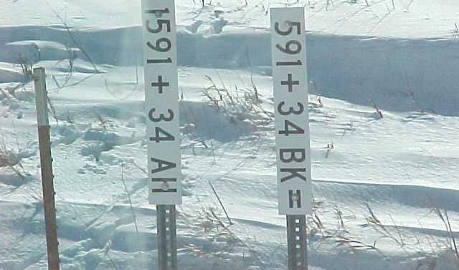
equations

Slide 22
Why equations?
End of one project ~ start of another
Construction ramps
County or corporate limits (often split at corporation lines)
Reconstruction project in the middle of a continuous stationing progression
Shortening or lengthening of a highway due to realignment
Alignment changes on a 4-lane where one lane is longer than the other

Slide 23
What if I can find stationing?
Flag or layout your proposed installation clearly marking the beginning and end with a distinguishing mark or different flag
Must be in the true position of the installation
Including proper distance from centerline of the highway
Note the lack of stationing/milepost on post-it or in a cover letter
Leave those areas of the permit blank (for now)
NEVER put N/A on a permit
Stationing and milepost are ALWAYS needed

Slide 24
ideas
ALWAYS field evaluate the location for anomalies
Not always apparent on aerial photos or a set of plans
Don’t design from behind your desk
Measure from a known and identified point to the beginning and ending location(s)
1 point for each and as close as possible
NOT intended to be used in place of established stationing

Slide 25
Highway mileposts – general guideline
North / South Highways (generally the odd numbered highways)
Runs from south to north
East / West Highways (generally the even numbered highways)
Runs from west to east
There are exceptions…
Milepost equations are less frequent, but follow the same basic reasoning as the Station equations

Slide 26
mileposts
2-Lane Roads
Right side of the highway
Running in the same direction as mileposts (ascending)
4-Lane Roads
Outside edges in both directions
Delineators every 264 feet
Have sub-milepost markers on those delineators (Example: 60.15)

Slide 27
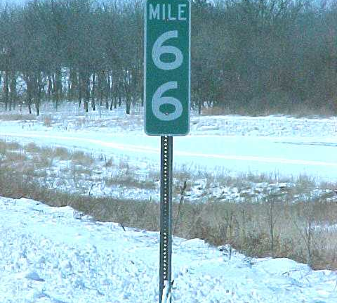
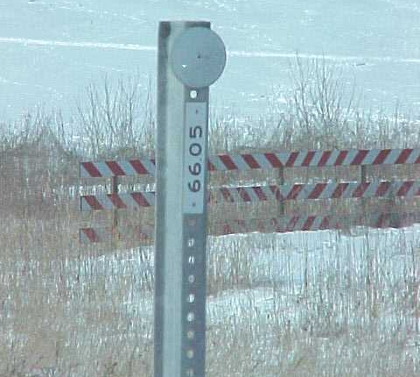
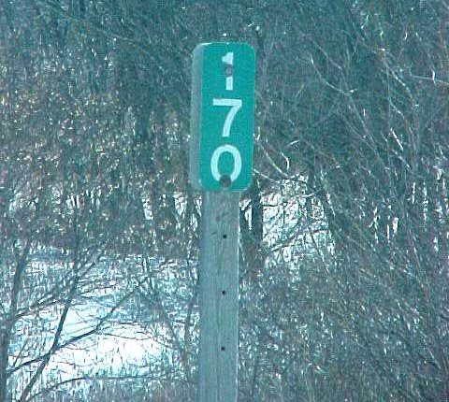
mileposts

Slide 28
Why do we need both stations & mileposts
Mileposts follow the hills and dales of the surrounding terrain
Stations are in horizontal distance as measured by survey equipment
Distance stays constant regardless of terrain
Therefore 1 mile (5,280 feet) does not always equal 52+80 in Station distance
Equations may have redundant stationing in a very short distance, so location by milepost is important in aiding specific location of an installation

Slide 29
Why do we need both stations & mileposts
Mileposts to the second decimal (i.e. 62.51) are only accurate to 26 feet at best
Installations should be measured within 5 feet, ideally to the nearest foot

Slide 30
Who signs & when?
Applicant
Representative from the Utility Company will be the “Owner” or responsible party of the installation once construction is complete (NOT the contractor)
Applicant’s signature MUST be an authorized representative of the Utility

Slide 31
Who signs & when?
Company (the Applicant)
Private contractors are NOT allowed to sign as the Utility Company’s representative unless they are under a contract specifying that they are an officially authorized representative of the Utility Company

Slide 32
City and/or county
City
Official from the city whenever installation is within the corporation limits of a city
DOT and city have joint jurisdiction on highways within a city
County
Official from the county whenever the installation originates from, exits into or crosses a county road or county-owned property
Signatures MUST be acquired BEFORE submitting the permit to the DOT

Slide 33
Other approvals
Needed when there are POTENTIAL impacts to:
Major waterways
Homeland security
Environmental, Historical, Ecological, or other “protected” areas
From who?
Army Corps of Engineers
Military Entities
DNR
Others???
In the form of a signed letter of approval

Slide 34
Special requirements
Reserved - to be completed by DOT representative
Restrictions or additional stipulations not outlined in the standard permit
Special construction methods
Specific traffic control
Special notifications of other parties
Work restrictions (hours or days)
Other important issues to be emphasized

Slide 35
Approval signatures
FHWA Action
Interstates
Central Office submits for approval
May exceed 30 day limit
DOT Action
Signed by EOT or Assistant District Engineer (ADE)
Contact Person
May be EOT, Garage Supervisor, or Resident Construction Engineer (RCE)

Slide 36
Permit ~ page 2
Must be included for permit to be valid
General construction & maintenance requirements
Liability
Notification of Work Commencement
Don’t overlook page 2 – applies to all installations unless specifically stipulated in the “Special Requirements”

Slide 37
miscellaneous
Print on LEGAL size paper – double-sided
Must be typed or printed in ink
All areas of the Applicant’s responsibility MUST be completed or an attached explanation of why it was left blank (NEVER put N/A on a permit)
Signatures of all parties must be originals
ALL signatures must be acquired BEFORE submitting to DOT for approval

Slide 38
Online resources – Links have changed
Permit link has changed:
https://iowadot.seamlessdocs.com/f/ApplicationAgreementforUseofHighwayRightofwayforUtilitiesAccommodation
Utility Accommodation Policy
https://iowadot.gov/rightofway/pdfs/UtilityPolicy.pdf
Traffic Control Standards
https://iowadot.gov/design/stdplne_tc

Slide 39
Thank you!
Any questions?

