Slide 1
Annual Utility Meeting 2021 | Teams Live event
Iowa Department of Transportation

Slide 2
Welcome & introductions
Iowa DOT Utility Program
Notes:
Good morning and welcome to the 2021 Annual Utility Meeting.
We’ve tried many different formats and schedules with our annual meetings
from one large meeting in Ames,
To separate meetings in each of the 6 DOT districts
and regional meetings, but this virtual platform is definitely a first.
We appreciate everyone taking time out of their schedules to join us this morning.
My name is Deanne Popp and I’ll be leading today’s meeting.
- As a Teams Live event, this meeting is being recorded.
We plan to make available after the meeting on the FTP site that was provided in the meeting invitation.
If you’ve not attended a Teams Live event before you’ll notice that it might be a bit different from other virtual meetings you’ve attended.
You’ll be hearing from several different presenters today including the DOT districts who will discuss upcoming projects.
The biggest difference is that only the presenters will be able to share their screen and camera and microphones
However, you can still interact with us.
Please post questions you have in the Q&A portion.
We will be monitoring the questions as their submitted and publishing those that are relevant to the topics. Other questions might answered directly by the moderator.
We expect this meeting to conclude prior to or at Noon. You’ll want to stay until the very end for a chance at some virtual swag.
If you’re not familiar with that term it’s the new way to reference conference giveaways for virtual meetings.
I’ll have a few quiz questions for the non-DOTers and if you participate you could received a nifty surprise in the mail a few weeks from now.
Ok, so Let’s get started…

Slide 3
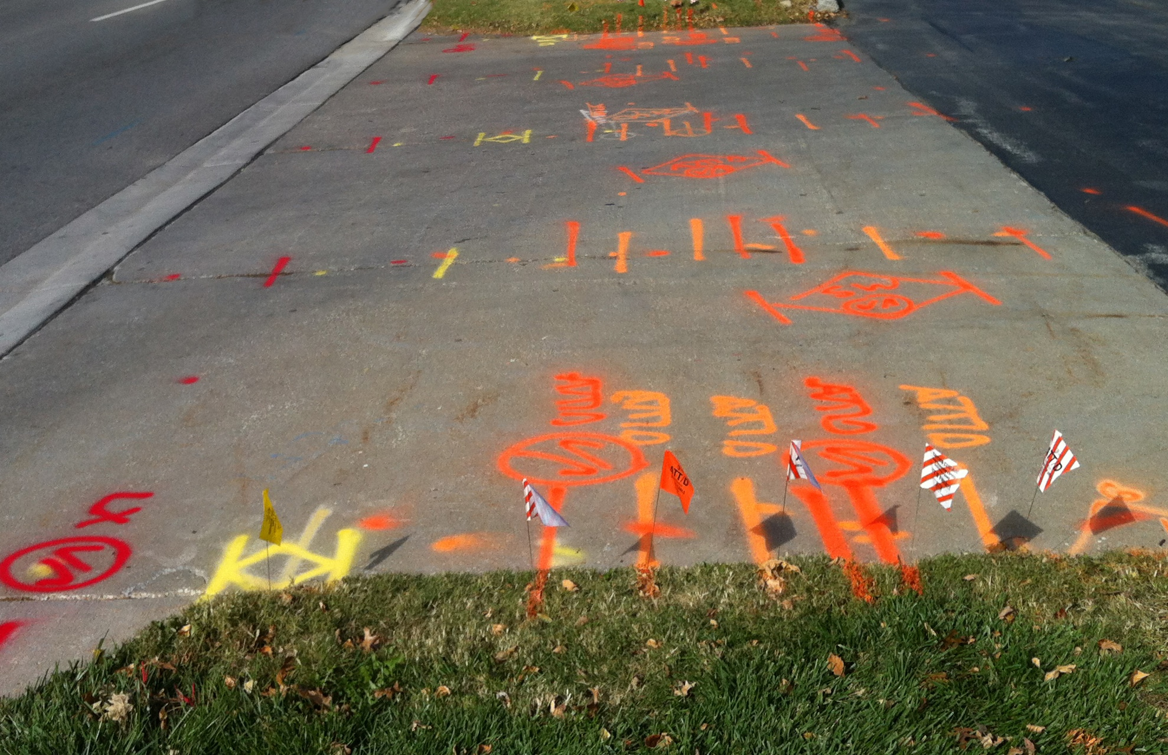
Accommodation & Coordination
Accommodation
Permitting
Relocations
Agreements
Management of the ROW
Notes:
The Utility Program covers all aspects of utility coordination from permitting to project relocations.
We are part of the Transportation Development Division and the Right of Way Bureau and play a major role in managing the assets in the public rights of way.

Slide 4
Utility program team
Central Office
District offices
Field offices
Notes:
Our team is spread out among various locations including
The central office in the Right of Way Bureau
The district offices in 6 locations
And field offices in 16 locations

Slide 5
Central Office – Right of Way Bureau
BUREAU DIRECTOR – BRAD HOFER
Bureau Leader
Approval of budget items including utility relocations
UTILITIES SECTION SUPERVISOR – ERIC WRIGHT
Process & Procedure Implementation
Project & Production Champion
Design, Utilities & Fiscal & Title Sections
Notes:
The Right of Way Bureau is lead by Brad Hofer
He gets involved with utility related discussions
and approval of utilities related budget items – like reimbursement agreements and some subsurface engineering efforts
Eric Wright is the Utilities Section Supervisor
Leads the utility section staff in implementation of our processes and procedures
He is the ROW champion of project and production status
He is also the supervisor for the Design and Fiscal and Title Sections in the bureau

Slide 6
Central Office – Right of Way Bureau
PROJECTS & AGREEMENTS COORDINATOR – MATT BUTTZ
Project Notifications
Plan Submittals
Utility Reimbursement Agreements
PRODUCTION & FIELD COORDINATOR – VACANT
Project Scheduling
Project Status
Accommodation Specialist
Field Assistance
Notes:
We have a new team member in the central office
Matt Buttz is our new Projects and Agreements Coordinator
Matt handles project notifications & plan submittals
As well as Utility Reimbursement Agreements – and all things related
Preparation and negotiation
Payments
Release of easements
Matt is acting as the Q&A moderator today – so he will be the one reviewing any comments or questions that you add to the Q&A
We currently have a Production & Field Coordination position vacant in the Utilities Section
Jeff McCollough (whom some of you may remember working with) recently retired so Eric will working to fill his Senior Engineering Tech position
That position will be handling
Project scheduling & status of utility events
They will also act as our permitting specialist
And give assistance in the field when needed

Slide 7
Central Office – Right of Way Bureau
PROGRAM ADMINISTRATOR – DEANNE POPP
Program Leader - Policy Administrator
Initiatives
Stakeholder Liaison
TRANSPORTATION PLANNER – ASPEN PFLANZ
Right of Way Information Management
Parcel Mapping
GIS
Notes:
I am the administrator for the Utility Program
Taking the lead on administering policy
Providing guidance to all team members
Leading initiatives and process improvements
And, acting as a liaison to our stakeholders
Aspen Pflanz is our Transportation Planner
She is working on developing a ROW management system
We anticipate that this system will include parcel and utility mapping
Aspen is acting as the Producer of this Teams Live Event – so she is the one staging the various presentations today.

Slide 8
District Utility Coordinators
District 1 – Jerry Lavine
District 2 – Tracy Meise
District 3 – Kelly Mulvihill
District 4 – Kurtis Shackelford
District 5 – Bonnie Clancy
District 6 – Steve Flockhart
Project Coordination
Utility Work Plan Review
Utility Accommodation Permit Review
Utility Reimbursement Agreement Review
Notes:
There are 6 District Utility Coordinators across the state
They handle
Project coordination
Work plan reviews
Some utility permit reviews
And they also get involved in the development and review of reimbursement agreements

Slide 9
Notes:
This map shows the 6 different District areas covered by each DUC – you’ll likely be seeing this map again today in the district led presentations
The map is also available on the FTP site for the meeting.

Slide 10
Engineering Operations Technicians
Utility Accommodation Permit Review
Project Coordination Assistance
Utility Work Plan Review
Other permits
Notes:
There are 18 field staff across the state that handle permitting.
These are our Engineering Operations Technicians or EOTs
They handle all Utility Accommodation permits
Work on ROW permits
As well as access permits
They also get involved in project coordination and work plan review

Slide 11
Utility Accommodation and Coordination
Communication is KEY
Information Sharing
Annual Utility Meetings
Program Updates
Policy & Procedures
5-year program
Notes:
The success of the Utility Program relies on good communication between all of the stakeholders involved
Some of the ways we work to achieve this is by sharing information
Sharing
The right information - at the right time – with the right people
The Annual Utility Meetings are one of the ways we accomplish this
Today you’ll receive information about our program – as I’ve already been sharing with you
We’ll continue today’s meeting by covering our processes and some of the associated policy
We’ll follow that with each district sharing their upcoming projects and the 5-year Program
Be sure to stick around until the end of the show for a chance to win some virtual bling!

Slide 12
Iowa Administrative Code 761-115 (306A)
Utility Accommodation Permits
Section 115.25 – Point25
Notes:
The work we do within the Utility Program is done under Iowa Code Section 306A
More specifically under Iowa Administrative Code – 761 Chapter 115
Many of you know this as our Policy for Accommodating and Adjustment of Utilities on the Primary Road System
Section 115.25 covers the adjustment and coordination on highway projects – we reference this as simply Point25
Applies to all DOT projects – except
Those developed on an accelerated schedules
And those with no anticipated utility involvement

Slide 13
Point25 Overview IAC 761-115.25 = Point 25
State highway projects
Requirements that must be met
Non-responsive utility can be held liable delay costs
Utility and contractor settle directly
State is provider of evidence
State cannot take on liability of either party
Notes:
Point25 is specifically for state highway improvement projects
It sets forth the timing of notifications and plan submittals that DOT provides to utility companies
As well as the required responses from utility companies
If all the notifications and submittals are met,
Non-responsive utility owners can be held liable for project delay damages
These will be settled directly between the DOT contractor and the utility owner
In those instances the State will only be a provider of evidence
We cannot take on liability of either party
Let’s take a look at the various steps in the Point25 process

Slide 14
U0 Event | investigation
Investigate – look for utility facilities within the project area
Identify – utility facility ownership in the project area
Prerequisites: Final Concept Completion
Utility permit records
Utility reimbursement agreement records
Field examinations (Concept Reviews)
Existing utility maps
Iowa One Call (Design Request)
Notes:
We begin with the U0 event – this is the investigation step for utility facilities within the project area
We seek to identify utility facility ownership in the project area
We do that using various pieces of information such as
Existing utility permit records
Previous reimbursement agreements
Field examinations
Utility maps
We also perform an Iowa One Call (design request)

Slide 15
U1 Event | major impacts
Look for the potential for impacts to large capacity facilities
Request more precise location information from utility owner
Provide the information to designers to lessen impacts
Avoid
Minimize
Accommodate
Notes:
During the U0 investigation we look for the potential for impacts to major or large capacity utility facilities
On some projects we might find something that we need to look into a little further
So, we’ll send a request to that company
For more precise location and capacity information
We might also ask for a high level estimate for relocation or adjustments should they become necessary
These help us to make better design and development decisions.
We pass that information on to our designers with the intent to design around the utility - to lessen the impact.
If we find that we cannot avoid the facility altogether, we do our best to minimize the impact or come up with a solution to accommodate the facility as much as possible.
The goal for the event to be early enough in the project development process to allow for modifications to the design

Slide 16
U2 Event |notification
Prerequisites:
Completed D02 (Field Exam Plans)
Request verification of facility locations (90 days to reply)
Public ROW or private easement?
If facilities ARE on private easement and relocation is necessary…
Will company purchase their own replacement easement?
Will company request DOT to purchase their replacement easement?
Notes:
When the field exam plans have been completed we are ready for the U2 event
These plans include a general project layout
At this point the new ROW lines have not been determined
With the U2 we submit an notification to the known utility companies in the project area
We request maps or plans from utility companies on their existing facility locations (90 days to reply)
We also request to know whether their facilities are on the public ROW or in private easement in the vicinity of the project.
We ask - If the facilities ARE on private easement – would the company purchase their own replacement easement?
Or, would they request the DOT to purchase the replacement easement for them?
Again, our goal is to be early enough in the design development to allow for modifications
And for our ROW Design staff to make plans to include any utility easement needs in the ROW design.

Slide 17
U3 Event | 1st plan submittal
Prerequisites:
Completed road design (D05)
Proposed new ROW layout (R01)
All MUST reply whether impacted or not (90 days to reply)
All impacted utilities must provide a relocation plan (same 90 days)
Show relocation on DOT plan & cross section sheets
What is an acceptable relocation plan?
Notes:
Next is the U3 event – it’s the 1st plan submittal
These plans include the completed road design AND the new proposed ROW layout
This submittal is sent to all known utility companies with facilities in the project area.
Each company has 90 days to reply as to whether or not their facilities will be impacted.
Everyone must reply whether they’re impacted or not
If they are going to be impacted by the road project they MUST provide us with a relocation work plan within the same 90-day time period.
The relocation plan is to be shown on DOT project plans and cross section sheets
Let me give you an idea of what we’re looking for in the relocation plan

Slide 18
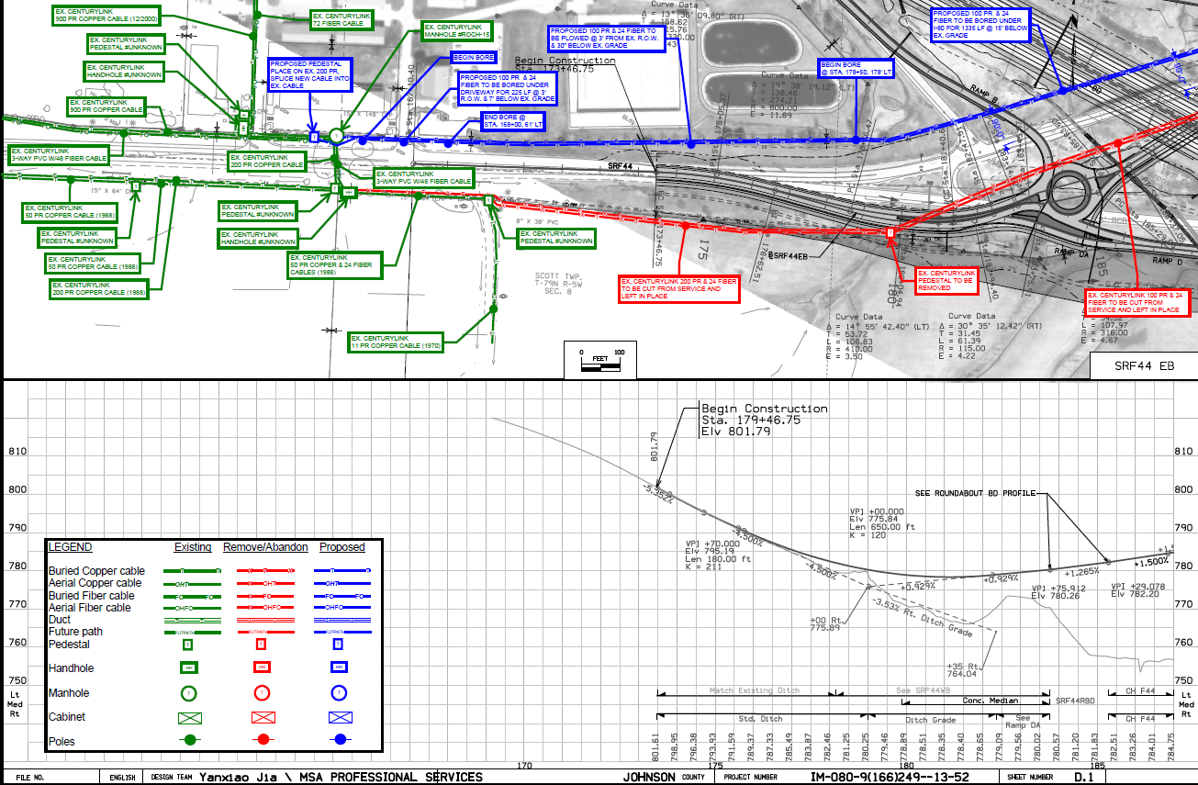
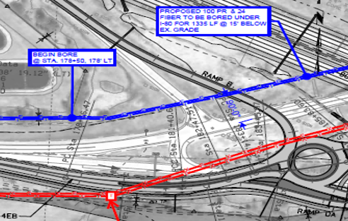
Notes:
This slide shows one example of how we would like to see your relocation plan.
In this example the utility company overlaid their design on the D sheets
They included a legend that shows
Green represents their existing facilities
Red represents what they plan to remove or abandon
And blue shows their new proposed route
Notice they have call-outs with specific details about various locations
This is a good example of the sort of information and detail we’d like to receive.
One thing to note is that if you’re planning to request reimbursement, we’d prefer this information be shown on the H sheets (that’s the ROW sheets).

Slide 19
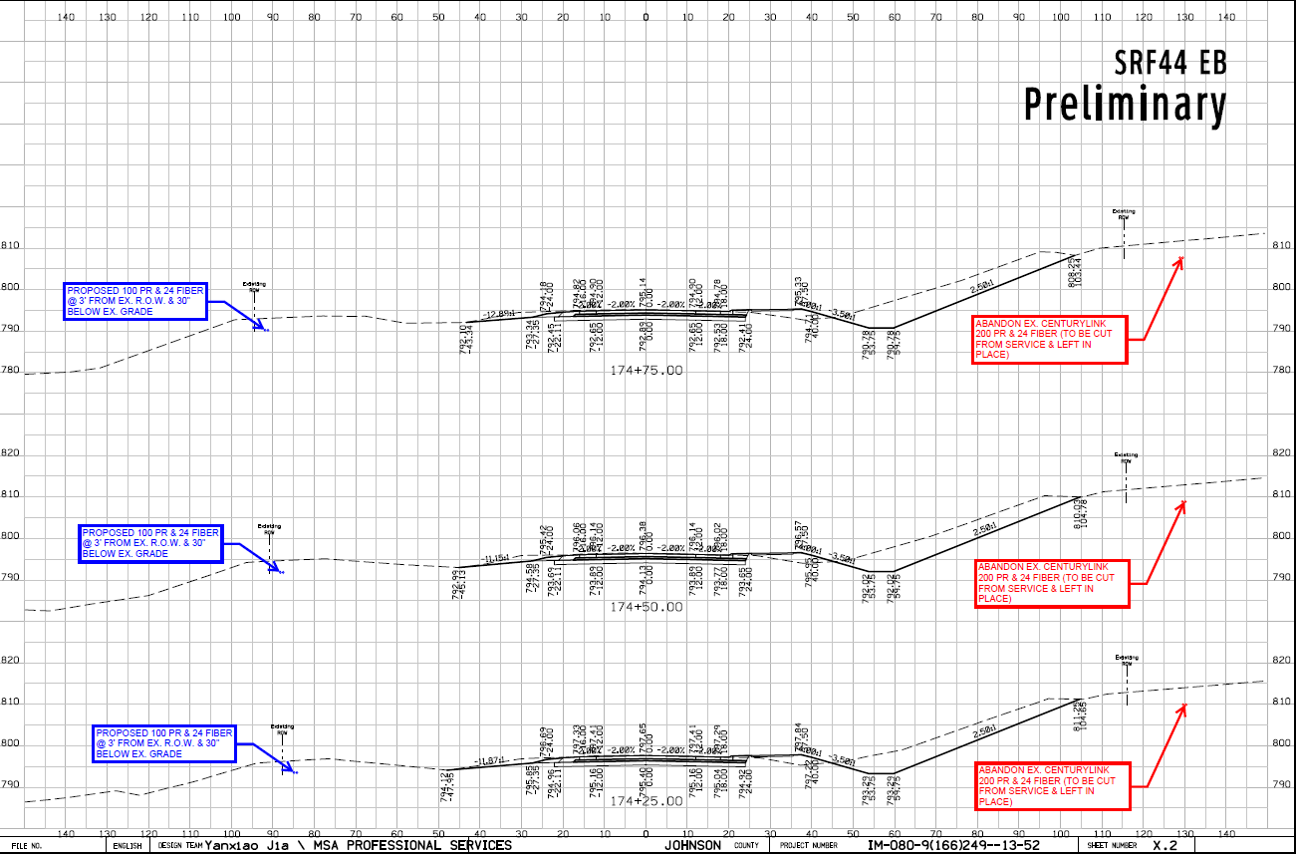
Notes:
Here’s an example of how the utility has shown their relocation on a cross section.
It shows the approximate depth and location of and underground facility – and details about what the plan is for the facility at that location

Slide 20
U4 Event | 2nd plan submittal
Prerequisites:
Public hearing or information meeting completed
Changes incorporated into proposed ROW layout
All MUST reply whether impacted or not (60 days to reply)
All impacted utilities must provide a FINAL relocation plan (same 60 days)
Show relocation on DOT plan & cross section sheets
Notes:
The 2nd plan submittal or U4 is done following the Public Hearing or Information Meeting
Any changes requested as a result of the public’s input are incorporated into the final ROW layout.
Again, this submittal is sent to all known utility companies with facilities in the project area.
Each company has 60 days to review the information and reply as to whether or not their facilities will be impacted.
Again, everyone must reply whether they’re impacted or not
If they are going to be impacted by the road project they MUST provide us with a FINAL relocation plan within the same 60-day time period.
And again, the relocation is to be shown on DOT project plans and cross section sheets

Slide 21
U5 Event | agreement
Reimbursement Agreement
Who pays?
Relocation necessary to accommodate construction
Existing facility
Private Easement
Public Right of Way
Prerequisites
Easement documentation
Relocation work plan
Estimate of relocation costs
Notes:
Some utility relocations or adjustments may be eligible for reimbursement
How do establish who pays? – State or the utility company?
First off, the relocation must be necessitated to accommodate the proposed construction
Then it depends on the location of the existing facility
If it’s on private easement – it would be eligible for reimbursement
If it’s on the public right of way – then the company must pay for relocation work
There are a few things we need to begin the agreement process – we need
Copies of the easements
The company’s relocation plan
And a detailed estimate of relocation costs
We’ll discuss further a few slides later

Slide 22
U6 Event | notice to proceed
Prerequisites:
Final utility relocation work plan approved
New right of way acquired
Reimbursement agreement executed (if applicable)
Permits issued (if applicable)
Coordination with DOT contractor?
Notes:
The Notice to Proceed is the next step
There are several things that have to fall into place before the notice can be given.
The utility’s relocation plan must be approved
The New ROW must be acquired
The reimbursement agreement must be executed (if there is one)
And, the utility permits must be issued (if there are any)
In addition, if there is any coordination required with the DOT’s contractor, then the notice may be conditional to the contractor’s schedule

Slide 23
U7 Event | bid attachment (UBA)
ALL Point 25 Projects (Recommended for Non-Point 25 projects)
Included in bid documents
Written details regarding conflict locations and resolutions
Anticipated start and completion dates for relocations
Utility company contact information
For bidding contractors’ use – to make them aware of the status of utility relocations and timeline – so they can bid accordingly
Notes:
The final event is the U7 – the Utility Bid Attachment (or UBA)
This is a document the DUC provides to our Contracts Bureau to be included in the final bidding documents
It is required on ALL Point25 projects (and is sometimes included on Non-Point25 projects)
It is a formal report of the status of utility relocations at the time of plan-turn-in
It provides written details about remaining conflict locations and their intended resolution
It also states anticipated start and completion dates for utility relocations that still needs to be done
The UBA is intended for the bidding contractor’s use – to make them aware of the status of utility relocations – and allows them to bid accordingly.

Slide 24
Reimbursement Agreements
Existing facility
Private Easement
Public Right of Way
Eligibility
State’s authority to reimburse
Evidence of easements
Notes:
As I mentioned before, some utility relocations or adjustments may be eligible for reimbursement.
The relocation MUST be necessitated to accommodate the proposed DOT construction project.
Who pays for the relocation is determined by the location of the existing utility facility
Private easement – eligible for reimbursement
Public right of way – company must pay for relocation work
To get started on the agreement we need certain bits of information to establish eligibility and determine how much is reimbursable.
To aid in developing the agreement we have resurrected an “old friend”.

Slide 25
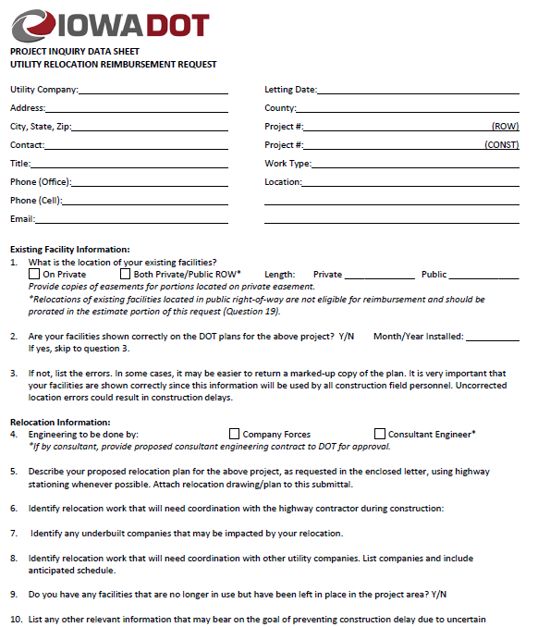
Project inquiry data sheet
Company information
Existing facility information
Relocation details
Notes:
The Project Inquiry Data Sheet
It is a 4-page form
That includes questions and boxes for information needed to prepare the agreement
This form’s given to utility companies when they ask about reimbursement.
This form needs to be filled in and returned to us when requesting reimbursement.

Slide 26
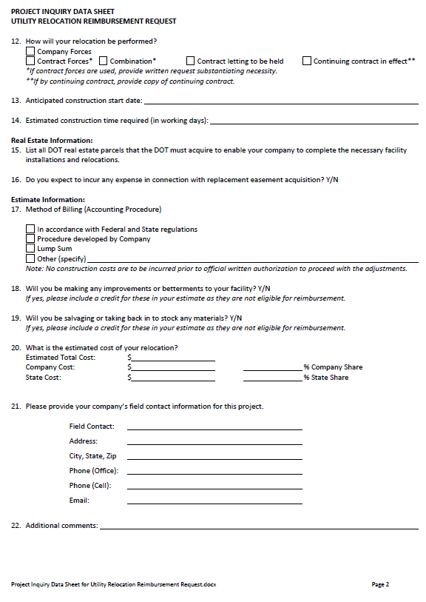
Project inquiry data sheet
Real estate information
Correlate the company easements to the DOT parcels
Estimate information
Accounting methods
Notes:
The 2nd page includes more detail about the relocation plan, estimate, work methods and easements
- including a list of DOT parcels affected so we correlate between the company’s easements and the land we’re acquiring
All of this should also be shown on the relocation plan as well – preferably on the ROW plan sheets (H sheets)

Slide 27
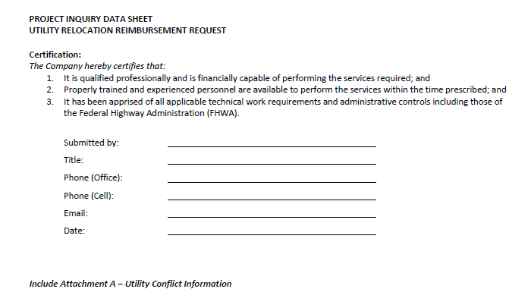
Project inquiry data sheet
Certification of information provided
Financially capable of performing services provided
Personnel available to perform the services within the time prescribed
Aware of requirements
Utility conflict information
Notes:
Page 3 is a certification of the information
It certifies that the company is financially capable of performing services provided
That they have trained and experienced personnel available to perform the services within the time prescribed

Slide 28
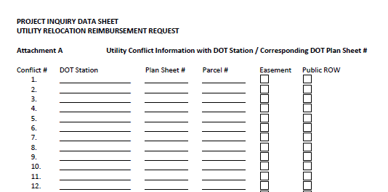
Project inquiry data sheet
Utility conflict information
DOT stationing
Corresponding DOT plan sheet#
Corresponding DOT parcel#
Easement | Public ROW
Form includes up to 100 conflict locations
Attach more pages if necessary
Notes:
The last few pages of the form is the Attachment A
Here we are asking for a list of identified conflicts
DOT station#
Plan sheet#
Parcel#
And whether identified conflict is
On private easement
On public ROW
The form should be filled out and sent along with the easement document and the relocation plan

Slide 29
Easement Documentation
Correct area
Correlate to DOT parcels
Notes:
It might seem obvious, but the easements should be for the area where the relocation is to be done
We ask that you please include the corresponding parcel numbers from DOT plans for cross reference
This helps us to establish the state’s authority to enter into the agreement.

Slide 30
Proposed Relocation Work Plan – EXHIBIT A
Show existing location of facilities
1
Show proposed location of facilities
2
Overlay on DOT plans and cross sections
3
Notes:
As I mentioned before the relocation plan should be shown as an overlay on the DOT plan sheets (preferably the H sheets with DOT parcel information)
This will become the EXHIBT A of the agreement
It’s pertinent to show where your existing facilities are located
The proposed location of your facilities
And any areas where you plan to remove or abandon facilities

Slide 31
Detailed Estimate of Relocation Costs – EXHIBIT B
Segregate direct, indirect & “unallowable” costs
1
Cost Accounting Standards
Work Order System
2
Ability to accumulate costs to a project
3
Notes:
A detailed and itemized estimate of the relocation cost is also needed
We need to determine whether or not your company is able to segregate the costs for the project;
To be able to show costs that are allowed vs costs that are not allowed;
Whether you are using a cost accounting system or a work order system; and
If your company can accumulate costs toward a specific project
This will become the EXHIBIT B of the agreement

Slide 32
Direct Costs
Benefit one project and only one project
Include:
Materials & equipment
Labor & wages
Engineering
Directly related
Notes:
The detail we are looking for in the agreement should show direct costs - that benefit one project and one project only.
It should include a breakdown of
Materials & equipment
Labor & wages
Engineering
And these must be directly related to the project

Slide 33
OVERHEAD & INDirect Costs
Eligible costs - must be actually incurred
Include:
Administration
Accounting fees
Legal fees
Insurance
Notes:
Some overhead and indirect costs may be allowed – these are costs incurred to run a business – in order to include them they must be actual costs that your company incurs such as:
Administration
Accounting fees
Legal fees
Insurance

Slide 34
OVERHEAD & INDirect Costs
Ineligible costs
Include:
Advertising
Interest on borrowings
Fines & penalties
First-class travel
Notes:
Ineligible costs would be things like
Advertising & sales promotion
Interest on borrowings
Contributions & donations
Fines & penalties
First-class travel & entertainment

Slide 35
Betterments & credits
Work done that is NOT attributable to the highway project - NOT reimbursable
Work done at the election of the utility – NOT reimbursable
Increased capacity - NOT reimbursable
Service improvements - NOT reimbursable
Salvage value of materials removed
Recovered from temporary use
Accepted for reuse by the utility
Must be shown as a credit in the estimate
Notes:
Only relocation work necessitated by the requirements of the highway construction are reimbursable
If you cannot attribute the work to the highway project then it would not be reimbursable
The same goes for work done at the election of the utility, such as
Increased capacity
Service improvements
There are also items that should be shown as a credit on the estimate
Salvage value of materials removed
Items recovered from temporary use
And items accepted for reuse by the utility company
All of these are NOT reimbursable and MUST be shown as a credit in the estimate
In some instances a non-equivalent replacement might be necessary for the relocation. This may appear on the surface as a betterment, but other issues may support the need for the alternate choice.
Things such as economy (non-stocked items may be uneconomical to purchase)
Compliance with governmental laws & ordinances
Compliance with regulatory commission or codes
And replacements that are of equivalent standard although not identical
At times items like this are required by current company design practices on their own jobs and for which there is a direct benefit to the highway project
Sometimes these may even be required by the highway project.
These kinds of items should be noted in the estimate for clarification

Slide 36
Putting it all together
Item | Amount |  | Eligible Costs
Design/engineering | $75,000.00 |  | $57,692.31
Materials | $250,000.00 |  | $192,307.69
Labor | $500,000.00 |  | $384,615.38
Subtotal | $825,000.00 |  | $634,615.38
Indirect (allowable) | $165,000.00 |  | $126,923.08
Indirect (unallowable) | $82,500.00 |  | $0.00
Betterment (credit) | $15,000.00 |  | -$15,000.00
Salvage (credit) | $5,000.00 |  | -$5,000.00
Total | $1,092,500.00 |  | $741,538.46
Length on Public ROW | 1,500 | ft | 23% | non-reimbursable
Length on Private Easement | 5,000 | ft | 77% | reimbursable
Total relocation length | 6,500 | ft | 100%
 | Contract Amount |  | $741,538.46
Notes:
This slide shows an estimate summary which should be included along with the supporting cost detail.
It shows a line item for the major components of the estimate.
A breakdown of each of these would be in the supporting details

Slide 37
Scope of Work
Clear description of the work required
Size(s) of facility
Length of relocation
On public ROW (at company expense)
On private easement (eligible for reimbursement)
Tabulation of conflict points
Crossings, Poles, Vaults, Ducts
Work to be done by Force Account or Competitively Bid?
Notes:
We will need a clear description of the work to be accomplished
Including the size or sizes of the facilities
The location and length of the relocation
How much is within the public ROW (this would be at company expense)
How much is on private easement (this is the portion that would be eligible for reimbursement)
A tabulation of the conflict points (that’s the attachment A to the data sheet)
We also need to know who will be performing the physical relocation work?
Will it be done by company forces
Or, will you be soliciting bids for the work?

Slide 38
Agreement Document
Pre-Audit - $50K 
Draft review
Send for signature
Internal Staff Action
Fully executed agreement
Notes:
We review all the information provided for compliance with the project and state and federal regulations.
When the estimated work is $50,000 and over we will need to have a pre-audit conducted
This is done by our internal Auditors in our Finance Bureau
After the pre-audit is complete and we’ve fully reviewed the document internally we send it out to the company for review & signature
Following the company’s execution we complete the internal DOT approvals (this is our Staff Action process)
It is the approval for the department to enter into agreement with the external party
Then the DOT may then sign agreement
And the fully executed agreement is returned to the company

Slide 39
Change orders - 125% of estimate
Prior approval needed
Request in writing to Central Office
Updated itemized cost estimate
Explanation of increased costs
Only reimburse additional cost if approved by DOT in writing
Notes:
We all know that in reality things don’t always turn out the way they appear paper
Significant changes to the scope of work must be requested in writing for approval from the DOT
An addendum to the agreement may be needed
If the costs will exceed 125% of the estimate ~ unless the increase is $10K or under
You should provide us with an updated cost estimate
Along with an explanation of increased costs
We can only reimburse for the additional costs if they were approved by DOT in writing

Slide 40
Invoices & payments
Expenses must be incurred prior to the date of the invoice
Progress payments allowed
Indicate Progress or Final on the Invoice
Notes:
As far as invoicing and payments –
Expenses must be incurred prior to the date of the invoice
Progress payments are allowed as the work is being done
Invoices need to show the % complete
Whether it’s a progress billing or a final invoice
Other things to note on the invoice are
The agreement number and the DOT project number
Any company project or activity numbers
The beginning and ending date of work for the period being billed
And support for the costs incurred - itemized statement – copies of receipts, time cards – that sort of thing
The total claimed to date should also be included.
We will retain 10% of the invoiced amount until the project is complete
When making payments we can only pay up to 90% of agreement amount
Any costs that exceed that will be included in the final audit which will determine if the additional costs were justified.

Slide 41
Final payment
Certificate of Completion
Final Audit
Disclaimer of Interest in Realty
Retainage
Notes:
Regarding the final payment - a few things are needed prior to the release of the retainage
One being the Certificate of Completion
That needs to be filled out including the completion date and submitted to DUC
The DUC will review and sign it if the relocation is complete and acceptable
We also perform a Final Audit of the entire cost of the relocation
We submit all invoices & supporting documents for review by our internal Auditors
This can take some time to go through
They will make a determination on whether charges are in line with estimates and the work performed
We may request repayment of some of the funds if our auditors determine that the company has been overpaid
We will release the retainage if all is in compliance
The release of easement rights also needs to be completed – this is the Disclaimer of Interest in Realty (or sometimes an Instrument of Subordination)
This releases the company’s interest in all real estate acquired for the project where the utility was originally located
The company will retain any easement rights outside of the ROW
After all of this is complete we can then release (or pay) the retainage (if any)

Slide 42
Success!
Agreement process is complete
Maintain files & records for a period of 3 years from the date of final payment.
Notes:
And - with all of that - the agreement process is then complete!
By regulation the utility company is required to keep their files and records for a period of 3 years from the date of final payment.
This is in case we need to revisit for audit purposes.

Slide 43
BUY AMERICA
https://iowadot.gov/rightofway/Utility-Accommodation-and-Coordination#50439618-buy-america
Buy America Guide
Bill of Materials
Flowcharts
Notes:
One other aspect of utility relocation that we often get asked about is Buy America.
You can find information on our website on accommodation, coordination, permitting and Buy America - under the Buy America tab
There you’ll find
A Buy America Guide
The Bill of Materials forms
And helpful flowcharts
That can help you determine whether or not Buy America applies to your relocation

Slide 44
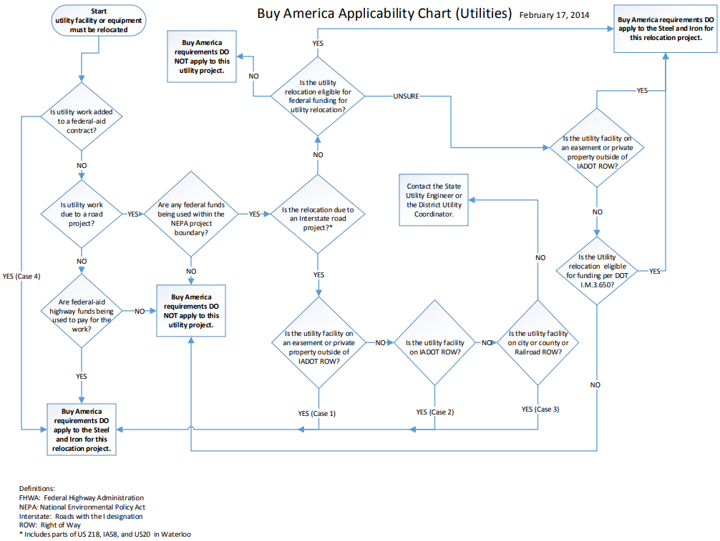
Notes:
The Flowchart walks you through a series of questions to help you figure it out
Again, this flowchart can be found on our webpage – under the Buy America tab
Boiled down…Buy America applies to
Any project that has federal participation (money) in ANY portion of the project; and
Interstate projects; and
Relocations from private easement
QA - Products that are 90% by weight Steel or Iron must meet requirements, as well as precast concrete products
Remind – please REPLY to submittals – helps us keep on track with our projects – and to make better decisions during development

Slide 45
Questions?
Thank you!
Notes:
We’ve covered a lot about utility coordination for our highway projects and agreements.
Next we’ll be highlighting some permitting information.
Please remember that you can post questions in the Q&A.
Do we have any questions that we need to go over before we move on?
Ok, we’ll go ahead and cue up the next presentation

