Slide 1
UTILITY PERMITS
IOWA DEPARTMENT OF TRANSPORTATION
UTILITY ACCOMMODATION PERMIT
Notes:
Utility permitting is a big portion of what we do in the utility program.
As I mentioned earlier today utility permitting is done under the provisions of Iowa Administrative Code – 761 Chapter 115
Policy for Accommodating and Adjustment of Utilities on the Primary Road System

Slide 2
WHEN ARE PERMITS REQUIRED?
Any time you plan to locate facilities within the highway right of way
New installations
Upgrades
overhead changed to underground
Notes:
A permit is required any time you plan to locate facilities in the public right of way
This includes new installations
And upgrades to an existing facility
Such as changing overhead to underground

Slide 3
MAINTENANCE
Covered under original permit
Requires 48 hour notification
Exact same size, location, and install methods
Notes:
Maintenance of an existing facility is covered under the original permit
And requires a 48-hour notification to the DOT before beginning any work
Unless it’s an emergency
Maintenance includes any work on the facility that is for the exact same size, location and install methods
This would include pole replacement as long as the facility is NOT being upgraded
The new pole must be placed within 1 foot of the original location

Slide 4
When more than one permit is needed
Non-continuous installations
Multiple highways
Multiple utility types
Notes:
Sometimes more than one permit is required for an installation
Each non-continuous installation requires a separate permit
Installs that begin on one highway and continue onto another highway
If the permit involves more than one utility type such as fiber optic and telephone
Even if they’re installed in the same location at the same time
Installs that cross city limits or county lines can be done on one permit – you just need to attach copies of each county or city’s approval
The same goes for crossing DOT districts or EOT areas.
There may be some exceptions to this and your EOT will let you know.

Slide 5
When to submit
More lead time may be needed
30-days review period
Notes:
Allow for AT LEAST 30 days prior to the expected installation time
This is because it may take DOT some time to review the request
We have 30 days to review and return the permit – provided that
All of the pertinent and required information is included in the submittal
That everything is in the correct and accurate format
That all of the required attachments are included
And, that all of the prior approvals have been received and are included with the submittal
There may also be some federal highway administration approvals that are needed
These are allowed to exceed the 30-day timeframe
Large and complicated installs may need more lead time – since their may be more involved in the review

Slide 6
Where’s my permit?
Sent to the wrong DOT office
Incorrect format
Inaccurate or missing information
Notes:
Sometimes it may seem as if there is a delay in getting permits issued.
Multiple factors can plan in to why permits take longer than 30 days.
Sending the request to the wrong DOT office
Sending the request in the wrong format
Inaccurate or missing information – such as traffic control plans
So, where do you submit the permits?
EOT assigned to the territory – maps for the various areas are available on our ftp site and you’ll most likely be seeing some of those later in today’s meeting.

Slide 7
Who is the Applicant?
Utility Company
Company permanently responsible for the facilities once installed
Authorized Representative
Permission to sign requests – is NOT the applicant
Notes:
Some things to remember when completing the request for a permit.
The APPLICANT named should be – the company permanently responsible for the facilities that are being installed
Installers or the utility company’s contractor are NOT the applicant
The applicant’s signature MUST be someone that is an authorized representative of the utility company
Private contractors are NOT to be signing as the Utility Company’s representative
Unless, they are under a contract specifically giving them authorization to officially represent the company
This might be the case if the utility company has contracted with a consultant to for their engineering and permit applications
However, the utility company should still be listed as the applicant – the consultant’s contract only gives them the authorization to sign the requests on behalf of the company
The applicant contact information is also very important – and should be filled out completely
It should list someone who can answer questions that may arise from the permit

Slide 8
Describe the installation
Method of installation
Materials to be used & encasement details
Section, Township & Range
Sec/Twp/Rge -Stationing & Mileposts
Show this on your site plan
Notes:
You need to properly describe the installation and the method for installing
boring, digging, open trench – and what materials will be used
Also the materials to be used and specifics on the encasement
The work site location should also be very specific
Including the Section, Township and Range
Which highway is involved
Stationing
Mileposts
And a reference to which side of the highway you’re wanting to be on
This information should also be reflected on the site plan

Slide 9
Stationing
1 Station = 100 feet (meters)
Stamped in pavement or posted
Right side of highway
Outside edges or at ROW line
Notes:
Stationing is a unit of measure for highway construction and other road work
It is a true horizontal distance regardless of the terrain
1 Station = 100 true horizontal feet
Some road segments were done in Metric – in those instances 1 Metric Station = 100 true horizontal meters (328.08 feet)
You’ll find the station numbers either stamped in the pavement or posted along the ROW
For 2 lane roads
They’ll be on the right side of the highway
Running in the same direction as stationing
For 4 lane roads
They’ll be on the outside edges in both directions

Slide 10
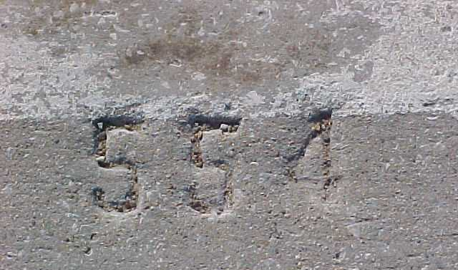
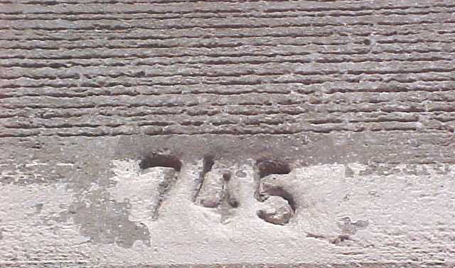
PCC Stationing
Notes:
For PCC Concrete – the stationing will be stamped in pavement at the edge of the road
You’ll find it about 1 foot in from the outside edge every - 100 feet (or 20 meters)

Slide 11
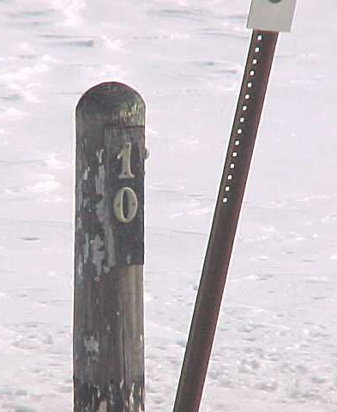
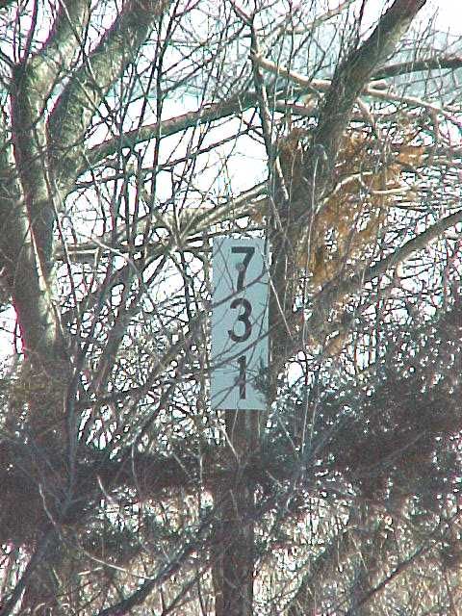
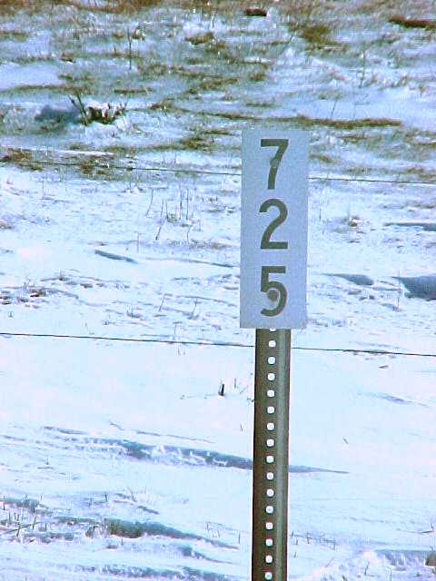
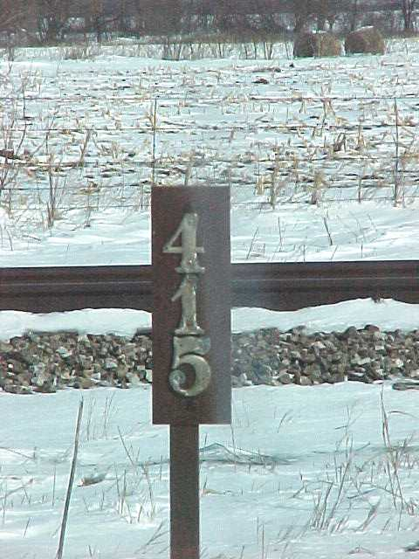
ACC Stationing (500 ft. marker)
Notes:
For ACC (Asphalt) – the stationing is normally post-mounted
You’ll find it along the ROW fence line or in the foreslope - 500 feet (or 100 meters

Slide 12
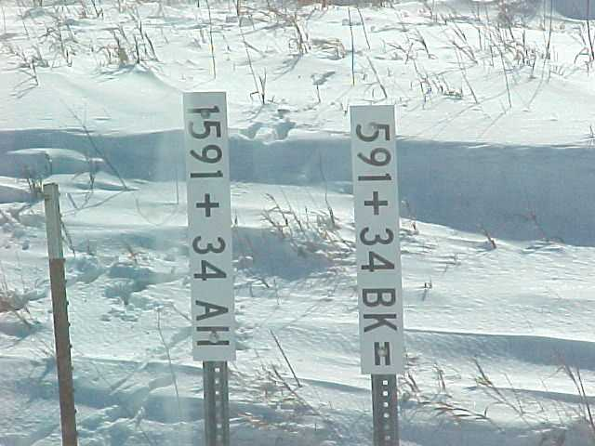
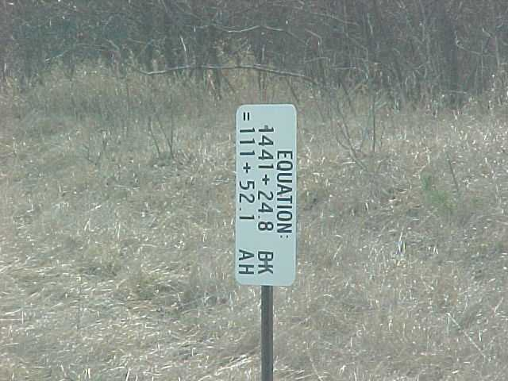
Equations
Notes:
Station numbers can change
Typically this is because there is an equation – that would a location where one series of station ends and a new series begins
They are signified by Back Station point = Ahead Station point
If you’re wondering why there are equations – well a few reasons might be
When you’re at the end of one project and the start of another
When the county or corporate limits changes – there are often splits at the corporation lines
When there is a reconstruction project in the middle of a continuous stationing progression
Or, when the road segment was shortened or lengthened due to a highway realignment
Sometimes there are even alignment changes on 4-lane roadways where on lane is longer than the other
These would all be shown as stationing equation

Slide 13
What if I can find stationing?
Layout the installation as clearly as you can
Note the lack of stationing/milepost
Leave those areas blank (for now)
NEVER put N/A on a permit
Notes:
Sometimes it may be difficult to find the stationing.
If that happens layout your proposed installation as clearly as you can
Mark the beginning and the end with a distinguishing mark or flag of some kind
And then note the lack of stationing or milepost in your submittal
Leave those areas of the permit blank (for now) -
And NEVER put N/A on a permit - Stationing and milepost are ALWAYS needed

Slide 14
Field reviews
ALWAYS field evaluate the location for anomalies
Measure from a known and identified point to the beginning and ending location(s)
Notes:
It’s ALWAYS a good idea to field evaluate the area for anomalies
Some things aren’t always apparent on aerial photos or a set of plans
We don’t recommend designing your installation from behind a desk
You should make your measurements from a known and identified point to the beginning and ending location(s)
You might find a milepost marker and you can use that.

Slide 15
Highway mileposts – general guideline
North / South Highways – S to N
East / West Highways = W to E
There are exceptions…
Notes:
In general on
North / South Highways – mileposts typically run from south to north (those are generally the odd numbered highways)
And on East / West Highways – mileposts typically run from west to east (those are generally the even numbered highways)
There are exceptions sometimes…
Occasionally there are milepost equations
They follow the same basic reasoning as the Station equations – but they’re less frequent

Slide 16
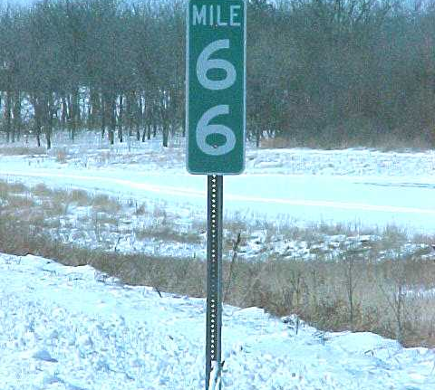
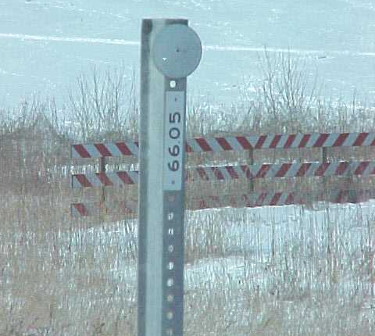
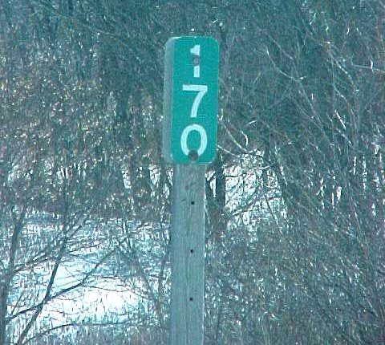
mileposts
Notes:
On 2-Lane Roads you’ll find the markers
On the Right side of the highway
Running in the same direction as mileposts (ascending)
On 4-Lane Roads
They’ll be at the outside edges in both directions
There should be delineators every 264 feet
Sometimes there are sub-milepost markers on those delineators (like what you see in the center photo here – that would be milepost 60.05)
Q/A - Why do we need both stations & mileposts
Mileposts follow the hills and dales of the surrounding terrain
While stations are in horizontal distance as measured by survey equipment
Distance stays constant regardless of terrain
Therefore 1 mile (5,280 feet) does not always equal 52+80 in Station distance
Equations may have redundant stationing in a very short distance, so location by milepost is important in aiding specific location of an installation
Mileposts to the second decimal (i.e. 62.51) are only accurate to 26 feet at best
Installations should be measured within 5 feet, ideally to the nearest foot

Slide 17
Permit approvals
Cities – joint jurisdiction
Counties
Corps of Engineers – major waterways
Protected areas – DNR
Notes:
Approvals on permits often involve multiple parties
In addition to the applicant –
For installations where any portion is within the corporation limits you’ll need the city’s approval
The DOT and cities have joint jurisdiction on primary highway extensions within a city
Whenever the installation originates from, exits into or crosses a county road or county-owned property you’ll need county approval
Both of these approvals need to be acquired BEFORE you submit your request to the DOT
Other approvals might be needed for things like
Impacts to major waterways or “protected” areas
You may need approval from the Army Corps of Engineers or the DNR
These can be in the form of a signed letter that you submit with the request

Slide 18
Other things to note
Special requirements – added by DOT
Restrictions or additional stipulations not outlined in the standard permit
Don’t forget page 2 – the permit won’t be valid without it!
Notes:
There are items that will be added or completed by the DOT rep
Special requirements, restrictions or additional stipulations that might not be outlined in a standard permit
These might include special construction methods
Special traffic control
Work restrictions (for certain hours or days)
Also, DON’T forget page 2 – the permit will NOT be valid without it.
It includes general construction an maintenance requirements
Liability
These provisions apply to ALL installations unless specifically modified by the DOT in the “Special Requirements”

Slide 19
https://iowadot.gov/rightofway/Utility-Accommodation-and-Coordination
Notes:
That about covers it for permitting for today
You can find our policy guidebook on our webpage – on the accommodation tab
And our permit request form - on the permit process tab

Slide 20
Thank you!
Up next – smart arrow boards
Notes:
Up next…I believe we have Willy Sorenson here today to talk about smart arrow boards
Please remember to post your questions in the Q&A.
Following Willy we’ll hear from Nikki Cuva about utility relocation estimates
And from Seana Godbold about trees in the ROW
And then we’ll be taking a quick break – when we come back we’ll hear about some GIS efforts and about upcoming projects across the state.

