Slide 1
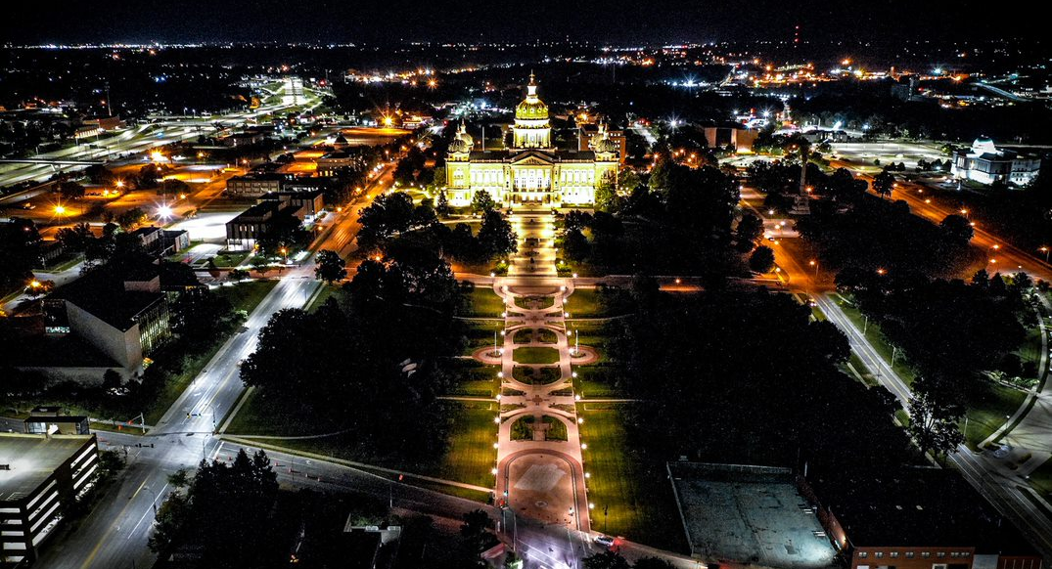
District 1 Projects
District 1 Projects

Slide 2
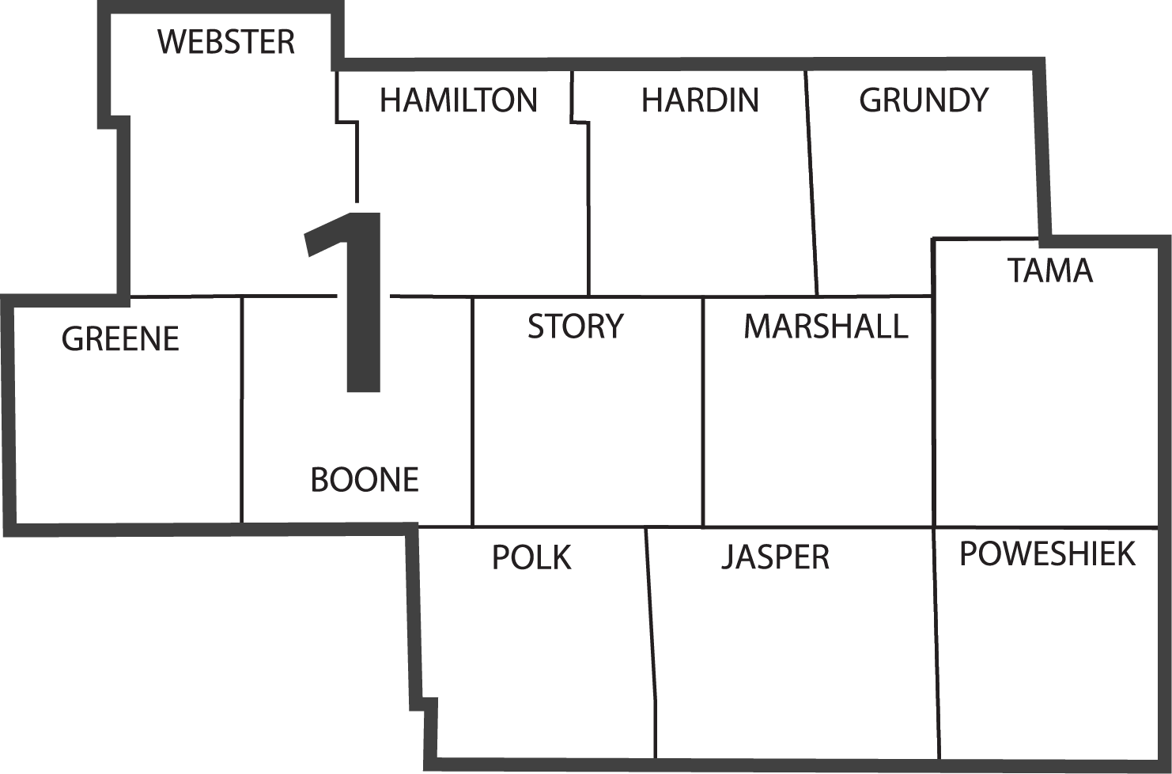
DISTRICT 1
Tony Gustafson, P.E.
District 1 Engineer
Marshalltown
Ames
Jefferson
Iowa DOT District Office
Des Moines
Resident Construction Office
Maintenance Garage
District Operations Manager Office

Slide 3
TONY GUSTAFSON, P.E.
DISTRICT 1 ENGINEER
ALLISON SMYTH, P.E.
ASSISTANT DISTRICT 1 ENGINEER
SCOTT NIXON, P.E.
DISTRICT 1 CONSTRUCTION ENGINEER
VACANT, P.E.
RCE– GRIMES
JENNY HOSKINS, P.E.
RCE– JEFFERSON
DUSTIN SKOGERBOE, P.E
RCE– MARSHALLTOWN
District 1 Staff

Slide 4
District 1 Staff

Slide 5
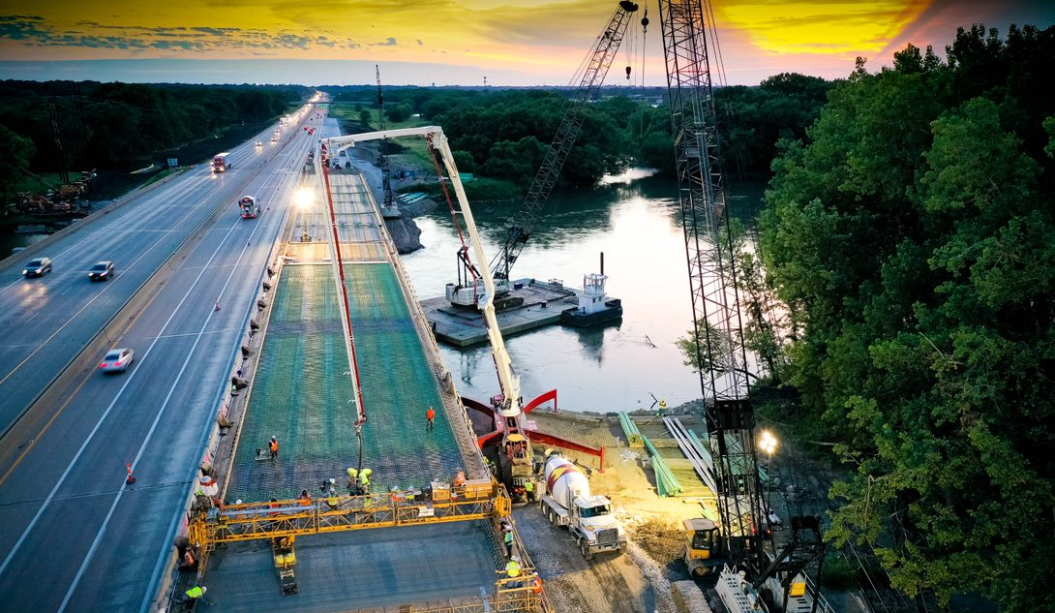
Ongoing Projects

Slide 6
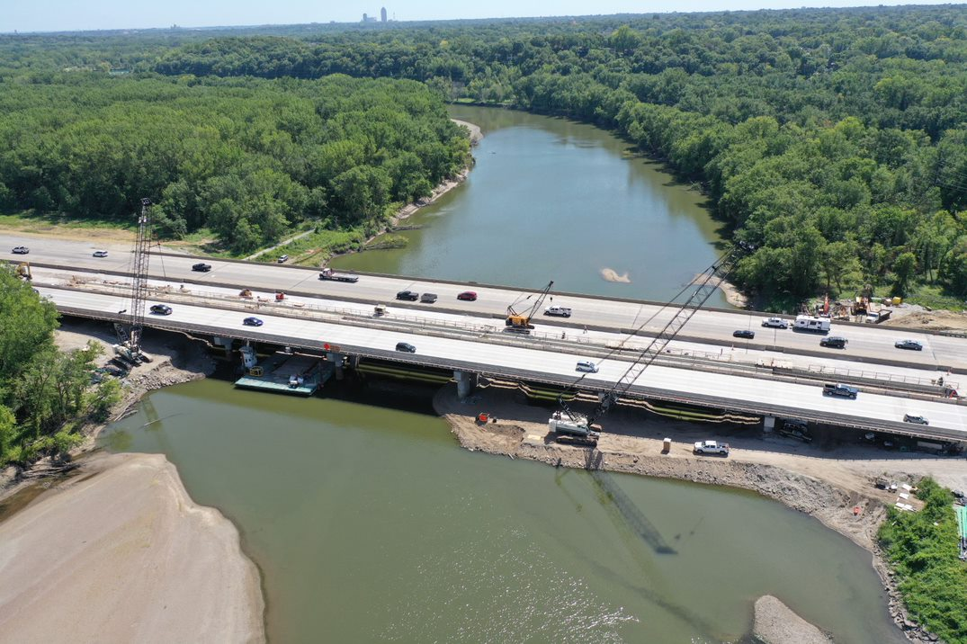
I-35/80 BRIDGE OVER DES MOINES RIVER ($23.8M)
Notes:
2019 $17.7M programmed $23.8M awarded

Slide 7
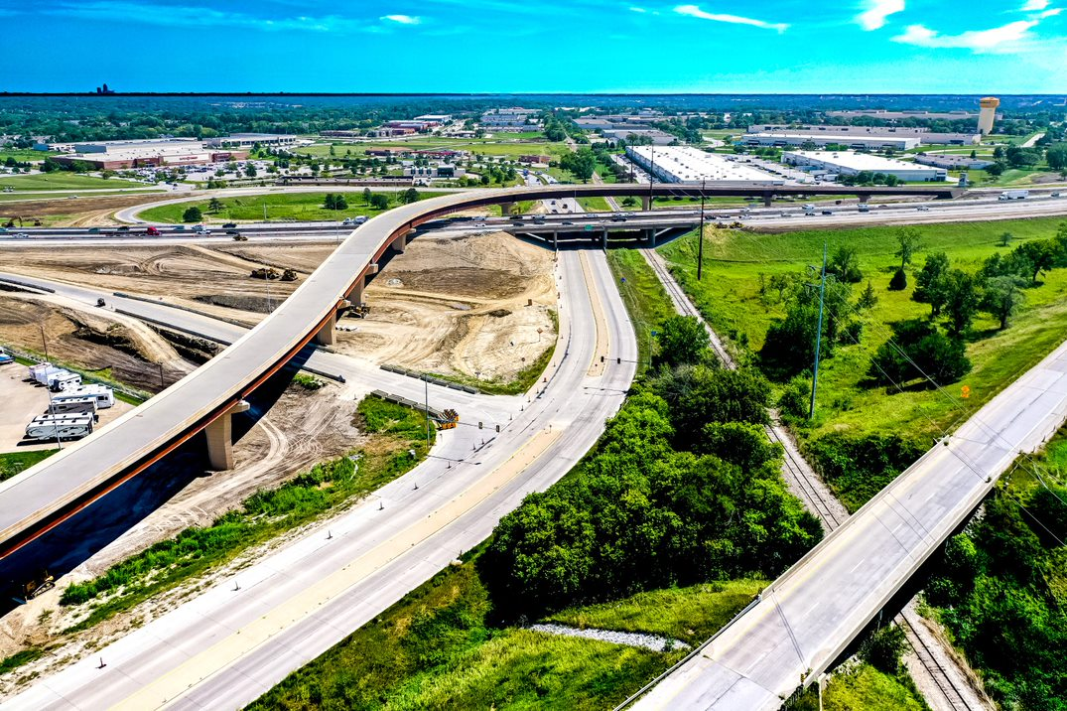
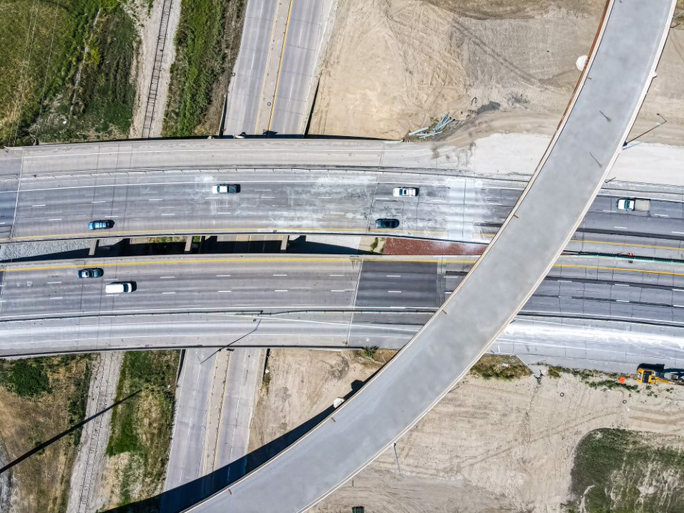
I-35/80 INTERCHANGE AT IOWA 141
Notes:
$47.4M Programmed $65M awarded bid
2018 $0.8M ROW
2019 $25.2M Grade, Bridge
2020 $20.8M Grade/Pave, signals/lights
2021 $0.6 Erosion control, signs
2018 $7.7M Paving for 100th Street Interchange – State Share (Yellow)

Slide 8
I-35 / 1ST ST. INTERCHANGE

Slide 9
U.S. 69 – CAPACITY & RECONSTRUCTION
2021-2022 $33 M
Notes:
$21M Programmed $33M awarded
2020 $1.7M ROW
2021-2022 $19.8 M Grade, Pave
2023 $0.2 Erosion Control

Slide 10
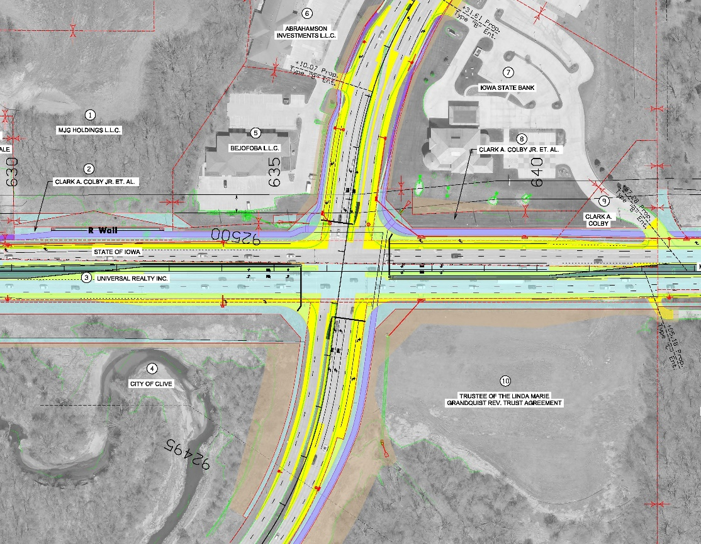
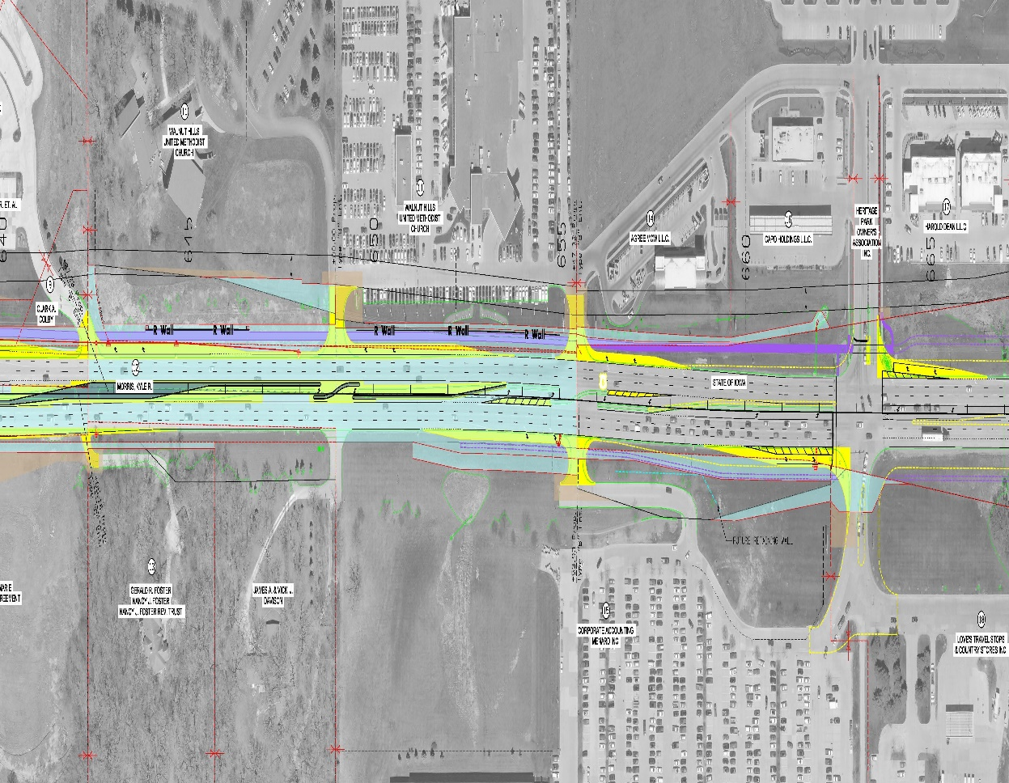
U.S. 6 intersection with 128th St
($5.9M estimated cost) 2021 construction
Notes:
Dual left-turn lanes on all four approaches - Upgraded traffic signals - Raised medians
ICAAP $1.14M
$700,000 STBG
TSIP ($500,000)
DOT $500,000

Slide 11
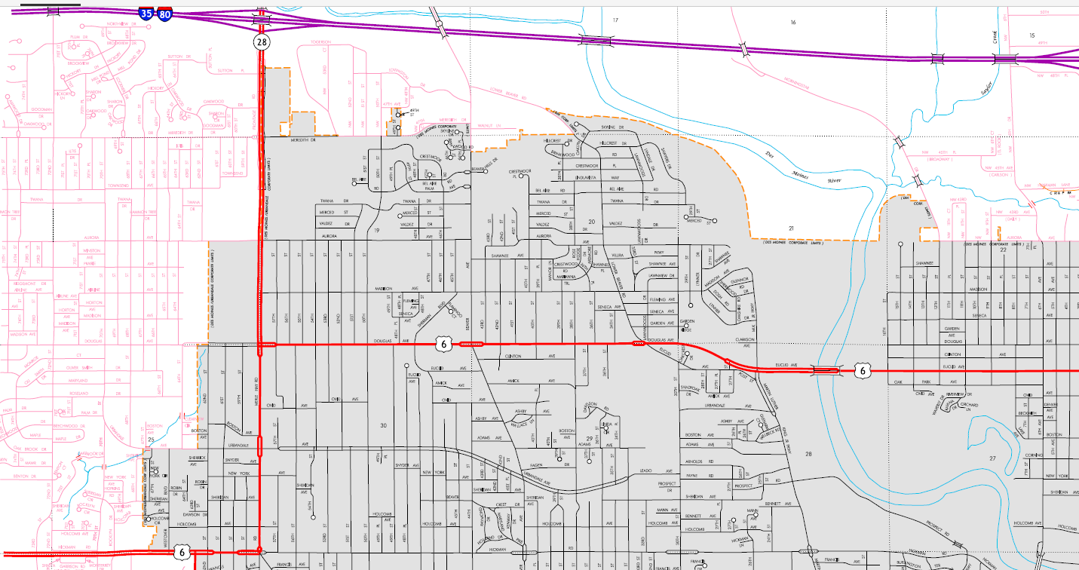
Iowa 28 and US 6 ($2.5M total) Pavement Rehab, ADA & Road Diet on Douglas (DSM initiative)
Notes:
Douglas 2021 $1.8 M resurfacing + restriping to 3-lane (City will provide stripe detail)
Merle Hay 2021 $.7M

Slide 12
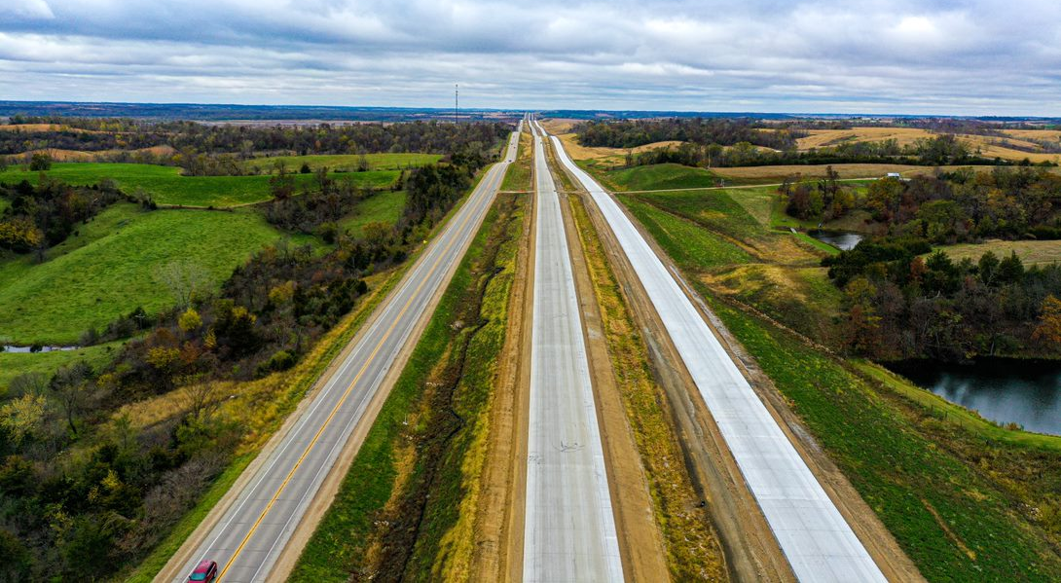
US 30 Tama County
$65.5M Grading, culverts, bridges, Paving
2022 $9.5M Grading, culvert extensions
2024 $.3M Erosion Control
Notes:
$65.5M awarded
2018 $35M Grading, culverts, bridges
2020-2021 $29.2M Paving
2022 $9.5M Grading, culvert extensions
2023 $.3M Erosion Control

Slide 13
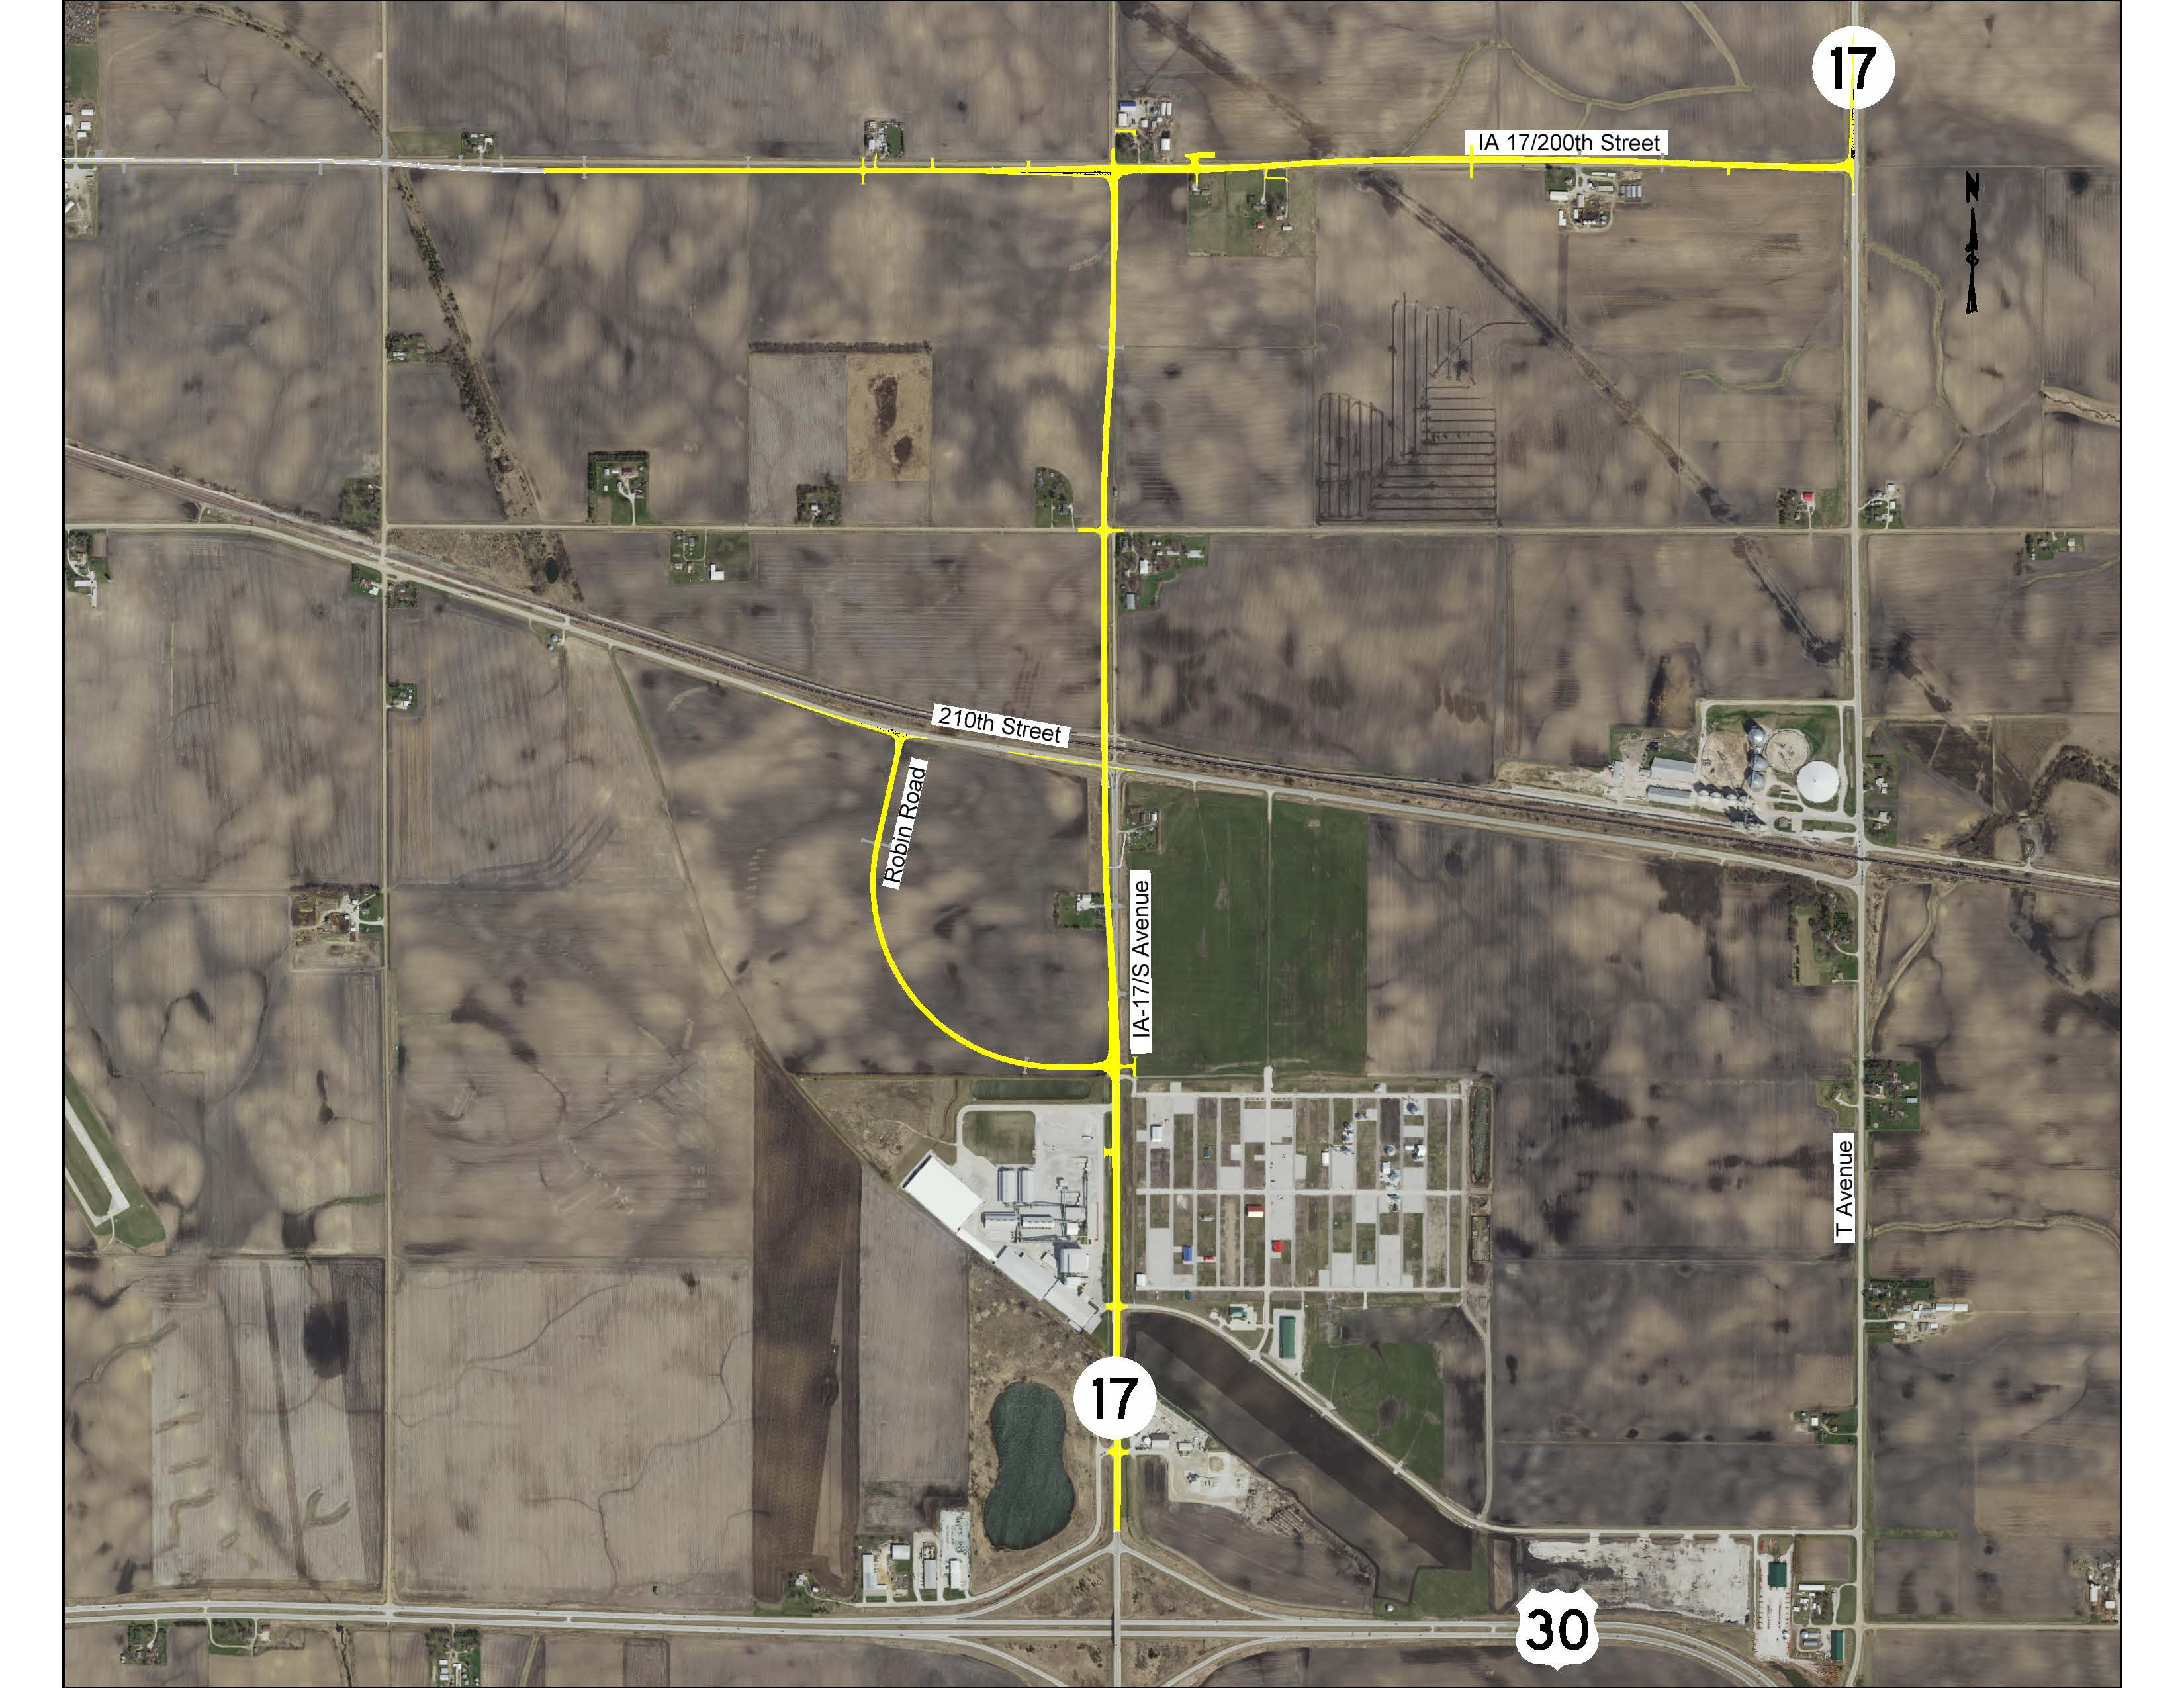
Iowa 17/ Union Pacific RR Grade Separation 2021 $7.8M bridge, grading, ROW 2022 $6M paving 2023 $.2M EC
Notes:
Programmed (state share)
2021 $7.8M bridge, grading.ROW
2022 $6M paving

Slide 14
FUTURE PROJECTS

Slide 15
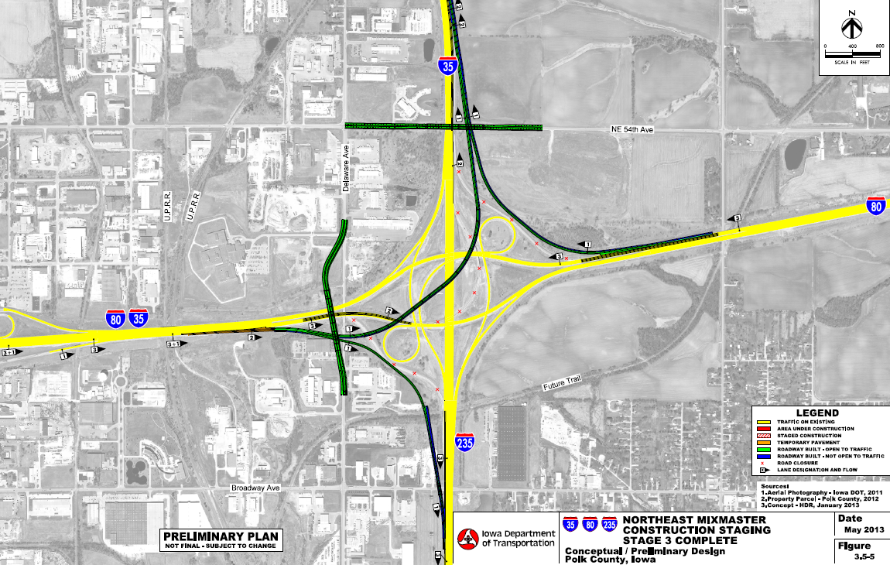
I-35/80/235
SYSTEMS INTERCHANGE
($77M total 2017-2025)
Notes:
Phase 1 of the I-35/80/235 Systems Interchange Long Range Plan.
2022 $2.5M ROW, signs
2023 $41.5M – Grading and E to N Flyover Bridge
2024 $17.2M – Paving, lighting, signs
2025 $500K erosion control

Slide 16
I-80 Capacity Improvement
NEMM to US 65 ($30.1M 2024-2025)
Notes:
2024 $19.7M Bridge, Grading
2025 $10.4 M Paving, Signs

Slide 17
I-35 – Six laning
36th St. to Ames
Not Programmed
Programmed
2023 $30.6M ROW - bridge – grading - signs
2024 $36M paving
2025 $62.7M grade/pave
Notes:
west shift the preferred alternative. Full funding is secured for south of Iowa 210.
2023 $30.6M Bridge, grading, ROW
2024 $36M Paving
2025 $62.3M Grade and pave

Slide 18
I-35/80 – U.S. 6 INTERCHANGE (IJR Approved)
($60M estimated cost $28M 2025 programmed)
Notes:
2025 $28 M Bridge, grade, pave, ROW , signs
2026 anticipate final funding

Slide 19
Iowa 28 over the Raccoon River
($6.9M 2022)
SB Bridge Replacement
Notes:
2022 $6.9 M Includes bike/ped acc.

Slide 20
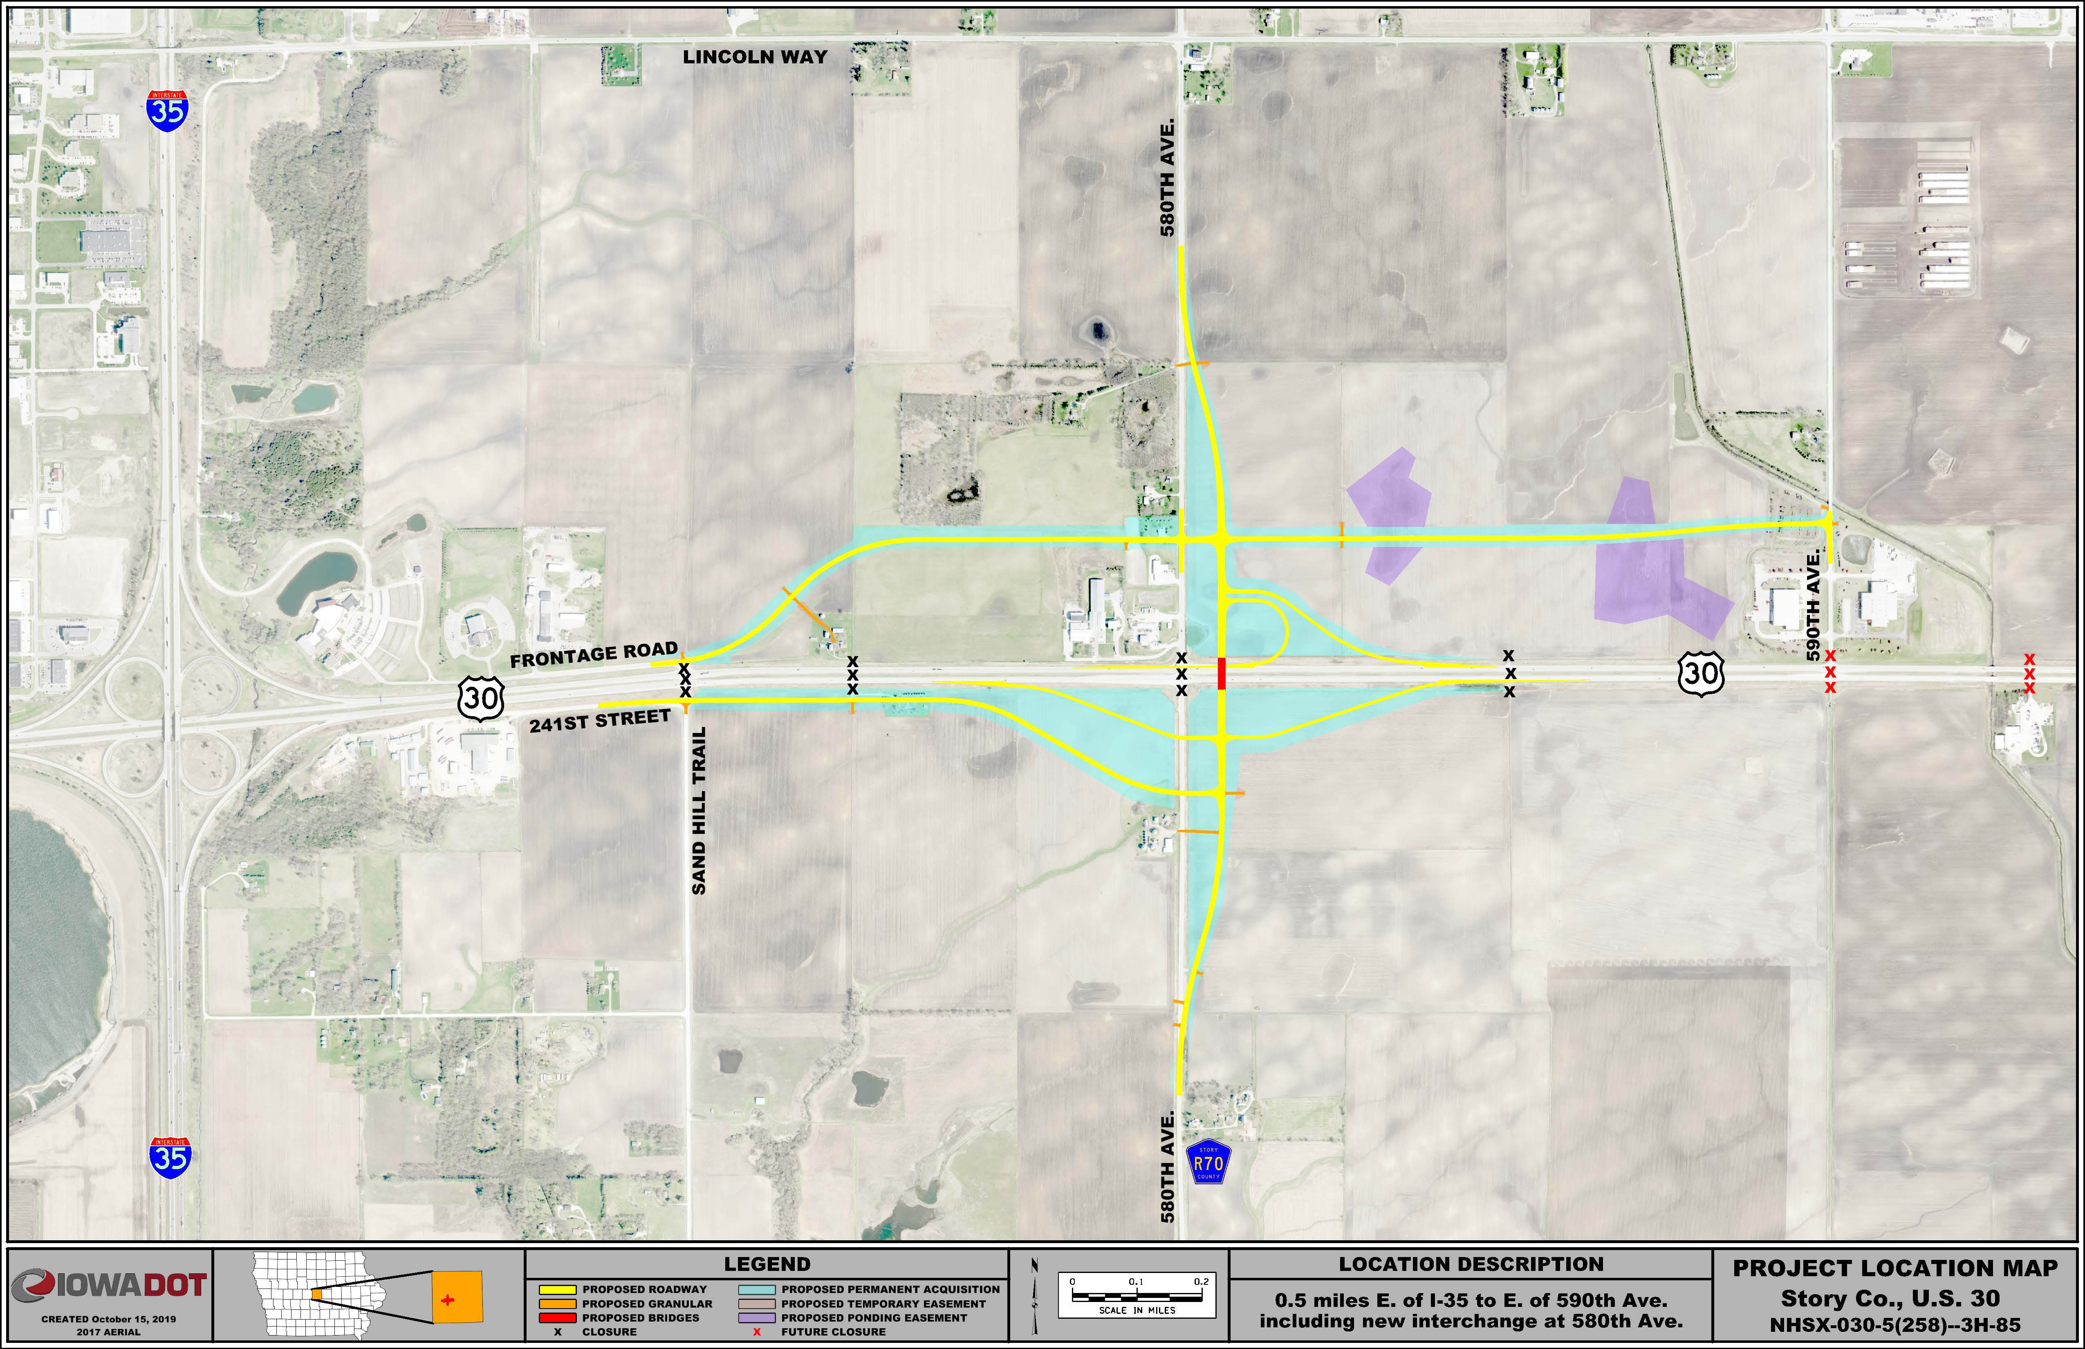
U.S. 30/County Road R-70 Interchange
2023 $14.5M bridge, grading, ROW
2024 $10.3M paving
2025 $.4M erosion control
Future closures
Notes:
Programmed
2023 $14.5M bridge, grading, ROW
2024 $10.3M paving
2025 $.4M erosion control

Slide 21
U.S. 30/Airport Rd. Interchange
UNFUNDED
U.S. 30/S-14 Grade Separation
2023 $5.7M bridge, grading, paving

Slide 22
US 30/ Iowa 21 Interchange
2022 $18.4M bridge, culvert, grad/pave, lighting, traffic signs
Notes:
2022 $18.4M bridge, culvert, grad/pave, lighting, traffic signs

Slide 23
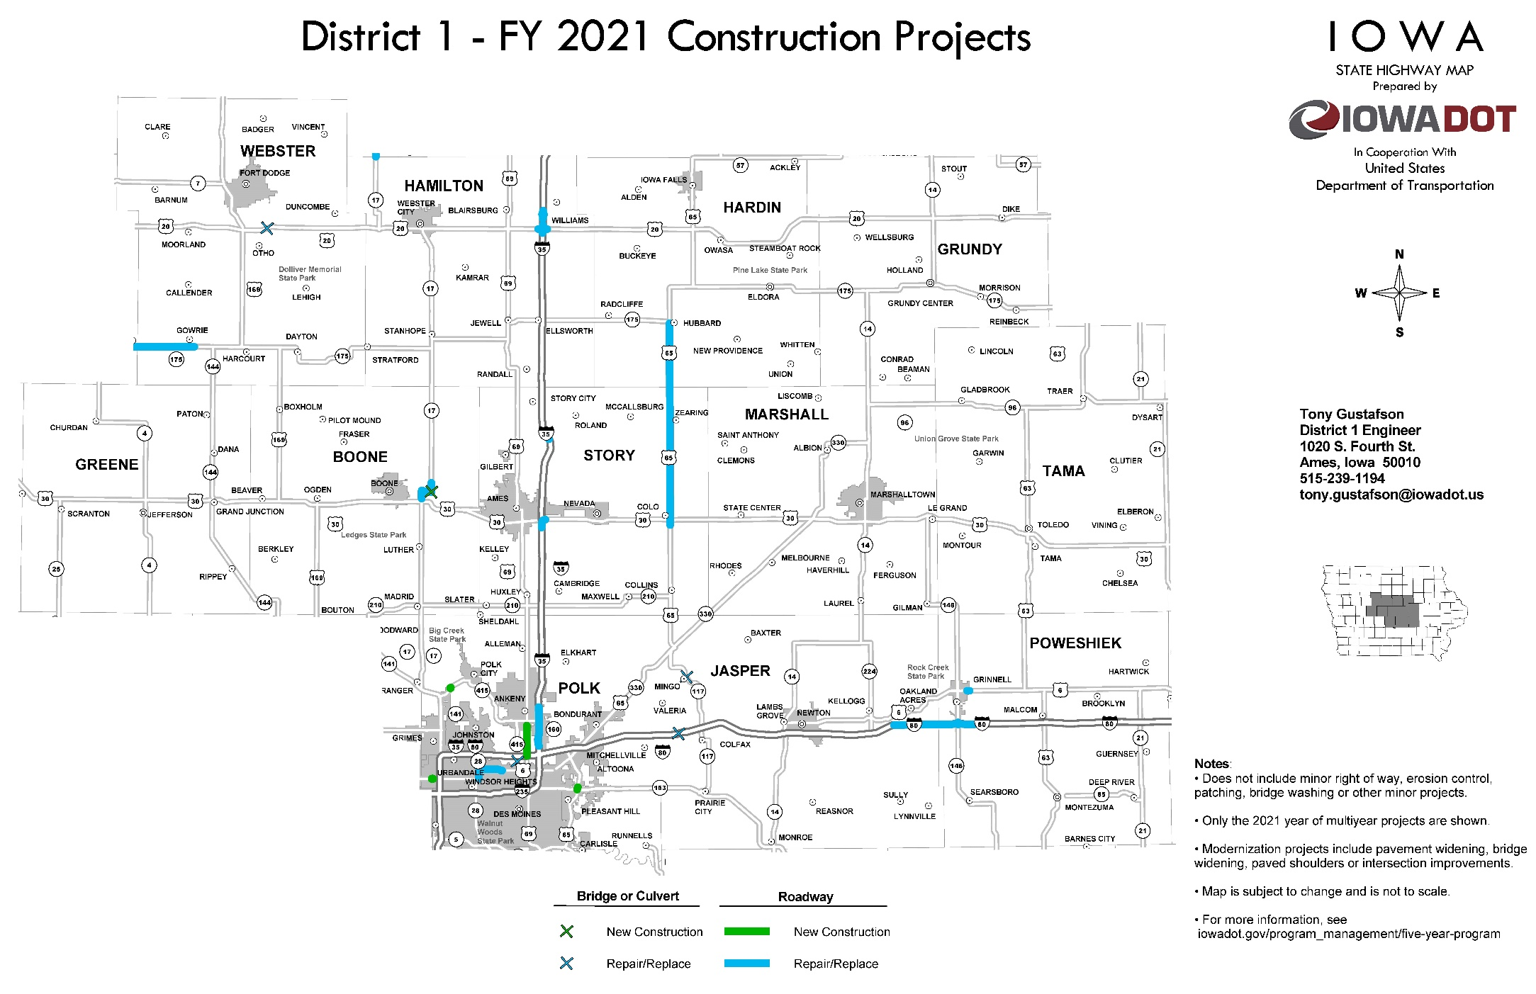
QUESTIONS?

