Slide 1
District 2
Upcoming Projects

Slide 2
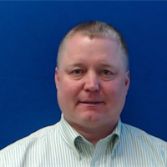
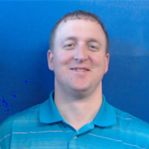
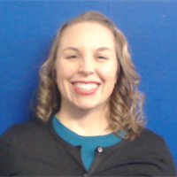
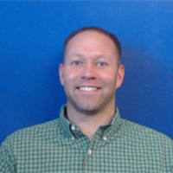
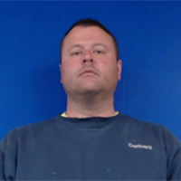
Jon Ranney
Nick Humpal
Tracy Meise
district engineer
assistant district engineer
district utility coordinator
Mike Frank
Mike Frank
Jess Ellingson
westside permitting
eastside permitting

Slide 3
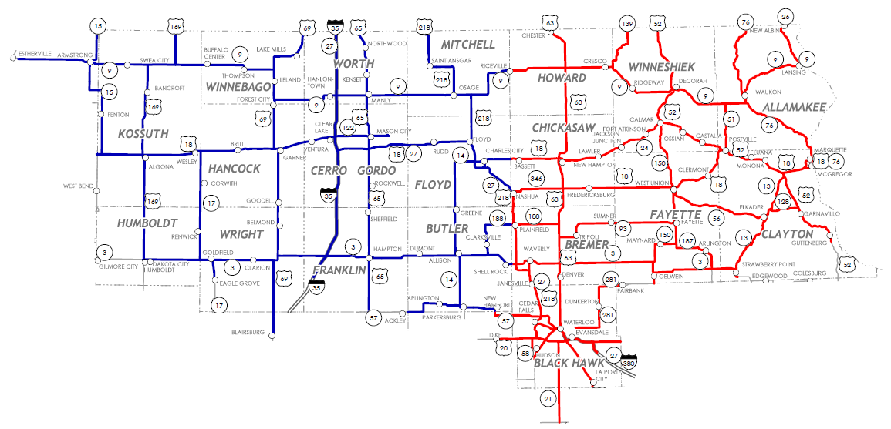
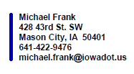

Slide 4
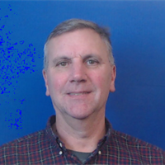
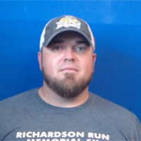
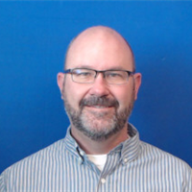
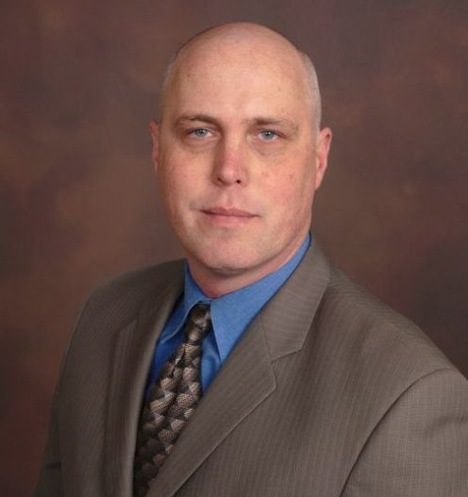
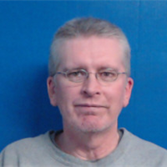
New Hampton Construction
Ron Loecher
Tyler Kubik
resident construction engineer
construction supervisor
Roy Gelhaus
district construction engineer
Mason City Construction
Ken Howe
Mike Frank
Jason Ruter
resident construction engineer
construction supervisor

Slide 5
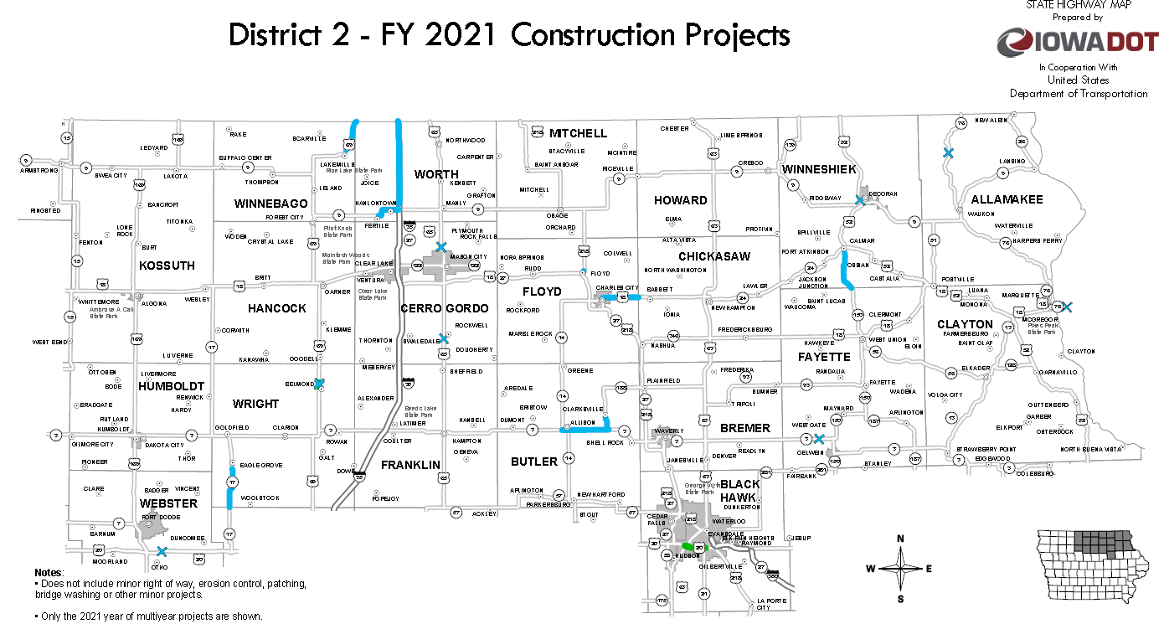

Slide 6
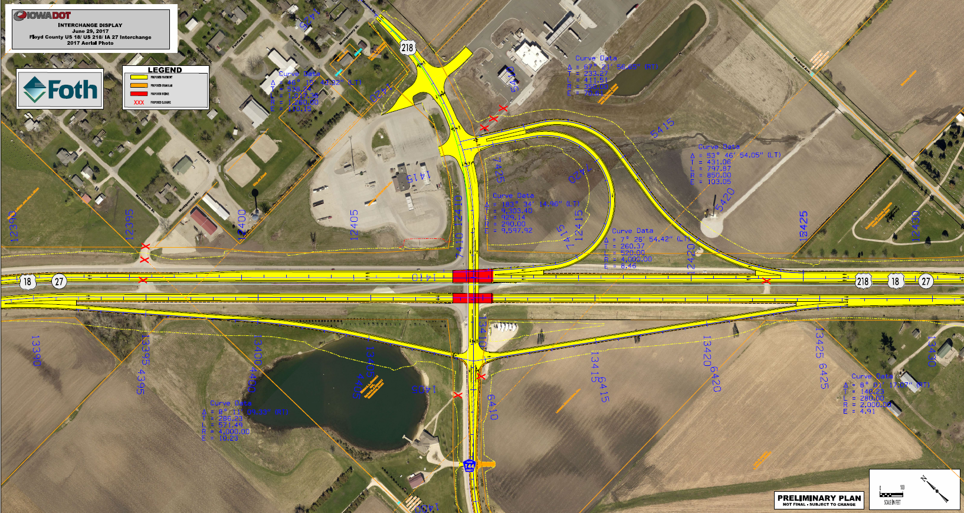

Slide 8
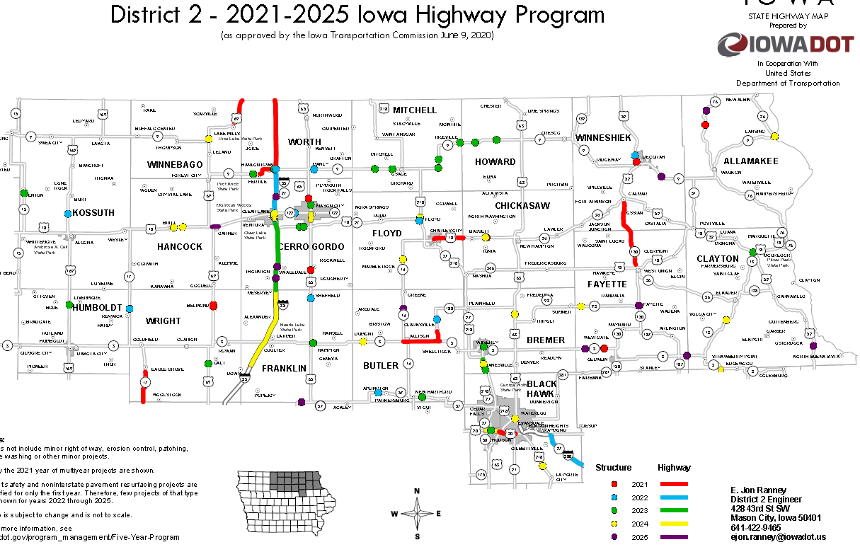

Slide 10
THANK YOU FOR YOUR TIME AND ATTENTION
Nick Humpal, P.E
assistant district engineer
District 2
641-423-7584 or
Nickolas.Humpal@iowadot.us

