Slide 1
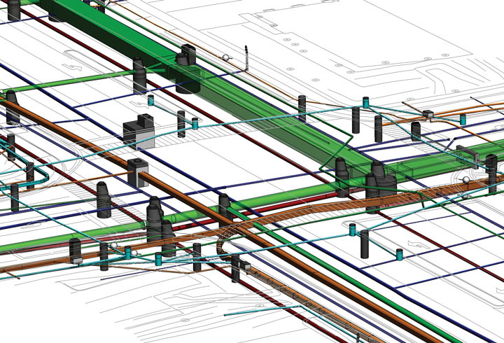

District 3
2021 Utility Meeting
Notes:
Thanks for inviting us to Discuss IA 10 and Jay Ave and the option of a roundabout

Slide 2

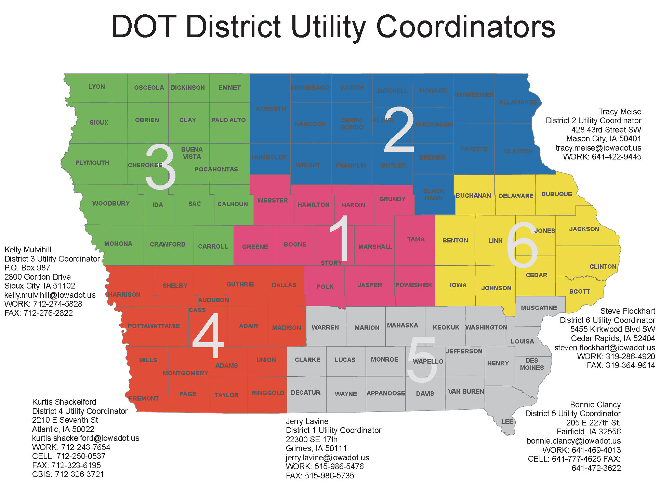
Notes:
New School was catalyst for intersection improvements as IA 10 and Jay Ave.
DOT became involved in the options for the intersection when contacted by the city and consultant.
Started a review of the information and options

Slide 3

Shane Tymkowicz
District 3 - Asst Dist. Engineer
shane.tymkowicz@iowadot.us
(712) 274-5834
Kelly Mulvihill
District 3 Utility Coordinator
kelly.mulvihill@iowadot.us
(712) 539-1268 Cell
(712) 274-5828 Office
Notes:
Introduce Myself and Jason Klemme

Slide 4
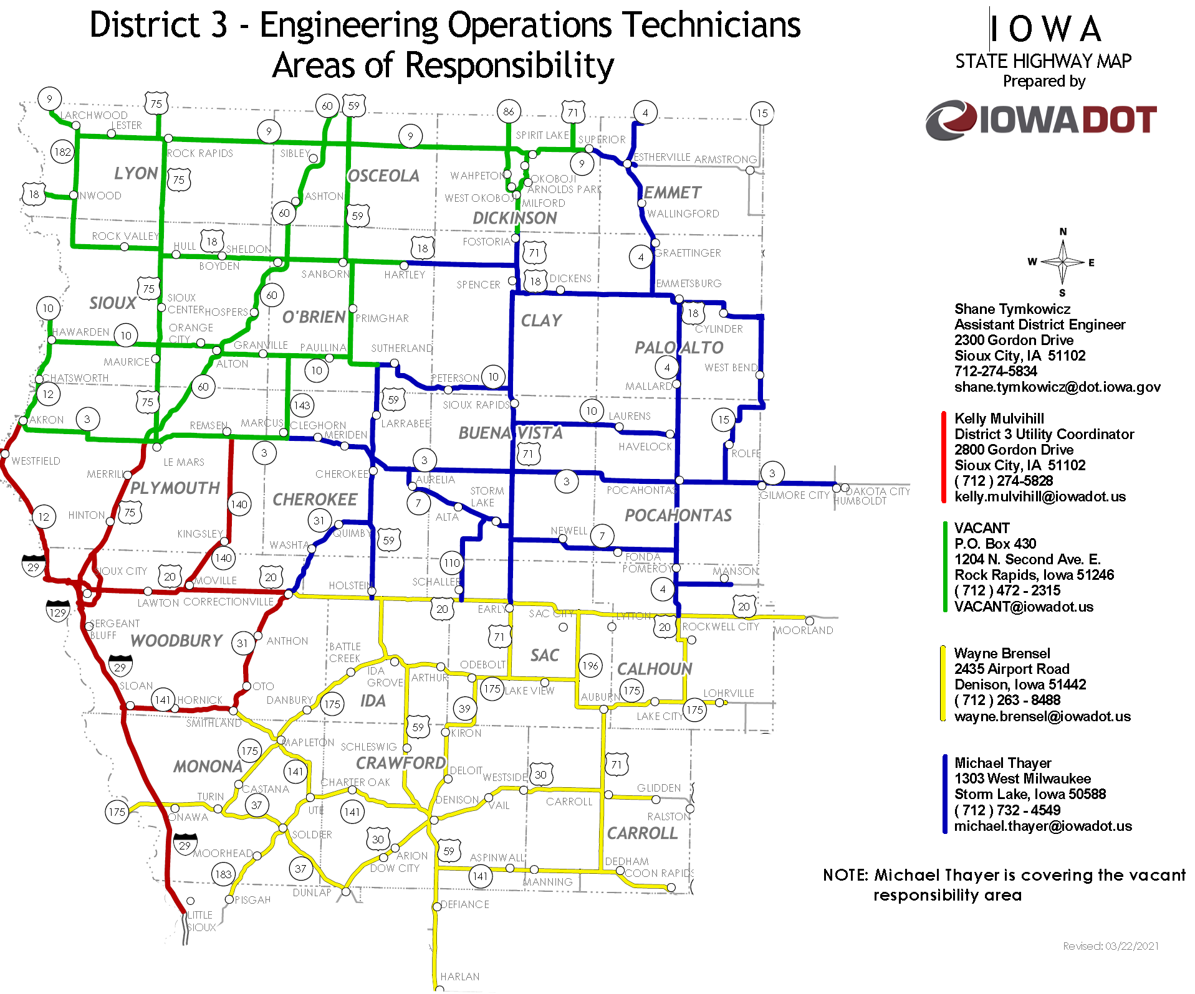
CHANGES COMING

Slide 5
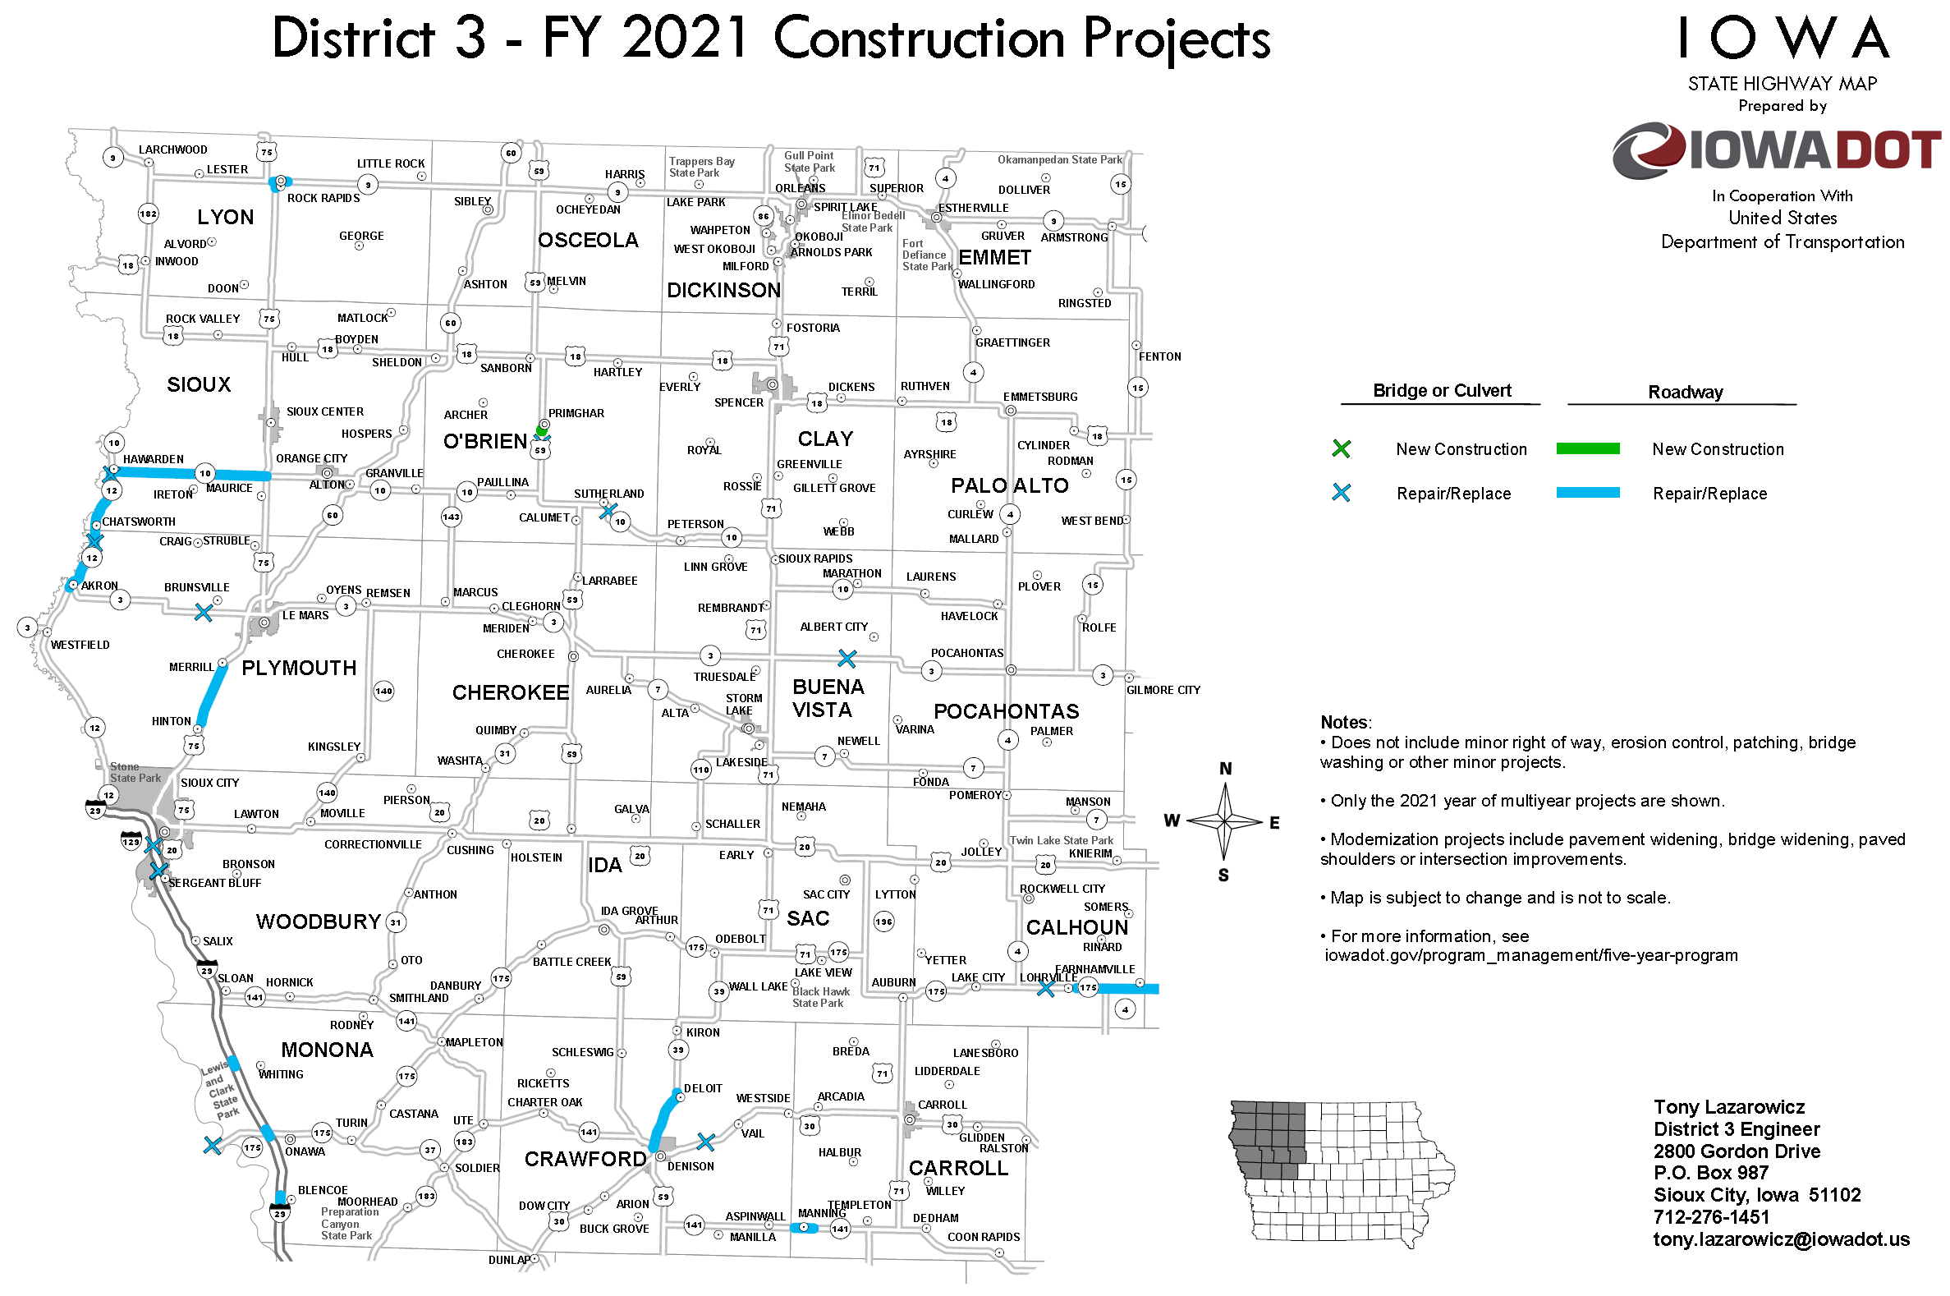

Slide 6
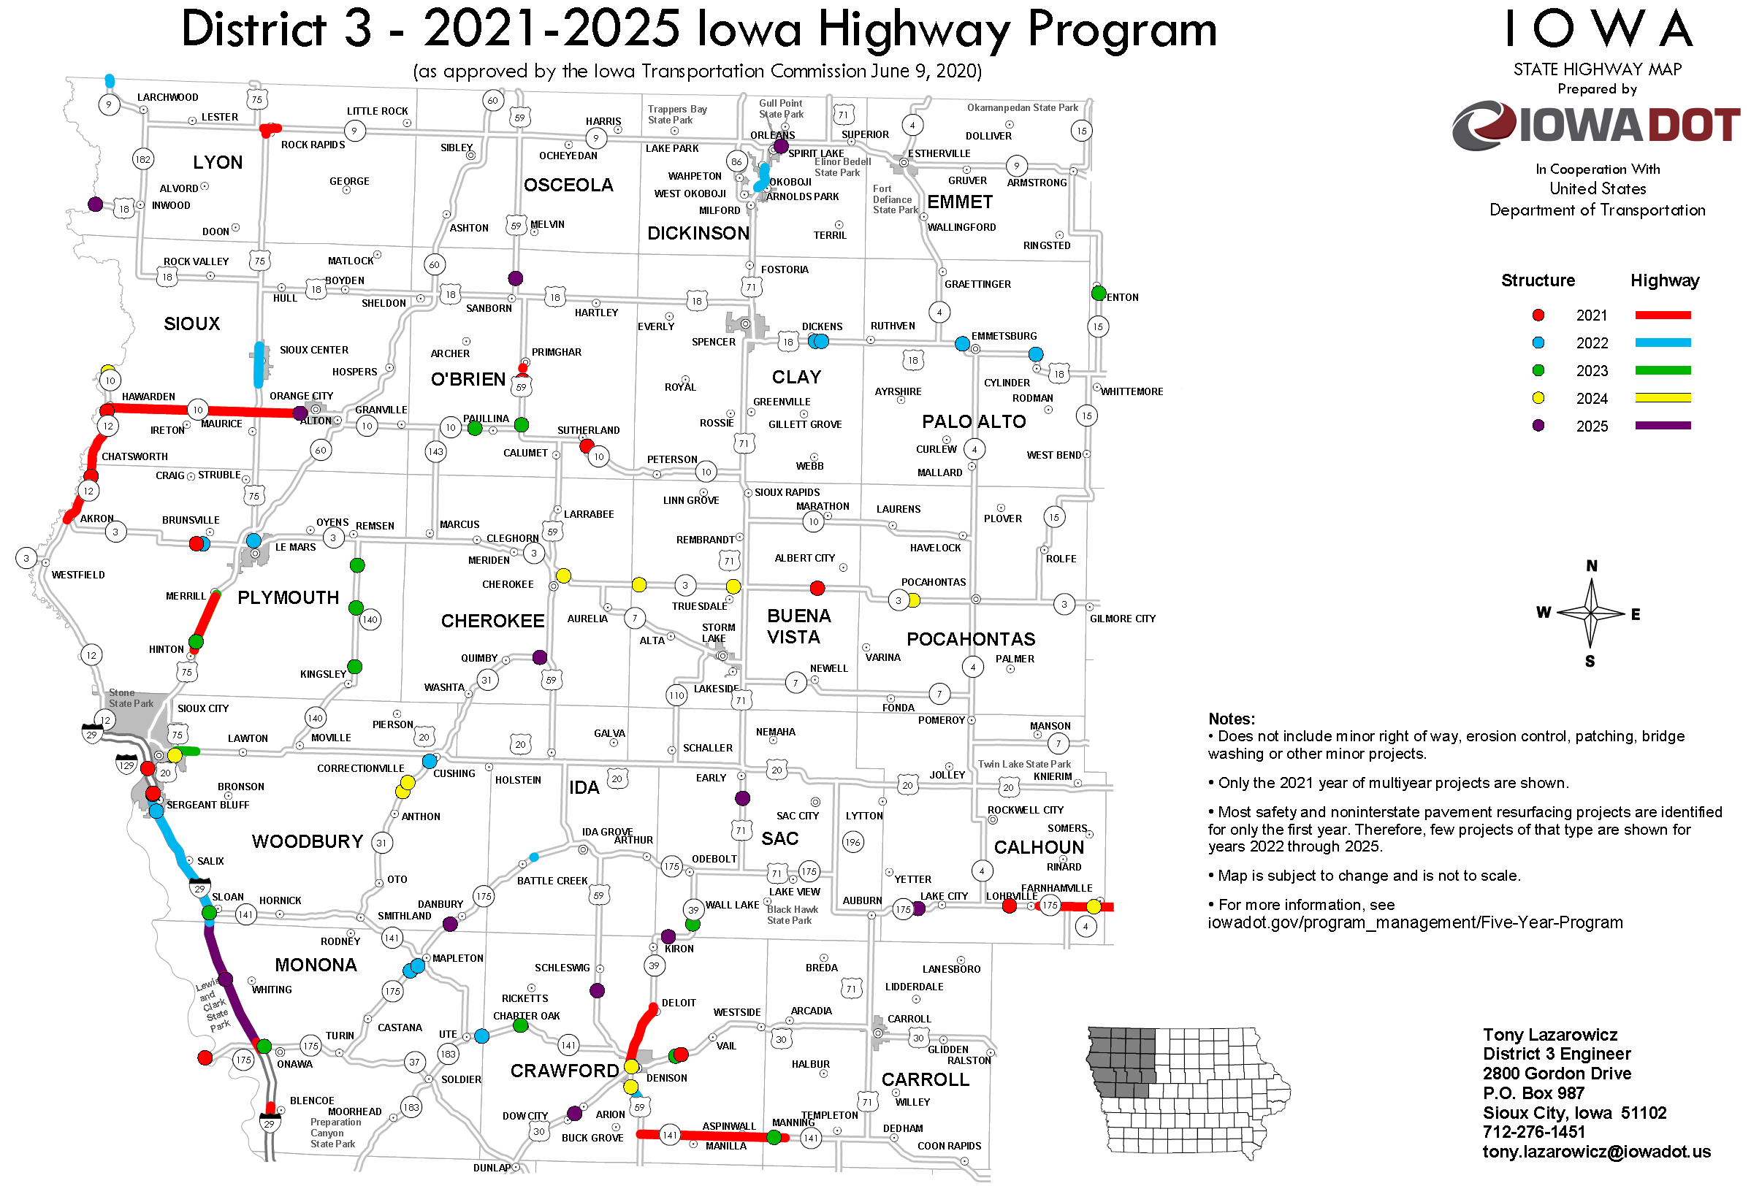


Slide 7
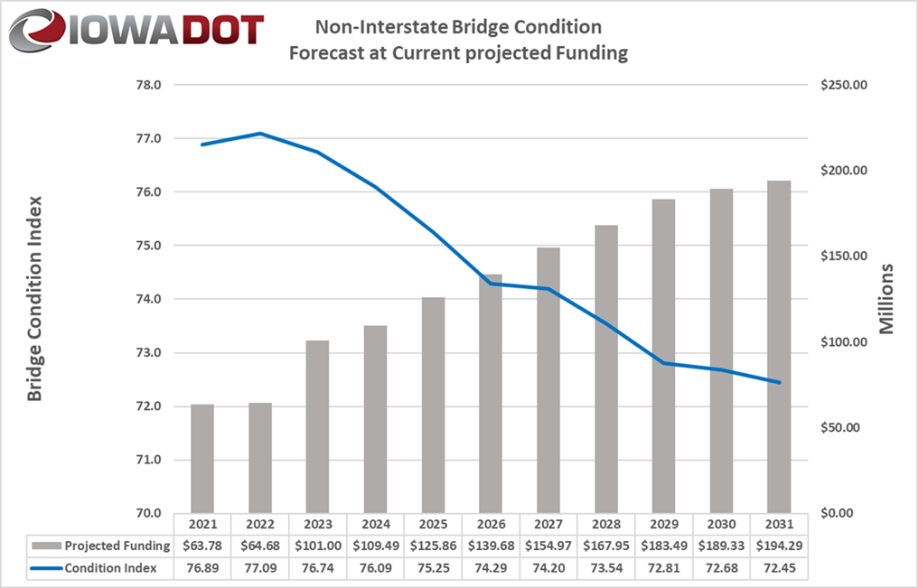
Expect More Bridge Projects
Bridge Funding
$64 Million in 2021
$140 Million in 2026
$200+ Million? in 2031

Slide 9
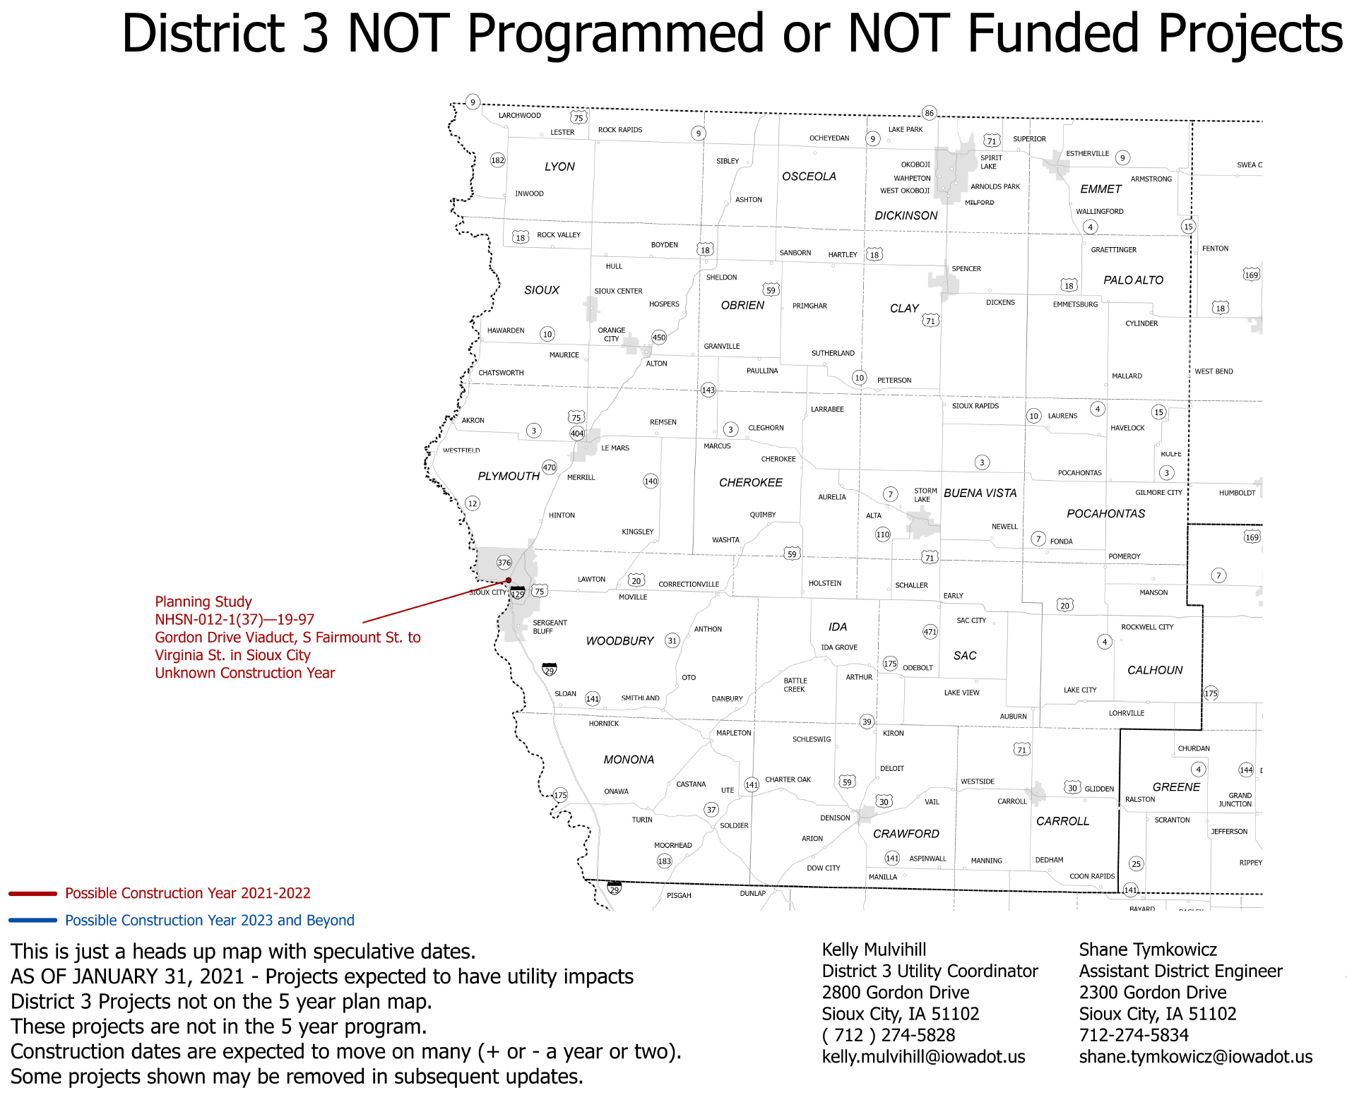
2027+ Before Construction

Slide 10
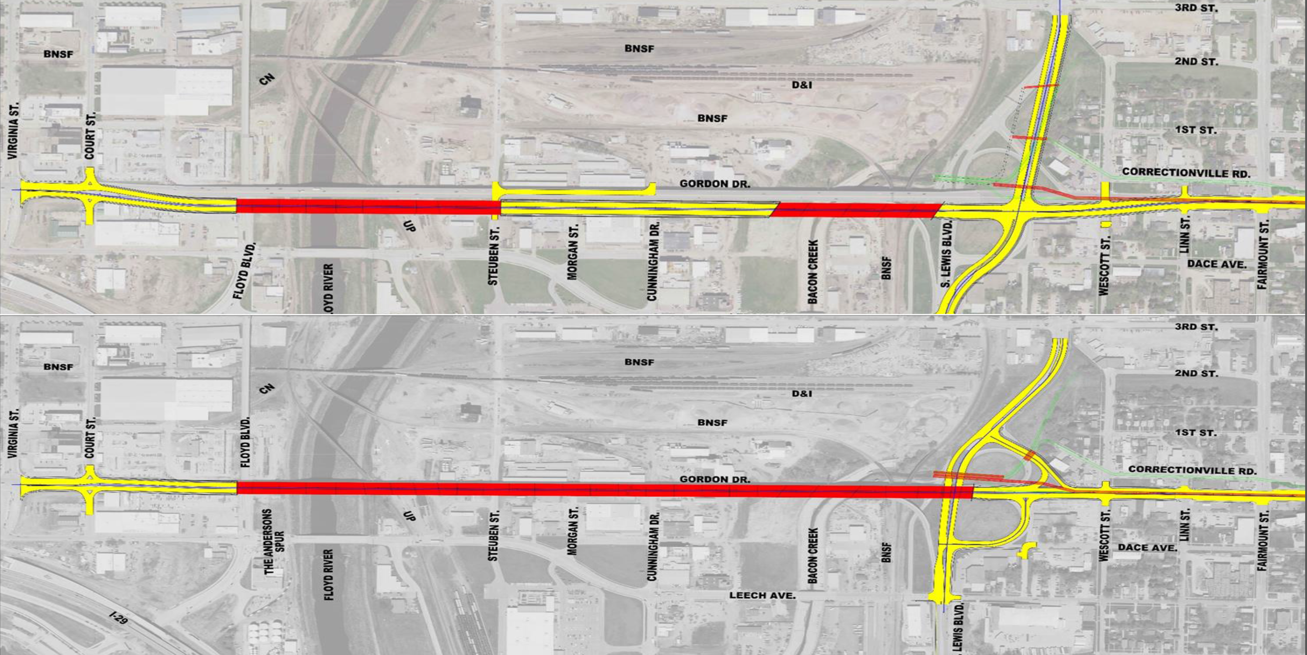
IA 12 Viaduct Replacement
Study
On Alignment
South of Existing

Slide 11
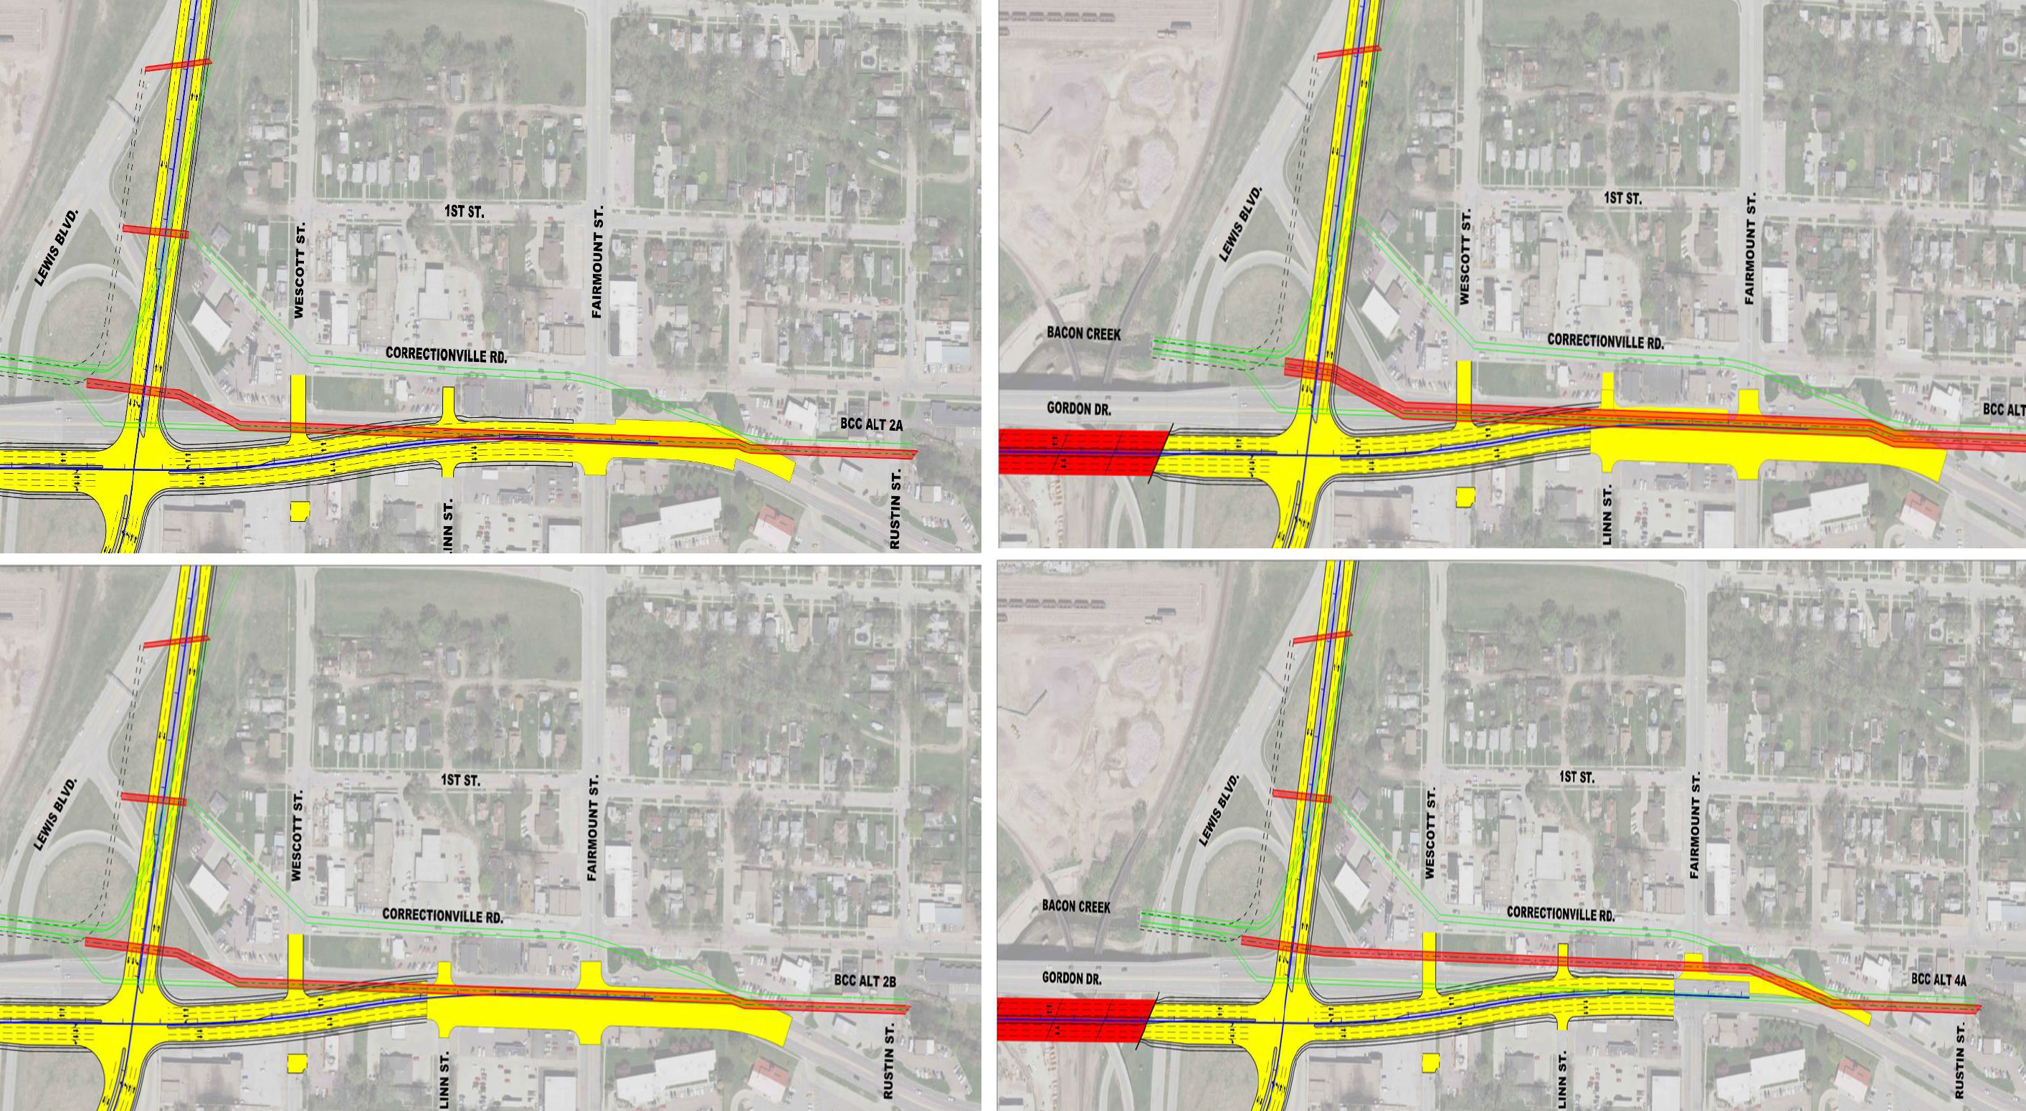
Bacon Creek Conduit
Replace Conduit & Rebuild IA 12

Slide 12

THANK YOU

