Slide 1
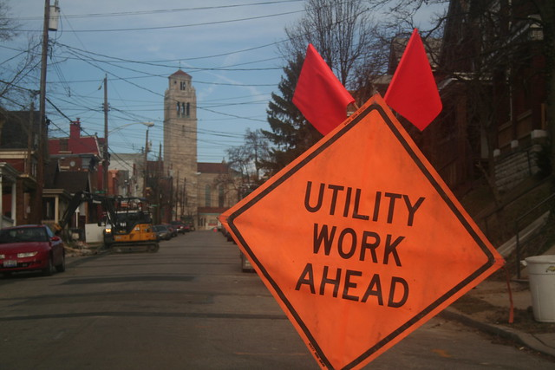

DISTRICT 5 UPDATE
2021 Utility Meeting

Slide 2
DISTRICT 5 CONTACTS
Bob Younie, District Engineer (Interim) 641-469-4005
VACANT, Assistant District Engineer 641-469-4003
Bob Porter, District Maintenance Manager 641-469-4008
Jim Webb, District Construction Engineer 641-469-4045
Bonnie Clancy, District Utilities Coordinator 641-469-4013
Dale O’Brien, Engineer Operations Tech 641-774-2420
Brenda Sanders, Engineering Operations Tech 641-683-3331
Nora Lind, Engineering Operations Tech 641-469-4025
Liz Finarty, Chariton Resident Construction Engineer 641-774-5056
Kyle Hardin, Construction Technician Supervisor (Chariton) 641-774-5056
Lauren Giarmo, Fairfield Resident Construction Engineer 641-469-4062
Anthony Blint, Construction Technician Supervisor (Fairfield) 641-469-4061

Slide 5
Significant Construction in District 5 – I-35 and US 61

Slide 7
Interstate reconstruction and expansion FY 2021-25
Warren County I-35
North areas gap reconstruction FY21, FY 25
South areas pavement rehab FY25
Clarke County I-35
North areas pavement rebab – several FY’s

Slide 8
Oskaloosa US 63 Bypass (NW)
ROW FY23
Grading FY24
Bridge FY 25
Paving TBD – not in 5-Year Plan

Slide 9
Iowa 92 Reconstruction
US 218 to Columbus Junction
FY23 (possibly Fall 2022 letting)
Grade and Pave, alignment modifications

Slide 10
US 61 Corridor Expansion
Phase 1 completion 2022
Phase 2 grading starts Fall 2021 (Mepo Bypass), paving FY24
Phase 3 – Mepo to north of Iowa 78, Grading FY 24
Phase 4 – Wapello Bypass, ROW FY25

Slide 13

THANK YOU FOR YOUR TIME AND ATTENTION
Jim Webb, District 5 Construction Engineer
641-469-4045 (office)
641-919-8551 (cell)

