Slide 1
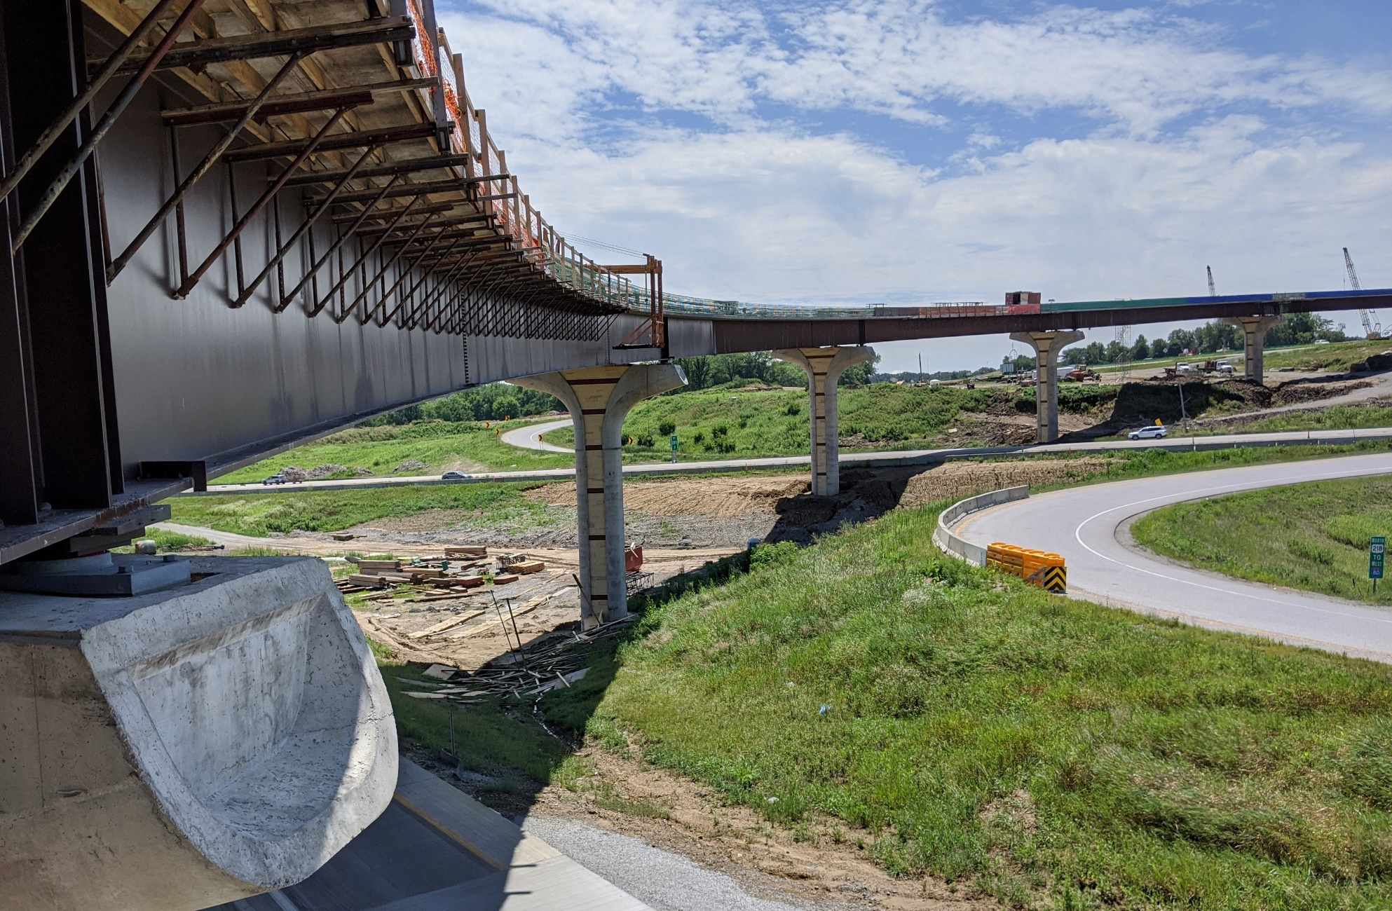
District 6 Project Information
District 6 Projects

Slide 2
District 6 Project Information
District 6 Projects

Slide 3
District 6 Projects

Slide 4
District 6 Projects

Slide 5
District 6 Projects

Slide 6
District 6 Projects
District 6 Overview – Unique (ish) Traits

Slide 7
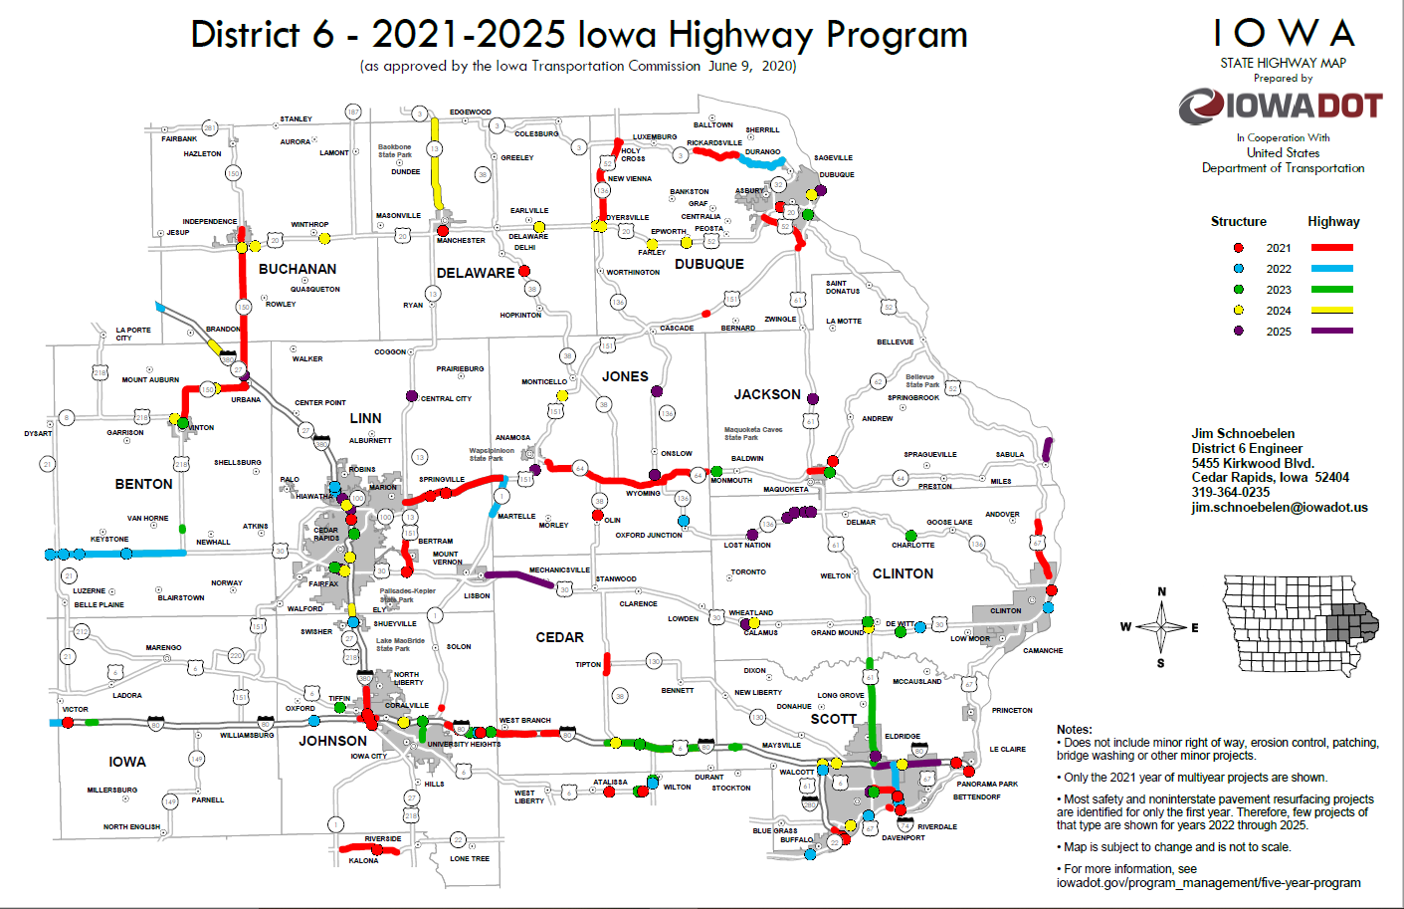
District 6 Projects

Slide 8
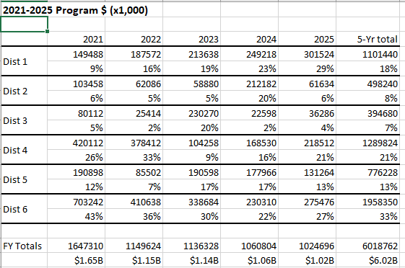
District 6 Projects

Slide 9
District 6 Projects

Slide 10
District 6 Projects
Questions
Steve Flockhart
District 6 Utility Coordinator
515-450-3063
steven.flockhart@iowadot.us

