Slide 1
Utility Relocation Estimates
Nikki Cuva
Right of Way Bureau – Design Section

Slide 2
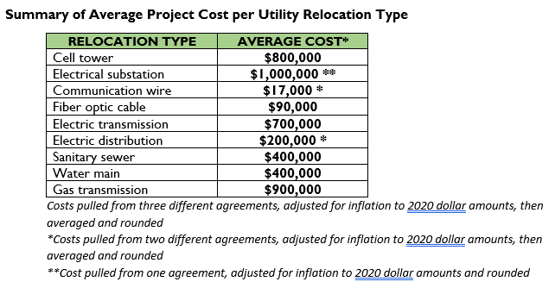
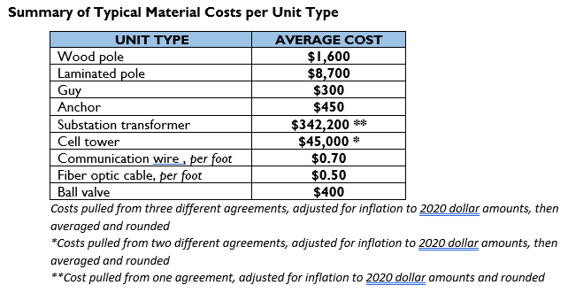
Utility Estimates Going Forward
Notes:
NIKKI - ​
Historically, utility impacts have not always been included in the ROW project estimate, which has resulted in the ROW estimate not being a true depiction of potential ROW costs. In an attempt to come up with a better estimate, the Utility section has begun to review all projects in the 5 year program and determine whether there are potential impacts to existing facilities within the project limits, and assign an approximate dollar amount to these impacts to include in the ROW estimate.​
In these charts shown, you’ll get a general idea as to the dollar amounts that could be included in the estimate depending on the type of utility that may be impacted. These dollar amounts are based on the typical material costs per unit type in 2020.​
Once these impacts have been initially identified, for estimate purposes, our goal would be to go back and pinpoint those projects far enough out, possibly in Years 3, 4, and 5, that could be reviewed for design modifications to minimize, or possibly even eliminate any major, high dollar utility impacts; resulting in less costs to the DOT, and also emphasizing our desire to partner with Utility companies in the project development process.​
​

