Slide 1
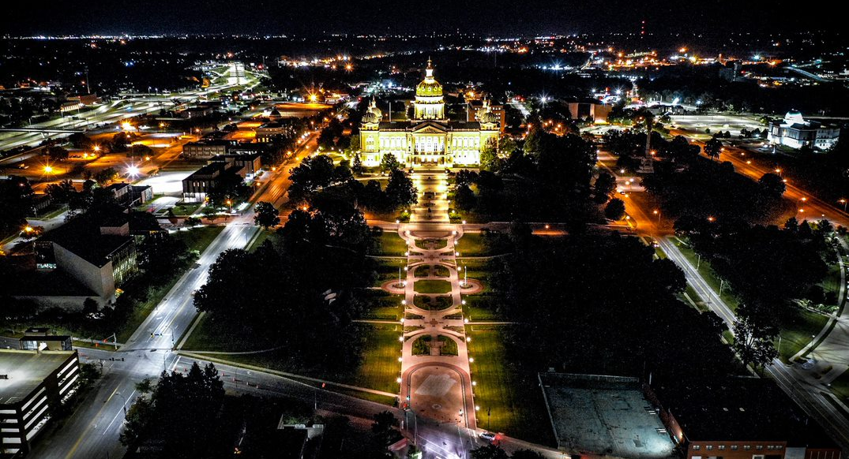
IOWA DOT District 1 Projects – 2022-2027

Slide 2
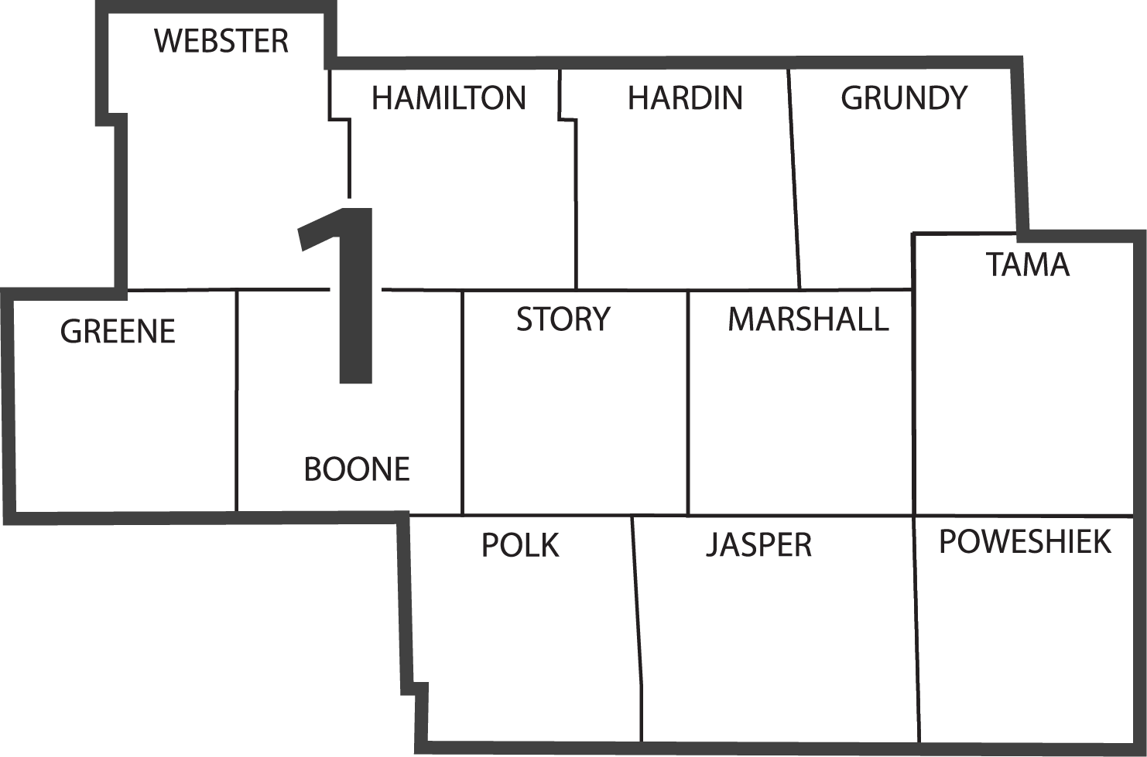
DISTRICT 1
Allison Smyth, P.E.
Assistant District 1 Engineer
Marshalltown
Ames
Jefferson
Iowa DOT District Office
Des Moines
Resident Construction Office
Maintenance Garage
District Operations Manager Office

Slide 3
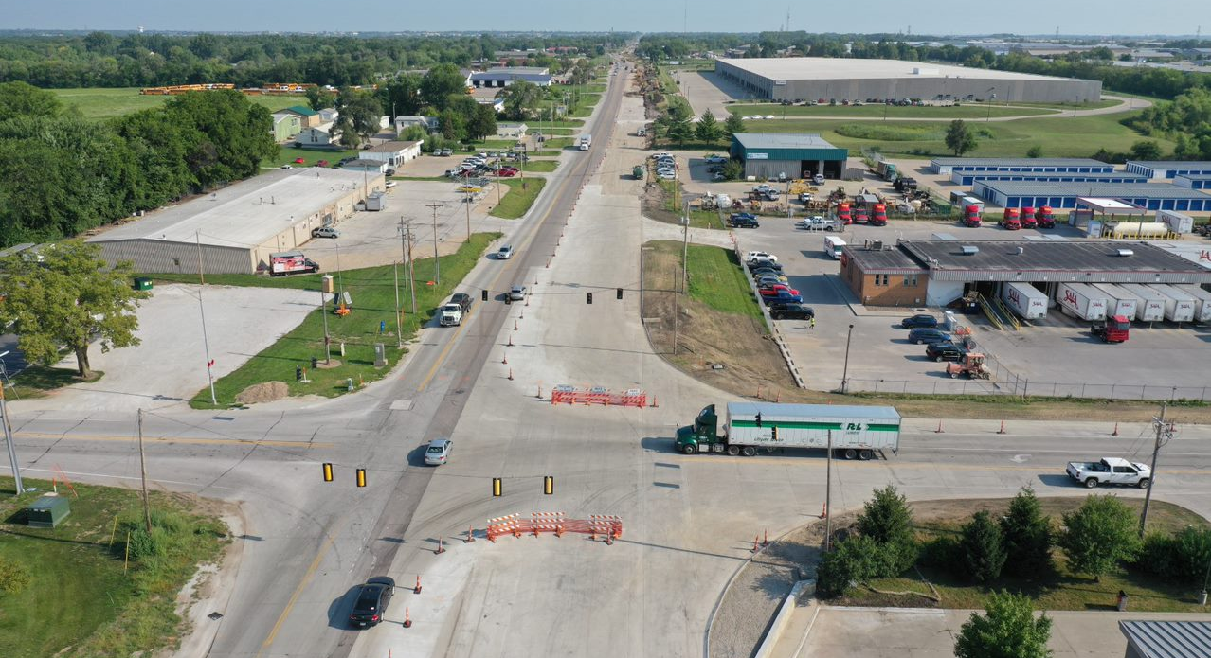
ON-GOING PROJECTS
U.S. 69 – CAPACITY & RECONSTRUCTION 2021-2022 $33 M
Notes:
$21M Programmed $33M awarded
2020 $1.7M ROW
2021-2022 $19.8 M Grade, Pave
2023 $0.2 Erosion Control

Slide 4
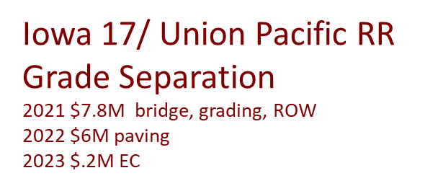
US 30 Tama County
$65.5M Grading, culverts, bridges, Paving
2022 $9.5M Grading, culvert extensions
2024 $.3M Erosion Control
Notes:
$65.5M awarded
2018 $35M Grading, culverts, bridges
2020-2021 $29.2M Paving
2022 $9.5M Grading, culvert extensions
2023 $.3M Erosion Control

Slide 5
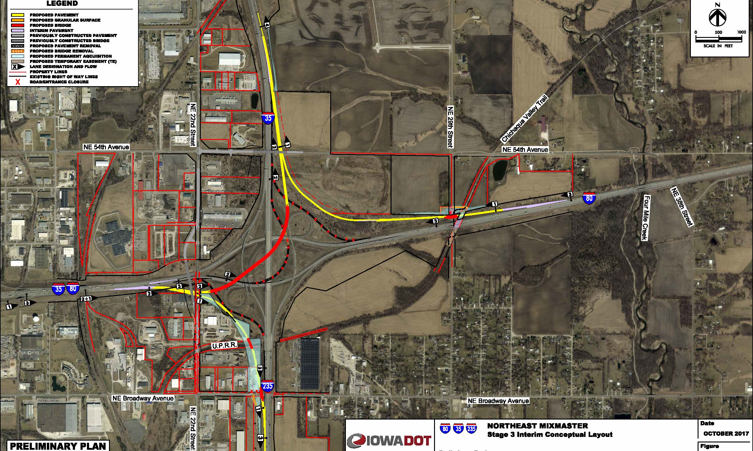
I-35/80/235
SYSTEMS INTERCHANGE
($65M total 2022-2025)

Slide 6
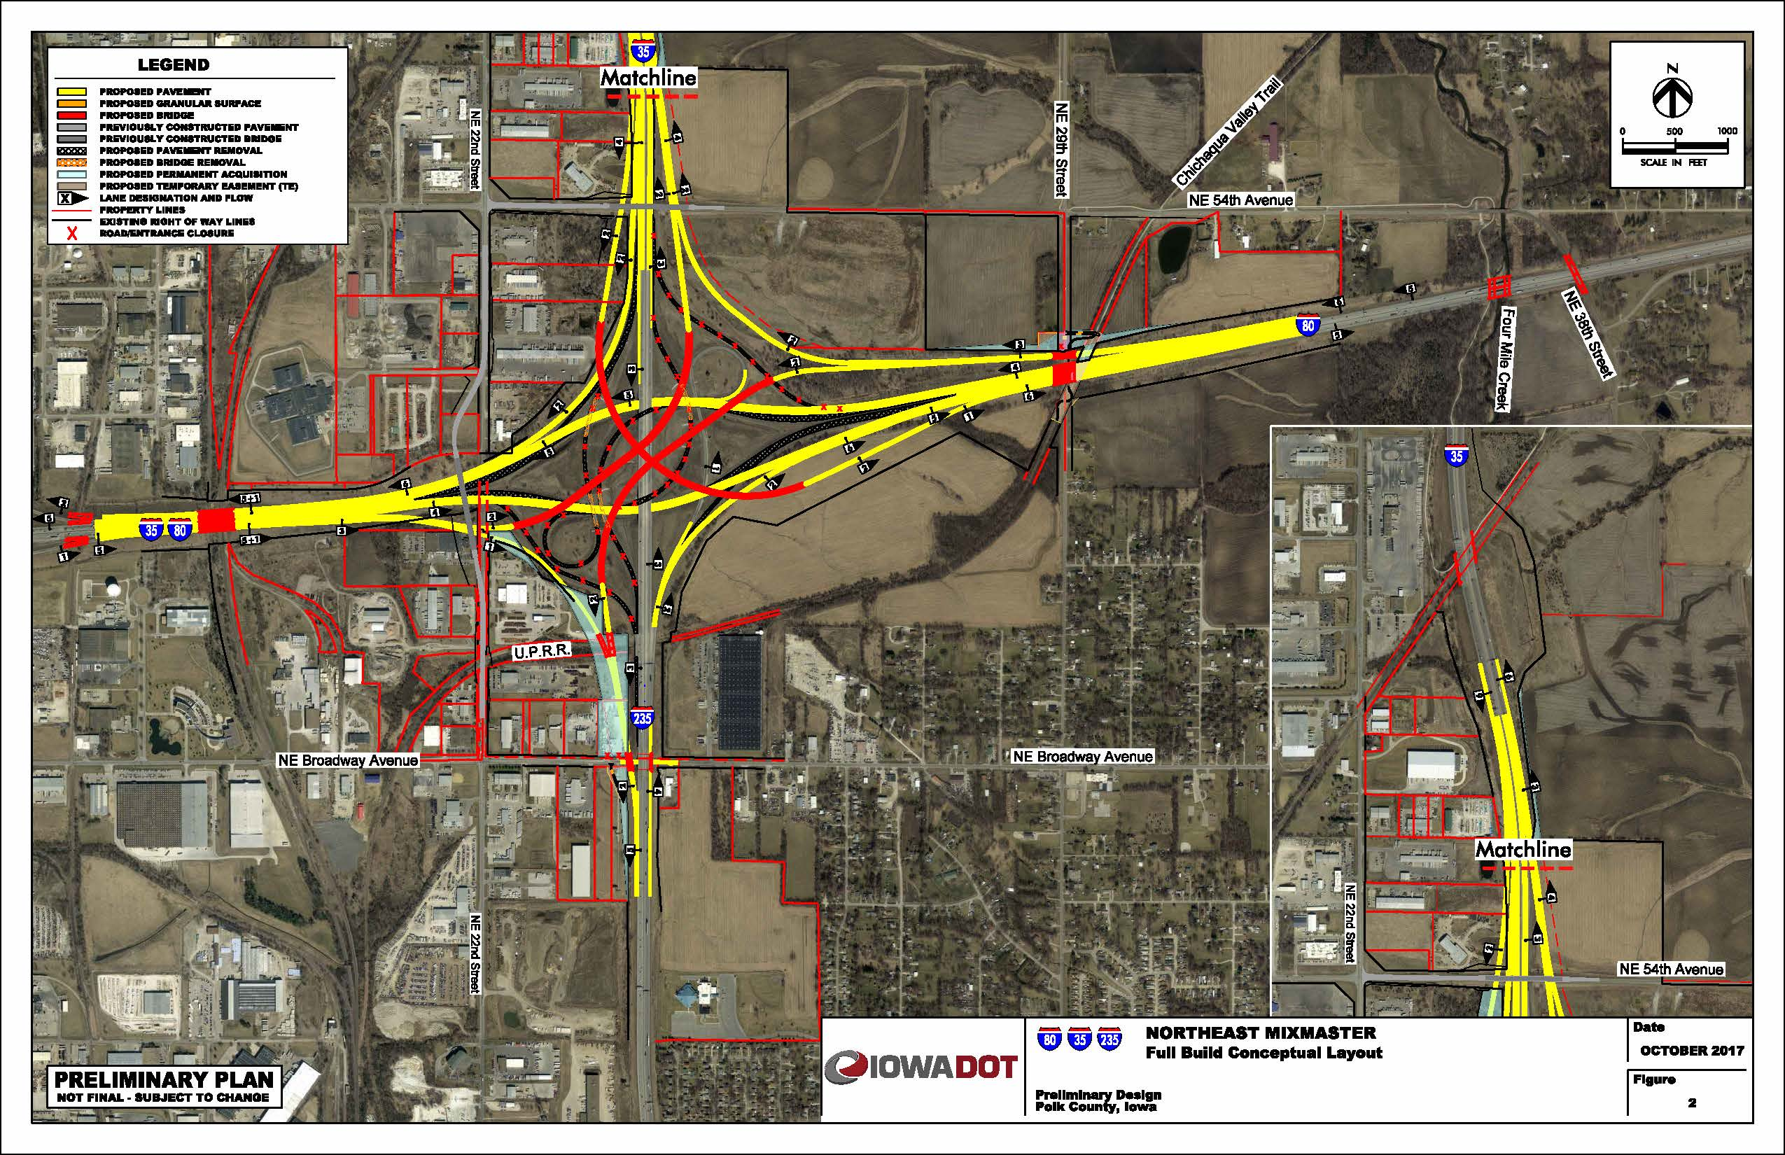
I-35/80/235
SYSTEMS
INTERCHANGE
(Long Range, not programmed)
Notes:
I-35/80/235 Systems Interchange Long Range Plan.

Slide 7
Iowa 28 over the Raccoon River
($6.6M 2022)
SB Bridge Replacement
Notes:
2022 $6.6 M Includes bike/ped acc.

Slide 8
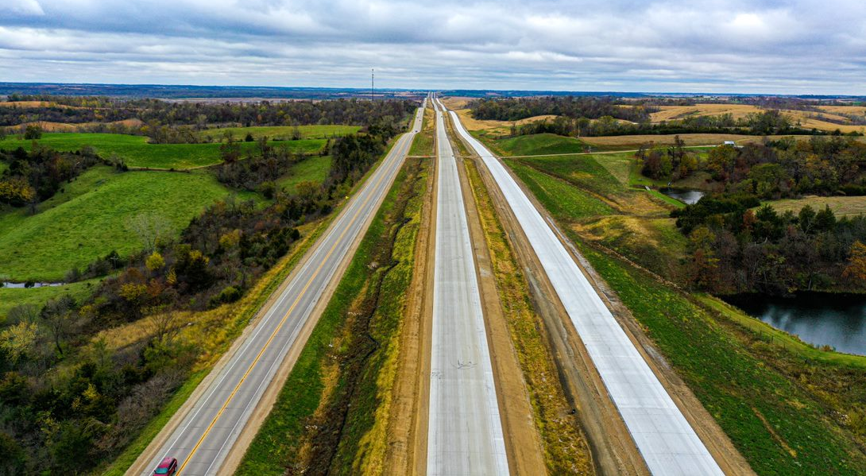
US 30 Tama County
$65.5M Grading, culverts, bridges, Paving
2022 $5.1M Grading, culvert extensions
2024 $.3M Erosion Control
Notes:
$65.5M awarded
2018 $35M Grading, culverts, bridges
2020-2021 $29.2M Paving
2022 $9.5M Grading, culvert extensions
2023 $.3M Erosion Control

Slide 9
US 30/ Iowa 21 Interchange
2022 $16.3M bridge, culvert, grad/pave, lighting, traffic signs
Notes:
2022 $16.3M bridge, culvert, grad/pave, lighting, traffic signs

Slide 10
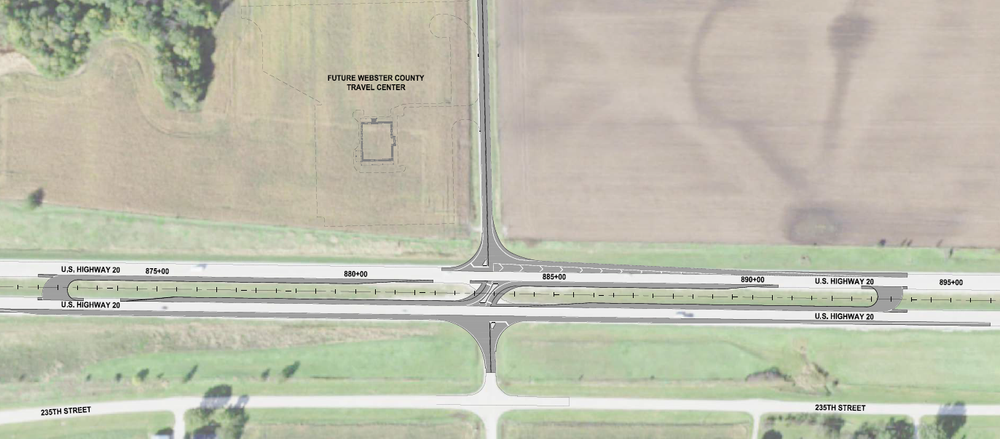
RCUT for the Travel Center
US 20 at Poplar Ave.

Slide 11
DISTRICT 1
PROGRAMMED PROJECTS
(2022-2026)

Slide 12
I-80 Capacity Improvement
NEMM to US 65 ($37.5M 2023-2026)
Notes:
2023 $5.1M ROW
2025 $21M Bridge, Grading
2026 $11.4 M Paving, Signs

Slide 13
I-35/80 – U.S. 6 INTERCHANGE (IJR Approved)
($52.5M programmed 2024-2026)

Slide 14
US 69 Improvements
US 69 at Maury St.
($750K +state share)
US 69 over DSM River
($21.5M 2025)

Slide 15
I-35 – Six laning
36th St. to Ames
Not Programmed
Programmed
2023 $30.6M ROW - bridge – grading - signs
2024 $36M paving
2025 $62.7M grade/pave
2026 $14.3M bridge/culvert/grading

Slide 16
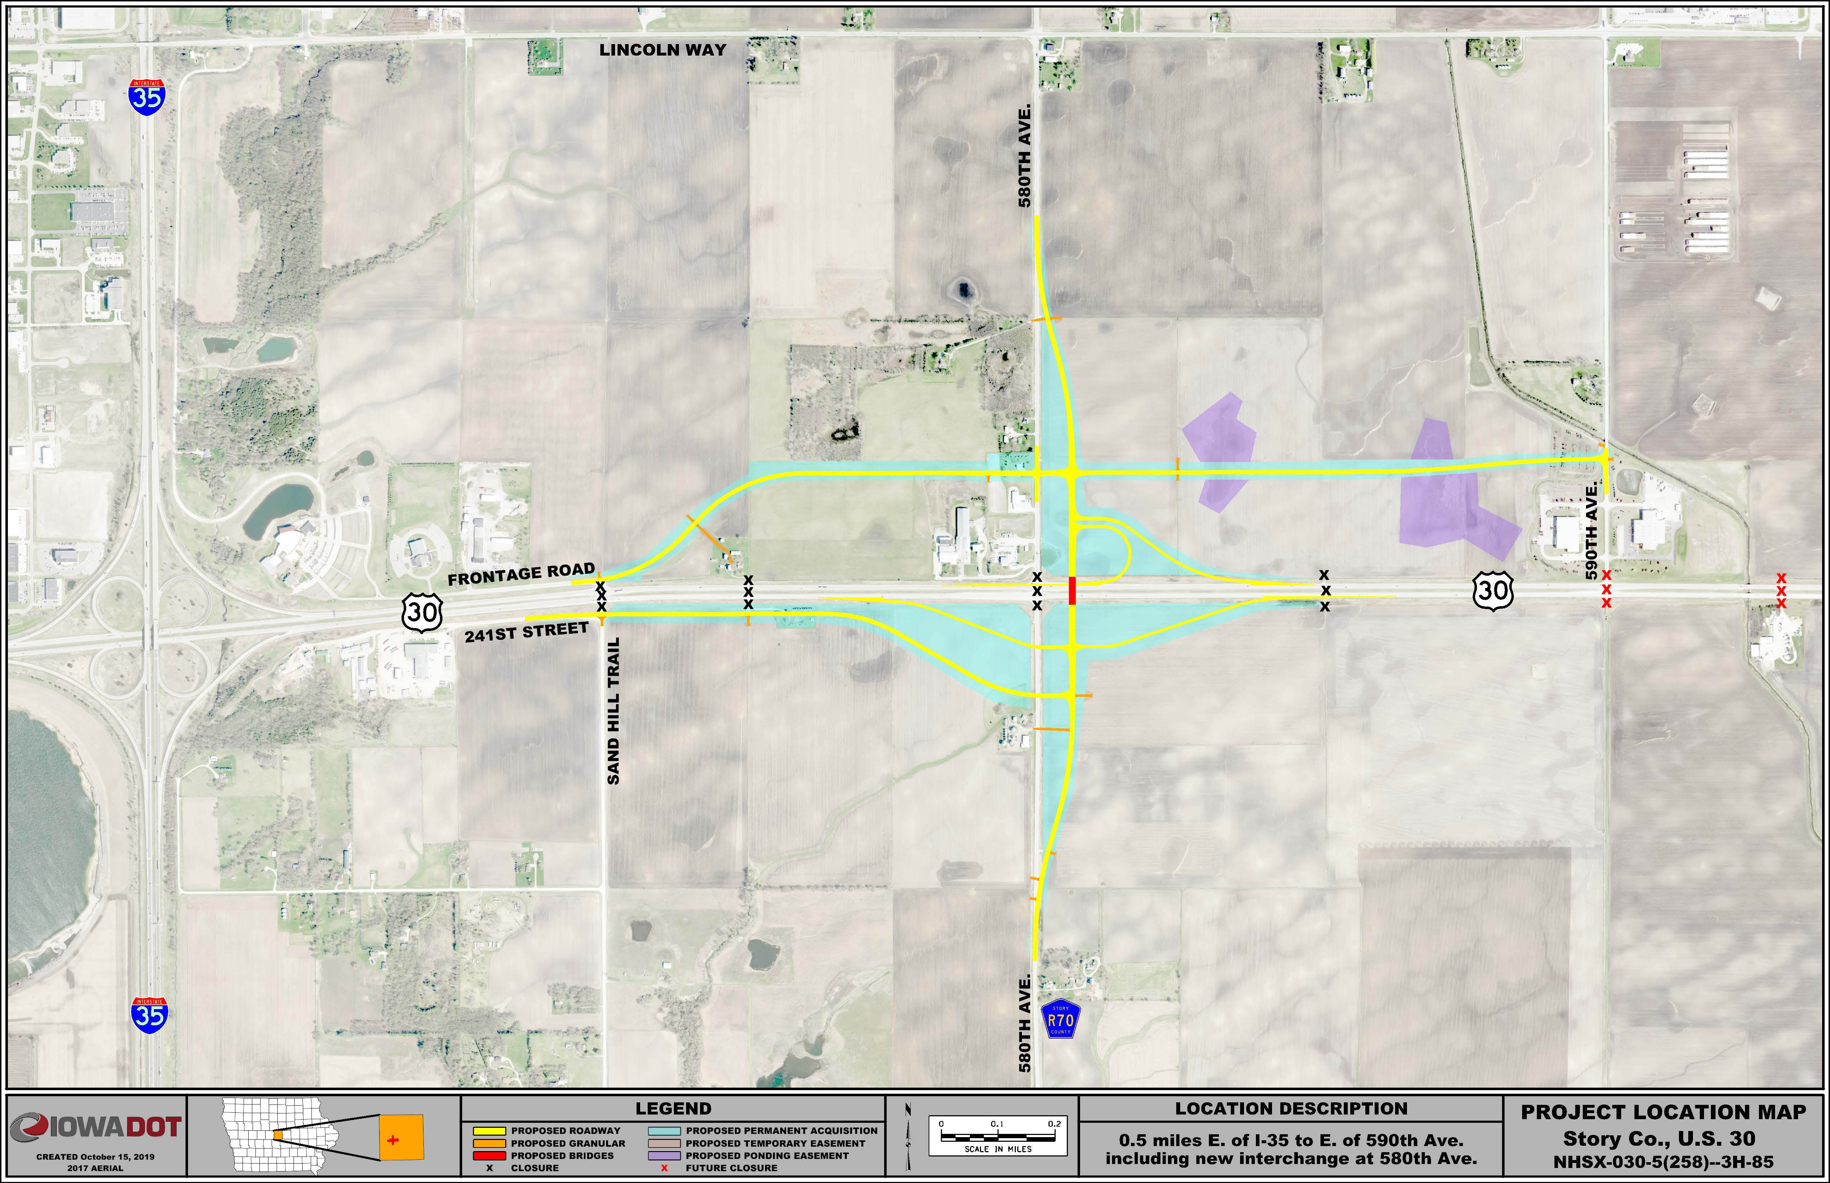
U.S. 30/County Road R-70 Interchange
2023 $16.7M bridge, grading, ROW
2024 $11.2M paving, light, signs
2025 $.4M erosion control
Future closures
Notes:
Programmed
2023 $16.7M bridge, grading, ROW
2024 $11.2M paving, light, signs
2025 $.4M erosion control

Slide 17
U.S. 30/Airport Rd. Interchange
UNFUNDED
U.S. 30/S-14 Grade Separation
2023 $5.7M bridge, grading, paving

Slide 18
I 80 / Iowa 21 Interchange

Slide 19
TAMA
US 63 Super 2
$8.5M 2024-2025
grade/pave, signs, ROW
$11.2M 2024-2025
grade/pave, pavement rehab, signs, ROW

Slide 20
DRAFT PROGRAM PROJECTS
I-35/80/235 – SW SYSTEMS INTERCHANGE

Slide 21
DISTRICT 1
Thanks!
Marshalltown
Ames
Jefferson
Iowa DOT District Office
Des Moines
Resident Construction Office
Maintenance Garage
District Operations Manager Office

