Slide 1
District 2
Upcoming Projects

Slide 2
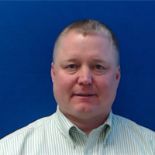
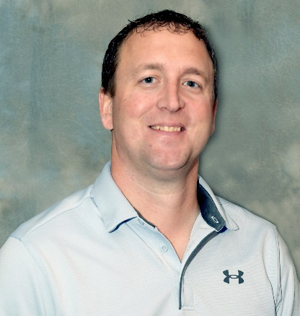
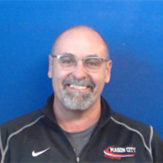
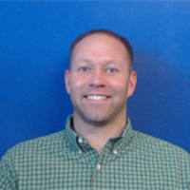
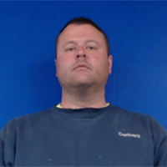
Jon Ranney
Nick Humpal
Daryl Erickson
district engineer
assistant district engineer
district utility coordinator
Mike Frank
Mike Frank
Jess Ellingson
westside permitting
eastside permitting

Slide 3
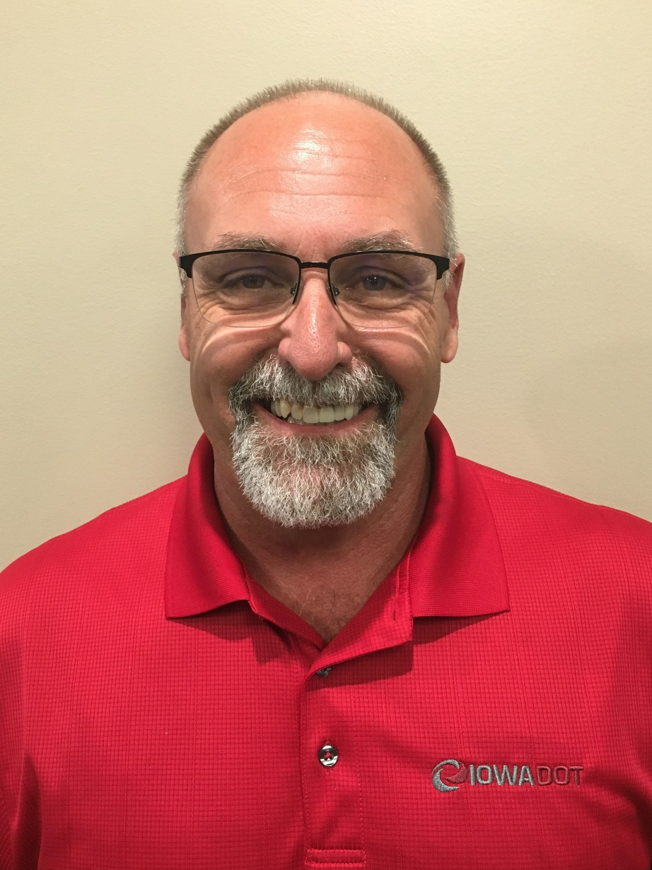
Daryl Erickson
District utility coordinator
641-422-9449 office
641-430-2395 mobile
Daryl.Erickson@iowadot.us

Slide 4
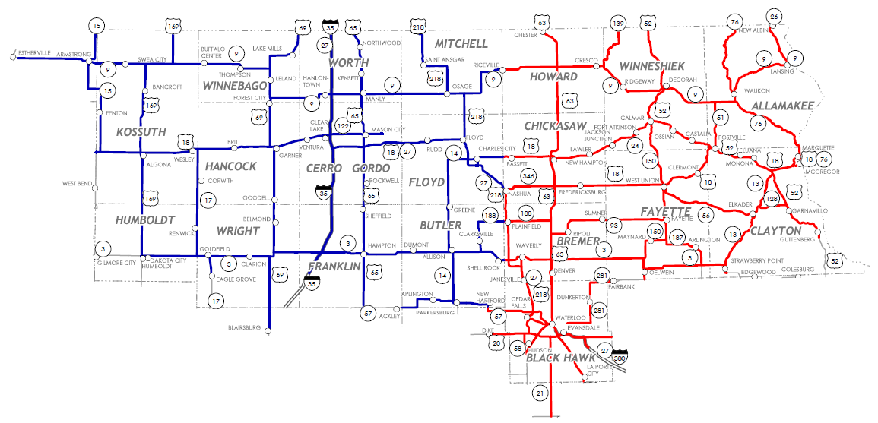
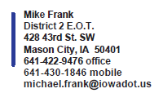
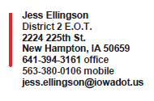

Slide 5
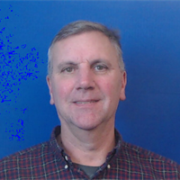
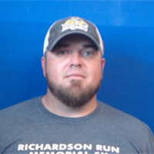
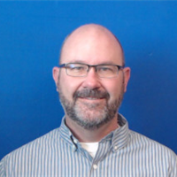
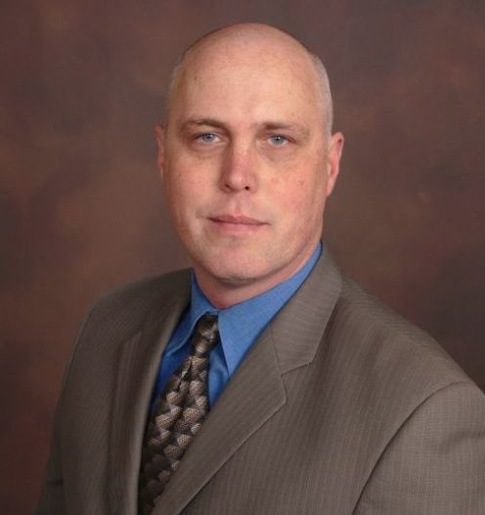
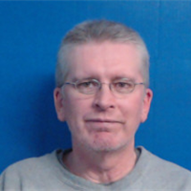
New Hampton Construction
Ron Loecher
Tyler Kubik
resident construction engineer
construction supervisor
Roy Gelhaus
district construction engineer
Mason City Construction
Ken Howe
Mike Frank
Jason Ruter
resident construction engineer
construction supervisor

Slide 7
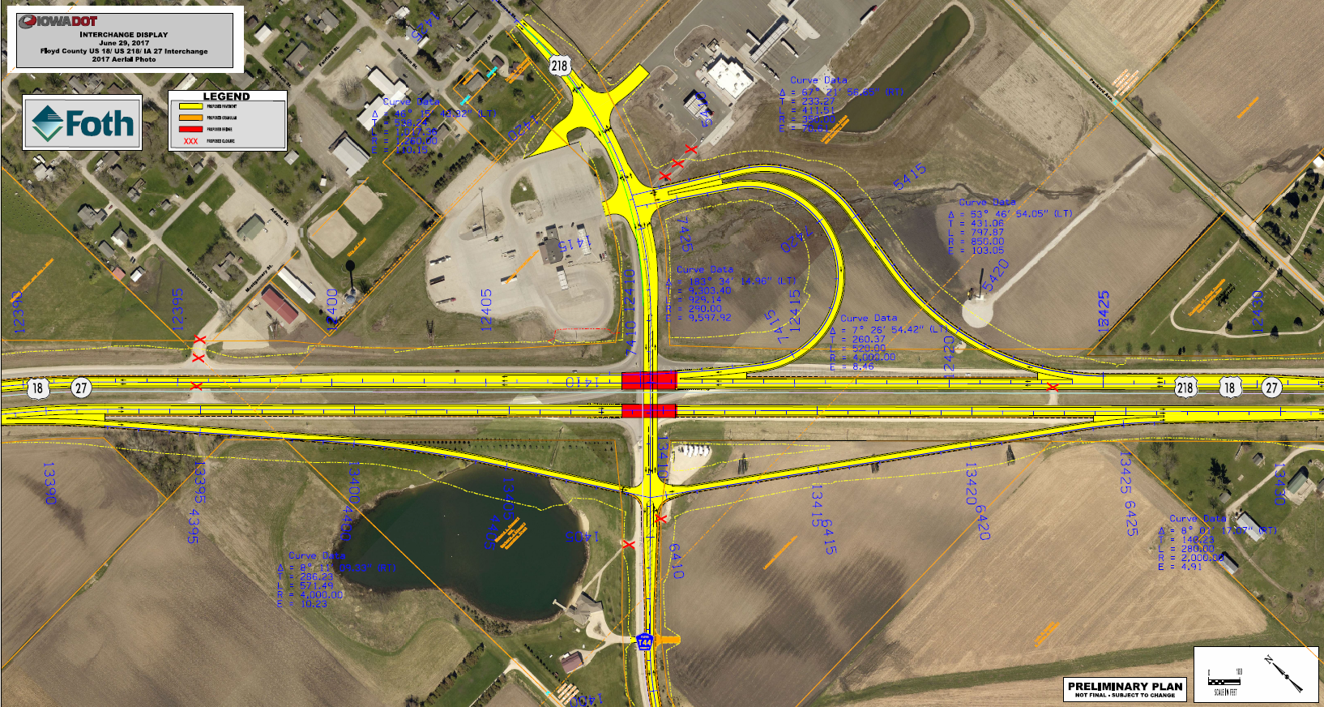
THANK YOU!

Slide 8
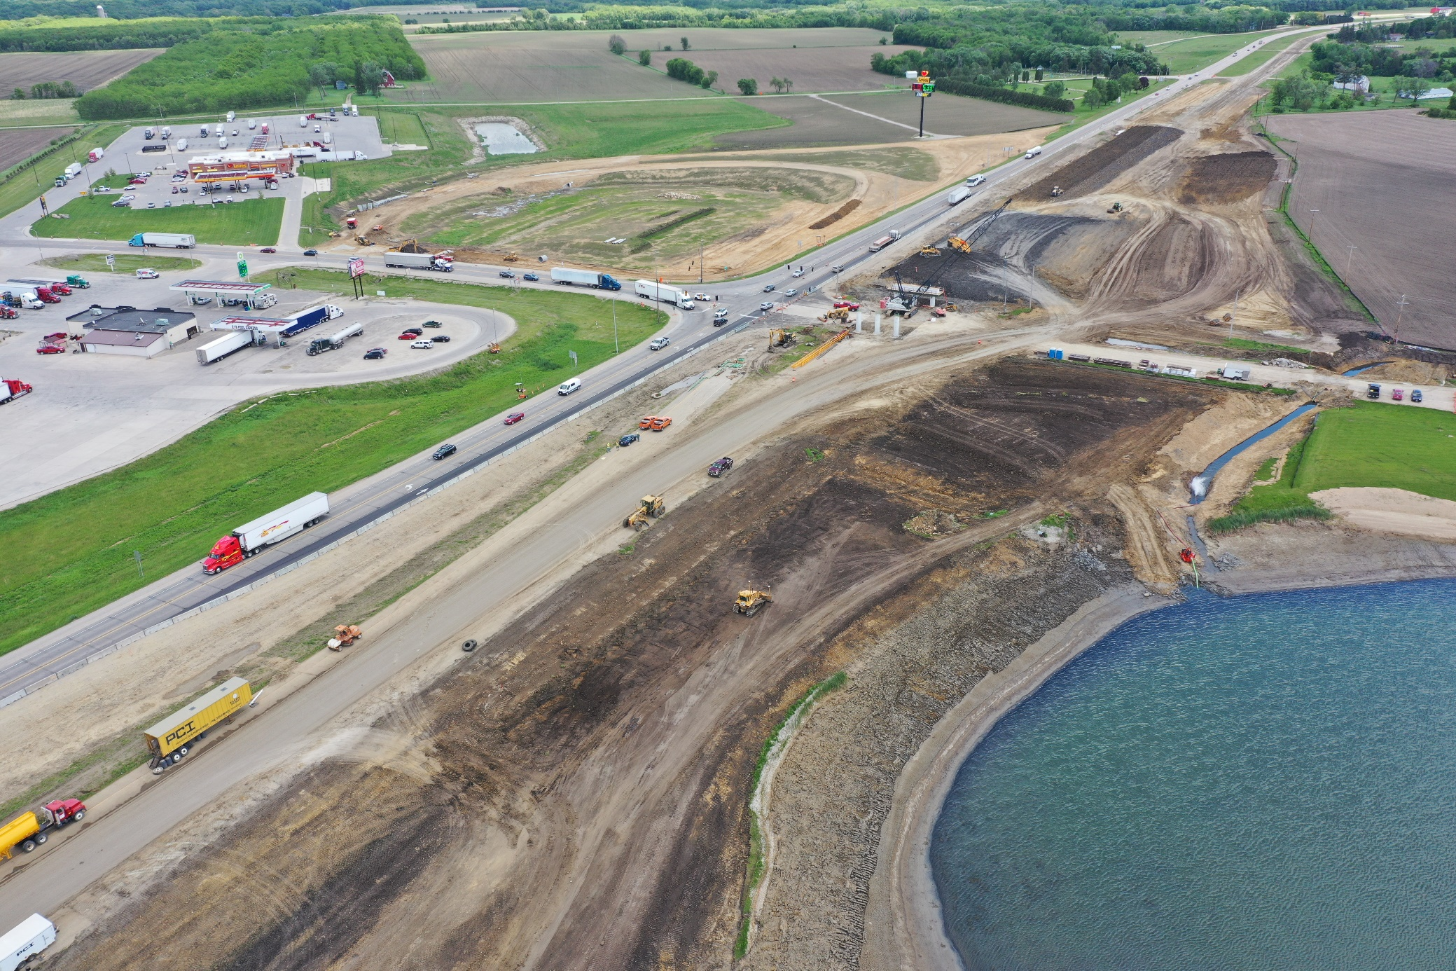

Slide 9
Notes:
Lansing July 2023
Janesville to Waverly July 2023
Mason City December 2023

Slide 10
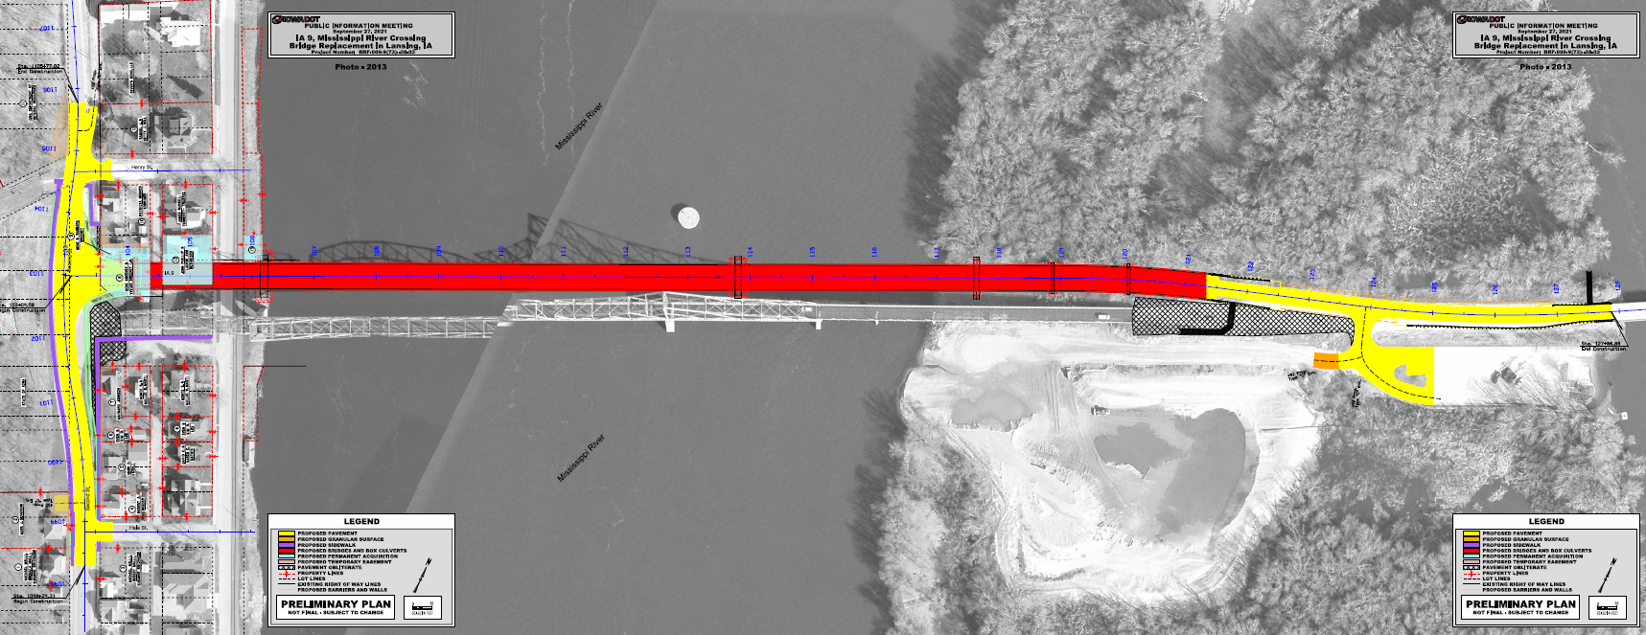
IA 9/WI 82 Mississippi River Bridge in Lansing
Construction to begin fall 2023
N

Slide 11
US 65 In Mason City
Construction to begin spring 2024
N

Slide 12
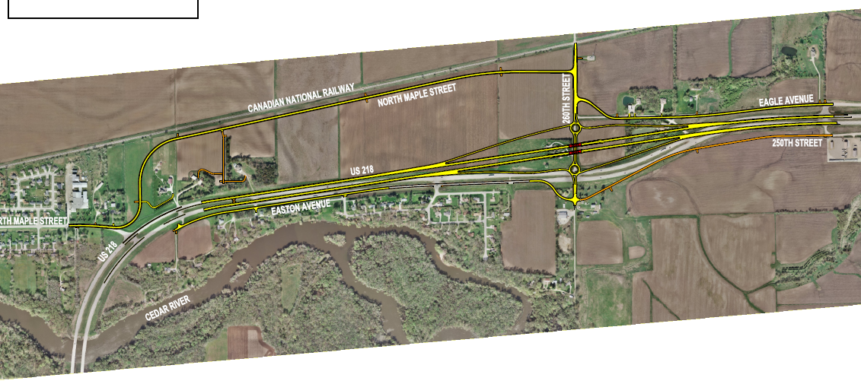
US 218 Janesville to Waverly
N
Construction to begin fall 2023
N

Slide 13
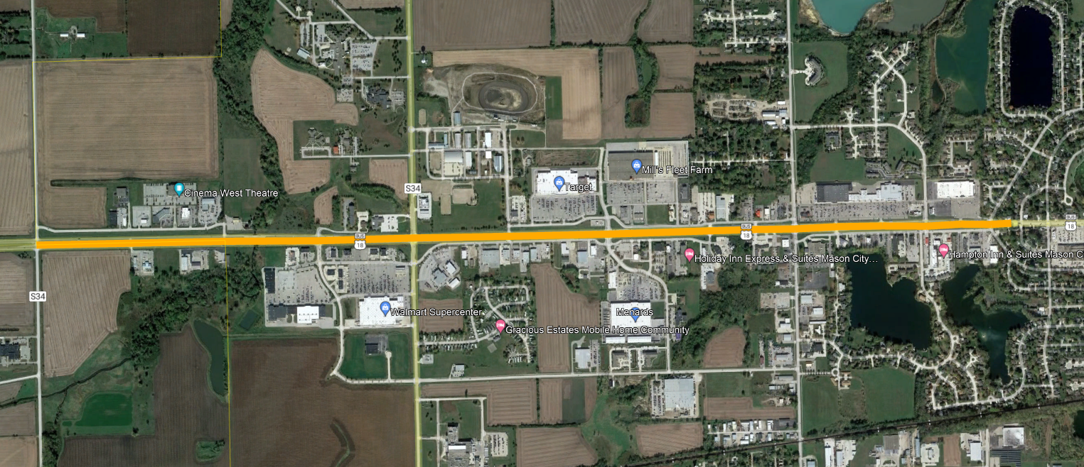
IA 122 Feasibility Study in Mason City
Eisenhower Ave
Lark Ave
Taft Ave

Slide 15
THANK YOU FOR YOUR TIME AND ATTENTION
Nick Humpal, P.E
assistant district engineer
District 2
641-423-7584 or
Nickolas.Humpal@iowadot.us

