Slide 1
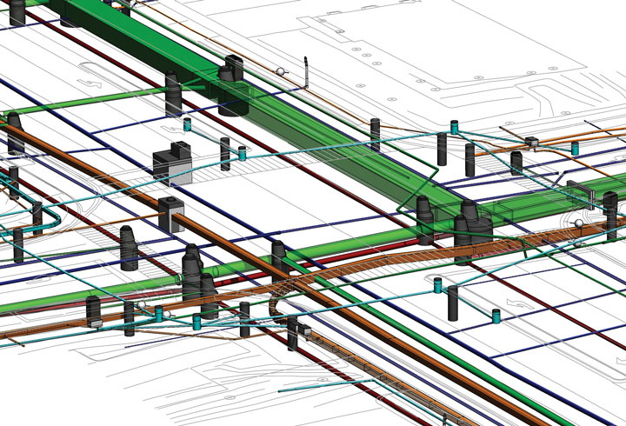

District 3
2022 Utility Meeting
Notes:
Thanks for inviting us to Discuss IA 10 and Jay Ave and the option of a roundabout

Slide 3

Shane Tymkowicz
District 3 - Asst Dist. Engineer
shane.tymkowicz@iowadot.us
(712) 274-5834
Kelly Mulvihill
District 3 Utility Coordinator
kelly.mulvihill@iowadot.us
(712) 539-1268 Cell
(712) 274-5828 Office
Notes:
Introduce Myself and Jason Klemme

Slide 7

THANK YOU

