Slide 1
District 4
Annual Utility Meeting

Slide 2
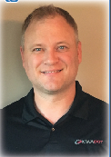
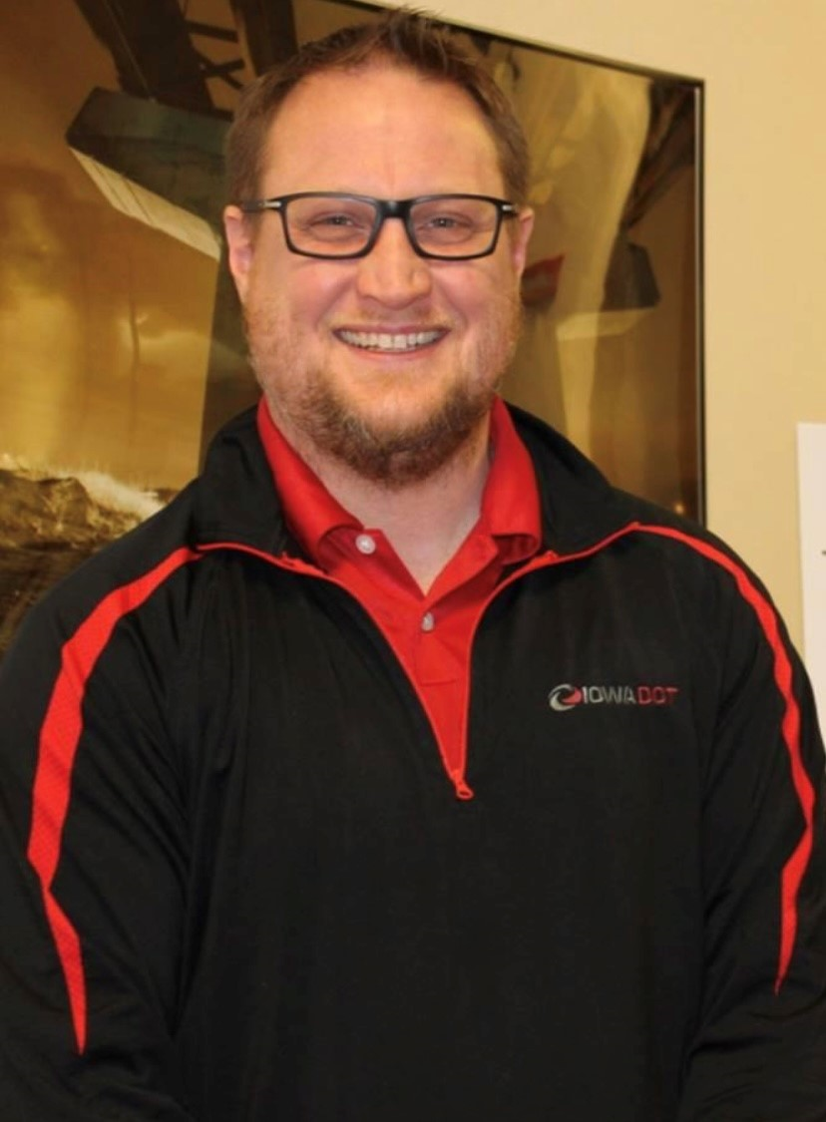
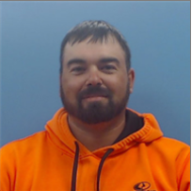
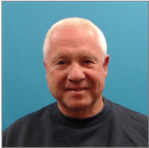
Scott Schram
Wes Mayberry
Nate Epperson
district engineer
assistant district engineer
district utility coordinator
Dick Moraine
Mike Frank
Nick Mocha
westside permitting
eastside permitting

Slide 3
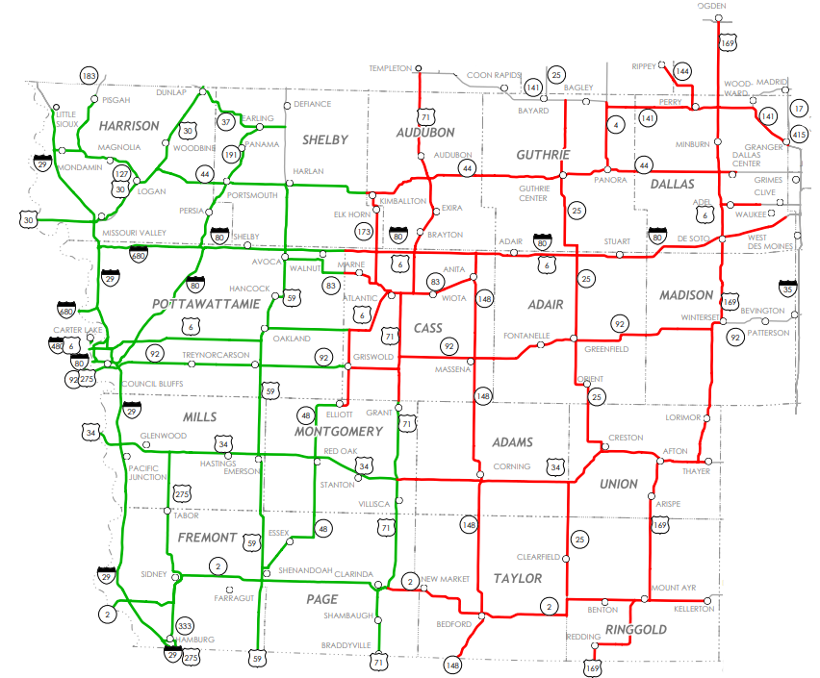
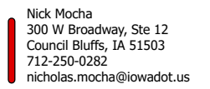

Slide 4
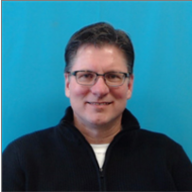
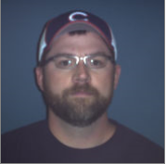
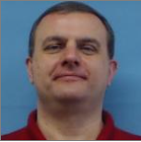
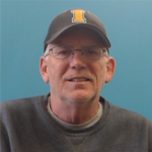
Council Bluffs Construction
Dave Dorsett
Troy Moraine
resident construction engineer
construction supervisor
Dan Redmond
district construction engineer
Creston Construction
Brian Smith
Mike Frank
Jeff Huntsman
resident construction engineer
construction supervisor

Slide 5
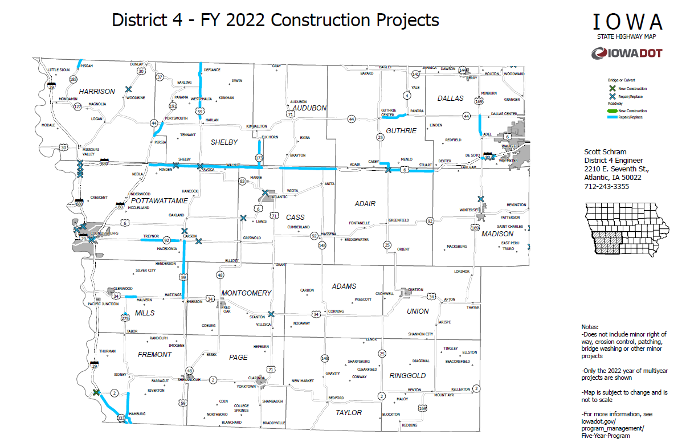

Slide 8
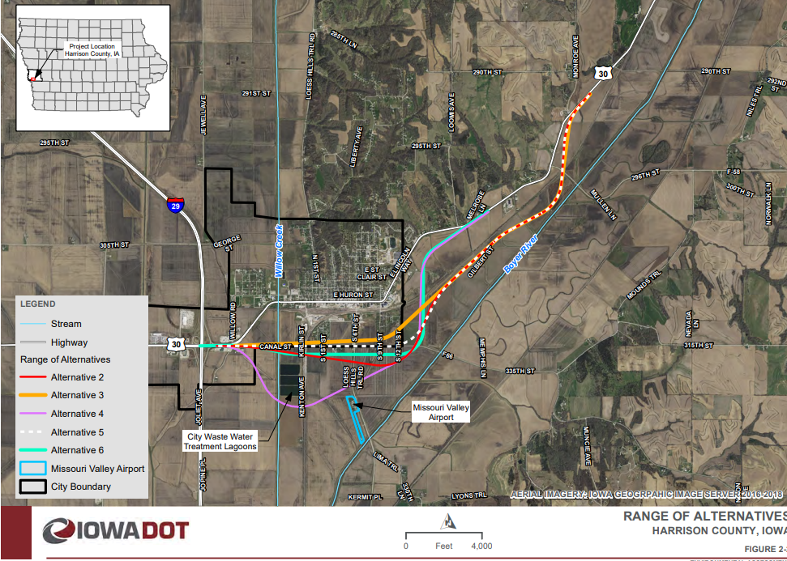
Harrison County Hwy 30 Missouri Valley By-Pass
FY 2023 Environmental Assessment Complete
FY 2025 Right of Way
FY 2026 Grading
FY 2027 Bridge New

Slide 9
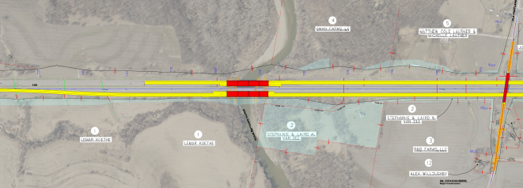
Dallas County I-80 – Raccoon River Bridges
FY 2023 EB Paving
FY 2024 WB Grade and Paving

Slide 10
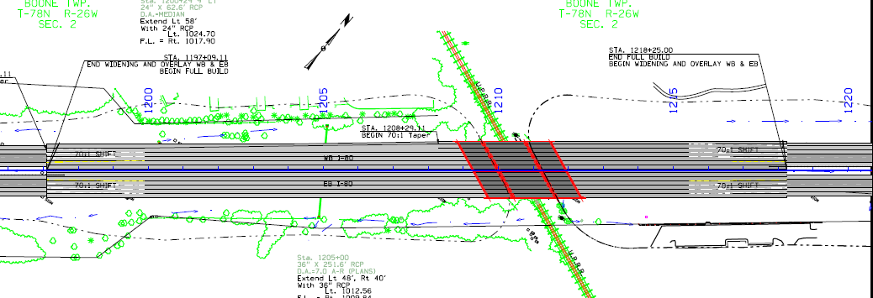
County I-80 – Grand Prairie Parkway to 60th Street
FY 2023 Median Paving and New Bridge
FY 2024 EB Paving and Bridge Replacement
FY 2025 WB Paving and Bridge Replacement

Slide 11
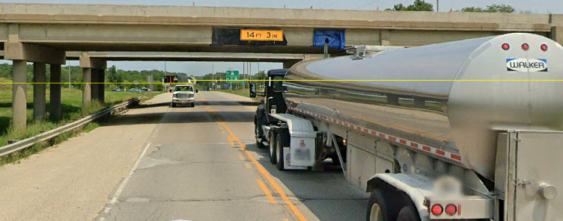
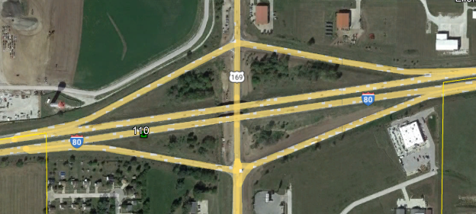
I-80 US 6 Interchange De Soto
FY 2027 Bridge Replacements

Slide 12
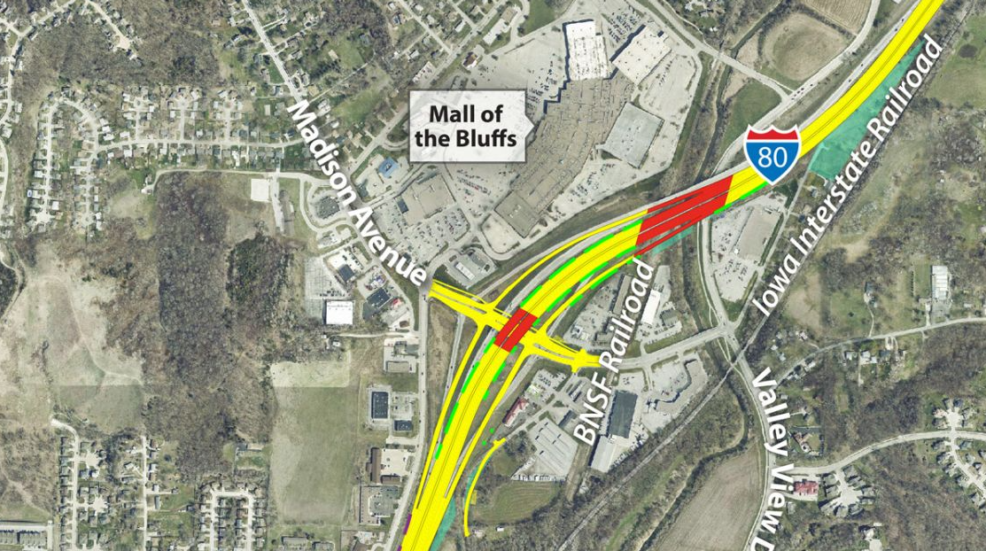
Madison Avenue Interchange in Council Bluffs
FY 2023 Grade and Pave, Bridge Replacement
FY 2024 Grade and Pave, Bridge Replacement

Slide 13
THANK YOU FOR YOUR TIME AND ATTENTION
Wes Mayberry, P.E
Assistant District Engineer
District 4
Cell: 712-250-0496 Wes.Mayberry@iowadot.us

