Slide 1
Iowa DOT SPR 3082 Discovery
Avoid | Minimize | Mitigate
Early Identification and Location of Utility Facilities within Iowa DOT Project Footprints
Philip J. Meis, P.E., M.ASCE
Chair ASCE 75 Standard Guideline for Recording and Exchanging Utility Infrastructure Data
2021 Chair ASCE Utility Engineering Surveying Institute’s Utility Risk Management Division
ASCE 38-22 Committee Member
President of Utility Mapping Services, P.C.
Daniel E. Colby, M.ASCE
Chair ASCE Utility Risk Management Division’s Utility Asset Management and Data Security
Member ASCE 75, Member OGC MUDDI
Senior Vice President of Technology, Utility Mapping Services, P.C.

Slide 2
Iowa DOT SPR 3082 Discovery
Research Team
Utility Mapping Services, Inc.
Avoid | Minimize | Mitigate

Slide 3
Iowa DOT SPR 3082 Discovery
Ongoing Partnership Research Projects
Early Identification and Location of Utility Facilities within Iowa DOT Project Footprints
Project Development and Utility Coordination as a Partnership
Best Practices for Utility Management in the Public Right of Way
Avoid | Minimize | Mitigate

Slide 4
Iowa DOT SPR 3082 Discovery
1.) Early Identification and Location of Utility Facilities within Iowa DOT Project Footprints
Identifying Best Practices, Data Standards and Methods for the Early Identification and Location of Utility Facilities
A standard for documenting utility infrastructure, (ASCE 75) “Standard Guideline for Recording and Exchanging Utility Infrastructure Data”
Lifecycle asset management practices that applies for all facilities residing or being installed within IADOT ROW and includes: a systematic permitting to regulate and monitor all changes and construction activities affecting utility infrastructure; and a utility data repository built around ASCE 75 for capture of standardized spatial and feature attributes during the permit process. (Note: proposed alignment coordinates are recorded for permit approval needs, and later actual coordinates are captured by the contractor or utility representative at the time of construction.)
Systematic capture and management of standardized data when installations are newly installed, exposed for construction or maintenance purposes, investigated for project development needs (such as by subsurface utility engineering methods in accordance with ASCE 38), or proposed for permitting approval.

Slide 5
Iowa DOT SPR 3082 Discovery
Benefits from Leveraging Industry Standards & Best Practices
ASCE 75 has been designed for capturing sufficient spatial and attribute data on utilities to enable creation of an accurate 3D digital twin; and
The Open Geospatial Consortium has adopted ASCE 75 as key input to their Modeling Underground Data Definition and Integration (MUDDI) standard, which means emerging software applications will be able to accept, visualize, and share digital 3D models of utilities seamlessly. ASCE 75 is designed to accept ASCE 38 data and scalable to accommodate even the most primitive record data.

Slide 6
This effort will investigate approaches for enhancing the alignment of utility coordination and project development to gain efficiencies in the current processes and minimize utility-related delays and costs for the Iowa DOT. The primary objective of this project is to develop procedures for the incorporation of partnership of utility stakeholders into the project development process at the concept stage. The developed guidance will include suggestions for identifying, managing, and mitigating, utility-related risks using Subsurface Utility Engineering (SUE), Utility Conflict Management (UCM), Value Engineering and early Utility Coordination. This study will provide guidance for improved collection and use of utility location data for project development decision making and an improved process to align and integrate project design and utility coordination. These efforts stand to streamline project development and reduce delays and added costs of utility-related issues.
Iowa DOT SPR 3082 Discovery
2.) Project Development and Utility Coordination as a Partnership

Slide 7
As utility companies seek to expand and enhance the services they provide, more utility infrastructure is being crowded into public rights of way (ROW). These new facilities are often installed with minimal oversight and without consideration of other future utility space needs. When new utility facilities are installed to replace existing infrastructure, the existing utility facilities are seldom removed and become abandoned, further congesting the public right of way. To complicate this situation, utility permit and documentation requirements for utility installations vary considerably throughout the United States. Within Iowa, ROW management of construction and utility activities varies between cities, counties and the Iowa Department of Transportation (DOT). This variation has led to differing methodologies and unorganized coordination within public agencies on infrastructure projects containing utilities. There is a need for a broader utility management approach to control the planning and installation of utilities within public ROW, require documentation of utility as-built plans and location information, and manage this information so it can be useful to future construction efforts. Without such an approach, the accommodation of utility facilities will continue to be disorganized, inefficient, and cause increased costs and delays in construction projects. This study will provide benefit to public municipalities in managing the right of way. This will be achieved by preparing policies to enforce proper installation and documentation of utilities in the ROW.
Iowa DOT SPR 3082 Discovery
3.) Best Practices for Utility Management in the Public Right of Way

Slide 8
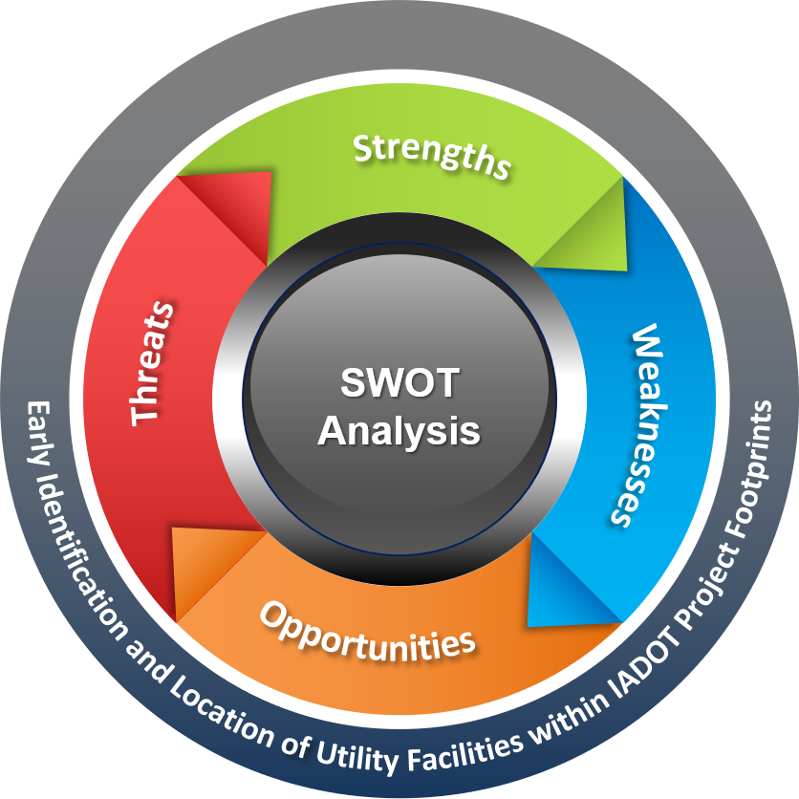
Iowa DOT SPR 3082 Discovery
SWOT Inquiry
The purpose of this SWOT inquiry is to assess current procedures, protocols, methods, constraints, and opportunity to improve IADOT processes.
Avoid | Minimize | Mitigate

Slide 9
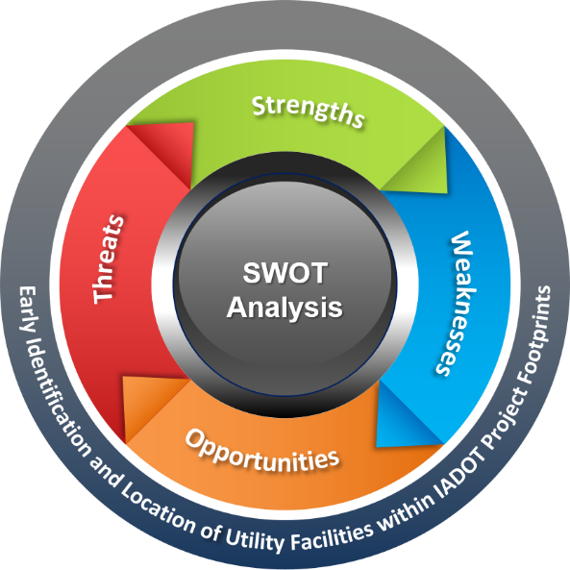
Iowa DOT SPR 3082 Discovery
SWOT Analysis
The purpose of the SWOT analysis is to assess current procedures, protocols, methods, constraints, and opportunity for utility data collection from utility companies by IADOT.
Utility Permitting Processes and Business Practices
Paper, on-line, etc.
Utility permit types (e.g., Occupation, encroachment, hybrid, reimbursable, non-reimbursable, acquired easement, emergency maintenance, etc.)
Requirements based on type of installation
Review requirements
Approval authority ( HQ vs districts and design vs RW vs maintenance vs construction)
IA and IADOT recognized utility types and different review processes
Special permits for “clean energy connectivity” (longitudinal for broadband along restricted access highways)
Utility types permitted
Pipeline management
Abandonment/out of service
Joint duct, trench, use installations
New permitting application that was developed internally
Utility Permit Language
Legal base
Enforcement teeth
Special Provisions and Exceptions to Administrative Code

Slide 10
Iowa DOT SPR 3082 Discovery
SWOT Analysis Cont..
Other ROW Permitting
Access
Maintenance
Occupation
Events
IADOT Utility Accommodation Policy
Governing Statutes
One-Call Law (collaborate with other 2 IADOT R&D projects – Roy and Jim)
Utility Accommodation
IA Legal Code ( Law) and Administrative Code
New Federal Policy/Code for Utility Accommodation
AASHTO Guides ( Hwy and Freeway)
Federal Mandates
Project Development and Delivery Flow Process with Utilities
SUE data collection
SUE data submittals
Survey Control and Topography Surveys
Iowa Real-Time Network
Conflict Matrices
Design Specifications, Construction Specifications
Construction As-Built Surveys

Slide 11
Iowa DOT SPR 3082 Discovery
SWOT Analysis Cont..
Utility Data / As-built Collection through permit, through design, through construction processes
Identify potential utility stakeholders to be engaged with this R&D process
Identify One-Call liaison for evaluating integration with IADOT permit, collection, and data store system and potential areas of collaboration.
Current Technology Landscape
Enterprise GIS
CADD, BIM
3D Design
Virtual Design and Construction
Machine Guidance
Augmented Reality Viewing
Data Stores
IT Security (firewall constraints for development and deployment)
Management and Implementation of 3rd Party Applications and SaaS
Other IA Government Agency (e.g., Department of Administration) involvement
Identify data gaps and pain points
With utility supplying information
With design and coordination
Stakeholder Collaboration
With construction (field engineer interviews)
With operations and maintenance
With planning
With damage prevention and emergency response
With permit process
With regulations and enforcement

Slide 12
Iowa DOT SPR 3082 Discovery
SWOT Analysis Cont..
Vision and Wish List
3rd Party Coordination between permit applicants
Resiliency analytics
Emergency Response Coordination
Civil Defense Coordination
Redirect traffic for active occupations
OGC MUDDI Implementation – integrating with other subsurface information
Transparency across agencies (state, local, county)
Shared, common platform for permits and utility data
Internal Stakeholder Parties
Right of Way
Systems Planning
Utilities
Project Management
Design & Survey
Bridges & Structures
Field Operations
Construction
Location & Environmental
Traffic Operations (TSMO & ITS)
Information Technology

Slide 13
Iowa DOT SPR 3082 Discovery
Identifying Data Gaps & Pain Points
With supplying utility data and information
With design and coordination
With stakeholder collaboration
With construction and constructability
With operations, maintenance and service sustainment
With planning
With damage prevention and emergency response
With the permitting process
With regulations and enforcement
With cost and schedule
With communication

Slide 14
Iowa DOT SPR 3082 Discovery
Identifying Opportunities for Improvement
Third party coordination between permit applicants
Resiliency analytics
Emergency response coordination
Civil defense coordination
Redirect traffic for active occupations
Best practices and industry data standards
Data transparency across all stakeholders
Provide a shared, common secure platform for permits & utility data
Conflict management workflow and processes
Safety

Slide 15
Iowa DOT SPR 3082 Discovery
Goals of the Research Projects
Avoid | Minimize | Mitigate
Reduce project schedule & project costs
Improve working relations & communication
Improve and centralize data exchange
Minimize strikes
Influence IADOT best practices
Notes:
DC: Minimize Risk and Improve Infrastructure Protection / Damage Prevention Efforts

Slide 16
Iowa DOT SPR 3082 Discovery
The Vision
Standardized permit process (DOT, Cities, County, etc.)
Expedited and transparent permit processing
Proactive 3rd party coordination with utility owners
Enhanced safety and damage prevention
Joint trench and construction cost sharing opportunities
Traffic control and pavement repair cost sharing opportunities
Improved and enhanced “utility” project design and construction (conflict analytics, cost reductions, expedited construction, damage reduction)
Modernized collaborative conflict analytics for “roadway improvements”, reducing relocations and better protecting existing infrastructure
Notes:
Standardized permit process (DOT, Cities, County, etc.)
Expedited and transparent permit processing
Proactive 3rd party coordination (e.g., between gas pipeline owners and HDD driller)
Enhanced safety and damage prevention
Joint trench and construction cost sharing opportunities
Traffic control and pavement repair cost sharing opportunities
Better “utility” project (e.g., HDD, pipelines, duct installations, buried power) design and construction (conflict analytics, cost reductions, expedited construction, damage reduction)
Better conflict analytics for “roadway improvements”, reducing relocations and better protecting existing infrastructure
Better usage of limited space within ROW (overhead, surface and underground)
Better relations with ROW owners, partnering opportunities – evolve ROW usage into one that embraces shared multi-modal, joint usage
Better, proactive communications between ROW owners and utilities
As-built data in nationally recognized standardized format for enhanced exchanging, software use
Enable 811 responders to use augmented reality viewing and GNSS navigation along with pipe and cable locators to eliminate mis-marks and enhance damage prevention
Enable contractors to use augmented reality viewing and machine guidance to avoid strikes

Slide 17
Iowa DOT SPR 3082 Discovery
The Vision (cont..)
Improved usage of limited space within ROW (overhead, surface and underground)
Better relations with ROW owners, partnering opportunities – evolve ROW usage into one that embraces shared multi-modal, joint usage
Improved proactive communications between ROW owners and utilities
As-built data in nationally recognized standardized format for enhanced data exchange and software use
Enable 811 responders to use augmented reality viewing and GNSS navigation along with pipe and cable locators to eliminate mis-marks and enhance damage prevention
Enable contractors to use augmented reality viewing and machine guidance to avoid strikes
Notes:
Standardized permit process (DOT, Cities, County, etc.)
Expedited and transparent permit processing
Proactive 3rd party coordination (e.g., between gas pipeline owners and HDD driller)
Enhanced safety and damage prevention
Joint trench and construction cost sharing opportunities
Traffic control and pavement repair cost sharing opportunities
Better “utility” project (e.g., HDD, pipelines, duct installations, buried power) design and construction (conflict analytics, cost reductions, expedited construction, damage reduction)
Better conflict analytics for “roadway improvements”, reducing relocations and better protecting existing infrastructure
Better usage of limited space within ROW (overhead, surface and underground)
Better relations with ROW owners, partnering opportunities – evolve ROW usage into one that embraces shared multi-modal, joint usage
Better, proactive communications between ROW owners and utilities
As-built data in nationally recognized standardized format for enhanced exchanging, software use
Enable 811 responders to use augmented reality viewing and GNSS navigation along with pipe and cable locators to eliminate mis-marks and enhance damage prevention
Enable contractors to use augmented reality viewing and machine guidance to avoid strikes

Slide 18
Iowa DOT SPR 3082 Discovery
Avoid | Minimize | Mitigate
Early Identification and Location of Utility Facilities within Iowa DOT Project Footprints

