Slide 1
Utility GIS Inventory
Jon Rees
Right of Way Bureau
Notes:
-Intro
-7 years at DOT
-Recent hire at ROW
-A lot of cool initiatives in ROW- electronic systems and applications

Slide 2
By the Numbers…
Iowa
240,000 acres of right of way
115,500 miles of public highway
9,600- primary system
24,000 bridges
4,180- primary system
3,800 miles of rail
2,748 DOT employee’s
Notes:
Iowa by the numbers—
240,000 acres of right of way
Nearly 114,000 miles of highway in Iowa
Over 22,000 bridges
3,800 miles of rail
-Run through the numbers
-Make point that it’s easy to find this information from our GIS portal
-Anyone can access

Slide 3
Iowa DOT GIS Portal
DOT maintains inventory through geographic information systems (GIS)
Bridges, signage, pavement conditions, traffic data etc.
Data and custom viewers available to DOT Staff
Open Data Portal: https://data.iowadot.gov
Notes:
-DOT has robust inventory of everything we own and maintain
-GIS inventory
-Quick– what is GIS?
-Everything in Open Data portal
-Allows us to do our jobs more efficiently– information at our fingertips

Slide 4
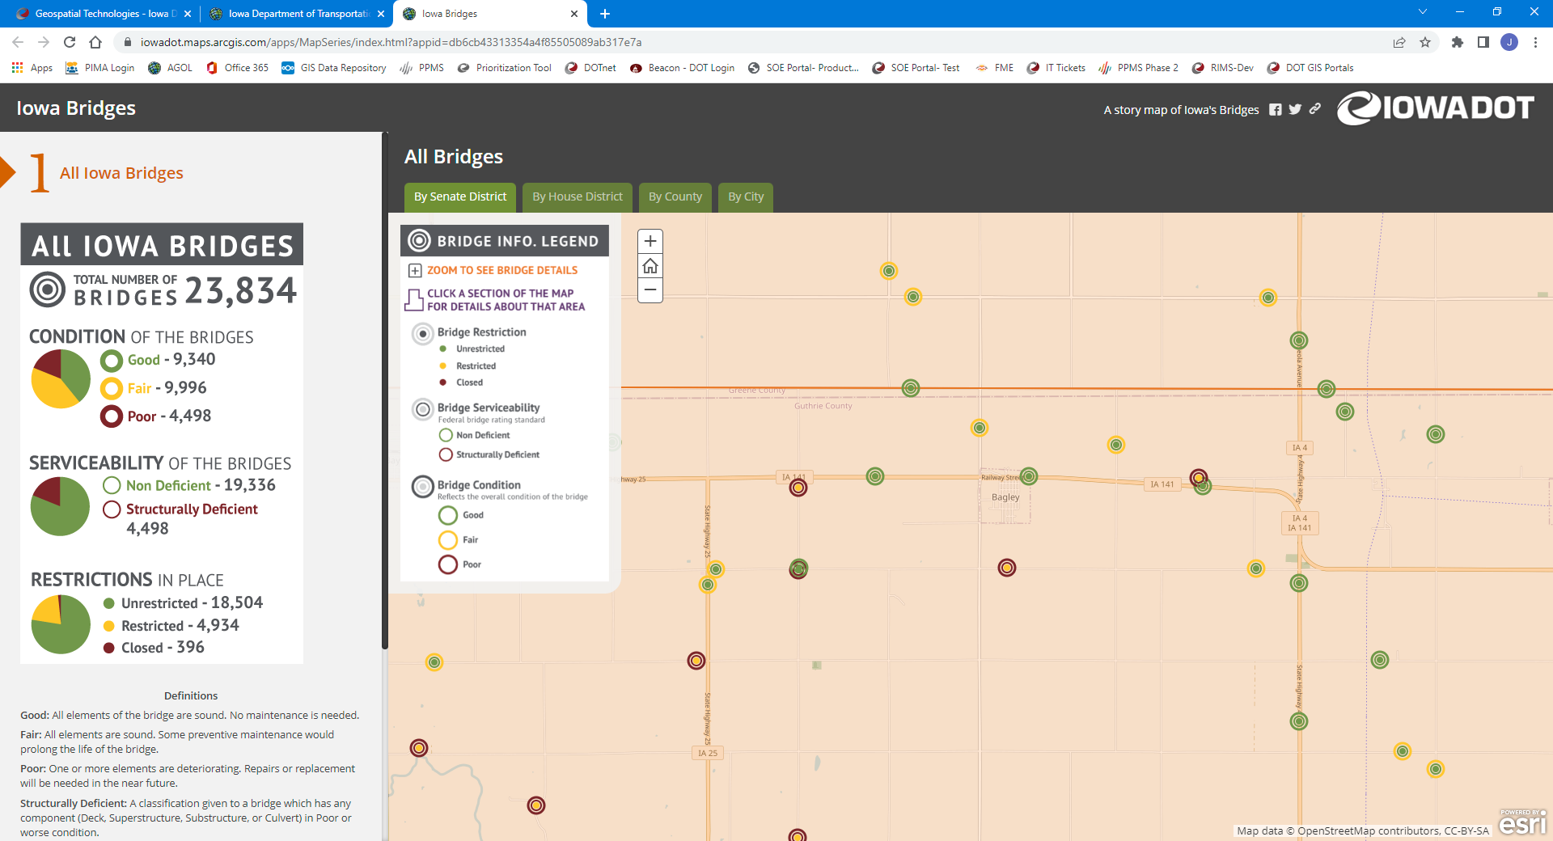
Example: Bridge Inventory
Notes:
-Example of our bridge inventory in GIS
-Only a few clicks to find information on a single bridge
-Paper files/cabinets could take hours to track this information

Slide 5
Iowa DOT GIS
Area of inventory we are currently missing- UTILITIES
Help us make informed decisions on current and future projects
Utility relocations can be costly and time consuming
Identify utilities early in the planning phase of a project to avoid or minimize impacts
Avoid costly/time consuming impacts to utilities
Notes:
-Area Iowa DOT is missing- Utilities
-We have tons of infrastructure, but no information on the utilities
-Need this information to make informed decisions
-Early in planning process
-Avoid timely and costly utility impacts/relocations
-Affects our customers as well as your customers
-Current GIS initiative to collect utilities in GIS

Slide 6
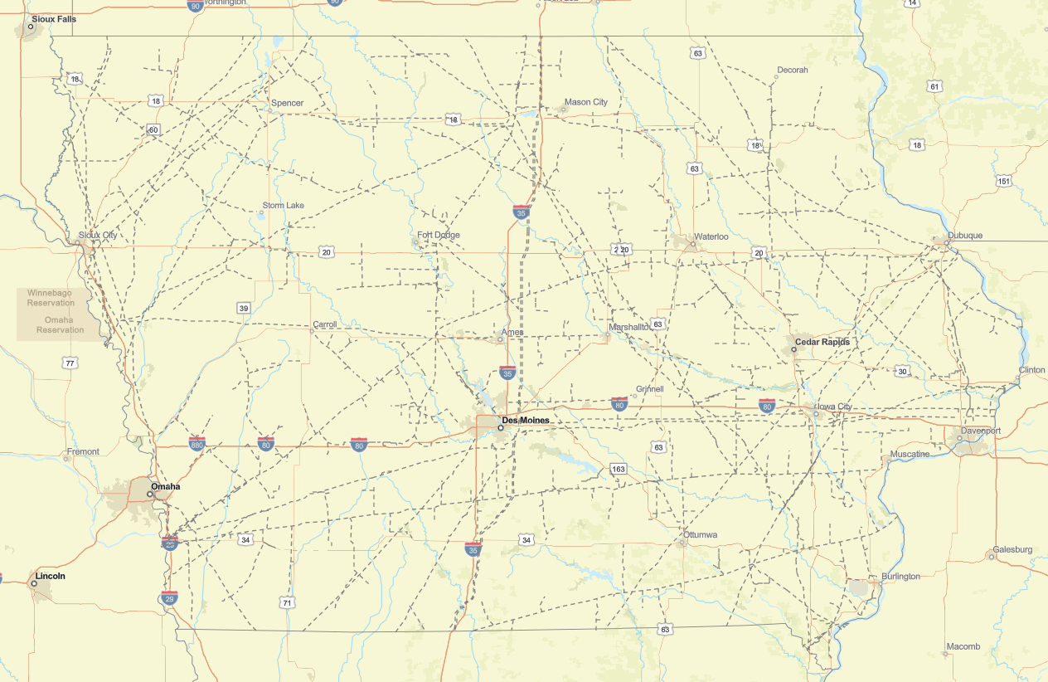
Current Utility Data
Published layers
U.S. Energy Information Administration (EIA)
U.S. DOT, National Pipeline Mapping System (NPMS)
U.S. DHS, Homeland Infrastructure Foundation- Level Data (HFLA)
Notes:
-Currently utility information in GIS
-Published layers
-Useful but not accurate

Slide 7
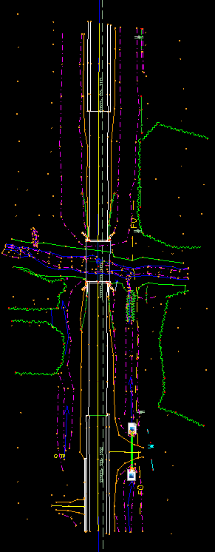
Current Utility Data
Preliminary survey (CAD)
Converting to GIS (under construction)
Statewide layer w/ simple map viewer
Lacks detailed information, low quality level
Need: accuracy, detailed information
Notes:
-Preliminary surveys
-Great resource
-Lower level quality- C or D
-Not accurate
-Need more accurate information– go straight to the source. Utility companies.

Slide 8
Moving Forward
We need your help!
We may reach out to you requesting utility information
Accuracy, detailed information
Existing utilities, as-builts, relocation plans
Electronic format- GIS/CAD files
Geospatially located
Notes:
-We need your help
-Give you a heads-up we will likely be starting the conversation in coming months
-Want to discuss with your appropriate staff any relevant GIS/CAD we could access for our inventory

Slide 9
THANK YOU
DEANNE POPP
UTILITY PROGRAM ADMINISTRATOR
RIGHT OF WAS BUREAU
Deanne.Popp@iowadot.us
Office: 515-239-1787
JON REES
TRANSPORTATION PLANNER
RIGHT OF WAY BUREAU
Jon.Rees@iowadot.us
Office: 515-239-1081
Iowa DOT, Right of Way Bureau
Utility Accommodations & Coordination
https://iowadot.gov/rightofway/contact-us
Notes:
Thank you slide. We may be reaching out.

