Slide 1
Annual Utility Meeting 2022 | Teams Live event
Iowa Department of Transportation

Slide 2
Welcome & introductions
Iowa DOT Utility Program
Notes:
Good morning and welcome to the Iowa DOT’s 2022 Annual Utility Meeting. We appreciate everyone taking time out of their schedules to join us today.
This meeting as many of you know usually takes place during late winter or early spring.
Over the last year we’ve had a lot of staffing changes and related training for new staff going on – which affected the scheduling of this meeting.
My name is Deanne Popp and I’ll be leading today’s event.
This meeting is being recorded and will be made available on an FTP site for future access.
Today you’ll be hearing from several different presenters including the DOT districts who will discuss upcoming projects.
If you’ve not attended a Teams Live event before you’ll notice that it might be a bit different from other virtual meetings you’ve attended.
The biggest difference is that only the presenters can share their screen, camera and microphones.
You can, however, still interact with us.
Comments and questions can be posted in the Q&A portion.
We will be monitoring the Q/A and publishing posts that are relevant to the topics. Some questions might be answered directly by the moderator.
We expect to conclude the event by Noon.

Slide 3
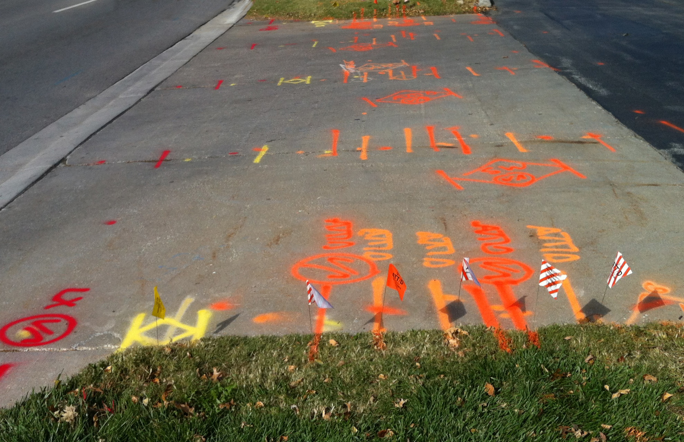
Accommodation & Coordination
Accommodation
Permitting
Relocations
Agreements
Management of the ROW
Notes:
The Utility Program covers all aspects of utility coordination from permitting to project relocations.
We are part of the Transportation Development Division and the Right of Way Bureau and play a major role in managing the assets in the public rights of way.

Slide 4
Utility program team
Central Office
District offices
Field offices
Notes:
Our team is spread out among various locations including
The central office in the Right of Way Bureau in Ames
Six district offices
And 16 field offices throughout the state

Slide 5
Central Office – Right of Way Bureau
BUREAU DIRECTOR – BRAD HOFER
Bureau Leader
Approval of budget items including utility relocations
UTILITIES SECTION SUPERVISOR – ERIC WRIGHT
Process & Procedure Implementation
Project & Production Champion
Design, Utilities & Appraisal
Notes:
The Right of Way Bureau is lead by Director, Brad Hofer
Brad is a great supporter of the Utility Program and various initiatives underway
Utility related budget items must be approved by Brad, such as reimbursement agreements and subsurface engineering contracts
Eric Wright is the Utilities Section Supervisor
Leads the section staff in implementation of our processes and procedures
and reporting on project and production status
He is also the supervisor for the Design and Appraisal sections in the ROW bureau

Slide 6
Central Office – Right of Way Bureau
REGIONAL UTILITY PROGRAM COORDINATORS
Project scheduling & monitoring
Project plan submittals
Utility Reimbursement Agreements
Invoices, audits & payments
Disclaimers of Interest in Realty
Field assistance when needed
Notes:
As I mentioned, we’ve seen a lot of staffing changes in the program – including the central office in Ames.
Greg Cagle joined our office and has been performing plan submittals and handling production & project status reporting.
Matt Buttz who had previously joined our team has taken a job in the ROW Property Management Section – he is continuing to work on our Polk/Story I-35 project.
As a result of Matt’s move, we have a new team member in the central office, her name is Dana Blue.
– Dana came to us from the ROW Acquisition & Relocation Section.
With the change in staffing, we decided it would be a good time to consider some other changes
– including the distribution of work within the central office.
– in the past we’ve had one person responsible for project & production coordination and one person responsible for the reimbursement agreement function
– Now, all tasks are distributed evenly among the staff.
Each person will function as a Regional Utility Program Coordinator with certain districts assigned to them.
- So, they’ll be covering everything from project scheduling and monitoring to plan submittals and relocation reimbursements and giving some field assistance when needed.

Slide 7
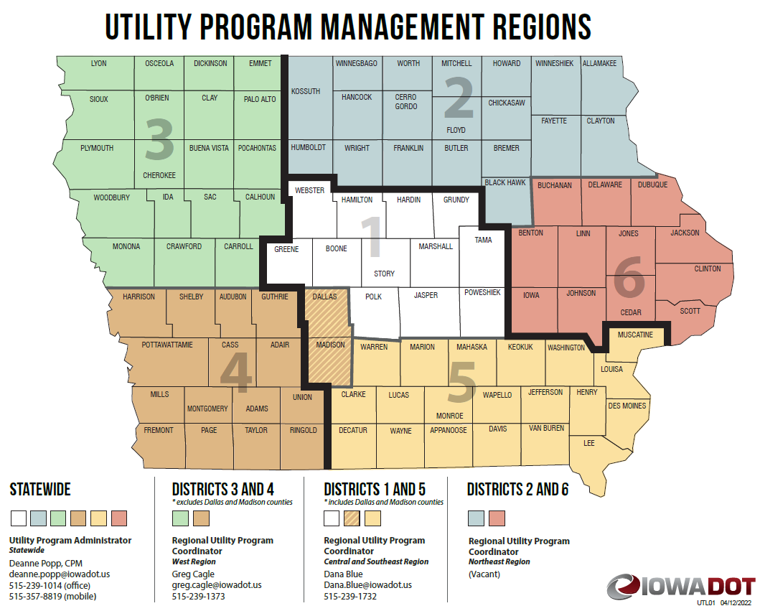
Notes:
This map shows the regions that each regional coordinator will be handling.
Districts 1 and 5 – the central and southeast regions will be handled by our newest staff member, Dana Blue.
Districts 3 and 4 – the west region will be handled by Greg Cagle.
We will soon have another person handling Districts 2 and 6 – the northeast region.
I am still the statewide administrator of the Utility Program
Taking the lead on administering policy
Providing guidance to all team members statewide
Leading initiatives and process improvements
And, acting as a liaison to our stakeholders

Slide 8
Central Office – Right of Way Bureau
PROGRAM ADMINISTRATOR – DEANNE POPP
Program Leader - Policy Administrator
Initiatives
Stakeholder Liaison
TRANSPORTATION PLANNER – JON REES
Right of Way Information Management
Parcel Mapping
GIS
Notes:
In addition to the regional coordinators and myself we have our new Transportation Planner, Jon Rees.
If you were here last year you met, Aspen Pflanz. She promoted outside the department and Jon, was hired as her replacement.
He is continuing the work on developing a ROW management GIS that includes right of way parcel information and utility mapping layers. Jon will be speaking about this later this morning.

Slide 9
District Utility Coordinators
District 1 – Sean Passick
District 2 – Daryl Erickson
District 3 – Kelly Mulvihill
District 4 – Nate Epperson
District 5 – Bonnie Clancy
District 6 – Steve Flockhart
Project Coordination
Utility Work Plan Review
Utility Accommodation Permit Review
Utility Reimbursement Agreement Review
Notes:
We have 6 District Utility Coordinators across the state – and there have been some staffing changes there as well.
The DUCs (as we refer the them) handle
Project coordination
Work plan reviews
Some utility permit reviews
And they also get involved in the development and review of reimbursement agreements
In District 1 we now have Sean Passick who filled the vacancy left when Jerry Lavine retired
The District 2 DUC is Daryl Erickson replacing Tracy Meise. Daryl has previous experience as an EOT approving permits.
District 3 is Kelly Mulvihill
District 4 is Nate Epperson – who filled a vacancy left by the retirement of Kurtis Shackelford
District 5 is Bonnie Clancy
And District 6 is Steve Flockhart

Slide 10
Notes:
The DOT District Utility Coordinator map has been updated with the new staffing assignments.
It shows the 6 different District areas covered by each DUC – you’ll likely be seeing this map again today in the district led presentations.
The map is also available on the FTP site for the meeting.

Slide 11
Engineering Operations Technicians
Utility Accommodation Permit Review
Project Coordination Assistance
Utility Work Plan Review
Other permits
Notes:
There are 16 additional field staff across the state that handle permitting.
These are the Engineering Operations Technicians or EOTs
They receive and process various types of permits including
Utility Accommodation
Work on ROW and
Access (or entrance) permits
They frequently get involved in project coordination and relocation work plan reviews.

Slide 12
Utility Accommodation and Coordination
Communication is KEY
Information Sharing
Annual Utility Meetings
Program Updates
Policy & Procedures
5-year program
Notes:
We all know that good communication is vital to the success of any program.
Its about sharing…
The right information - at the right time – with the right people
The Annual Utility Meetings are one of the ways we share information
Today we’ll be sharing information about various aspects of the utility program
including processes and related policy
Reimbursement agreements
Permitting
Each district will also share information about current and upcoming projects including the 5-year Program
We’ll also be sharing some information about current initiatives underway including three utility coordination research projects

Slide 13
District presentations
A closer look at current and upcoming projects
Notes:
Ok, now that we’ve covered introductions
- let’s take a closer look at what work going on in our districts.
We’re going to switch things up a bit and start with District 6 and then we’ll hear from Districts 5, 4 and 3.
Following that I’ll be going over the
Point25 process and
hit the highlights related to permitting.
then, we’ll take a little break and hear from Districts 2 and 1

Slide 14
Iowa Administrative Code 761-115 (306A)
Utility Accommodation Permits
Section 115.25 – Point25
Notes:
The work we do within the Utility Program is done under Iowa Code Section 306A
More specifically under Iowa Administrative Code – 761 Chapter 115
Many of you know this rule as our Policy for Accommodating and Adjustment of Utilities on the Primary Road System
Section 115.25 covers the adjustment and coordination on highway projects – we reference this as simply Point25 – so you’ll hear that reference frequently
Applies to all DOT projects – except
Those developed on an accelerated schedules
And those with no anticipated utility involvement

Slide 15
Point25 Overview IAC 761-115.25 = Point 25
State highway projects
Requirements that must be met
Non-responsive utility can be held liable delay costs
Utility and contractor settle directly
State is provider of evidence
State cannot take on liability of either party
Notes:
Point25 is specifically for state highway improvement projects
It sets forth the timing of notifications and plan submittals that DOT provides to utility companies
As well as the required responses from utility companies
If all the notifications and submittals are met,
Non-responsive utility owners can be held liable for project delay damages
Any claims will be settled directly between the DOT contractor and the utility owner
In those instances, the State will only be a provider of evidence
We CANNOT take on liability of either party

Slide 16
Utility coordination | “U” events
Utility milestone events
U0 Investigation (0-10% design completion)
U1 Major impacts (10% design completion)
U2 Notification (30% design completion)
U3 1st plan submittal (60% design completion)
U4 2nd plan submittal (90% design completion) (P25 projects only)
U5 Reimbursement agt. (60-90% design completion)
U6 Notice to proceed (following all approvals)
U7 Utility bid attachment (relocation status in contract letting docs)
U10 Utility clearance (relocation status [clear/not clear/conditional])
Notes:
Utility coordination and the Point25 process for state projects is broken down into project development milestones.
We refer to these milestones as “U” events
The events are tracked in our internal Project Scheduling System.

Slide 17
U0 Event | investigation
Investigate – look for utility facilities within the project area
Identify – utility facility ownership in the project area
Prerequisites: Final Concept Completion
Iowa One Call (Design Request)
Field examinations (Concept Reviews)
Utility permit records
Utility maps
Notes:
The U0 event – is the investigation step for utility facilities within the project area
We seek to identify utility facility ownership in the project area
We gather information from various sources, such as:
Iowa One Call (design request)
Field examinations (concept review)
Utility maps
Existing permit records

Slide 18
U1 Event | major impacts
Look for the potential for impacts to large capacity facilities
Request more precise location information from utility owner
Provide the information to designers to lessen impacts
Avoid
Minimize
Accommodate
Notes:
During the U0 investigation we look for the potential for impacts to major or large capacity facilities
If we see something that we need to look into a little further, we’ll contact that company
For more precise location and capacity information
We might also ask for a high-level estimate for relocation or adjustments should they become necessary
These help us to make better design and development decisions.
The information we receive is provided to the project designer with the intent to design around or at the very least minimize the impact to that facility.
The goal for the event is to be early enough in the project development process to allow for modifications to the design.

Slide 19
U2 Event |notification
Prerequisites:
Completed D02 (Field Exam Plans)
Request verification of facility locations (90 days to reply)
Public ROW or private easement?
If facilities ARE on private easement and relocation is necessary…
Will company purchase their own replacement easement?
Will company request DOT to purchase their replacement easement?
Notes:
When the field exam plans have been completed, we are ready for the U2 event
These plans include a general project layout (approximately 30% design)
At this point the new ROW lines have not been determined
With the U2 we submit a notification to the known utility companies in the project area
We request verification of existing facility locations from utility companies (90 days to reply)
We also want to know if your facilities are on the public ROW or in private easement in the vicinity of the project.
If the facilities ARE on private easement – would your company purchase their own replacement easement?
Or, would they request the DOT to purchase replacement easement for them if it’s needed?
Again, our goal is to be early enough in the design development to allow for modifications
And for our ROW Design staff to include any utility easement needs in the ROW design.

Slide 20
U3 Event | 1st plan submittal
Prerequisites:
Completed road design (D05)
Proposed new ROW layout (R01)
All MUST reply whether impacted or not (90 days to reply)
All impacted companies must provide a relocation plan (same 90 days)
Show relocation on DOT plan & cross section sheets
What is an acceptable relocation plan?
Notes:
Next is the U3 event – this is the 1st plan submittal
These plans include the proposed road design AND the new proposed ROW layout (approximately 60% design)
This submittal is sent to all known utility companies with facilities in the project area.
Each company has 90 days to reply as to whether or not their facilities will be impacted.
Every company must reply regardless if they’re impacted or not
If you do expect to be impacted by the road project you MUST provide us with a relocation work plan within the same 90-day time period.
The relocation plan is to be shown on DOT project plans and cross section sheets
Let me give you an idea of what we’re looking for in the relocation plan

Slide 21
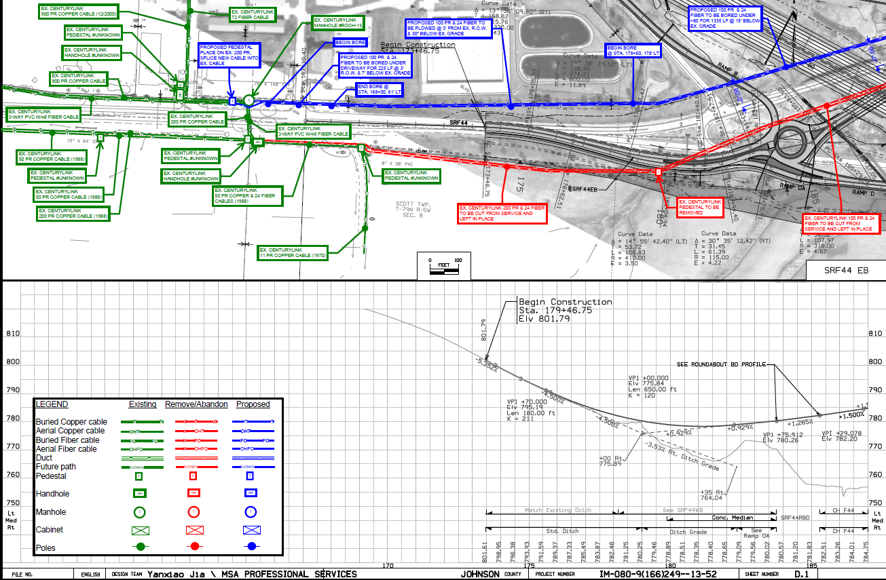
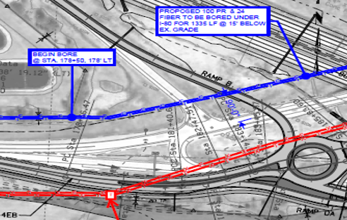
Notes:
This slide shows one example of basic information we would like to see in your relocation plan.
Here the utility company shows their design in an overlay on the D sheets (plan and profile sheets)
They included a legend…
Green represents their existing facilities
Red represents what they plan to remove or abandon
And blue shows their new proposed route
Notice they have call-outs with specific details about various locations
This is one example of the basic information we’d like to receive.
One thing to note is that if you’re planning to request reimbursement, we’ll need to see this information on the H sheets as well (that’s the ROW sheets).

Slide 22
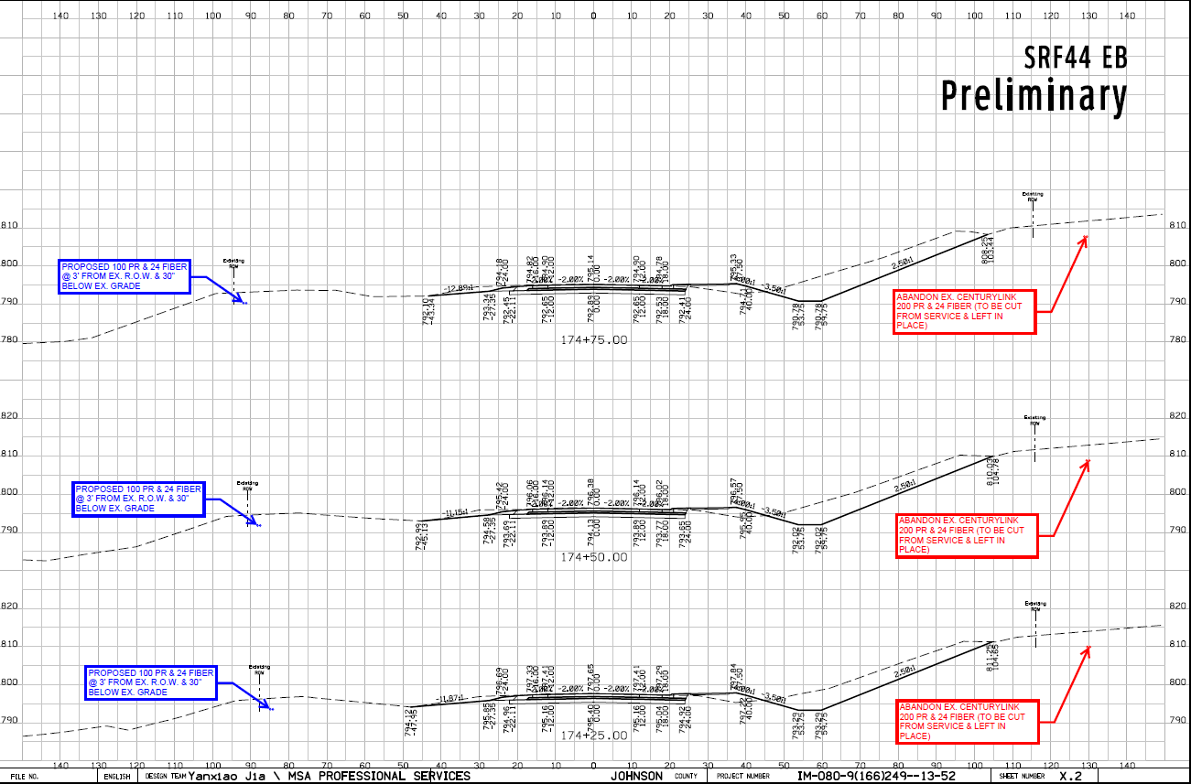
Notes:
This slide shows an example of utility information on a cross section sheet.
It shows the approximate depth and location of the underground facility – and details about what the plan is for the facility at that location

Slide 23
U4 Event | 2nd plan submittal
Prerequisites:
Public hearing or information meeting completed
Changes incorporated into proposed ROW layout
All MUST reply whether impacted or not (60 days to reply)
All impacted utilities must provide a FINAL relocation plan (same 60 days)
Show relocation on DOT plan & cross section sheets
Notes:
The 2nd plan submittal or U4 is done following the Public Hearing or Public Information Meeting
Any changes requested as a result of the public’s input are incorporated into the final ROW layout (approximately 90% design)
Again, this submittal is sent to all known utility companies with facilities in the project area.
Each company has 60 days to review the information and reply as to whether or not their facilities will be impacted.
Again, everyone must reply regardless if they’re impacted or not
If they are going to be impacted by the road project they MUST provide us with a FINAL relocation plan within the same 60-day time period.
And again, the relocation is to be shown on DOT project plans and cross sections
The U4 submittal is only provided on Point25 projects

Slide 24
U5 Event | agreement
Reimbursement Agreement
Who pays?
Relocation necessary to accommodate construction
Existing facility
Private Easement
Public Right of Way
Prerequisites
Easement documentation
Relocation work plan
Estimate of relocation costs
Notes:
Some utility relocations or adjustments may be eligible for reimbursement
If it’s determined that a reimbursement agreement is needed, then we track that as a U5 event
So, how do we establish who pays? – State or the utility company?
First off, the relocation must be necessitated by the highway project
Then it depends on the location of the existing facility
If it’s on private easement – it would be eligible for reimbursement
If it’s on the public right of way by permit – then the company must relocate at their own expense
There are a few things we need to begin the agreement process – we need
The company’s existing easements
Their approved relocation plan (shown on the H sheets)
And a detailed estimate of relocation costs
We’ll discuss this further a few slides later

Slide 25
U6 Event | notice to proceed
Prerequisites:
Final utility relocation work plan approved
New right of way acquired
Reimbursement agreement executed (if applicable)
Permits issued (if applicable)
Coordination with DOT contractor or other utility companies?
Notes:
The Notice to Proceed is the next step – that’s the U6 event
There are several things that must fall into place before the notice can be given.
The company’s relocation plan must be approved
Any necessary new ROW in the vicinity of the relocation must be acquired
The reimbursement agreement must be executed (if there is one)
And the utility permits must be issued (if there are any)
In addition, if there is any coordination required with the DOT’s contractor or other utility companies, then the notice may be conditional to the other party’s schedule

Slide 26
U7 Event | bid attachment (UBA)
ALL Point 25 Projects (Recommended for Non-Point 25 projects)
Included in bid documents
Written details regarding conflict locations and resolutions
Anticipated start and completion dates for relocations
Utility company contact information
For bidding contractors’ use – to make them aware of the status of utility relocations and timeline – so they can bid accordingly
Notes:
The U7 is the Utility Bid Attachment (or UBA)
This is a document the DUC provides to our Contracts Bureau to be included in the final bidding documents
It is required on ALL Point25 projects (and is sometimes included on Non-Point25 projects)
It is a formal report of the status of utility relocations at the time of plan-turn-in
It includes written details about any remaining conflict locations and their intended resolution
It also states anticipated start and completion dates for utility relocations that still needs to be done
The UBA is intended for the bidding contractor’s use – to make them aware of the status of utility relocations – and allows them to bid accordingly.

Slide 27
Reimbursement Agreements
Existing facility
Private Easement
Public Right of Way
Eligibility
State’s authority to reimburse
Evidence of easements
Notes:
As I mentioned before, some utility relocations or adjustments may be eligible for reimbursement.
To get started on the agreement we need to establish eligibility and determine how much is reimbursable.
To do this we need to review the company’s easements

Slide 28
Easement Documentation
Correct area
Correlate to DOT parcels
Notes:
It might seem obvious, but the easements should be for the area where the relocation is to be done
When providing easements, it helps us if you reference the corresponding DOT parcel numbers from our plans
We need to correlate the area to make sure it’s for the correct area
This helps us to establish the state’s authority to reimburse and enter into the agreement.

Slide 29
Proposed Relocation Work Plan – EXHIBIT A
Show existing location of facilities
1
Show proposed location of facilities
2
Overlay on DOT plans and cross sections
3
Notes:
As I mentioned before the relocation plan should be shown as an overlay on the DOT plan sheets
(for the agreement, preferably on the H sheets showing the ROW and parcel information)
This will become the EXHIBIT A of the agreement
It’s pertinent to show where your existing facilities are located
The proposed location of your facilities
And any areas where you plan to remove or abandon facilities

Slide 30
Scope of Work
Clear description of the work required
Size(s) of facility
Length of relocation
On public ROW (at company expense)
On private easement (eligible for reimbursement)
Tabulation of conflict points
Crossings, Poles, Vaults, Ducts
Work to be done by Force Account or Competitively Bid?
Notes:
We need a clear description of the work to be accomplished
Including the size or sizes of the facilities
The location and length of the relocation
How much is within the public ROW (this would be at company expense)
How much is on private easement (this is the portion that would be eligible for reimbursement)
A tabulation of conflict points, crossings, poles, etc.
We also need to know who will be performing the physical relocation work?
Will it be done by company forces
Or, will you be soliciting bids for the work?

Slide 31
Detailed Estimate of Relocation Costs – EXHIBIT B
Segregate direct, indirect & “unallowable” costs
1
Cost Accounting Standards
Work Order System
2
Ability to accumulate costs to a project
3
Notes:
A detailed and itemized estimate of the relocation costs is also needed
The detail is necessary to determine if your company can segregate the costs for the project;
To be able to show costs that are allowed vs costs that are not allowed;
Whether you are using a cost accounting system or a work order system; and
If your company can accumulate costs toward a specific project
This will become the EXHIBIT B of the agreement

Slide 32
Direct Costs
Benefit one project and only one project
Include:
Materials & equipment
Labor & wages
Engineering
Directly related
Notes:
The detail we are looking for in the estimate should show direct costs - that benefit one project and one project only.
It should include a breakdown of
Materials & equipment
Labor & wages, and
Engineering
Again, these must be directly related to this specific project

Slide 33
OVERHEAD & INDirect Costs
Eligible costs - must be actually incurred
Include:
Administration
Accounting fees
Legal fees
Insurance
Notes:
Some overhead and indirect costs may be allowed – these are costs incurred to run a business – in order to include them they must be actual costs that your company incurs such as:
Administration
Accounting fees
Legal fees
Insurance

Slide 34
OVERHEAD & INDirect Costs
Ineligible costs
Include:
Advertising
Interest on borrowings
Fines & penalties
First-class travel
Notes:
Ineligible costs would be things like
Advertising & sales promotion
Interest on borrowings
Contributions & donations
Fines & penalties
First-class travel & entertainment

Slide 35
Betterments & credits
Work done that is NOT attributable to the highway project - NOT reimbursable
Work done at the election of the utility – NOT reimbursable
Increased capacity - NOT reimbursable
Service improvements - NOT reimbursable
Salvage value of materials removed
Recovered from temporary use
Accepted for reuse by the utility
Must be shown as a credit in the estimate
Notes:
Only relocation work necessitated by the requirements of the highway construction are reimbursable
If you cannot attribute the work to the highway project, then it would not be reimbursable
The same goes for work done at the election of the utility, such as
Increased capacity
Service improvements
There are also items that should be shown as a credit on the estimate
Salvage value of materials removed
Items recovered from temporary use
And items accepted for reuse by the utility company
All of these are NOT reimbursable and MUST be shown as a credit in the estimate
In some instances, a non-equivalent replacement might be necessary for the relocation. This may appear on the surface as a betterment, but other issues may support the need for the alternate choice.

Slide 36
Putting it all together
Item | Amount |  | Eligible Costs
Design/engineering | $75,000.00 |  | $57,692.31
Materials | $250,000.00 |  | $192,307.69
Labor | $500,000.00 |  | $384,615.38
Subtotal | $825,000.00 |  | $634,615.38
Indirect (allowable) | $165,000.00 |  | $126,923.08
Indirect (unallowable) | $82,500.00 |  | $0.00
Betterment (credit) | $15,000.00 |  | -$15,000.00
Salvage (credit) | $5,000.00 |  | -$5,000.00
Total | $1,092,500.00 |  | $741,538.46
Length on Public ROW | 1,500 | ft | 23% | non-reimbursable
Length on Private Easement | 5,000 | ft | 77% | reimbursable
Total relocation length | 6,500 | ft | 100%
 | Contract Amount |  | $741,538.46
Notes:
This slide shows an estimate summary which should be included along with the supporting cost detail.
It shows a line item for the major components of the estimate.
A breakdown of each of these would be in the supporting details
An Excel spreadsheet is available for use in preparing and submitting your estimates.
You’ll likely see us providing this to you when we request supporting information for the agreement.

Slide 37
Agreement Document
Pre-Audit - $50K 
Draft review
Send for signature
Internal Staff Action
Fully executed agreement
Notes:
We review all the information provided for compliance with the project and state and federal regulations.
When the estimated work is $50,000 or greater, we’re required to have an internal pre-audit conducted
This is done by our DOT Auditors in our Finance Bureau
After the pre-audit is complete and we’ve fully reviewed the draft agreement internally we send it out to the company for review & signature
Following the company’s execution, we complete the internal DOT approvals (this is our Staff Action process)
It’s the departmental approval to enter into an agreement with an external party
Then the DOT may then sign agreement
And the fully executed agreement is returned to the company

Slide 38
Change orders - 125% of estimate
Prior approval needed
Request in writing to Central Office
Updated itemized cost estimate
Explanation of increased costs
Only reimburse additional cost if approved by DOT in writing
Notes:
We all know that in reality things don’t always turn out the way they appear on paper
Significant changes to the scope of work must be requested in writing for approval from the DOT
An addendum to the agreement may be needed
If the costs will exceed 125% of the estimate ~ unless the increase is $10K or under
You should provide us with an updated cost estimate
Along with an explanation of increased costs
We can only reimburse for the additional costs if they were approved by DOT in writing

Slide 39
Invoices & payments
Expenses must be incurred prior to the date of the invoice
Progress payments allowed
Indicate Progress or Final on the Invoice
Notes:
As far as invoicing and payments –
Expenses must be incurred prior to the date of the invoice
Progress payments are allowed as the work is being done
Invoices need to show the % complete
Whether it’s a progress billing or a final invoice
Other things to note on the invoice are
The agreement number and the DOT project number
Any company project or activity numbers
The beginning and ending date of work for the period being billed
And support for the costs incurred - itemized statement – copies of receipts, time cards – that sort of thing
The total claimed to date should also be included.
We will retain 10% of the invoiced amount until the project is complete
When making payments we can only pay up to 90% of agreement amount
Any costs that exceed that will be included in the final audit which will determine if the additional costs were justified.

Slide 40
Final payment
Certificate of Completion
Final Audit
Disclaimer of Interest in Realty
Retainage
Notes:
Regarding the final payment - a few things are needed prior to the release of the retainage
One being the Certificate of Completion
That needs to be filled out including the completion date and submitted to DUC
The DUC will review and sign it if the relocation is complete and acceptable
We also perform a Final Audit of the entire cost of the relocation
We submit all invoices & supporting documents for review by our internal Auditors
This can take some time to go through
They will make a determination on whether charges are in line with estimates and the work performed
We may request repayment of some of the funds if our auditors determine that the company has been overpaid
We will release the retainage if all is in compliance
The release of easement rights also needs to be completed – this is the Disclaimer of Interest in Realty (or sometimes an Instrument of Subordination)
This releases the company’s interest in all real estate acquired for the project where the utility was originally located
The company will retain any easement rights outside of the ROW
After all of this is complete, we can then release (or pay) the retainage (if any)

Slide 41
Success!
Agreement process is complete
Maintain files & records for a period of 3 years from the date of final payment.
Notes:
And - with all of that - the agreement process is then complete!
By regulation the utility company is required to keep their files and records for a period of 3 years from the date of final payment.
- in case we need to revisit for audit purposes.

Slide 42
UTILITY PERMITS
IOWA DEPARTMENT OF TRANSPORTATION
UTILITY ACCOMMODATION PERMIT
Notes:
Utility permitting is a big portion of what we do in the utility program.
Iowa Administrative Code – 761 Chapter 115 includes the regulations that govern where and how utility facilities can occupy primary highway rights of way in Iowa.

Slide 43
WHEN ARE PERMITS REQUIRED?
Any time you plan to locate facilities within the highway right of way
New installations
Upgrades
overhead changed to underground
Notes:
A permit is required any time you plan to locate facilities in the public rights of way
This includes new installations
And upgrades to an existing facility
Such as changing overhead to underground

Slide 44
MAINTENANCE
Covered under original permit
Requires 48-hour notification
Exact same size, location, and install methods
Notes:
Maintenance of an existing facility is covered under the original permit
And requires a 48-hour notification to the DOT before beginning any work
Unless it’s an emergency
Maintenance includes any work on the facility that is for the exact same size, location and install methods
This would include pole replacement as long as the facility is NOT being upgraded
The new pole must be placed within 1 foot of the original location

Slide 45
When more than one permit is needed
Non-continuous installations
Multiple highways
Multiple utility types
Notes:
Sometimes more than one permit is required for an installation
Each non-continuous installation requires a separate permit
Installs that begin on one highway and continue onto another highway must be split
If the permit involves more than one utility type such as fiber optic and telephone – it must be split
Even if they’re installed in the same location at the same time

Slide 46
When to submit
More lead time may be needed
30-days review period
Notes:
What the lead time?
Allow for AT LEAST 30 days prior to the expected installation time
This is because it may take DOT some time to review the request
We have 30 days to review and return the permit – provided that
All of the pertinent and required information is included in the submittal
That everything is in the correct and accurate format
That all of the required attachments are included
And, that all of the prior approvals have been received and are included with the submittal
There may also be some federal highway administration approvals that are needed
These are allowed to exceed the 30-day timeframe
Large and complicated installs may need more lead time – since their may be more involved in the review

Slide 47
Where’s my permit?
Sent to the wrong DOT office
Incorrect format
Inaccurate or missing information
Notes:
Sometimes it may seem as if there is a delay in getting permits issued.
Multiple factors can play into why permits take longer than 30 days.
Sending the request to the wrong DOT office
Sending the request in the wrong format
Inaccurate or missing information – such as traffic control plans
How do you know which EOT to work with?
EOT territory maps are available on our website and the ftp site for this meeting
- And you can always call and ask for assistance if you’re not sure

Slide 48
Who is the Applicant?
Utility Company
Company permanently responsible for the facilities once installed
Authorized Representative
Permission to sign requests – is NOT the applicant
Notes:
Some things to remember when completing the request for a permit.
The APPLICANT named should be – the company permanently responsible for the facilities that are being installed
Installers or the utility company’s contractor are NOT the applicant
The applicant’s signature MUST be someone that is an authorized representative of the utility company
Private contractors are NOT to be signing as the Utility Company’s representative
Unless they are under a contract specifically giving them authorization to officially represent the company
This might be the case if the utility company has contracted with a consultant for their engineering and permit applications
However, the utility company should still be listed as the applicant – the consultant’s contract only gives them the authorization to sign the requests on behalf of the company
The applicant contact information is also very important – and should be filled out completely
It should list someone who can answer questions that may arise from the permit

Slide 49
Describe the installation
Method of installation
Materials to be used & encasement details
Section, Township & Range
Highway involved – Reference points & side of road
Show this on your site plan
Notes:
You need to properly describe the installation and the method for installing
boring, digging, open trench – and what materials will be used – and encasement materials if any
The work site location should also be very specific
Including the Section, Township and Range
The highway is involved
Reference points
And which side of the road you’re going to be working on
All this information should also be reflected on the site plan

Slide 50
Field reviews
ALWAYS field evaluate the location for anomalies
Measure from a known and identified point to the beginning and ending location(s)
Notes:
It’s ALWAYS a good idea to field evaluate the work area
Some things aren’t always apparent on aerial photos or a set of plans
We don’t recommend designing your installation from behind a desk
You should make your measurements from a known and identified point to the beginning and ending location(s)
You might find a milepost marker and you can use that.

Slide 51
Permit approvals
Cities – joint jurisdiction
Counties
Corps of Engineers – major waterways
Protected areas – DNR
Notes:
Approvals on permits often involve multiple parties
In addition to the applicant –
For installations where any portion is within the corporation limits of a city, you’ll need that city’s approval
Whenever the installation originates from, exits into or crosses a county road or county-owned property you’ll need county approval
City and county approvals should be acquired BEFORE you submit your request to the DOT
Other approvals might be needed for things like
Impacts to major waterways or “protected” areas
You may need approval from the Army Corps of Engineers or the DNR
These approvals can be in the form of a signed letter that you submit with the request

Slide 52
Other things to note
Special requirements – added by DOT
Restrictions or additional stipulations not outlined in the standard permit
Your issued permit includes ALL pages to be valid
Notes:
Special requirements, restrictions or additional stipulations may be added by the DOT repthat might not be outlined in a standard permit
These might include special construction methods
Special traffic control
Work restrictions (for certain hours or days)
Please remember that you need to have your issued permit with you on the job site!
This should be the entire permit including all pages and attachments
These pages include general construction and maintenance requirements
Liability
These provisions apply to ALL installations unless specifically modified by the DOT in the “Special Requirements”

Slide 53
Electronic permitting system
VERY close to completion
Successfully tested
More testers needed!
Notes:
The development of the long awaited Electronic Permitting System (EPS as you may have heard it referenced) is VERY close to completion
A consultant working for a utility company has successfully requested several permits through the system
We gave them access to the system and they submitted 8 permit requests
Our staff was able to complete the review and issue the approved permits
– We are still working through some refinements dealing with attachments, notifications and the final issuance.
– If your company is interested in trying the new system, I suggest you first work through our training module
– And then, contact me to get you set up to access the system and get you going.
Once we’ve had a few more companies try it out we’ll get it opened to everyone.

Slide 54
Online training module
Self-lead training module
Notes:
We have a training module we’ll have you go through prior to using EPS.
A link to the module can be found on our website on the Permit Process tab.
– This is a self-lead training course that will help acquaint you with the system
– It will walk you through the process from creating an account to final submittal.
And there’s a knowledge check at the end to check what you learned.

Slide 55
Utility permit request
Link to training module
Recommend completing
Notes:
Once you get set up with access to EPS this is the main Utility Permit Request page.
– There’s a link to the training module here as well.

Slide 56
Let’s take a brief break…
Notes:
Well, we’ve covered a lot this morning.
Let’s take a few minutes for a break and be back here at (10:15).

Slide 57
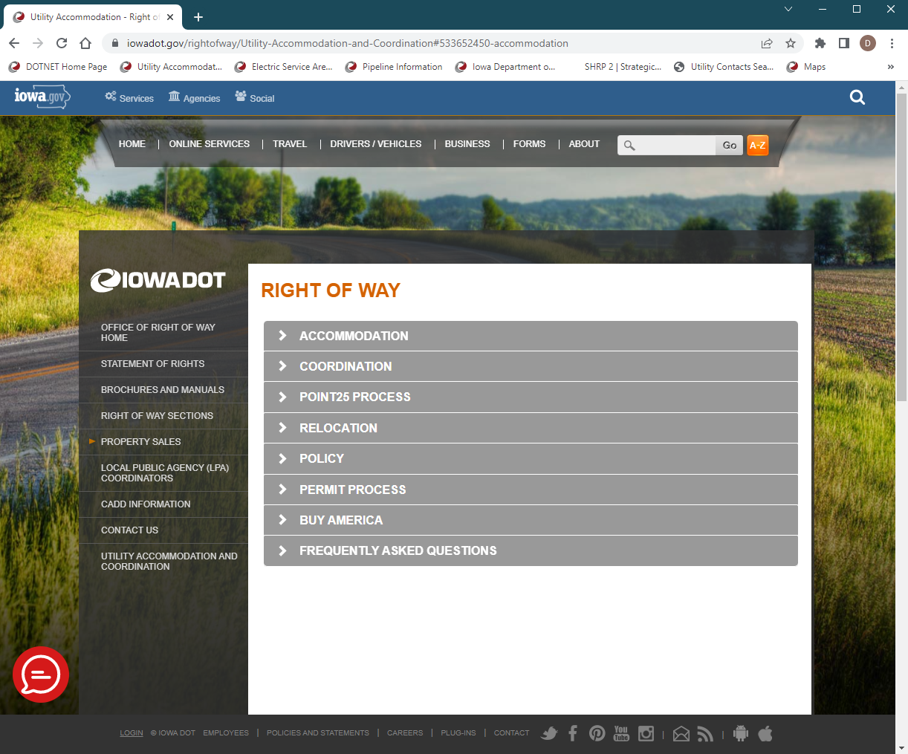
Right of Way
UTILITY ACCOMMODATION AND COORDINATION
https://iowadot.gov/rightofway/Utility-Accommodation-and-Coordination
Notes:
I mentioned our website earlier.
The site has undergone some updating over the past year – to help give you better information.
The text was revised and refreshed on several pages
A section was also added that covers the Point25 process
Updated contact information is included on the various pages for central office and field staff
Including many of the maps you’ve seen today showing who you should be working with for the various areas of the state.

Slide 58
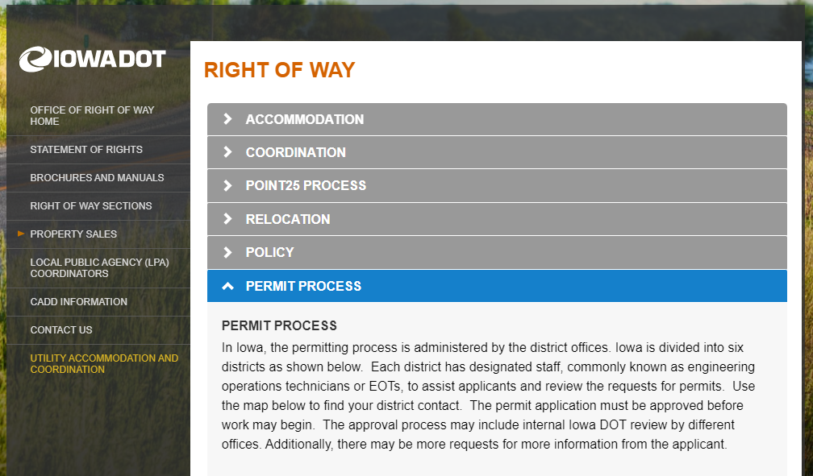
Eps training module
PERMIT PROCESS
Link to a training module for the Electronic Permitting System
Step by step instructions
Walks you through how the system works
From setting up an account to initiating and submitting a permit request
Notes:
I mentioned the training module earlier too.
You’ll find that on the Permit Process tab.
If you are involved with requesting permits, I highly recommend you take a look at the training to get a head start on what’s coming.
You’ll need to scroll all the way to the bottom to find that link – it’s the blue button here at the bottom of this image

Slide 59
FAQ
Updated questions and answers for frequent questions we receive regarding permitting
Notes:
We also updated our FAQ page with more questions and answers
These help answer the most common questions we receive regarding permitting.

Slide 60
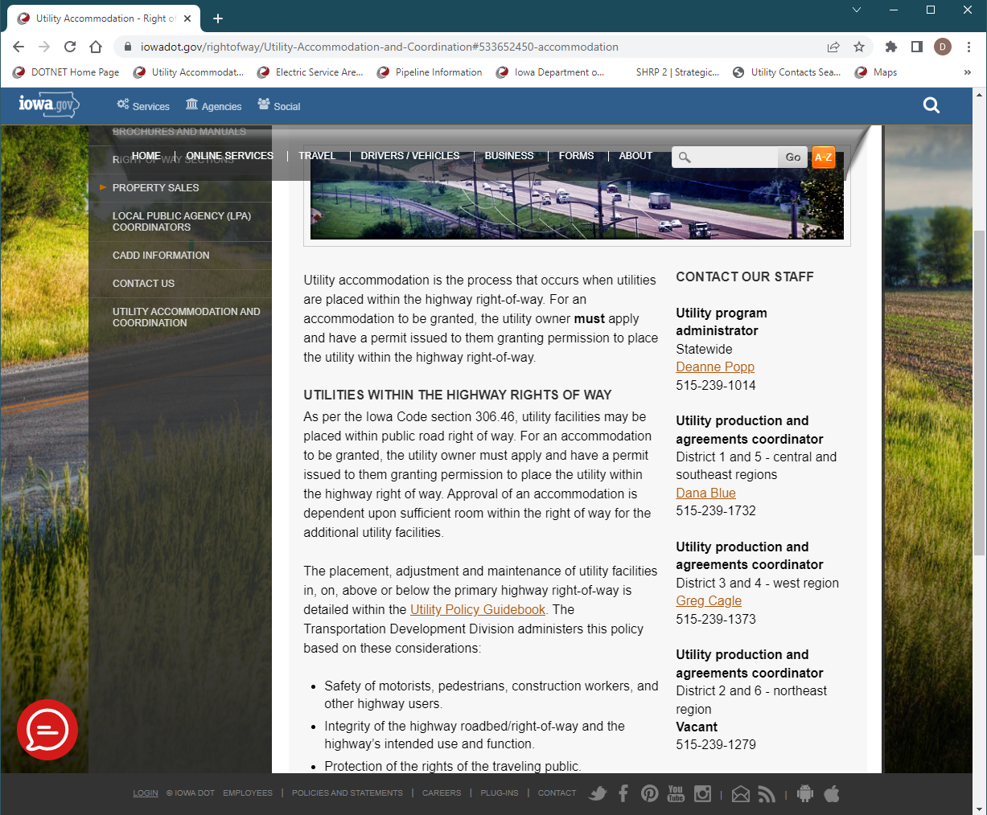
Contact our staff
UTILITY ACCOMMODATION AND COORDINATION
https://iowadot.gov/rightofway/Utility-Accommodation-and-Coordination
Notes:
My contact information can be found on our main Accommodation & Coordination page.
Along with contact info for the Regional Utility Program Coordinators
Dana Blue
Greg Cagle
And the soon to be filled vacant position

Slide 61
Questions?
Thank you for attending today!
Ftp site: https://utilities.iowadot.gov/Annual%20Util%20Mtg%202022/
Notes:
That about does it for our program today.
We’ve covered utility coordination, reimbursement agreements, permitting, research projects, GIS and our highway program.
Do we have any questions we need to cover in the Q&A?
Thank you to our presenters today and to everyone for joining our annual meeting this morning.
If there are any questions remaining, we’ll take a look at those following the meeting and get a response to you.
As a reminder – the meeting materials are available on the FTP site for the meeting.
Please remember that you can always email any one of the utility program staff if you have questions or need additional information.

Slide 62
Menti.com
Go to menti.com
Enter the code 3222 4074
Follow the prompts

