Slide 1
2023 IowaDOT Annual Utility Meeting
District 4 Presentation

Slide 2
District 4-Southwest Iowa
Scott Schram
Wes Mayberry
Scott Suhr
Orest Lechnowsky, PE
District Planner
District Engineer
Assistant Engineer
West Staff Engineer

Slide 3
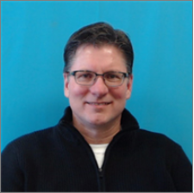
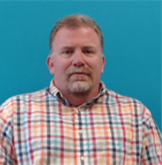
District 4-Southwest Iowa
Dave Dorsett
Vacant
Dan Redmond
Brian Smith
Tim Hensley
District 3 RCE-Cherokee
Construction Engineer
RCE-Council Bluffs
RCE-Creston
Materials Engineer

Slide 4
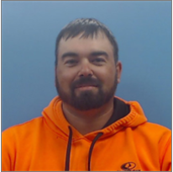
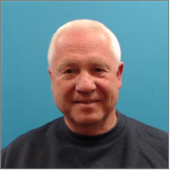
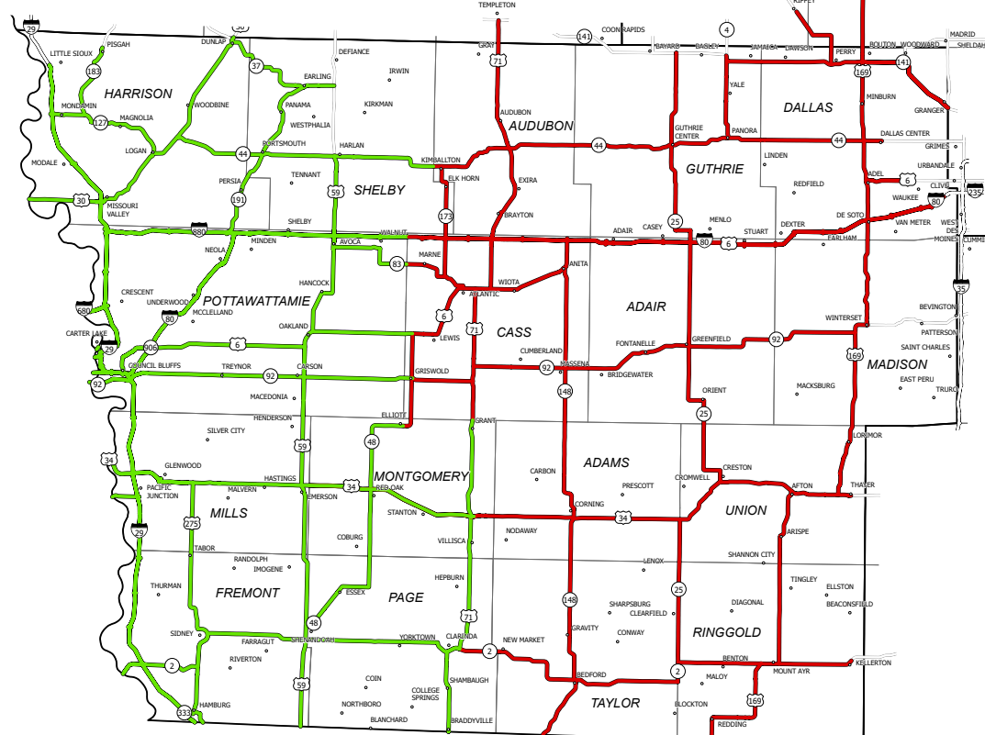
District 4-Southwest Iowa
Nate Epperson
Dick Moraine
Nick Mocha
District Utility Coordinator
Western Half
Eastern Half
Vacant
Tim Henley
District 3 RCE-Cherokee
Materials Engineer

Slide 5
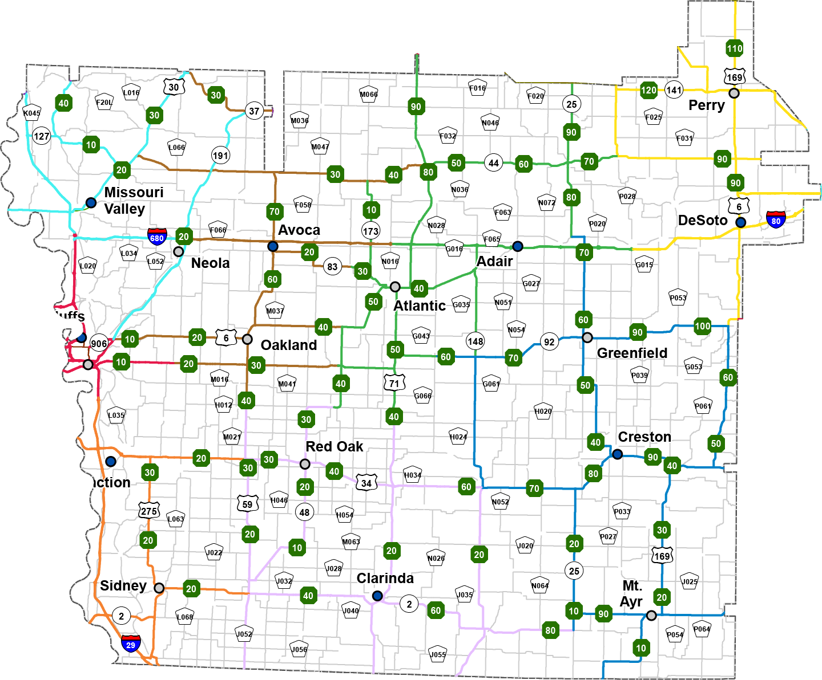
District 4
17 Counties
703 Bridges
3,792 Lane Miles
17 Maintenance Garages
2 Construction Residencies
54 Projects scheduled for 2022

Slide 6
2023 Programmed Projects
Structures
$55,175,000
Highways
$95,838,000
Total
$151,013,000
(21.3% of Highway Program)
*For work types
Pavement New/Rehab
Bridge New/Rehab

Slide 7
PROGRAM OVERVIEW Current Funding/ Construction Progress

Slide 8
Open
Dec 2022

Slide 9
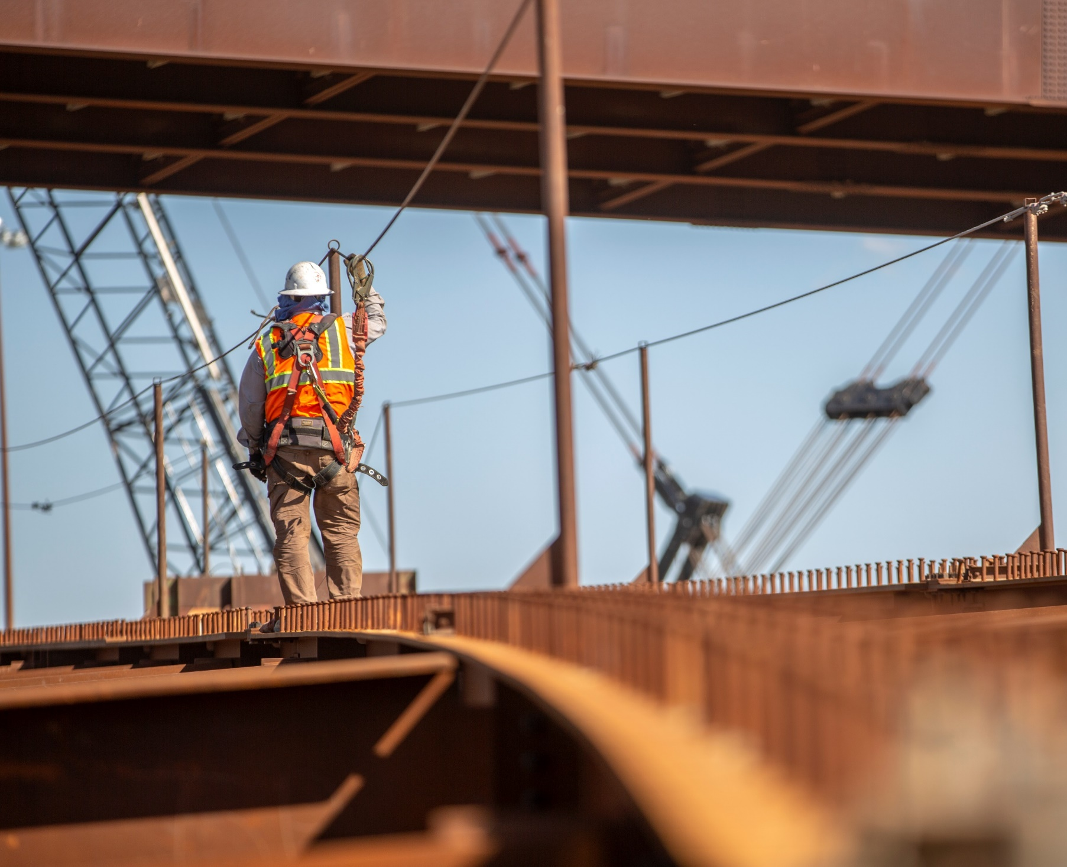
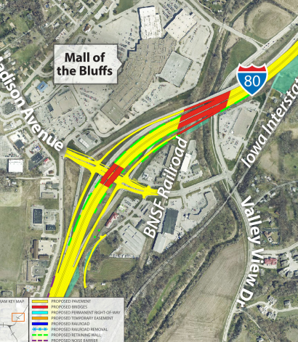
Madison Ave Interchange
Programmed Amount =
FY 23 = $66M ($60.4 Awarded)
FY 24 = $55M (November 2023 Letting)

Slide 10
2022 | Nebraska Ave Completion Madison Ave Letting #1
2023 | Madison Ave Letting #2
2024 | I-29/I-480 Completion Madison Completion
2025
2026 | Paint/Landscaping

Slide 11
Dallas County I-80 Racoon River
FY 23 $15 million for paving and bridges
FY 24 $28.5 million for grading, paving, and bridges
FY 25 $86 thousand for erosion control

Slide 12
Dallas County I-80 Widening to 6 lanes Phase I (Phase II in FY24)
FY 23 $11.3 million for grading, paving and bridges
FY 24 $19.3 million for grading, paving, and bridges
FY 25 $22.7 million for grading, paving and bridges

Slide 13
Montgomery County FY24 Grade and Pave in Red Oak
FY 24 $11.5 million for paving

Slide 14
Highway 30 Missouri Valley by-pass
FY 25 Right of way programmed
FY 26 $58.9 million for grading and culverts
FY 27 $17.9 million for bridges
FY 28 Paving to be programmed

Slide 15
QUESTIONS?

