Slide 1
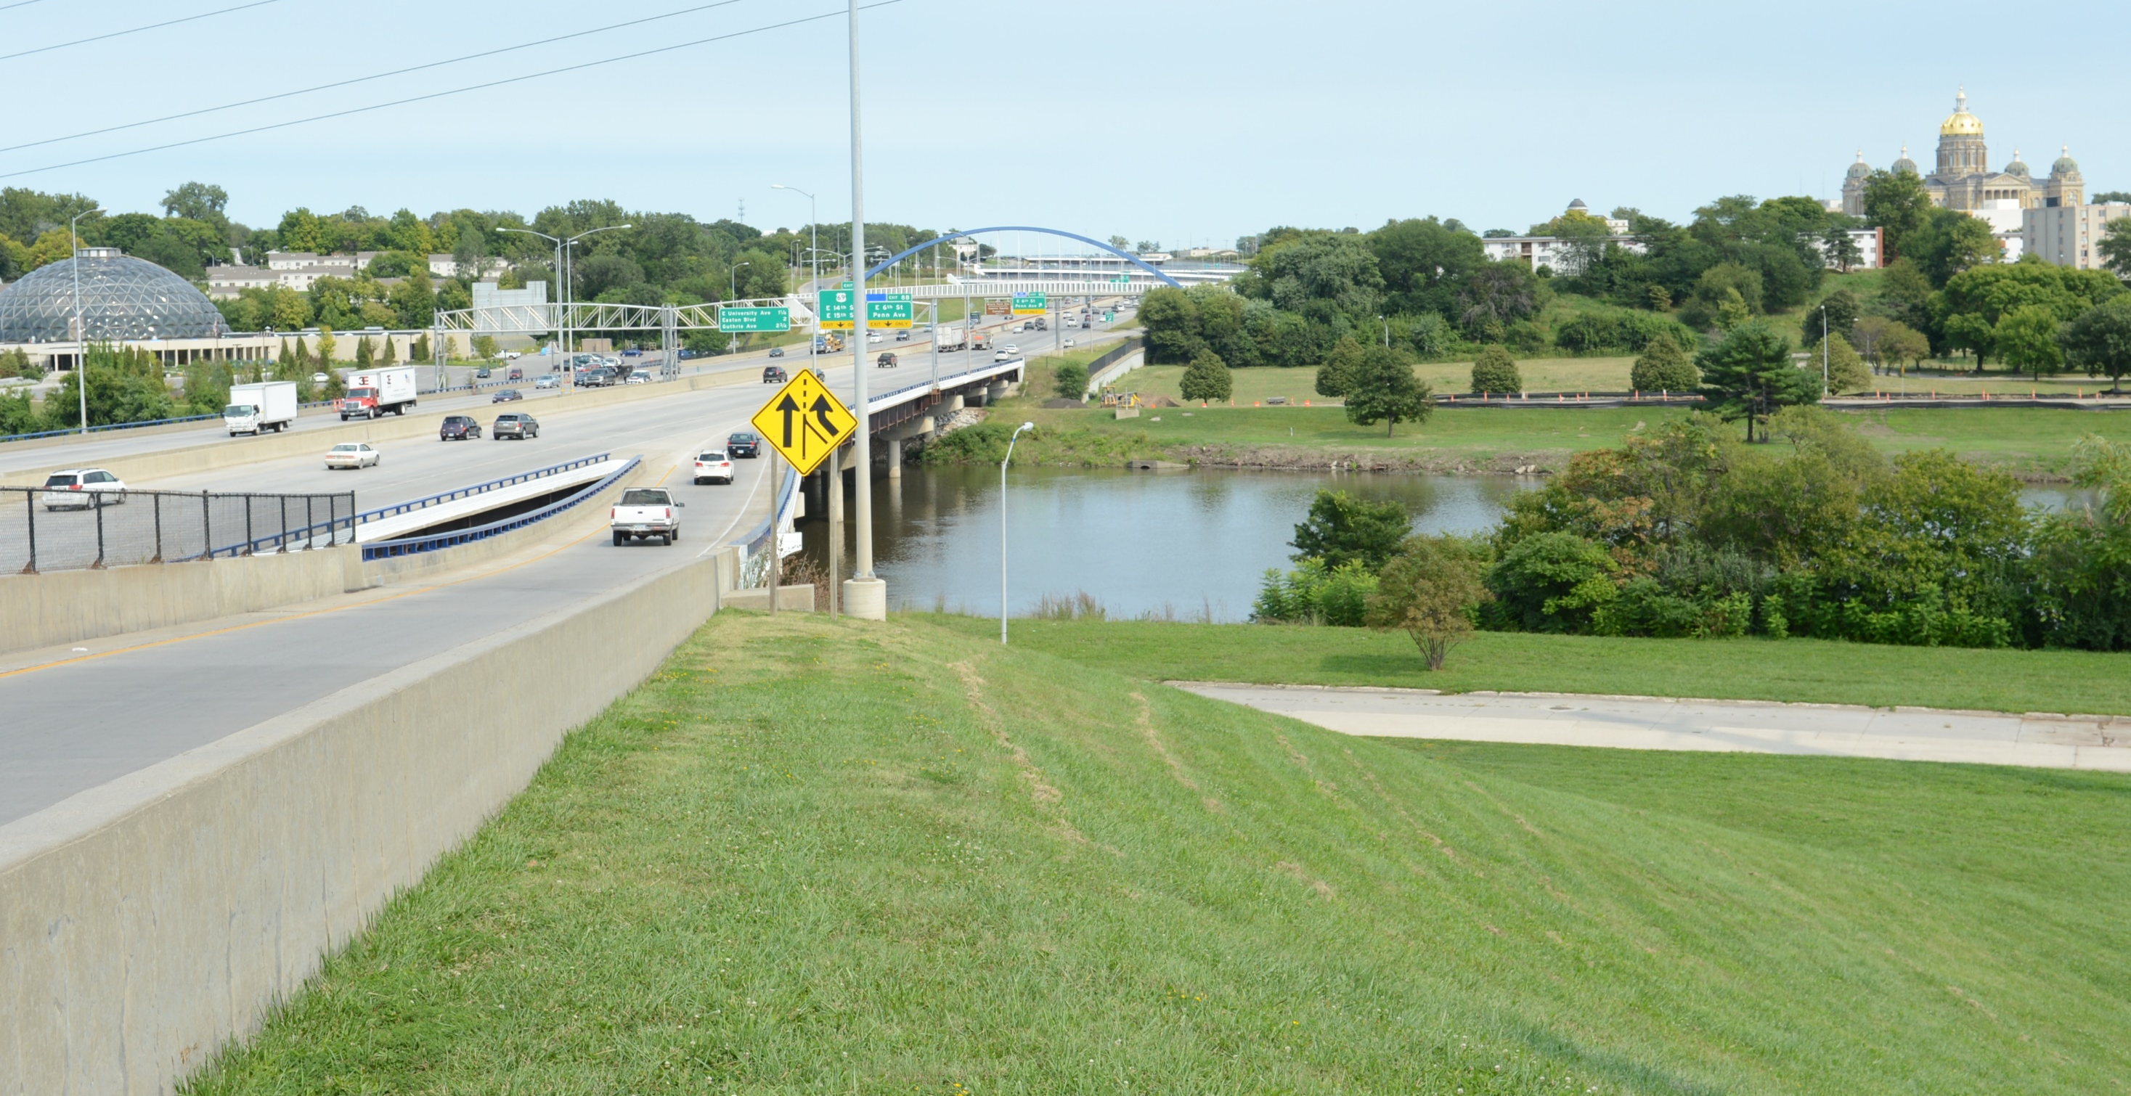
District 1 Projects – 2023 DOT Annual Utility Meeting

Slide 2
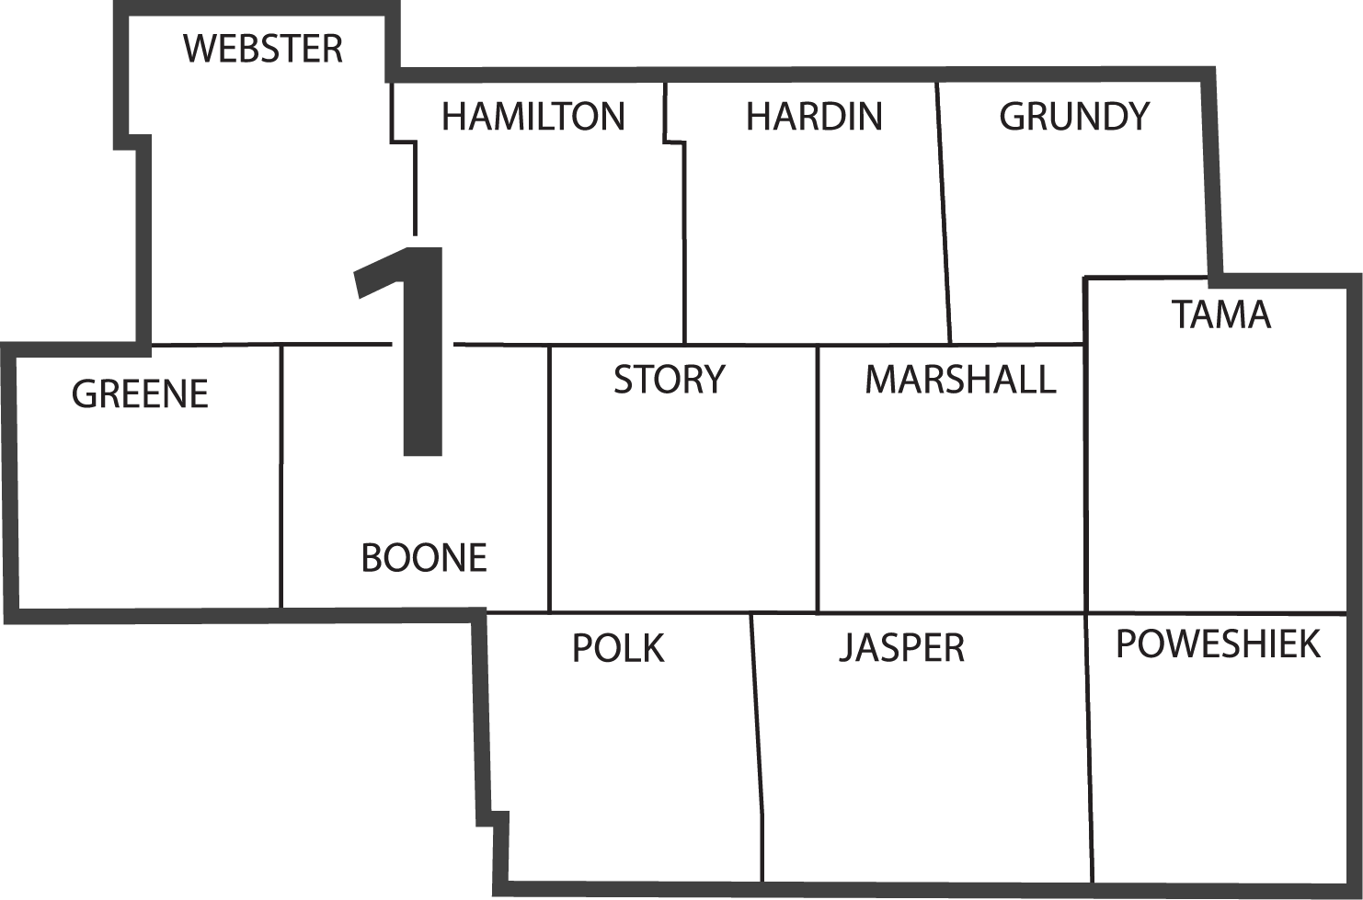
DISTRICT 1
Tony Gustafson, P.E.
District 1 Engineer
Marshalltown
Ames
Jefferson
Iowa DOT District Office
Des Moines
Resident Construction Office
Maintenance Garage
District Operations Manager Office

Slide 3
DISTRICT 1 ENGINEERING STAFF
TONY GUSTAFSON, P.E.
DISTRICT 1 ENGINEER
ALLISON SMYTH, P.E.
ASSISTANT DISTRICT 1 ENGINEER
SCOTT NIXON, P.E.
DISTRICT 1 CONSTRUCTION ENGINEER
VACANT
TRANSPORTATION SYSTEMS MANAGEMENT & OPERATIONS ENGINEER
FRANK LEONG, P.E.
RCE– GRIMES
JENNY HOSKINS, P.E.
RCE– JEFFERSON
DUSTIN SKOGERBOE, P.E
RCE– MARSHALLTOWN
MIKE LAURITSEN, P.E.
DISTRICT 1 MATERIALS ENGINEER

Slide 5
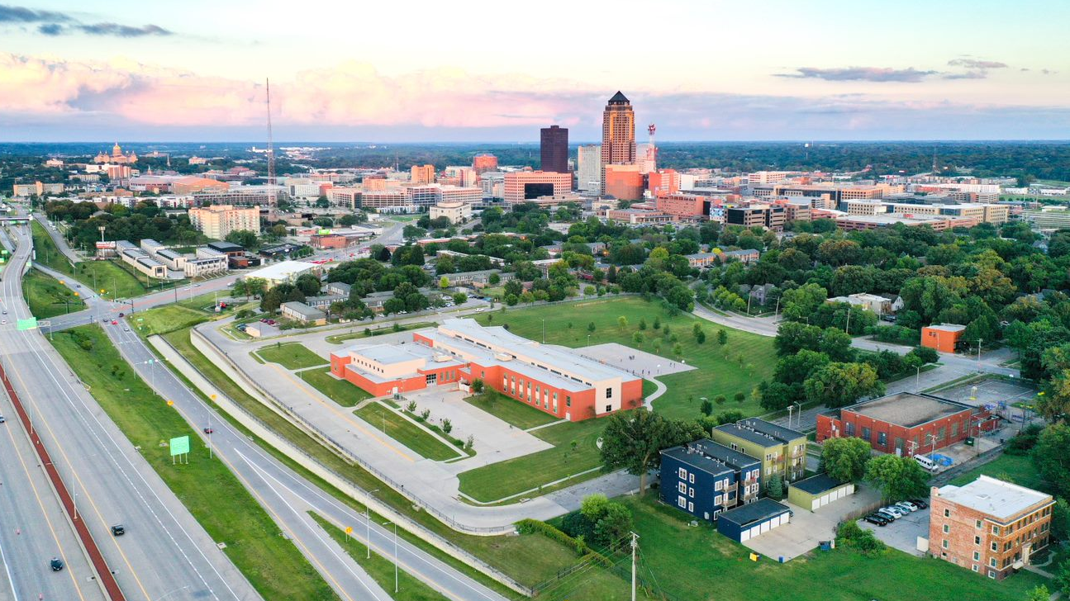
DISTRICT 1 GOALS
SAFETY
STEWARDSHIP
OPERATIONS

Slide 6
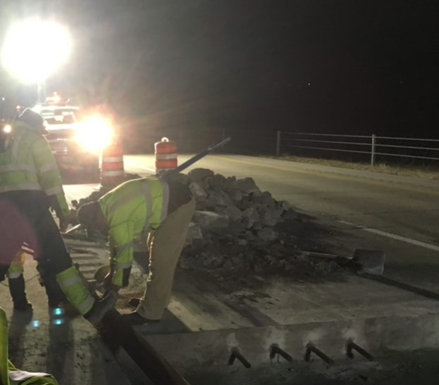
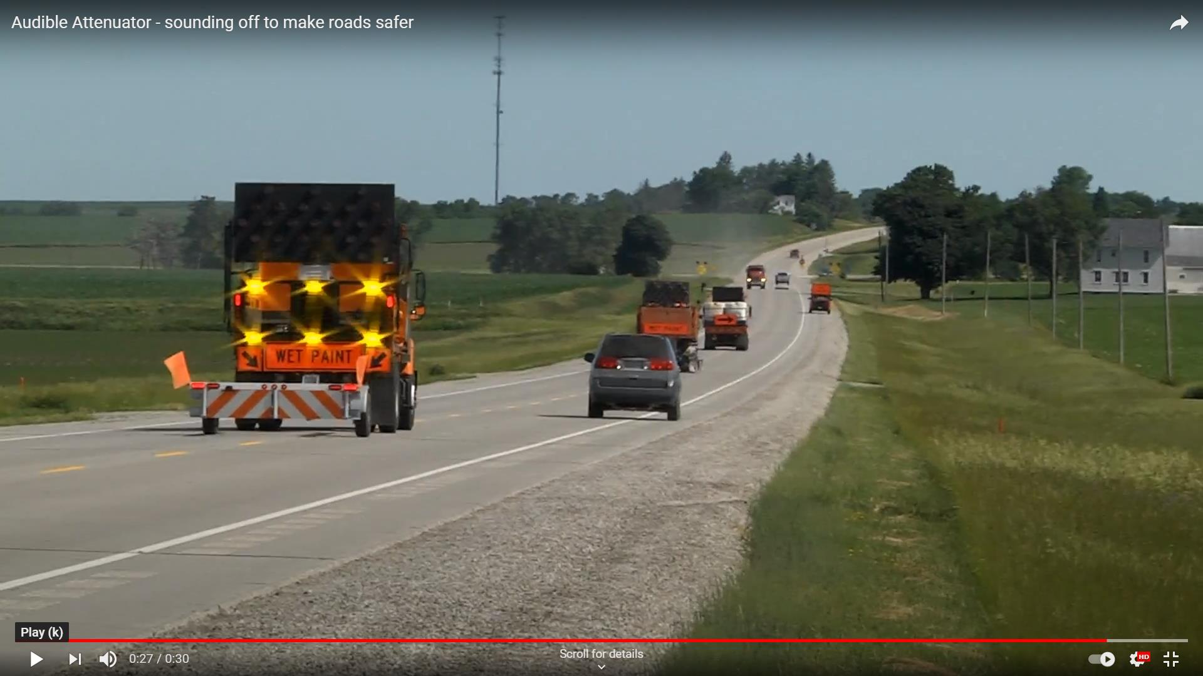
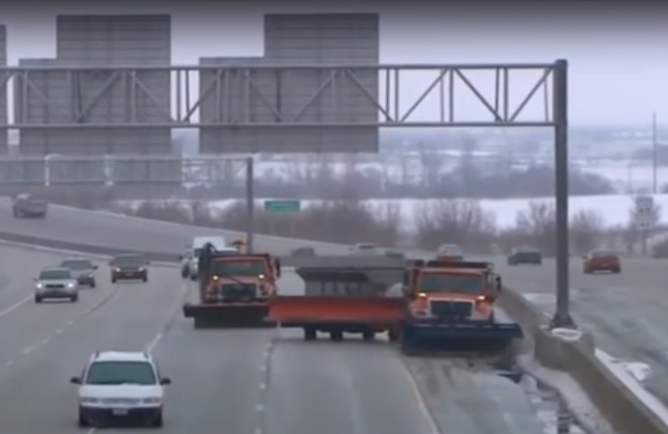
SAFETY
DOT Employees
Traveling Public
Distracted Drivers

Slide 7
STEWARDSHIP
Interstate
CIN/NHS
Other primary highways

Slide 8
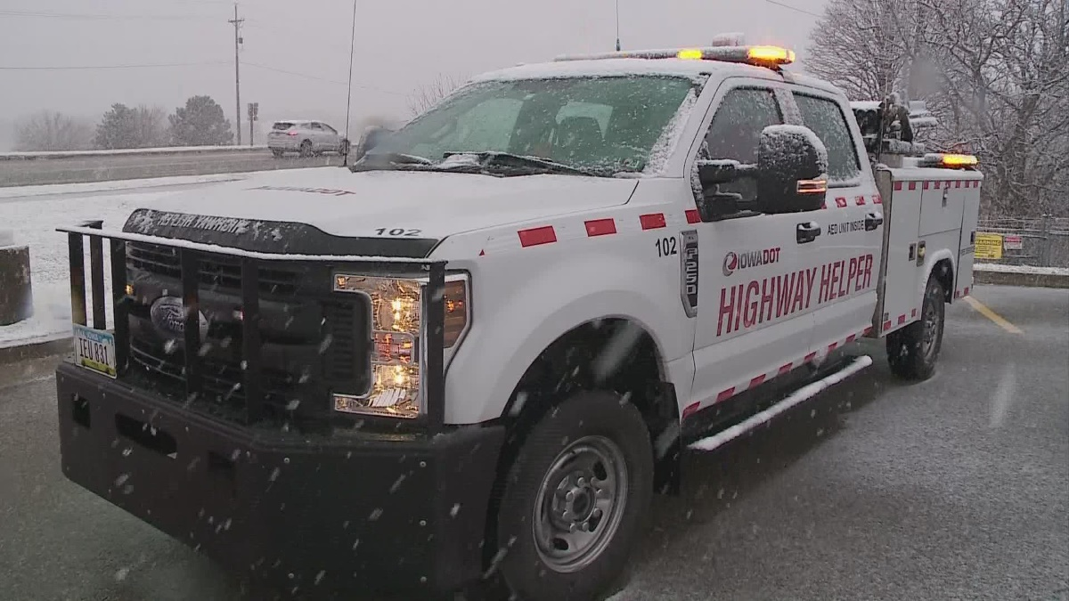
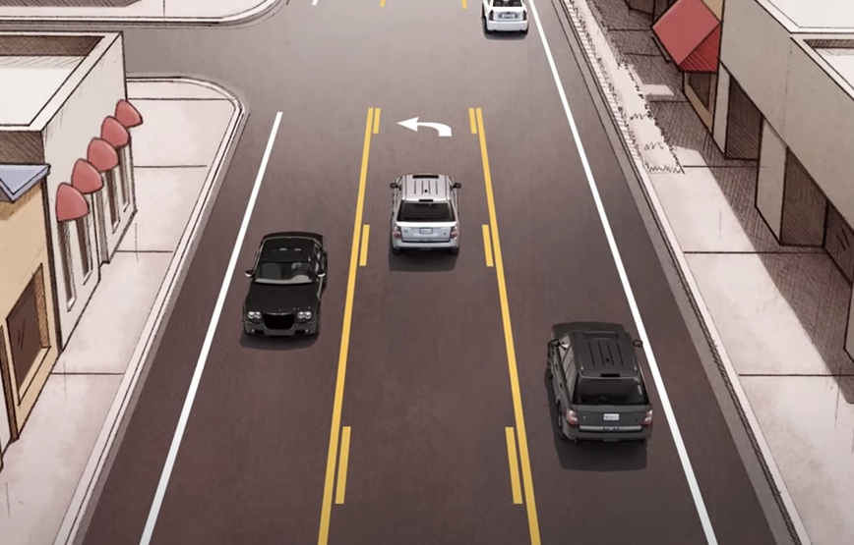
OPERATIONS
Intersections
Interchanges
Bottle necks
Resiliency
ICM
Highway Helper
Towing Program (TRIPS)

Slide 9
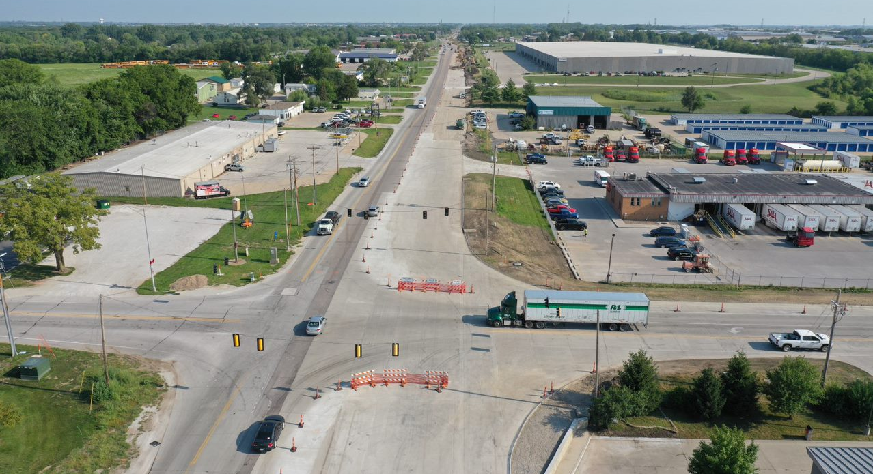
ON-GOING
U.S. 69 – CAPACITY & RECONSTRUCTION 2021-2023 $39 M
Notes:
$21M Programmed $33M awarded
2020 $1.7M ROW
2021-2022 $19.8 M Grade, Pave
2023 $0.2 Erosion Control

Slide 10
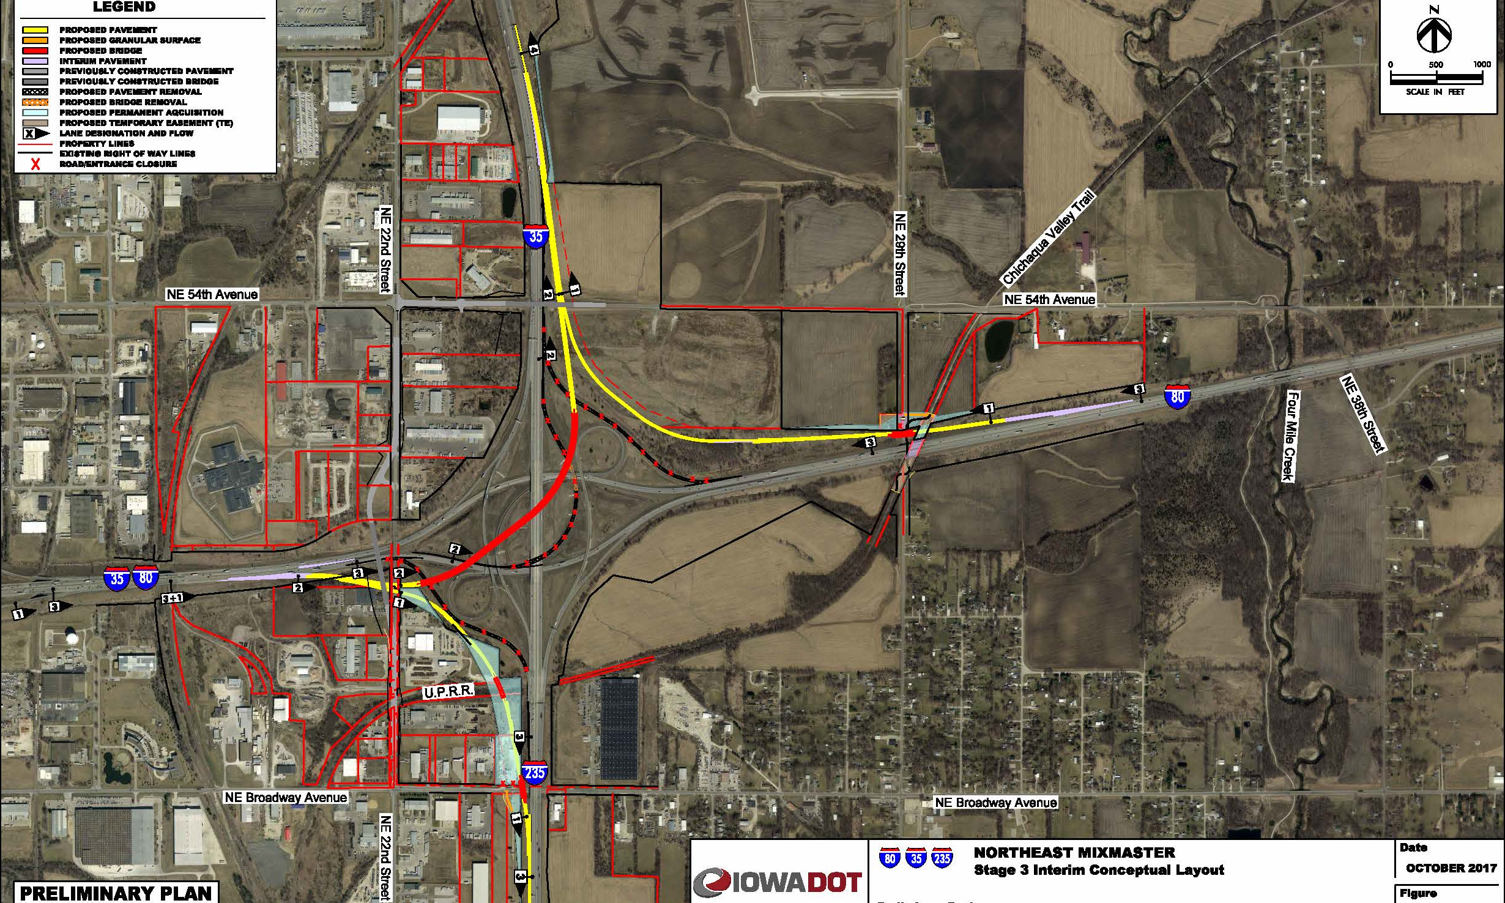
I-35/80/235
SYSTEMS INTERCHANGE
Awarded $56.7
Future letting 7/18/23 grade/pave/signals/lighting
Notes:
Phase 1 of the I-35/80/235 Systems Interchange Long Range Plan.
2023 $51.1M – ROW, Grading and E to N Flyover Bridge
2024 $17.9M – Grading, Paving, lighting, signs
2025 $465K erosion control

Slide 11
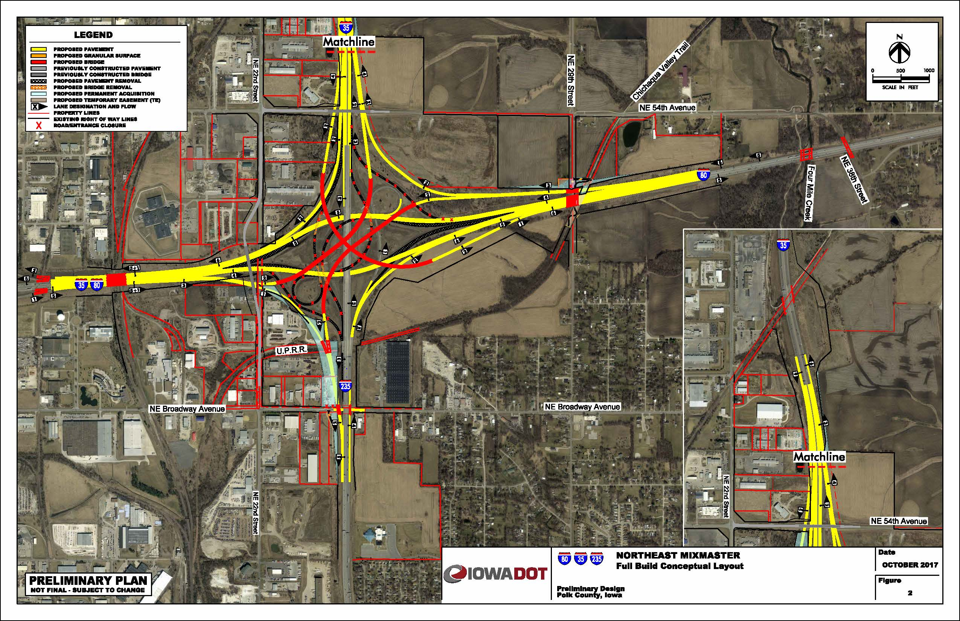
I-35/80/235
SYSTEMS
INTERCHANGE
Notes:
I-35/80/235 Systems Interchange Long Range Plan.

Slide 12
US 30/ Iowa 21 Interchange
Awarded $18.5M

Slide 13
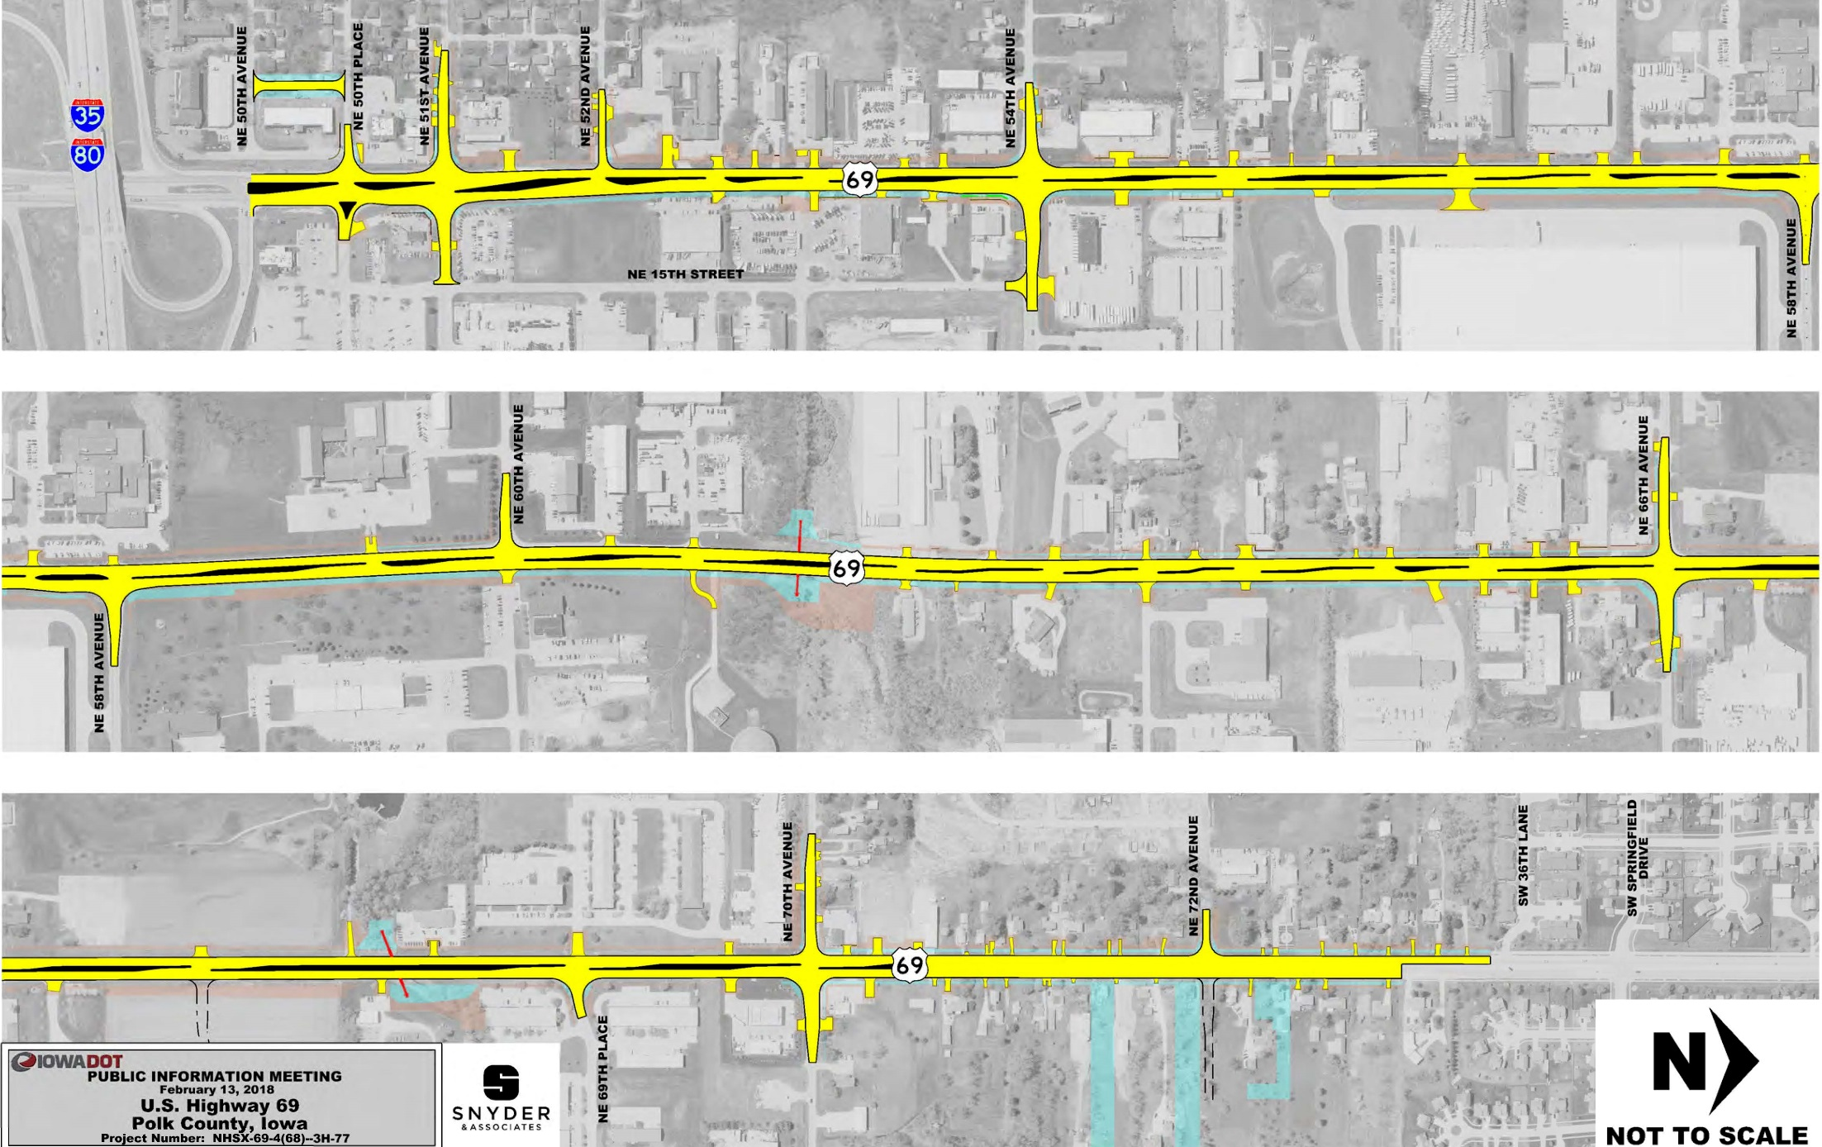
U.S. 69
CAPACITY &
RECONSTRUCTION
Notes:
$33M awarded
2020 $1.7M ROW
2021-2022 $19.8 M Grade, Pave
2023 $0.2 Erosion Control

Slide 14
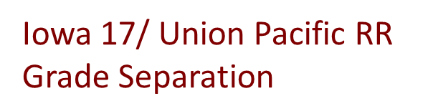
US 30 Tama County
$65.5M Grading, culverts, bridges, Paving
2022 $9.5M Grading, culvert extensions
2024 $.3M Erosion Control
$19.7 awarded
Notes:
$65.5M awarded
2018 $35M Grading, culverts, bridges
2020-2021 $29.2M Paving
2022 $9.5M Grading, culvert extensions
2023 $.3M Erosion Control

Slide 15
Iowa 28 over the Raccoon River
($6.1M awarded)
SB Bridge Replacement
Notes:
2022 $6.6 M Includes bike/ped acc.

Slide 16
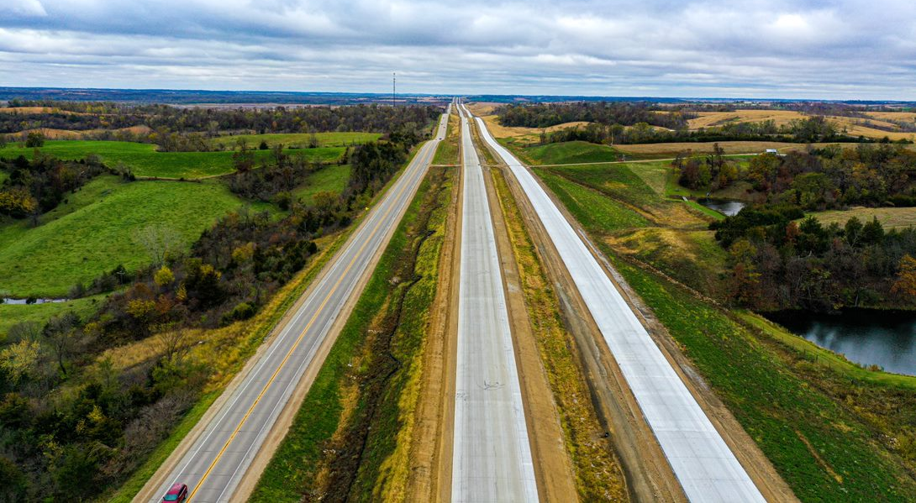
US 30 Tama County
$65.5M Grading, culverts, bridges, Paving
2022 $20M Grading, culvert extensions
2024 $.3M Erosion Control
Notes:
$65.5M awarded
2018 $35M Grading, culverts, bridges
2020-2021 $29.2M Paving
2022 $9.5M Grading, culvert extensions
2023 $.3M Erosion Control

Slide 17
PAVEMENT REHABILITATION
U.S 63 - PCC Overlay
Traer to south of Hudson
&
US 63 – HMA Rubblization
0.5 Miles south of Iowa 96 to SCL Traer
Notes:
Traer to Hudson 2022 $7.5M awarded
Iowa 96 to Traer $4.3M awarded

Slide 18
Upcoming

Slide 20
I-80 Capacity Improvement NEMM to US 65 ($64.2M 2025-2026)
Notes:
2025 $23.7M Bridge, Grading, ROW
2026 $40.5 M Pavement Rehab, Paving, bridge widening, grad/pave, new bridge, traffic signs

Slide 21
I-35 – Six laning
36th St. to Ames
Programmed
2027 $4.9M ROW
Not Programmed
Programmed
2023 $67.3M ROW - bridge – grading - signs
2024 $38.2M paving
2026 $67.2M grade/pave
2027 $1.1M erosion control
Notes:
2023 $67.3M ROW - bridge – grading - signs
2024 $38.2M paving
2026 $67.2M grade/pave
2027 $1.1M erosion control

Slide 22
I-35 – Six laning 36th St. to 3 miles north of Iowa 210
Notes:
2023 $67.3M ROW - bridge – grading - signs
2024 $38.2M paving
2026 $67.2M grade/pave
2027 $1.1M erosion control

Slide 23
I-35
U.S. 30 to Skunk River
Notes:
2023 $67.3M ROW - bridge – grading - signs
2024 $38.2M paving
2026 $67.2M grade/pave
2027 $1.1M erosion control

Slide 24
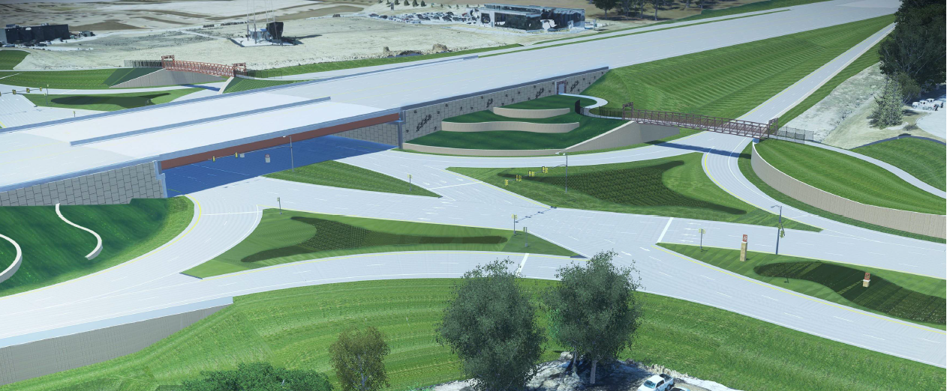
I-35/80 – U.S. 6 INTERCHANGE (IJR Approved)
($90M programmed 2024-2027)
Notes:
2024 $5.2M ROW
2025 $34.1M Bridge, culvert, grade and pave, signs
2026 $32.7M Bridge, culvert, grade and pave, signs
2027 $17.9M Grade and pave, signals, signs, lighting

Slide 25
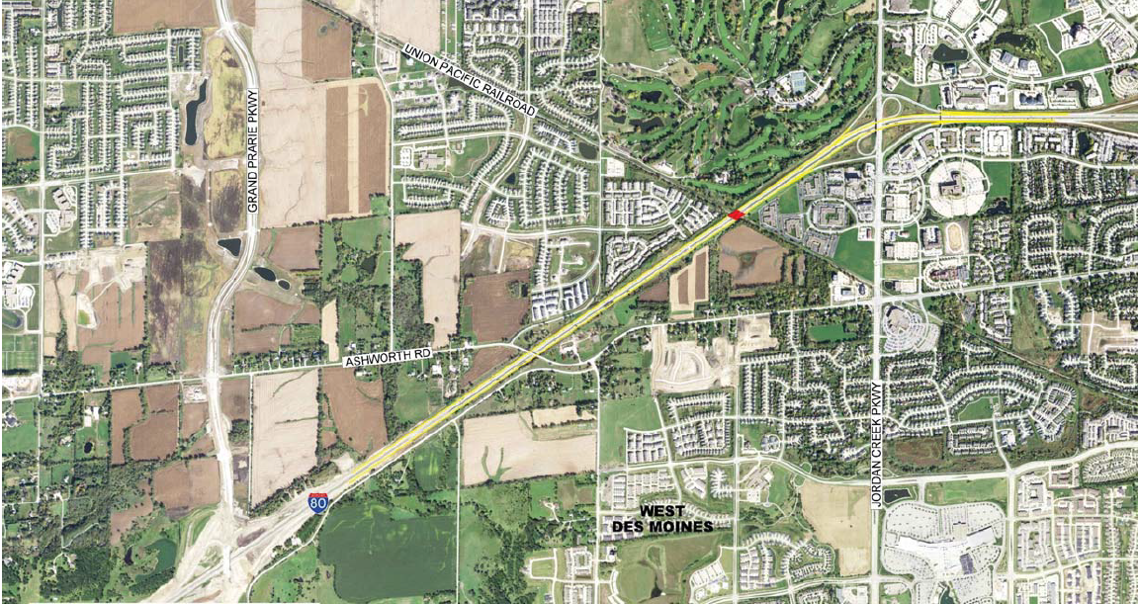
I-80 Capacity Improvement
GPP to JCP ($57M 2023-2026)
Notes:
2023 $15.2M bridge, grade, pave
2024 $19.2M bridge, grade, pave
2025 $ 22.6M bridge, grade, pave
2027$.3M erosion control

Slide 26
US 69 Improvements
US 69 at Maury St.
($900K +state share)
US 69 over DSM River
($23 M 2026)
Notes:
2025 $900,000 (State share) Maury intersection
2026 River Bridge ($23M)

Slide 27
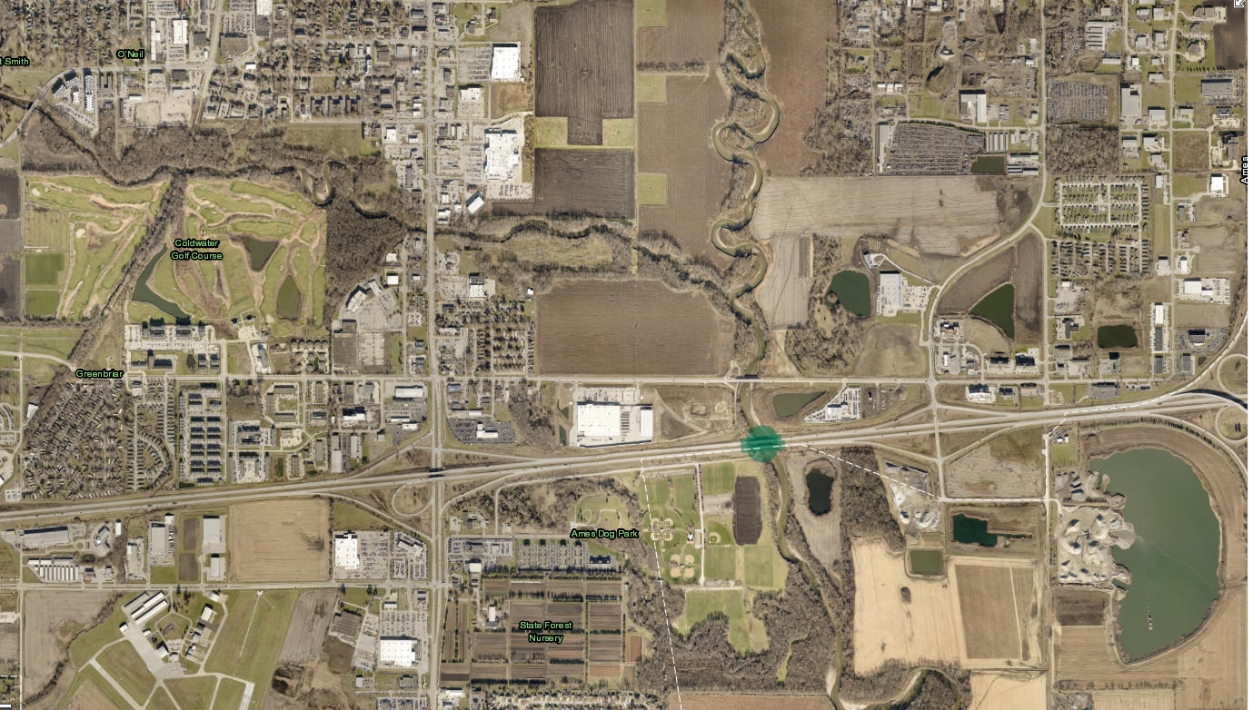
US 30 (EB & WB) Bridge Replacement over the South Skunk River
($13.4 M 2025)
Notes:
2025 $900,000 (State share) Maury intersection
2026 River Bridge ($23M

Slide 28
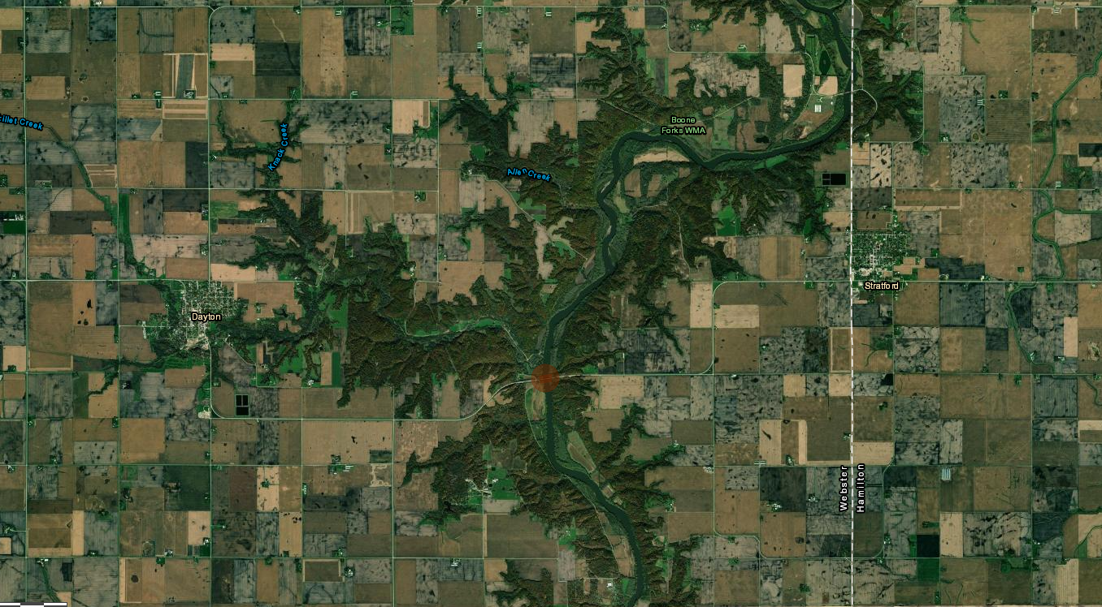
Iowa 175 Bridge Replacement over the Des Moines River
175
Iowa 175 over DSM River
($8.4 M 2026)
Notes:
2025 $900,000 (State share) Maury intersection
2026 River Bridge ($23M

Slide 29
I-35/80/235 SWMM
$36M 2027
Grading, paving, bridge

Slide 30
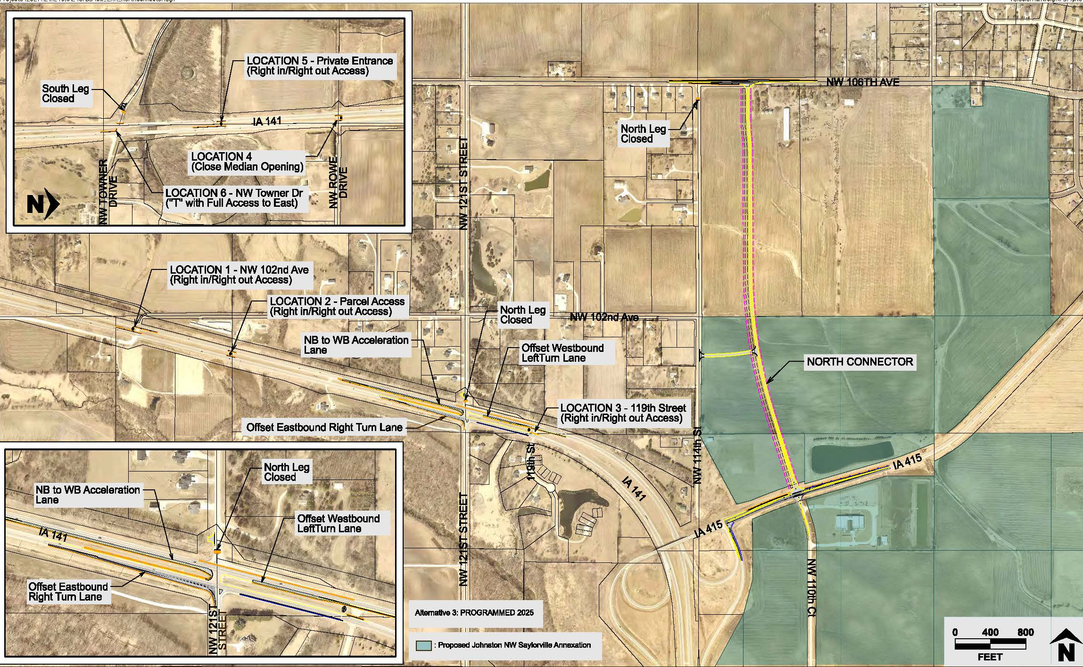
Iowa 141 and NW 121st St
2024-2025 $10M ROW, grade and pave
Notes:
2024 $1.9 M – ROW, lighting, signs
2025 $8.1M – grade and pave

Slide 31
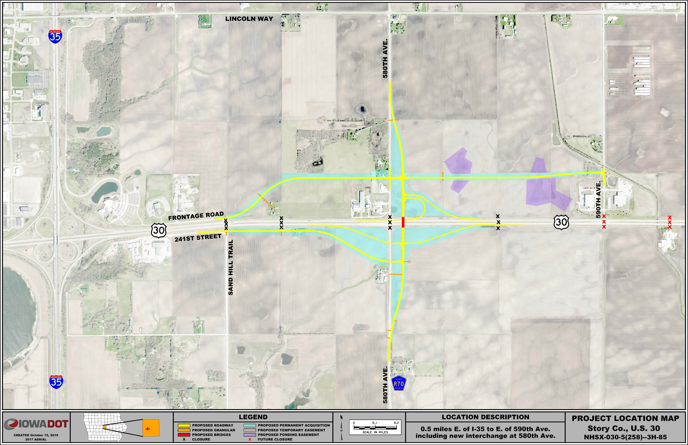
U.S. 30/County Road R-70 Interchange
2023 $16.2M bridge, grading, ROW
2024 $11.2M paving, light, signs
2025 $.4M erosion control
Future closures
Notes:
Programmed
2023 $16.2M bridge, grading, ROW
2024 $11.2M paving, light, signs
2025 $.4M erosion control

Slide 32
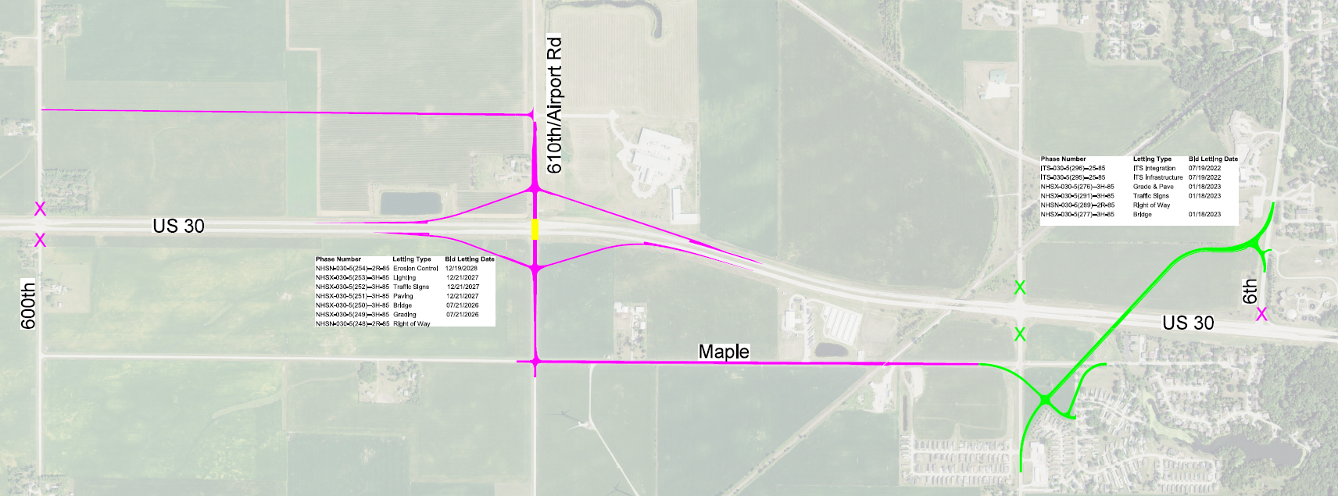
U.S. 30 Nevada, Iowa
U.S. 30/S-14 Grade Separation
2023 $6.6M bridge, grading, paving
U.S. 30/Airport Rd. Interchange
2025 $1.7M ROW
2027 $11M grading, bridge
Notes:
West of Iowa 21 to East of Iowa 21 ($35.8M estimated)
2026 Bridge $4.2 M, Grading $6.0M

Slide 33
I 80 / Iowa 21 Interchange
2026 Bridge $4.2 M, Grading $6.0M
($35.8M total project estimate)
Notes:
West of Iowa 21 to East of Iowa 21 ($35.8M estimated)
2026 Bridge $4.2 M, Grading $6.0M

Slide 34
U.S. 63
Super 2
$7.5M 2024-2025
grade/pave, signs, ROW
$8.5M 2024-2025
grade/pave, signs, ROW
$11.8M 2024-2025
grade/pave, pavement rehab, signs, ROW

Slide 35
2023 3R Projects
Route | Location | Work
Polk IA 141 | IA 44 to I-35/80 | HMA Resurfacing w/ Scarification
Dallas/Boone IA 210 | IA 141 to 0.2 mi. N. of Woodward | HMA Resurfacing w/ Scarification
Greene US 30 | W. Of IA 25 to E. of IA 4 | CIP Recycling & HMA Resurfacing
Hamilton US 69 | Jct. IA 175 in Jewell N. to US 20 | CIP Recycling & HMA Resurfacing
Boone US 30 | W. Of R18 to E. of IA 17 | Microsurfacing
Polk US 69 | Autumn Crest Drive to 118th Ave | HMA Resurfacing w/ Scarification
Boone IA 930 | US 30 to Story County Line | CIP Recycling & HMA Resurfacing
Hardin US 20 | South Fork Iowa River to US 65 (WB) | HMA Resurfacing

Slide 36
2023 3R Projects

Slide 37
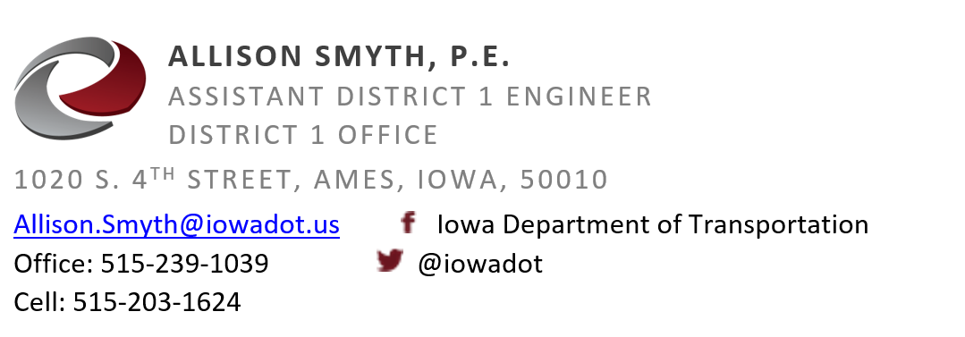
Thank you

