Slide 1
District 2
Upcoming Projects

Slide 2
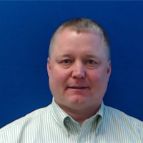
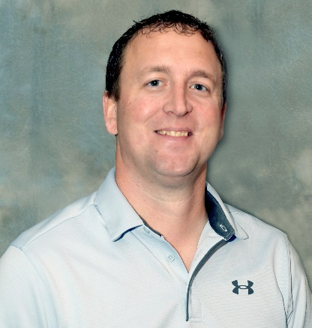
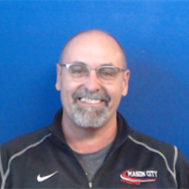
Jon Ranney
Nick Humpal
Daryl Erickson
district engineer
assistant district engineer
district utility coordinator
Mike Frank
Mike Frank
Nick Sorenson
westside permitting
eastside permitting

Slide 3
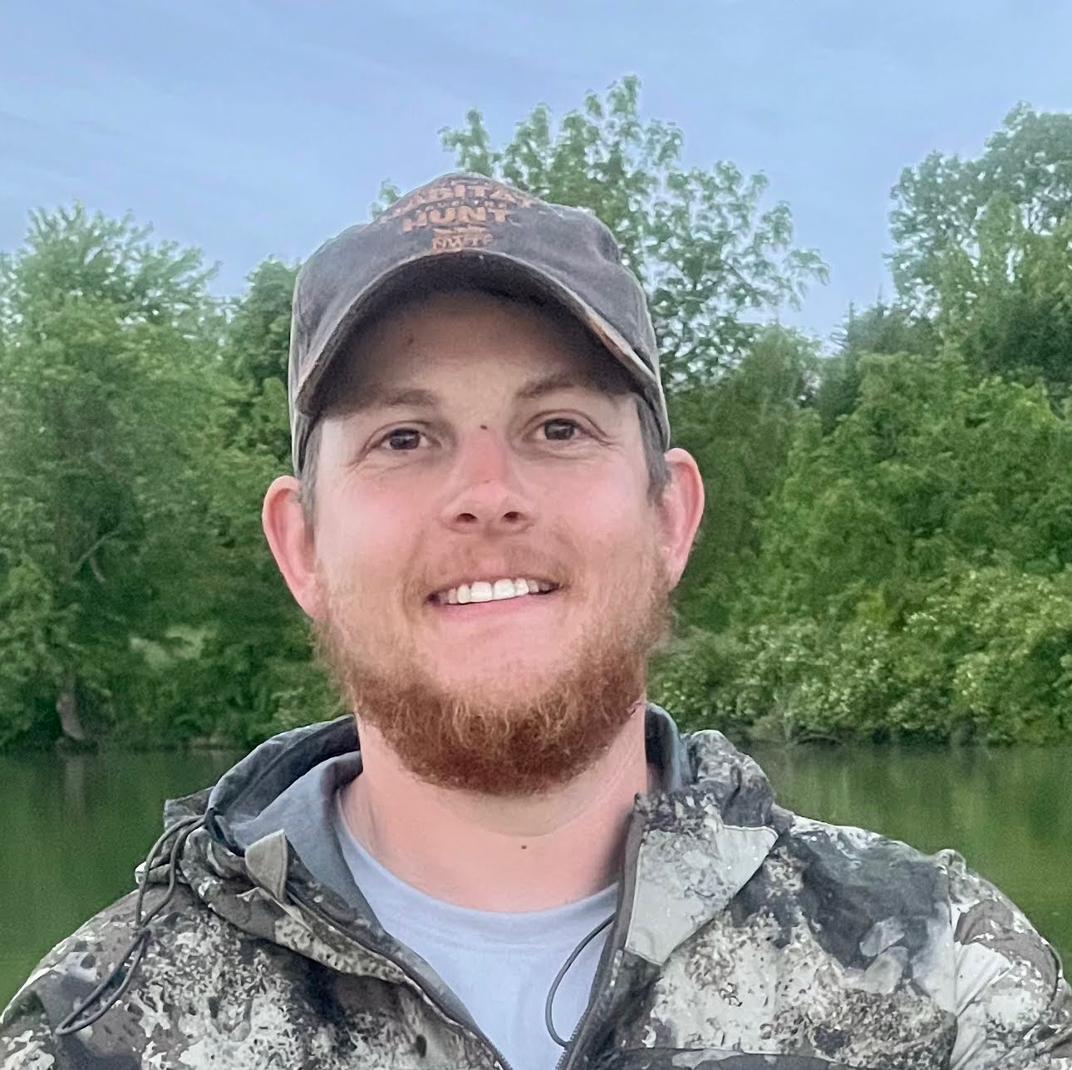
NEW EMPLOYEE SPOTLIGHT
Nick Sorenson
Engineering Operations Tech.
641-394-3161 office
563-380-0106 mobile
Nicholas.sorenson@iowadot.us

Slide 4
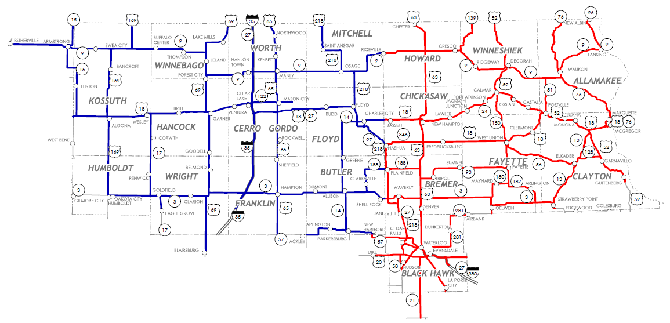
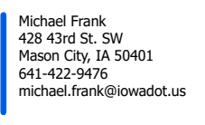
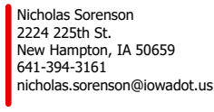

Slide 5
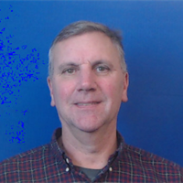
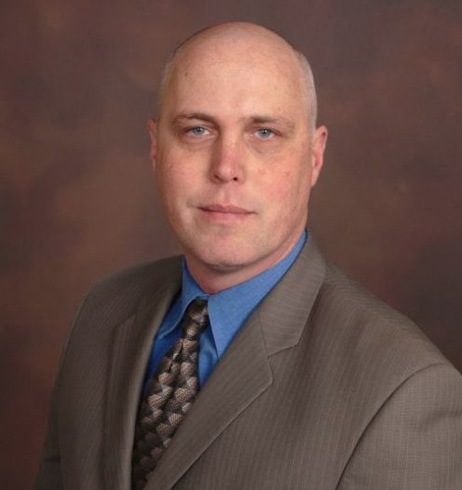
New Hampton Construction
Ron Loecher
Tyler Kubik
resident construction engineer
construction supervisor
Roy Gelhaus
district construction engineer
Mason City Construction
Ken Howe
Mike Frank
Jason Ruter
resident construction engineer
construction supervisor

Slide 6
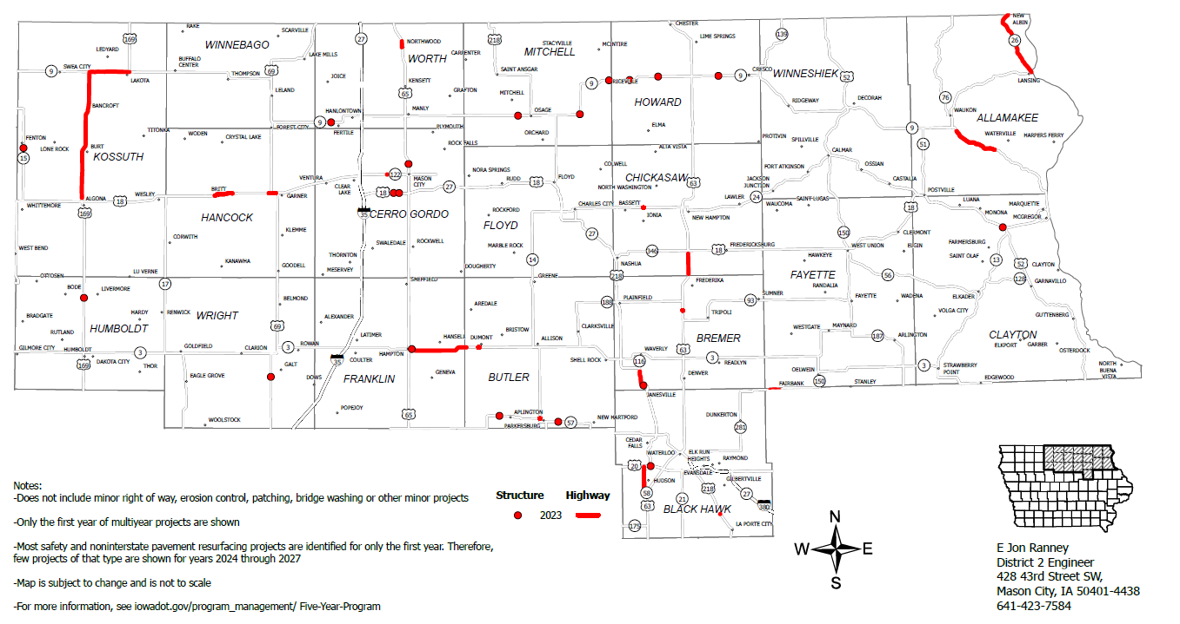
2023 Iowa Highway Program

Slide 7
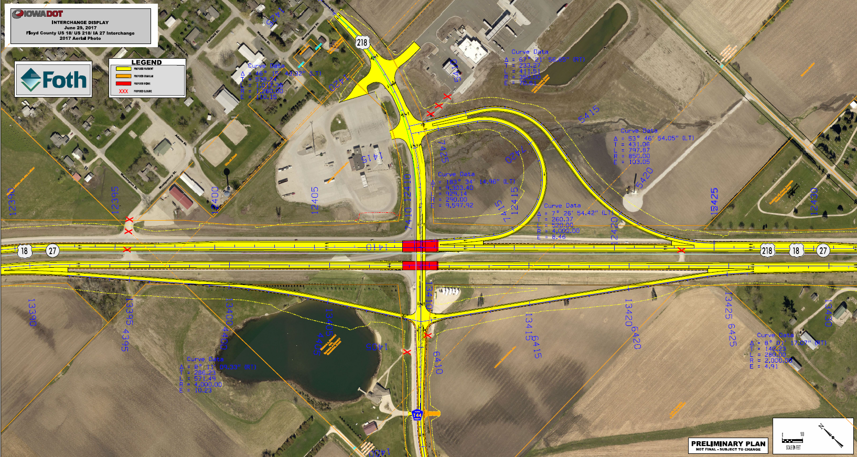
Floyd Interchange

Slide 8
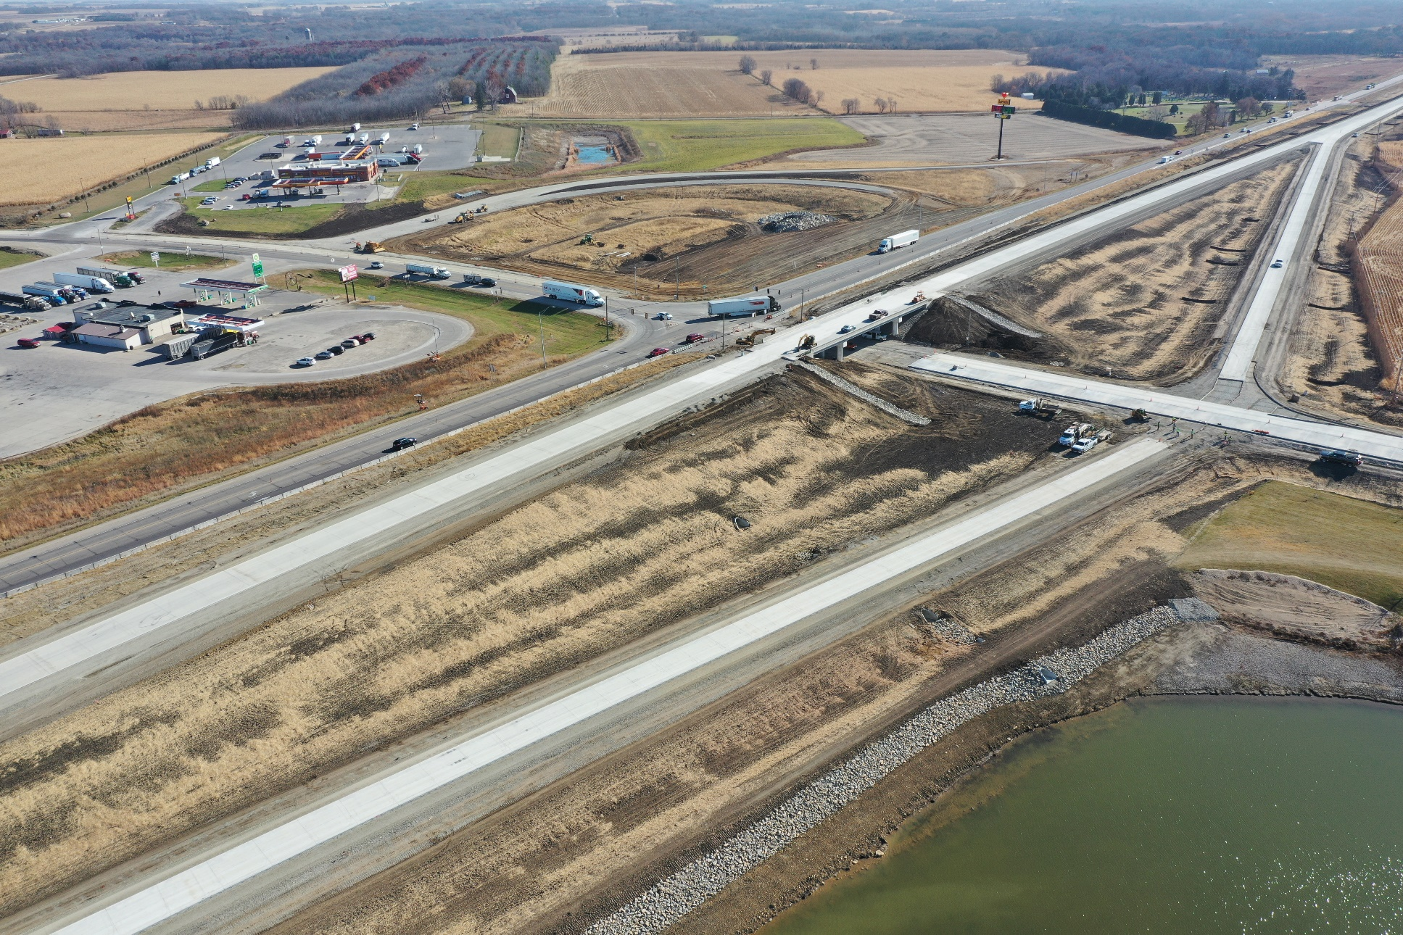
Floyd Interchange

Slide 9
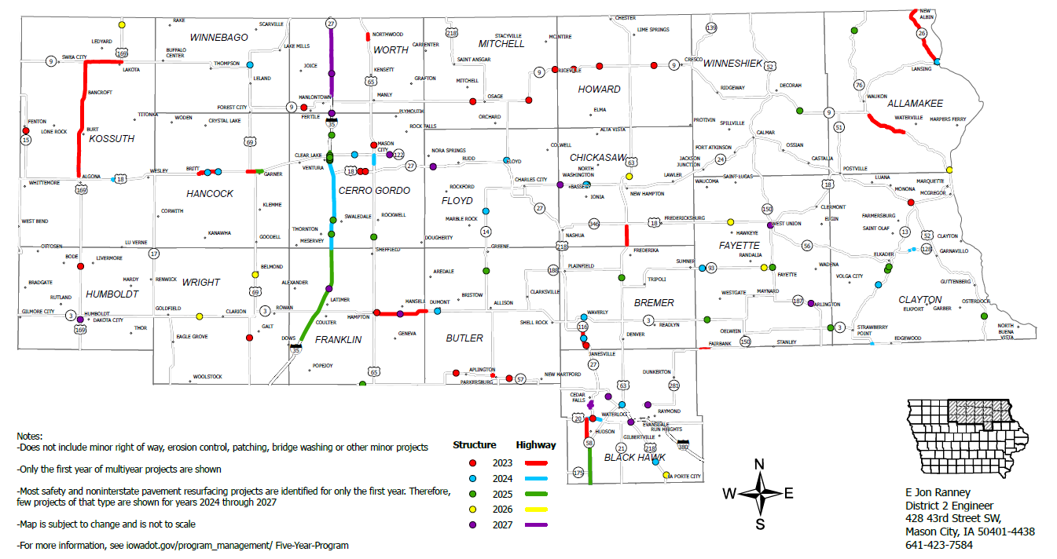
2023-2027 Iowa Highway Program
Notes:
Lansing July 2023
Janesville to Waverly July 2023
Mason City December 2023

Slide 10
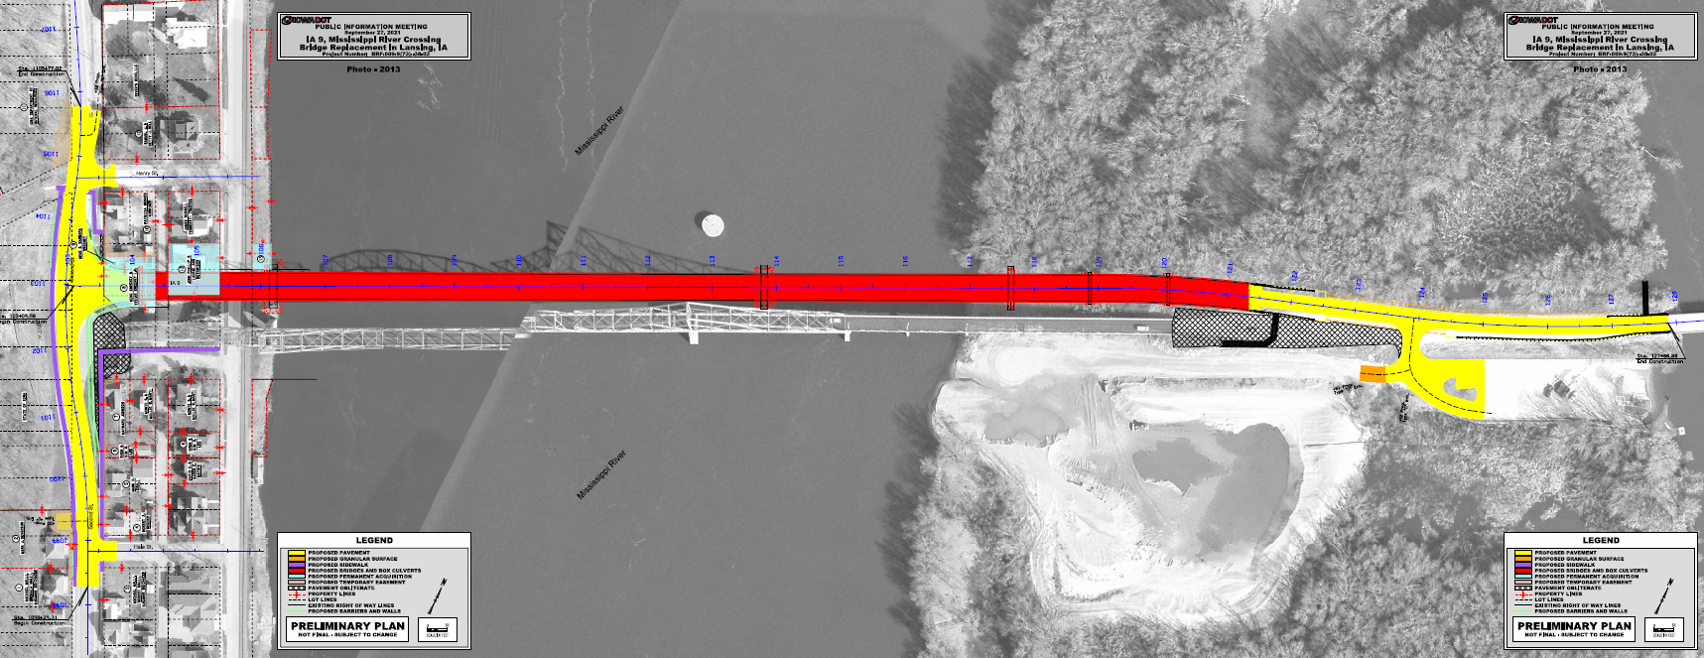
IA 9/WI 82 Mississippi River Bridge in Lansing
Construction to begin fall 2023
N

Slide 11
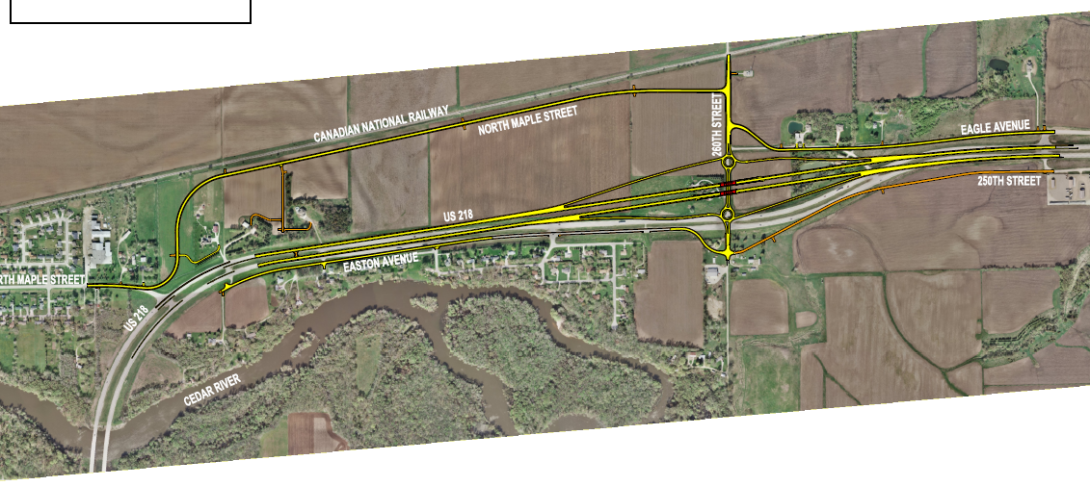
US 218 Janesville to Waverly
N
Construction to begin fall 2023
N

Slide 12
US 65 In Mason City
Construction to begin spring 2024
N

Slide 13
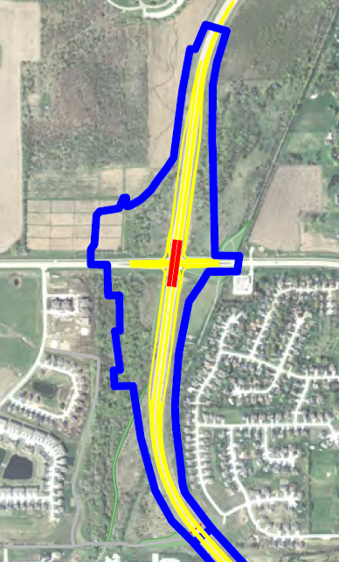
IA 58/Greenhill Road in Cedar Falls
Construction to begin spring 2027
N

Slide 14
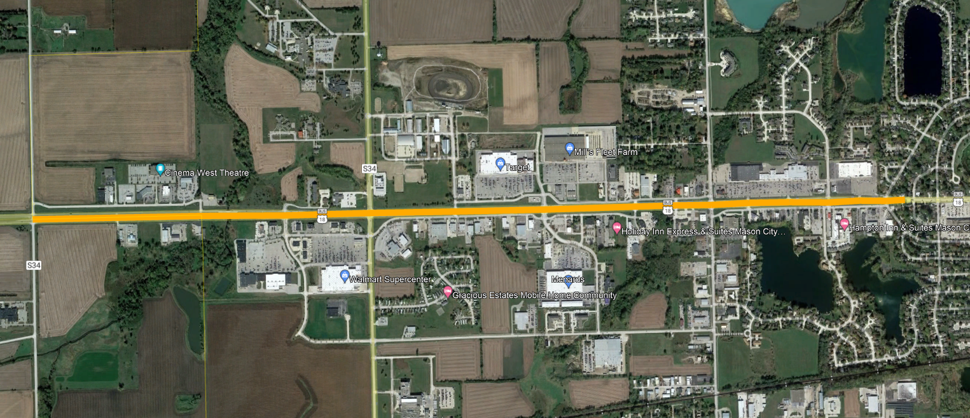
IA 122 Feasibility Study in Mason City
Partnering with Mason City.
Currently not funded.
Eisenhower Ave
Lark Ave
Taft Ave

Slide 15
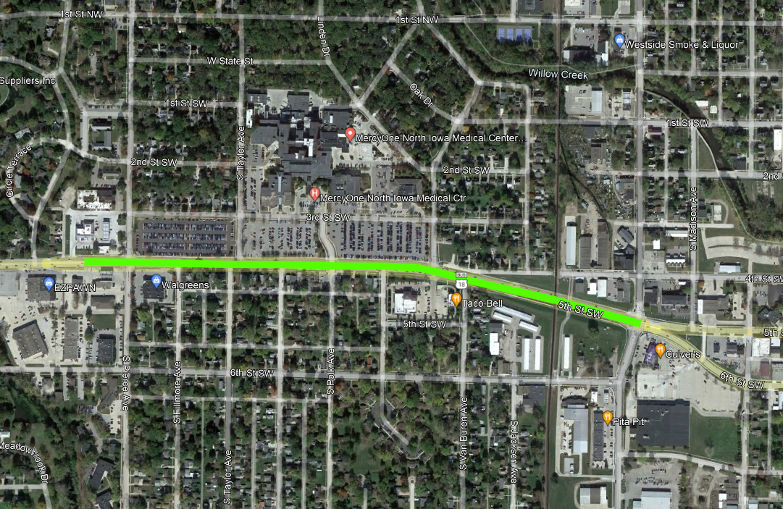
IA 122 Reconstruction in Mason City
Partnering with Mason City.
Currently not funded.

Slide 17
THANK YOU FOR YOUR TIME AND ATTENTION
Nick Humpal, P.E
assistant district engineer
District 2
641-423-7584 or
Nickolas.Humpal@iowadot.us

