Slide 1
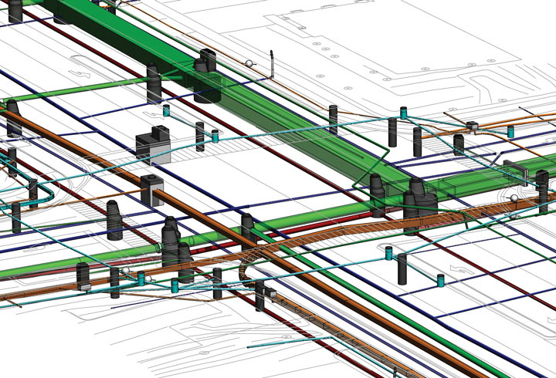

District 3
2023 Utility Meeting
Notes:
Thanks for inviting us to Discuss IA 10 and Jay Ave and the option of a roundabout

Slide 2

Dakin Schultz
District 3 - Planner
Dakin.schultz@iowadot.us
(712) 274-5837
Kelly Mulvihill
District 3 Utility Coordinator
kelly.mulvihill@iowadot.us
(712) 539-1268 Cell
(712) 274-5828 Office
Notes:
Introduce Myself and Jason Klemme

Slide 6
US 75 Grade and Pave
Hinton to Merrill NB 2023
SB 2024
Hinton - 2028
IA 3 Little Sioux River Bridge replacement, new overflow bridge and .5 miles of grade and pave 2026

Slide 7
US 20 from US 75/IA 12 interchange east 2 miles 2023
I-29 IA 141 interchange at Sloan 2024
US 20 Bridge removals near Morningside Av 2025
Southbridge Interchange 2026?
NB Rest Area removal 2024
Gordon Drive Viaduct 2028?
I-29 IA 175 interchange replacement at Onawa 2026
IA 175 Decatur Bridge Replacement - Study

Slide 8
US 71 reconstruction from Okoboji Grove Road A.P. to Okoboji View in Okoboji
March 2023 – December 2024
https://iowadot.gov/lakes71
IA 9 reconstruction from .5 miles west of the CL of Estherville to the West Fork of the Des Moines River 2023
IA 4 .2 mi south of the SCL through the RR bridge
IA 4 from IA 9 to the 5th Ave N

Slide 9

THANK YOU

