Slide 1
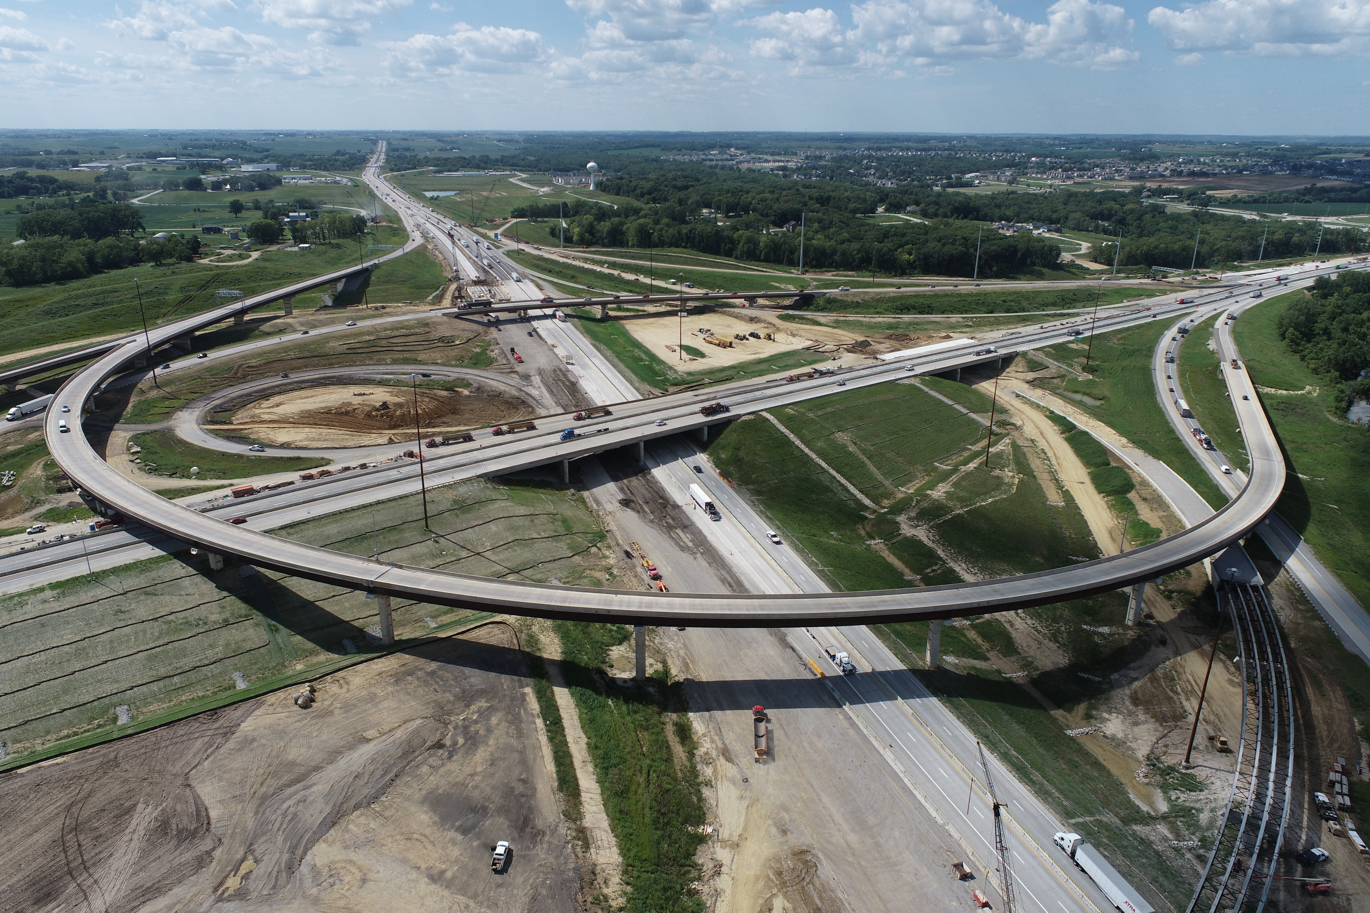

People & Projects
Iowa DOT District 6
Notes:
80/380 Interchange
Substantially complete later this year (2023)!
Thank you for your help!

Slide 2

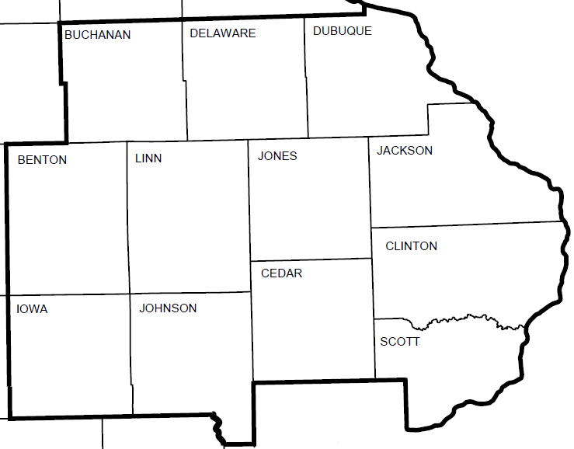
District 6 People & Places
Manchester
Cedar Rapids
District Office
Resident Construction Office
Maintenance Garage
Davenport
Notes:
12 counties
15 garages – Indy, Urbana, Newhall, W’burg, Coralville, C.R. Marion, Anamosa, Manchester, Tipton, Dyersville, DBQ, Maquoketa, DeWitt, Davenport
3 RCE offices

Slide 3
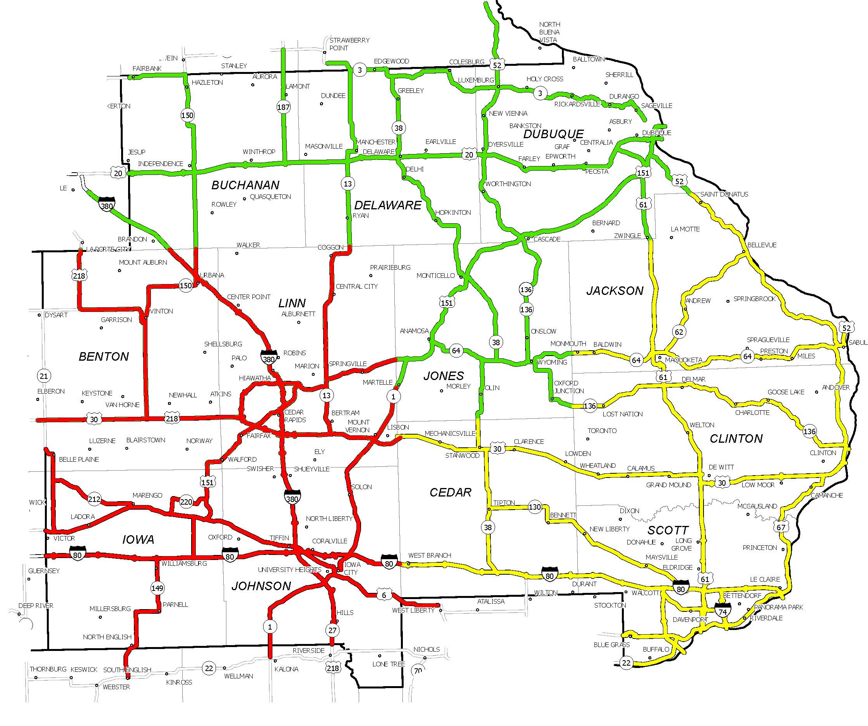
District 6 Utility Partners
Terry Kluesner
Jesse Tibodeau
D6 Permits - N
Assistant D6 Engineer
Steve Flockhart
D6 Utility Coordinator
Sheila Lee
Arielle Muench
Sheila Lee
D6 Permits - SW
D6 Permits - SE

Slide 4
D6 by the numbers
2023-27 Program
Roadway Lane Miles
Bridges
2023-27 Projects
$900 M
4,291
876
435

Slide 5
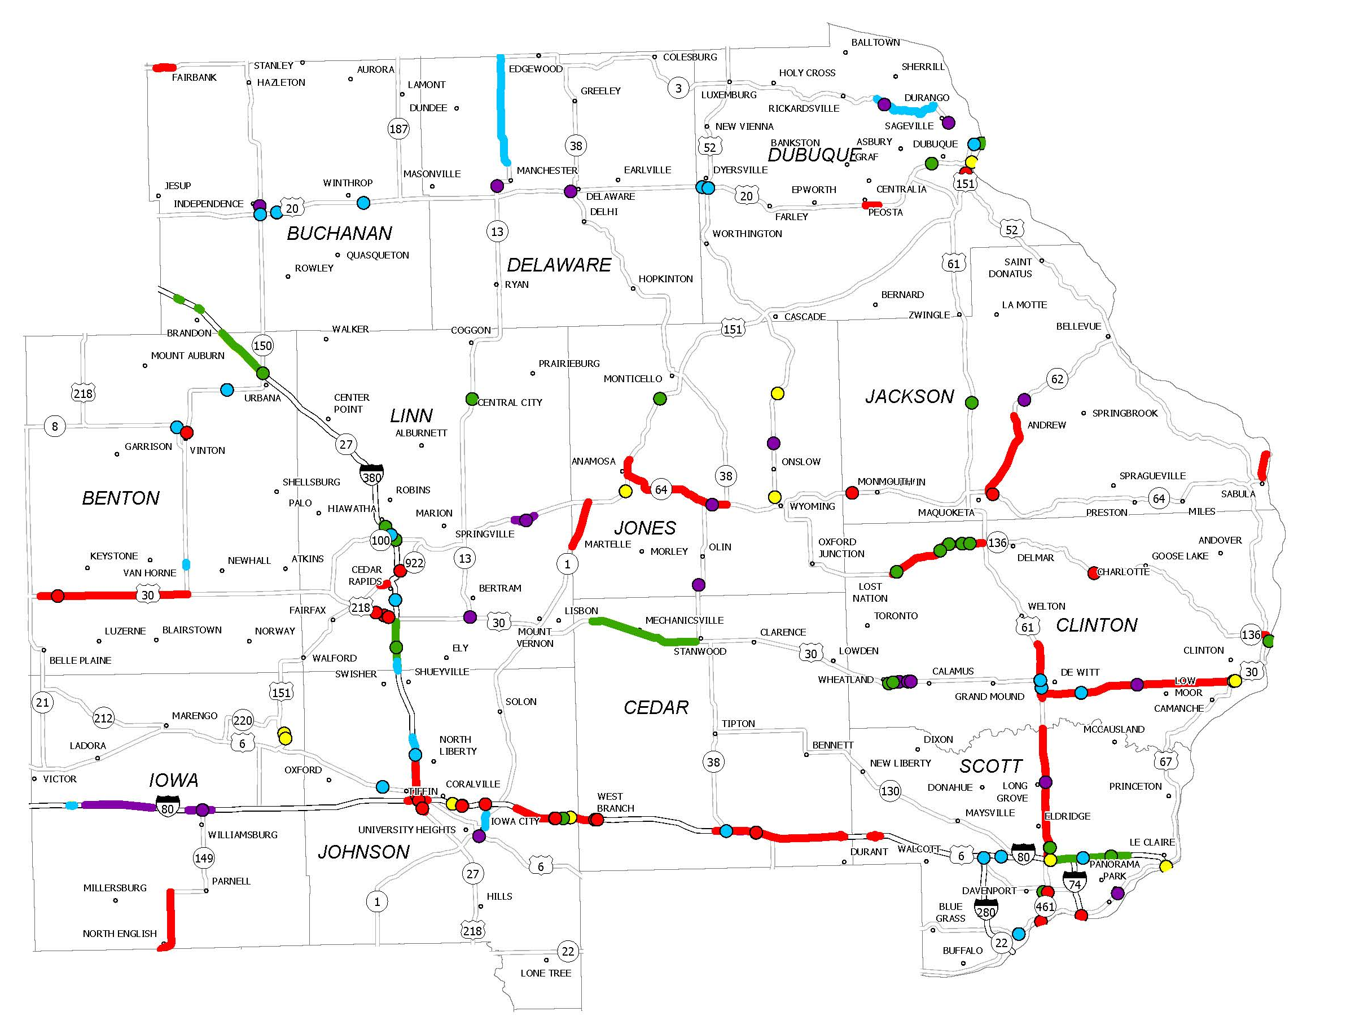
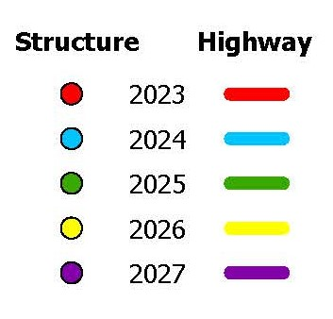
FY 2023-27 Program (D6)
Notes:
Presentation focuses on 16 major projects (ie - over $20M)

Slide 6
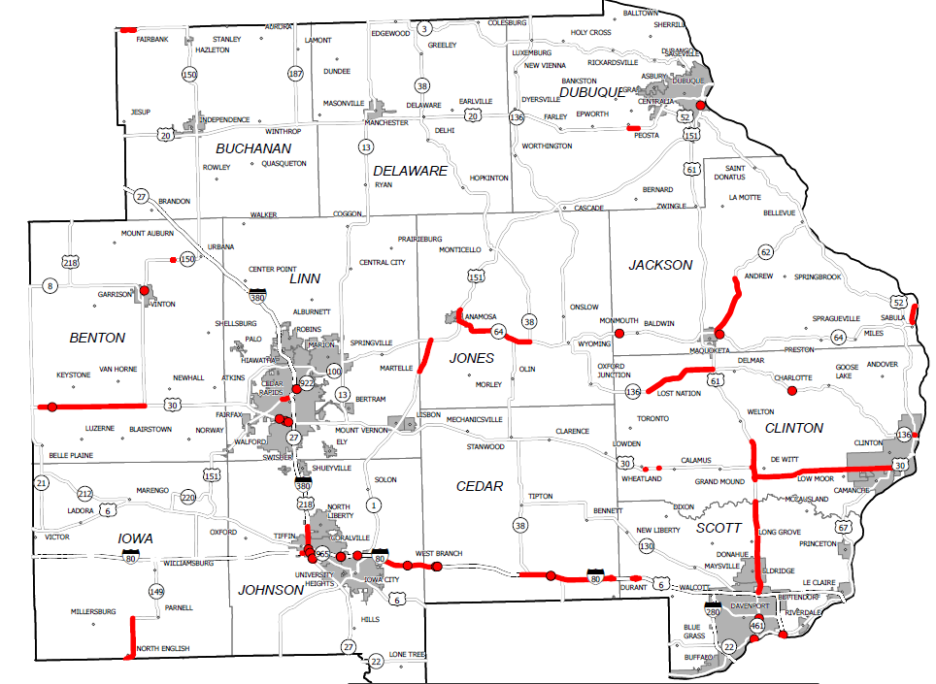
FY 2023 Projects (D6)

Slide 7
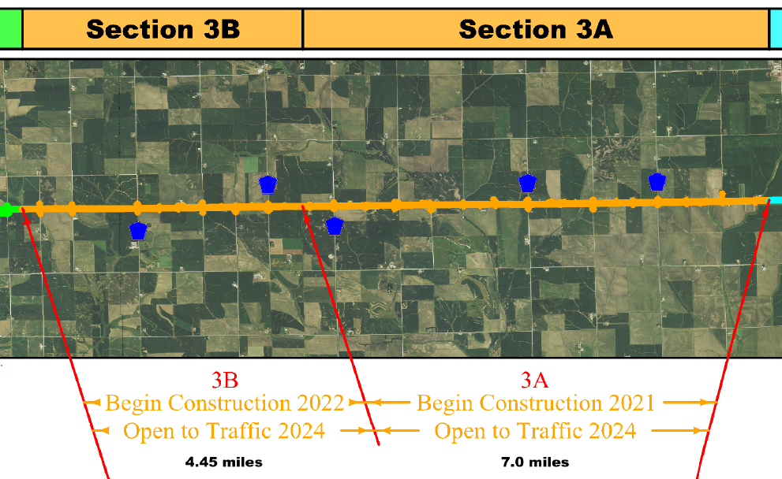

US 30 4 Lane – Benton County
$36M
FY 23
$45M
FY 22

Slide 8
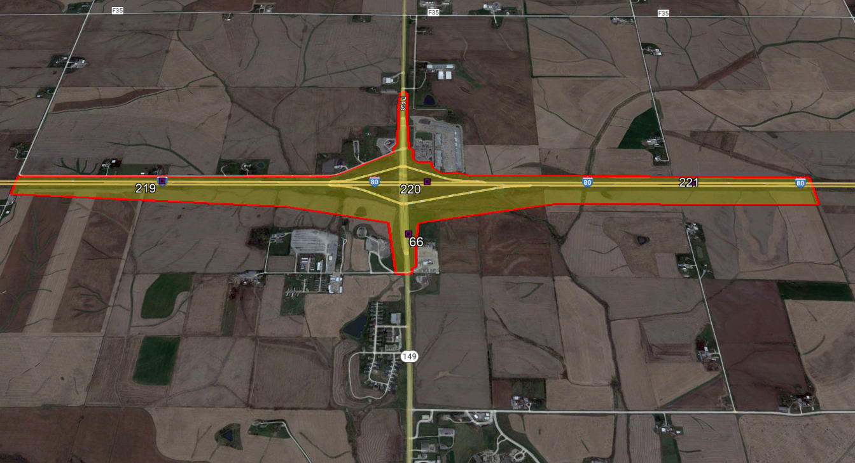
I-80 / IA 149 Bridge Replacements – Iowa County
$21.4M Programmed in FY 27
Notes:
Starting Project Development Soon
Likely 3 Year Project Similar to Grinnell I-80/IA 146 Interchange
Survey Limits Shown Above - Plan to Do Some SUE

Slide 9
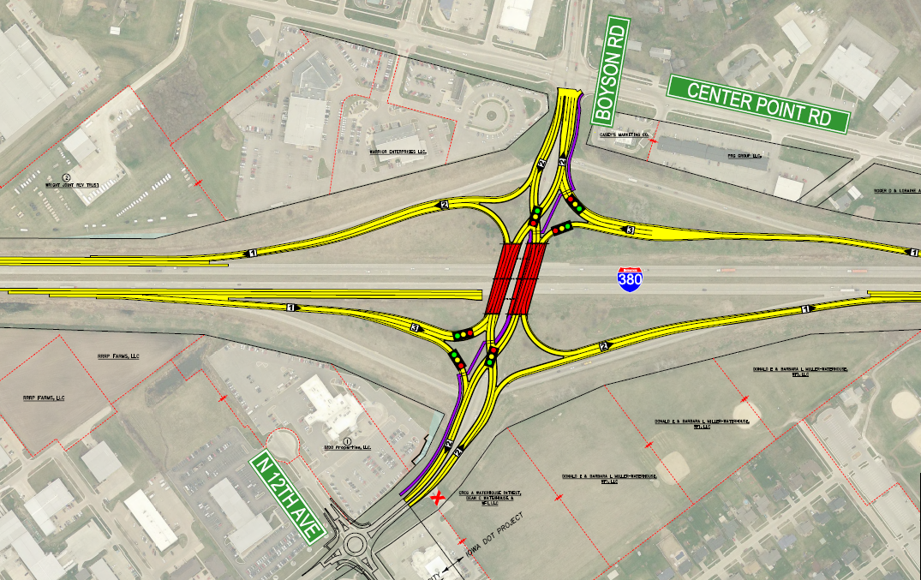

I-380/Boyson Rd Interchange – Linn County
$24M FY 25
Notes:
Improve traffic operations & increase capacity
44,000 vpd S of Boyson
City project to west

Slide 10
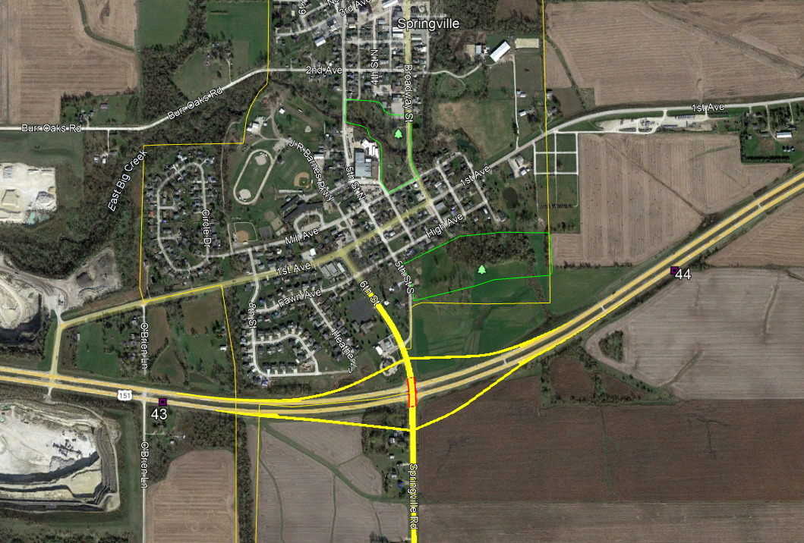
US 151 Springville Interchange
$31M FY 27
Notes:
Improve safety & traffic operations

Slide 11
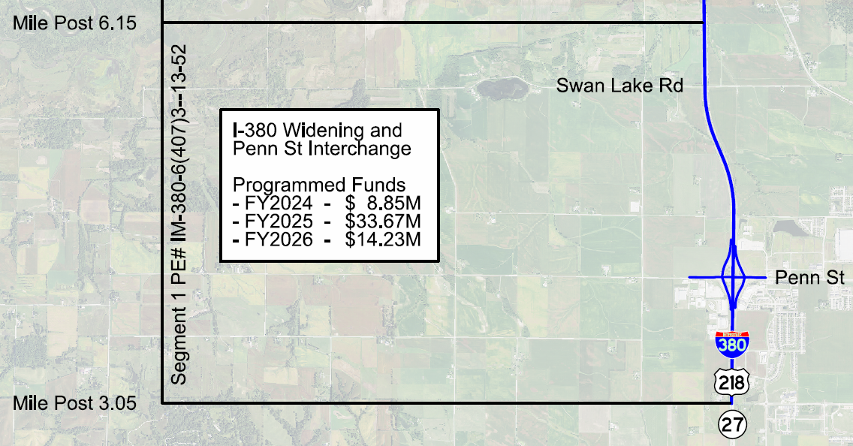
I-380 Widening & Penn Street Interchange – Johnson County
South Segment
Notes:
3 year project. 1st letting in late 2023. 3 lettings.
Widen from 4 to 6 lanes. Replace pavement.
Penn Street remains diamond interchange

Slide 12
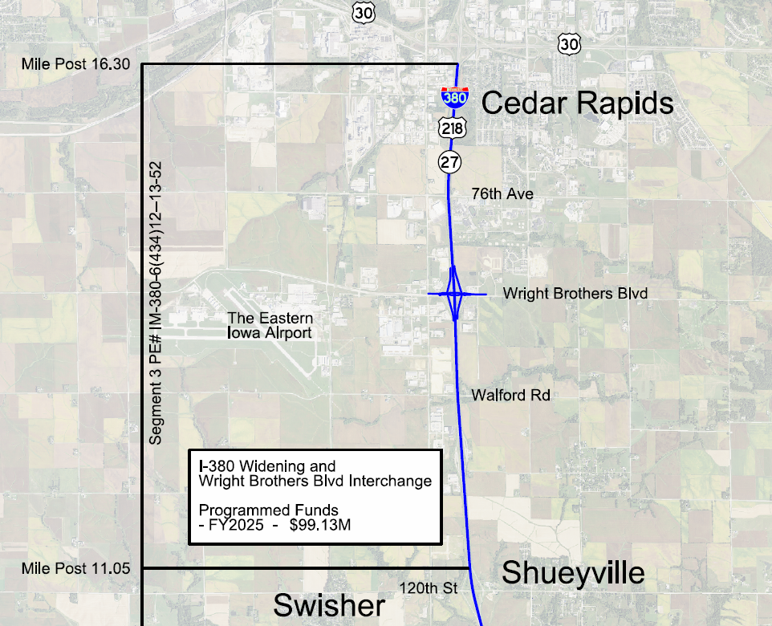
I-380 Widening & WBB Interchange – Linn/Johnson County
North Segment
Notes:
2 year project. letting in summer 2024
Widen from 4 to 6 lanes. Replace pavement.
Rebuild WBB interchange as DDI

Slide 13
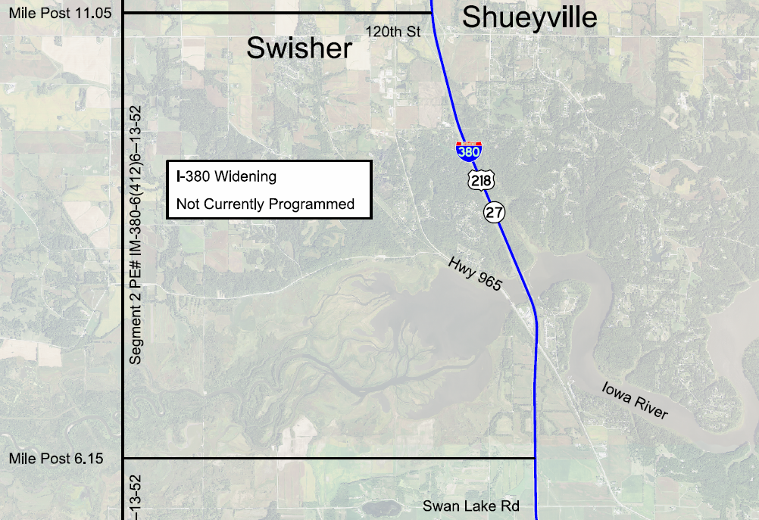
I-380 Widening & 120th Street Interchange – Johnson County
Middle Segment – Not Programmed
Notes:
Widen from 4 to 6 lanes. Replace pavement.
Evaluating 120th Interchange

Slide 14
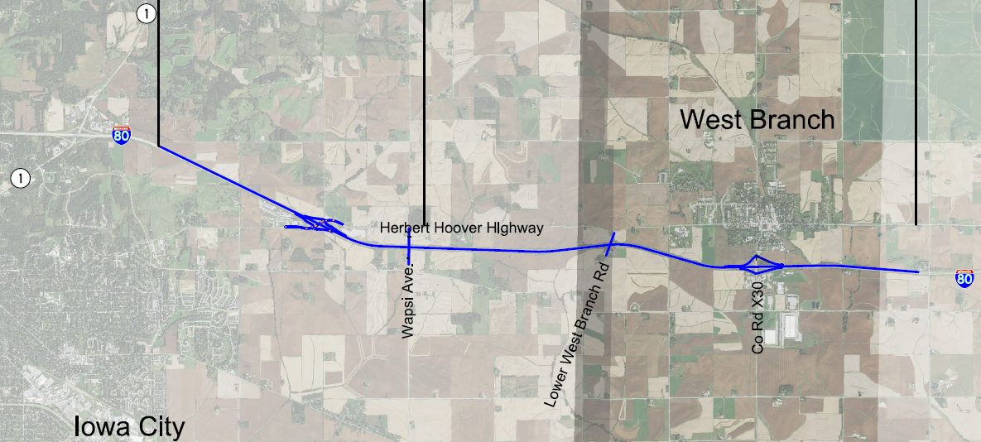

I-80 Widening – Johnson County
West Segment – 3.1 miles
Open in late 2023
$52M
East Segment – 4.5 miles
Open in late 2026
$67M
Notes:
6 lane. Replace pavement. Widen & replace bridges.
West – HHH Interchange
East – Grading letting March 2023.

Slide 15
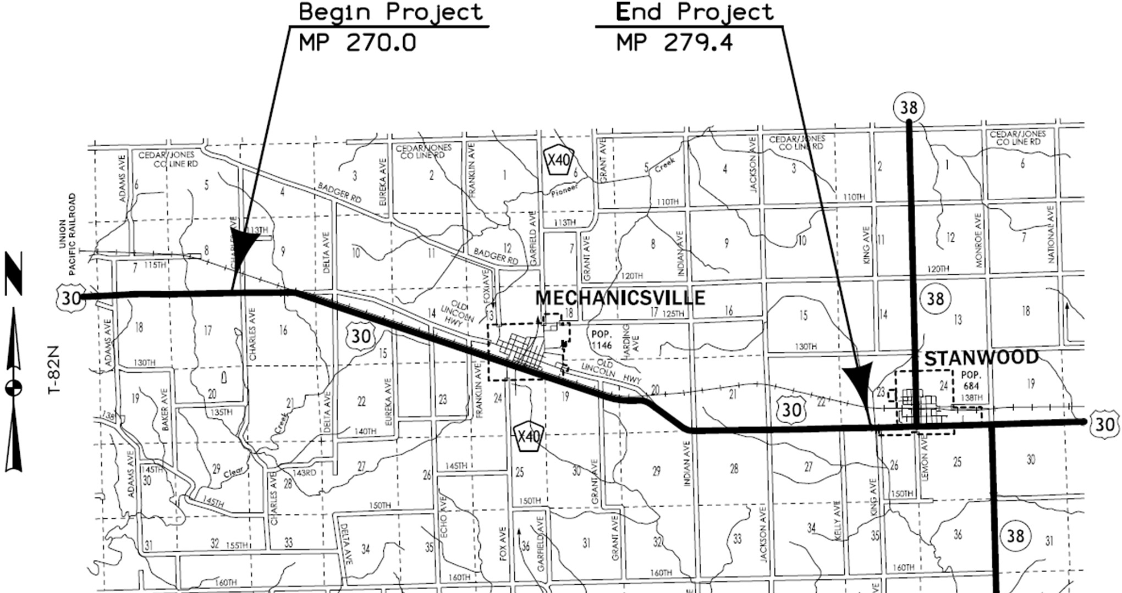
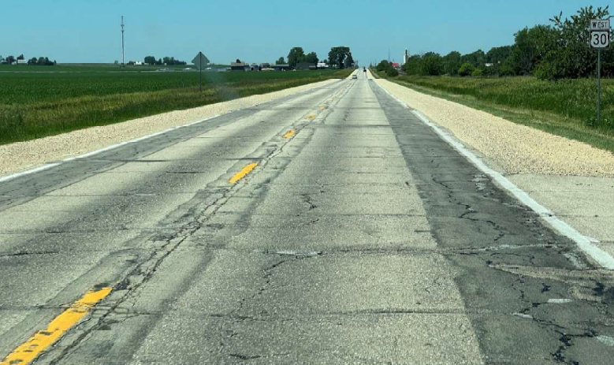
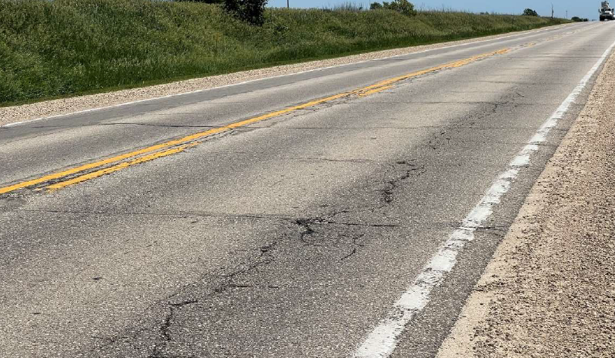
US 30 Pavement Rehab/ Super 2 – Cedar County
$22.3M FY 25 & 26
Notes:
Pavement rehab., paved shoulders
Passing lanes, turn lanes

Slide 16
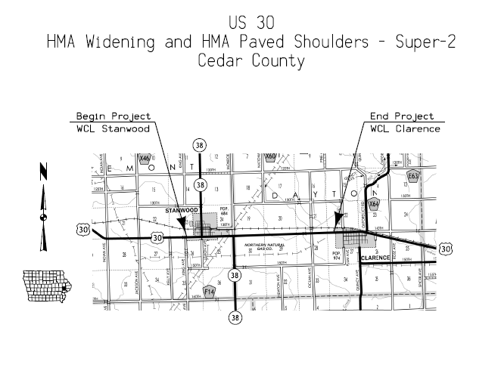
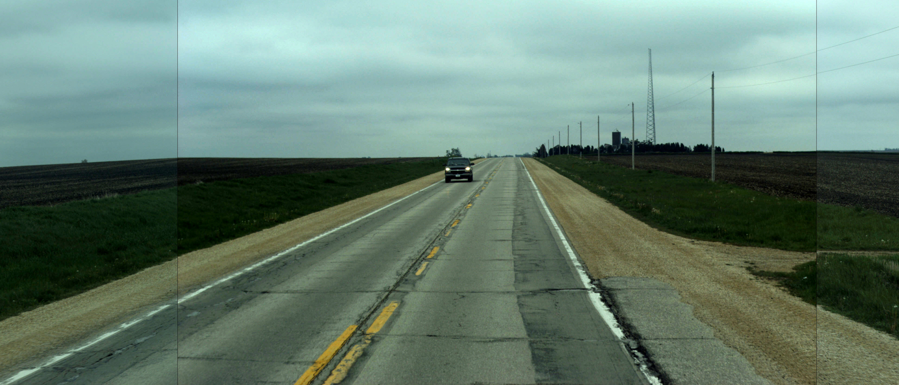
US 30 Pavement Rehab/ Super 2 – Cedar County
Not Programmed
Notes:
Pavement rehab., paved shoulders
Passing lanes, turn lanes

Slide 17
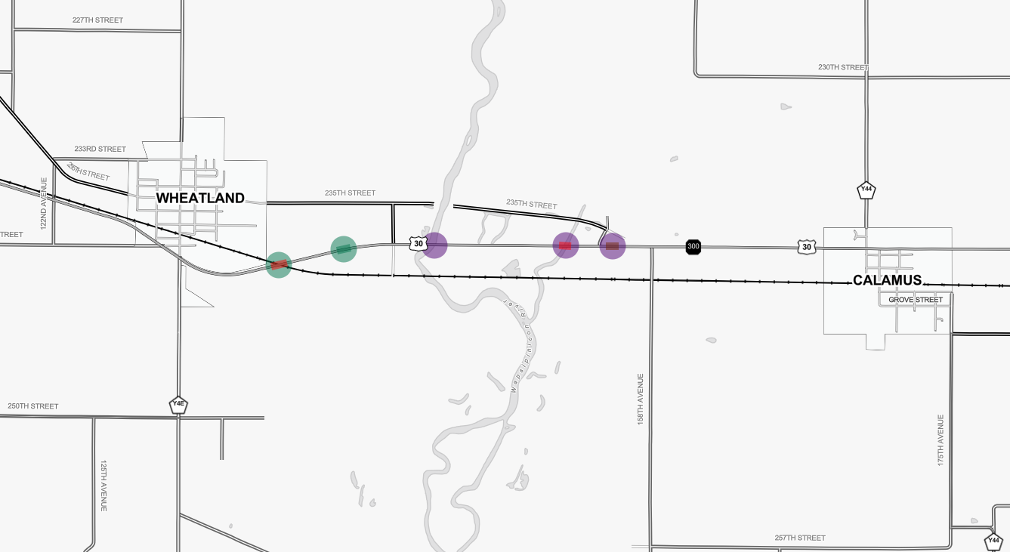
US 30 Bridge Replacements – Clinton County
West $19.1M (FY 26 & 27) East $14M (FY 25)
Notes:
FY 25 – Replace 3 bridges (including Wapsi)
FY 27 – Replace 2 bridges (including RR)
RR bridge on new alignment due to skew & RR req’ts

Slide 18
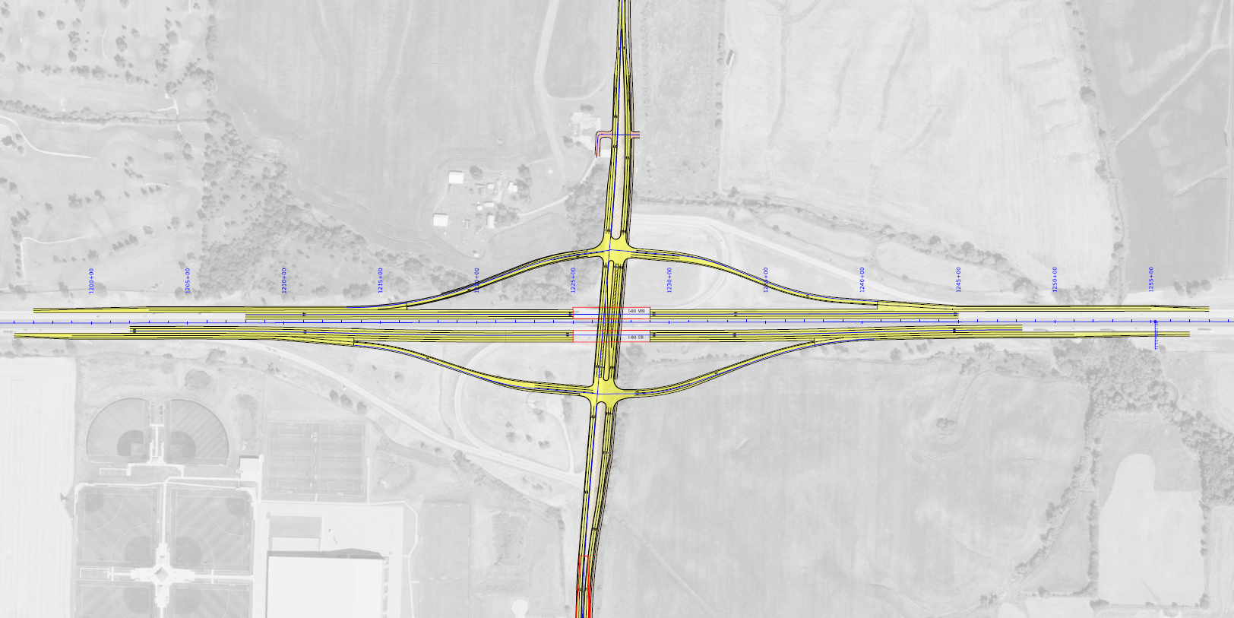

I-80 / Middle Road Interchange – Scott County
$46M (FY 25)
Middle Road
Notes:
Replace bridges & pavement
Increase capacity and improve traffic safety & operations
Convert to diamond interchange

Slide 19
I-80 Mississippi River Bridge Replacement – Scott County
PEL Study Completed
Programmed FY 26-28
Illinois DOT Recommends Moving to FY 28-30
Illinois DOT - lead Agency

Slide 20
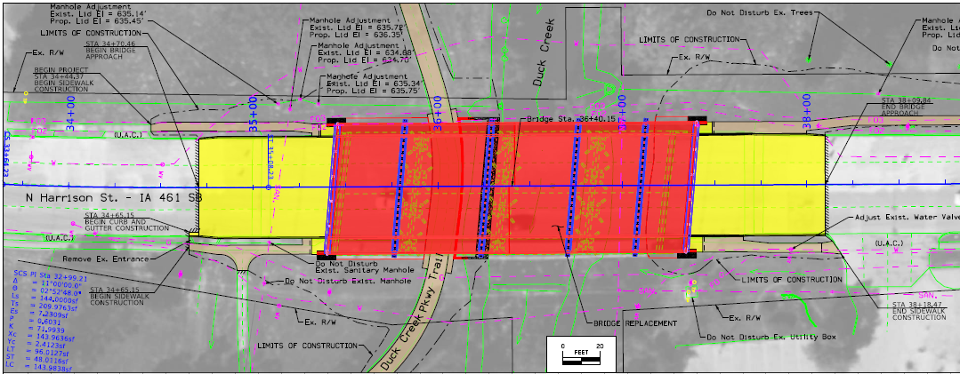
IA 461 SB Over Duck Creek – Scott County
Bridge Replacement
$3.8M FY 25
Notes:
Staged. Maintain 2 lanes.
0.3 miles S of US 6.
NB is 2023.

Slide 21
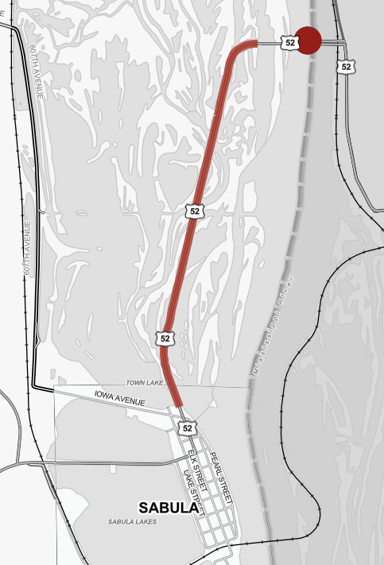
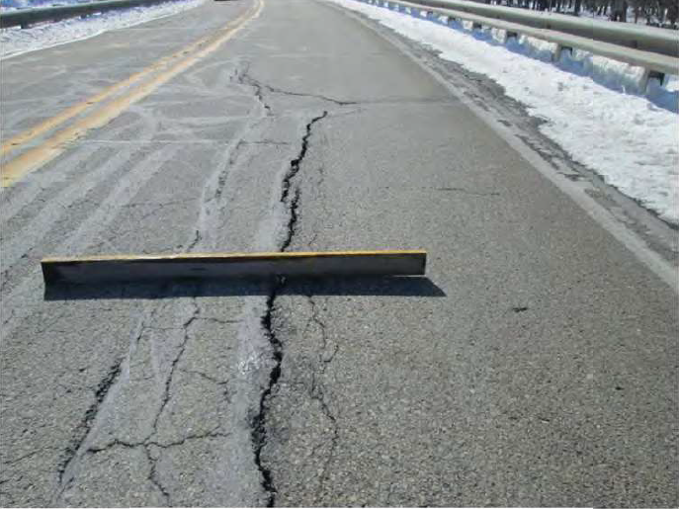
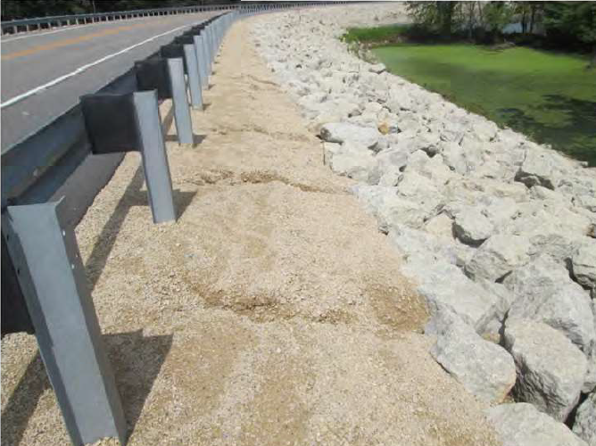
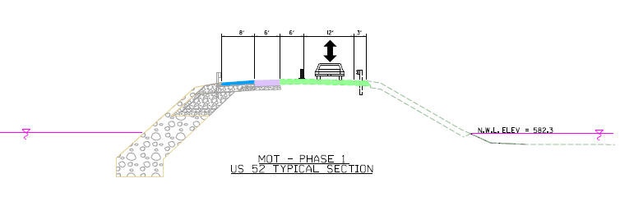
US 52 Sabula Causeway – Jackson County
$33M FY 25
Notes:
Just under 2 miles.
Rebuild causeway and armor with rip rap.
Causeway eroding -was built with river bottom muck.
Bridge shown is bridge washing

Slide 22
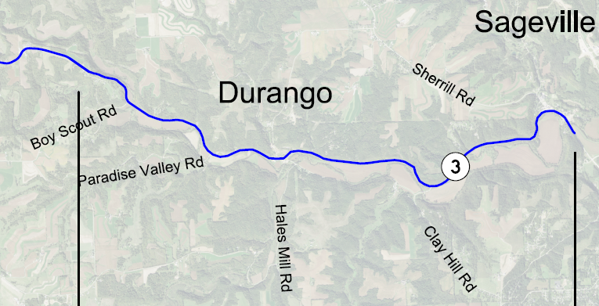
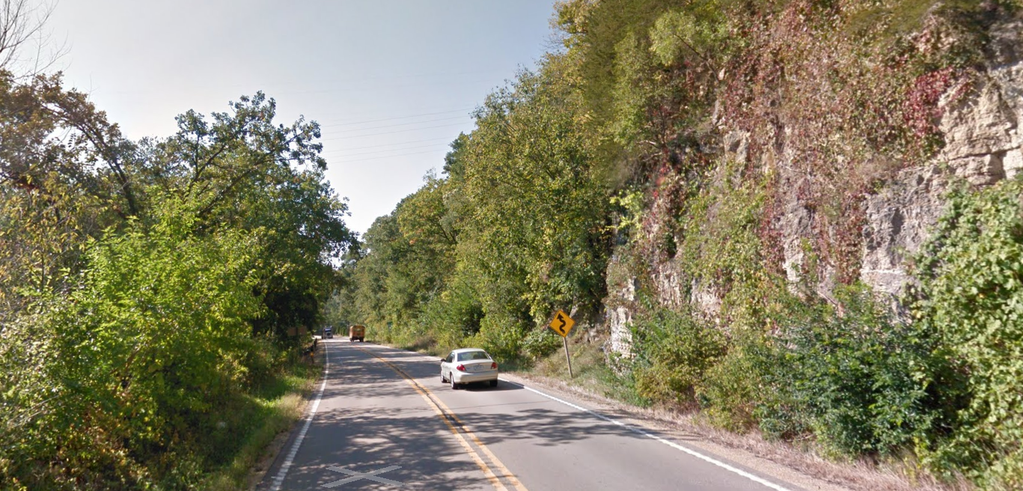

IA 3 Pavement Replacement – Dubuque County
$20M FY 24
6.3 miles
Notes:
4th & final segment. 1st 2 complete. 3rd under construction.
Original pavement 1927! Widening & resurfaced many times.
Narrow, curvy, hilly.
f/k/a US 52

Slide 23
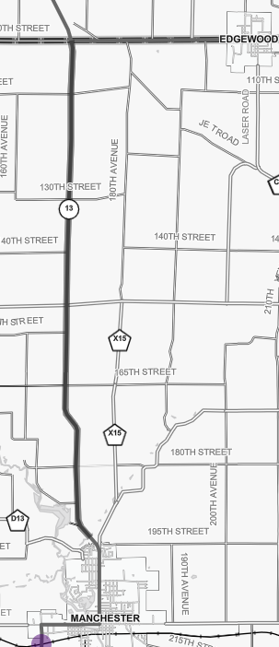


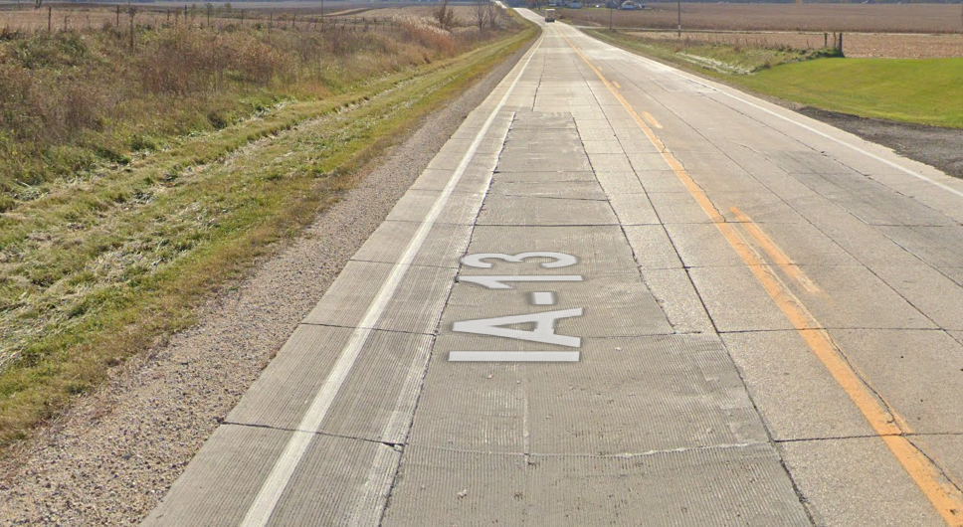
IA 13 Pavement Replacement – Delaware County
$22.9M FY 24
Notes:
9.7 miles.
Original pavement 1931. Thin PCC overly 2002.
Narrow shoulder, ditches. Drifting in winter.

Slide 24
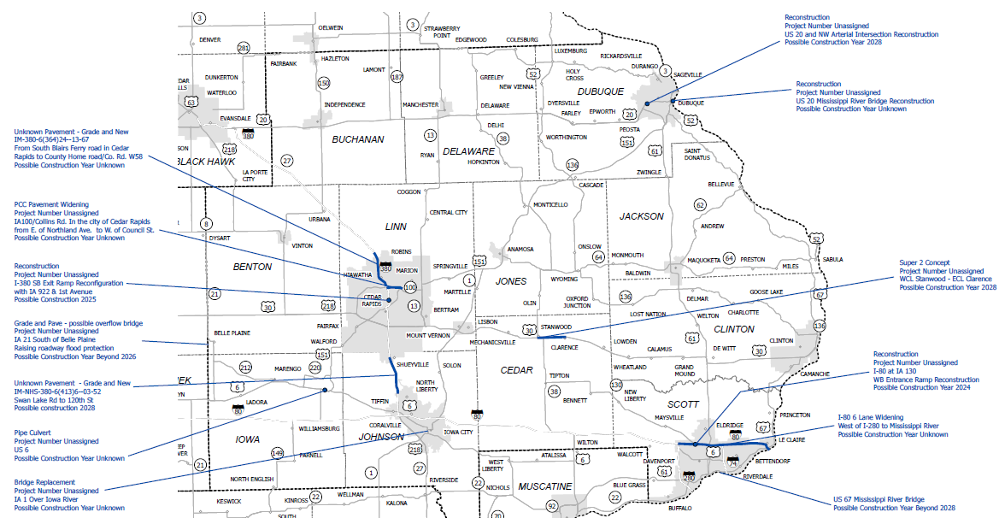
District 6 NOT Funded Projects
Notes:
This is a handout too

Slide 25

THANK YOU FOR YOUR TIME AND ATTENTION
Jesse Tibodeau, PE, CPM
DISTRICT 6
IOWA DEPARTMENT OF TRANSPORTATION
Jesse.Tibodeau@iowadot.us
319-364-0235

Slide 26
References/notes
Iowa DOT District Contacts: https://iowadot.gov/districts/district-contacts
Iowa DOT FY 2023-27 Highway Program Interactive Map: https://iowadot.gov/program_management/interactivemap
Iowa DOT Winter Quick Facts: https://iowadot.gov/maintenance/pdf/winter_quick_facts.pdf
Iowa DOT Utility Accommodation Info: https://iowadot.gov/rightofway/Utility-Accommodation-and-Coordination

