Slide 1
Utility GIS Inventory
Adam Shell
Iowa DOT GIS Program Manager
Notes:
Intro

Slide 2
Data Management Strategy
Notes:
Data Management – allows us to manage data to achieve our goals
View data as an asset to support business decisions
Early stages of this journey, ultimately working to better govern and manage our data for use by internal and external customers of the department
******************************
Notes
Data Management - The development, execution, and supervision of plans, policies, programs, and practices that control, protect, deliver, and enhance the value of data and information assets.

Slide 3
Iowa DOT GIS Portal
DOT maintains inventory through geographic information systems (GIS)
Bridges, signage, pavement conditions, traffic data etc.
Data and custom viewers available to DOT Staff
Open Data Portal: https://data.iowadot.gov
Notes:
-Iowa DOT has a very robust GIS portal
-Information at your fingertips
-Over 2,700 employees at DOT. This is a great tool to convey data and allow consistent messaging of information from one Bureau to another.

Slide 4
Iowa DOT GIS
Area of inventory we are currently missing- UTILITIES
Help us make informed decisions on current and future projects
Utility relocations can be costly and time consuming
Identify utilities early in the planning phase of a project to avoid or minimize impacts
Avoid costly/time consuming impacts to utilities
Notes:
-While we have a very robust GIS inventory, we are lacking in the area of utilities
-Utility relocations can be very costly and time consuming on projects
-It affects our projects, as well as your customers.
-Working on improving our GIS inventory of utilities so that we can better avoid or minimize impacts to utilities, through early identification.

Slide 5
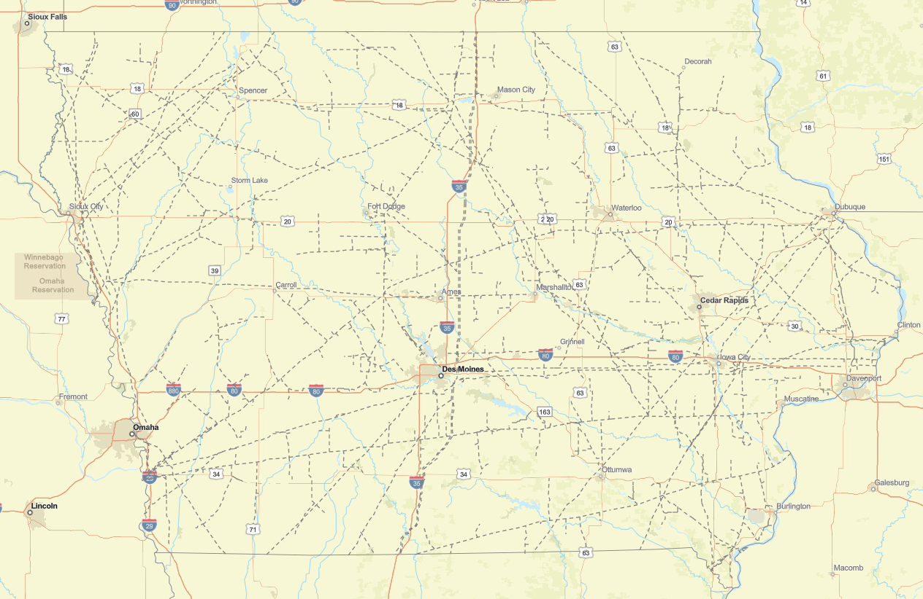
Current Utility Data
Published layers
U.S. Energy Information Administration (EIA)
U.S. DOT, National Pipeline Mapping System (NPMS)
U.S. DHS, Homeland Infrastructure Foundation- Level Data (HFLA)
Notes:
-Currently we have access to published layers
-These are great, they give us a good idea of major utilities that may be within a project area
-These layers lack accuracy

Slide 6
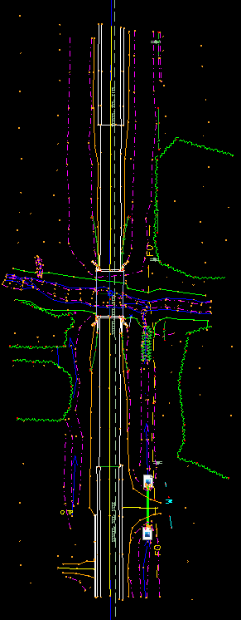
Current Utility Data
DOT surveyors- Preliminary survey (CAD)
Converting to GIS (on-going)
Gives us a good idea of what is out there for utilities
ASCE 75 standards
Lacks detailed information, low quality level (Typically Level D)
Need: accuracy, detailed information
Notes:
-Prior to the planning phase of a project, DOT surveys the project limits (D01- prelim survey)
-Following standards from ASCE 75 report.
-They shoot points locating any utilities visible aboveground.
-Underground, they shoot the locations of utilities marked by Iowa OneCall (flags and spraypaint markings)
-Lacks accuracy and not very detailed. We don’t always necessarily know who owns which lines.

Slide 7
Moving Forward
We need your help!
GIS data (for internal use only)
Feature service connections preferred
Iowa DOT is an ESRI shop
Allows you to control what information we have access to
Win-win situation
State Agency Alignment Opportunities
Notes:
-Would like to partner with utility companies
-Gain access to their geospatial data
-DOT is an ESRI shop
-Prefer service connections, where utility companies can control what we have access to. Prefer this over static data that would need updated.
-Otherwise GIS shapes/CAD files for us to push to GIS. (This can get messy and time consuming though)
-This would be a win-win situation for both the DOT and utility companies
-Avoid hitting utilities
-Less down time for customers
-Keep our projects on budget and on time
State Agency Alignment Opportunities
Other state agencies like the OCIO are working to inventory infrastructure assets related broadband
Given the work the DOT is doing, an opportunity to partner and align with other state agencies and potentially others to support utility data coordination going forward

Slide 8
THANK YOU
DEANNE POPP
UTILITY PROGRAM ADMINISTRATOR
TRANSPORTATION DEVELOPMENT DIVISION
Deanne.Popp@iowadot.us
Office: 515-239-1014
ADAM SHELL
GIS PROGRAM MANAGER
TRANSPORTATION DEVELOPMENT DIVSION
Adam.Shell@iowadot.us
Office: 515-239-1650
Iowa DOT, Right of Way Bureau
Utility Accommodations & Coordination
https://iowadot.gov/rightofway/contact-us
Notes:
Contact info slide.

