Slide 1

Annual Utility Meeting
2023 | Gateway Hotel - Ames, IA
Iowa Department of Transportation

Slide 2



Welcome & introductions
Iowa DOT Utility Program
Notes:
Good morning and welcome to the Iowa DOT’s 2023 Annual Utility Meeting. We appreciate everyone taking time out of their schedules to join us today.
This meeting as many of you know usually takes place during late winter or early spring.
Over the last year we’ve had a lot of staffing changes and related training for new staff going on – which affected the scheduling of this meeting.
My name is Deanne Popp and I’ll be leading today’s event.
Material from today’s meeting will be made available on our FTP site for future access.
Today you’ll be hearing from several different presenters including the DOT districts who will discuss upcoming projects.

Slide 3

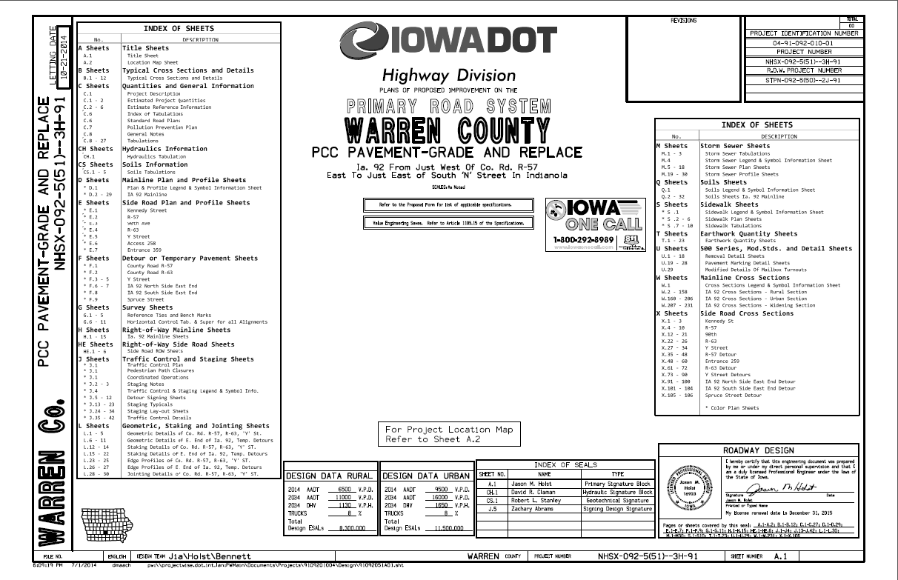

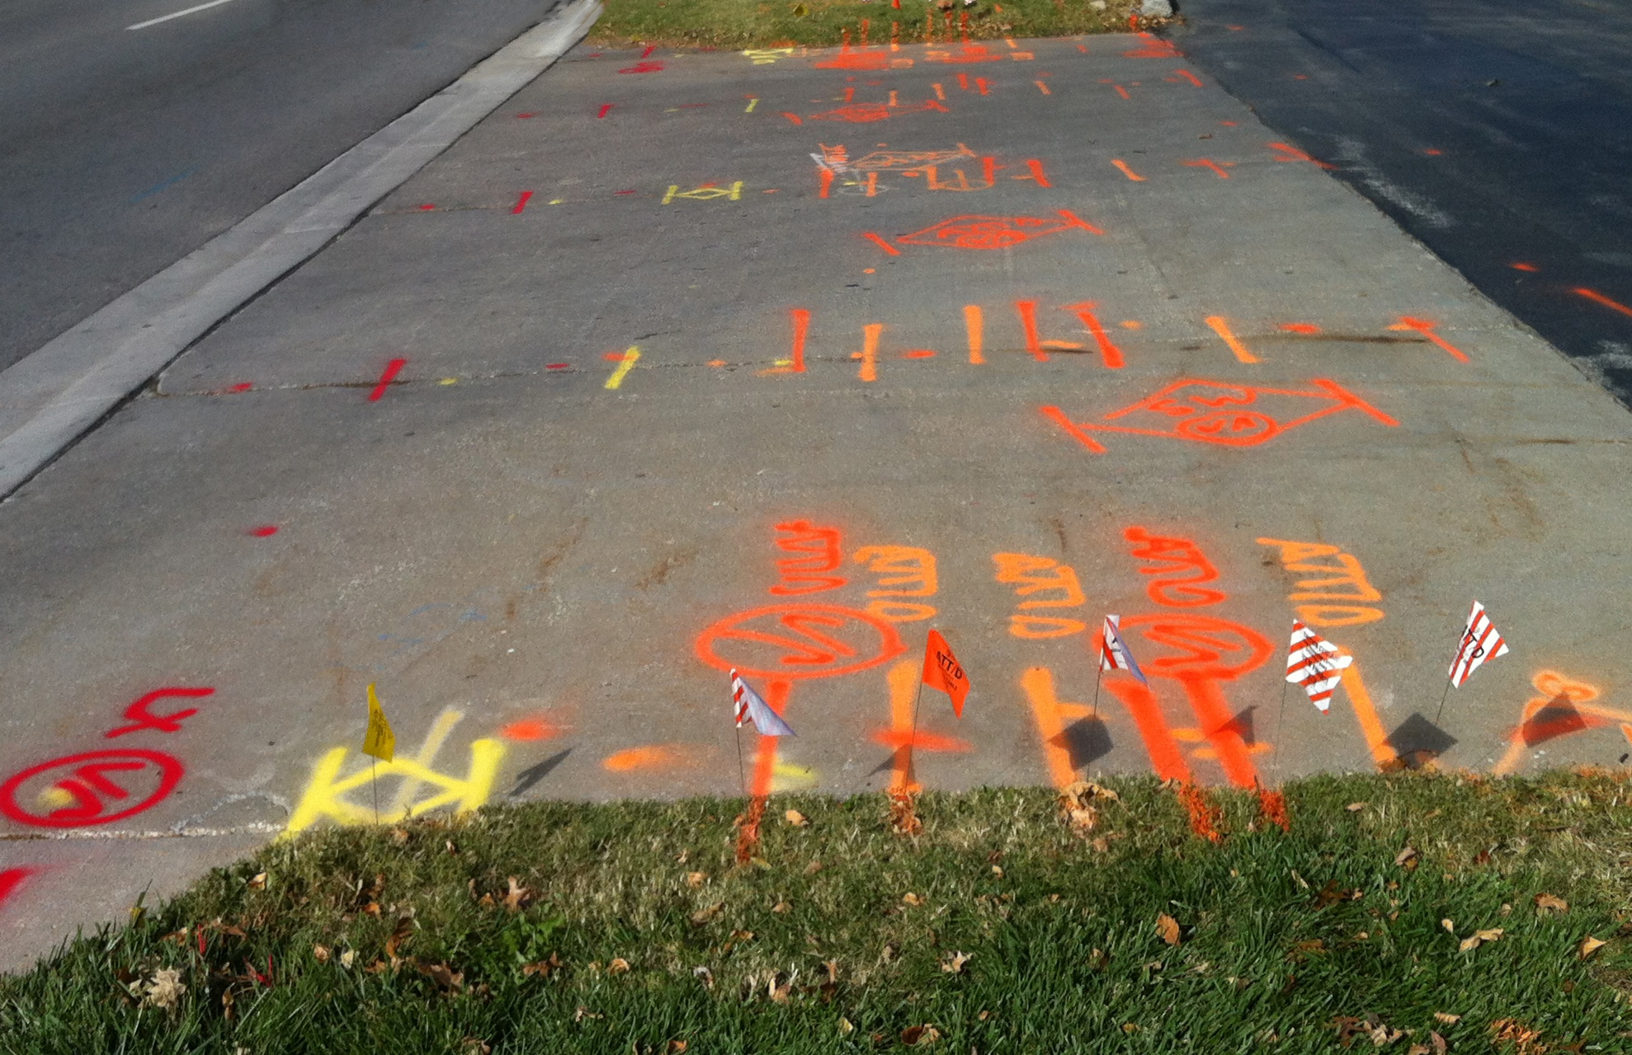

Accommodation & Coordination
Accommodation
Permitting
Relocations
Agreements
Management of the ROW
Notes:
The Utility Program covers all aspects of utility coordination from permitting to project relocations.
We’re part of the DOT’s Transportation Development Division and the Right of Way Bureau.
The work we do plays a major role in managing the assets in the public rights of way.

Slide 4
Utility program team
Central Office
District offices
Field offices
Notes:
Our team is spread out among various locations including
The central office in the Right of Way Bureau in Ames
Six district offices
And 16 field offices throughout the state

Slide 5

Central Office – Right of Way Bureau
BUREAU DIRECTOR – BRAD HOFER
Bureau Leader
Approval of budget items including utility relocations
UTILITIES SECTION SUPERVISOR – ERIC WRIGHT
Process & Procedure Implementation
Project & Production Champion
Design, Utilities & Appraisal
Notes:
The Right of Way Bureau is lead by Director, Brad Hofer
Brad is a great supporter of the Utility Program and various initiatives underway
Utility related budget items must be approved by Brad, such as reimbursement agreements and subsurface engineering contracts
Eric Wright is the Utilities Section Supervisor
Leads the section staff in implementation of our processes and procedures
and reporting on project and production status
He is also the supervisor for the Design and Appraisal sections in the ROW bureau

Slide 6
Central Office – Right of Way Bureau
REGIONAL UTILITY PROGRAM COORDINATORS
Project scheduling & monitoring
Project plan submittals
Utility Reimbursement Agreements
Invoices, audits & payments
Disclaimers of Interest in Realty
Field assistance when needed
Notes:
The Central Office in the ROW Bureau monitors project schedules and clearances and sends out all of the project notifications and plan submittals.
They also negotiate utility reimbursement agreements and handle all the related payments and release of easement functions.
This work is all performed by three Regional Utility Program Coordinators.

Slide 7
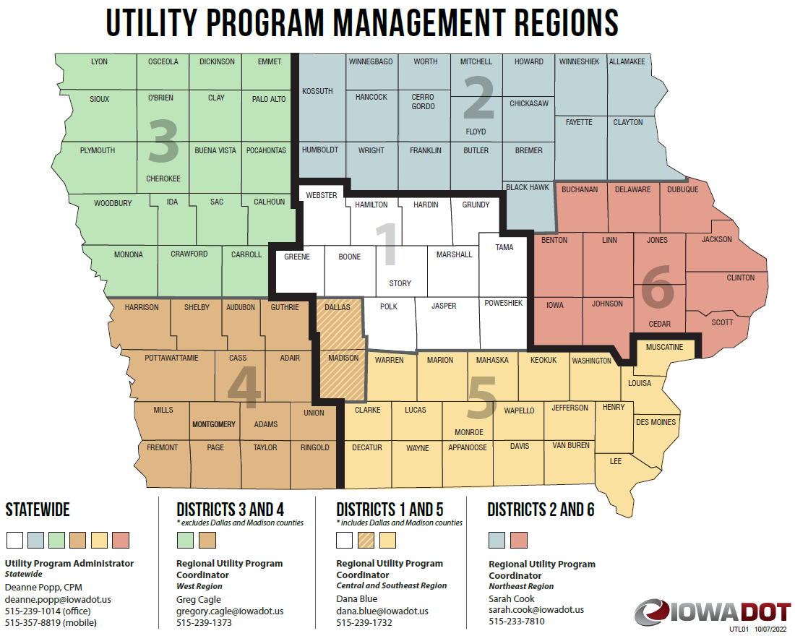
Notes:
The 3 coordinators each have an assigned region.
Dana Blue is the Regional Coordinator for Districts 1 and 5 – the central and southeast regions
Greg Cagle is the coordinator for Districts 3 and 4 – the west region
Sarah Cook is the coordinator for Districts 2 and 6 – the northeast region
I am the statewide administrator of the Utility Program
administering policy
And providing guidance to all team members statewide
Leading initiatives and process improvements
And, acting as a liaison to our stakeholders

Slide 8
Central Office – Right of Way Bureau
PROGRAM ADMINISTRATOR – DEANNE POPP
Program Leader - Policy Administrator
Initiatives
Stakeholder Liaison
TRANSPORTATION PLANNER – JON REES
Right of Way Information Management
Parcel Mapping
GIS
Notes:
We also have a Transportation Planner in the ROW Bureau, Jon Rees, who is working on the development of a GIS based ROW management system that includes right of way parcel information and utility mapping layers.

Slide 9

District Utility Coordinators
District 1 – Sean Passick
District 2 – Daryl Erickson
District 3 – Kelly Mulvihill
District 4 – Nate Epperson
District 5 – Bonnie Clancy
District 6 – Steve Flockhart
Project Coordination
Utility Work Plan Review
Utility Accommodation Permit Review
Utility Reimbursement Agreement Review
Notes:
There are 6 District Utility Coordinators across the state
The DUCs (as we refer the them) handle
Project coordination
Utility work plan reviews
Coordination and collaboration meetings

Slide 10
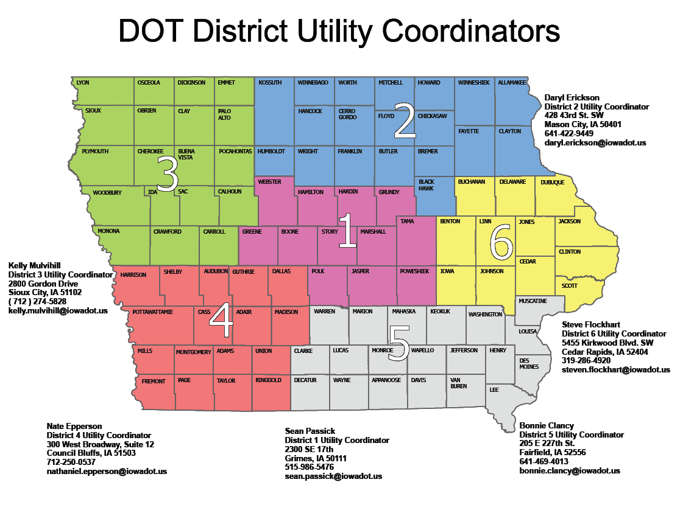
Notes:
It map shows the 6 different District areas covered by each DUC

Slide 11

Engineering Operations Technicians
Utility Accommodation Permit Review
Project Coordination Assistance
Utility Work Plan Review
Other permits
Notes:
There are 16 additional field staff across the state that handle permitting.
These are the Engineering Operations Technicians or EOTs
They receive and process various types of permits including
Utility Accommodation
Work on ROW and
Access (or entrance) permits
They frequently get involved in project coordination and relocation work plan reviews.

Slide 12

Utility Accommodation and Coordination
Communication is KEY
Information Sharing
Annual Utility Meetings
  Program Updates
  Policy & Procedures
  5-year program
Operational Planning Mtgs
Utility Coordination Mtgs
Notes:
Good communication is vital to the success of any business and highway planning and construction is no different..
That success depends on sharing…
The right information - at the right time – with the right people
Meetings are one of the ways we share information
Annual Utility Meeting – late winter
Share program and policy information
Permitting and Reimbursement agreements
Each district also shares information about current and upcoming projects including the 5-year Program
Operational Planning Meetings – held early in the project development to look for ways to collaborate and plan together
Utility Coordination Meetings – held throughout project development and cover relocation schedules and work that needs to be coordinated

Slide 13

Project development & Utility coordination as a partnership
Research Project
Reviewing practices
Opportunities to improve
Project milestones
Roles & responsibilities
Guidance
Risk management

Slide 14

Conflict analysis & resolution
Begin reviewing earlier during design
Develop alternatives
Look at constructability & costs
Sub-surface investigations
Determine resolutions together

Slide 15

Iowa Administrative Code 761-115 (306A)
Utility Accommodation Permits
Section 115.25 – Point25
Notes:
The work we do within the Utility Program is done under Iowa Code Section 306A
More specifically under Iowa Administrative Code – 761 Chapter 115
Many of you know this rule as our Policy for Accommodating and Adjustment of Utilities on the Primary Road System
Section 115.25 covers the adjustment and coordination on highway projects – we reference this as simply Point25 – so you’ll hear that referenced frequently
P25 Applies to all DOT projects – except
Those developed on an accelerated schedules
And those with no anticipated utility involvement

Slide 16

Point25 Overview
IAC 761-115.25 = Point 25
State highway projects
Requirements that must be met
Non-responsive utility can be held liable delay costs
Utility and contractor settle directly
State is provider of evidence
State cannot take on liability of either party
Notes:
Point25 is specifically for state highway improvement projects
It sets forth the timing of notifications and plan submittals that DOT provides to utility companies
As well as the required responses from utility companies
If all the notifications and submittals are met,
Non-responsive utility owners can be held liable for project delay damages
Any claims will be settled directly between the DOT contractor and the utility owner
In those instances, the State will only be a provider of evidence
DOT CANNOT take on liability of either party

Slide 17
Milestones
Design events (D)
  D00 – Concept
  D02 – Field Exam
  D05 – Design
ROW events (R)
  R01 – Right of Way Layout
  R03 – Right of Way Acquisition
  R04 – Right of Way Relocation
Utility events (U)
Notes:
DOT projects are tracked in our project scheduling system by milestones.
Each discipline such as Design, ROW, Utilities have their own letter designation which you may have heard before.
Here are a few examples…

Slide 18
Utility coordination | “U” events
Utility milestone events
  U00 Investigation (0-10% design completion)
  U01 Major impacts (10% design completion)
  U02 Notification (30% design completion)
  U03 1st plan submittal (60% design completion)
  U04 2nd plan submittal (90% design completion) (P25 projects only)
  U05 Reimbursement agt. (60-90% design completion)
  U06 Notice to proceed (following all approvals)
  U07 Utility bid attachment (relocation status in contract letting docs)
  U10 Utility clearance (relocation status [clear/not clear/conditional])
Notes:
Utility coordination for DOT projects is broken down into project development milestones.
We refer to these milestones as “U” events
The events are tracked in our internal project scheduling system.

Slide 19
U00 Event | investigation
Investigate – look for utility facilities within the project area
Identify – utility facility ownership in the project area
  Iowa One Call (Design Request)
  Field reviews
  Permit records
  Utility maps
  GIS – shared utility location data
Best practices under research
Better decisions during design
Notes:
The U0 event – is the investigation step for utility facilities within the project area
We seek to identify utility facility ownership in the project area
We gather information from various sources, such as:
Iowa One Call (design request)
Field examinations (concept review)
Utility maps
Existing permit records

Slide 20
U01 Event | major impacts
Concept development (D00)
Look for the potential for impacts to large capacity facilities
Request more precise location information from utility owner
Provide the information to designers to lessen impacts
  Avoid
  Minimize
  Accommodate
Better decisions during design
Notes:
During the U0 investigation we look for the potential for impacts to major or large capacity facilities
If we see something that we need to look into a little further, we’ll contact that company
For more precise location and capacity information
We might also ask for a high-level estimate for relocation or adjustments should they become necessary
These help us to make better design and development decisions.
The information we receive is provided to the project designer with the intent to design around or at the very least minimize the impact to that facility.
The goal for the event is to be early enough in the project development process to allow for modifications to the design.

Slide 21
U02 Event |notification
    Completed Field Exam Plans – (D02)
    Request verification of facility locations (90 days to reply)
    Public ROW or private easement?
    If facilities ARE on private easement and relocation is necessary…
      Will company purchase their own replacement easement?
      Will company request DOT to purchase their replacement easement?
Notes:
The U2 Event is next. We send out Project Notifications to all the know companies
This occurs after the Design field exam has been completed – we provide the field exam plans for your review
These plans include a general project layout (approximately 30% design)
At this point the new ROW lines have not been determined
With the U2 we submit
We request verification of existing facility locations from utility companies (90 days to reply)
We also request that you let us know at this time if your facilities are on the public ROW or in private easement in the vicinity of the project.
If the facilities ARE on private easement – would your company purchase their own replacement easement?
Or, would they request the DOT to purchase replacement easement for them if it’s needed?
Again, our goal is to be early enough in the design development to allow for modifications
And for our ROW Design staff to include any utility easement needs in the ROW design.

Slide 22
U03 Event | 1st plan submittal
  Completed road design (D05)
  Proposed new ROW layout (R01)
  All MUST reply whether impacted or not (90 days to reply)
  All impacted companies must provide a relocation plan (same 90 days)
Notes:
Next is the U3 event – this is the 1st plan submittal
This submittal includes the current design plans with the new proposed ROW layout (approximately 60% design)
It is sent to all known utility companies with facilities in the project area.
Each company has 90 days to reply to let us know if their facilities will be impacted or not.
Every company must reply even if they don’t think they’ll be impacted
If you do expect to be impacted by the road project, you MUST provide us with a relocation work plan within the same 90-day time period.

Slide 23
U04 Event | 2nd plan submittal
  Point25 projects only (shorter schedules don’t include)
  Following public hearing or information meeting
  Changes incorporated into proposed ROW layout
  All MUST reply whether impacted or not (60 days to reply)
  All impacted utilities must provide a FINAL relocation plan (same 60 days)
Notes:
The U4 submittal is only provided on Point25 projects
The 2nd plan submittal or U4 is done following the Public Hearing or Public Information Meeting
Any changes requested as a result of the public’s input are incorporated into the final ROW layout (approximately 90% design)
Again, this submittal is sent to all known utility companies with facilities in the project area.
Each company has 60 days to review the information and reply as to whether or not their facilities will be impacted.
Again, everyone must reply regardless if they’re impacted or not
If they are going to be impacted by the road project they MUST provide us with a FINAL relocation plan within the same 60-day time period.

Slide 24
U05 Event | agreement
Reimbursement Agreement
Who pays?
  Relocation necessary to accommodate construction
Existing facility
  Private Easement
  Public Right of Way
Prerequisites
  Easement documentation
  Relocation work plan
  Estimate of relocation costs
Notes:
Some utility relocations or adjustments may be eligible for reimbursement
If it’s determined that a reimbursement agreement is needed, then we track that as a U5 event
So, how do we establish who pays? – State or the utility company?
First off, the relocation must be necessitated by the highway project
Then it depends on the location of the existing facility
If it’s on private easement – it would be eligible for reimbursement
If it’s on the public right of way by permit – then the company must relocate at their own expense
There are a few things we need to begin the agreement process – we need
The company’s existing easements
Their approved relocation plan (shown on the H sheets)
And a detailed estimate of relocation costs
We’ll discuss this further a few slides later

Slide 25
U06 Event | notice to proceed
  Final utility relocation work plan must be approved
  New right of way must be acquired (if applicable)
  Reimbursement agreement must be executed (if applicable)
  Permits must be issued (if applicable)
  Coordination with DOT contractor or other utility companies?
Notes:
The Notice to Proceed is the next step – that’s the U6 event
There are several things that must fall into place before the notice can be given.
The company’s relocation plan must be approved
Any necessary new ROW in the vicinity of the relocation must be acquired
The reimbursement agreement must be executed (if there is one)
And the utility permits must be issued (if there are any)
In addition, if there is any coordination required with the DOT’s contractor or other utility companies, then the notice may be conditional to the other party’s schedule

Slide 26
U07 Event | bid attachment (UBA)
  ALL Point 25 Projects (Recommended for Non-Point 25 projects)
      Included in bid documents
      Written details regarding conflict locations and resolutions
      Anticipated start and completion dates for relocations
      Utility company contact information
      For bidding contractors’ use – to make them aware of the status of utility relocations and timeline
Notes:
The U7 is the Utility Bid Attachment (or UBA)
This is a document the DUC provides to our Contracts Bureau to be included in the final bidding documents
It is required on ALL Point25 projects (and is sometimes included on Non-Point25 projects)
It is a formal report of the status of utility relocations at the time of plan-turn-in
It includes written details about any remaining conflict locations and their intended resolution
It also states anticipated start and completion dates for utility relocations that still needs to be done
The UBA is intended for the bidding contractor’s use – to make them aware of the status of utility relocations – and allows them to bid accordingly.

Slide 27

Reimbursement Agreements
Existing facility
    Private Easement
    Public Right of Way
Eligibility
    State’s authority to reimburse
    Evidence of easements
Notes:
As I mentioned before, some utility relocations or adjustments may be eligible for reimbursement.
To get started on the agreement we need to establish eligibility and determine how much is reimbursable.
To do this we need to review the company’s easements

Slide 28

Easement Documentation
Correct area
Correlate to DOT parcels
Notes:
It might seem obvious, but the easements should be for the area where the relocation is to be done
When providing easements, it helps us if you reference the corresponding DOT parcel numbers from our plans
We need to correlate the area to make sure it’s for the correct area
This helps us to establish the state’s authority to reimburse and enter into the agreement.

Slide 29
Proposed Relocation
Work Plan – EXHIBIT A
Show existing location of facilities
1
Show proposed location of facilities
2
Overlay on DOT plans and cross sections
3
Notes:
Relocation Work Plan
overlay on the DOT plan sheets & cross sections
D sheets (plan & profile)
H sheets (ROW & parcels)
Existing facilities
Proposed location
Removal
Abandon

Slide 30
Scope of Work
Clear description of the work required
Size(s) of facility
Length of relocation
  On public ROW (at company expense)
  On private easement (eligible for reimbursement)
Tabulation of conflict points
  Crossings, Poles, Vaults, Ducts
Work to be done by Force Account or Competitively Bid?
Notes:
We need a clear description of the work to be accomplished
Including the size or sizes of the facilities
The location and length of the relocation
How much is within the public ROW (this would be at company expense)
How much is on private easement (this is the portion that would be eligible for reimbursement)
A tabulation of conflict points, crossings, poles, etc.
We also need to know who will be performing the physical relocation work?
Will it be done by company forces
Or, will you be soliciting bids for the work?

Slide 31
Detailed Estimate of Relocation Costs – EXHIBIT B
Segregate direct, indirect & “unallowable” costs
1
Cost Accounting Standards
Work Order System
2
Ability to accumulate costs to a project
3
Notes:
A detailed and itemized estimate of the relocation costs is also needed
The detail is necessary to determine if your company can segregate the costs for the project;
To be able to show costs that are allowed vs costs that are not allowed;
Whether you are using a cost accounting system or a work order system; and
If your company can accumulate costs toward a specific project
This will become the EXHIBIT B of the agreement

Slide 32
Direct Costs
Benefit one project and only one project
Include:
Materials & equipment
Labor & wages
Engineering
Directly related
Notes:
The detail we are looking for in the estimate should show direct costs - that benefit one project and one project only.
It should include a breakdown of
Materials & equipment
Labor & wages, and
Engineering
Again, these must be directly related to this specific project

Slide 33
OVERHEAD & INDirect Costs
Eligible costs - must be actually incurred
Include:
Administration
Accounting fees
Legal fees
Insurance
Notes:
Some overhead and indirect costs may be allowed – these are costs incurred to run a business – in order to include them they must be actual costs that your company incurs such as:
Administration
Accounting fees
Legal fees
Insurance

Slide 34
OVERHEAD & INDirect Costs
Ineligible costs
Include:
Advertising
Interest on borrowings
Fines & penalties
First-class travel
Notes:
Ineligible costs would be things like
Advertising & sales promotion
Interest on borrowings
Contributions & donations
Fines & penalties
First-class travel & entertainment

Slide 35
Betterments & credits
NOT reimbursable – show as a credit
Work NOT attributable to the highway project
Work done at the election of the utility
  Increased capacity
  Service improvements
Salvage value of materials removed
Recovered for reuse by the utility
Notes:
Only relocation work necessitated by the requirements of the highway construction are reimbursable
If you cannot attribute the work to the highway project, then it would not be reimbursable
The same goes for work done at the election of the utility, such as
Increased capacity
Service improvements
There are also items that should be shown as a credit on the estimate
Salvage value of materials removed
Items recovered from temporary use
And items accepted for reuse by the utility company
All of these are NOT reimbursable and MUST be shown as a credit in the estimate
In some instances, a non-equivalent replacement might be necessary for the relocation. This may appear on the surface as a betterment, but other issues may support the need for the alternate choice.

Slide 36

Agreement Document
Pre-Audit - $50K 
Draft review
Send for signature
Internal Staff Action
Fully executed agreement
Notes:
We review all the information provided for compliance with the project and state and federal regulations.
When the estimated work is $50,000 or greater, we’re required to have an internal pre-audit conducted
This is done by our DOT Auditors in our Finance Bureau
After the pre-audit is complete and we’ve fully reviewed the draft agreement internally we send it out to the company for review & signature
Following the company’s execution, we complete the internal DOT approvals (this is our Staff Action process)
It’s the departmental approval to enter into an agreement with an external party
Then the DOT may then sign agreement
And the fully executed agreement is returned to the company

Slide 37
Change orders - 125% of estimate
Prior approval needed
Request in writing to Central Office
Updated itemized cost estimate
Explanation of increased costs
Only reimburse additional cost if approved by DOT in writing
Notes:
We all know that in reality things don’t always turn out the way they appear on paper
Significant changes to the scope of work must be requested in writing for approval from the DOT
An addendum to the agreement may be needed
If the costs will exceed 125% of the estimate ~ unless the increase is $10K or under
You should provide us with an updated cost estimate
Along with an explanation of increased costs
We can only reimburse for the additional costs if they were approved by DOT in writing

Slide 38
Invoices & payments
Beginning & ending dates
Incurred prior to invoice date
Progress payments allowed
Include % complete
Reference numbers
(Project/Agreement)
Support for costs
Notes:
As far as invoicing and payments –
Expenses must be incurred prior to the date of the invoice
Progress payments are allowed as the work is being done
Invoices need to show the % complete
Whether it’s a progress billing or a final invoice
Other things to note on the invoice are
The agreement number and the DOT project number
Any company project or activity numbers
The beginning and ending date of work for the period being billed
And support for the costs incurred - itemized statement – copies of receipts, time cards – that sort of thing
The total claimed to date should also be included.
We will retain 10% of the invoiced amount until the project is complete
When making payments we can only pay up to 90% of agreement amount
Any costs that exceed that will be included in the final audit which will determine if the additional costs were justified.

Slide 39
Final payment
Certificate of Completion
Final Audit
Disclaimer of Interest in Realty
Retainage
Notes:
Regarding the final payment - a few things are needed prior to the release of the retainage
One being the Certificate of Completion
That needs to be filled out including the completion date and submitted to DUC
The DUC will review and sign it if the relocation is complete and acceptable
We also perform a Final Audit of the entire cost of the relocation
We submit all invoices & supporting documents for review by our internal Auditors
This can take some time to go through
They will make a determination on whether charges are in line with estimates and the work performed
We may request repayment of some of the funds if our auditors determine that the company has been overpaid
We will release the retainage if all is in compliance
The release of easement rights also needs to be completed – this is the Disclaimer of Interest in Realty (or sometimes an Instrument of Subordination)
This releases the company’s interest in all real estate acquired for the project where the utility was originally located
The company will retain any easement rights outside of the ROW
After all of this is complete, we can then release (or pay) the retainage (if any)

Slide 40

CLOSE OUT
Agreement process is complete
Maintain files & records for a period of 3 years from the date of final payment.
Notes:
And - with all of that - the agreement process is then complete!
By regulation the utility company is required to keep their files and records for a period of 3 years from the date of final payment.
- in case we need to revisit for audit purposes.

Slide 41
UTILITY PERMITS
UTILITY ACCOMMODATION POLICY
IAC 761 Chapter115
Where & How
Notes:
Utility permitting is a big portion of what we do in the utility program.
Iowa Administrative Code – 761 Chapter 115 includes the regulations that govern where and how utility facilities can occupy primary highway rights of way in Iowa.

Slide 42
WHEN ARE PERMITS REQUIRED?
Any time you plan to locate facilities within the highway right of way
New installations
Upgrades
overhead changed to underground
Notes:
A permit is required any time you plan to locate facilities in the public rights of way
This includes new installations
And upgrades to an existing facility
Such as changing overhead to underground

Slide 43
MAINTENANCE
Covered under original permit
Requires
48-hour notification
Exact same size, location, and install methods
Notes:
Maintenance of an existing facility is covered under the original permit
And requires a 48-hour notification to the DOT before beginning any work
Unless it’s an emergency
Maintenance includes any work on the facility that is for the exact same size, location and install methods
This would include pole replacement as long as the facility is NOT being upgraded
The new pole must be placed within 1 foot of the original location

Slide 44
When more than one permit is needed
Non-continuous installations
Multiple highways
Multiple utility types
Notes:
Sometimes more than one permit is required for an installation
Each non-continuous installation requires a separate permit
Installs that begin on one highway and continue onto another highway must be split
If the permit involves more than one utility type such as fiber optic and telephone – it must be split
Even if they’re installed in the same location at the same time

Slide 45
When to submit
More lead time may be needed
30-days review period
Notes:
What the lead time?
Allow for AT LEAST 30 days prior to the expected installation time
This is because it may take DOT some time to review the request
We have 30 days to review and return the permit – provided that
All of the pertinent and required information is included in the submittal
That everything is in the correct and accurate format
That all of the required attachments are included
And, that all of the prior approvals have been received and are included with the submittal
There may also be some federal highway administration approvals that are needed
These are allowed to exceed the 30-day timeframe
Large and complicated installs may need more lead time – since their may be more involved in the review

Slide 46
Describe the installation
Method of installation
Materials to be used & encasement details
Section, Township & Range
Highway involved – Reference points & side of road
Show this on your site plan
Notes:
You need to properly describe the installation and the method for installing
boring, digging, open trench – and what materials will be used – and encasement materials if any
The work site location should also be very specific
Including the Section, Township and Range
The highway is involved
Reference points
And which side of the road you’re going to be working on
All this information should also be reflected on the site plan

Slide 47
Permit approvals
Cities – joint jurisdiction
Counties
Corps of Engineers – major waterways
Protected areas – DNR
Notes:
Approvals on permits often involve multiple parties
For installations where any portion is within the corporation limits of a city, you’ll need that city’s approval
Whenever the installation originates from, exits into or crosses a county road or county-owned property you’ll need county approval
Other approvals might be needed for things like
Impacts to major waterways or “protected” areas
You may need approval from the Army Corps of Engineers or the DNR

Slide 48
PERMIT NEEDED ON THE JOB SITE
Issued permit
Include ALL pages to be valid
Notes:
Please remember that you need to have your issued permit with you on the job site!
This should be the entire permit including all pages and attachments

Slide 49
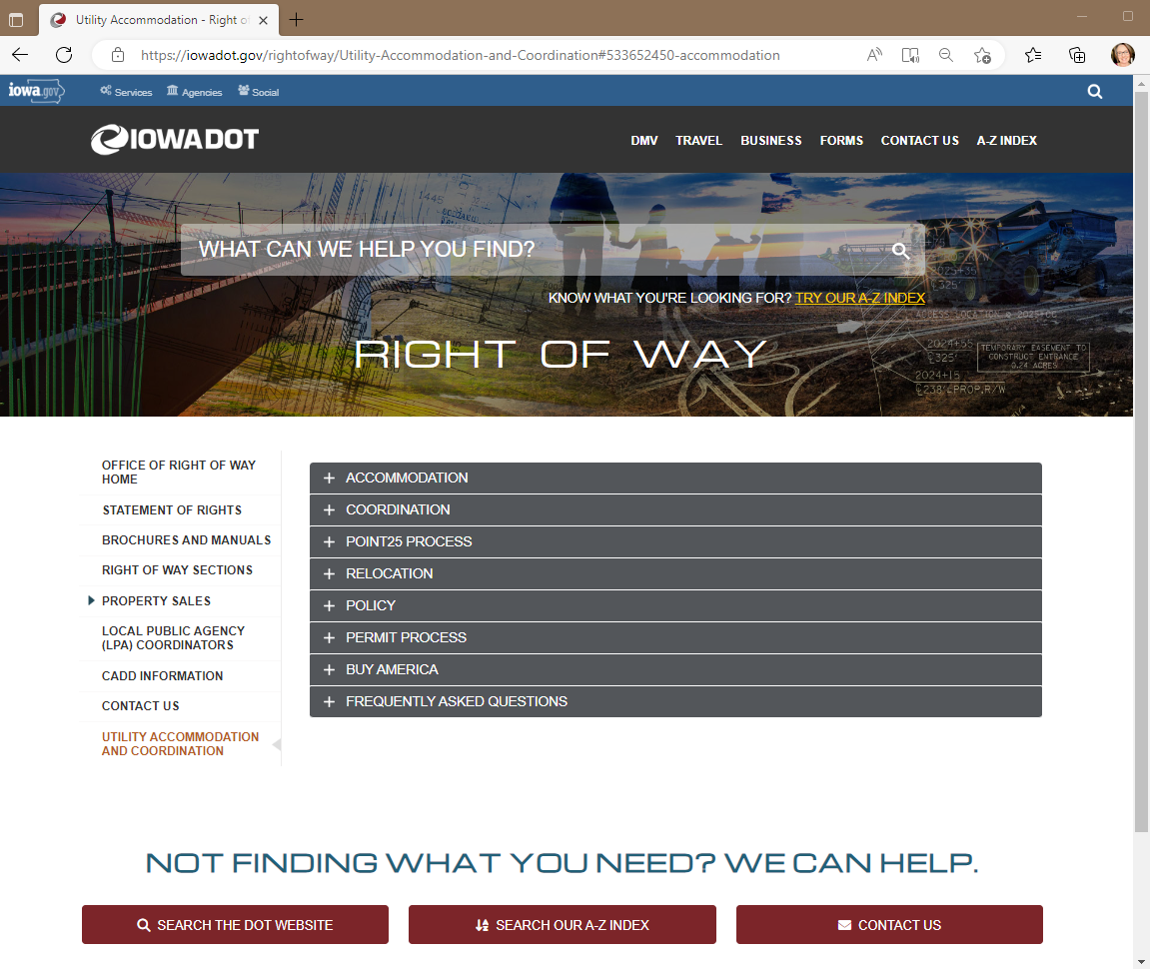
Utility Program Website
Utility Accommodation and Coordination
https://iowadot.gov/rightofway/Utility-Accommodation-and-Coordination
Notes:
Information on the Utility Program can be found on our website
There are sections on various topics including the Point25 process & permitting
You’ll find contact information for both central office and field staff
And the associated regional maps to determine who to contact for the various areas of the state.

Slide 50
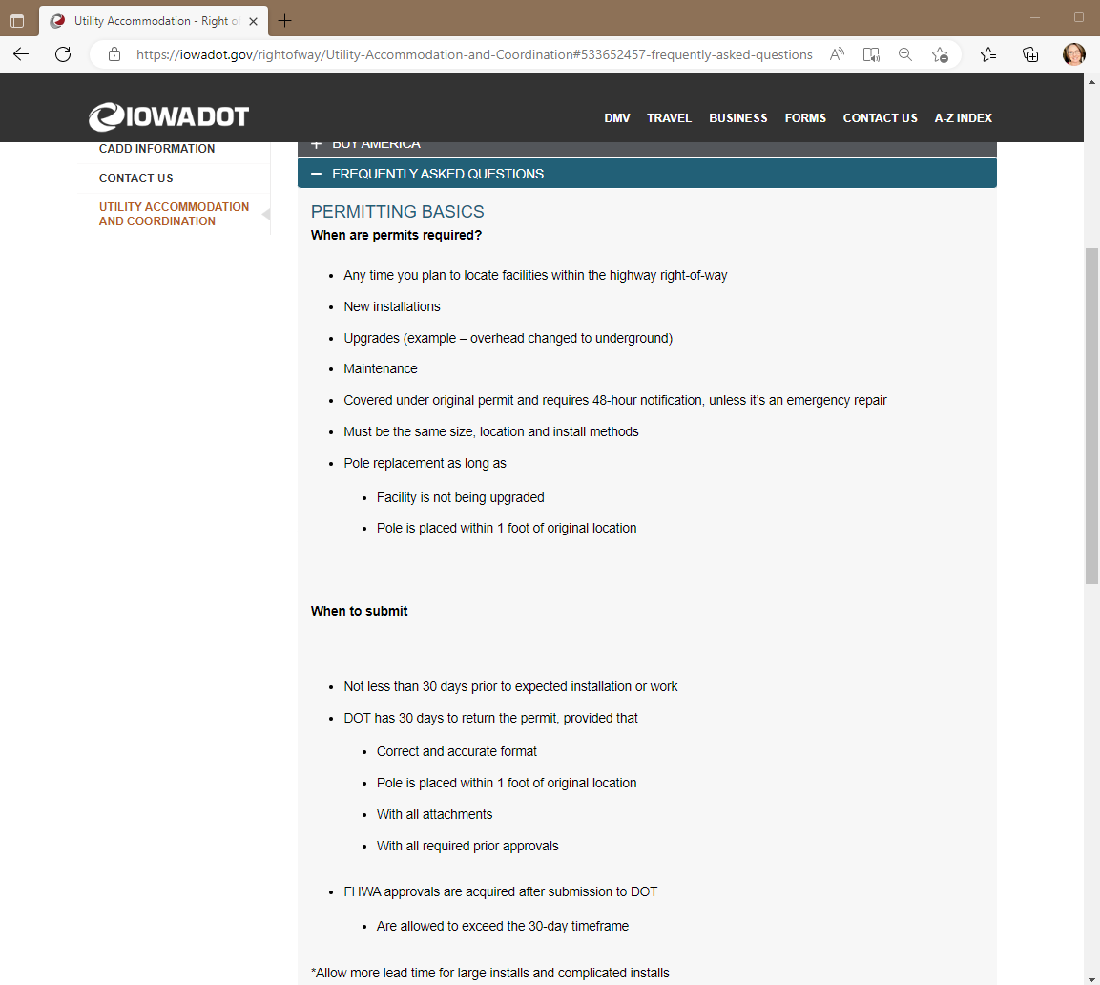
FAQ
Updated questions and answers for frequent questions we receive regarding permitting
Notes:
The FAQ page is a great resource for permitting
Helps answer the most common questions we receive.

Slide 51
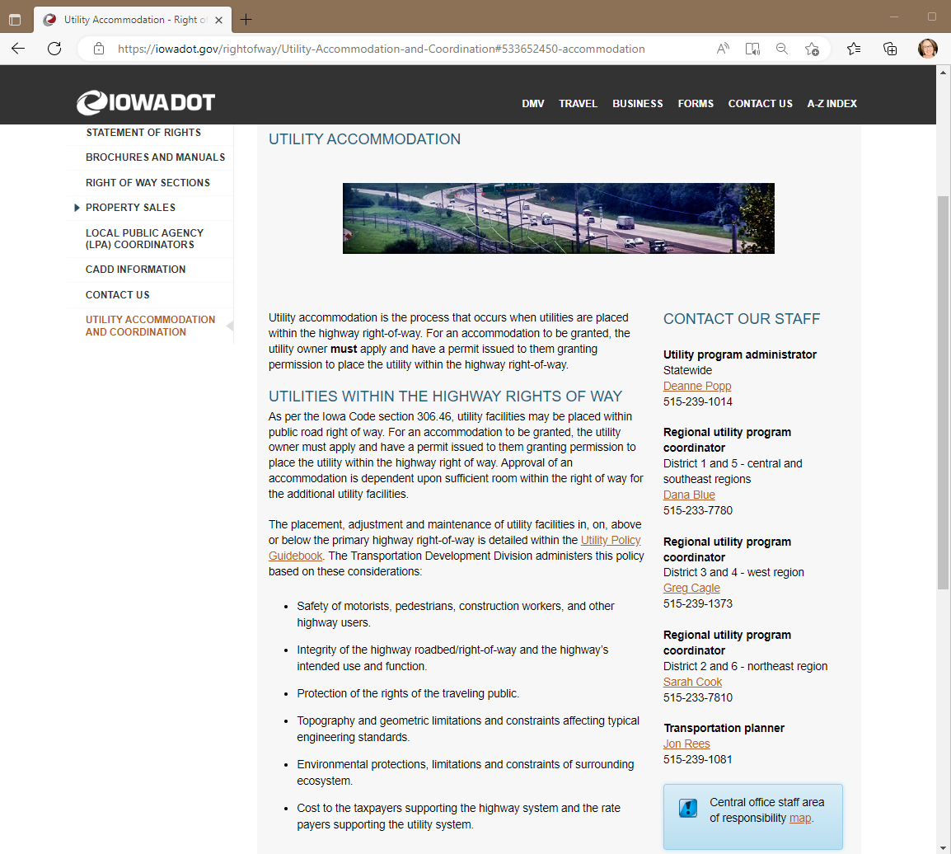
Contact our staff
Utility Accommodation and Coordination
https://iowadot.gov/rightofway/Utility-Accommodation-and-Coordination
Notes:
My contact information can be found on our main Accommodation & Coordination page.
Along with contact info for the Regional Utility Program Coordinators
Dana Blue
Greg Cagle
Sarah Cook
Jon Rees

Slide 52
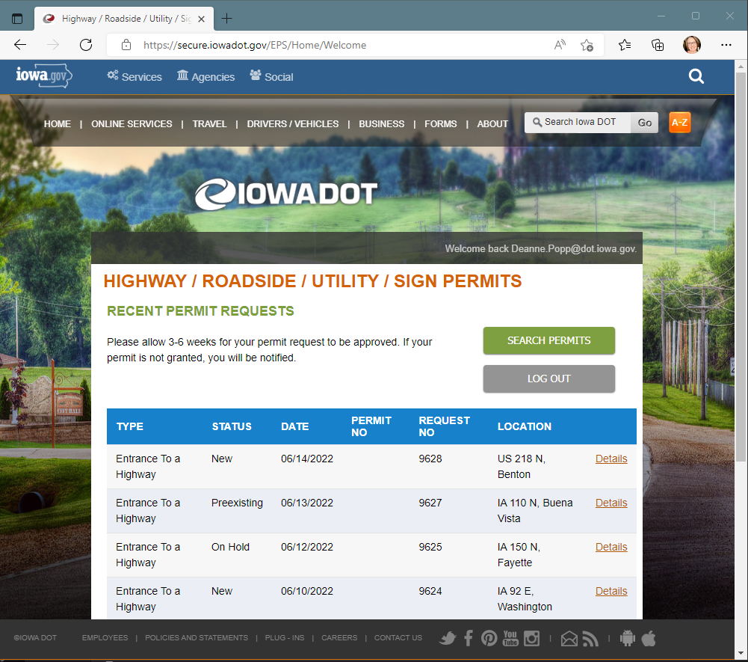
Electronic permitting system
Ready to Go
Are you?
Notes:
The Electronic Permitting System is ready for you to test – are you ready for EPS?
Online Training
Create an account
Give it a go…

Slide 53
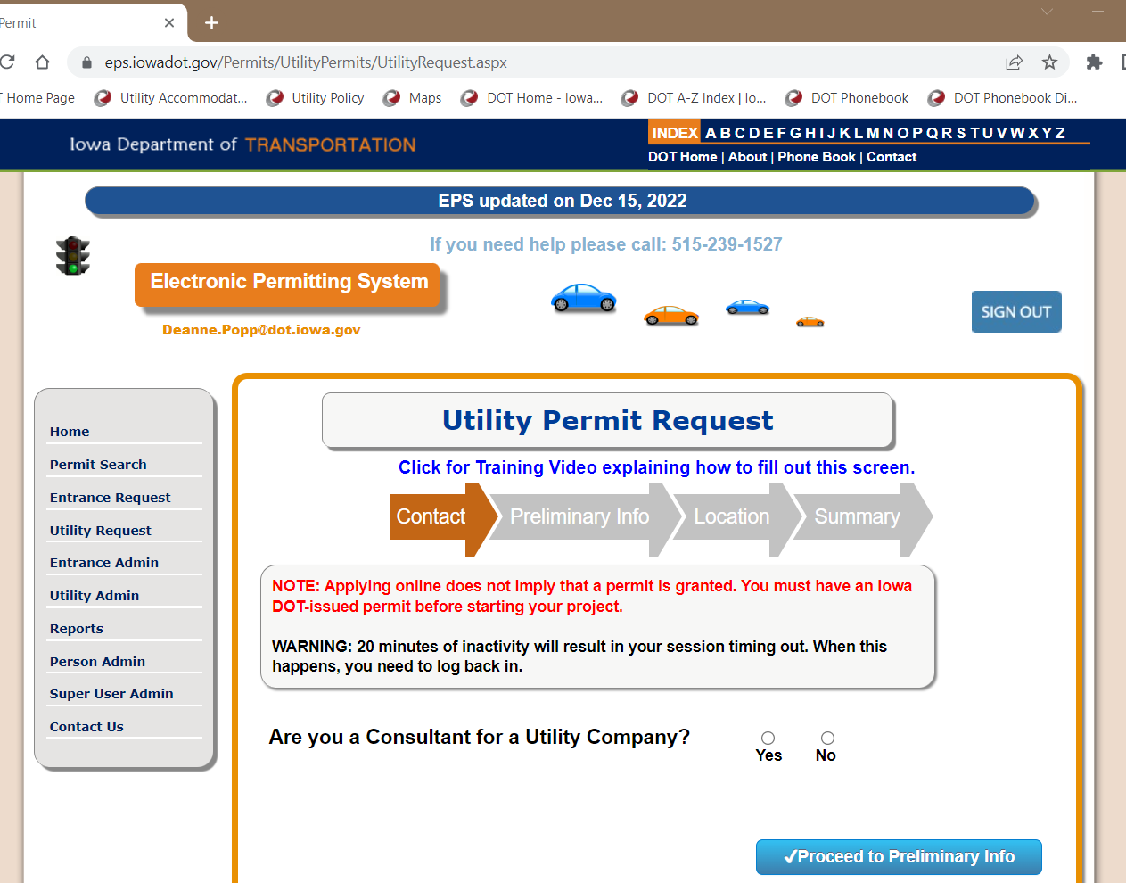
Utility permit request
Link to training module
Recommend completing
Notes:
This is the main Utility Permit Request page
– There’s a link to the training module – shown in blue text here.

Slide 54
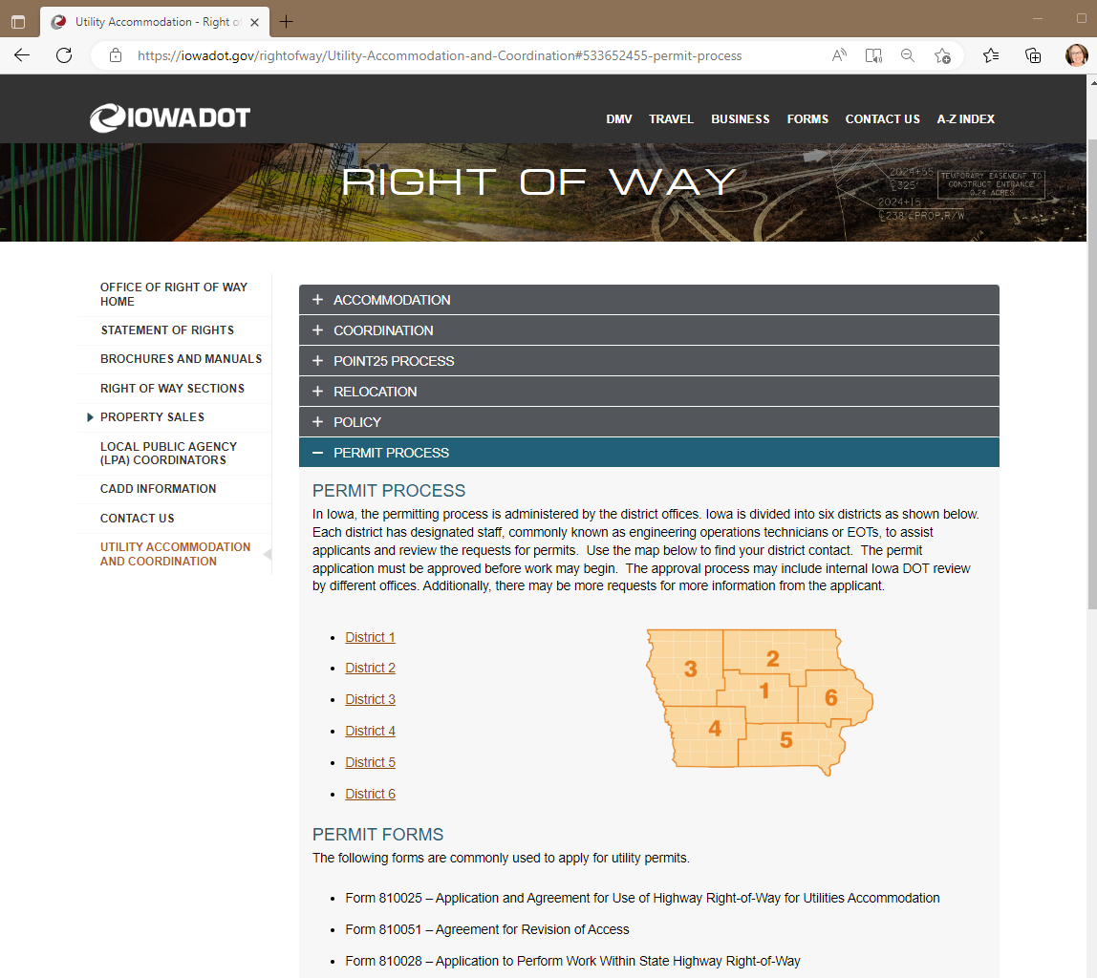
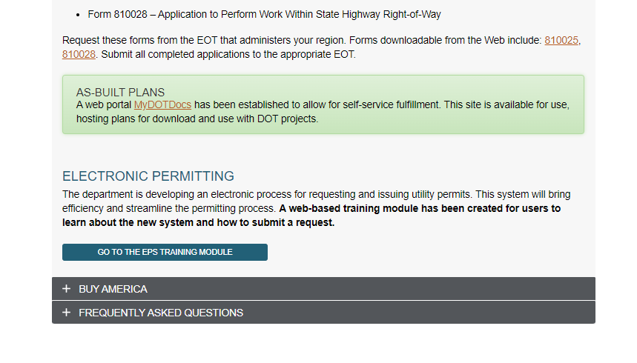
Eps training module
Step by step
Walks user through
Notes:
You can also find a link to the training module on our website
Permit Process tab
If you are involved with requesting permits, I highly recommend you take a look at the training to get a head start on what’s coming.
You’ll need to scroll all the way to the bottom to find that link – it’s the blue button here at the bottom of this image

Slide 55
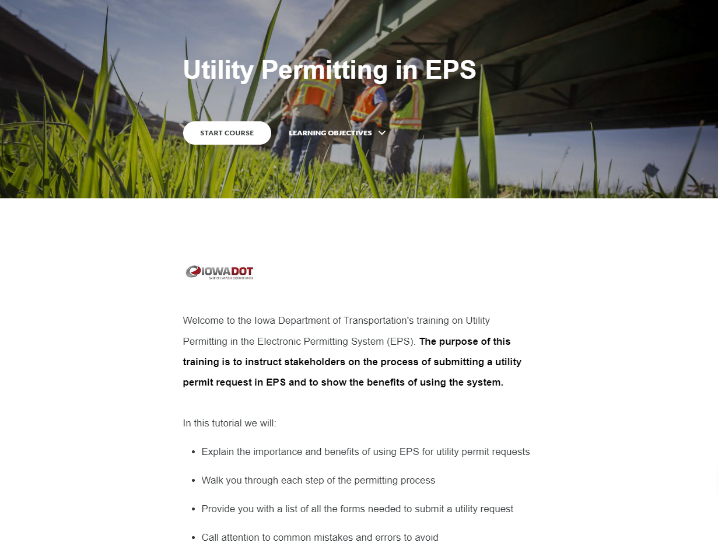
Online training module
Self-lead training module
Additional training possibilities
Notes:
This is a self-lead training course that will help acquaint you with the system
– It will walk you through the process from creating an account to final submittal.
And there’s a knowledge check at the end to check what you learned.
Additional training sessions are possible if there is interest
We would schedule for some time this spring and summer

Slide 56

Let’s take a brief break…
Notes:
Well, we’ve covered a lot this morning.
Let’s take a few minutes for a break and be back here at (10:15).

Slide 57


District presentations
A closer look at current and upcoming projects

Slide 58

Questions?
Thank you for attending today!
Ftp site: https://utilities.iowadot.gov/Annual%20Util%20Mtg%202023/
Notes:
That about does it for our program today.
Thank you to our presenters today and to everyone for joining our annual meeting this morning.
As a reminder – the meeting materials are available on the FTP site for the meeting.
Please remember that you can always email any one of the utility program staff if you have questions or need additional information.

