Slide 1
DOT PLAN READING AND RELOCATION PLANS
For Utility Owners, Designers and Contractors
3/2/2023
Benjamin Adey, P.E.
District 1 – South Area Engineer
February 29, 2024
Notes:
Welcome to the Iowa DOT’s Highway Plan Reading short course. This course has been designed specifically for utility owners, designers, and contractors as an aid to understanding the pertinent information contained in DOT highway project plans and where it is located.

Slide 2
Course Objectives
Become familiar with plan features important to utilities:
Title Sheets
Plan and Profile Sheets
Right of Way Sheets
Typical Sections
Cross Sections
Learn how to locate plan features in the field
Identifying a conflict
Basic conflict resolution
Drafting a relocation plan
Notes:
The objectives are to identify a conflict. Basic conflict resolution and drafting a relocation plan.

Slide 3
User Note: Click the image icon to add your image
DELETE THIS BOX WHEN FINISHED
Plan Reading

Slide 4
Title Sheet
Sheet A.1
Notes:
Point out to participants:
Copies of plan sheets used in presentation are provided
Sheet number in lower left corner of slide corresponds to plan sheet being used

Slide 5
Title Sheet: Project Number
Sheet A.1
Notes:
The project number is so important that it is shown in 3 places on the title sheet.
The location at the bottom right of the sheet is where it is shown on every other sheet in the plan set.
For easy project location, the county is listed three times as well. Can you find all three?
In a way, the county is listed 3 more times as it is the last 2 digits in the project number.
Also prominently displayed is the type of project: in this case, twice and it is PCC Pavement – Grade and Replace.

Slide 6
Title Sheet: Project Number
System Prefix Letter Code
Alpha-numeric System Prefix
Paren Number
County Number
Route Number
Federal Control Section Number
Sheet A.1

Slide 7
Title Sheet: Project Description
Sheet A.1
Notes:
Front and center – where the project is located.
Big letters - COUNTY
- TYPE OF PROJECT
- Description of the project limits

Slide 8
Title Sheet: Letting Date
The typical project development life cycle is 5-6 years.
Watching letting dates will let you how soon construction is slated to begin.
Target: relocation work complete 3 to 6 months prior to the letting date.
Sheet A.1
Notes:
Letting date reflects our best laid plans.
The letting dates may move but we try to keep them in the same fiscal year.
These may easily be out there several years with our early plan submittals.
The letting date is when the DOT accepts the _________.
Factoid:
The DOT operates on a fiscal year that runs July 1 to June 30 so we are in fiscal year 2024 and have been for over 8 months.

Slide 9
Title Sheet: Sheet Numbers & Index
Approx. 4 mile project and 656 sheets!
Sheet A.1
Notes:
Index makes it look like there are hundreds of sheets.
There are 656 sheets in this set of plans!
Only a fraction of the 656 pages are utility critical.
So as you are flipping through the pages, lets start to limit the sheets we want to look at.

Slide 10
Title Sheet: Index of Sheets
A sheets: Title/Map sheets
B sheets: Typical Cross Sections and Details
C sheets: Quantities and General Information
CH sheets: Hydraulics Information
CS sheets: Soils Information
D sheets: Mainline Plan and Profile sheets
E sheets: Side Road Plan and Profile sheets
F sheets: Detour or Temporary Pavement sheets
G sheets: Survey sheets
H sheets: Right-of-Way Mainline sheets
HE sheets: Right-of-Way Side Roads sheets
J sheets: Traffic Control and Staging sheets
K sheets: Interchange sheets
L sheets: Geometric, Staking & Jointing sheets
M sheets: Storm Sewer sheets
N sheets: Traffic Signal sheets
P sheets: Lighting Layout sheets
Q sheets: Soils sheets
S sheets: Sidewalk sheets
T sheets: Earthwork Quantity sheets
U sheets: 500 Series, Mod. Stds. & Detail sheets
V sheets: Bridge, Culvert & Retaining Walls
W sheets: Mainline Cross Sections
X sheets: Side Road Cross Sections
Y sheets: Ramp Cross Sections
Notes:
During review, emphasis should be placed on those sections which are in bold as the others hold less utility-important information.
By the end of this presentation, you will see a specific order to examine the sheets you need.

Slide 11
Title Sheet: Index of Sheets
Utilities should focus their review on:
“A” sheets: Title/Map
“D” (mainline) & “E” (side roads) sheets: Plan and Profile
“H” (mainline) & “HE” (side road) sheets: Right-of-Way
“W,” “X,” & “Y” sheets: Cross Sections
“B” sheets: Typical Sections
“M” sheets: Storm Sewer
“V” sheets: Bridge, Culvert & Retaining Walls
“K” sheets: Interchange sheets (if applicable)
Notes:
Now, hundreds of sheets are pared down significantly.
A:
D & E:
H & HE:
W, X, & Y:
B:
M:
V:
K:
So, lets get back to the A sheets

Slide 12
Location Map Sheet
Project location always noted on location map
Project begin & end noted with station and milepost.
Sheet A.2
Notes:
The second A-sheet, which happens to be named A.2, shows the location of the project with beginning and ending stations and mileposts.

Slide 13
Scales
Scale bar allows accurate scaling independent of print size.
Included on all plan sheets
Sheet D.26
Notes:
Since we don’t know what size of paper the plans will be printed on, we include a scale bar on every drawing sheet so that you can convert distances on the sheet to real-world dimensions.

Slide 14
Scales
How wide is ‘R’ Street?
1” (Ruler Measure)
1” (Ruler Measure) = ~28’ (Plan Dimension)
Sheet D.26

Slide 15
Three Views
F02
Plan
F02
F01
F01
F01
Profile
(Cross) Section
(and Typical Sections)
F02
F02
F02
Notes:
Plan view: overhead view from airplane
Profile view: side view
Section view: cut through perpendicular (90 degrees) to roadway
Two utilities are shown:
FO1 is mostly parallel to the road – we call this a longitudinal installation
F02 is mostly perpendicular or crossing the roadway – we call this a transverse installation

Slide 16
Plan View
Plan
(D, E, & K sheets)
Notes:
D – Mainline plan sheets
E – Side Roads plan sheets
K – Interchange plan sheets

Slide 17
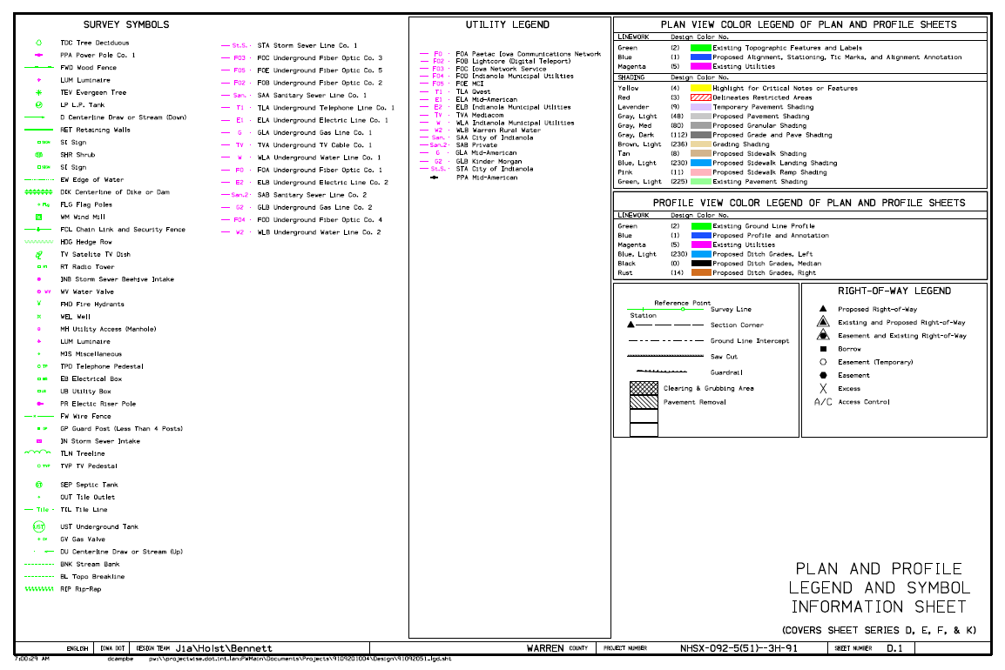
Plan View: Plan Sheet Legend
Utility line types
NOTE:
Most existing utility features are in pink
Existing features (picked up by survey) are in green
Always see Sheet D.1 for complete legend of abbreviations and symbols.
Sheet D.1
Notes:
How many Fiber Optic lines are shown in the utility legend (in pink)?
The symbols legend is always on sheet D.1
These apply for all the D, E, F, & K sheets.
Before we move on to the plan sheets, look at the Right of Way legend – it will make perfect sense very soon.

Slide 18
Plan View: Plan Sheet
Sheet D.26
Always see Sheet D.1 for complete legend of abbreviations and symbols.
Notes:
Look at sheet D.26
This is a transition for this particular road, from a 3-lane rural section with ditches on the left to an urban section with curb and gutter on the right.

Slide 19
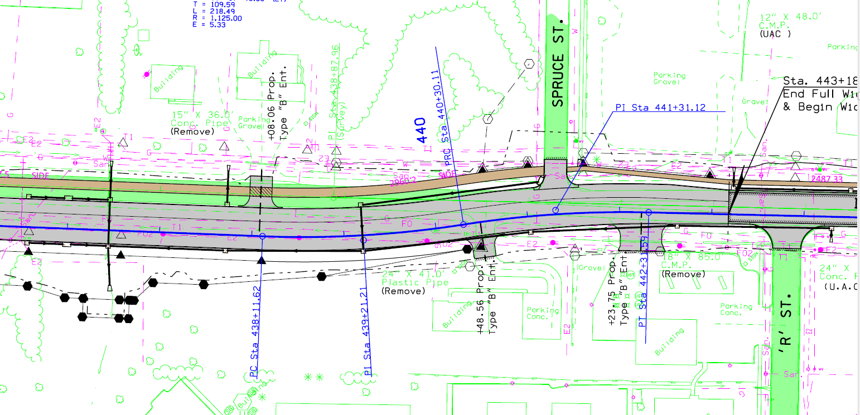
Plan View: ROW & Need Lines
ROW and Easement information can also be found on the “H-sheets.”
Existing Right-of-Way
(Open triangles at corners)
Existing and Proposed Right-of-Way
(Shaded triangle with open triangle around it)
Construction Limits (Need Line)
(Black double skip-dash line)
Proposed Right of Way
(Black line with shaded
triangles at corners)
Permanent Easement
(Black line with shaded hexagons at corners)
Temporary Easement
(Black dashed line with
open hexagons at corners)
Sheet D.1
Always see Sheet D.1 for complete legend of abbreviations and symbols.
Notes:
Look at sheet D.26
Go over R.O.W. – easements
Temporary easements – driveway construction
Permanent easements – for drainage
-Utilities use of easements – not shown on this sheet but we did have some for electric transmission west of here.
Discuss need line – edge of construction (either fill or cut to this limit)
Outside is considered safe zone.
In side it may be safe if it is fill or minor cut – we will have to wait until the cross sections to see what is going on here.

Slide 20
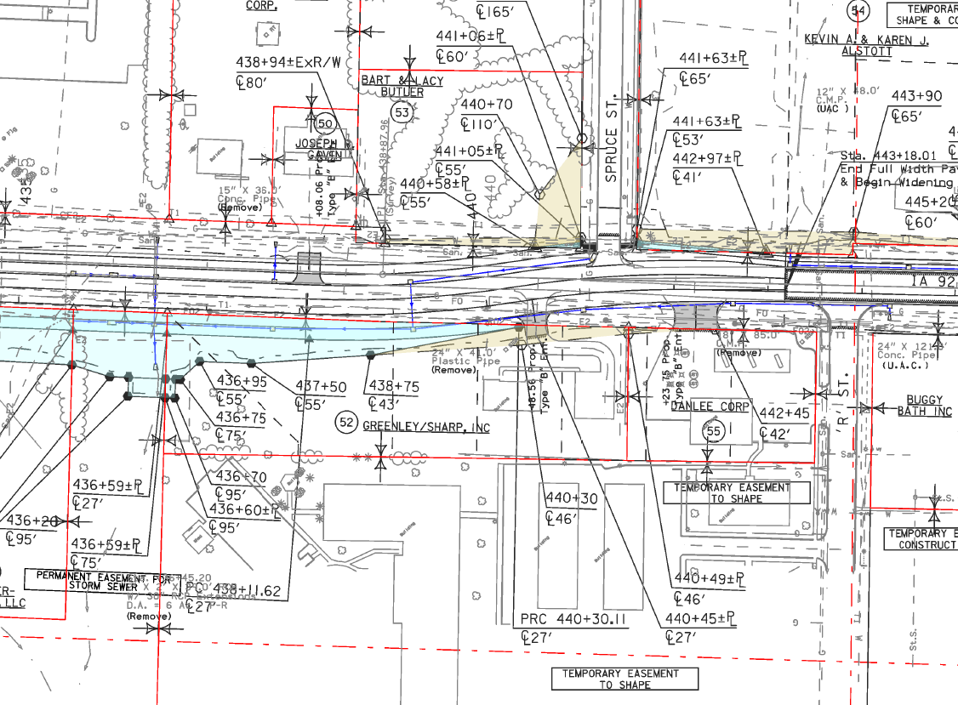
Plan View: ROW (H-sheets)
Existing Property & ROW Lines
(Red lines with open triangles at intersections)
Temporary Easement
(Tan shading & black dashed line
With open hexagons at corners)
Easement Notes
(Explains reason for easements)
Permanent Easement
(Cyan shading & black line with shaded hexagons at corners)
Sheet D.1
The “H-sheets” are another place to see ROW, easements, etc.
Notes:
Turn to sheet H.13
New ROW is much clearer on the H-sheets with the shading.
Try to make ROW lines straight outside of need lines
Sometimes odd shapes happen – such as permanent easement for storm sewer
It would seem like all the temporary easements in tan would be fairly small, but sometimes we shape for snow borrows that can be quite large.

Slide 21
Plan View: Drainage
NOTE: Existing pipe information is placed as close to the pipe symbol as possible to avoid other plan information.
Proposed Storm Sewer Intake/Junction Box
(in black)
Existing Pipe Info.
(in Green)
(“Remove” note indicates proposed removal of pipe. “UAC” note indicates Use As Constructed.)
Proposed Pipe
Outlet Apron
Proposed Storm Sewer
(Arrow indicates flow direction; see M sheets for add’l info.)
Drainage Arrows
(Black indicates proposed;
green indicates existing.)
Sheet D.1
Always see Sheet D.1 for complete legend of abbreviations and symbols.
Notes:
Pipes:
Information as close to pipe as possible without cluttering plan sheets
Point out green drainage arrows
3 primary pipe culvert classifications
Utilities:
-Ask how many utilities they can find: T1, E2, G1, FO, FO2, W, San, St. Sewer – Answer: 8
-Utilities shown picked up by IaDOT preliminiary survey based on above ground and OneCall flagging

Slide 22
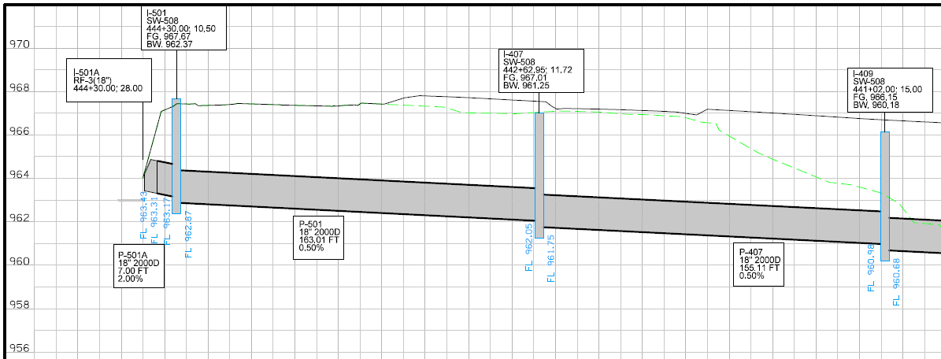
Plan View: Drainage
NOTE: Storm sewer plan view and profile view are not located on the same or adjacent sheets.
P-407
Sheet M.14 (Plan View) & M.27 (Profile View)

Slide 23
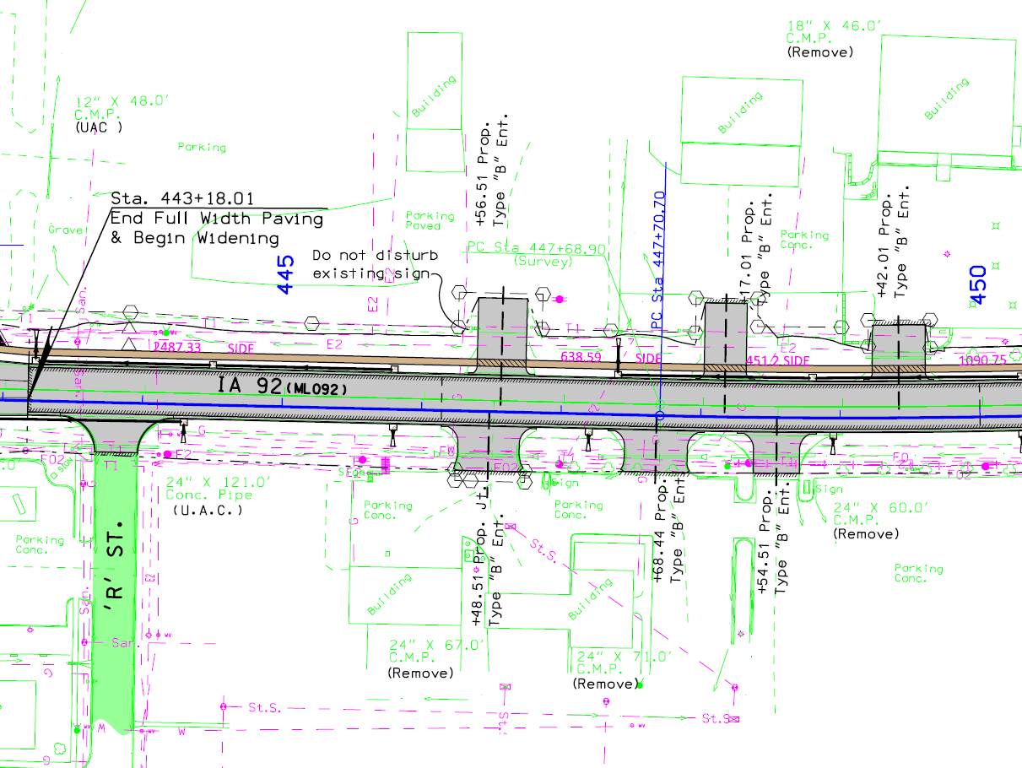
Plan View: Stationing
Proposed Baseline Stationing
(Blue)
Existing Centerline
(Green)
Proposed Baseline
(Blue)
Sheet D.26
Always see Sheet D.1 for complete legend of abbreviations and symbols.
Notes:
Time to get to a subject everyone loves – STATIONING
DOT projects are measured in stationing (we’ll learn why on the next slide)
How does stationing show on the plans?
500 ft. numbers
Green and blue tick marks do not line up the same due to slight changes in road length between projects.
NOTE: this project utilized a “Baseline” that was not located in the center of the roadway rather than a “Centerline,” which is located in the center of the roadway. Most projects use a centerline, but as in this job, sometimes a baseline is used in certain sections to ease in constructability for the contractor. You can determine if the blue line shown is a centerline or baseline by looking at the Typical Sections (B-sheets) and finding the typical that applies to the area you are looking at. We’ll get into the Typicals in a few more slides…

Slide 24
Stationing
What is Stationing?
A station is a longitudinal measurement method used to provide location along highway and other longitudinal projects.
The measurement is taken horizontally (i.e. does not follow ground contour) along the highway project centerline.
1 STA. = 100 Feet
East-west roads, stationing typically begins on the west county line.
North-south roads, stationing typically begins on the south county line.
Stationing typically resets to 0+00 when crossing a county line.
STA. 445+00 = 44,500’ from station 0+00
Notes:
Longitudinal location – typically used on longitudinal-type projects (highways, railroads, pipelines, etc.)
One station is 100’ long
Stations are measured horizontally – they do not follow the contour (ups and downs) of the roadway

Slide 25
Stationing
How does stationing work?
Stationing
Example: This point is at
Sta. 451+00 - 50’ Lt.
(Left of centerline)
Labeled every 500’ on rural scales
Labeled every 100’ on urban scales
445
450
Left Side
Ahead
100’
Right Side
Back
Example: This point is at
Sta. 451+25 - 100’ Rt.
(Right of centerline)
500’
Notes:
Who uses stationing? The DOT’s do!
Since the DOT’s do, Utilities needs to also to be able.
To be able to communicate with DOT we need to know where things are in relation to the stationing and the offset from centerline.
How do you know if it is a left offset or right offset? Look in the direction of increasing station…Right on right.

Slide 26
Stationing
Where can I find Stationing for a Highway?
Physically on 2-Lane Roads:
The right side of the roadway when looking in the same direction as stationing.
Physically on 4-Lane Roads:
In similar locations as outlined previously on the outside edges in both directions.
DOT Project Plans:
Obtain project plans from Engineering Operations Technician (EOT)

Slide 27
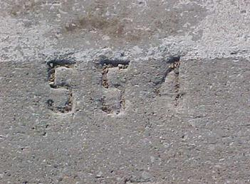
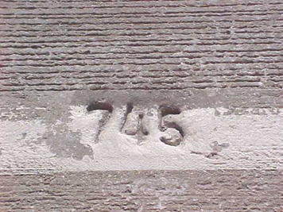
Stationing
How to I find stationing in the field?
About 1 foot in from the outside edge of the road every 100 ft. stamped in the pavement on PCC (concrete) roadways.
Notes:
PCC = Portland Cement Concrete

Slide 28
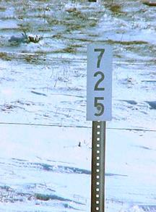
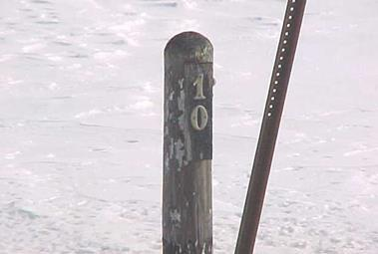
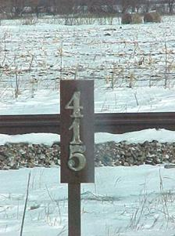
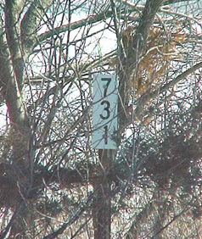
Stationing
How to I find stationing in the field?
Every 500 ft. on HMA (Asphalt) surfaced roadways.
Notes:
Can markers always be found? NO!
Sometimes farmers remove them
Not a priority for replacement
If you can’t find stationing, check with the EOT.

Slide 29
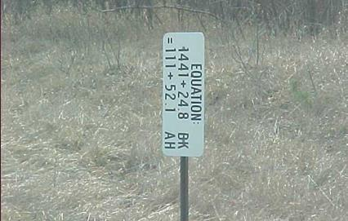
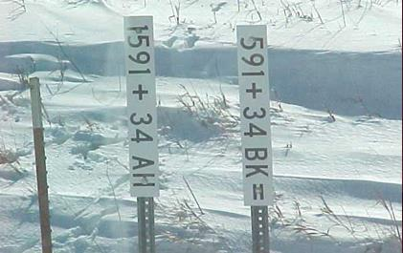
Stationing: Equations
What happens when stationing changes along a road? A station equation is created.
Common reasons include:
shortening or lengthening of a highway line due to highway realignment
4-lane highway where one lane is longer than another due to alignment.
1410
1410
Ahead
115
Left Side
1411+24.8
111+52.1
Right Side
Back
Notes:
Drill down for the sign on the left.

Slide 30
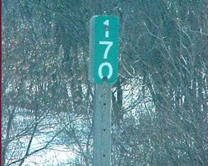
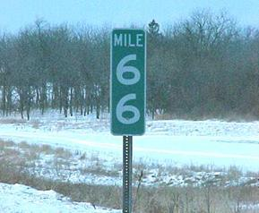
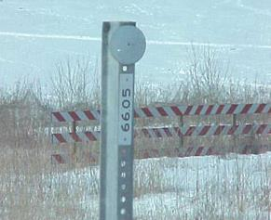
Mileposts
Mileage is measured along the centerline profile from the start of the highway.
NOTE: Mileposts may be up to 50’ ahead or back from their “correct” location when field conditions warrant, which is why they are called “reference posts.”
East-west roads, mileposts typically begin on the west end of the route in the state.
North-south roads, mileposts typically begin on the south end of the route in the state.
Mileposts are continuous throughout the length of the route across the state.
Notes:
Mileposts follow the contour, so a mile on anything other than a flat road will be less than 52+80 stations.

Slide 31
Profile View
Profile
(D, E, & K sheets)
Notes:
Each profile sheet aligns with a plan sheet
Sometimes both plan and profile are on the same sheet (like E.2)
And sometimes they are on separate matching sheets (like D.26 and D.27) and lay out together (same stations)

Slide 32
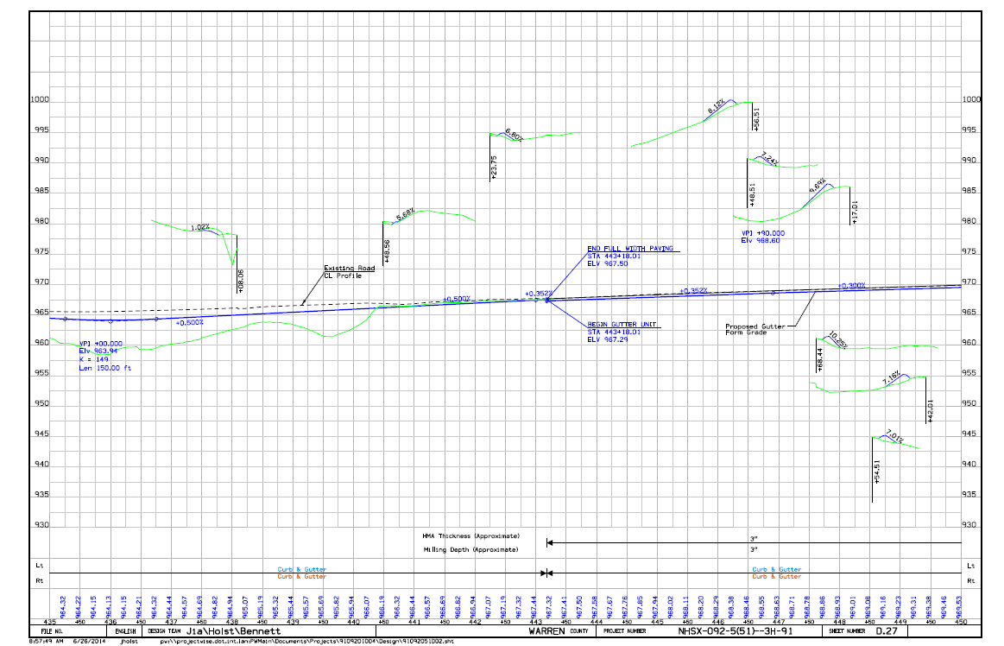
Profile Sheet
Profile sheets have elevations labeled
(in feet) along the left and right edges.
Profile sheets have corresponding centerline stationing
as shown in the plan view or plan sheet.
Sheet D.27

Slide 33
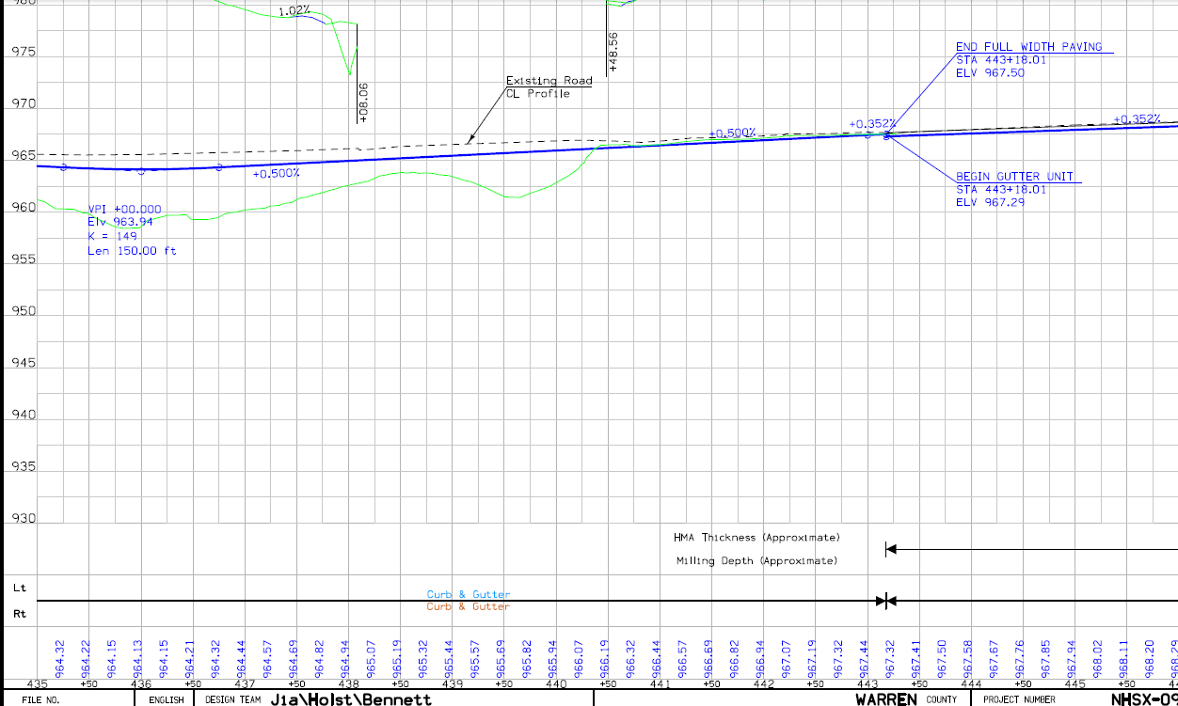
Profile Sheet
964.94’
962.50’
Fill = 2.44’
2.44’
What is the cut or fill
at STA. 438+00?
Profile @
New Project
Center Line
(Blue line)
Existing Ground @
New Project Center
Line (Green line)
Elev. 962.50
Profile Elevation
@ Sta. 438+00
= 964.94’
“Profile” is
also called:
“Grade-Line” or
“Profile Grade Line”
Elevations
(in feet)
438+00
Centerline
Stationing
Sheet D.27

Slide 34
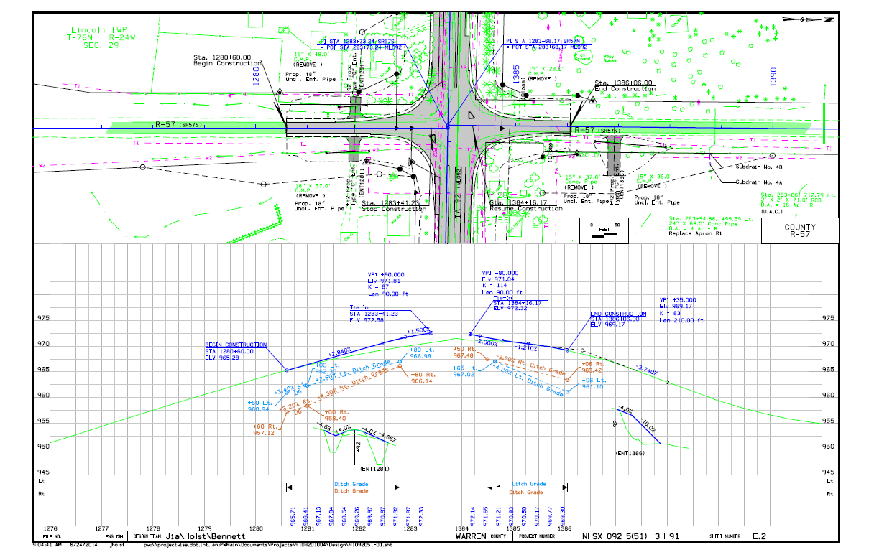
Profile Sheet
Sometimes the plan view and profile view are included on the same sheet.
Sheet D.27
Notes:
E sheets are typically side roads or other roads receiving improvements as part of the project that are not the main highway route.
This one has plan and profile on the same page.
Ditch grades (slopes) and elevations are shown in light blue/tan if the ditch grade is different than the profile grade of the roadway.

Slide 35
Section Views
Typical Section
(B sheets)

Slide 36
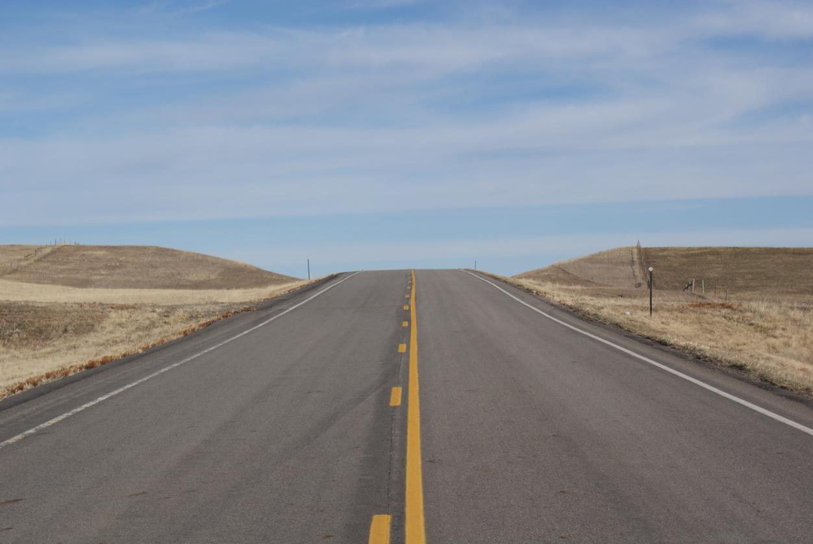
Section: Typical Section
Project Center line
Typical Section
Image courtesy of the South Dakota Department of Transportation

Slide 37
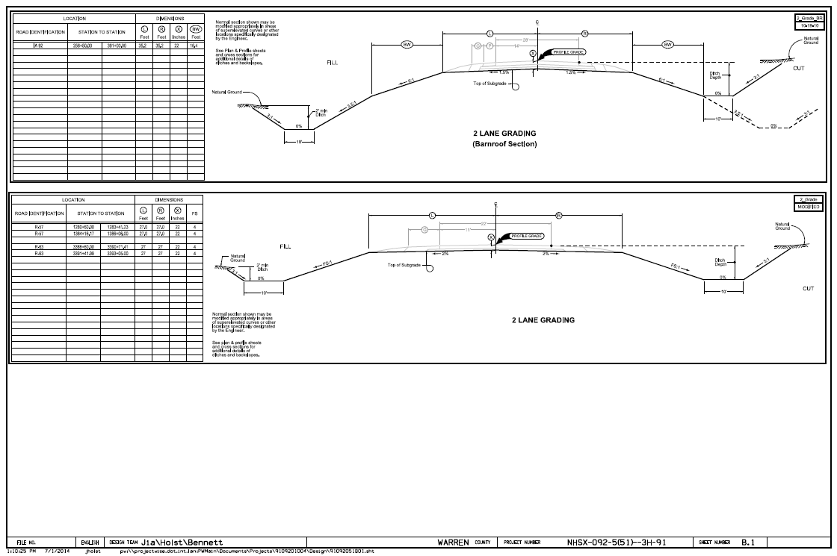
Section: Typical Section
Sheet B.1
Typical Section for Grading
Notes:
Typical Sections are not as helpful for investigating potential conflicts at specific locations, but are useful for gaining a general idea of what type of grading and paving improvements will be occurring on a specific section of the project.
The top typical is a barnroof-type section that has a variable foreslope whereas the bottom typical has a standard section with uniform foreslopes.

Slide 38
Section: Typical Section
Left Side
C
Right Side
L
Foreslope
Foreslope
Shoulder
Break Point
Ditch
Backslope
Fill
Section
Cut
Section
NOTE:
Longitudinal utility installations are NOT allowed in the foreslope or ditch bottom.
The table shows areas where this typical section applies (station ranges) and also provides values for dimensions shown on section.
Sheet B.1
Typical Section for Grading.

Slide 39
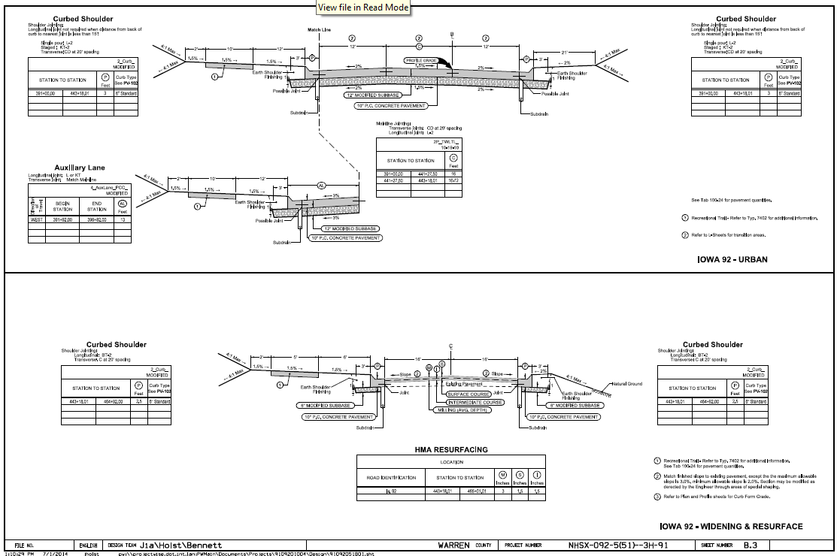
Section: Typical Section
Note the presence of sub-drains!
Subdrains are typically constructed
42” deep and are outlet into the ditch
(through the foreslope) every 500’.
This is where you can also see if a Centerline (CL) or a Baseline (BL) is used on each section of the project.
Sheet B.3
Typical Section for Paving.
Notes:
This is a paving typical and shows the paving or resurfacing to be completed.
Utilities may not think this is important, but if you notice, this typical shows if subdrains will be constructed with the project or lanes will be added in certain locations (based upon the tables).
Theoretically, subdrains and utilities should not conflict, but this problem has occurred many times.

Slide 40
Slope Ratio
3:1 Slope
H:V Slope
Slope
1
Vertical
1
2
3
3 Horizontal
The first number is the number of feet the slope must go horizontally to raise one foot vertically.
NOTE: this is different than the mathematical slope of V:H!
Notes:
Most of the world thinks of slope as “rise over run,” but in roadway plans, we typically show slope as “run over rise.”
Typical foreslopes:
Recoverable 6:1 or greater
Transversable (but not recoverable) 3:1 to 6:1
Both count as clear zone as long as there are no fixed objects within the clear zone distance
Typical backslopes: typically 3:1 for ease/safety of maintenance operations.

Slide 41
Section Views
Cross Section
(W, X, & Y sheets)
Notes:
Cross sections are one of the most important sheets in the plans, along with the D/E/K and H/HE sheets.

Slide 42
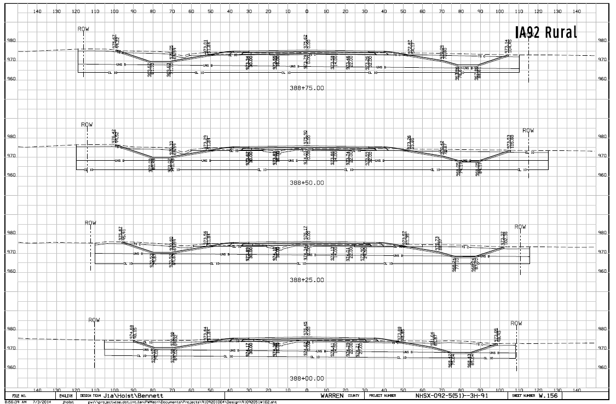
Section Views: Cross Section Sheet
Cross section frequency: 50’ (rural) or 25’ (urban)
(stationing is shown at the lower center of each cross section)
Sheet W.156
Notes:
Elevations appear along the left and right sides for each section.
Cross sections are typically cut every 50’ on rural projects and every 25’ on urban projects.
Now, let’s zoom in on one cross section and explore what is shown!

Slide 43
Section Views: Cross Section Sheet
Existing Ground
(Dashed Line)
Proposed Final Grade
(Solid Line)
90.15’ Lt. – Distance from CL to tie into existing ground.
Elevations
Top of New Pavement Elev.
@ Sta. 388+00 = 976.45’
Offset from CL
Centerline
STA. 388+00
0’ offset = Design Center Line
(middle of the new road)
Left Side I Right Side
Sheet W.156
Notes:
Let’s look at the cross section at STA. 388+00.00
This is a grade and pave project, so the numbers above the lines are the final pavement/topsoil elevations. The numbers below the lines refer to the top of the subgrade grading.
Topsoil replacement: take note that in the foreslope, backslope, and ditch bottom areas, we excavate an additional six inches below the finished grade in order to be able to place 6 inches of topsoil back in its place. Therefore, in those areas, the lower line and lower elevations are most critical for calculating utility cover.
Large scrapers and bulldozers are often used to remove the soil initially and replace the topsoil when grading is complete. Due to their size and weight, they exert a significant amount of pressure on the soil and can affect underground facilities several feet deeper than the elevation shown. Take this into consideration when reviewing plans!

Slide 44
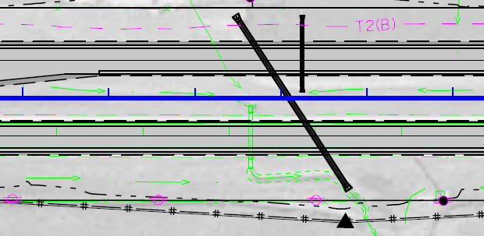
Section Views: Skewed Culvert
11625
11630
Sheet W.52
Notes:
Let’s look at sheet W.52, which is the last sheet in your packet.
You may notice that this sheet is from a US 20 plan set, as the Indianola project we have been using did not have any examples of cross sections cut at skewed culverts.
A skewed culvert means the culvert is not perpendicular (or square) with the centerline of the road.
This culvert is skewed 33 degrees Right Ahead. Let’s dive into what that means…
“Right Ahead” means that when looking in the direction if increasing station, the end of the culvert on the right side is forward of the centerline location.
The angle between the culvert and the centerline is 33 degrees.
That is where the notation of “Skew 33 degrees Right Ahead” comes from.

Slide 45
Section Views
OK
NO-GO Zone
(Longitudinal utilities not allowed in this area)
OK
Maybe
Maybe
OK:
As close to the R.O.W. in this area is the preferred area for longitudinal utility installations.
This area is past the need line and should not be affected by the project
(with the possible exception of sign foundations, noise walls, etc.).
Maybe:
This area is generally not allowed, but if an existing installation is located in this area
the DOT may allow it to remain depending upon depth.
NO-GO Zone:
Longitudinal utility installations are NOT allowed in this area,
except in extremely rare circumstances.
Sheet W.156
Notes:
Note: this applies to longitudinal utility installations.
What if you have a transverse installation in this area?
Can you tell where the old ditch was? Answer: about 15’ LT of new CL.

Slide 46
Electronic Plans
PDF plans posted to Utilities FTP site for all projects
Link to FTP site sent with project notifications (U02, U03, U04)
Microstation design files (.dgn) are available upon request
Contact the District Utility Coordinator to request these files
The Iowa DOT does not provide AutoCAD files (.dwg) but Microstation files can often be converted to AutoCAD (.dwg) by others.
Notes:
PDF files are typically sent via a link to an FTP site. If plans are very small, sometimes they can be an attachment to an email.

Slide 47
Review
Look at title sheet (A.1) to determine project scope.
Look at map sheet (A.2) to determine project location.
If your installation may be impacted, go to the Plan and Profile sheets (D sheets) to find your utility installation on the plan sheets.
Check to see if your facilities are inside the “need line.”
Check to see if the R.O.W. is changing in the area where your facility is located.
If it appears your facilities may be impacted, go to the impacted locations in the cross sections to see extent of grading work.
If no “D sheets” in plan, check “B sheet” typical sections for extent of work.
Typically this occurs on jobs with minimal or no grading work.
If it is an urban job, check for “S sheets” to determine any sidewalk upgrades which would impact above-ground facilities (poles, pedestals, handholds, etc.).

Slide 48
User Note: Click the image icon to add your image
DELETE THIS BOX WHEN FINISHED
Relocation Plans
Notes:
Thanks Ben. My name is Sean Passick and I am the District 1 Utility Coordinator. Let’s take the information Ben just shared with us and identify a conflict, decided how best to resolve this conflict and crate a relocation plan.

Slide 49
Title Sheet
Sheet A.1
Notes:
We will be using the same Highway 92 project in Warren County that was used in Ben’s presentation.

Slide 50
Location Map Sheet
Project location always noted on location map
Sheet A.2
Notes:
On sheet A.2 we have identified the project is in Warren County on Hwy 92 between mile post 125.94 and 129.95.

Slide 51
Utility Legend Sheet D.1
Notes:
The next thing we need to do is identify our utility label. For this presentation, we are going to be Iowa Network Services and they are labeled as F03.

Slide 52
Conflict Analysis Sheet D.2
Notes:
We can now identify our line and follow its route on the plan and profile sheets. The read clouds are identifying the location of our fiber line that was picked up in preliminary survey. At the beginning of this project, we see that our fiber is near the new paving and within the grading limits. We see that our fiber may conflict with the rebuilding of the Kennedy Street intersection @ Hwy 96 station 258+87. We see that a new culvert is going to be installed under the rebuilt intersection. We also see that our existing fiber will be underneath the new roadway at approximately station 265+00.

Slide 53
Conflict Analysis Sheet D.4
Notes:
On sheet D.4, our fiber continues to be located under the new pavement. For the purposes of this presentation, we are going to stop our conflict analysis and relocation at station 282+41.

Slide 54
Typical Cross Sections and Details Sheet B.2
Notes:
Let’s take a look at the paving typical for this project We have identified our station range is between 256+50 and 282+50. This typical provides us with a lot of information. Between our station range, the total width of main line pavement will be 28’. The mainline pavement footprint will be comprised of 6” of special backfill, 6” of granular subbase and 10” of concrete. We will need to remember the total depth of the new paving is 22”. The shoulders will be 8’ wide and consist of 6” of granular subbase and either 8” or 9” of special back fill depending on our contractor's choice of pavement type. The DOT contractor can choose between 8” of asphalt or 7” of concrete for the shoulder pavement. We should note the total depth for the paved shoulders will be 21”. Note that there will also be subdrain installed adjacent the joint line between mainline and the shoulders. Let’s find some more information about that subdrain.

Slide 55
Quantities and General Information Sheet CS.1
Notes:
In this tab, we can see that the depth of subdrain is 42” and outlets are typically spaced every 500 feet and on both sides of and pipe culverts.

Slide 56
Notes:
Keep in mind that we measure subdrain starting from the bottom of the pavement. Now that we know the depth of subdrain is 42” and we have 10” of pavement, the bottom of subdrain would be 52” the top of pavement.

Slide 57
Cross Section Sheet W.3
Notes:
We see at station 256+50 there is a cut of approximately 5’ just off the edge of the shoulder. Looking ahead 25’ there is an approximate cut of 3’ off the edge of the shoulder. Our fiber as-builts show an installation depth of 30”. This means we have identified a conflict. Let’s review the plan and profile sheets again and see if we can identify more conflicts.

Slide 58
Conflict Analysis
Notes:
Another conflict is the fact that the existing fiber is within the No-Go zone once construction has been completed. Let’s take another look at a section view that was shared with us in the earlier presentation.

Slide 59
Section Views
OK
NO-GO Zone
(Longitudinal utilities not allowed in this area)
OK
Maybe
Maybe
OK:
As close to the R.O.W. in this area is the preferred area for longitudinal utility installations.
This area is past the need line and should not be affected by the project
(with the possible exception of sign foundations, noise walls, etc.).
Maybe:
This area is generally not allowed, but if an existing installation is located in this area
the DOT may allow it to remain depending upon depth.
NO-GO Zone:
Longitudinal utility installations are NOT allowed in this area,
except in extremely rare circumstances.
Sheet W.156
Notes:
At times, our existing fiber is in the new shoulder, new foreslope and even under the new roadway. This would put us in the NO-GO Zone. Before we start drafting our relocation plan, lets review some basic policy requirements.

Slide 60
Policy Highlights
Notes:
When crossing the ROW transversely, all utilities are required to be 48” under the pavement, shoulder and foreslope. Utilities should be located as near to the highway ROW as practical
There is a 20’ minimum overhead requirement. Pay special attention to this if you plan to under-build on an existing facility.
The following requirements are for longitudinal installations.
A 30” min. depth for communication lines
A 48” min. depth for electrical cable
A 36” min. depth for all other Utilities
There is a separate minimum requirement sheet for Urban Sections located in our policy manual. If you have trouble finding it, feel free to ask an EOT for a copy.

Slide 61
ROW Sheet H.1
Notes:
We have chosen to relocate our fiber as a resolution to the identified conflicts. Since this project has acquired ROW, the DOT requires the relocation plan to be drawn on the corresponding H or HE sheets. We used the information provided in the plan sheets as well as the utility policy manual to draft this relocation plan. Notice that our fiber is located within 5’ of the new ROW line. We called out our bore pits and new handhole locations by station and offset from centerline. We called out the depths and method of installation for each run of fiber.

Slide 62
ROW Sheet H.2
Notes:
Like I mentioned, for this presentation we stopped our relocation plan at station 282+41. Now we need to identify our installation on the cross sections.

Slide 63
Cross Section Sheet W.3
Notes:
Each square on the is cross section represents 5’ horizontally and 5’ vertically. Elevations are shown vertically and distance from centerline is shown horizontally. We now can show our relocated line as a dot in the correct square. Our relocation plan shows we spliced our existing line at station 256+00. Since that station is not within the grading limits there is no cross section. The grading begins close to station 256+25 so our cross sections begin at station 256+25. In this example, we identify our new line moving farther away from the new pavement as the stations move upwards. At station 256+25, our line is shown at an elevation of 945’ above sea level and 20’ from centerline. At station 256+50 our line is shown at an elevation of 944’ above sea level and 32’ from centerline. And finally at station 256+75 our line is shown at an elevation of 944’ above sea level and 39’ from centerline.

Slide 64
Cross Section Sheet W.4
Notes:
Since I do not want you to fall asleep listening to me, we are not going to continue marking up any more cross sections after this one. I would however like to show you how I determined where to put my red dot vertically. At station 257+50, our line is shown at an elevation of 947’ above sea level and the existing ground is shown at and elevation of 950’ above sea level. This tells anyone reading this sheet that the depth of the new installation is 36”. DOT engineers and designers use elevations to identify items on a plan set. Most utility construction companies like to see depths shown as number of inches from the existing ground. Unfortunately, this can create some issues. Cross Sections are a good tool for showing the designers and the utility construction companies where a new line is intended to be placed. That is why the DOT requires cross sections be included in your relocation plans.

Slide 65
Review
We need to draft relocation plans on ROW sheets (H sheets) if the sheets are available in the plan set. Otherwise use the Plan and Profile sheets (D sheets).
We need to identify DOT stationing, offsets from centerline, method of installation and depths (if applicable) on our relocation plan. We learned to identify the location of any installed utility facility by station and offset from centerline. This includes but is not limited to handholes, pedestals, transformers, switchgears, flowerpots, etc…
We should use the Utility Policy Manual as a reference guide. https://iowadot.gov/rightofway/pdfs/UtilityPolicy.pdf
Don’t be afraid to reach out to your District’s DUC or EOT for any questions you may have concerning a relocation plan.

Slide 66
Questions?
Benjamin Adey, P.E.
District 1 South Area Engineer
515-239-1194
benjamin.adey@iowadot.gov​
Sean Passick
District 1 Utility Coordinator
515-986-5476
sean.passick@iowadot.us

