Slide 1
Annual DOT Utility Meeting
2024 | Gateway Hotel – Ames, IA
Deanne Popp
Utility Program Administrator
February 29, 2024
3/2/2023

Slide 2
Agenda
Welcome & Introductions
Coordination & Collaboration
Initiatives
Process Improvements
Research Projects
Working Lunch – Q & A
Breakout Sessions
District Stations
Notes:
Thank you for joining us - Full agenda
Several speakers throughout day
Handouts
Maps - District stations
Breaks
Afternoon sessions
Housekeeping – restrooms – exits – participate!
I will kick things off - Program overview

Slide 3
Coordination & Collaboration
Current practices and obligations for each party

Slide 4
Accommodation & Coordination
Accommodation
Permitting
Relocations
Agreements
Management of ROW
Notes:
Utility Program - covers all aspects
Transportation Development Division
Right of Way Bureau
Major role in managing the assets in the public rights of way

Slide 5
Utility Program Team
Central Office
District Offices
Field Offices
Notes:
Team – several locations across the state

Slide 6
Central Office Leadership
Transportation Development Division – Deanne Popp
Program leader
Rules & policy administration
Stakeholder liaison
Right of Way Bureau Director – Brad Hofer
Directs all sections in the bureau
Approval of budget items including utility relocations
GIS champion for ROW parcels & utility locations
Utilities Section Supervisor – Eric Wright
Supervises Appraisal, Design, & Utilities Sections
Process & procedure implementation for utility program
Project coordination & production champion for these sections

Slide 7
Utilities Section
Regional Utility Program Coordinators
Project scheduling & monitoring
Project plan submittal
Utility reimbursement agreements
Invoices, audits & payments
Disclaimers of interest in realty – easement releases
Field assistance when needed

Slide 8
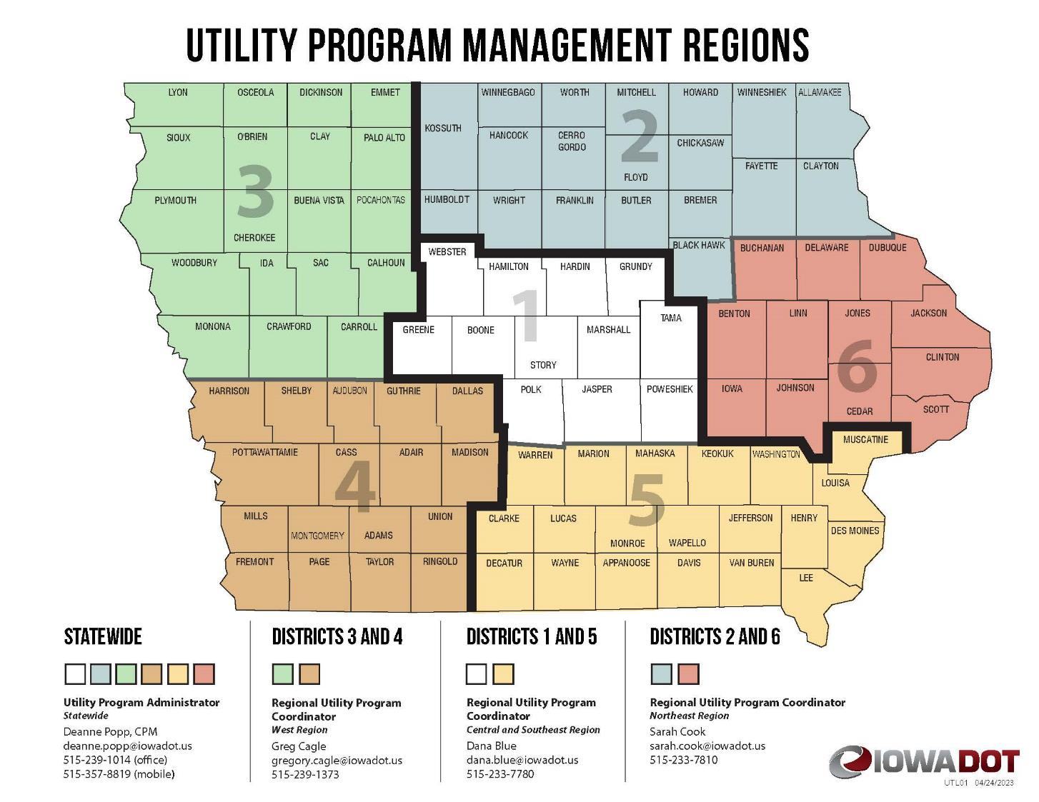

Slide 9
District Offices
District Utility Coordinators (DUCs)
District 1 – Sean Passick District 2 – Daryl Erickson District 3 – Mike Thayer District 4 – Nate Epperson District 5 – Bonnie Clancy District 6 – Steve Flockhart
Project coordination
Utility work plan review & approval
Coordination & collaboration meetings
Permitting assistance

Slide 11
Field Offices
Engineering Operations Technicians (EOTs)
16 locations across the state
Permit review, approval & issuance
Access, utility accommodation, work on right of way
Project coordination assistance

Slide 12
Project Notifications
Point25 process
Notes:
Much of the work we do falls under IAC 761 Chapter 115
Project Coordination – Point25

Slide 13
IAC 761 Chapter 115.25 (Point25)
State highway projects
Sets forth requirements for all parties
Timing of notifications and required responses
Milestones for events tracked in PPMS/Masterworks
Non-responsive utility owners can be held liable for project delay claims
Notes:
All DOT projects – except
Accelerated schedules
No anticipated utility involvement

Slide 14
Milestones | project tracking
Program and Project Management System (PPMS) | Masterworks
Project funding and scheduling of tasks & events
Various disciplines have their own events
Design events (D)
D00 – concept
D02 – field exam
Right of Way (R)
R01 – ROW layout
R02 – Appraisal
R03 – Acquisition
R04 - Relocation

Slide 15
Utility coordination | U events (current)
U00 – Investigation (0-10% design completion)
U01 – Major impacts (10% design completion)
U02 – Notification (30% design completion)
U03 – 1st Plan submittal (60% design completion)
U04 – 2nd plan submittal (90% design completion)
U05 – Agreement (60-90% design completion)
U06 – Notice to proceed (following all approvals)
U07 – Utility bid attachment (relocation status in contract letting docs)
U10 – Utility clearance (relocation status for FHWA)

Slide 16
U00 Event | investigation
Investigate – look for utility facilities within the project area
Identify – utility facility ownership in the project area
Iowa One Call (Design Request)
Field reviews
Permit records
Utility maps
GIS – shared utility location data
Better decisions during design

Slide 17
U01 Event | utility impacts
Concept development (D00)
Look for the potential for impacts to facilities
Request more precise location information from utility owner
Provide the information to designers to lessen impacts
Avoid
Minimize
Accommodate
Better decisions during design
Notes:
The goal for the event is to be early enough in the project development process to allow for modifications to the design.

Slide 18
U02 Event | notification
Completed Field Exam Plans – (D02 | 30% design completion)
Request verification of facility locations (90 days to reply)
Public ROW or private easement?
If facilities ARE on private easement and relocation is necessary…
Will company purchase their own replacement easement?
Will company request DOT to purchase their replacement easement?
Notes:
Again, our goal is to be early enough in the design development to allow for modifications
And for our ROW Design staff to include any utility easement needs in the ROW design.

Slide 19
U03 Event | 1st plan submittal
Completed road design (D05 | 60% design completion)
Proposed new ROW layout (R01)
All MUST reply whether impacted or not (90 days to reply)
All impacted companies must provide a relocation plan (same 90 days)

Slide 20
U04 Event | 2nd plan submittal
Point25 projects only (shorter schedules don’t include)
Following public hearing or information meeting
Changes incorporated into proposed ROW layout
All MUST reply whether impacted or not (60 days to reply)
All impacted utilities must provide a FINAL relocation plan (same 60 days)

Slide 21
U05 Event | agreement
Some relocations may be reimbursable (private easement vs. public ROW)
Request early – as soon as you think you might be impacted
Make sure the DUC knows
Prerequisites

Slide 22
Agreements & Reimbursement
A closer look
Notes:
Some relocations may be eligible for reimbursement
Let’s take a closer look at the when that applies…

Slide 23
Eligibility | location dependent
Public ROW (company expense)
Private (may be eligible)
Work necessary to accommodate project

Slide 24
Formal Request | documentation review
Existing easements
Correlate to DOT parcels
State’s authority to reimburse
Notes:
State’s authority to reimburse
Determine how much is reimbursable
Do this through evidence of easements

Slide 25
Formal Request | documentation review
Work plan
Existing & proposed locations
Overlay on DOT plans
Notes:
Show your facilities and how they’re affected
What you’re moving and where it’s going
Prefer to see this information as an overlay our DOT H sheets (ROW sheets w/parcel information)

Slide 26
Project Inquiry Datasheet | scope of work
Size & type of facility affected
Clear description of the work required
Length of facility affected by the project
How much on public ROW (at company expense)
How much on private easement (eligible for reimbursement)
Tabulation of conflicts points
Crossings, poles, vaults, ducts, etc.
Work to be done by force account or competitively bid?

Slide 27
Cost Estimate | method
Actual cost: segregated and itemized
Unit cost: amount based on number used in relocation
Lump sum: predetermined amount based on well-defined relocation
Notes:
Pre-audit if over $50K – able to segregate costs & provide evidence of costs incurred.
For unit cost agreements – your annual costs must be reviewed and approved by audits.

Slide 28
Payment | invoices support costs
Beginning & ending dates of work
Progress payments % complete
(except lump sum)
Reference numbers to correlate billing
Notes:
Project numbers - agreement numbers
Pay up to 90% of invoice until relocation and audit are complete
Overruns – authorized up to 125%
Addendum may be needed
Pre-authorized for extra work or change of scope

Slide 29
Completion | final payment
Certificate of Completion
Final audit
Release easement rights
Notes:
Disclaimer of Interest in Realty – releases easement within NEW land acquired by DOT for project
Only those parcels where the facility used to be
Release retainage held – if any

Slide 30
Accommodation & Permitting
Right of Way Occupancy
Notes:
IAC 761 Chapter 115 provides regulations that govern where and how utility facilities can occupy primary highway rights of way in Iowa.

Slide 31
Permits | when are they required?
Any time you plan to locate facilities within the highway right of way
New installations
Upgrades
Notes:
Upgrades – changing overhead to underground

Slide 32
Maintenance | covered under the original permit?
Work on the facility
Requires 48-hour notification
Replace same size, location, and install method
Notes:
Replacing poles - within 1 foot of original location

Slide 33
Permits | will more than one be needed?
Non-continuous installations
Multiple highways are involved
Multiple utility types are involved
Notes:
Begin on one highway and continue on another – must be split
Crosses county lines

Slide 34
Information | details of the installation
Location, highway involved, side of road
Method of installation
Materials, encasement details
Notes:
Gather information prior to request

Slide 35
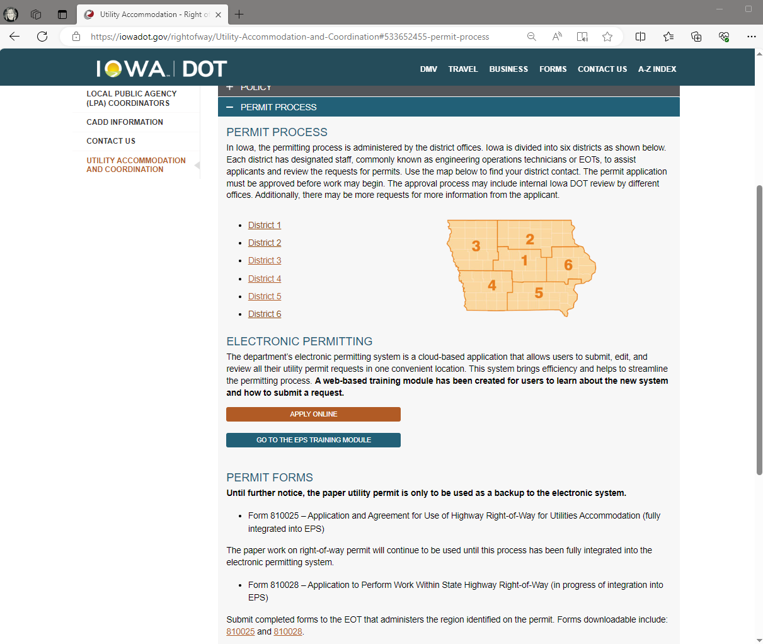
Electronic Permitting
System
Cloud based application
Link on webpage
Apply online
Training module
Permit form as a backup
Afternoon session
Notes:
A-Z index | utility permits
Search utility or utility permits to get to our website that contains the link

Slide 36
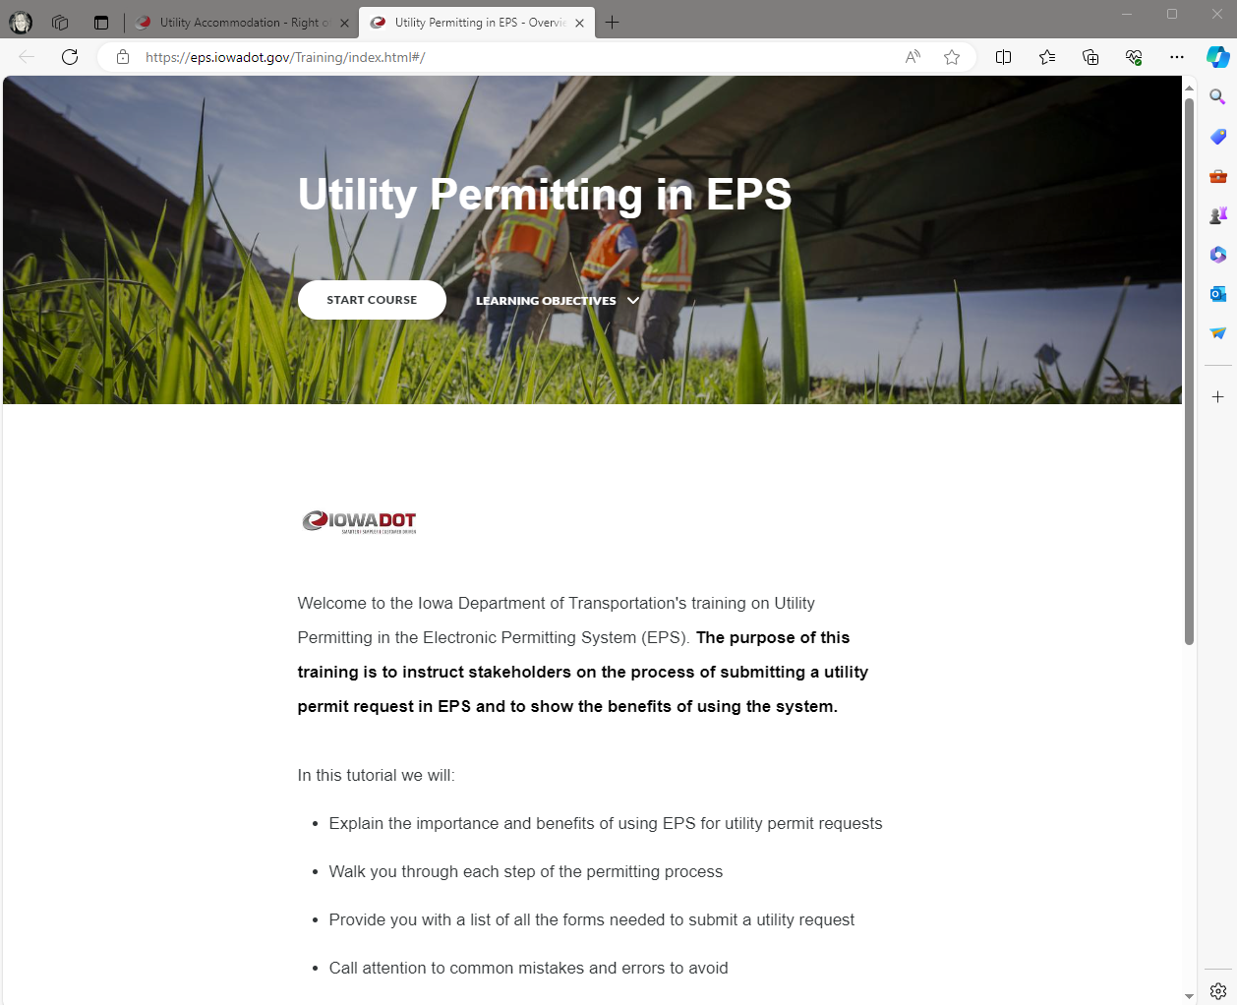
EPS Training Module
Self-led training
Walk-thru the request process
Notes:
Encourage you to go through the course before submitting your first request.
Get you acquainted with the system.

Slide 37
Timeline | when to submit request
More lead time may be needed
30-days review period
Notes:
All yourself some lead time - DOT 30-day period begins when
All required information is received/included
All information is correct an in the accurate format
May take additional time for other approvals

Slide 38
Issued Permit | required on the job site
Give proper notice 48-hour DOT 511 closures
Issued permit on the job site
Entire permit ALL pages
Notes:
REMEMBER you MUST have the issued permit with you on the job site!
MUST give proper notice

Slide 39
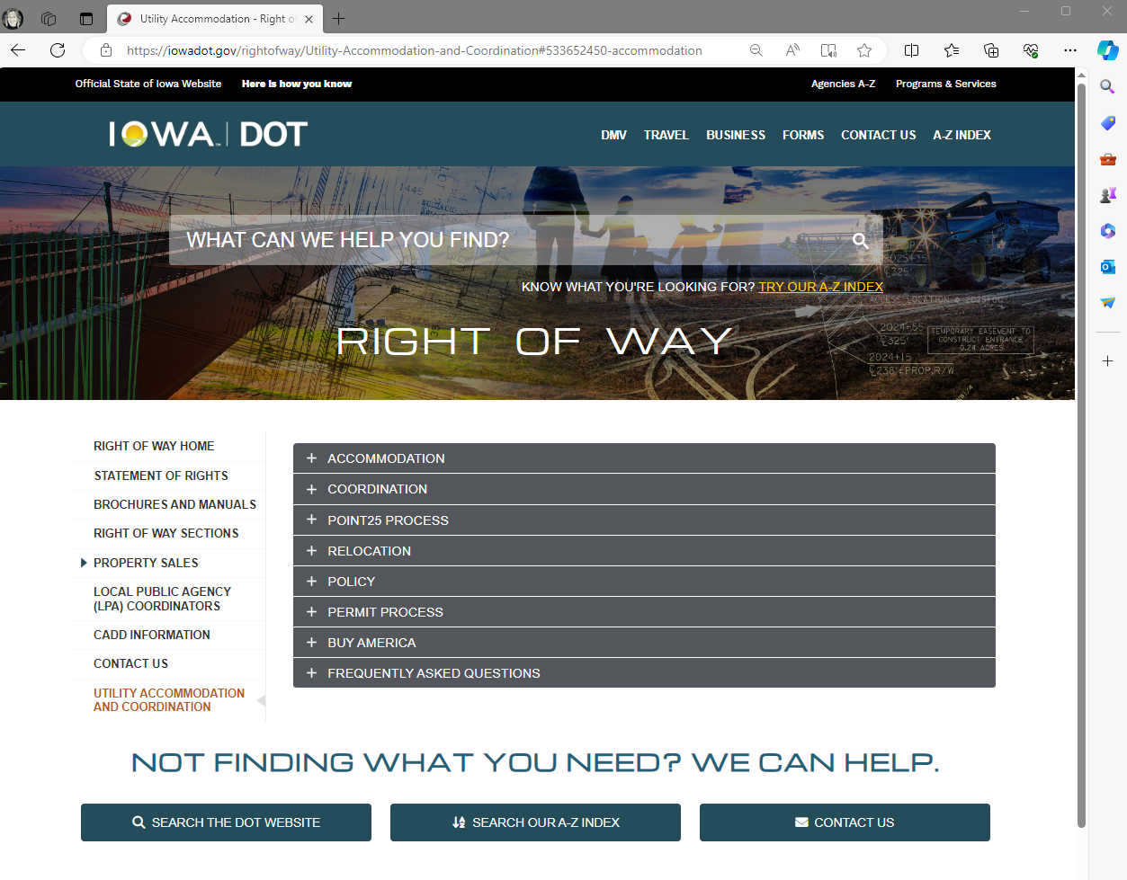
Utility Program Website
Utility Accommodation and Coordination
https://iowadot.gov/rightofway/Utility-Accommodation-and-Coordination
Notes:
Information on the Utility Program can be found on the utility program website
Contact information for central office, district, and field staff
Associated regional maps to determine who to contact for the various areas of the state.

Slide 40
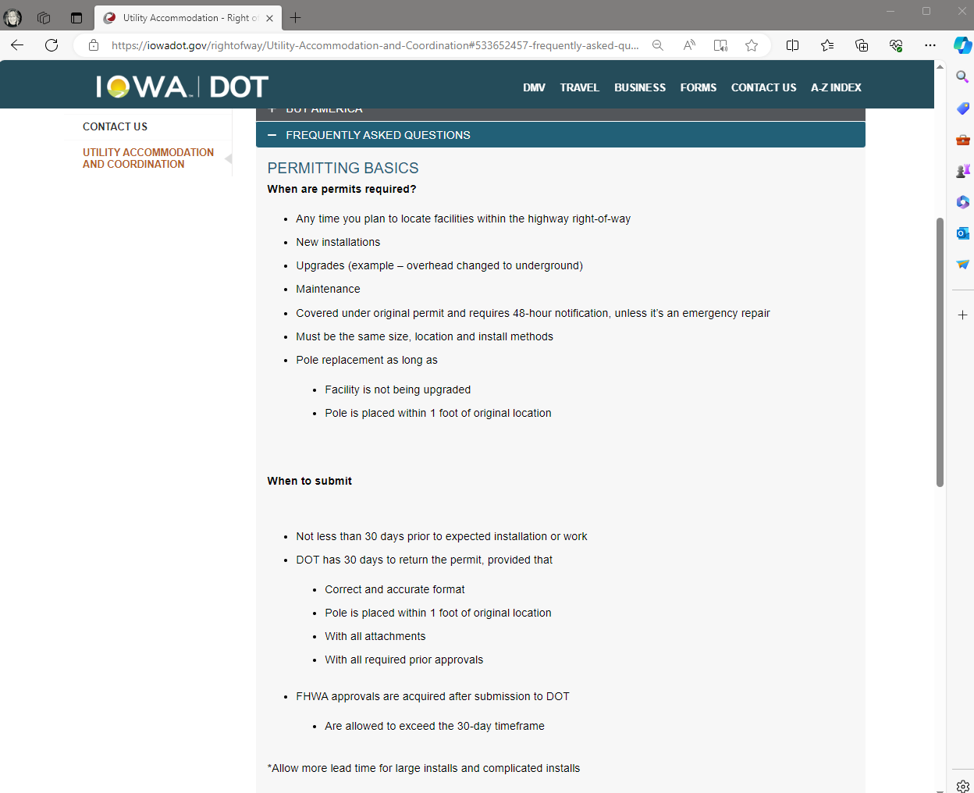
FAQ
Answer to common questions about permitting
Notes:
The FAQ page is a great resource for permitting
Helps answer the most common questions we receive.

Slide 41
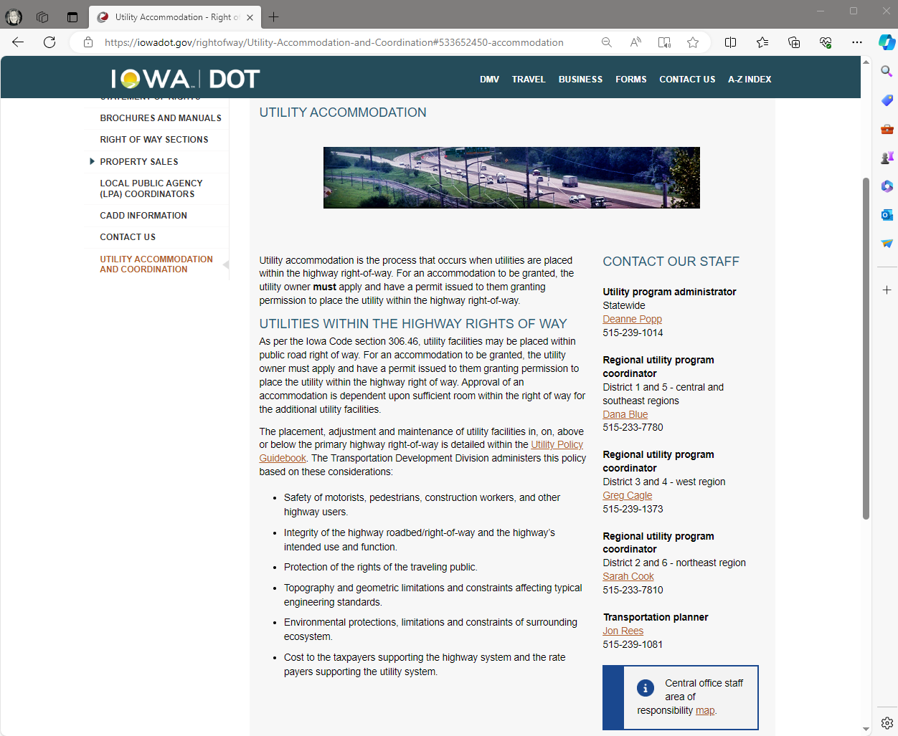
Staff Contacts
Notes:
My contact information can be found on our main Accommodation & Coordination page.
Along with contact info for the Regional Utility Program Coordinators
Dana Blue
Sarah Cook
Greg Cagle
Jon Rees

Slide 42
Initiatives
Overview & update on various utility-related initiatives

Slide 43
Electronic Permitting System
Ready, set, go

Slide 44
Electronic Permitting
System
Permit process page
Apply online
Notes:
A-Z index | utility permits
Search utility or utility permits to get to our website that contains the link

Slide 45
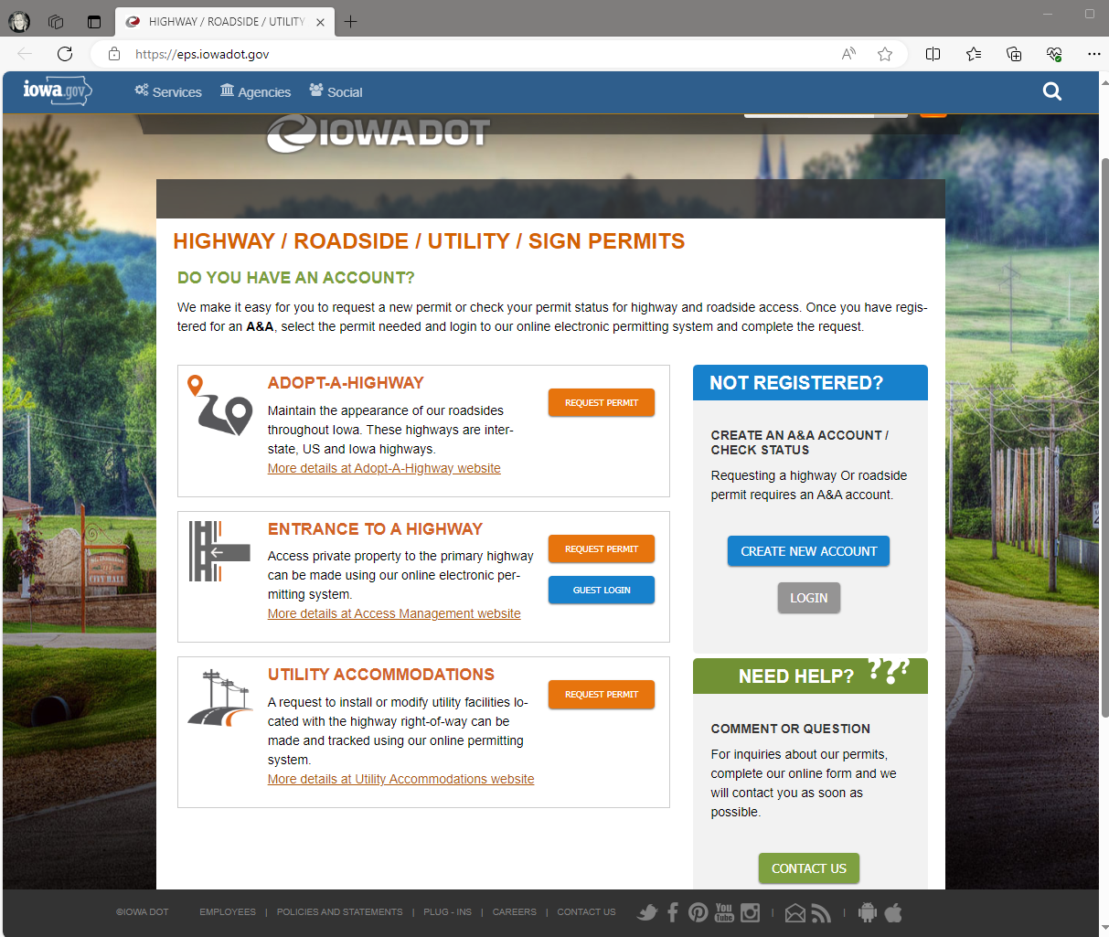
Electronic Permitting
System
Permitting page
Other types of permit requests

Slide 46
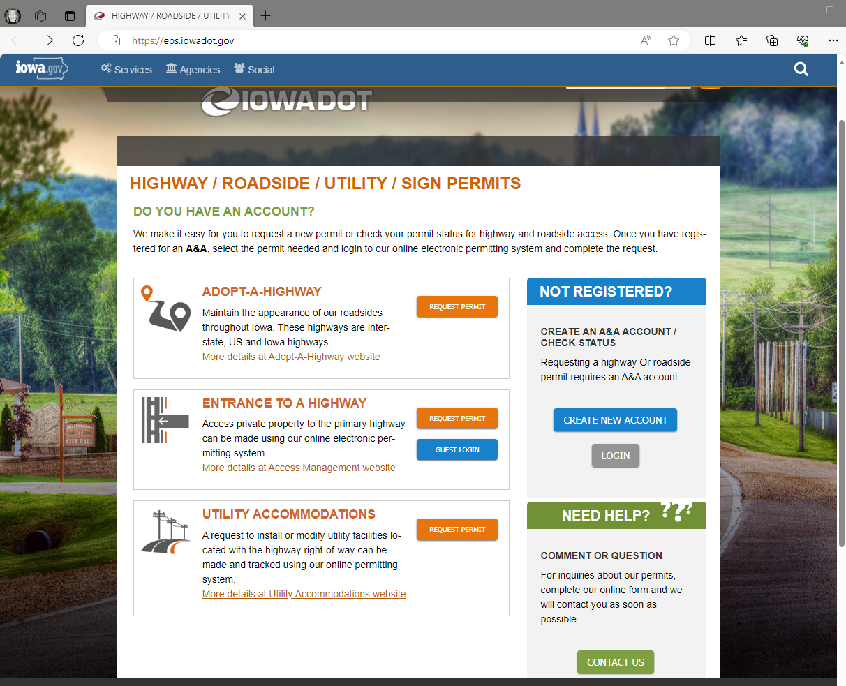
Electronic Permitting
System
Enterprise A&A
First time user
Create an account

Slide 47
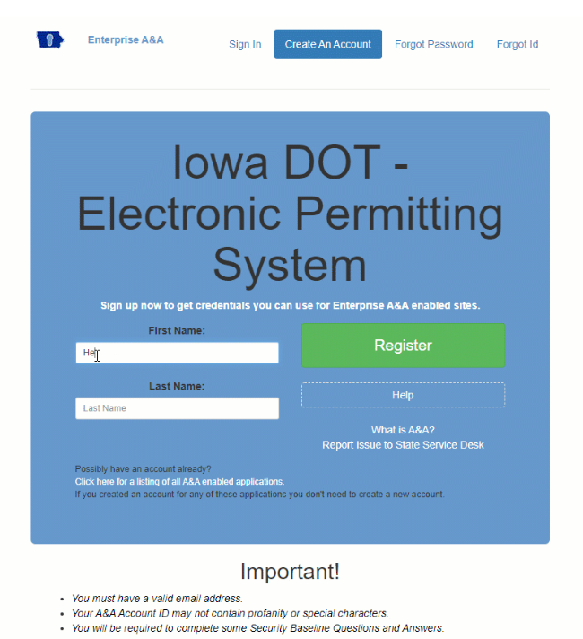
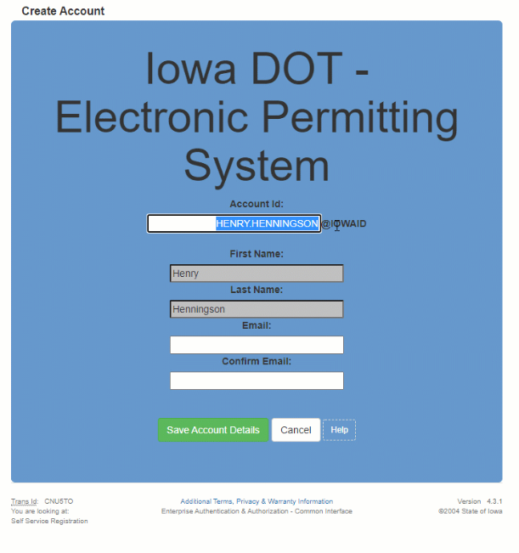
Electronic Permitting
System
Enter your name
Register
Account ID
First & Last Name
Valid email address
Save Account Details
Confirmation email

Slide 48
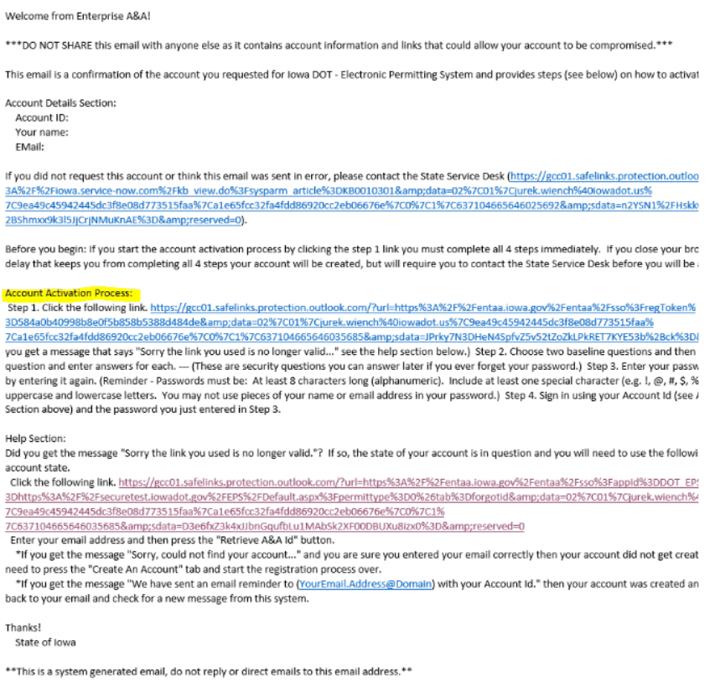
Electronic Permitting
System
Follow email instructions
Account activation process
Click on the link provided

Slide 49
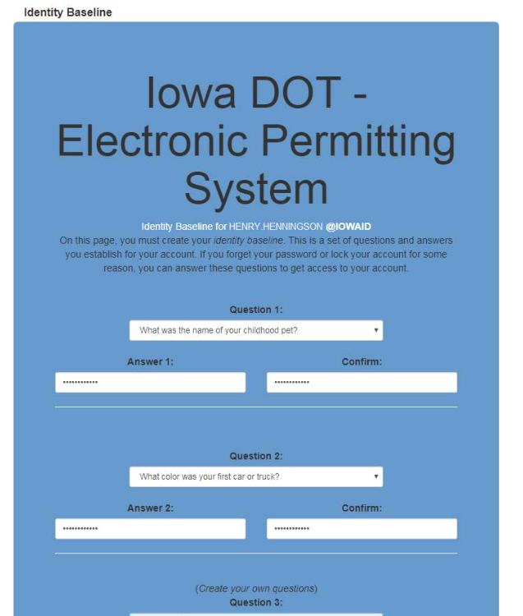
Electronic Permitting
System
Create your identify baseline
Security questions

Slide 50
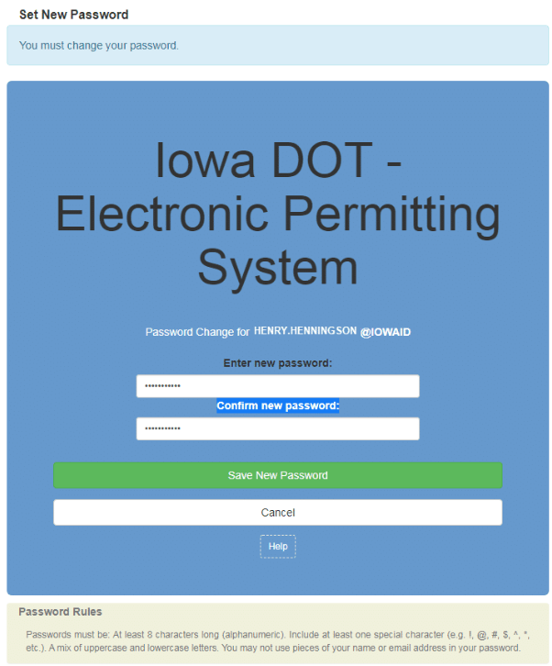
Electronic Permitting
System
Create your password
Password rules

Slide 51
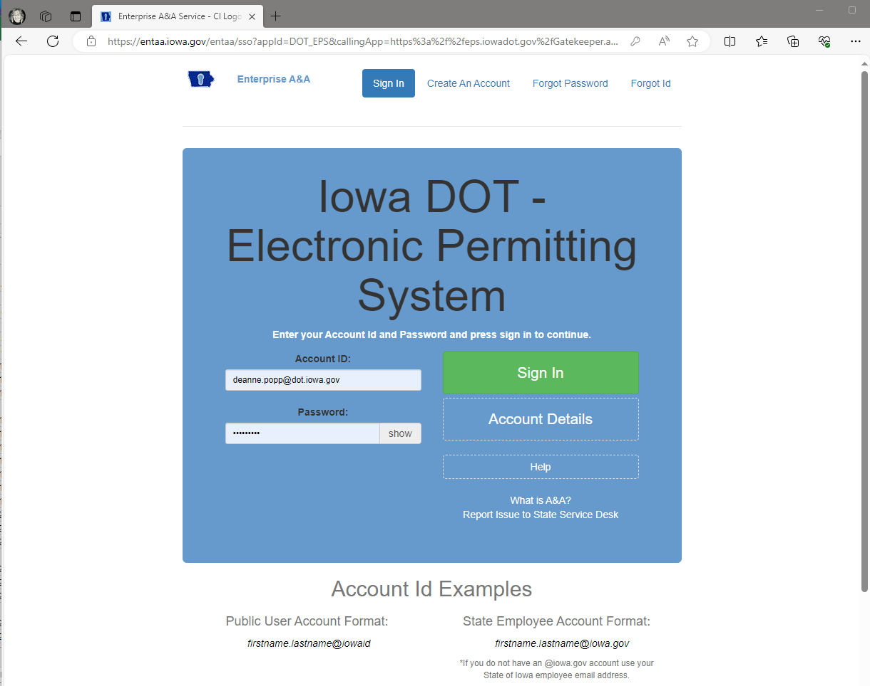
Electronic Permitting
System
Enterprise A&A
Returning user
Log in

Slide 52
Electronic Permitting
System
Request permit
Need help?
Contact us

Slide 53
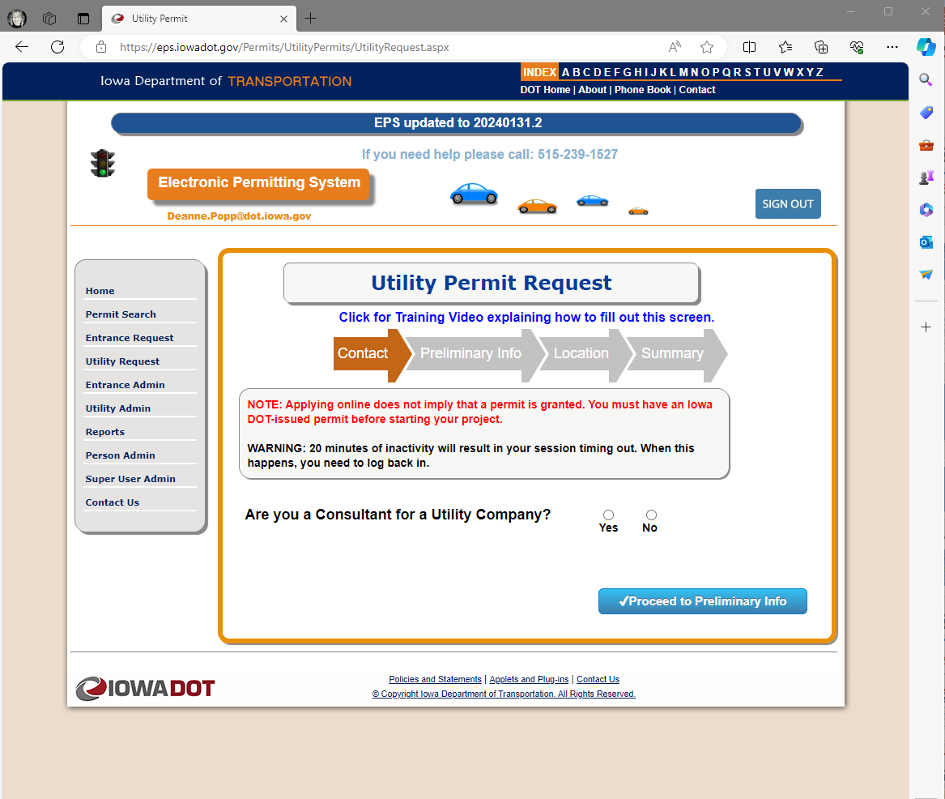
Electronic Permitting
System
Begin request
Training module
3 steps
Preliminary request
Official request
DOT processing
Afternoon session
Notes:
3 steps to the permit request
The first two steps are performed by the applicant and the last is performed by Iowa DOT representative

Slide 54
PPMS Masterworks
External user collaboration

Slide 55
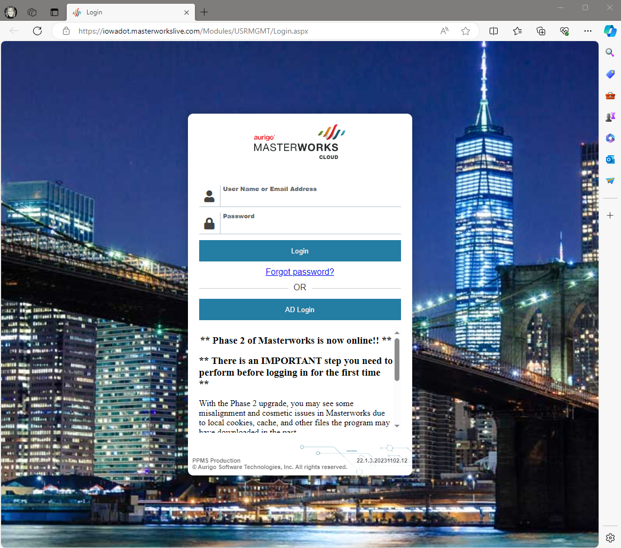
PMS Masterworks
Program and project management (PPMS)
Funding & schedules
Events | milestones
Phase 2
Right of Way
Environmental
Utility Coordination

Slide 56
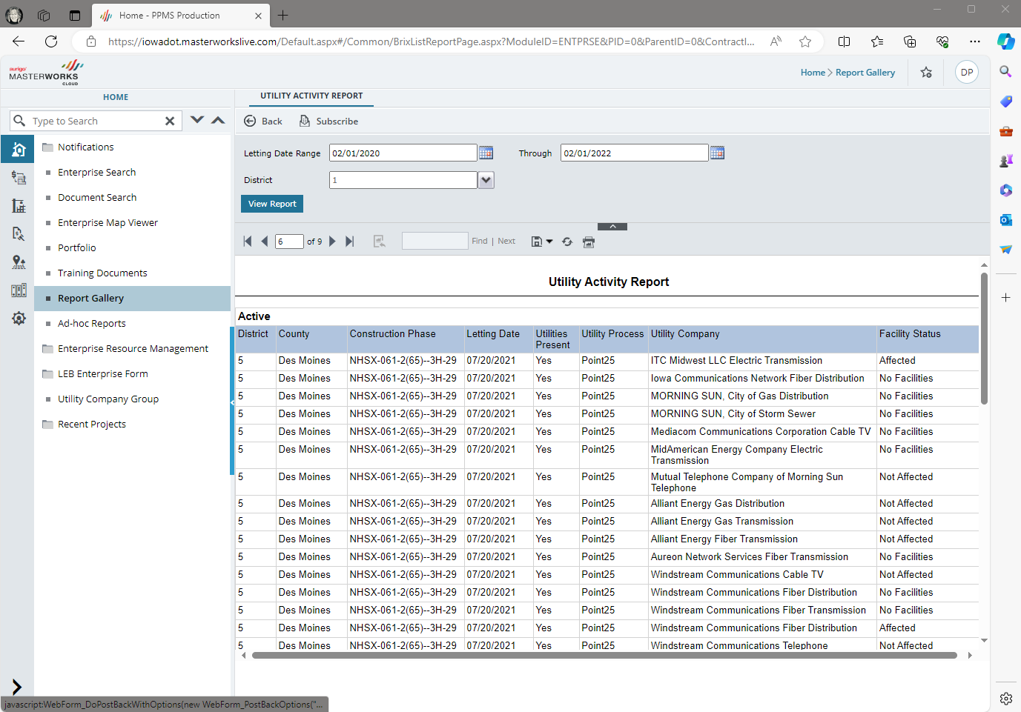
Coordination tasks
Conflict list
Reports
Users assigned to projects
Afternoon session

Slide 57
Utility Task Force
Process improvement team

Slide 58
Identify, evaluate, prioritize and lead the implementation of improvements to utility accommodation and coordination processes in order to avoid utility conflicts when possible, and when not possible, minimize relocation costs, project delays, and damage claims.
Notes:
Mission
What we did / how / list
Narrowed down list
Rocks

Slide 59
Utility Task Force | Process Improvement Team
Executive Sponsor – Charlie Purcell
Team Leader – Deanne Popp
Members – 18 staff from multiple divisions & bureaus
What are the issues that prevent avoiding design conflicts?
What can be done to address the issue?
Ranked items – 16 top priority – looked for greatest impact to improvement
8 high impact and low effort
8 high impact and high effort
Grouped into 2 main goals with 6 priorities
Notes:
Identify - Whiteboard exercise w/ sticky notes
Address – sort by topic or likeness – root cause analysis
Top16 - greatest impact to improvement
Similarities allowed us to combine items & group into 2 main goals
Hear more about this after the morning break

Slide 60
Break – district stations
Notes:
10am break – back in 15 minutes – or back by 10am
Switch to Charlie’s presentation

Slide 61
Research Projects
Overview & status of 3 utility-related research projects
Where we are
Where we’re headed

Slide 62
#3052
Managing ROW In progress

Slide 63
Best Practices for Utility Management in Public Right of Way
Surveyed current practices city, county, DOT
Looked for shortcomings or gaps
Documented solutions to missing pieces
Developed document of best practices
Developing in-person & online training courses (spring ‘24)
Present at various outlets (spring ‘24)
Lead training circuit (summer ‘24)
Long-term hosting & access (fall ‘24)

Slide 64
#3081
Utility coordination as a partnership
In progress

Slide 65
Project Development and Utility Coordination as a Partnership
Data collection methods (all stakeholders)
Project scheduling method at DOT
Roles & responsibilities (all stakeholders)
Develop outreach efforts (ongoing)
Met with stakeholders
Draft manuals/host discussions (spring ‘24)
Drafted policy & legislative changes
Develop final report/technology transfer (fall ‘24)

Slide 66
#3082
Early Identification & Location of Utility Facilities in DOT Project Footprints
Complete 2023

Slide 67
Modernizing Utility Infrastructure Management
Completed (summer 2023)
Federated GIS system
Allows for collaborative geospatial data sharing retaining full autonomy over their own GIS security, resources & services
Utility owners securely share location information with multiple entities, such as DOT, OneCall, other state agencies
Potential to reduce costs & duplicate efforts
Next steps
Notes:
Multiple GIS systems
Databases or services linked together
Accessed through common platform
- Grant projects – as-built data exchange

Slide 68
Lunch – Q & A – district stations
Notes:
Noon – 1pm
Time for interactive question & answer on any utility related topic.
Mic that we’ll pass around so everyone can hear the questions / and answers.
Following lunch, we’ll have breakout sessions
Plan reading & work plan requirements
Electronic permitting system
PPMS/Masterworks workshop

Slide 69
Breakout Sessions
#1 Plan reading & work plan requirements workshop
#2 Electronic permitting system workshop
BREAK – district stations
#1 Plan reading & work plan requirements workshop
#3 PPMS/Masterworks – external user workshop

Slide 70
Break – district stations
Notes:
2pm break – back in 15 minutes – or back by 2:15

Slide 71
Breakout Sessions
#1 Plan reading & work plan requirements workshop
#3 PPMS/Masterworks – external user workshop
Closing session

Slide 72
Closing Session
Notes:
That brings us to the end of our meeting today.
Thank you for attending today and participating in the Q & A lunch and breakout sessions.
I’d like to ask you a question before you leave.
What was one thing you learned today that you didn’t know before you got here?

Slide 73
Questions?
DEANNE POPP
515.239.1014
deanne.popp@iowadot.gov​
iowadot.gov

