Slide 1
Utility Process Improvement Update
Annual Iowa DOT Utility Meeting
February 29, 2024

Slide 2
Objectives:
Update the Utility Accommodation and Coordination Policy
Work with Iowa One-call to improve utility locates
Develop a utility construction conflict resolution process
Goal 1:
Improve awareness and compliance with utility policy and permit requirements

Slide 3
Objectives:
Develop pilot projects identification, conflict analysis, and resolution of utility impacts
Pilot the use of multi-duct installations in congested areas
Pilot digital utility as-builts on a few contracts for installation of DOT owned utility facilities
Goal 2:
Implement a more proactive project development process to avoid, minimize and mitigate the impacts on utility facilities

Slide 4
Update the Utility Accommodation and Coordination Policy
Quarterly Goals |  | Status
2023 Q3 | Review recommendations from utility research projects related to our utility policy. | Complete.
2023 Q4 | Begin drafting policy changes. | Complete. 1st draft of policy changes has been completed and has been reviewed by DOT staff.
2024 Q1 | Review proposed policy changes with DOT leadership and begin review with external stakeholders. | On-track. Continuing to review and reconcile comments received and prepare a revised draft for external review.
2024 Q2 | Continue review of proposed policy changes with external stakeholders.
2024 Q3 | Submit policy changes for formal public review as part of the Executive Order 10 (Red Tape) Administrative Rule review process.
2024 Q4 | Updated policy is finalized and published.
4

Slide 5
Summary of proposed policy changes
Utility as-builts required in electronic format
10-day notice required for lane restrictions or closures
Utilities must rework or remove unacceptable installations
District must be notified when utility work is completed (provide opportunity to inspect and notify if work is non-compliant)
5

Slide 6
Summary of proposed policy changes
Point 25 process updates
Earlier notification of utilities (10% design/concept)
Improved investigation to identify utilities in the project limits
Utilities required to provide location information of their facilities within the project limits to help with conflict avoidance and mitigation
Earlier plan submittal to utility companies (30% design / ROW impact buffer)
Utilities required to review design conflicts with their facilities and provide one work plan (instead of two) but earlier in the process
Non-compliance better defined as failure to: provide an acceptable work plan, adjust its facilities according to the accepted work plan, or otherwise follow the policy

Slide 7
Utility coordination | U events (proposed)
U00 – Investigation (0-10% design completion)
U01 – Notification | Location data request (10% design completion) (60 days to provide)
U02 – Location verification (30 days to provide)
U03 – Preliminary plan submittal (30% design completion) (60 days to provide conflict review)
U04 – Semifinal plan submittal (60% design completion) (90 days to provide relocation work plan)
Final plan (if needed - significant changes to department plan)
U05 – Agreement (30-60% design completion)
U06 – Notice to proceed (after all approvals)
U07 – Utility bid attachment (relocation status in contract letting docs)

Slide 8
Work with Iowa One-call to improve utility locates
Quarterly Goals |  | Status
2023 Q4 | Review process used for locates of DOT-owned facilities to identify opportunities for improvement that can be applied more broadly to other types of utility locates. | Mostly complete. Discussed with most of the Districts. Targeting early Jan for completing the first round of review.
2024 Q1 | Provide input on proposed legislative changes to increase accountability for accurate and timely utility locates. | Complete. Participated in discussions with legislators and stakeholders. Provided comments on HF 2581.
2024 Q2 | Engage with Iowa One-call to identify how we can work together to identify and implement improvements.
2024 Q3 | Develop and distribute guidance for DOT staff and contractors about how to report non-responsive or inaccurate utility locate requests.
8

Slide 9
Develop a utility construction conflict resolution process
Quarterly Goals |  | Status
2024 Q1 | Prepare initial draft of a resolution process to address utility-related construction conflicts. | Complete. Researched current practices in Iowa and other states. Developed initial draft of process and reviewed with process improvement team.
2024 Q2 | Review draft utility conflict resolution process with contractors and utility companies.
2024 Q3 | Finalize and publish the utility conflict resolution process.
2023 Q4 | Evaluate effectiveness of utility conflict resolution process by doing a de-brief of parties involved where the new process was used.
9

Slide 10
Initial ideas for conflict resolution process
“Building blocks” for an effective resolution process
Explore use of surety bonds
Require on-site inspection by utilities companies to ensure compliance
Better train DOT field staff to improve their review and enforcement of permit requirements
Better define in our policy what is considered “timely” response by the utility
Require utilities to provide a response within 24-hours of notification, and the contact info of the person with authority to authorize an immediate response
Better process to determine if the ROW is “fully occupied”
Better enforcement of utility as-built submittals
10

Slide 11
Develop pilot projects for early identification, conflict analysis, and resolution of utility impacts
Quarterly Goals |  | Status
2023 Q3 | Identify candidate pilot projects. | Complete. Projects include Gordon Dr. Viaduct in Sioux City, US 69 reconstruction in Ankeny, and I-380 reconstruction / widening in Johnson / Linn Counties.
2023 Q4 | Develop consultant contract to assist with conflict identification, analysis, and resolutions for at least one pilot project. | Complete. Contracts have been developed for the Gordon Drive and US 69 Ankeny projects.
2024 Q1 | Continue conflict identification and analysis work and review initial results with utility coordinators. | On-track. Scoping for I-380 Segment 2 project continues. Planning to add another pilot project at I-80 / IA 149 Interchange.
2024 Q2 | Evaluate the draft conflict analysis on one or more pilot projects. Adjust approach as needed.
2024 Q3 | Evaluate the draft conflict analysis on one or more pilot projects. Adjust approach as needed.
11

Slide 12
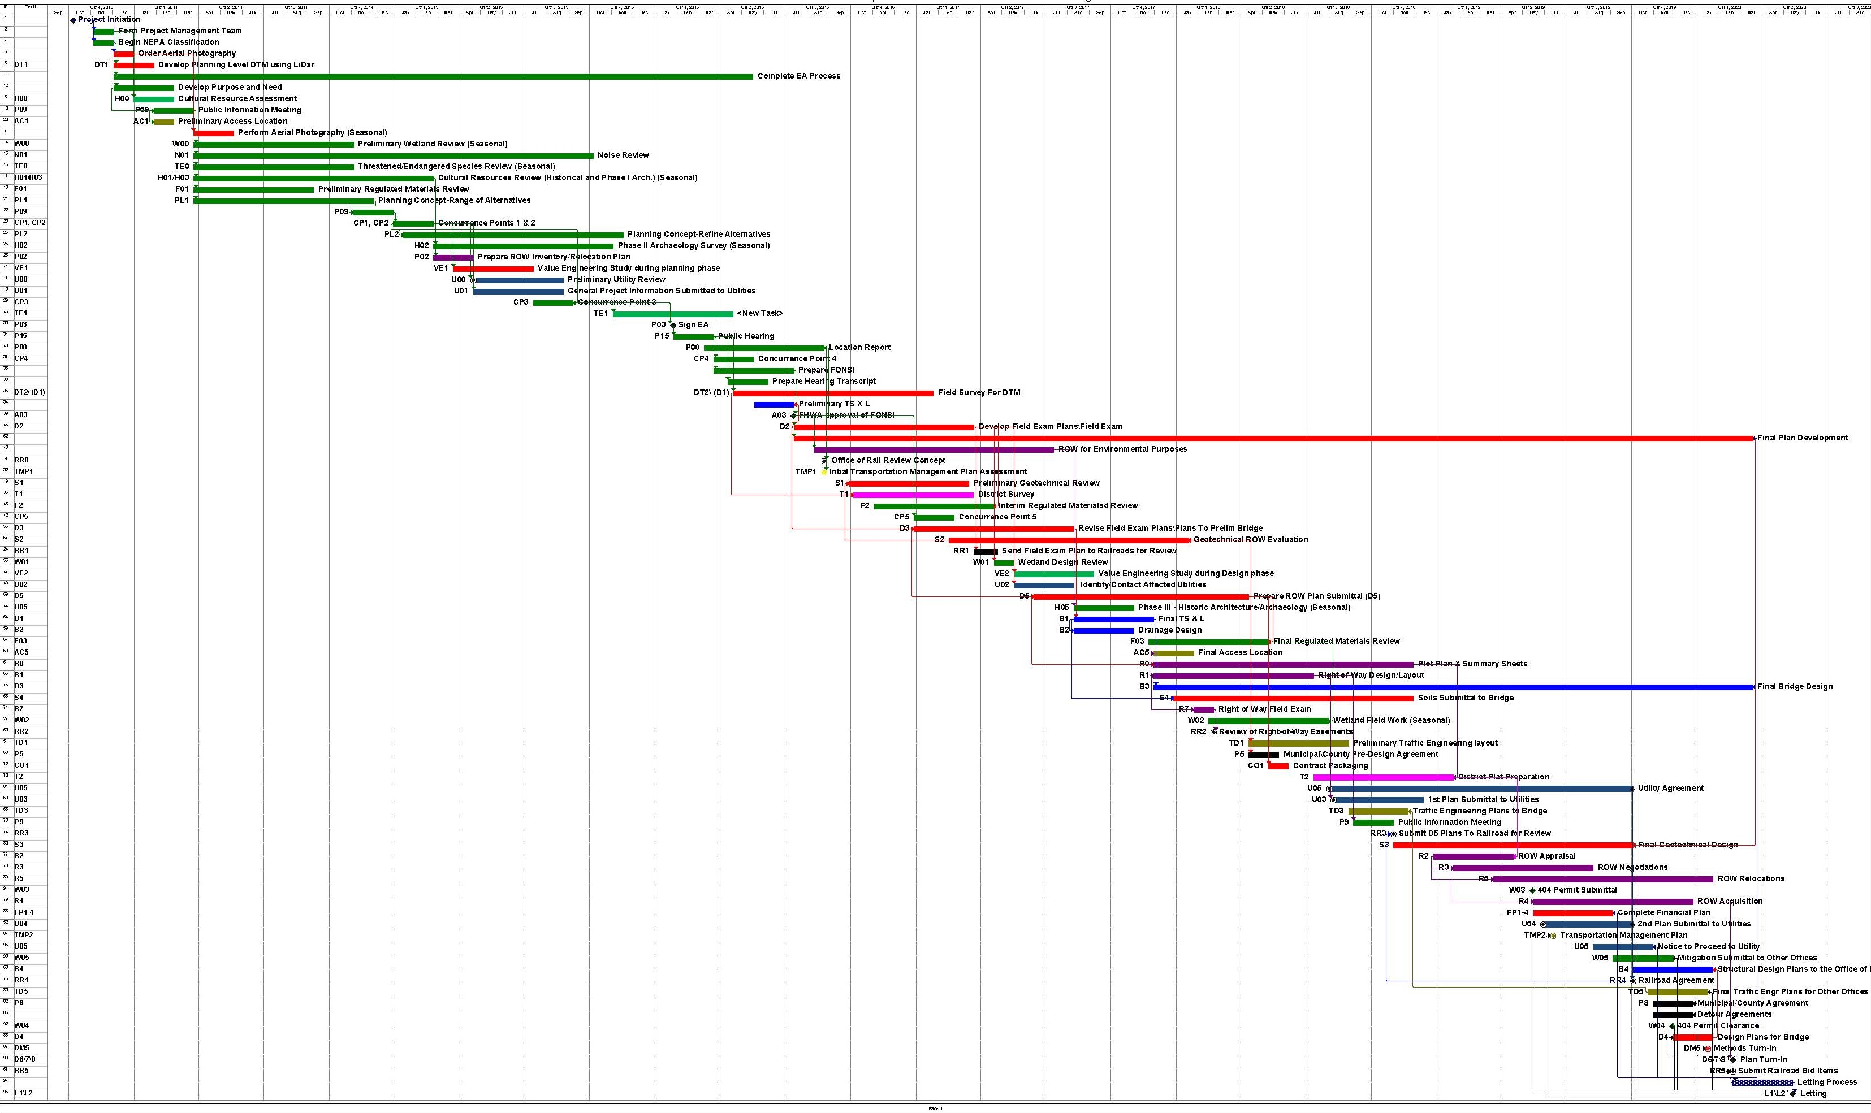
5-6 Years
Notifications Earlier
Unavoidable Impacts Identified
Own the Process
Identify Where Relocations Go
Work on Modifications Together Earlier
12-16 months
Letting
Possession of Property
NTP to Utilities
Second Plan set to Utilities
First Plan set to Utilities

Slide 13
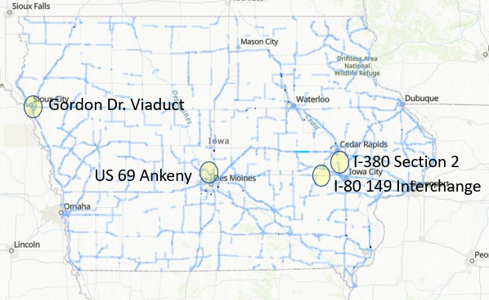
Pilot Project Goals
Identify Utilities Early in the Process
Conduct Notifications Much Earlier
Identify Project Utility Corridors
By D2 (20%) have a draft relocation plan
By D5 (85%) have a final relocation plan
Include known property needs in ROW design

Slide 14
Pilot the use of multi-duct installations in congested areas
Quarterly Goals |  | Status
2023 Q4 | Identify a candidate project. | Complete. I-80 / Hickman Road interchange and widening project has been selected..
2024 Q1 | Develop construction plans for multi-duct installation and let the project. | Complete. Plans have been completed and turned in for January letting. Contract has been let. Pre-con meeting is scheduled for 3rd week of February. Construction work is expected to start this summer.
2024 Q2 | Report on progress of utility installations. | On-track. Utility relocation plans are due in the beginning of January.
2024 Q3 | Summarize lessons learned including recommendations for future multi-duct installations.
14

Slide 15
Multi-duct installations
Pilot project – I-80 & Hickman Road (U.S. 6)
Other efforts underway
U.S. 69 Ankeny
IA 122 Mason City
Install multi-duct conduit as part of the project
DOT pays for the design & installation
Capture lessons learned

Slide 16
Pilot digital utility as-builts on a few contracts for installation of DOT owned utility facilities
Quarterly Goals |  | Status
2023 Q4 | Refine the process for collecting data | Mostly complete.
2024 Q1 | Develop scopes of services for consultants assisting the Iowa DOT in implementing its Accelerating Innovative Delivery (AID) and Advanced Digital Construction Management systems (ADCMS) grants for digital project delivery. | On-track. Scopes for AID grant are complete and project work has started. Scopes for ADCMS are in progress.
2024 Q2 | Refine the schema for hosting data inside the DOT network.
2024 Q3 | Develop a web-based QA-QC process for contractors to submit data.
2024 Q4 | Pilot changes with several construction projects.
16

Slide 17
Questions?
charlie.purcell@iowadot.us
515-357-0143

