Slide 1
2025 Annual Utility Meeting
An information exchange and networking event
Deanne Popp
Utility Program Administrator
January 2025
3/2/2023

Slide 2
Agenda
Welcome & Introductions
Utility Program: Update & Overview
Agreements & Permitting Roundtable
5-Year Program & Projects in District
Notes:
Thank you for joining us – new (old) format for meetings
Agenda
Housekeeping – restrooms – exits – participate

Slide 3
Utility Program Team
Central Office
District Offices
Field Offices
Notes:
Utility Program – from accommodation & permitting to project development & relocations
Team – staff from various offices & locations across the state
Plays a major role in assisting to manage the assets in the public rights of way
Take a look at some of the major players…

Slide 4
Central Office Leadership
Transportation Development Division – Deanne Popp
Program director
Rules & policy administration
Stakeholder liaison
Approval of utility relocation payments
Right of Way Bureau Director – Brad Hofer
Directs all sections in the bureau
Approval of budget items including utility relocations
Approval of utility agreements
GIS champion for ROW parcels & utility locations
Notes:
Team leadership from the central office

Slide 5
Utilities Section
Utilities Section Supervisor – Eric Wright
Supervises Appraisal, Design, & Utilities Sections
Process & procedure implementation for utility program
Project coordination & production champion for these sections
Statewide Utility Program Coordinators
Project coordination & agreement monitoring
Regional Utility Program Coordinators
Project notifications & utility milestone submittals
Utility reimbursement agreements
Payments & release of easement rights
Notes:
ROW Utilities Section team

Slide 6
District Staff
District Utility Coordinators
Utility coordination for projects
Utility work plan review & approval
Utility coordination & collaboration meetings with companies
Permit review/assistance
Engineering Operations Technicians
Permit review, approval & issuance
Access, utility accommodation, work on right of way
Resident Construction Engineer
Preconstruction meeting – invite utility companies
Coordination with contractor
Notes:
District and field staff team
The people are the boots on the ground for the utility program…
RCEs – key in coordinating work with DOT contractor for utility relocation work not yet complete

Slide 7
Other key players
Survey
Includes survey of utility locates in project design
Design
Key to facilitating successful utility conflict management
Performs engineering decisions related to highway design to avoid and minimize utility facility impacts in communication with Project Manager
Project Manager
Key to facilitating successful utility conflict management
Reviews project needs throughout development to determine utility investigation needs
Right-of-Way Acquisition
Acquires necessary parcels to facilitate relocations preferably prior to letting
Notes:
Early and often is the key to successful utility coordination.
Improved utility investigation (UI) is where we’re headed.
UI should be an iterative component to project development
Begins in survey with an assessment of what the current situation is
As the project develops, we should evaluate critical areas and request more data as needed

Slide 8
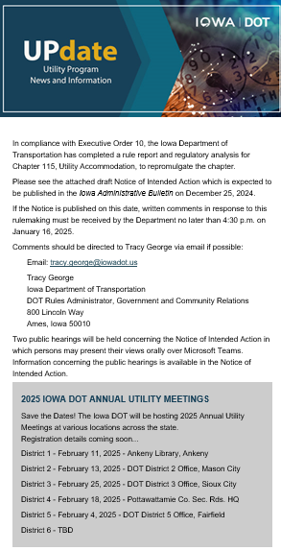
What’s New?
Outreach improvements
A newsletter to communicate with stakeholders
Managed through Govdelivery
Notes:
Improved communication with stakeholders
UPdate newsletter created
2 examples shown here
Welcome notice
Chapter 115 notice(s) – several have been sent
Sent to all utility contacts in Masterworks as a starting point
Govdelivery – subscribers can add/remove themselves from the list

Slide 9
Proposed rule changes published
Iowa Administrative Bulletin 10/2/2024
Public hearing held 10/28/2024
Written and oral comments received from 11 constituents in support for proposed chapter
Responses sent to commenters
No changes made to proposed rule
Regulatory analysis complete
Notice of intended action published 12/25/2024
Administrative Rules Review Committee 1/13/2025
Public hearing #1 held 1/16/2025
Public hearing #2 held 1/16/2025
Written comments received
Reviewing comments and drafting responses
Chapter 115
Administrative Rules Review

Slide 10
Proposed rule changes
Updated references to specific sections of Iowa Code – 318.5 (noncompliance and removal of obstructions
Updated references to specific department divisions and bureaus
Added and updated links to web pages
Consolidated duplicate rules related to encasement requirements and clear zone requirements
Added a requirement for performance bonds for utility permit requests for installations related to Department highway projects (updated the bond amounts)
From $5,000 to $10,000 minimum
From $50,000 to $100,000 annual

Slide 11
Proposed rule changes
Amended requirement to have as-built plans submitted in an electronic format that conforms to department standards
(DS-23045) Geospatial mapping of sub-surface and underground utilities
Added a requirement to provide a 10-day notice to the department’s 511 of any lane restrictions or traffic closures
Added language to address unacceptable work and to require rework (or removal)
Amended requirement to have utilities notify a district representative upon completion of work
To allow the department the opportunity to inspect the work
If the work was noncompliant to seek a remedy within a specified timeframe established by the department

Slide 12
Proposed rule changes
Amended a requirement to allow underground electric installations longitudinally with interstate and freeway rights-of-way
Adding that aboveground installations longitudinally may be allowed within interstate and freeway rights-of-way if…
It is necessary to advance the state’s priorities,
Can be installed safely with minimal impact on the traveling public
Can be safely accommodated within an existing right-of-way
If there are no planned improvements in the foreseeable future
If it extends for a relatively short distance
Any such installations would need to be approved by the Iowa Utilities Commission so we would work closely with the IUC on the review and approval

Slide 13
Proposed rule changes
Improved utility investigation to identify utilities within the project footprints
Allow the Department to analyze design conflicts with existing utility facilities
To make better design decisions that avoid or minimize impacts and reduce construction delays and costs
Require utility companies to provide the location of their facilities within the project footprints.
To allow the Department and utility companies to collaborate on highway design to avoid conflicting with utility facilities when feasible
To minimize the remaining impacts to existing facilities
To work together to resolve and mitigate those facilities that cannot be avoided

Slide 14
Proposed rule changes
Require utility companies to make final review of design conflicts with utility facilities earlier in the project timeline
Provide one relocation work plan instead of two,
Should streamline the work plan review and approval process
Updated the noncompliance rule to allow the department to determine a noncomplying utility facility to be an obstruction in accordance with Iowa Code section 318.5

Slide 15
Initiatives
Update on various utility-related initiatives
Notes:
Electronic Permitting System (EPS)
PPMS (Masterworks)
Utility Task Force

Slide 16
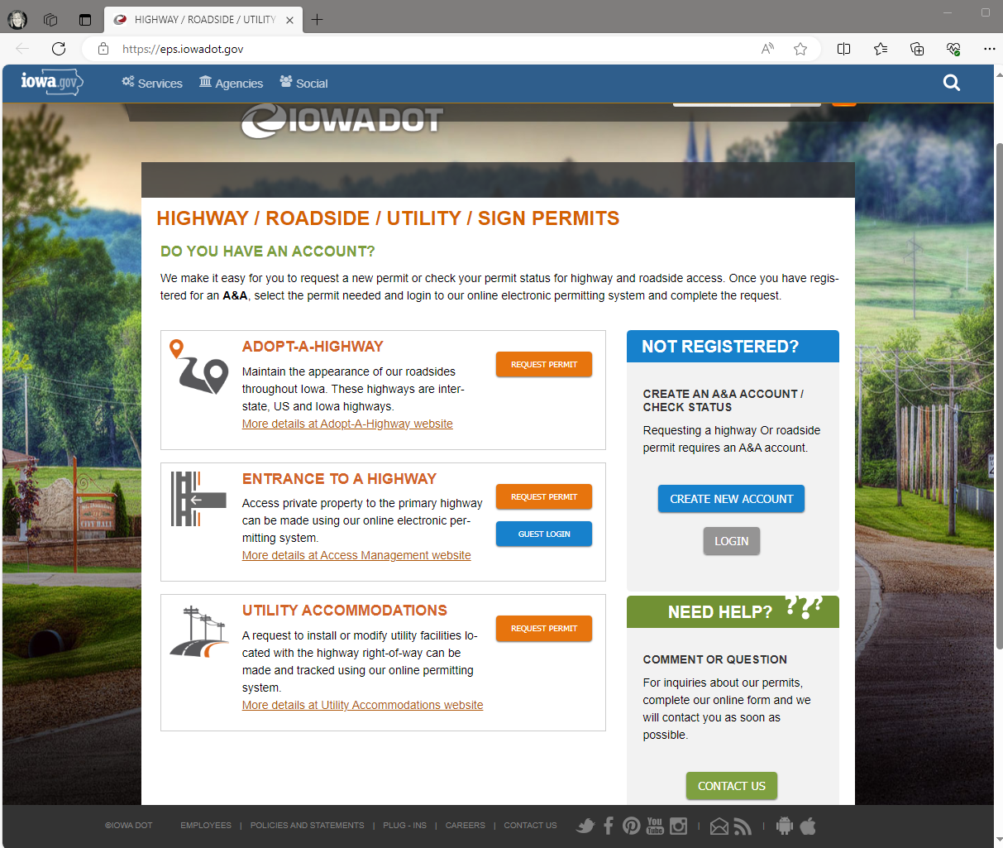
Electronic Permitting
System
In production
Permit process page
Apply online
Other types of permit requests
Enterprise A&A
First time user
Create an account
Request permit
Notes:
Cloud based application – allows users to:
Submit – edit – review requests for permits
Department audits and processes requests
Review – approve - issue
How to find the utility permit page…
A-Z index
Search utility or utility permits to get to our website that contains the link
Bookmark the utility coordination & accommodation web page

Slide 17
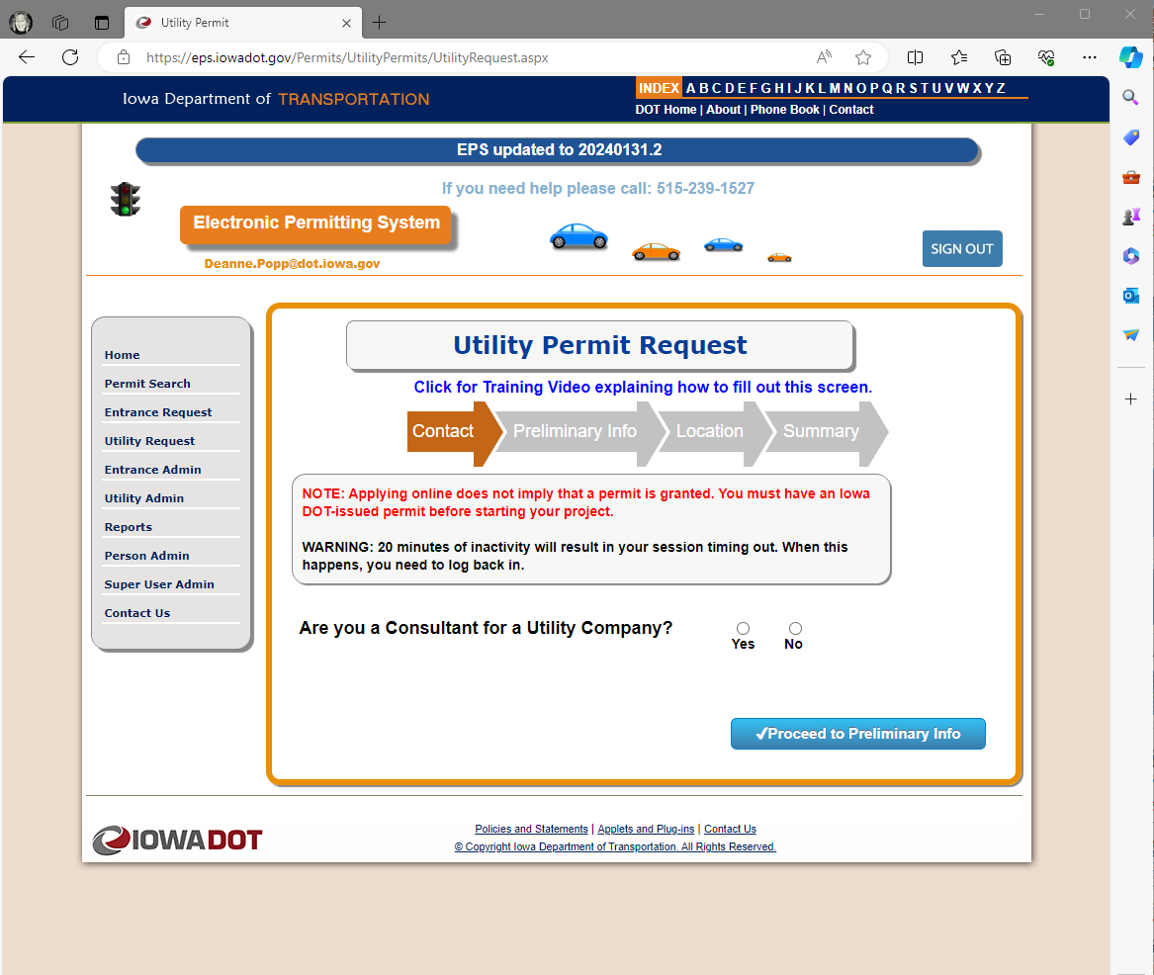
Electronic Permitting
System
Begin request
Training module
3 steps
Preliminary request
Official request
DOT processing
Notes:
3 steps to the permit request
1 & 2 by the applicant
3 by DOT representative - EOT

Slide 18
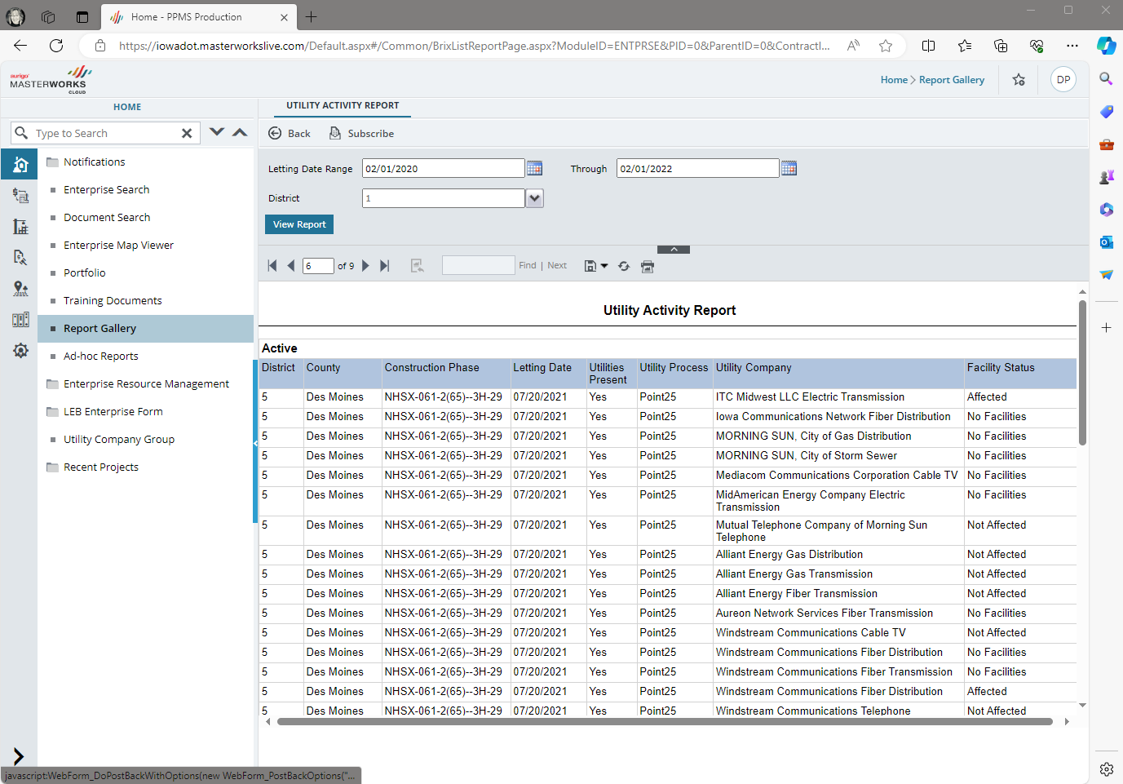
PPMS Masterworks
Coordination tasks
Conflict list
Reports
Users assigned to projects
Reports
Dashboards

Slide 19
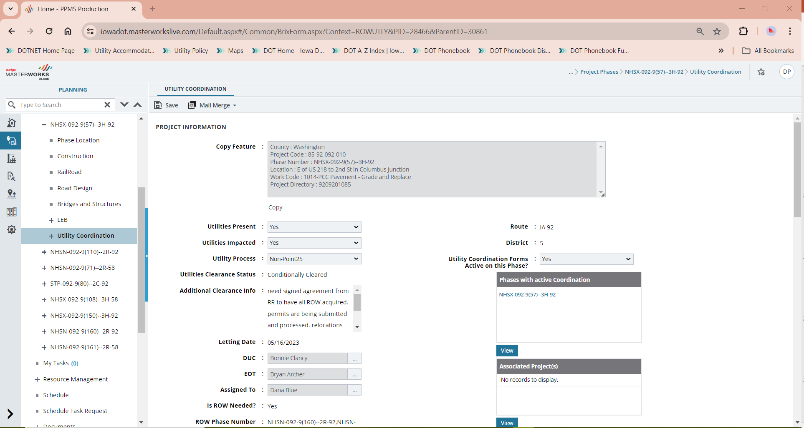
Notes:
Project example – set the criteria
Utilities present – impacted
Process we’ll follow
Utility coordination set to ACTIVE

Slide 20
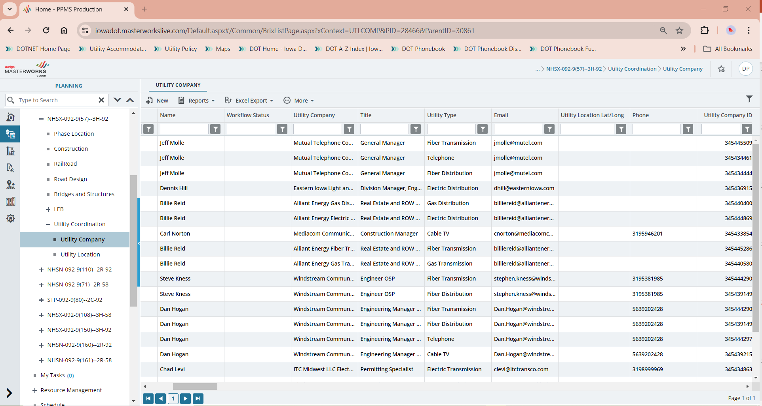
Notes:
Add (invite) utility companies to the project
Company Group – Main company
Company – includes type of utility

Slide 21
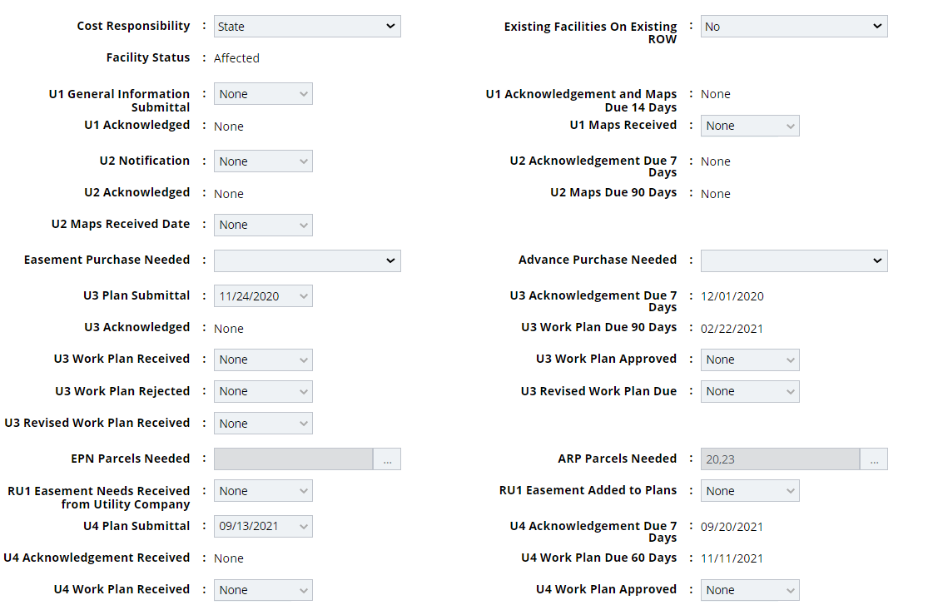
Track milestones
Coordination tasks
Due dates
Approval dates
Cost responsibility

Slide 22
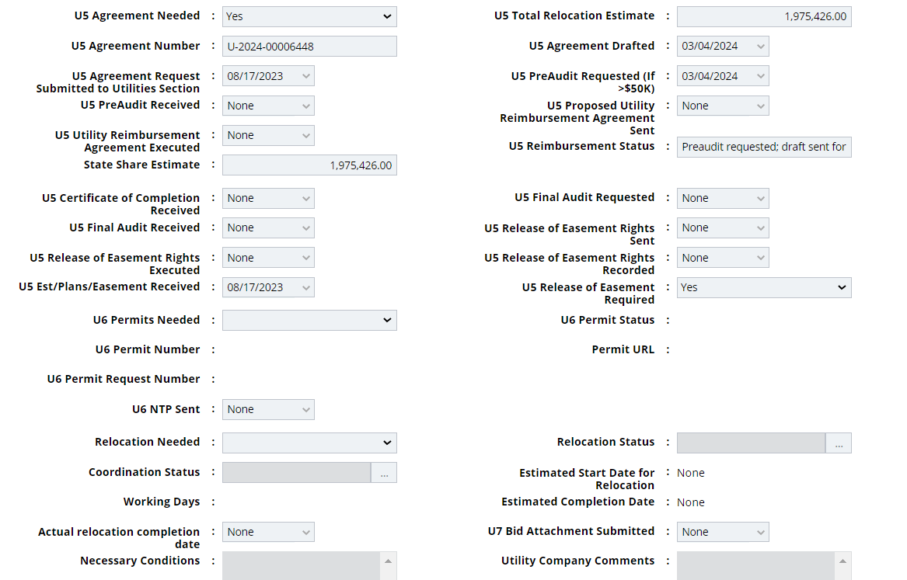
Agreement activities
Permits integrated with EPS
Notice to Proceed
Relocation status
Anticipated start date & working days
Actual completion date

Slide 23
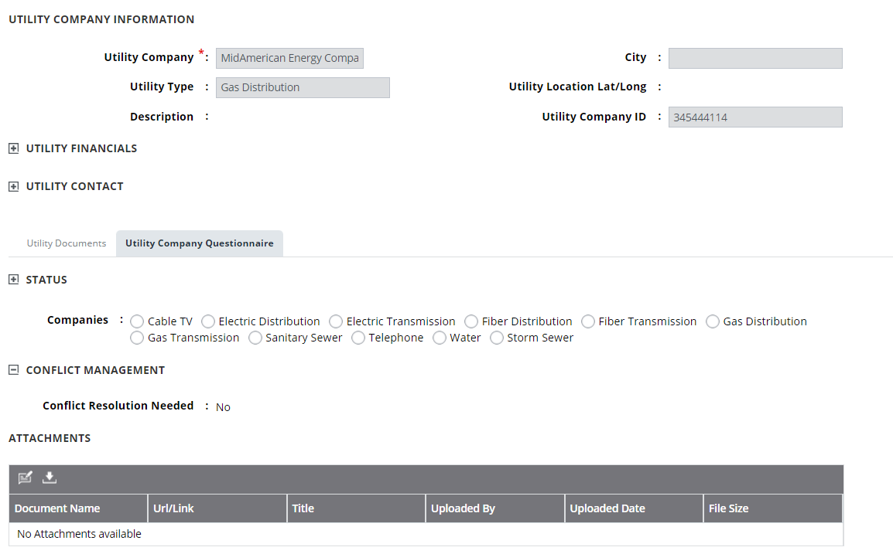
Utility conflict management
Enter conflicts
Resolutions
Pass information to contractors for construction purposes

Slide 24
Utility Task Force
Process improvement team
Notes:
Created in response to increasing instances and impacts of project delays and increased costs associated with utility conflicts.
Emerged from utility training sessions
And utility related research projects

Slide 25
Identify, evaluate, prioritize and lead the implementation of improvements to utility accommodation and coordination processes in order to avoid utility conflicts when possible, and when not possible, minimize relocation costs, project delays, and damage claims.
Notes:
Identify - Whiteboard exercise w/ sticky notes
Address – sort by topic or likeness – root cause analysis
Top16 - greatest impact to improvement
Similarities allowed us to combine items & group into 2 main goals
Hear more about this after the morning break

Slide 26
Objectives:
Update the Utility Accommodation and Coordination Policy
Work with Iowa One-call to improve utility locates
Develop a utility construction conflict resolution process
Goal 1:
Improve awareness and compliance with utility policy and permit requirements

Slide 27
Objectives:
Develop pilot projects identification, conflict analysis, and resolution of utility impacts
Pilot the use of multi-duct installations in congested areas
Pilot digital utility as-builts on a few contracts for installation of DOT owned utility facilities
Goal 2:
Implement a more proactive project development process to avoid, minimize and mitigate the impacts on utility facilities

Slide 28
Quarterly rocks | guide our progress
Update the Utility Accommodation & Coordination Policy (Chapter 115)
Work with Iowa One-call to improve utility locates (DOT-owned facilities)
Develop a utility construction conflict resolution process (initial ideas developed)
Develop pilot projects for early identification, conflict analysis, and resolution of utility impacts (4 projects)
Pilot the use of multi-duct installations in congested areas (3 projects)
Pilot digital utility as-builts on a few contracts for installation of DOT-owned utility facilities

Slide 29
Initial ideas for conflict resolution process
“Building blocks” for an effective resolution process
Explore use of surety bonds
Require on-site inspection by utilities companies to ensure compliance
Better train DOT field staff to improve their review and enforcement of permit requirements
Better define in our policy what is considered “timely” response by the utility
Require utilities to provide a response within 24-hours of notification, and the contact info of the person with authority to authorize an immediate response
Better process to determine if the ROW is “fully occupied”
Better enforcement of utility as-built submittals

Slide 30
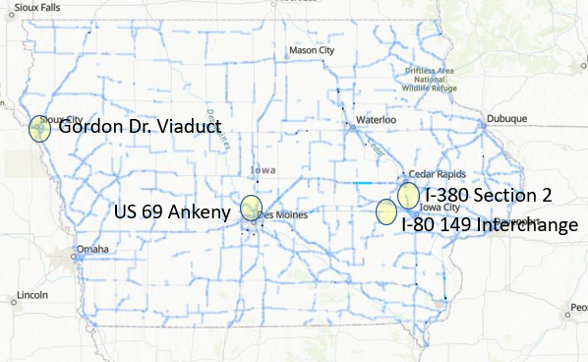
Pilot Project Goals
Identify utilities early in the process
Conduct notifications much earlier
Identify project utility corridors
By D2 (20%) have a draft relocation plan
By D5 (85%) have a final relocation plan
Include known property needs in ROW design
Capture lessons learned
30

Slide 31
Multi-duct installations
Pilot project – I-80 & Hickman Road (U.S. 6)
Other efforts underway
U.S. 69 Ankeny
IA 122 Mason City
Install multi-duct conduit as part of the project
DOT pays for the design & installation
Capture lessons learned

Slide 32
Moving forward
Tips to making positive change
Monitor the progress
Be aware of and communicate schedules
Attend the annual utility meetings
Invitations sent via UPdate newsletter

Slide 33
District 1 – February 11
Ankeny Kirkendall Public Library
District 2 – February 13
District 2 Conference Room
District 3 – February 25
District 3 Conference Room
District 4 – February 18
Pottawattamie County Secondary Roads Headquarters
District 5 – February 4
District 5 Conference Room
District 6 – February 21
District 6 Conference Room
2025 Annual Utility Meetings
February
8:30am-Noon
Each district
Notes:
8:30am - Check-in / Networking
9am - Welcome & Introductions
Utility Program Updates & Overview
Agreements & Permitting | Roundtable
5-Year Program & Projects in District
Q & A
Noon - Adjourn

Slide 34
FTP site for meeting materials
https://utilities.iowadot.gov/Annual%20Util%20Mtg%202025/
EPS site for permitting
https://eps.iowadot.gov/
Utility Program site
https://iowadot.gov/rightofway/Utility-Accommodation-and-Coordination
State newsletter subscriptions
https://www.iowa.gov/subscribe

Slide 35
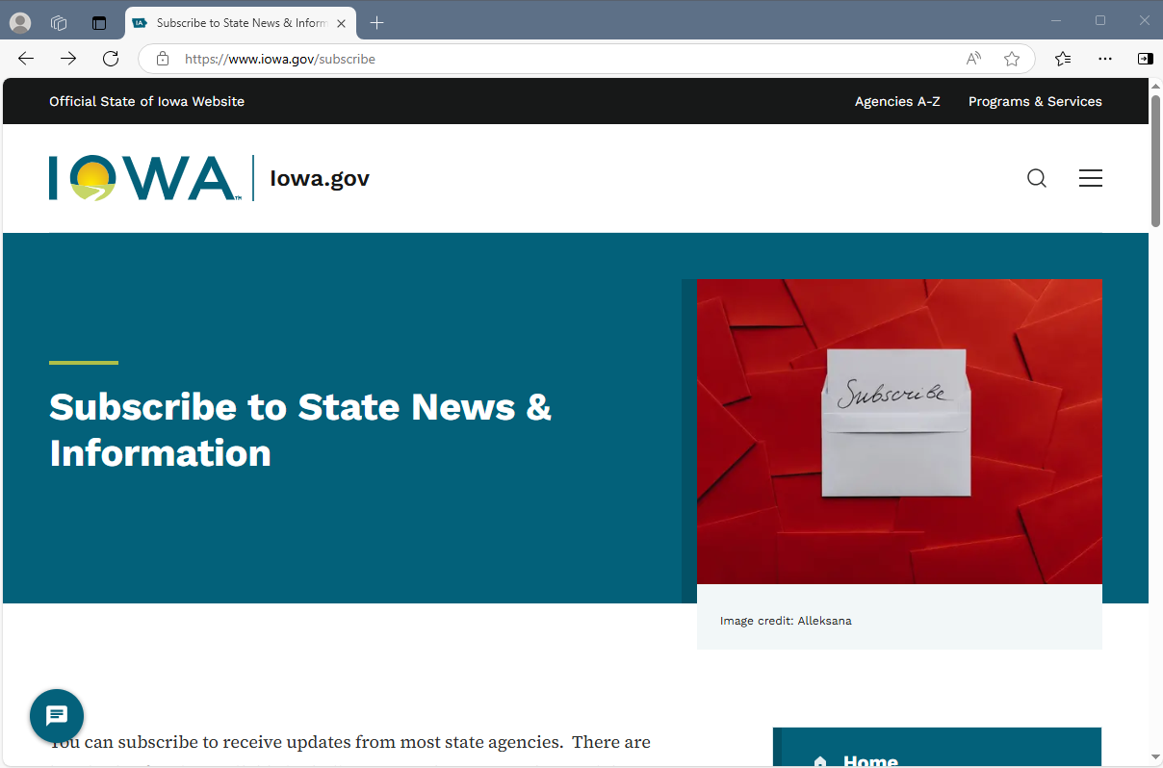
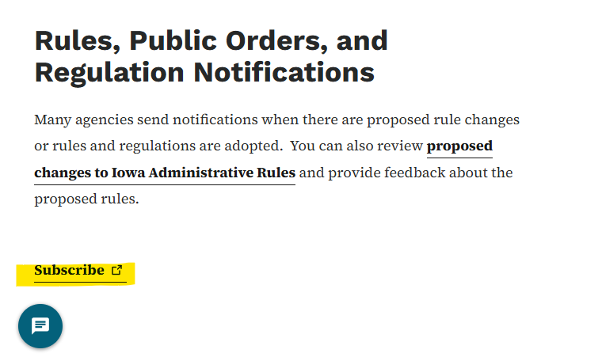

Slide 36
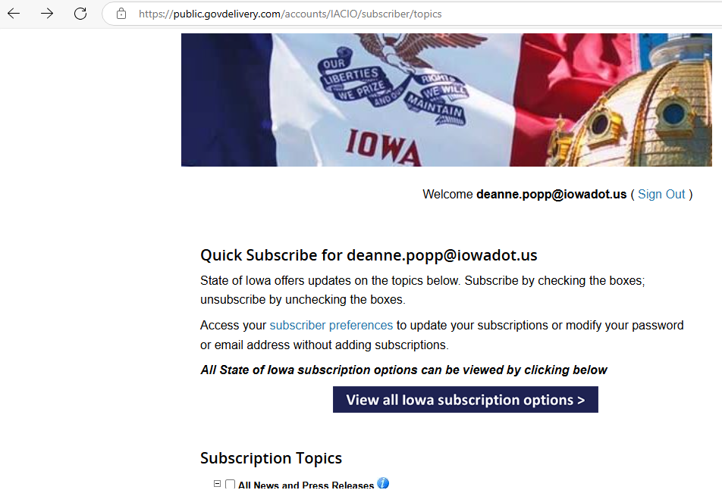
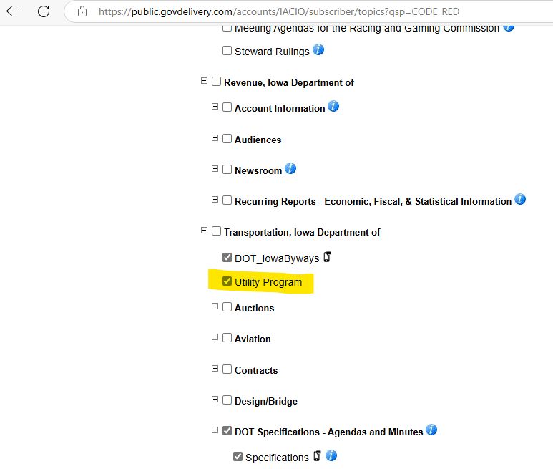

Slide 37
Questions?
DEANNE POPP
515.239.1014
deanne.popp@iowadot.gov​
iowadot.gov

