Slide 1
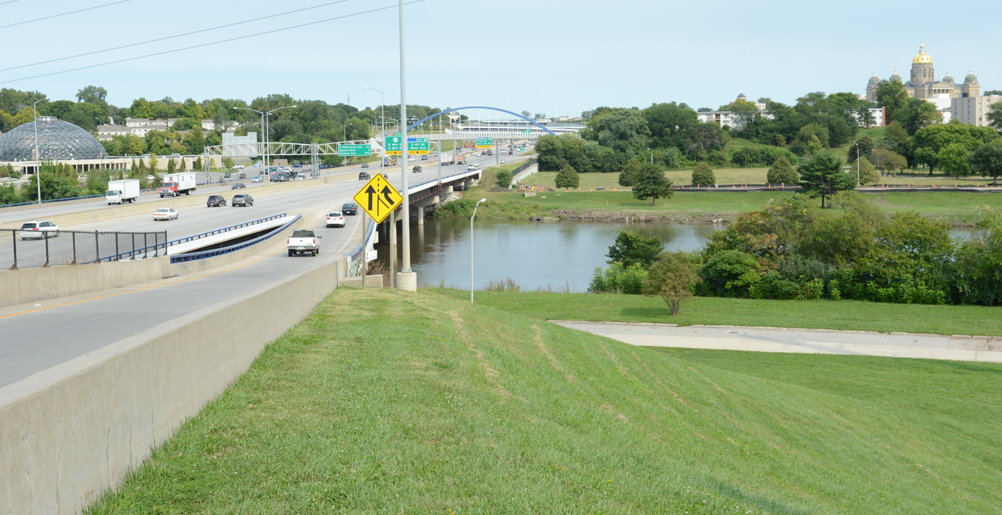


District 1 Projects
2025 Annual Utility Meeting
3/2/2023
Jeremey Vortherms
Assistant District 1 Engineer
February 11, 2025
Notes:
Good afternoon, everyone. Thank you for inviting the DOT to present at the workshop.
My name is Jeremey Vortherms, and I am the Assistant District 1 Engineer.
The DOT’s focus is on Safety, Mobility, and improving lives through transportation and I plan to share with you some of the projects we are working on in central Iowa.

Slide 2
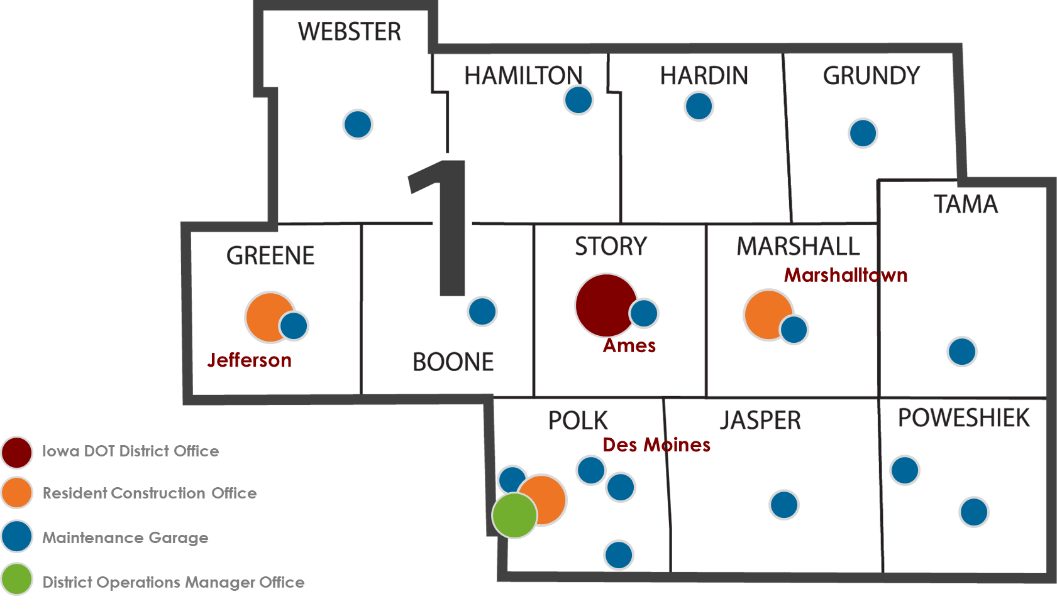
North Area
South Area
Notes:
District 1 is 12 counties in central Iowa, and includes Polk and Story Counties, and the Des Moines Metro Area.
We are responsible for the planning, design, construction, and maintenance of all the state-owned interstates, highways and bridges.
District 1 has
- 3 construction residencies,
- 16 maintenance garages,
- an operations office,
- and the District Office in Ames, just south of the main complex on South 4th Street.
We staff 310 full-time people year-round, and right now we are bringing on additional help for winter snow fighting operations.

Slide 3
District 1 Engineering Staff
Allison Smyth, P.E.
District 1 Engineer
Jeremey Vortherms, P.E.
Assistant District 1 Engineer
Scott Nixon, P.E.
District 1 Construction Engineer
Andy Swisher, P.E.
Transportation Systems Management & Operations (TSMO) Engineer
Frank Leong, P.E.
Grimes RCE
Jenny Hoskins, P.E.
Jefferson RCE
Dustin Skogerboe, P.E.
Marshalltown RCE
Mike Lauritsen, P.E.
Materials Engineer
Ben Adey, P.E.
South Area Engineer
Donna Breitbach, P.E.
North Area Engineer

Slide 4
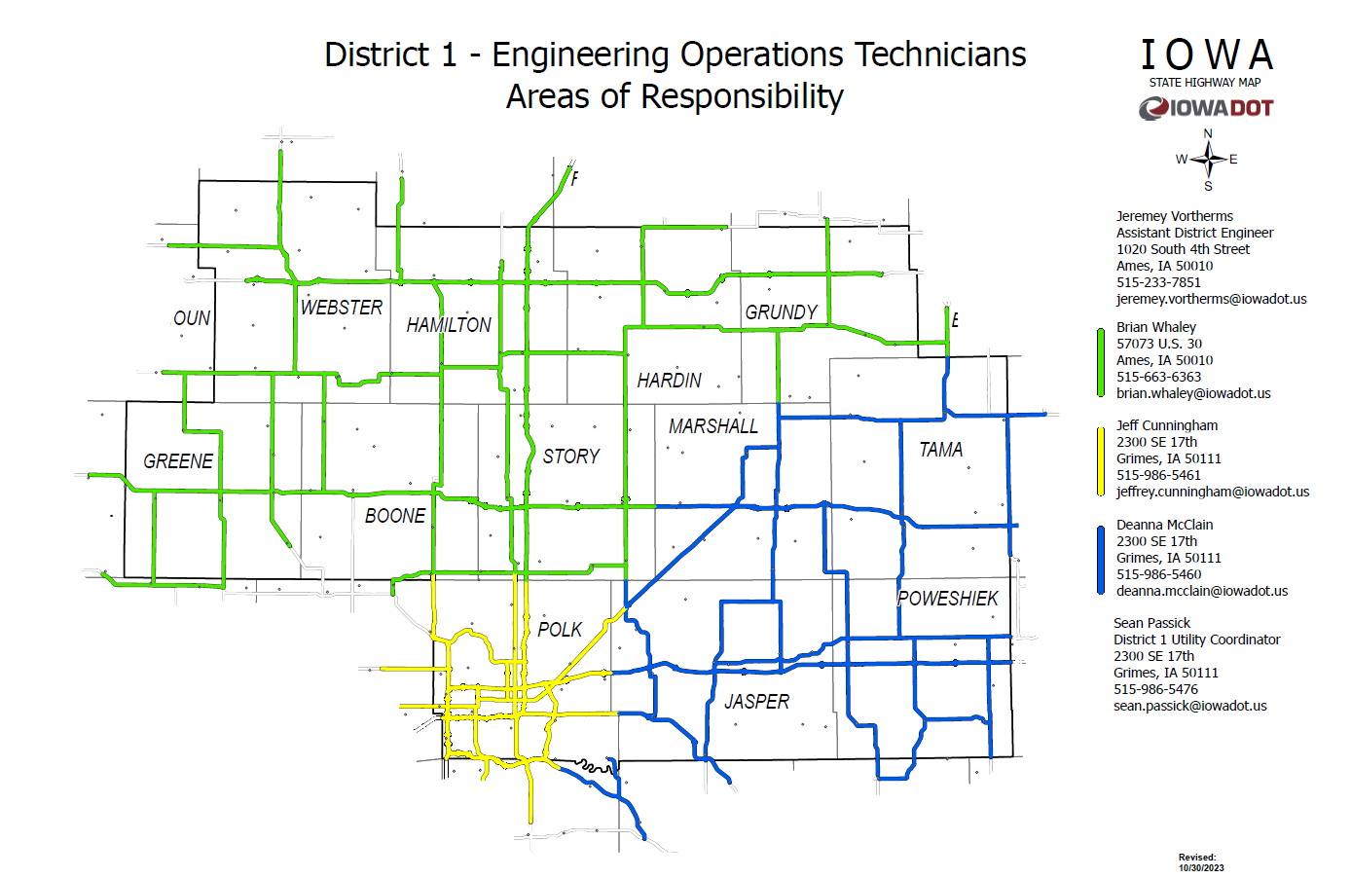

Slide 5
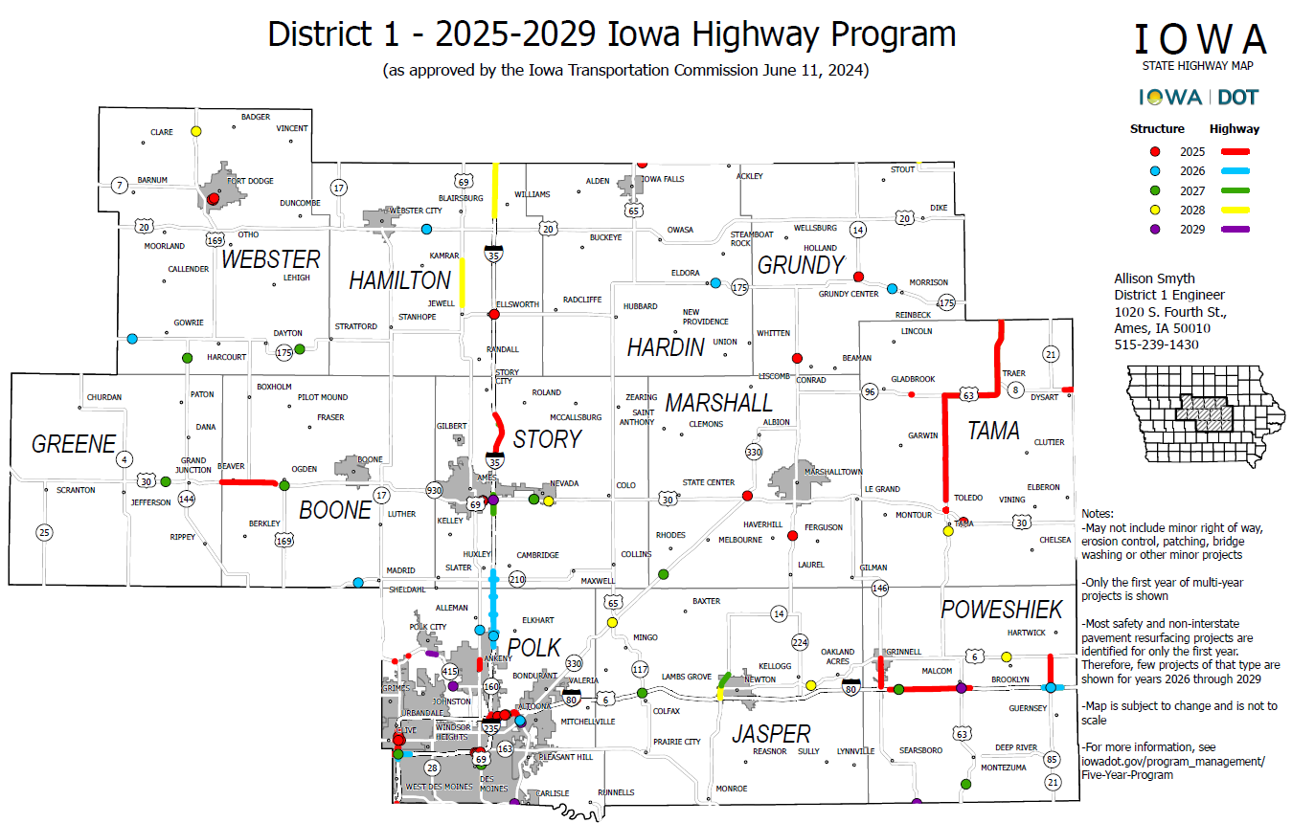
District 1 Projects
Notes:
This map is an overview of all the programmed District 1 projects.

Slide 6
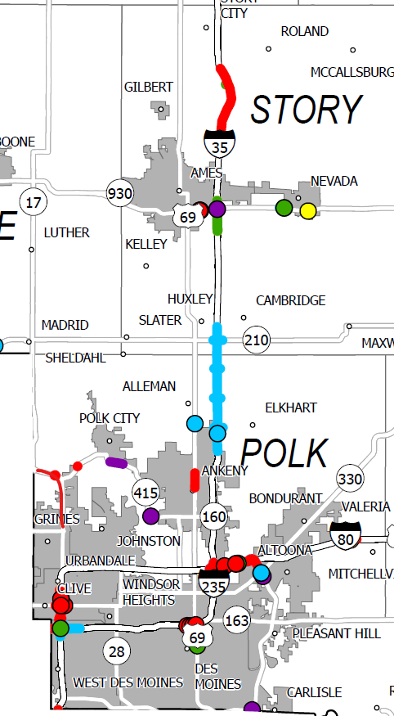
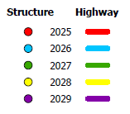
Polk & Story
County Projects
Notes:
This slide shows the project locations in Polk and Story Counties a little more clearly.
Next we will look at some of the notable projects in the District. We will start with the ongoing projects and then switch to the upcoming projects.

Slide 7
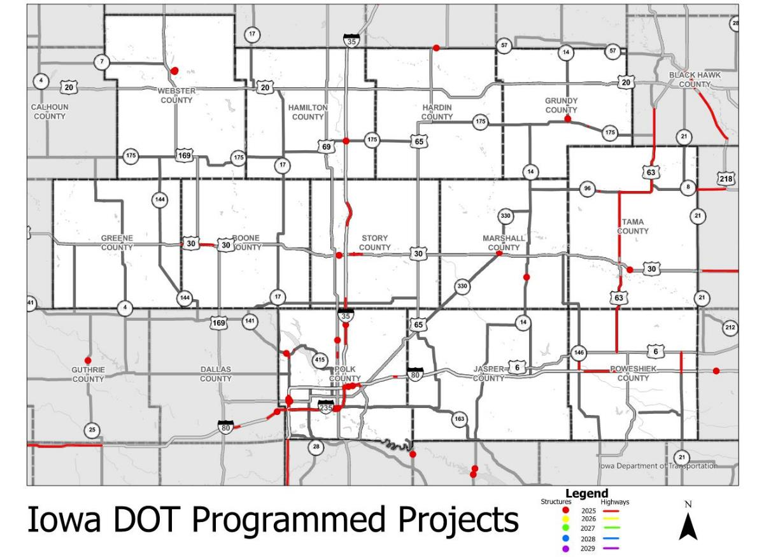
2025 Projects
Notes:
This slide shows the project locations in Polk and Story Counties a little more clearly.
Next we will look at some of the notable projects in the District. We will start with the ongoing projects and then switch to the upcoming projects.

Slide 8
Future 3R and Safety Projects
Fiscal Year | County | Route | Location
2026 | Jasper | 14 | 4th to 23rd in Newton
 | Polk | 6 | Des Moines, E of MLK Pkwy to E of SE 14th St.
 | Polk | 69 | SE Peterson Dr to 1st St in Ankeny
 | Polk | 28 | Raccoon River to I-235
 | Polk | 69 | E Vine St to E Ovid Ave
 | Carroll/Greene | 30 | 0.2 mi W of Zephyr Ave to Jct IA 25
 | Marshall | 330 | Story Co line to Melbourne (NB)
2027 | Greene | 30 | Jefferson to Grand Junction
 | Polk | 65 | IA 163 to I-80 (NB & SB)
 | Marshall | 330 | Melbourne to US 30 (SB)
 | Dallas | 44 | Dallas Center to Grimes
 | Hamilton | 175 | E of I-35 to US 65 in Hubbard
 | Greene | 30 | Grand Junction to Boone Co Line
 | Polk | 69 | NE 126th St Intersection
 | Boone | 30 | Marshall St Intersection
 | Boone | 30 | Snedden Dr Intersection
2028 | Story | 69 | IA 210 Intersection
Notes:
This slide shows the project locations in Polk and Story Counties a little more clearly.
Next we will look at some of the notable projects in the District. We will start with the ongoing projects and then switch to the upcoming projects.

Slide 9
BENJAMIN ADEY
South Area Engineer
South Area Projects
South Area
Notes:
District 1 is 12 counties in central Iowa, and includes Polk and Story Counties, and the Des Moines Metro Area.
We are responsible for the planning, design, construction, and maintenance of all the state-owned interstates, highways and bridges.
District 1 has
- 3 construction residencies,
- 16 maintenance garages,
- an operations office,
- and the District Office in Ames, just south of the main complex on South 4th Street.
We staff 310 full-time people year-round, and right now we are bringing on additional help for winter snow fighting operations.

Slide 10
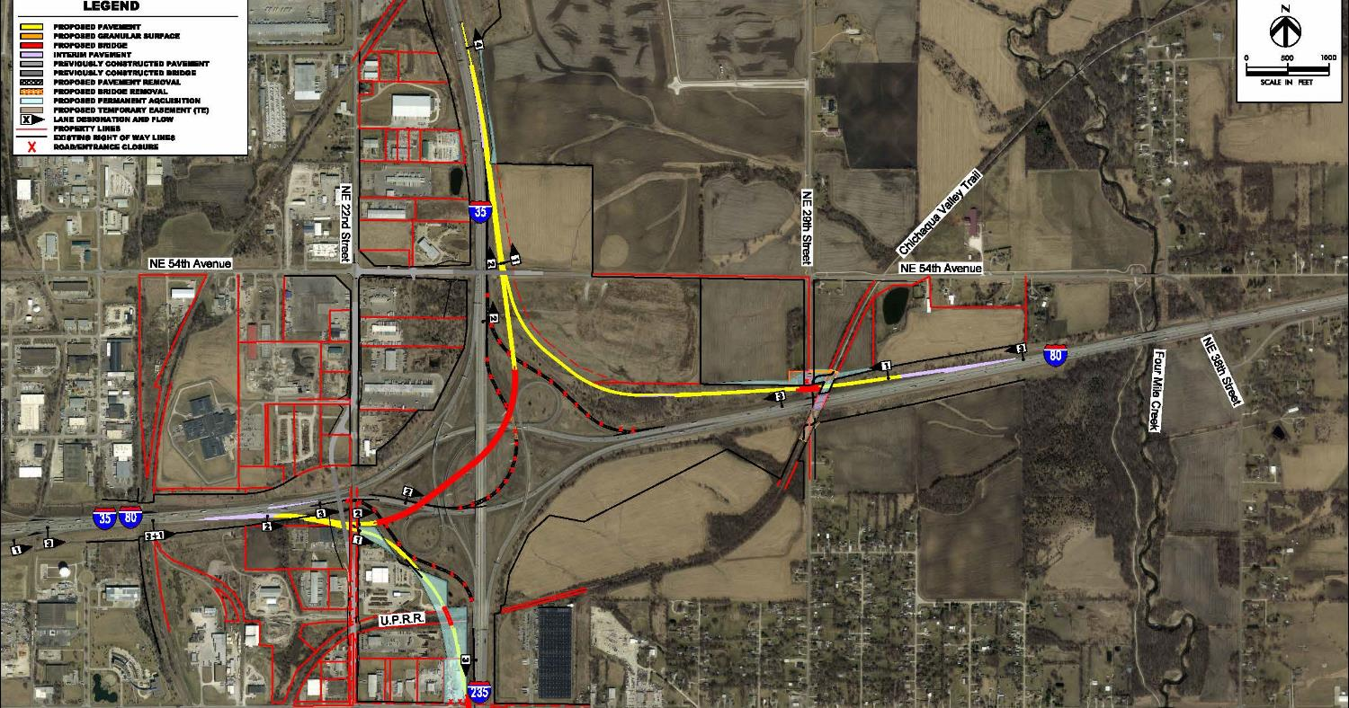
I-35/80/235
Northeast Mixmaster
Grading/Paving/Bridges
$ 123.3 Million (Awarded)
$ 500,000 (Programmed)
2022-2025
Ongoing Projects
Notes:
The first ongoing project to highlight is in northeast part of Des Moines at the I-35/I-80/I-235 systems interchange. In the image, Ankeny is to the north, Altoona is to the east, and Des Moines to the south and west.
This project will replace the single lane, left hand exit to I-35 northbound with a two-lane flyover bridge. Two adjacent ramps are affected by the new flyover and will be reconstructed as well.
If you came to the workshop from this direction, you may have noticed the new bridge piers and abutments are complete and the girders are being installed. One of the new ramps, the eastbound to southbound ramp, is also open to traffic.

Slide 11
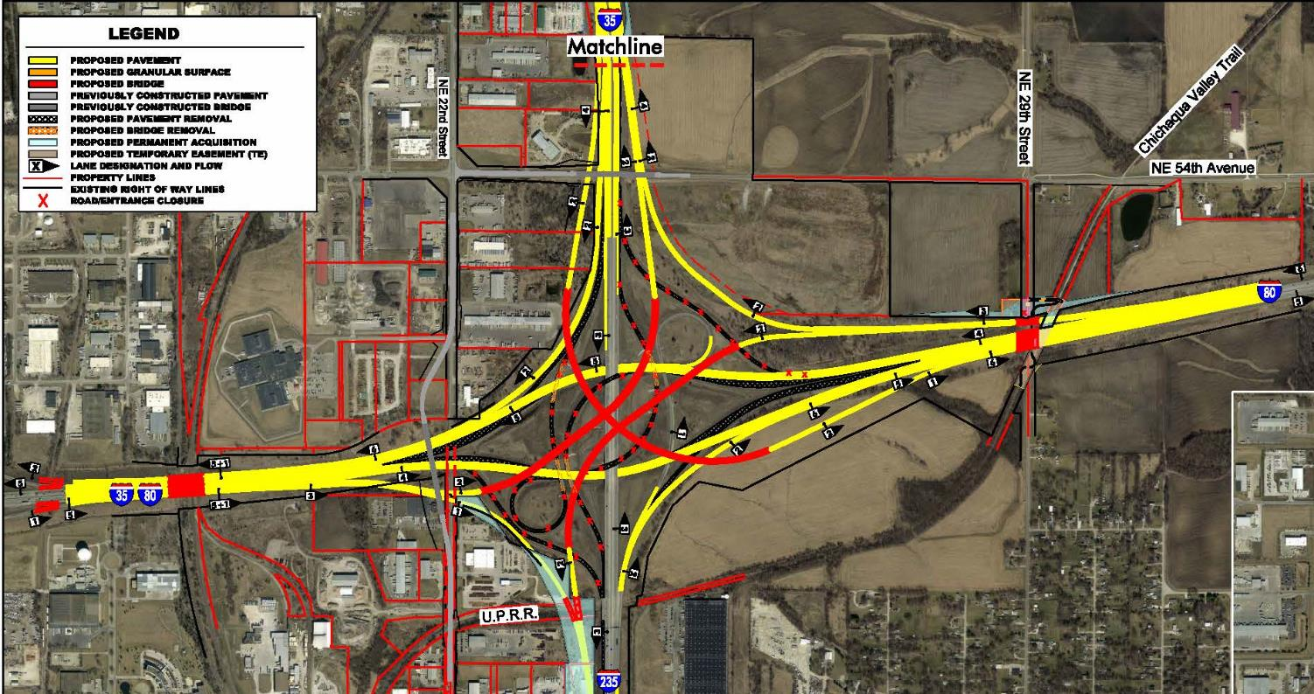
I-35/80/235
Northeast Mixmaster
Ultimate Design
Not Programmed
Ongoing Projects
Notes:
This is the same location but shows the long-range plan for the systems interchange

Slide 12
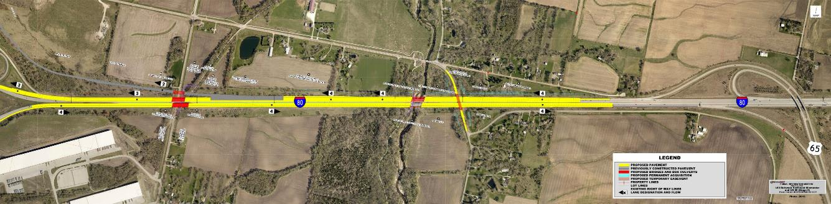
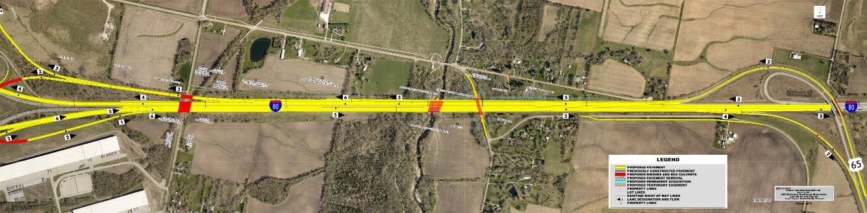
I-35/80/235 Northeast Mixmaster to US 65
Capacity Improvements
$ 76.6 Million (Programmed)
2025 - 2028
Ongoing Projects
Notes:
Amount updated

Slide 13
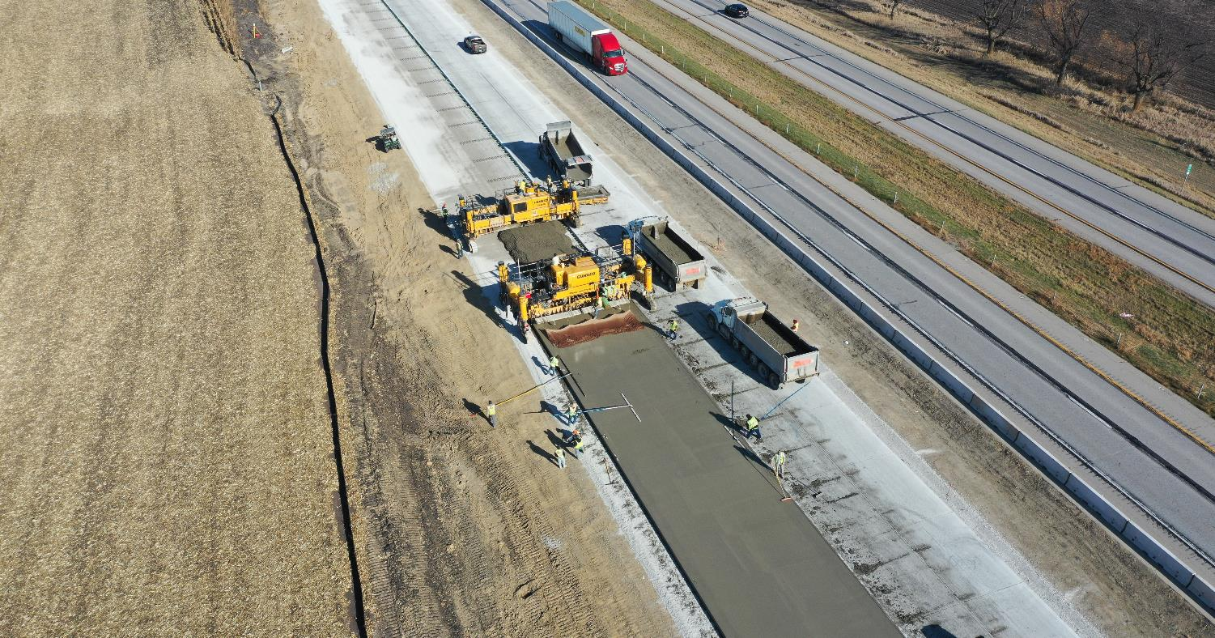
I-35 Capacity Improvements
Ankeny to Huxley
$ 119.2 Million (Awarded)
$ 54.7 Million (Programmed)
2023-2027
Ongoing Projects
Notes:
Our next project is the reconstruction of I-35 between Ankeny and Huxley. Once construction is complete, I-35 will have one additional travel lane in each direction.
Present work is reconstructing the southbound lanes and sideroad overheads. Northbound reconstruction will begin in 2026.

Slide 14
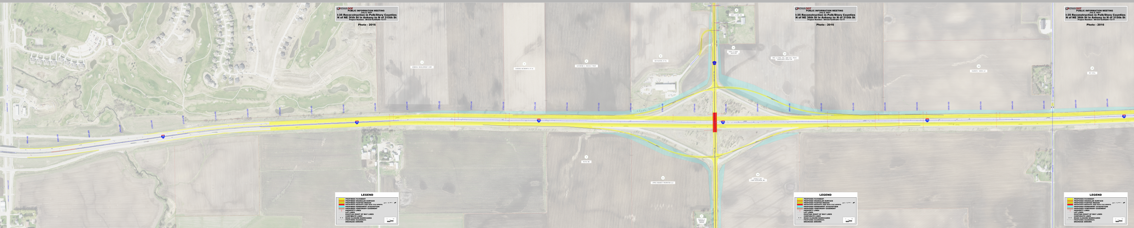
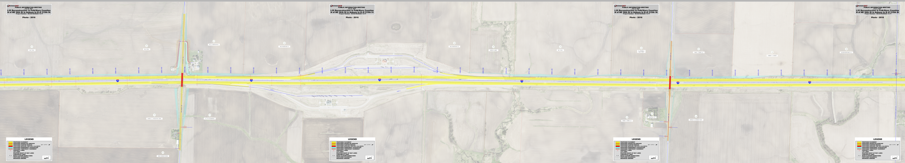
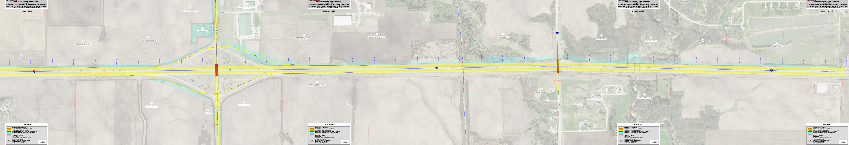
I-35 Capacity Improvements
Ankeny to Huxley
$ 119.2 Million (Awarded)
$ 54.7 Million (Programmed)
2023-2027
Ongoing Projects
Notes:
This is a strip map showing the extent of the project. Once complete, we will have reconstructed 9 miles of interstate, 5 bridges, and 2 interchanges.
NE 126th / Elkhart Rd - reconstructed
NE 142nd – reconstructed
NE 158th – in progress
Ia 210 – starting spring 2025
E 1st - reconstructed

Slide 15
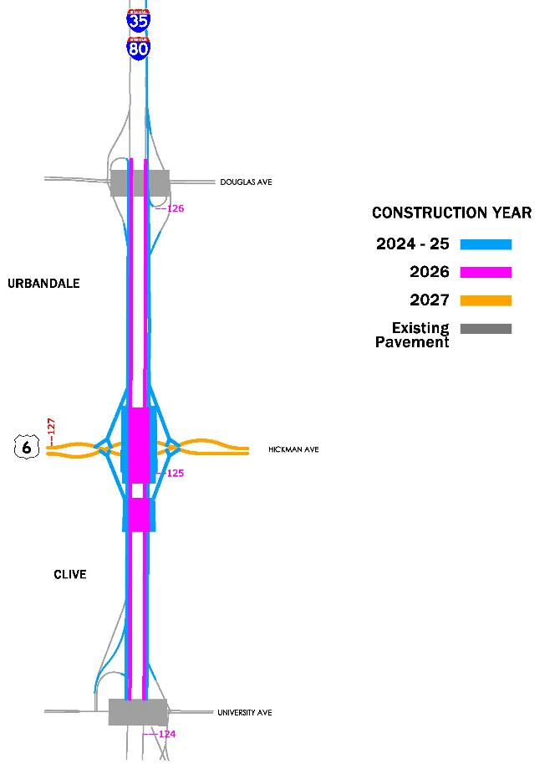
Ongoing Projects
I-35/80 & US 6 (Hickman Road)
Interchange Reconstruction
From University Avenue to Douglas Ave
$ 87.4 Million (Awarded)
$ 31.5 Million (Programmed)
Notes:
This project is the Hickman Road Interchange project on the west side of the metro in Clive and Urbandale. It involves the widening of I-35/80 and construction of a diverging diamond interchange at Hickman Road.
This project will be completed in three key phases. The exterior work along I-35/80 which includes the outer portion of the bridges over Hickman Road and Walnut Creek, retaining walls, and pavement widening. The interior work along I-35/80 to complete the bridge and pavement construction of the interstate. The last phase will be reconstruction of Hickman road and completion of the interchange ramps.

Slide 16
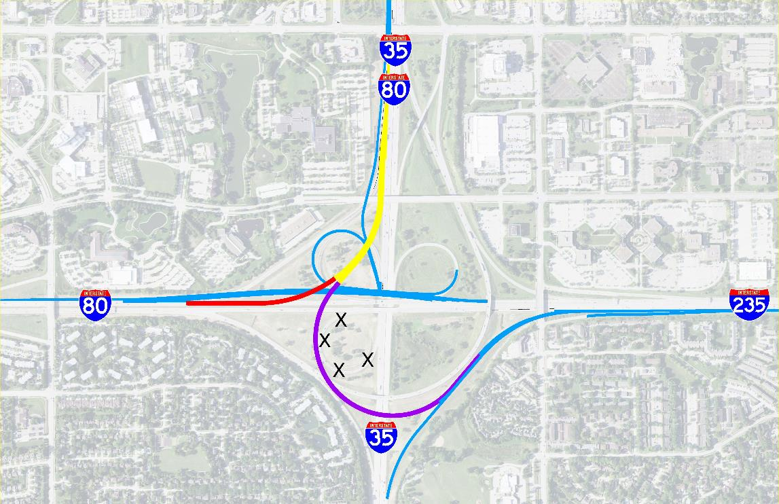
I-35/80/235 Southwest Reconstruction
$ 114.4 Million (Programmed*)
2027 - 2029
Upcoming Projects
*Under programmed
Notes:
This next location is in West Des Moines at the I-35/I-80/I-235 systems interchange.
North is oriented to the top of the image.
This project will replace the single lane loop ramp from southbound I-35 to eastbound I-235 because traffic has outgrown the original cloverleaf design. A new two-lane flyover bridge will be constructed to efficiently move commuters from I-35/80 to I-235. Adjacent ramps will be reconstructed to make room for the new flyover.
One additional notable change will be how the ramp to I-80 westbound ramp merges with I-235 westbound. I-80 bound traffic will now land on left side of the I-235 travel lanes.
During our planning studies, we learned that most travelers on I-235 exit the freeway at the next interchange, Jordan Creek Parkway. The proposed design keeps travelers on I-235 on the right to prevent unnecessary lane changing and ease the flow of traffic.

Slide 17
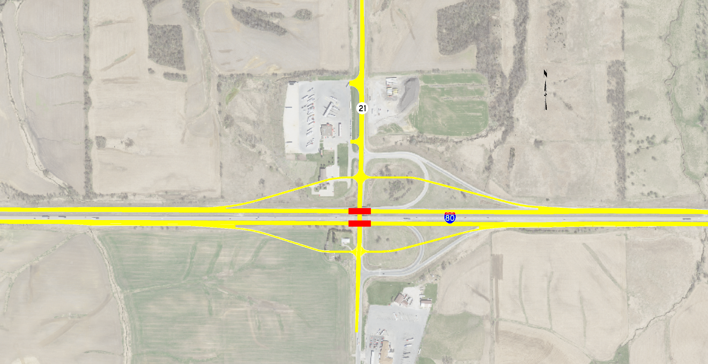
I-80 at IA 21 in Poweshiek County
Interchange Reconstruction
2026 Grade/Bridge $8 Million
2027 Pave/Signs/Lighting $8.8 Million
2028 Grade/Pave/Bridge $20 Million
(Programmed)
Upcoming Projects
Notes:
This next project is in Poweshiek County, near Brooklyn and Victor at the Ia 21 Interchange.
The eastbound and westbound I-80 bridges over Ia 21 have reached the end of their useful life and will be replaced. It is planned to reconstruct 2 miles of I-80, both interstate bridges and the interchange ramps.

Slide 18
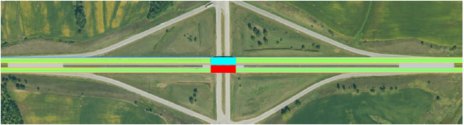


I-80 at US 63 in Poweshiek County
Interchange Reconstruction
2029 ROW $636,000
2029 New Bridge $14 Million
(Programmed)
Upcoming Projects
Notes:
Amount updated

Slide 19
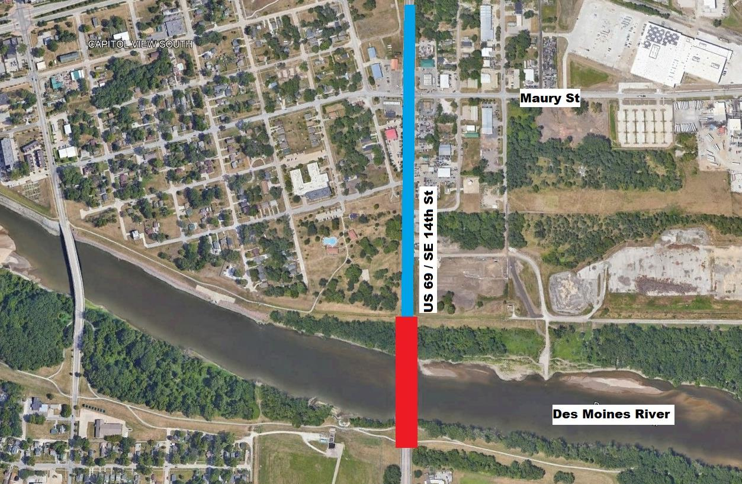
US 69 & Maury Street
Intersection Reconstruction
Bridge Replacement
Road $1.8 Million (Programmed)
Bridge $21 Million (Programmed)
2027
Upcoming Projects
Notes:
This project is on US 69/SE 14th Street and is located southeast of the capital.
This project is two-fold. The bridge over the Des Moines River has reached the end of its useful life and needs to be replaced. The portion of SE 14th Street depicted in blue has a history of safety and operational concerns. In partnership with the city of Des Moines, we are planning modifications at the Maury Street intersection, and widening SE 14th Street to construct a raised median.

Slide 20
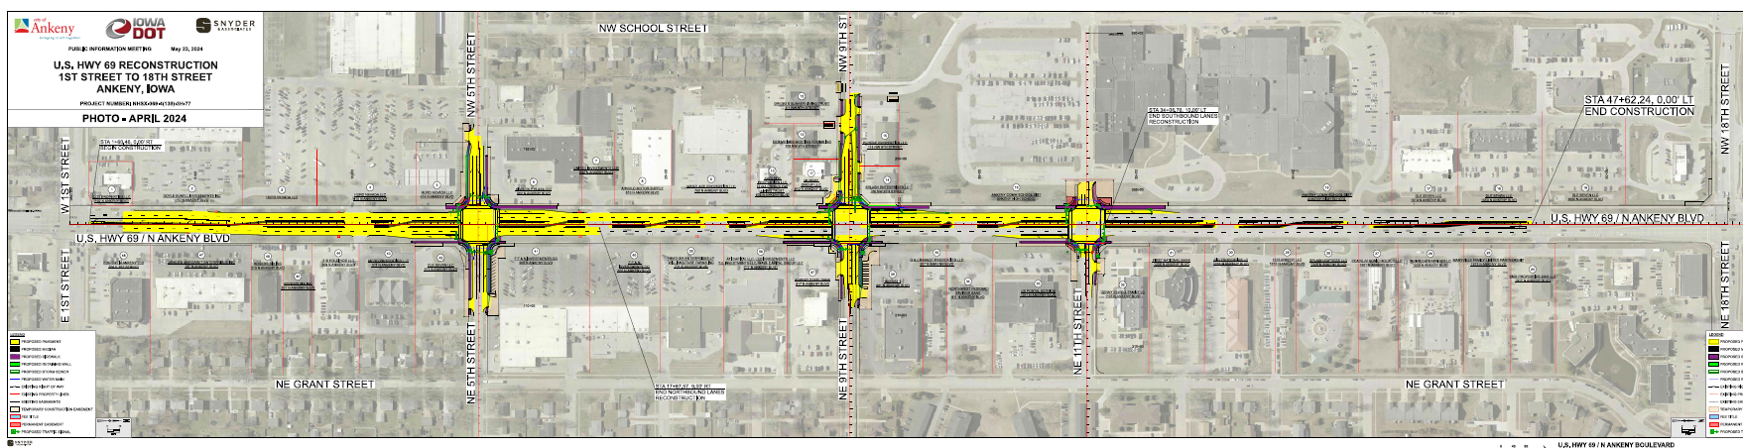
US 69 in Polk County
1st Street to 18th Street in Ankeny
2025 Paving $1.8 Million
(Programmed)
Upcoming Projects
Notes:
Amount updated

Slide 21
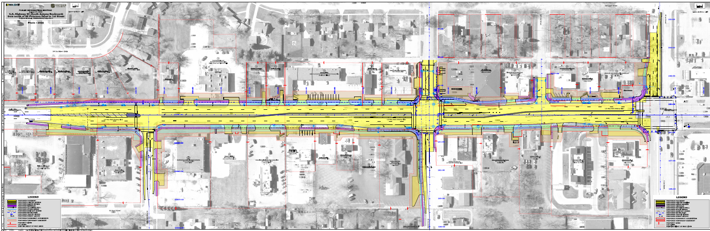
US 69 in Polk County
SE Peterson Dr to 1st Street in Ankeny
2026 Grade & Paving
(To Be Programmed)
Upcoming Projects
Notes:
Amount updated

Slide 22
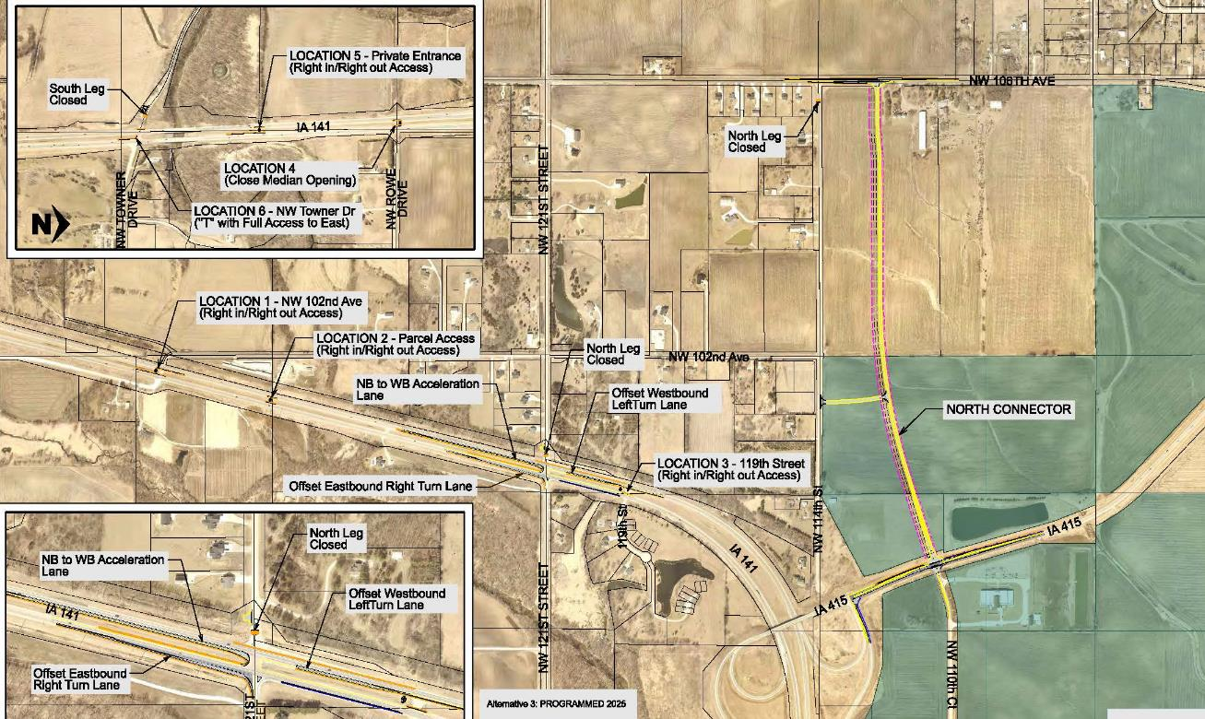
IA 141 at NW 121st Street Safety Improvements
$ 6.8 Million (Programmed)
2025
Upcoming Projects
Notes:
Our next project is a safety project on Ia 141 in the northwest part of the metro. In the image, Granger is to the northwest, Grimes is the south, and Saylorville Lake is the northeast.
The at grade intersection of Ia 141 and NW 121st has a history of serious injury crashes. This project will severe the connection of NW 121st on the north side of the intersection and close the median. The south connection to NW 121st will remain, but will be converted to a right in, right out access point.
Local roads will be reconnected to Ia 415 by extending NW 110th Street to NW 106th Avenue.

Slide 23
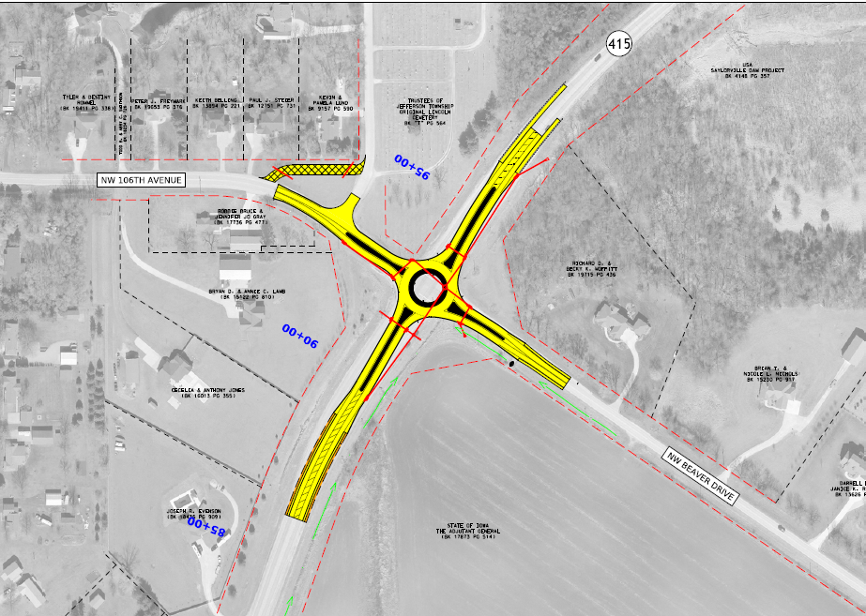
Iowa 415 in Polk County
Roundabout Project at Beaver Drive/NW 106th Avenue
2025 Grade/Paving $2.4 Million
(Programmed)
Upcoming Projects
Notes:
Amount updated

Slide 24
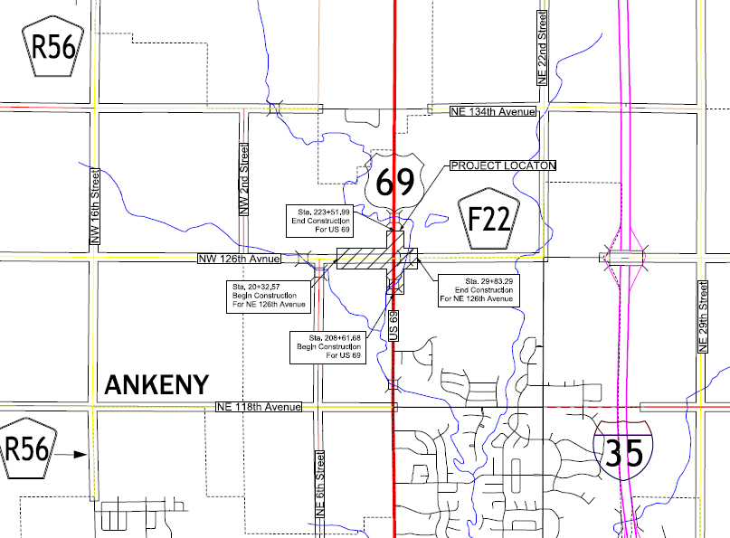
US 69 in Polk County
Roundabout Project at NE 126th Street
2027 Grade/Paving (Potential)
Upcoming Projects
Notes:
Amount updated

Slide 25
DONNA BREITBACH
North Area Engineer
North Area Projects
North Area
Notes:
District 1 is 12 counties in central Iowa, and includes Polk and Story Counties, and the Des Moines Metro Area.
We are responsible for the planning, design, construction, and maintenance of all the state-owned interstates, highways and bridges.
District 1 has
- 3 construction residencies,
- 16 maintenance garages,
- an operations office,
- and the District Office in Ames, just south of the main complex on South 4th Street.
We staff 310 full-time people year-round, and right now we are bringing on additional help for winter snow fighting operations.

Slide 26
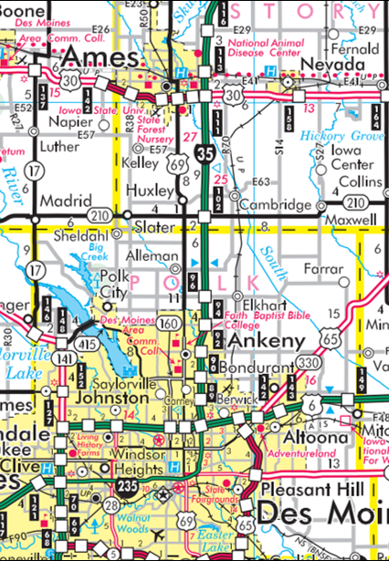
Upcoming Projects
I-35 Ankeny to Ames Capacity Improvements
E-57 to North of US 30
2027 ROW
$6.9 Million (Programmed)
2028 Grade/Pave/Signs
$ 11.6 Million (Programmed)
2029 Grade/Pave/Bridge
$31.9 Million (Programmed)
Huxley to E-57 (Unprogrammed)
Ankeny to Huxley
$ 119.2 Million (Awarded)
$ 54.7 Million (Programmed)
2023-2027
Notes:
The next project to highlight is in the I-35 Corridor between Ankeny and Ames.
The blue portion of the map is the ongoing reconstruction from Ankeny to Huxley that we previously talked about.
The green portion of the map is next to be constructed. This project will replace the I-35 bridges over US 30. It will reconstruct a small portion of US 30 within the interchange, along with I-35 and some ramp connections.

Slide 27
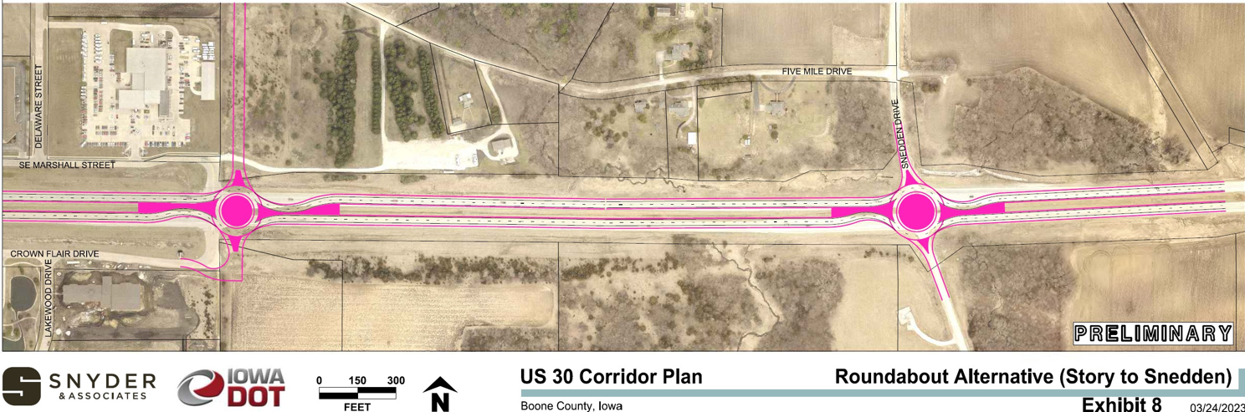
US 30 in Boone County
Roundabout Projects at Marshall St and Snedden Dr
2026 Paving $8.4 Million
(Unprogrammed)
Upcoming Projects
Notes:
Amount updated- concepts had $5.6M for Snedden and $2.8M for Marshall

Slide 28
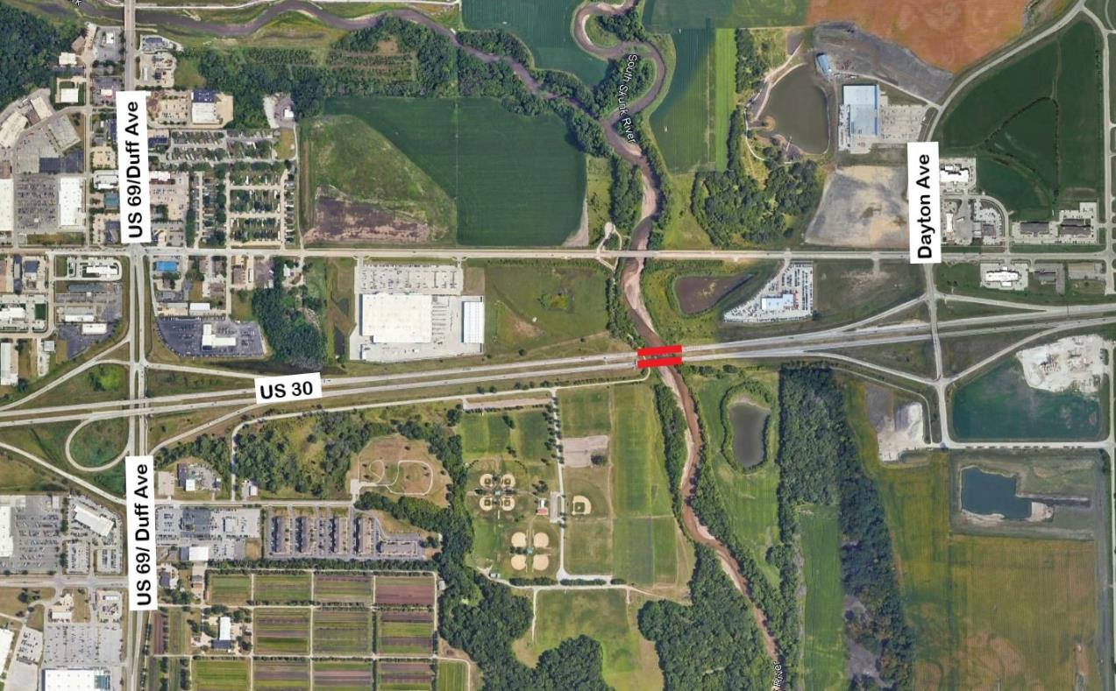
US 30 in Ames
Skunk River Bridge Replacements
Grade/Pave/Bridge/Signs/Lighting
2025 $ 4.7 Million (Programmed)
2026 $ 16.2 Million (Programmed)
2027 $ 7.4 Million (Programmed)
Upcoming Projects
Notes:
Our next project of note is still along US 30 in Ames.
Both the eastbound and westbound bridges over the South Skunk River have reached the end their useful life and are proposed to be reconstructed. When completed, US 30 will be three lanes in each direction between US 69/S Duff Ave and Dayton Road.
This location has a history of flooding, so resilience features have been included in the project. These include a box culvert near each end of the new bridges, and berms and flap gates on pipe culverts.

Slide 29
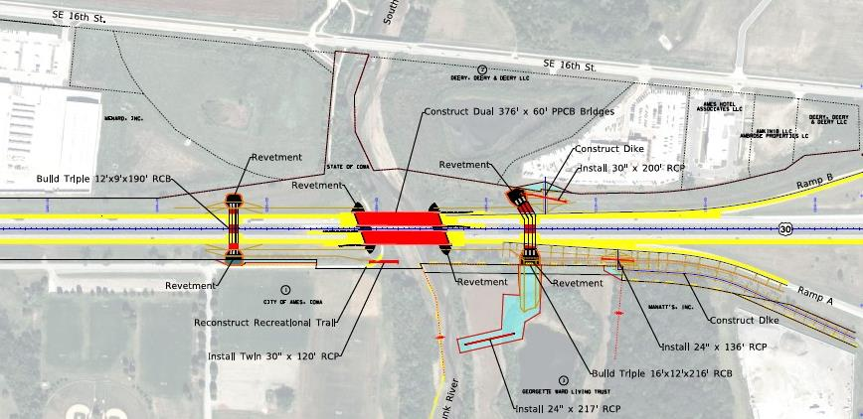
US 30 Skunk River Bridges
Grade/Pave/Bridge/Signs/Lighting
2025 $ 6.1 Million (Awarded)
2026 $ 16.2 Million (Programmed)
2027 $ 14.1 Million (Programmed)
Notes:
Amount updated

Slide 30
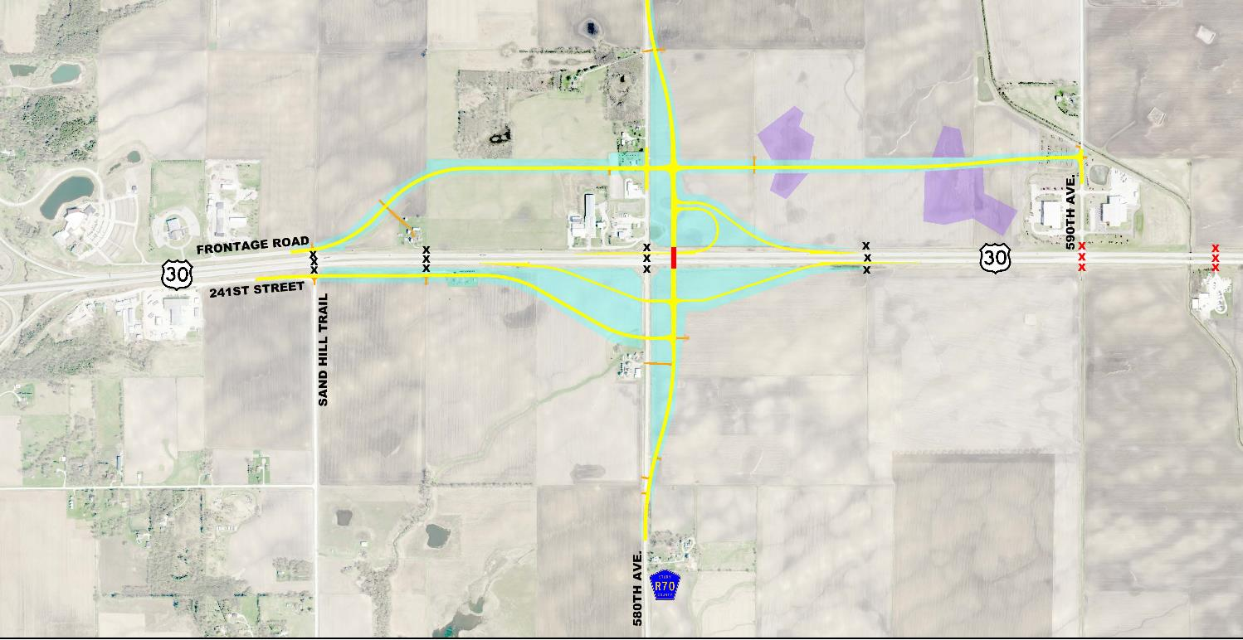
US 30 Interchange at 580th
Grading/Paving/Bridge
$ 22.8 Million (Awarded)
$ 358,000 (Programmed)
2023-2025
Ongoing Projects
Notes:
Amount updated- Added $13.2M from 11/21/23 letting.
This project is on US 30 between Ames and Nevada. In this image, I-35 is on the left and Nevada is to the right.
This is the second of three projects in the corridor, and the proposed improvements will replace at grade intersections on US 30 with safer interchanges.
This project is a proposed interchange at 580th Street with frontage roads connecting the local roads back to the interchange for access to US 30.
This interchange is open to traffic. The contractor is working on final grading, erosion control, and fencing.

Slide 31
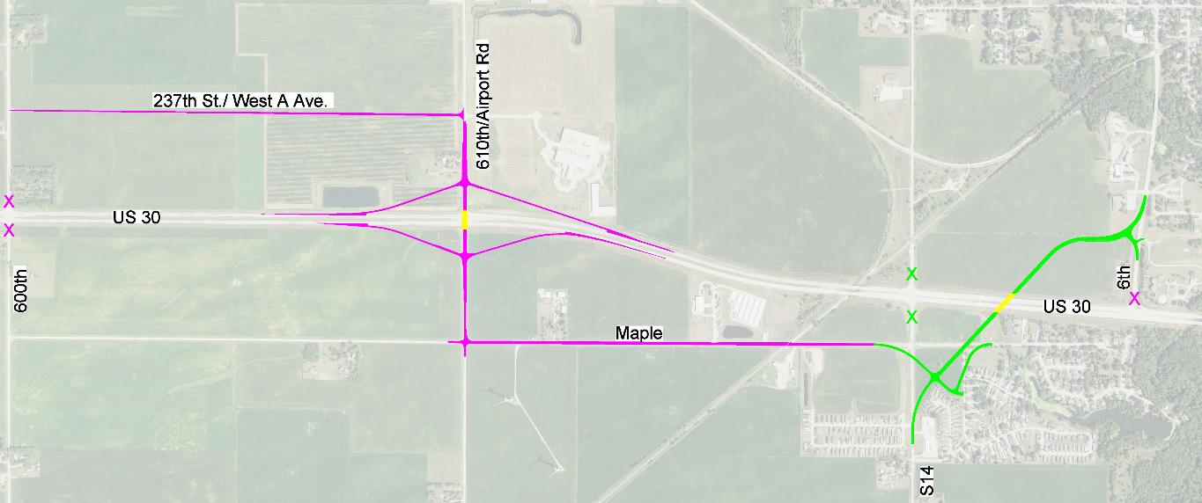
US 30/ 610th Ave in Nevada
New Interchange
2026 ROW/Signs $19.1 Million
2027 Grade/Pave/Bridge $14.1 Million
2028 Pave/Signs/Lighting $15.5 Million
(Programmed)
Upcoming Projects
Notes:
Staying in the US 30 Corridor between Ames and Nevada, the next project is to construct an interchange at 610th Avenue just west of Nevada. This project also includes frontage roads to connect the local roads to the safer interchange and will close the last of the at-grade intersections in the corridor.

Slide 32
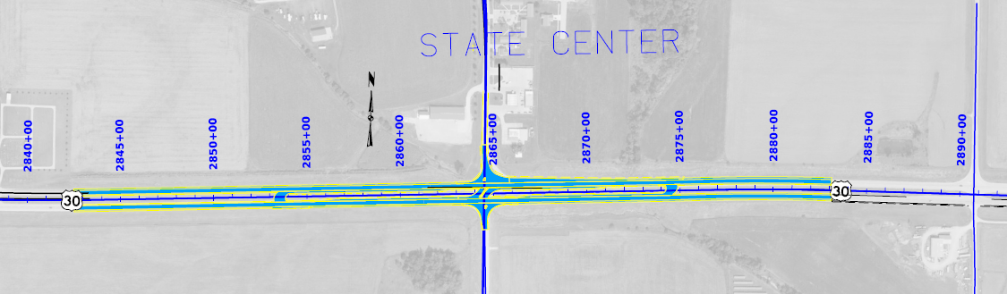
US 30 at State Center
Intersection Modifications at Durham Ave
2026 Grade/Paving
(To Be Programmed)
Safety
Notes:
Amount updated

Slide 33
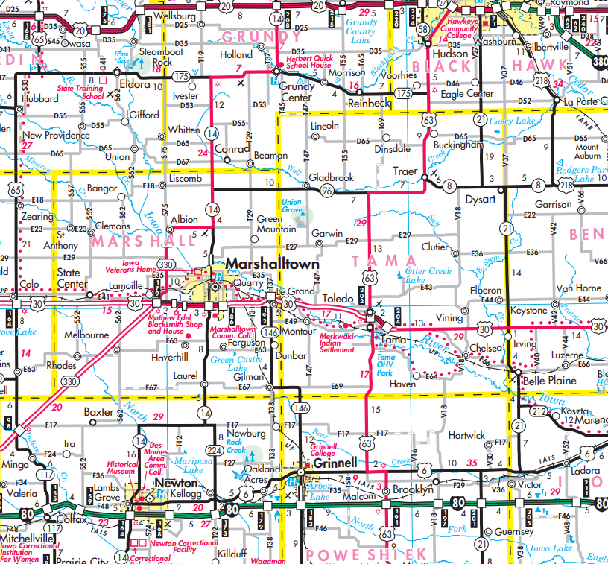





Ongoing and Upcoming Projects
US 63 – US 6 to Hudson
Super 2 Improvements
Traer to Hudson
2025 ROW
$600,000 (Programmed)
2027 Grade/Pave/Signs
$12.1 Million (Programmed)
IA 96 to Traer
(Future--Unprogrammed)
Toledo to IA 96
2025 ROW
$1.1 Million (Programmed)
2026 Grade/Pave/Signs
$15.3 Million (Programmed)
US 6 to Tama
2024 ROW/Grade/Pave
$26.6 Million (Awarded)
Notes:
Our last project is a series of Super 2 projects along US 63.
US 63 between US 6 near Grinnell and US 20 in Cedar Falls/Waterloo is considered a commuter corridor. Commuter corridors typically have more traffic than other two-lane highways, but not enough to consider a multilane highway.
A Super 2 project will consider adding elements such as passing/climbing lanes, full width paved shoulders, and channelized turn lanes at major intersections. These features offer reliable travel times to commuters with minimal right of way impacts at an affordable cost.
We have segmented the corridor into four sections. The blue section south of Tama-Toledo was constructed last summer. The portions north of Tama-Toldeo are in various stages of design.

Slide 34
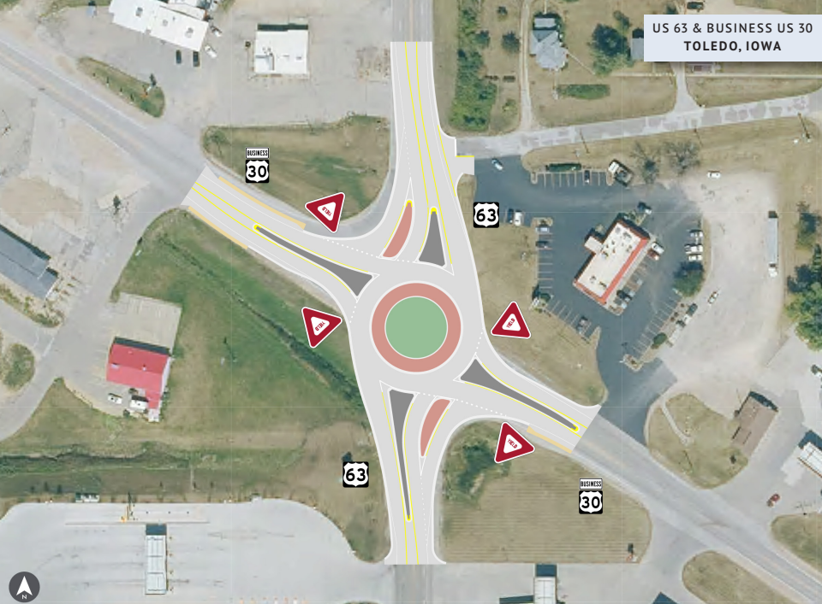
US 63 in Toledo
Roundabout Project at Business 30
2025 Grade/Paving $2.2 Million
(Programmed)
Safety
Notes:
Amount updated

Slide 35
US 69 in Huxley
Roundabout Project at Ia 210
2028 Grade/Paving (Tenative)
Safety
Notes:
Amount updated

Slide 36
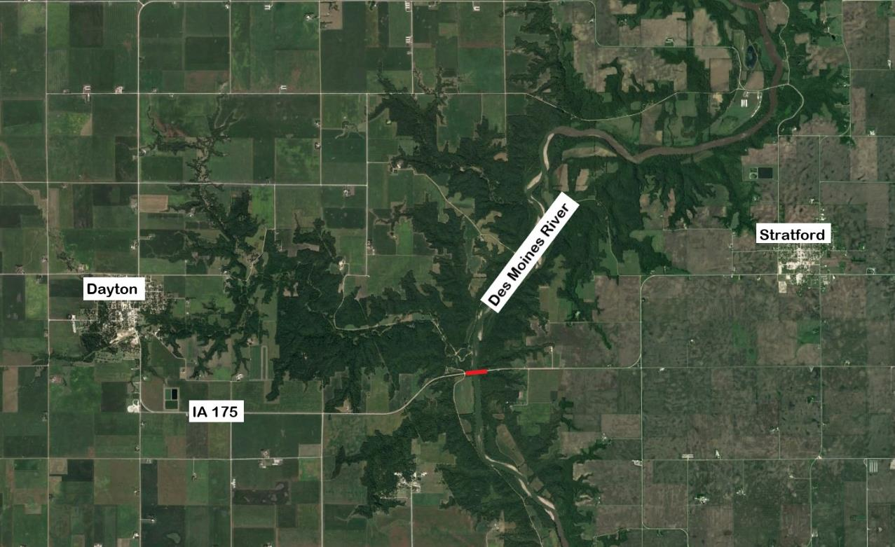
Webster IA 175
Des Moines River
Bridge Replacement
2027 $ 13.1 Million (Programmed)
Upcoming Projects
Notes:
Our next projects are located outside the Des Moines/Ames area.
This is a bridge replacement project on Ia 175 over the Des Moines River between Dayton and Stratford.
This is significant due to the site conditions and bridge size. The new bridge will be close to 800 feet long to span the river valley nearly 4 stories below

Slide 37
DONNA BREITBACH
North Area Engineer
515-239-1560
Donna.Breitbach@iowadot.us
iowadot.gov
BENJAMIN ADEY
South Area Engineer
515-239-1194
Benjamin.Adey@iowadot.us
iowadot.gov
Questions?
JEREMEY VORTHERMS
Assistant District Engineer
515-233-7851
Jeremey.Vortherms@iowadot.us
iowadot.gov

