Slide 1
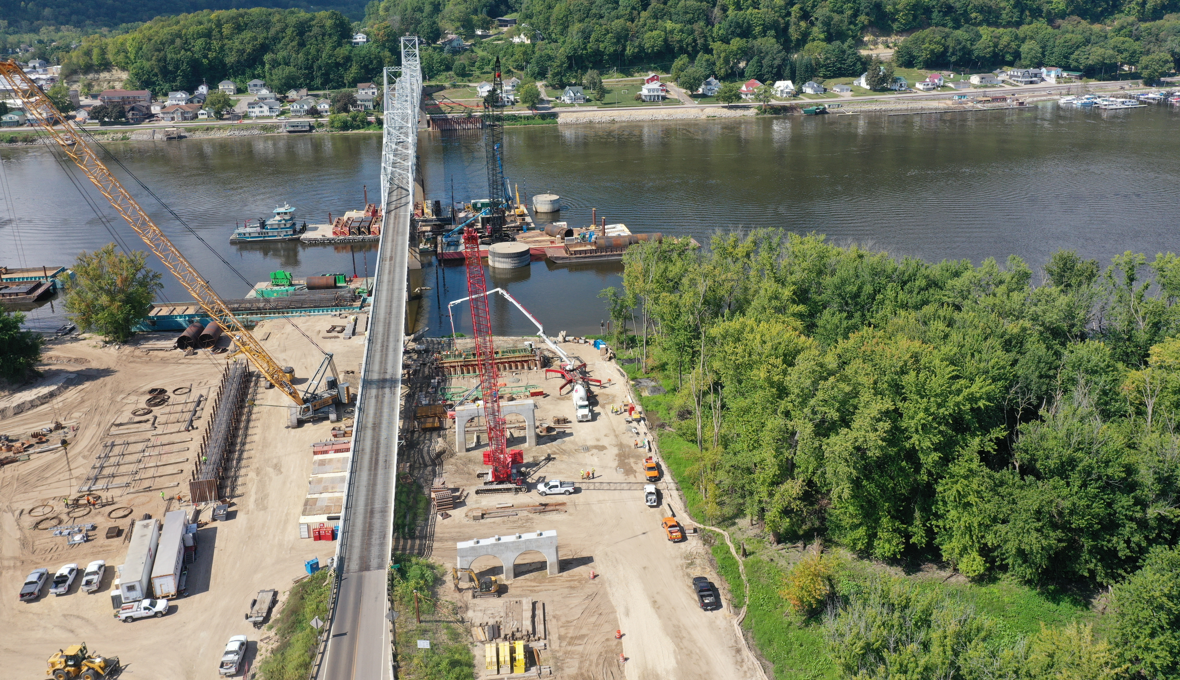


Upcoming Projects
District 2
Mary Kelly
District 2 Assistant District Engineer
3/2/2023

Slide 2
Iowa Department of Transportation
Mission Statement
Making Lives Better Through
Transportation

Slide 3




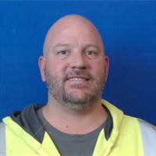
Nick Humpal
District Engineer
641-422-9446
Mary Kelly
Assistant District Engineer
641-422-9442
Daryl Erickson
District Utility Coordinator
641-422-9449
Nick Sorenson
Eastside Permitting
641-394-3161
Mark Nel
Westside Permitting
641-422-9476

Slide 4
NEW EMPLOYEE SPOTLIGHT
Mark Nel
Engineering Operations Tech.
641-422-9476 office
641-430-1846 mobile
Mark.nel@iowadot.us

Slide 5
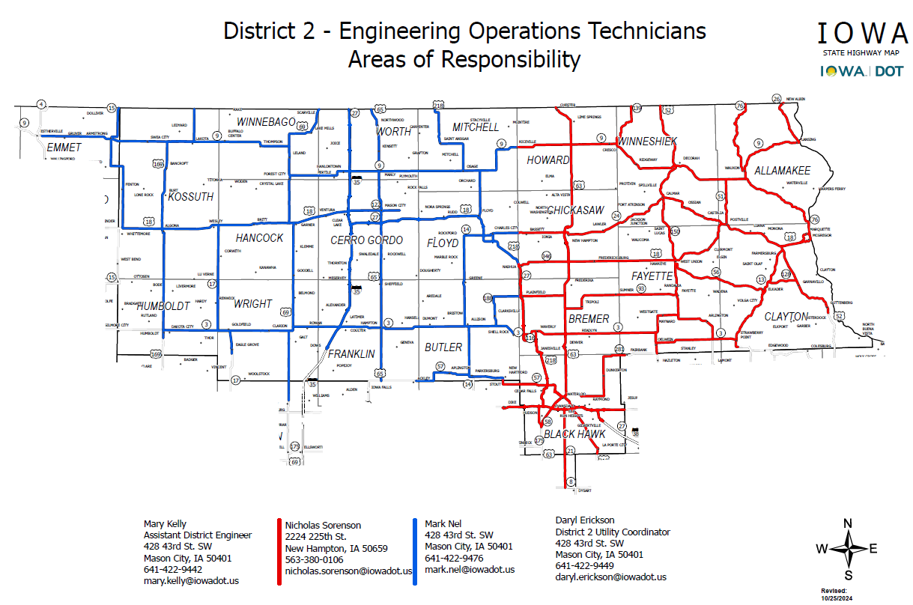

Slide 6





Mason City Construction
New Hampton Construction
Andrew Olson
Resident Construction Engineer
Ron Loecher
Resident Construction Engineer
Roy Gelhaus
District Construction Engineer
Jason Ruter
Construction Supervisor
Tyler Kubik
Construction Supervisor

Slide 7
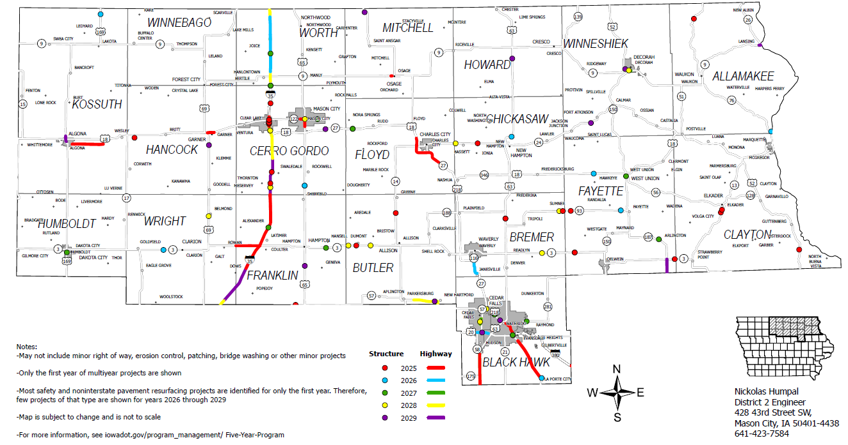
2025-2029 Iowa Highway Program

Slide 8
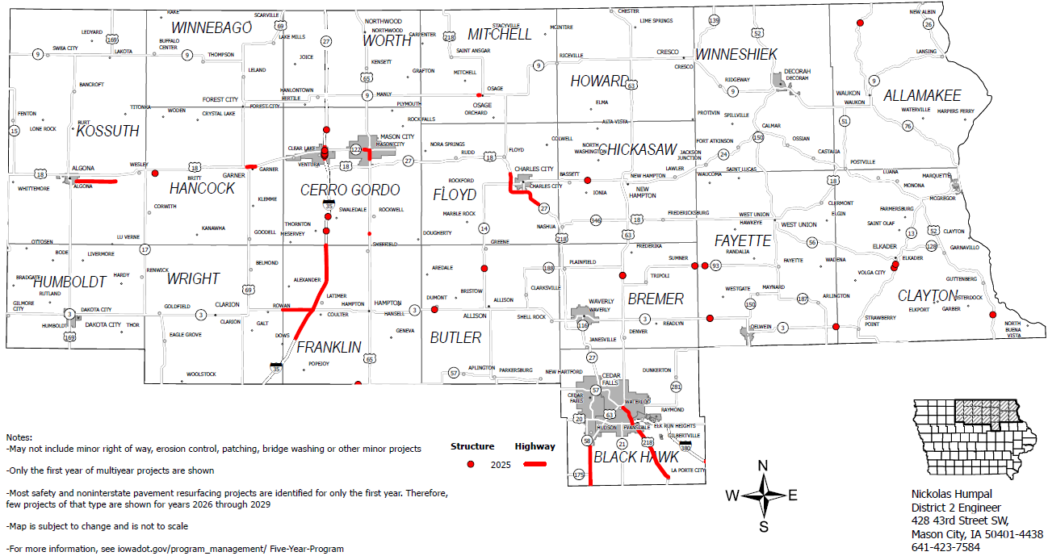
2025 Iowa Highway Program

Slide 9
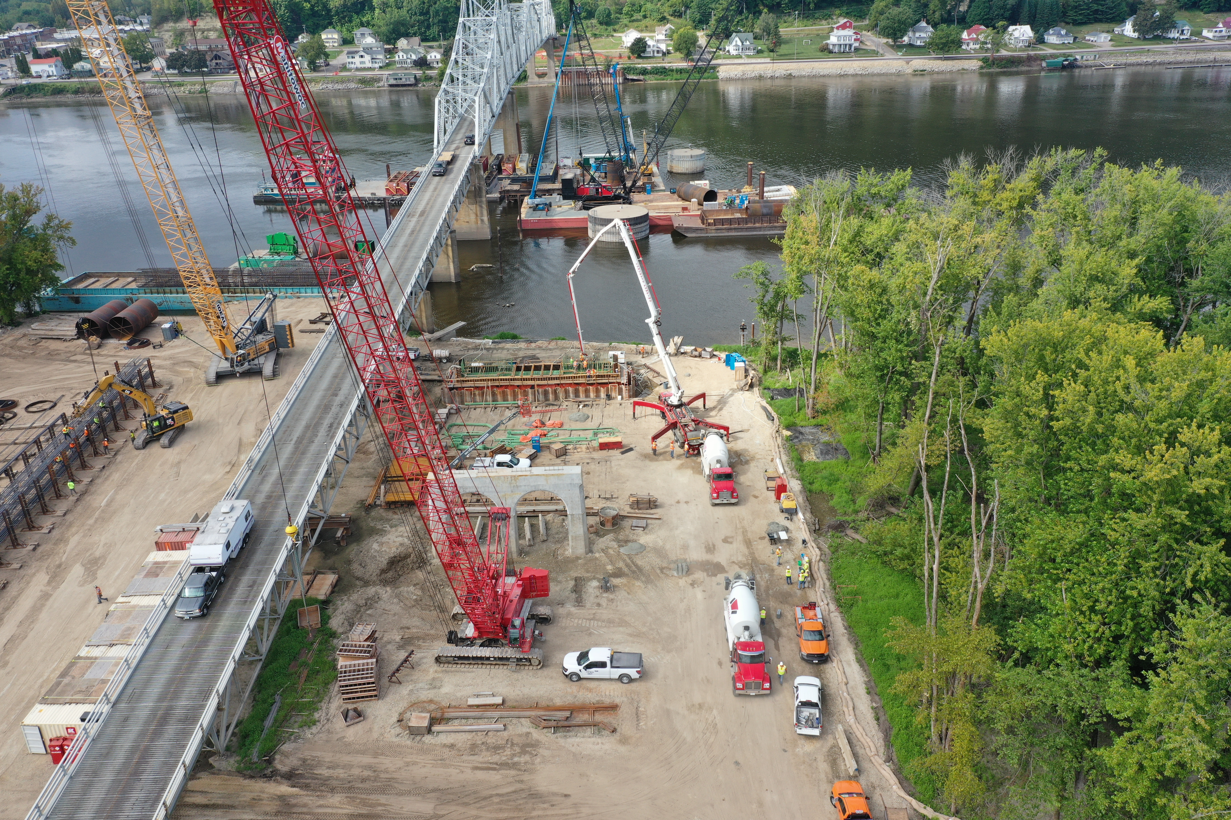
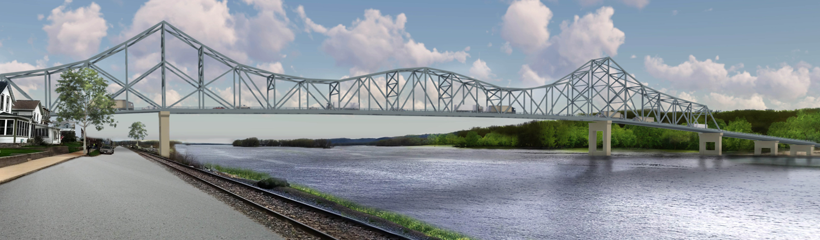
Mississippi River Bridge at Lansing
Bridge Replacement
Scheduled to open in Fall of 2026
https://iowadot.gov/lansingbridge/Home

Slide 10
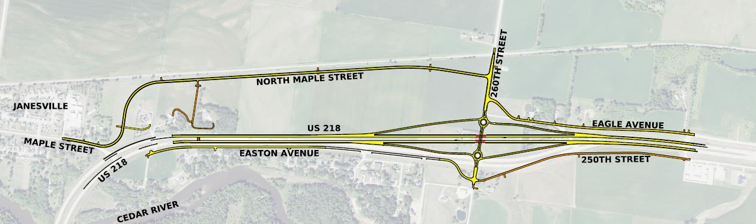
U.S. 218-Bremer County
Reconstruction
Current grading project under construction
Paving in July 2025 letting
Cedar River to IA 116 in Waverly

Slide 11
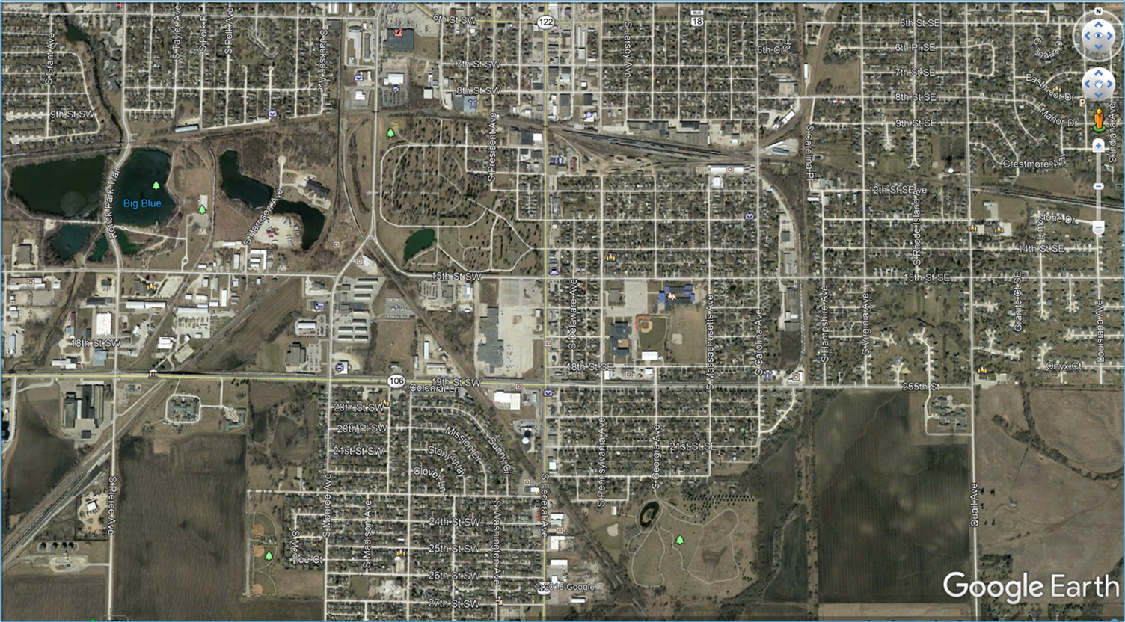


U.S. 65-Mason City
Reconstruction
0.1 miles S. of 27th St. SW to 6th St. S.
Currently Under Construction through 2026

Slide 12
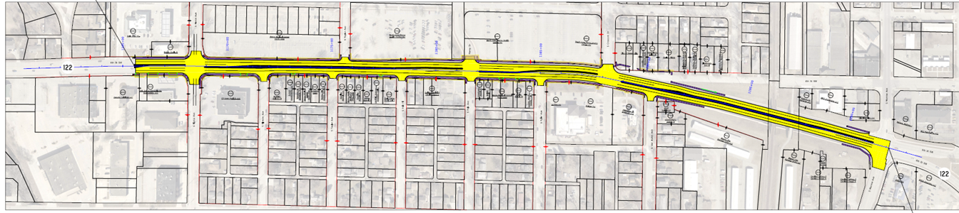


IA 122-Mason City
Pierce Avenue to Monroe Avenue
Reconstruction
Letting in February 2025

Slide 13
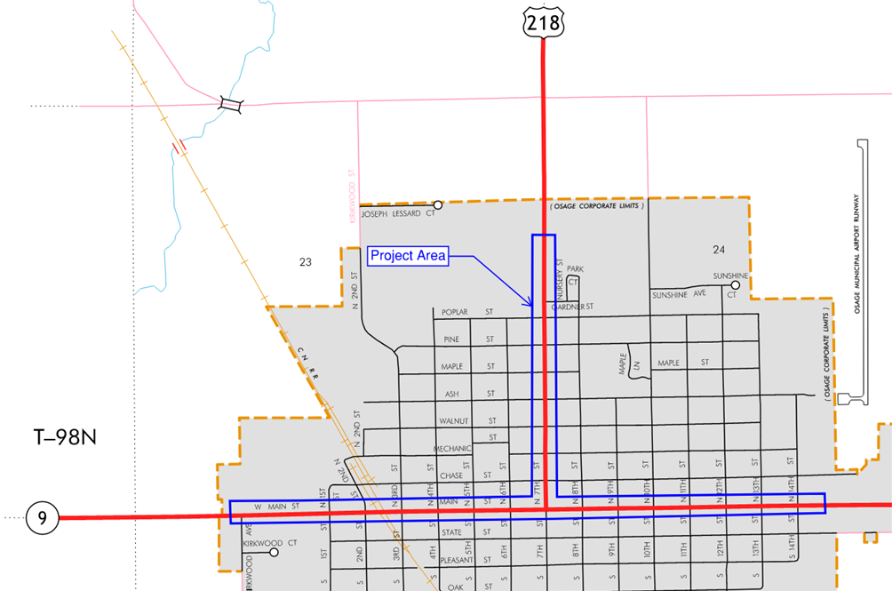
U.S. 218/IA 9-Osage
Reconstruction/Resurfacing/Sidewalk Replacement
Under contract
Construction scheduled for 2025

Slide 14
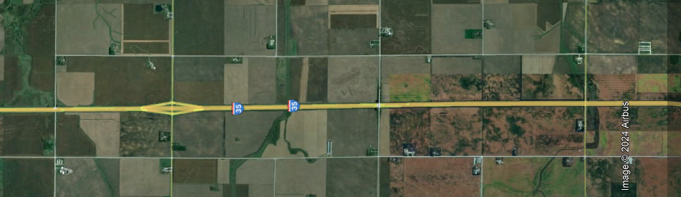

I-35-Franklin County
North
0.5 miles south of County Road C23 to Cerro Gordo County line
Reconstruction
SB Programmed for 2025
NB Programmed for 2026

Slide 15
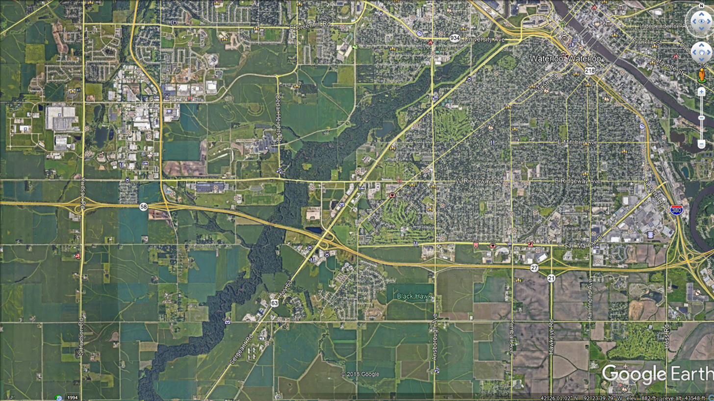
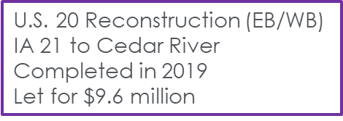






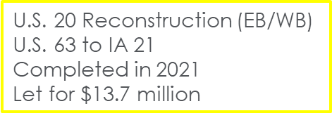
U.S. 20-Waterloo/Cedar Falls
U.S. 20 Reconstruction (EB/WB)
Hudson Rd. to U.S. 63
Programmed for 2026
$25.6 million

Slide 16
IA 57/Union Rd-Cedar Falls
Roundabout
Programmed for 2026

Slide 17
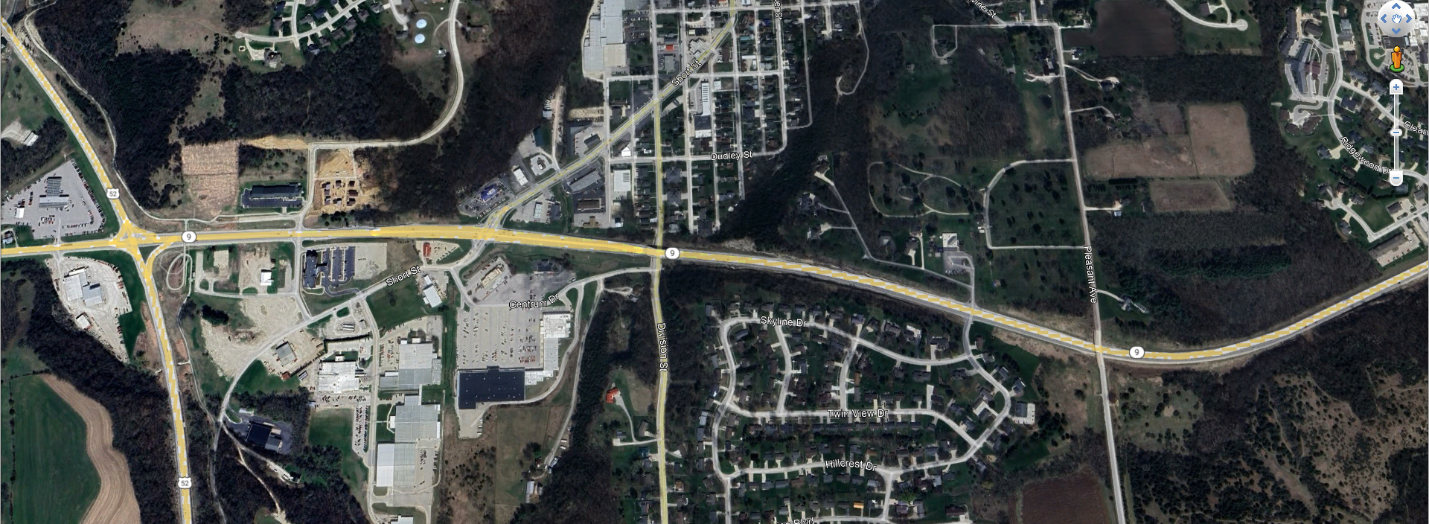
IA 9-Decorah
Reconstruction
U.S. 52 to east of Pleasant Ave.
Programmed for 2026

Slide 18
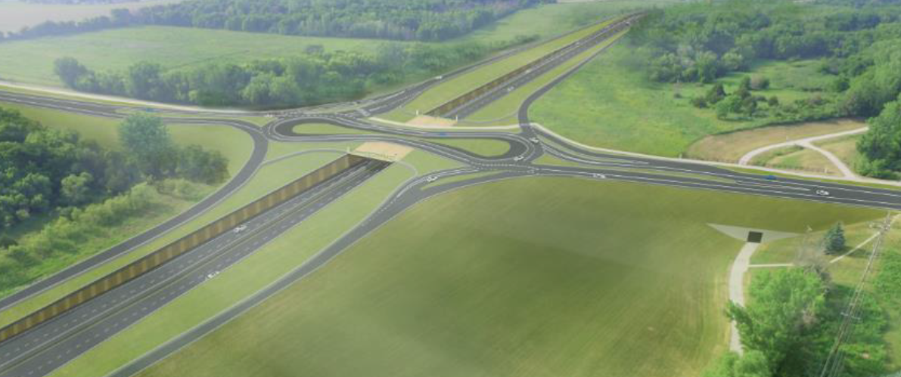
IA 58/Greenhill Rd-Cedar Falls
IA 58/Greenhill Rd Interchange
2028 Letting

Slide 19
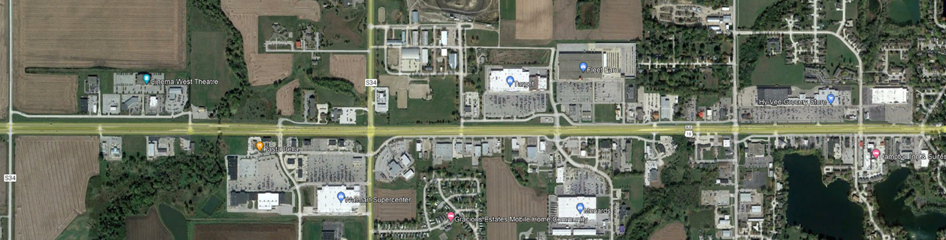

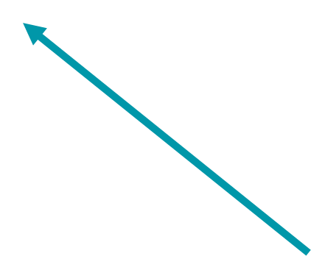





IA 122-Mason City West
Lark Avenue to Cerro Gordo/Winnebago Way
Reconstruction
Possibly Adding Roundabouts at 5 Intersections
Not Currently Programmed

Slide 20
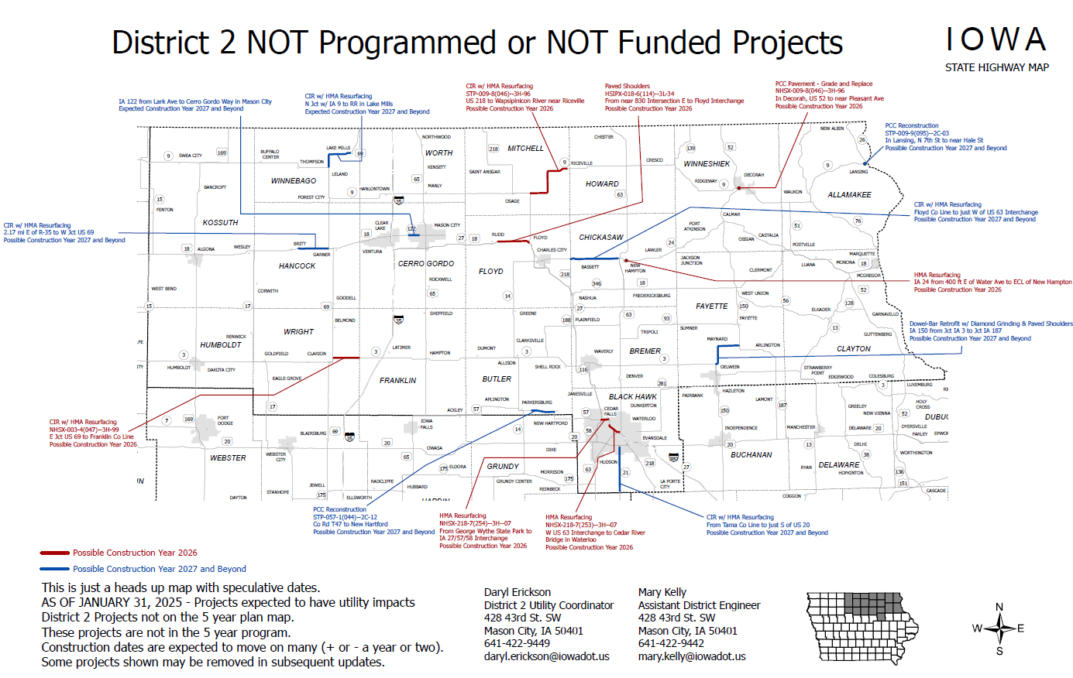

Slide 21
Questions?
Mary Kelly, P.E.
641-422-9442
Mary.kelly@iowadot.us
iowadot.gov

