Slide 1



Annual Utility Meeting
District 4 – 2025 Project Update
3/2/2023
Wes Mayberry, P.E.
Assistant District Engineer
February 6, 2025

Slide 2
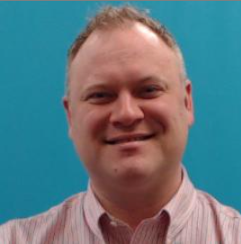
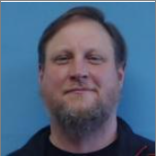
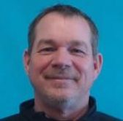
District 4 Staff
Scott Schram
Wes Mayberry
Scott Suhr
Orest Lechnowsky, PE
West Staff Engineer
District Engineer
Assistant Engineer
District Planner

Slide 3
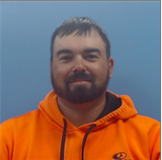

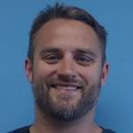
District 4 Utility Staff
assistant district engineer
Nate Epperson
Blake Asberry
Nick Mocha
Mike Frank
district engineer
EOT
westside permitting
EOT
westside permitting
district utility coordinator

Slide 4
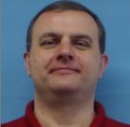
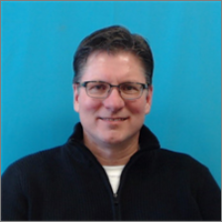

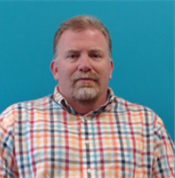
District Construction Staff
Dave Dorsett
Vacant
Dan Redmond
Vacant
Tim Hensley
District 4 RCE-Council Bluffs
District 3 RCE-Cherokee
District 4 Construction Engineer
District 4 RCE-Creston
District 4 Materials Engineer

Slide 5
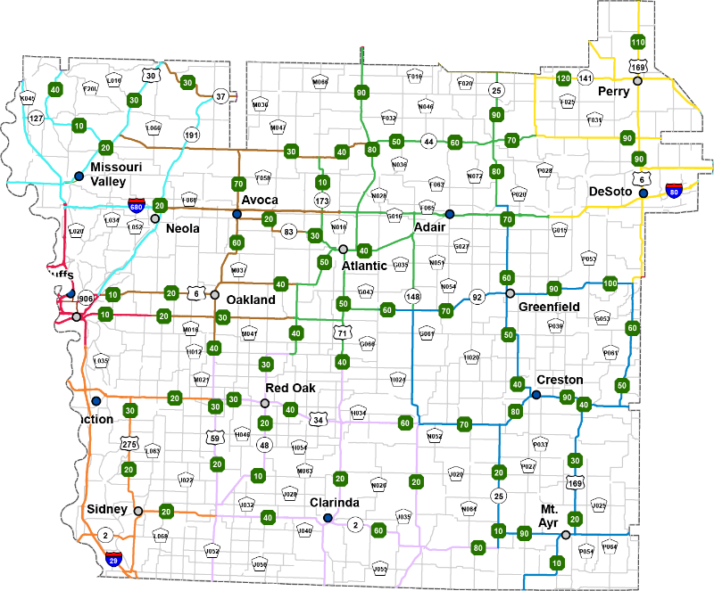
District 4
17 Counties
703 Bridges
3,792 Lane Miles
17 Maintenance Garages
2 Construction Residencies

Slide 6
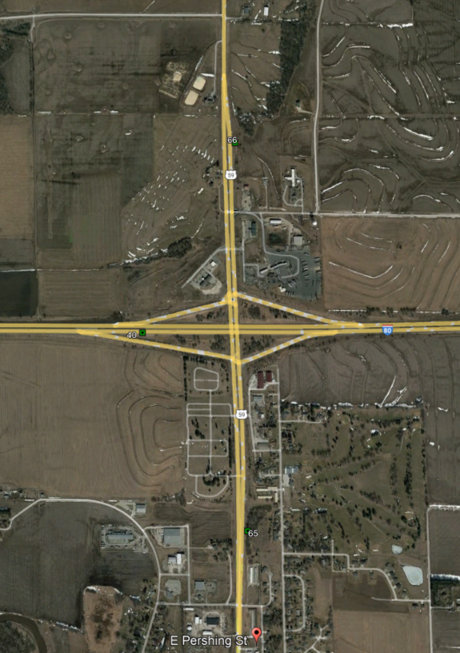
Hwy 59 – City of Avoca (Rural Section)
Programmed FY 28

Slide 7
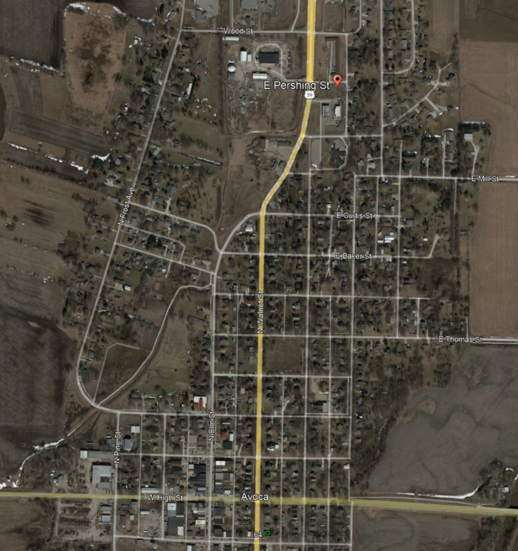
Hwy 59 – City of Avoca (Urban Section)
Programmed FY 29

Slide 8
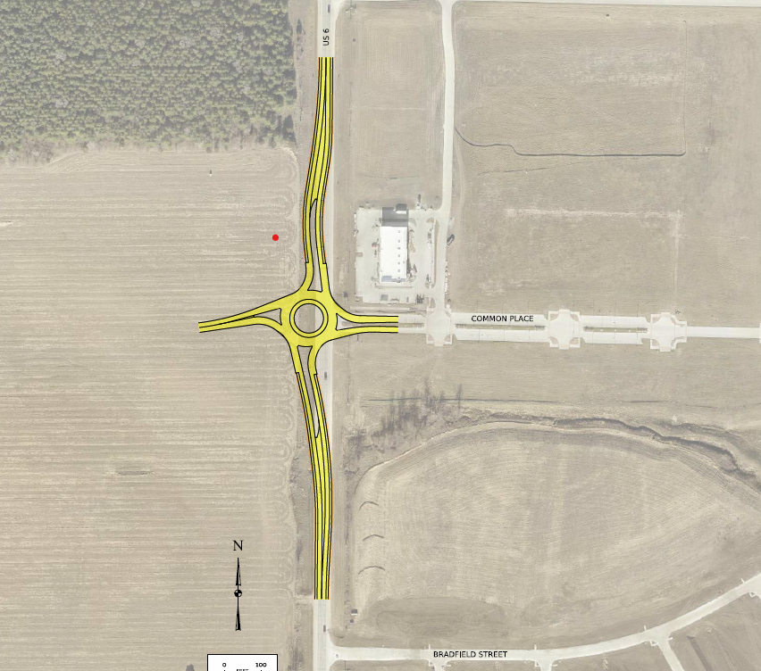
Hwy 6/169 – City of Adel
Programmed FY 26

Slide 9
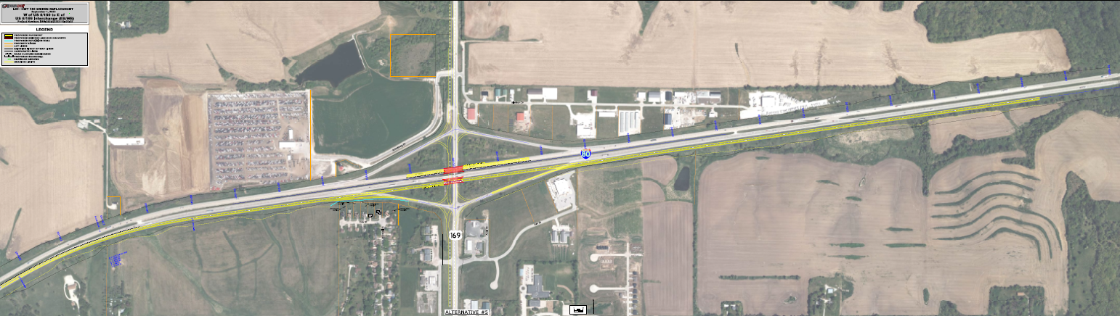
Interstate 80 – De Soto Interchange
FY 28 EB Grading
FY 29 EB Paving
FY 30 WB Grade/Pave

Slide 10
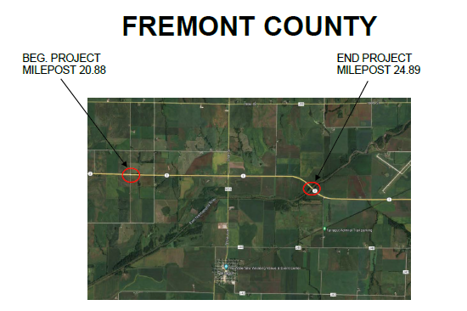
Hwy 2 – Fremont County
Programmed FY 26

Slide 11
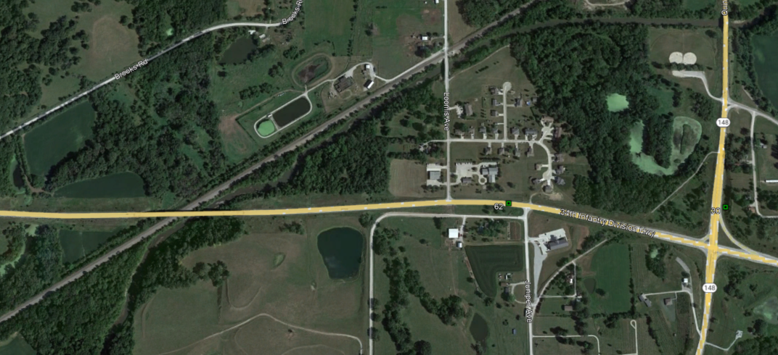
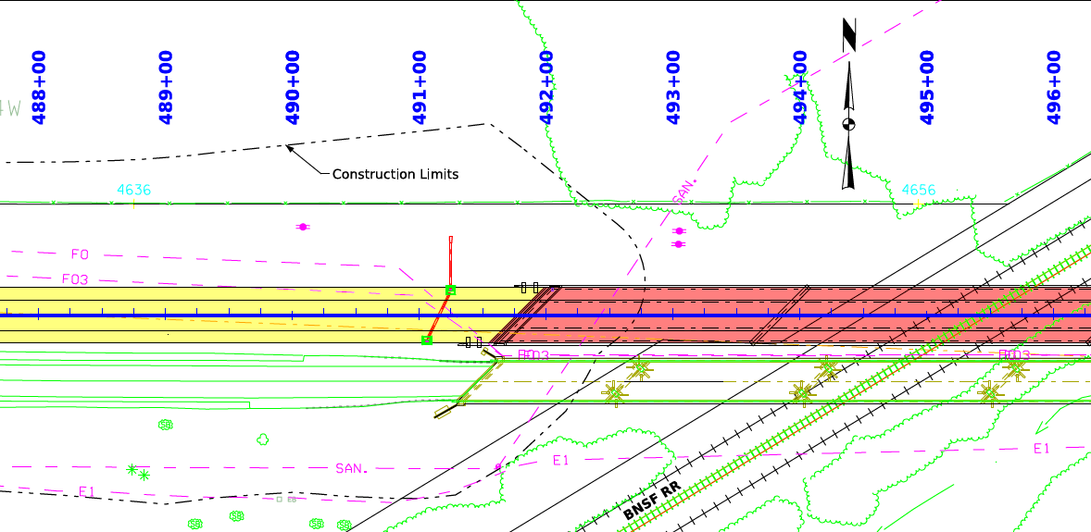
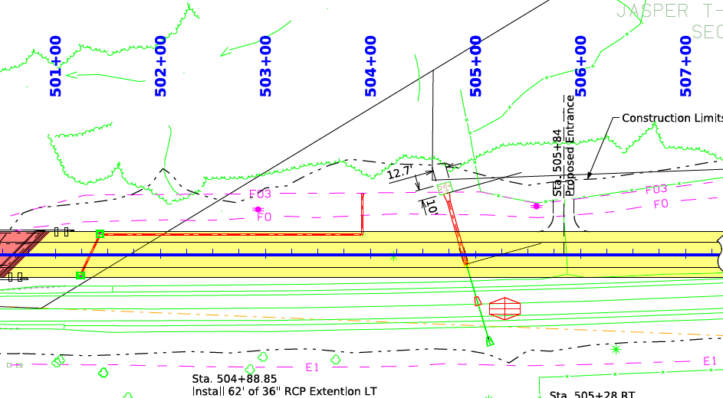
Hwy 34 – Adams County
Programmed FY 29

Slide 12
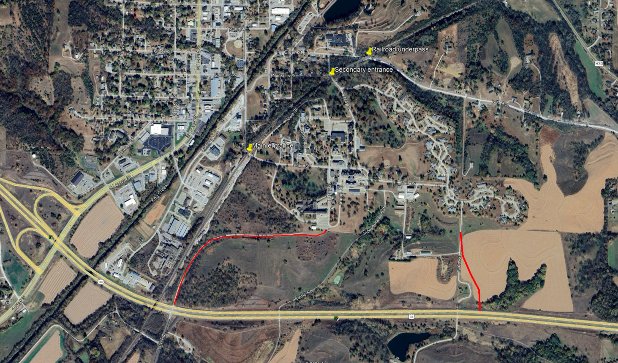
Hwy 34 – Glenwood Resource Center
Programmed FY 26

Slide 13
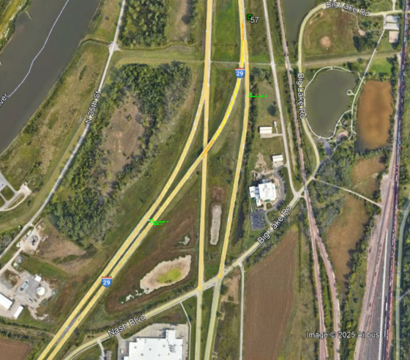
Interstate 29 – Council Bluffs
North 16th Street Interchange
Programmed FY 27

Slide 14
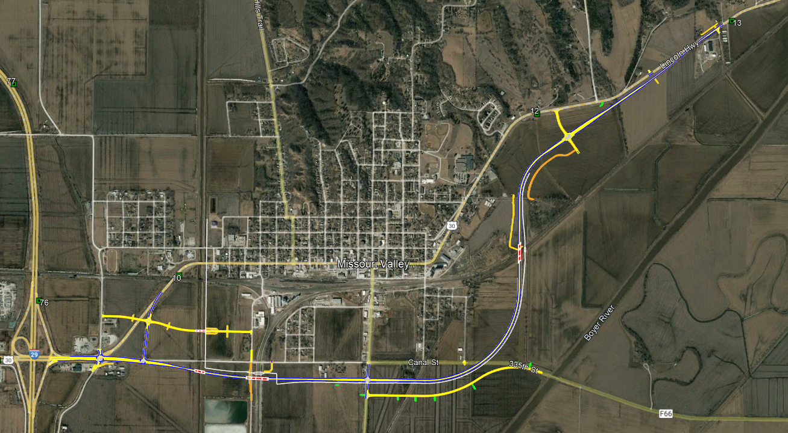
Highway 30
Missouri Valley by-pass
FY 25 Right of way programmed
FY 26 grading and culverts
FY 29 Paving

Slide 15
Questions?
Wes Mayberry, P.E.
712-250-0496 (cell)
Wes.mayberry@iowadot.us​
iowadot.gov

