Slide 1
DISTRICT 5
Upcoming Projects

Slide 2
Bob Younie
District Engineer
Steve McElmeel
Assistant District Engineer
Darrick Bielser
District Construction Engineer
Nora Lind
EOT (Permits) - Central
Bonnie Clancy
District Utility Coordinator
Liz Finarty
Res. Construction Eng.
Chariton
Kyle Hardin
Construction Tech Supvsr.
Chariton
John Doe
John Doe
manager
manager
Bryan Archer
EOT (Permits) - East
Beau Burgher
EOT (Permits) – West
Christy Vanbuskirk
Res. Construction Eng.
Fairfield
Anthony Blint
Construction Tech Supvsr.
Fairfield
John Doe
John Doe
John Doe
John Doe
manager
manager
manager
manager

Slide 4
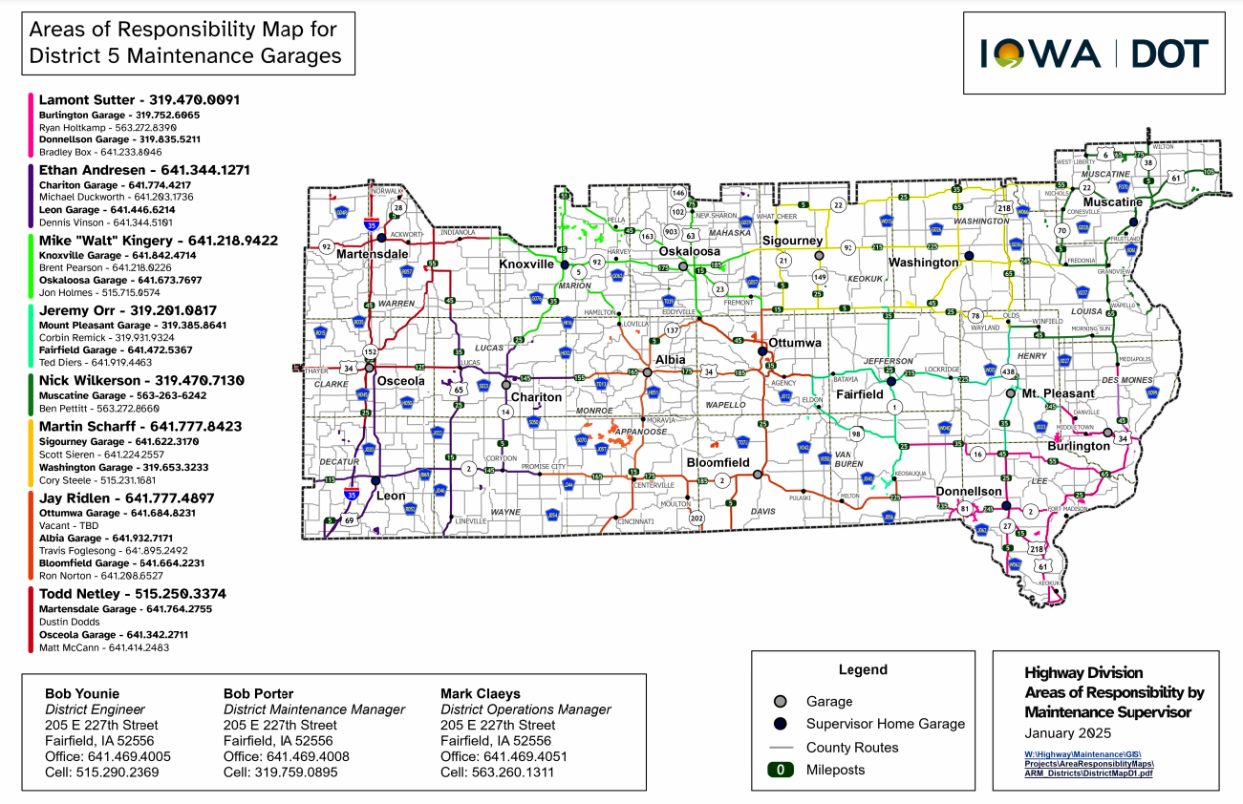

Slide 9
THANK YOU FOR YOUR TIME AND ATTENTION
Contact Information

