Slide 1



2026 Annual Utility Meeting
An information exchange and networking event
Deanne Popp
Utility Program Administrator
January 2026
3/2/2023

Slide 2


Agenda
Welcome & Introductions
Utility Coordination & Permitting
Upcoming Construction Projects
Roundtable | Q & A
Notes:
Thank you for joining us –
Agenda for the day
Housekeeping – restrooms – exits – participate
Enjoy yourself – have refreshment
Meet someone new – make connections - start partnering together
ICE BREAKER

Slide 3

Utility Program
Accommodation
Permitting
Relocations
Agreements
Management of ROW
Notes:
Utility Program - covers all aspects of utility-related activities
Many offices, bureaus, divisions
Staff play a major role in managing the assets in the public rights of way

Slide 4

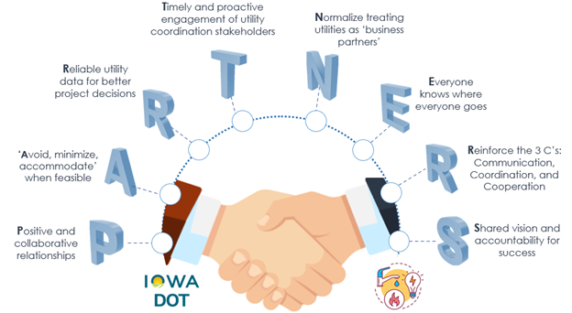
Notes:
Project Development and Utility Coordination as a Partnership
Draft recommendations incorporated into rules
Task force goals
pilot early collaboration
Investigation
Touches on
Data collection methods (all stakeholders)
Project scheduling method at DOT
Roles & responsibilities (all stakeholders)

Slide 5



Utility Program Team
Central Office
District Offices
Field Offices
Notes:
Utility Program – from accommodation & permitting to project development & relocations
Team – staff from various offices & locations across the state

Slide 6
Central Office Leadership
Transportation Development Division – Deanne Popp
Program director
Rules & policy administration
Stakeholder liaison
Approval of utility relocation payments
Right of Way Bureau Director – Brad Hofer
Directs all sections in the bureau
Approval of budget items including utility relocations
Approval of utility agreements
GIS champion for ROW parcels & utility locations
Notes:
Team leadership from the central office

Slide 7
Utilities Section
Utilities Section Supervisor – Eric Wright
Supervises Design & Utilities Sections
Process & procedure implementation for utility program
Project coordination & production champion for these sections
Statewide Utility Program Coordinators
Project coordination & agreement monitoring
Regional Utility Program Coordinators
Project notifications & utility milestone submittals
Utility reimbursement agreements
Payments & release of easement rights
Notes:
ROW Utilities Section team

Slide 8
District Staff
District Utility Coordinators
Utility coordination for projects
Utility work plan review & approval
Utility coordination & collaboration meetings with companies
Permit review/assistance
Engineering Operations Technicians
Permit review, approval & issuance
Access, utility accommodation, work on right of way
Resident Construction Engineer
Preconstruction meeting – invite utility companies
Coordination with contractor
Notes:
District and field staff team
The people are the boots on the ground for the utility program…
RCEs – key in coordinating work with DOT contractor for utility relocation work not yet complete

Slide 9
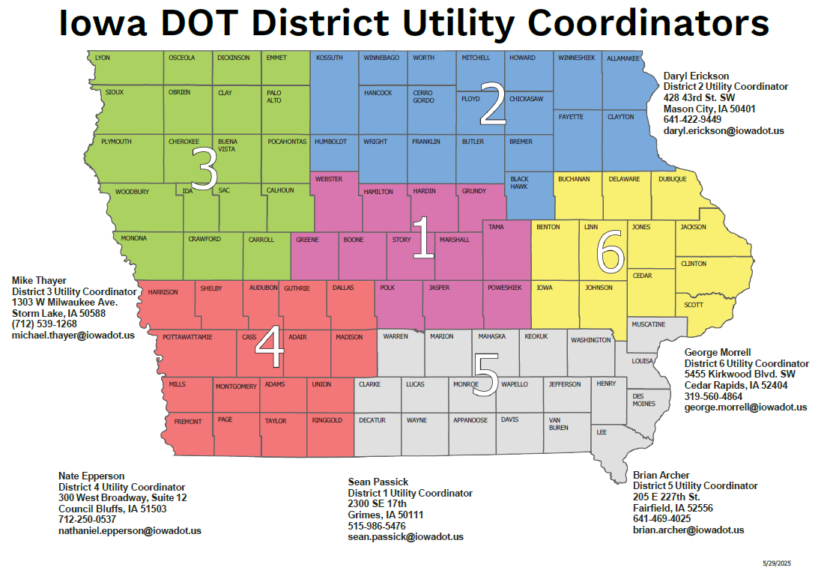
Notes:
DUCs – Sean Passick / Daryl Erickson / Mike Thayer / Nate Epperson / Bryan Archer / George Morrell

Slide 10
Other key players
Survey
Includes survey of utility locates in project design
Design
Key to facilitating successful utility conflict management
Performs engineering decisions related to highway design to avoid and minimize utility facility impacts in communication with Project Manager
Project Manager
Key to facilitating successful utility conflict management
Reviews project needs throughout development to determine utility investigation needs
Right-of-Way Staff
Designs and acquires necessary parcels to facilitate relocations
Process payments & release of easement documents
Notes:
Early and often is the key to successful utility coordination.
Improved utility investigation (UI) is where we’re headed.
UI should be an iterative component to project development
Begins in survey with an assessment of what the current situation is
As the project develops, critical areas are evaluated, and additional data is requested as needed
ROW Staff –
Design – Utility easements
A&R – Easements, service connections
P&A – Payments to utility companies
T&C – DIRs (release of easement rights)

Slide 11
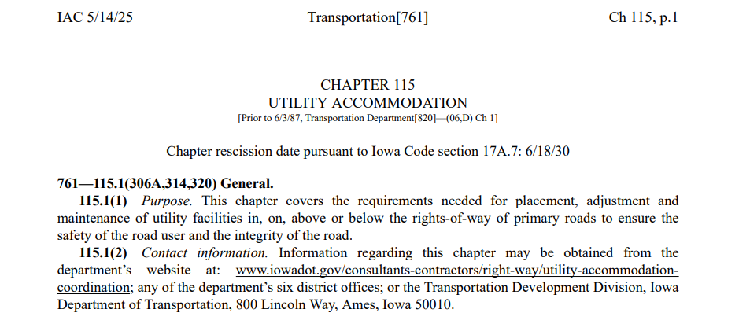
IAC 761--115
  Iowa Administrative Code
  Transportation [761]
  Chapter 115 – UTILITY ACCOMMODATION
Adopted June 18, 2025
https://www.legis.iowa.gov/docs/iac/chapter/761.115.pdf
Utility Coordination
Chapter 115
UTILITY ACCOMMODATION

Slide 12
Summary of new policy changes
Provide utility as-builts required in electronic format – DS 23045
Submit 10-day notice required for lane restrictions or closures – 511 Traffic Management Center
Rework or remove unacceptable installations
Notify district when utility work is completed (provide opportunity to inspect and notify if work is non-compliant)

Slide 13
Summary of new policy changes - coordination
Send project notification earlier of utilities (10% design/concept)
Improved investigation to identify utilities in the project limits
Utilities required to provide location information of their facilities within the project limits to help with conflict avoidance and mitigation
Send plan submittal earlier to utility companies (30% design / ROW impact buffer)
Utilities required to provide one work plan (instead of two) but earlier in the process
Better defined non-compliance as failure to: provide an acceptable work plan, adjust its facilities according to the accepted work plan, or otherwise follow the policy

Slide 14
IAC 761 Chapter 115 – Utility facility adjustments for primary road projects.
DOT primary road projects – not city or county projects
Sets requirements for all parties
Timing of notifications and required responses
Milestones for events tracked in Masterworks application
Non-responsive utility owners can be held liable for project delay claims
Notes:
Much of the work we do falls under IAC 761 Chapter 115
Project Coordination – 115.19 - All DOT projects – except
Accelerated schedules
No anticipated utility involvement

Slide 15
Project Development Milestones
Utility events tracked as UT
Who does what, when
Timeline for completion
Due dates
Expectations
Notes:
Milestones | project tracking | Masterworks
Project funding and scheduling of tasks & events | Various disciplines have their own events
Design events (D) Right of Way (R) Utility events (UT)

Slide 16
UT0 Event | investigation
0-10%
Notes:
Determine affected utilities
Periodically evaluate the information - determine the utility investigation needs – SUE???
Look at potential impacts and initiate coordination with utility owners – start utility conflict list

Slide 17
UT1 Event | notice of project
10%
Notes:
The goal for the event is to be early enough in the project development process to allow for modifications to the design.
Send notice of proposed project to each identified owner (306A.10)
Project concept
Route number
Geographical limits of the project
General description of the proposed work
Important milestones
Contact information for designer/department representative for coordination purposes
Utility has 30 days to respond to notice
Confirm if they do/do not have facilities in the vicinity of the project
Location and attributes
Co-location information

Slide 18
UT2 Event | preliminary plans
30%
Notes:
Again, our goal is to be early enough in the design development to allow for modifications
And for our ROW Design staff to include any utility easement needs in the ROW design.
Depict utility information collected on plans
Send preliminary plan (field exam plans) to utility owners
Request accuracy of depiction
Utility has 30 days to respond to notice
Statement regarding the accuracy of the location of their facilities; describe inaccuracies
Declaration of no conflicts; description of potential conflicts
Recommended changes to plan to avoid or minimize impacts to their facilities
Any other relevant information regarding potential impacts
right of way needs; permits required
Estimated timeframes for relocations; dependencies on other work
Utility Coordination Meeting

Slide 19
UT3 Event | semifinal plans
60%
Notes:
Send semifinal plan (right of way plans) to utility owners
Request work plan for adjustments or relocations
Utility has 90 days to provide work plan
Existing and proposed locations
Dependency on other work (Utility Coordination Meetings)
Right of way needs
Number of working days required
Approvals and permits needed
Expected lead time for materials, scheduling, easements
If reimbursable; easements & cost estimate
Notify utility owner of acceptance/rejection of work plan

Slide 20
UT4 Event | revised final plan
    Significant changes to department’s plan
    Send revised final plan to utility owners
    Request revised work plan if needed
    Utility Coordination Meetings
Internal process – not in rule
90%

Slide 21
UT5 Event | reimbursement agreement
30-60%
Notes:
Some relocations may be reimbursable (private easement vs. public ROW)
Agreement includes responsibilities of each party
Scope, description, and location of work
Approved work plan
Itemized cost estimate, including credits
Pro-rata share of costs for each party

Slide 22
UT6 Event | notice of work
90%
Notes:
Utility company notifies department after all approvals are received
Send notice to utility owner to begin work
Utility notifies department contractor if coordinated work is necessary
Contractor notifies department when work is complete and ready for utility work
Utility notifies department when relocation/adjustment work is complete
Preconstruction Meeting / Utility Coordination Meetings

Slide 23
UT7 Event | utility bid attachment
    Narration on status of utility conflicts
    Completed relocations
    Relocation schedules for remaining work
    Work that remains to be coordinated with contractor or other utility companies
    Anticipated dates & working days needed
    Submitted with final plans to be incorporated into contract documents
    Gives bidding contractors an idea of status and level of coordination remains
Internal process – not in rule
90-100%

Slide 24

Process flowcharts
Define what, when, how
Notes:
Performance Bonds
Non-compliance
Conflict Resolution

Slide 25

PERFORMANCE BONDS
What is a performance bond?
From one party to another
Guarantee
Protects project owners
Completion as agreed
Financial assurance
Notes:
Chapter 115.3(4)

Slide 26

PERFORMANCE BONDS
When is a performance bonds required?
History of performance problems
Installation conditions
Unusual installation
Abnormal site
Freeway
Permitted work being done as part of a DOT project (relocation or adjustment)
Notes:
Unusual installation
Abnormal site conditions

Slide 27

PERFORMANCE BONDS
How are performance bonds processed?
Utility company obtains bond from surety company
Utility sends bond to EOT
EOT informs utility company of bond requirements
Per installation
Statewide
Notes:
$10K per installation
$100K annual statewide

Slide 28

PERFORMANCE BONDS
How are performance bonds processed?
Utility company notifies EOT when complete
DOT
Utility company performs work
Rework?
Inspects as necessary
Claim/Release

Slide 29

NON-COMPLIANCE
What is a non-compliance?
All permitting requirements
Project relocations
Failure to comply with rules;
761 IAC 115
Non-response
No work plan
Not following accepted work plan
Notes:
Chapter 115.3(11)
Chapter 115.24(4)

Slide 30

NON-COMPLIANCE
When do we use non-compliance process?
Non-responsive
Improper procedures
If project related
Non-compliance with rules;
761 IAC 115
Has NOT stopped construction
Notes:
Project related obstructions – STOP construction – Conflict Resolution Process

Slide 31

NON-COMPLIANCE
How is non-compliance handled?
Utility company responds (with resolution plan within # days)
Resolution
District sends Non-compliance notice to utility company (requests resolution plan within # days)
Acceptable?
Result in an obstruction in the ROW?

Slide 32

NON-COMPLIANCE
Does the non-compliance result in an obstruction in the ROW?
Yes: Revocation of permit/notice to remove obstruction
No: Notice to remove obstruction
Require a new permit?
Was this a legally permitted occupancy?
Utility requests new permit
Utility proceeds with resolution within # days

Slide 33

NON-COMPLIANCE
Is escalation needed?
Utility company doesn’t remove obstruction
STOP ORDER
Utility doesn’t respond with resolution within # days
DOT halts All permit processing by utility for entire state

Slide 34

CONFLICT RESOLUTION
What conflicts are we talking about?
Identified during construction
Interferes
Utility facility conflicts with construction
With progress of the DOT contractor
Stops construction

Slide 35

CONFLICT RESOLUTION
When conflict stops construction, what happens?
Relocation to be completed within 5 days
DOT review plan
RCE notifies utility company of obstruction
(1 day to provide plan to resolve)
Approve
1 day

Slide 36

CONFLICT RESOLUTION
How to resolve?
A new permit may be required
Utility company performs resolution work
DOT approves utility company’s resolution plan
Notifies DOT when complete

Slide 37

CONFLICT RESOLUTION
How to resolve?
Legally permitted?
DOT contractor willing to remove?
Utility company doesn’t resolve
Performs work and bills DOT

Slide 38
CONFLICT RESOLUTION
How to resolve?
Issue STOP order until utility resolves
STOP ORDER
DOT contractor NOT willing to remove
DOT halts All permit processing by utility for entire state

Slide 39

Permitting
Utility Permits
Work on Right-of-Way

Slide 40
WHEN ARE UTILITY PERMITS REQUIRED?
Any time a utility company plans to locate facilities within the highway right of way
New installations
Upgrades
overhead changed to underground
Notes:
A permit is required any time you plan to locate facilities in the public rights of way
This includes new installations
And upgrades to an existing facility
Such as changing overhead to underground

Slide 41
WORK ON RIGHT OF WAY PERMIT
Any time someone wants to work within the highway right of way
Traffic impacts; lane closures
Maintenance
No upgrade to facility
Type or size

Slide 42
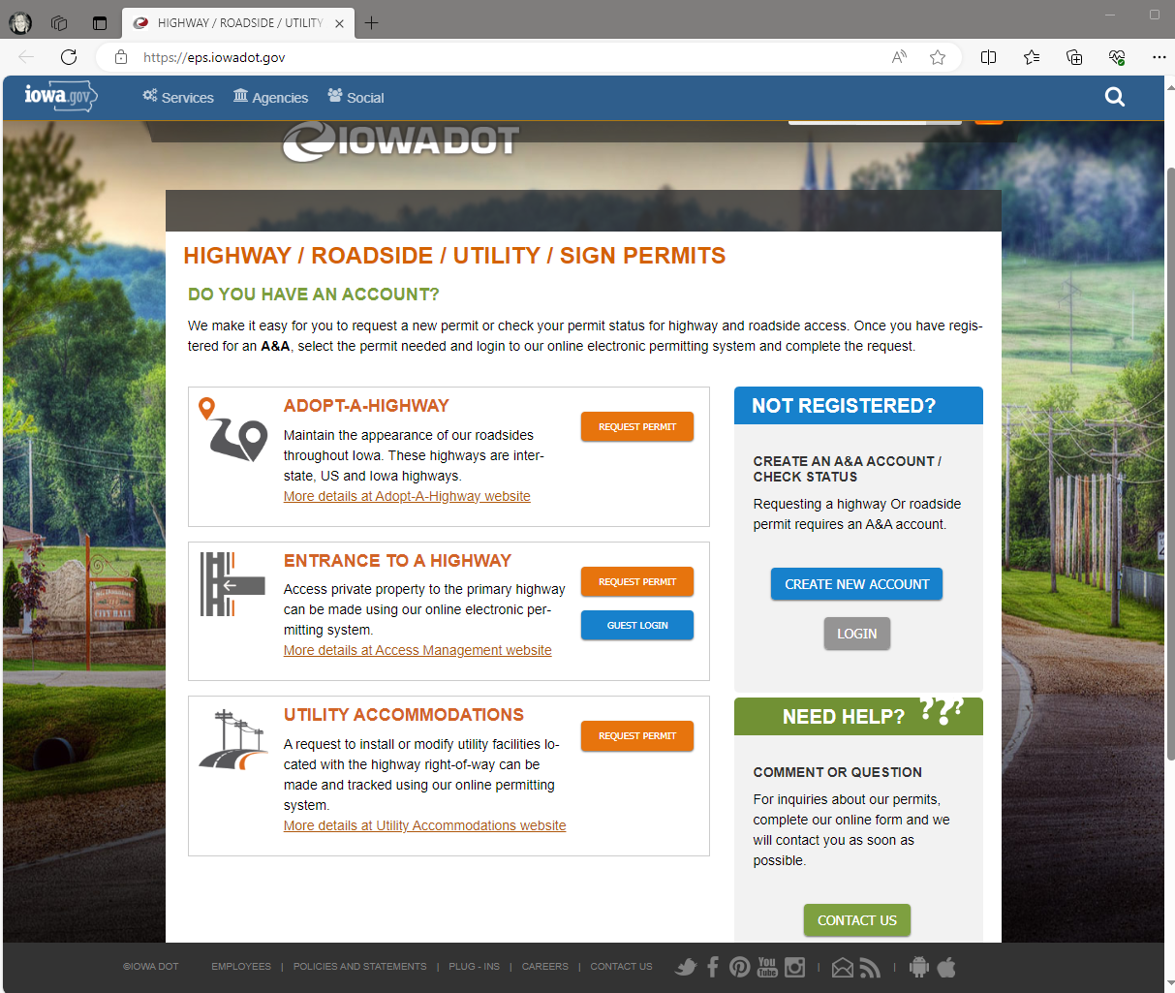
Electronic Permitting
System [EPS]
Cloud based app/create account – email address
Submit – edit – review requests
DOT reviews – approves – issues permit
https://eps.iowadot.gov/Home

Slide 43
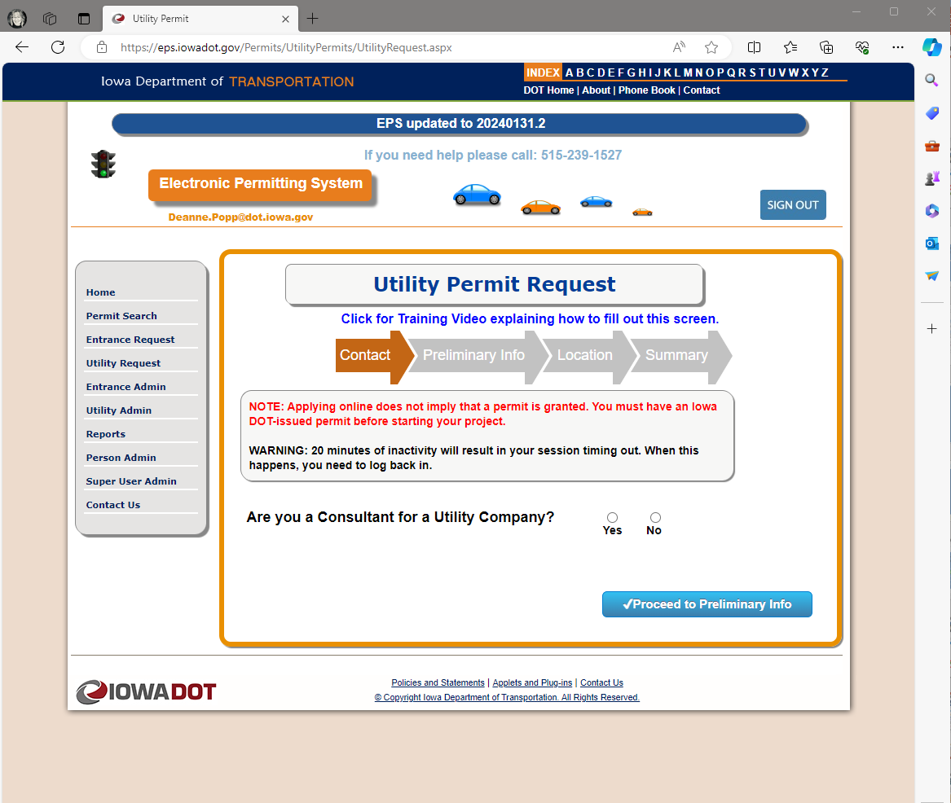
Electronic Permitting
System
Training module
Begin request
3 steps
  Preliminary request
  Official request
  DOT processing
Notes:
3 steps to the permit request
1 & 2 by the applicant
3 by DOT representative - EOT

Slide 44
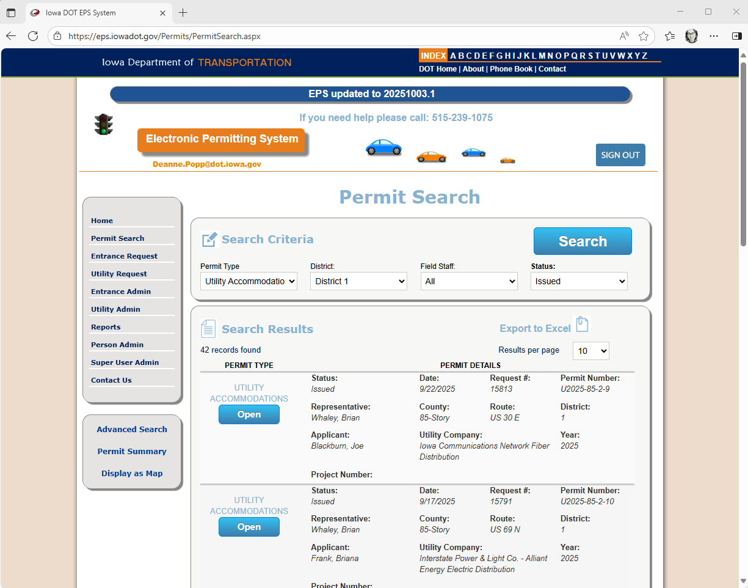
Electronic Permitting
System
Permit search
Set parameters
Display as map

Slide 45
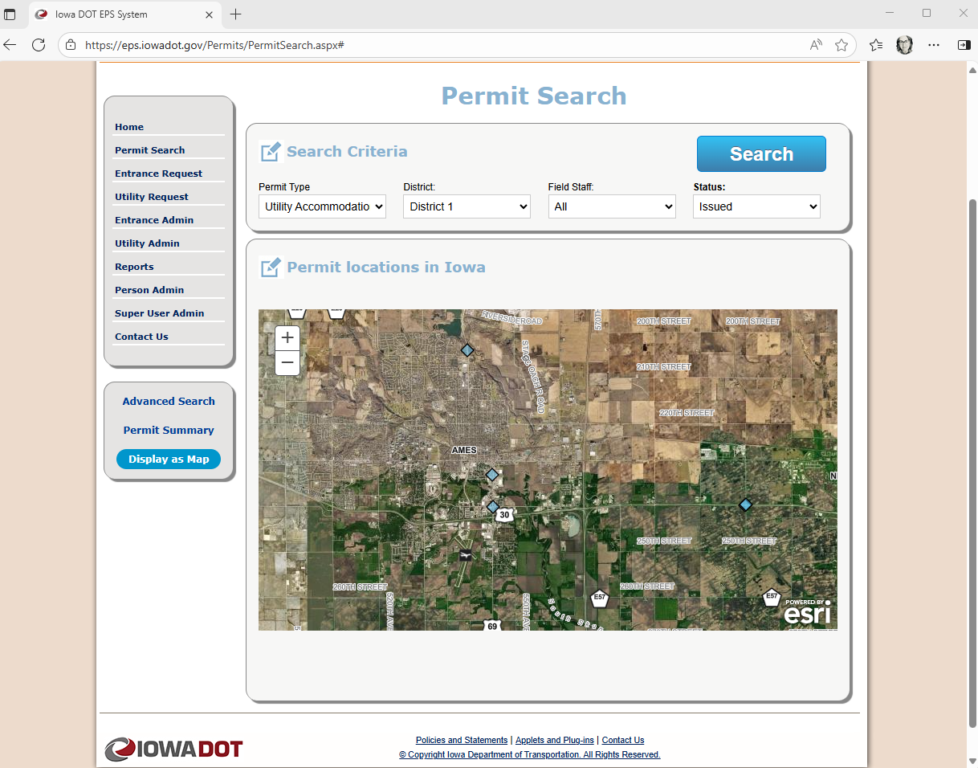
Electronic Permitting
System
Easily see the location

Slide 46
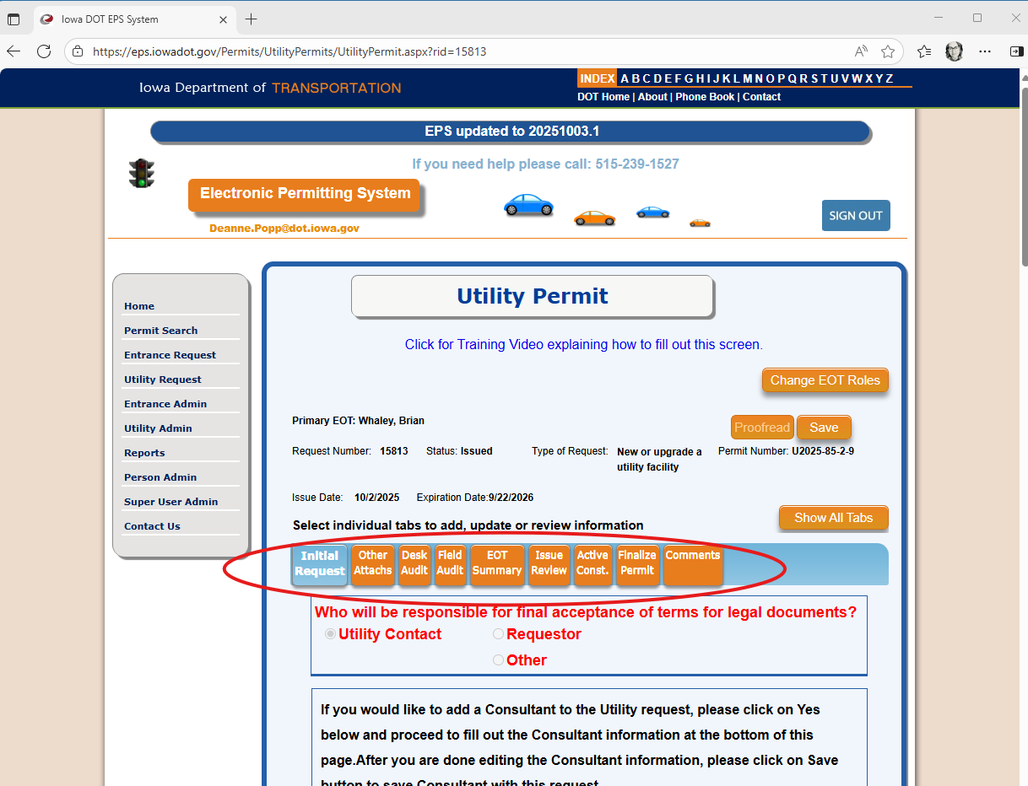
Electronic Permitting
System
Steps to complete
Shown in tabs
Check boxes & fill-in fields
Attachments
  Site plan

Slide 47

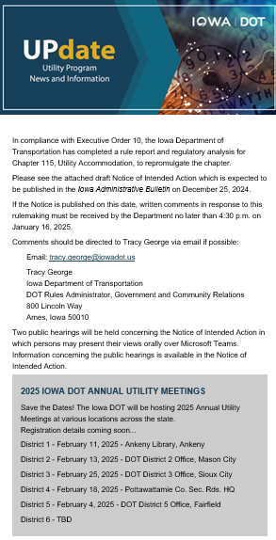
Outreach
UPdate newsletter
Govdelivery
Notes:
Improved communication with stakeholders
UPdate newsletter
News about rules & processes
Invitations to meetings & training opportunities
Govdelivery – subscribers can add/remove themselves from the list

Slide 48

District 1 – March 11
  Ankeny Kirkendall Public Library, Ankeny, IA
District 2 – March 2
  District 2 Conference Room, Mason City, IA
District 3 – March 12
  District 3 Conference Room, Sioux City, IA
District 4 – February 26
  District 4 Conference Room, Atlantic, IA
District 5 – February 3
  District 5 Conference Room, Fairfield, IA
District 6 – February 20
  District 6 Conference Room, Cedar Rapids, IA
2026 Annual Utility Meetings
February | March
8:30am-Noon
Each district

Slide 49

Moving forward
Be aware of and communicate schedules
Monitor the progress | projects & relocations
Attend and participate in coordination meetings
Look for opportunities to partner

Slide 50
FTP site for meeting materials
  https://utilities.iowadot.gov/Annual%20Util%20Mtg%202026/
EPS site for permitting
  https://eps.iowadot.gov/Home
Utility Program site
  https://iowadot.gov/rightofway/Utility-Accommodation-and-Coordination
State newsletter subscriptions
  https://www.iowa.gov/subscribe

Slide 51

Questions?
DEANNE POPP
515.239.1014
deanne.popp@iowadot.gov​
iowadot.gov

