Slide 1
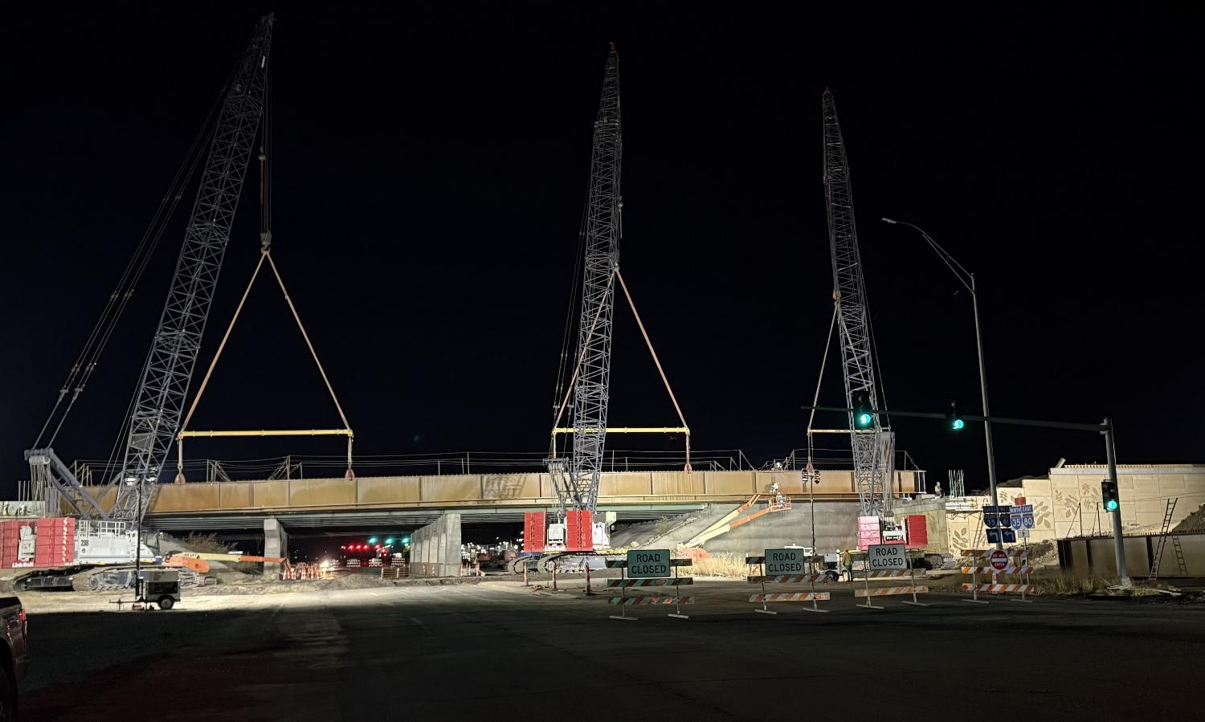


District 1 Projects
2026 Annual Utility Meeting
3/2/2023
Jeremey Vortherms
Assistant District 1 Engineer
March 11, 2026

Slide 2
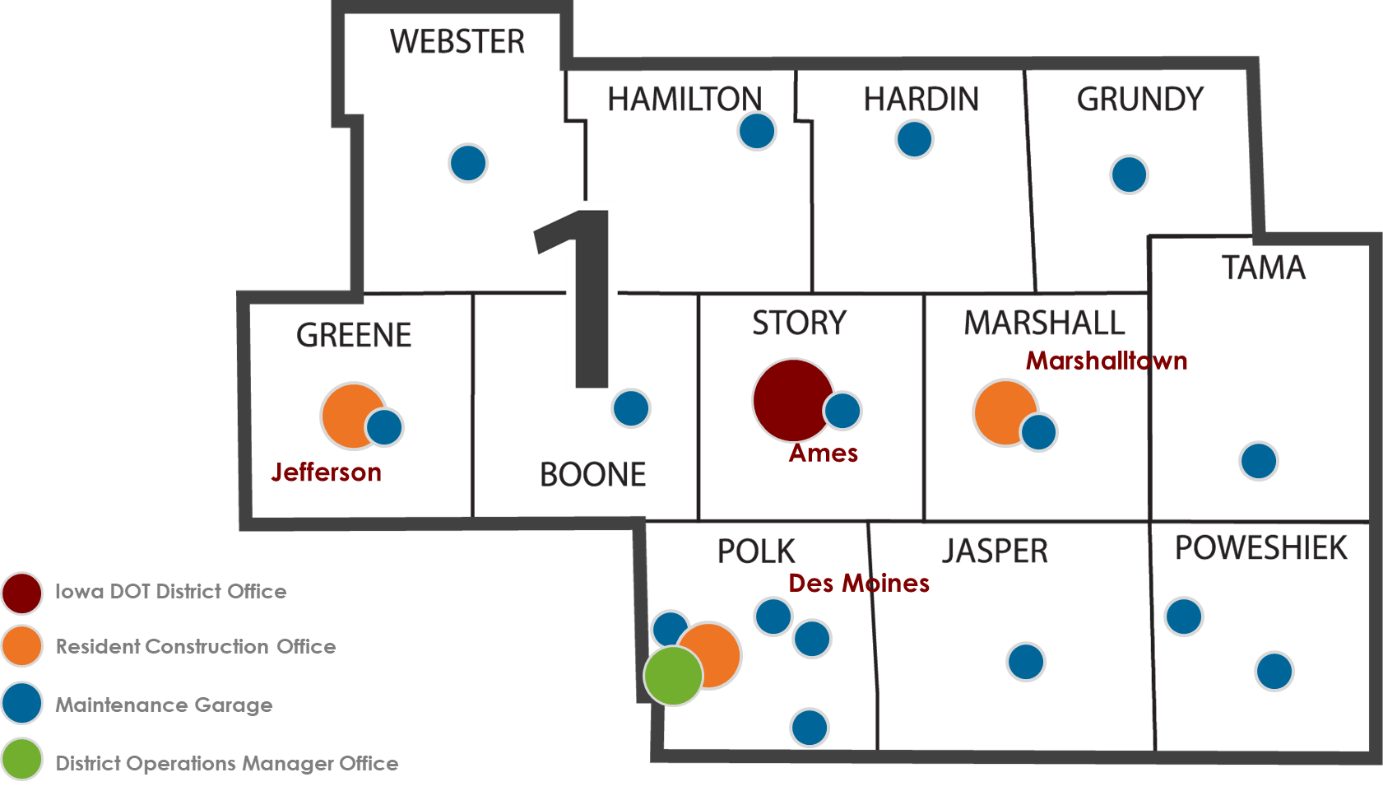
ALLISON SMYTH
District Engineer

Slide 3
District 1 Engineering Staff
Allison Smyth, P.E.
District 1 Engineer
Jeremey Vortherms, P.E.
Assistant District 1 Engineer
Frank Leong, P.E.
District 1 Construction Engineer
Andy Swisher, P.E.
Transportation Systems Management & Operations (TSMO) Engineer
Kasi Province, P.E.
Grimes RCE
Jenny Hoskins, P.E.
Jefferson RCE
Dustin Skogerboe, P.E.
Marshalltown RCE
Mike Lauritsen, P.E.
Materials Engineer
Ben Adey, P.E.
South Area Engineer
Devendra Tamrakar, P.E.
North Area Engineer

Slide 4
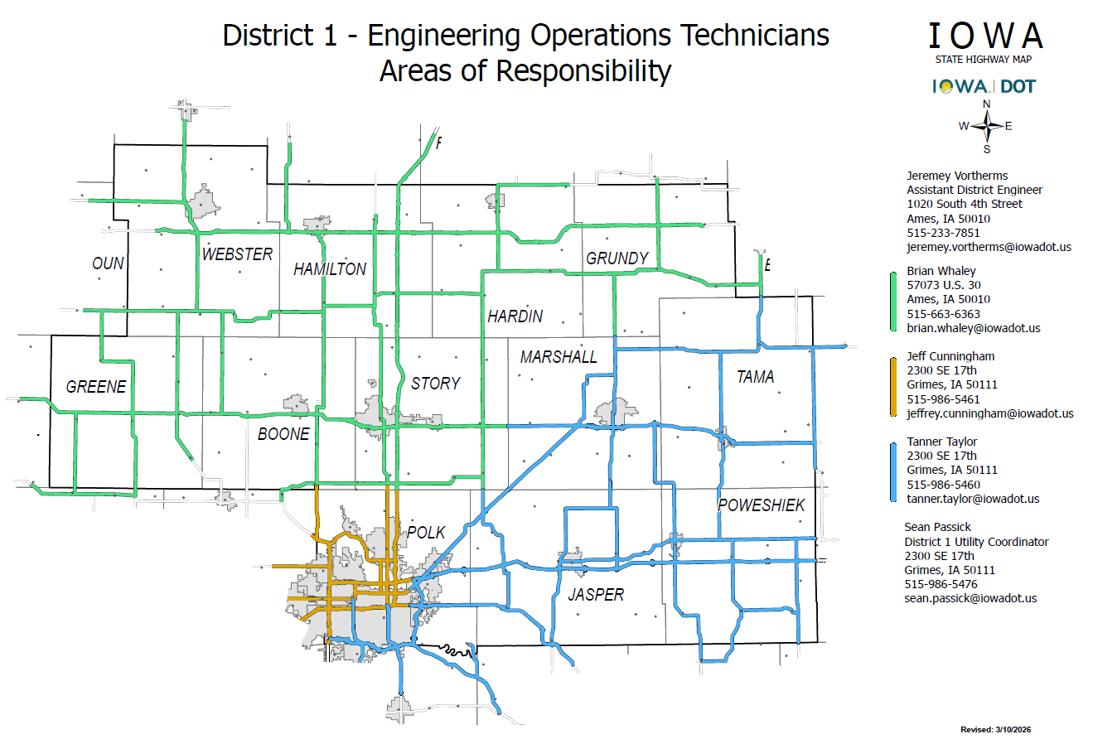

Slide 5
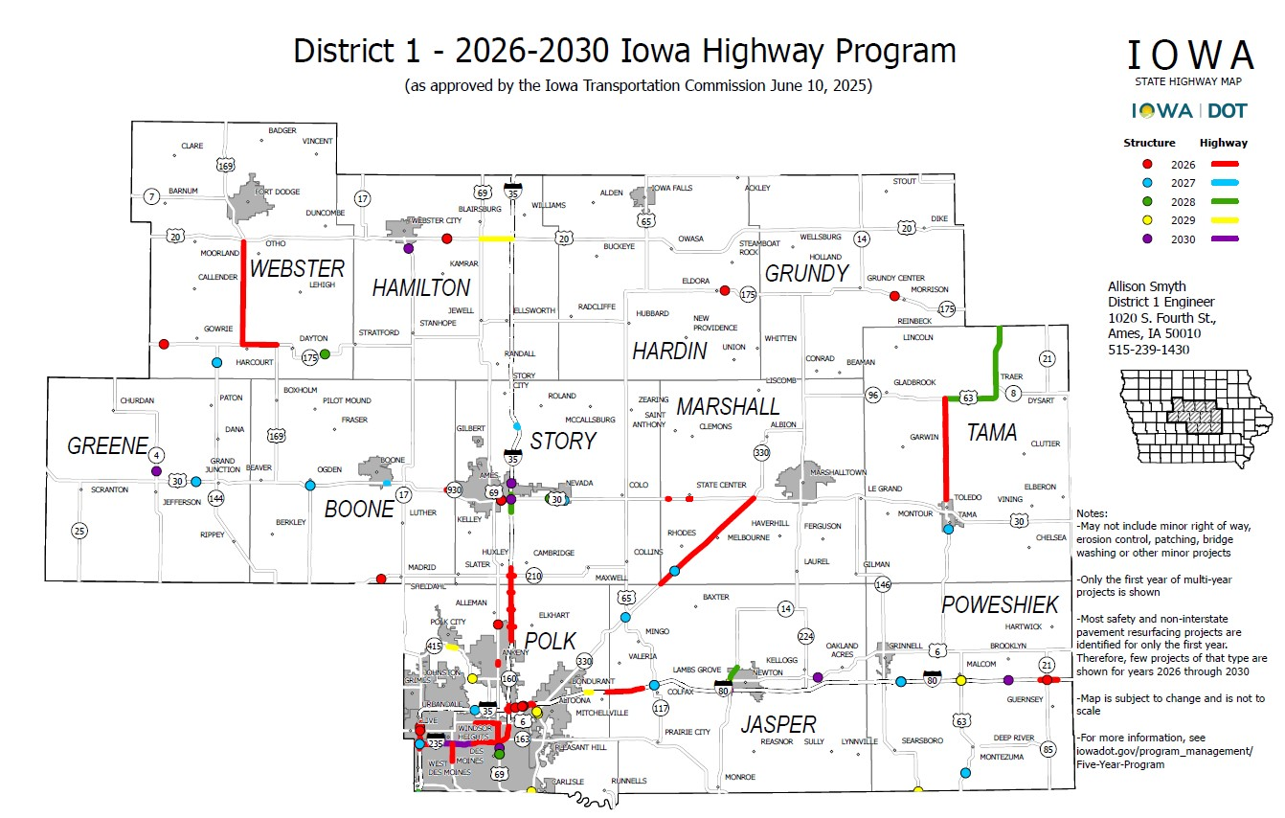
District 1 Projects

Slide 6
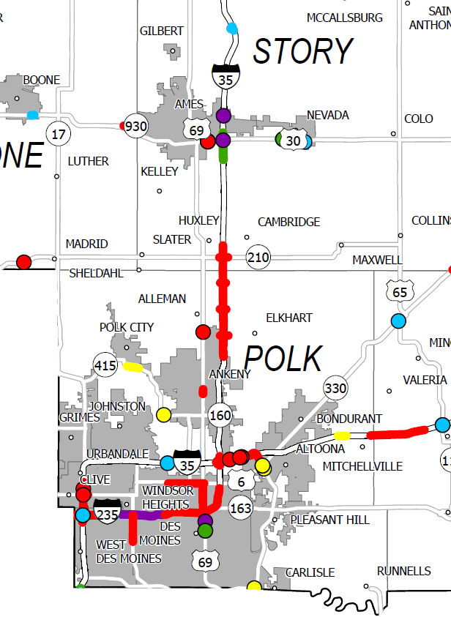
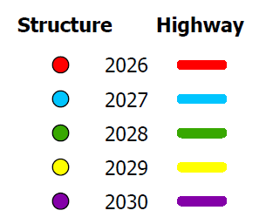
Polk & Story
County Projects

Slide 7
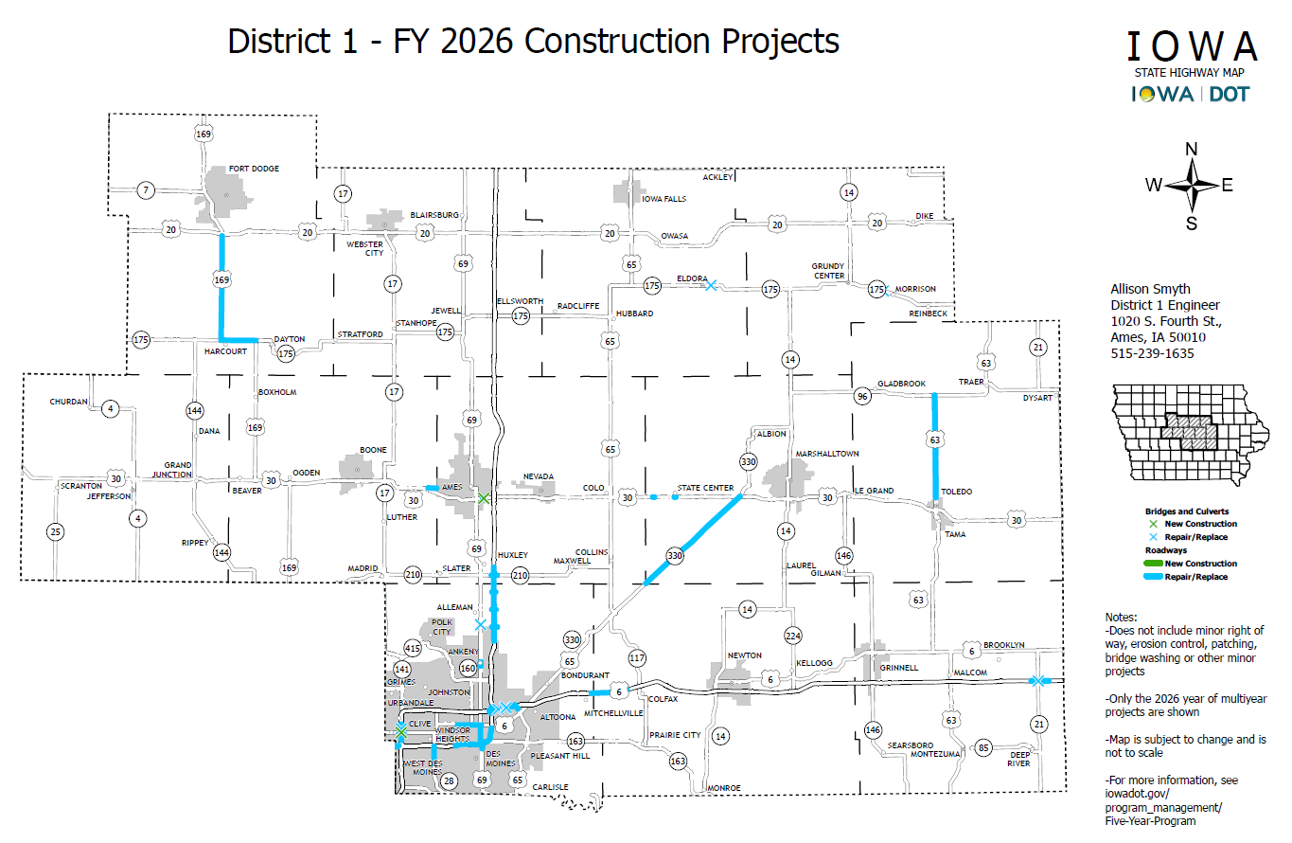

Slide 8
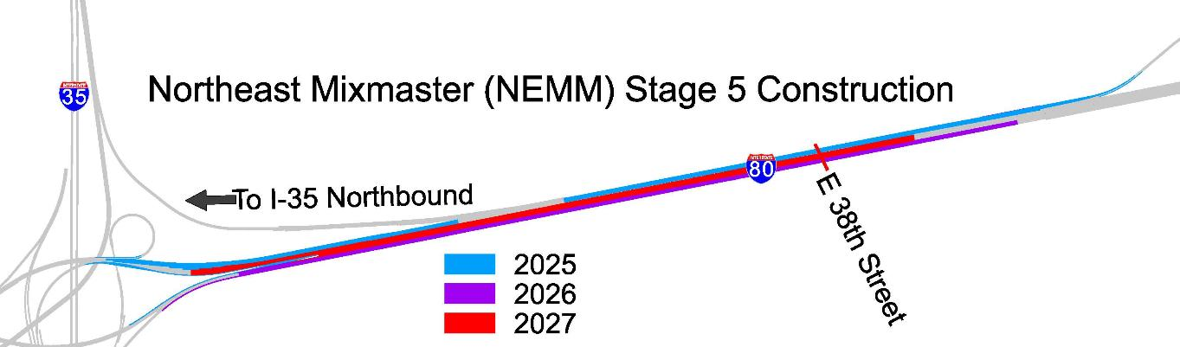
I-35/80/235 Northeast Mixmaster to US 65
Capacity Improvements
$ 40.1 Million (Awarded)
$ 29.2 Million (Programmed)
2025 - 2028
Ongoing Projects

Slide 9
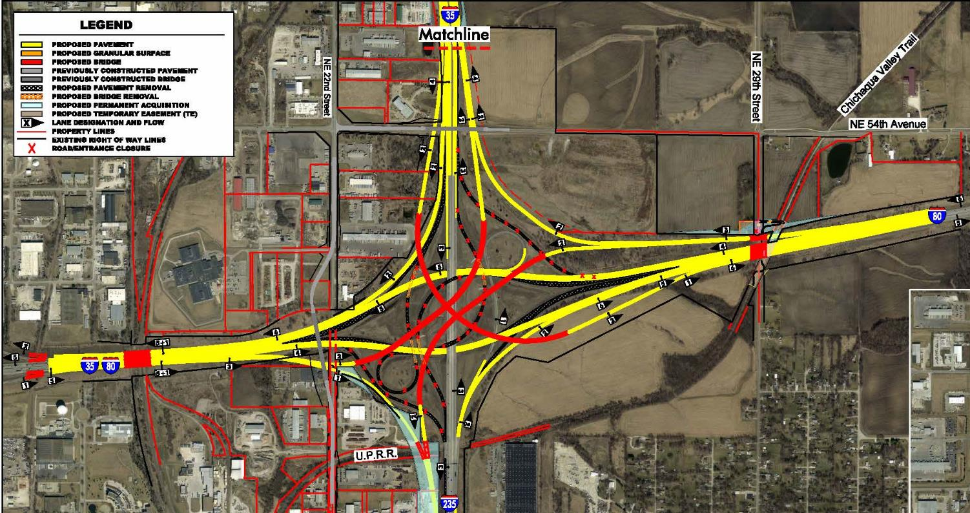
I-35/80/235
Northeast Mixmaster
Ultimate Design
Not Programmed
Ongoing Projects

Slide 10
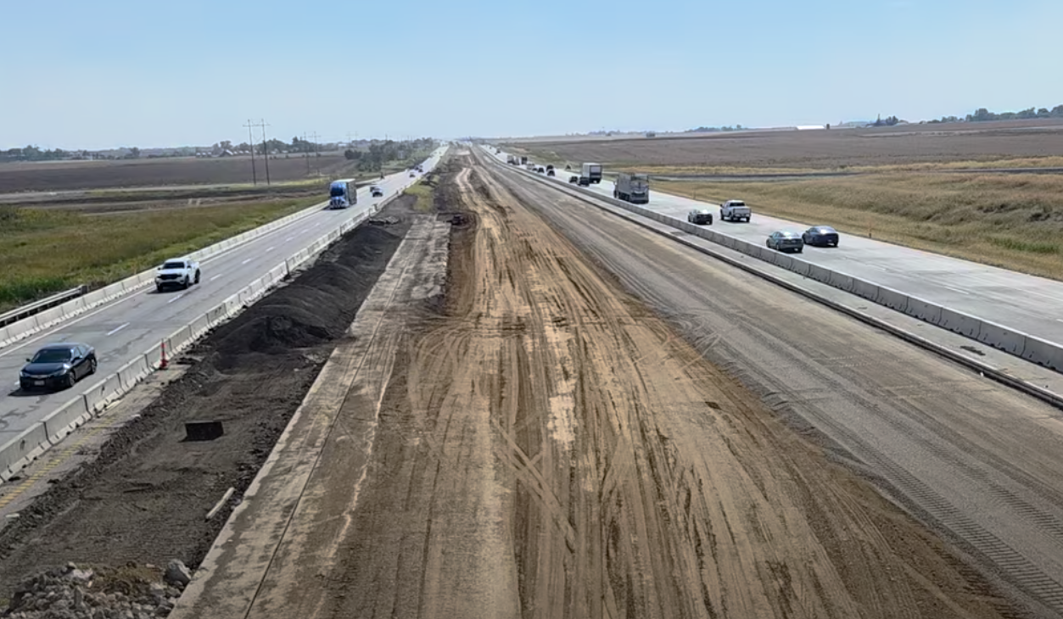
I-35 Capacity Improvements
Ankeny to Huxley
$ 156.3 Million (Awarded)
$ 1.2 Million (Programmed)
2023-2027
Ongoing Projects

Slide 11
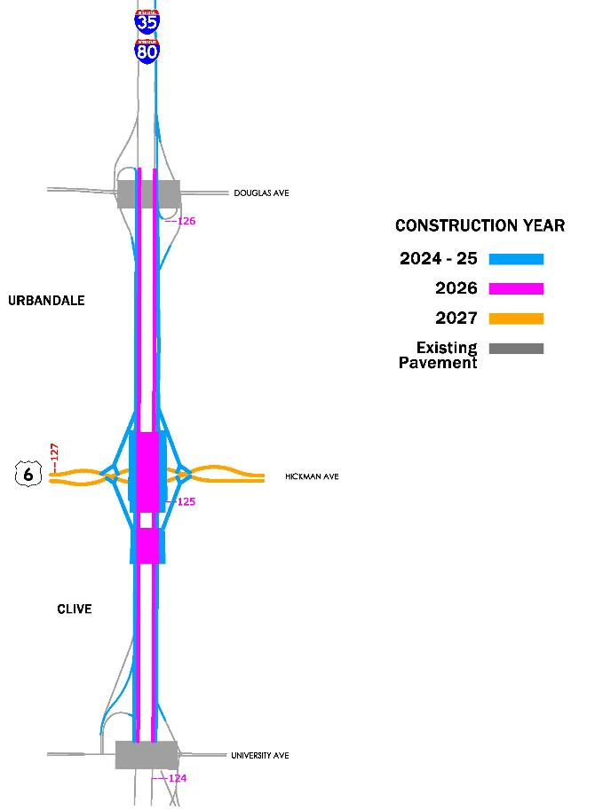
Ongoing Projects
I-35/80 & US 6 (Hickman Road)
Interchange Reconstruction
From University Avenue to Douglas Ave
$ 128.0 Million (Awarded)
$ 13.3 Million (Programmed)

Slide 12
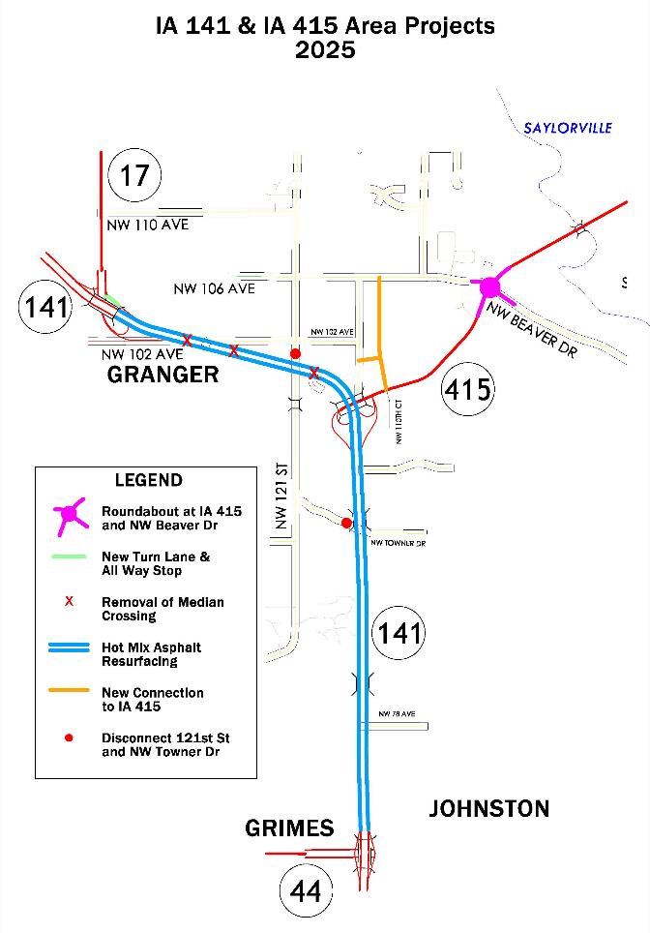
Ongoing Projects
IA 141 at NW 121st Street Safety Improvements
$ 15 Million (Awarded)
2025
Iowa 415 and Beaver Drive/ NW 106th Avenue
Roundabout Project
$2.7 Million (Awarded)
2025

Slide 13
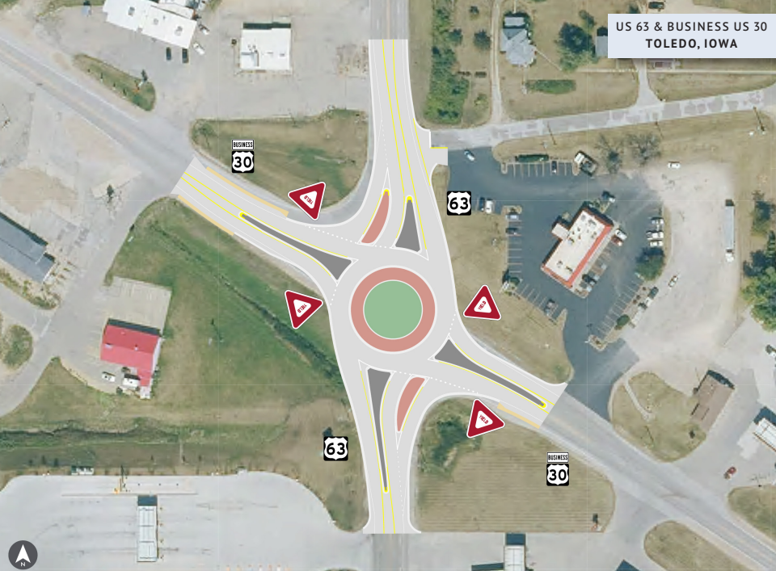
US 63 in Toledo
Roundabout Project at Business 30
2025 Grade/Paving $2.2 Million
(Programmed)
Safety
Notes:
Amount updated

Slide 14
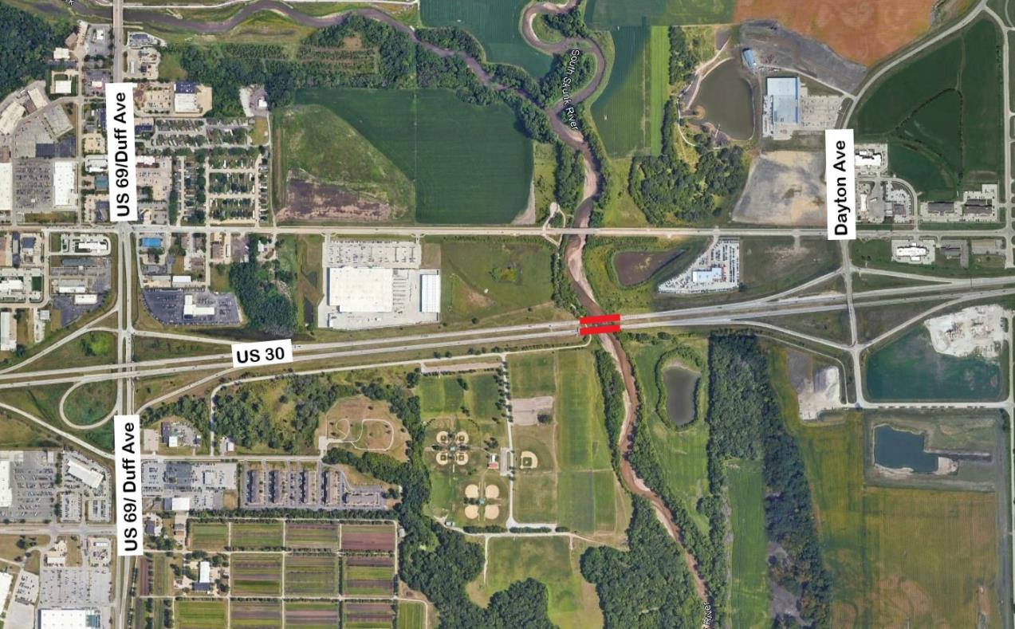
US 30 in Ames
Skunk River Bridge Replacements
Grade/Pave/Bridge/Signs/Lighting
2025 $ 6.1 Million (Awarded)
2026 $ 11.3 Million (Awarded)
2027 $ 10.6 Million (Programmed)
Ongoing Projects

Slide 15
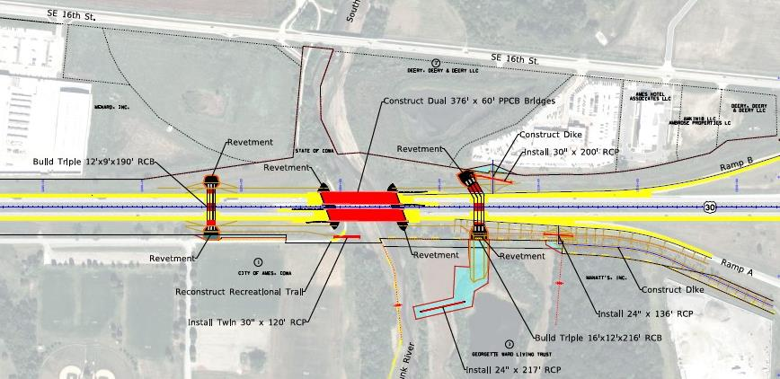
US 30 Skunk River Bridges
Grade/Pave/Bridge/Signs/Lighting
2025 $ 6.1 Million (Awarded)
2026 $ 16.2 Million (Programmed)
2027 $ 14.1 Million (Programmed)
Notes:
Amount updated

Slide 16
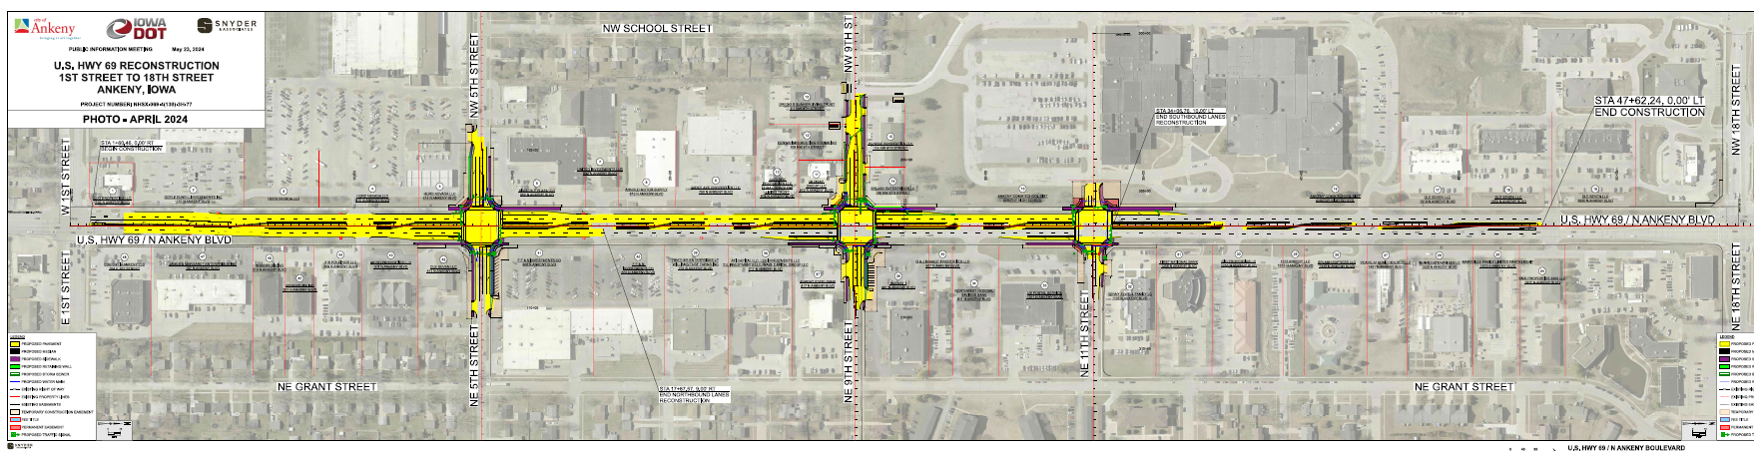
US 69 in Polk County
1st Street to 18th Street in Ankeny
2025 Paving $6.4 Million (Awarded)
Ongoing Projects

Slide 17
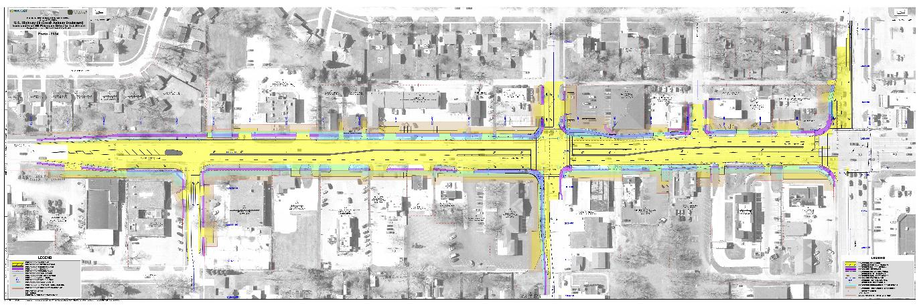
US 69 in Polk County
SE Peterson to 1st Street in Ankeny
2026 ROW $1.5 Million
2026 Grade/Pave $14.7 Million (Awarded)
Upcoming Projects

Slide 18
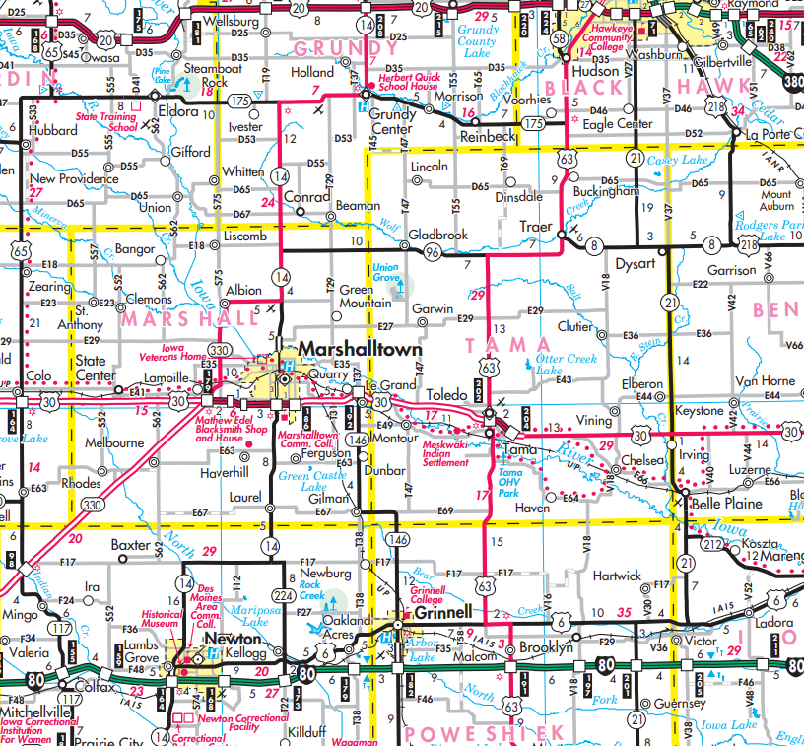





Ongoing and Upcoming Projects
US 63 – US 6 to Hudson
Super 2 Improvements
Traer to Hudson
(Future--Unprogrammed)
IA 96 to Traer
(Future--Unprogrammed)
Toledo to IA 96
2025 ROW
$1.1 Million (Programmed)
2026 Grade/Pave/Signs
$15.7 Million (Programmed)
US 6 to Tama
2024 ROW/Grade/Pave
$26.6 Million (Awarded)

Slide 19
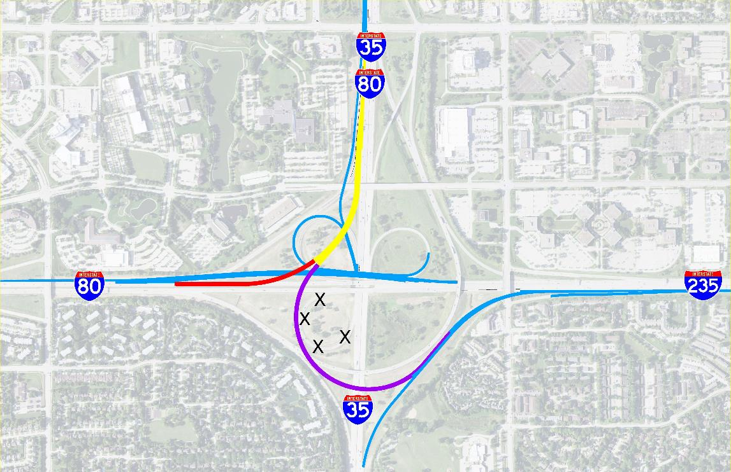
I-35/80/235 Southwest Reconstruction
$ 115.8 Million (Programmed)
2026 - 2029
Upcoming Projects

Slide 20
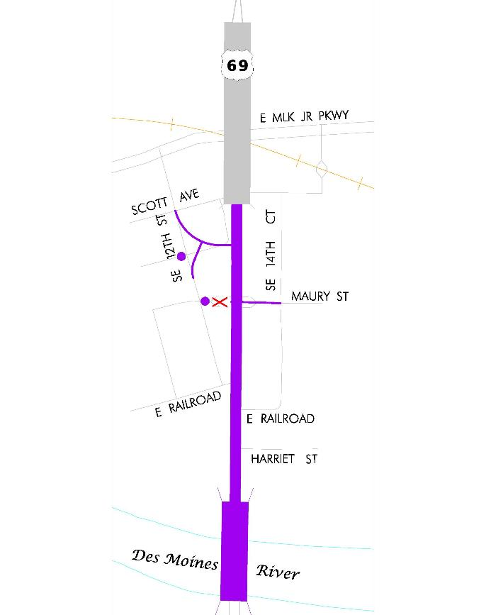
Upcoming Projects
US 69 & Maury Street
2027 Intersection Reconstruction
Road $3.2 Million (Programmed)
US 69 Des Moines River Bridge
2029 Bridge Replacement
Bridge $23 Million (Programmed)
US 69 Railroad Viaduct
2030 Bridge Replacement
Bridge $52 Million (Programmed)

Slide 21
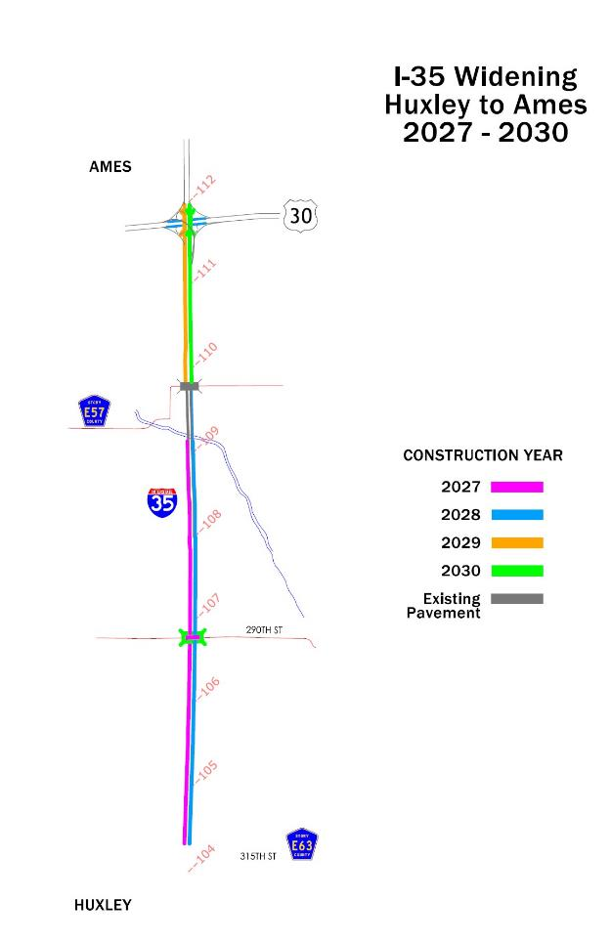
Upcoming Projects
I-35 Ankeny to Ames Capacity Improvements
E-57 to North of US 30
2027 ROW
$6.9 Million (Programmed)
2028 Grade/Pave/Signs
$ 11.6 Million (Programmed)
2029 Grade/Pave/Bridge
$31.9 Million (Programmed)
Huxley to E-57 (Unprogrammed)
Ankeny to Huxley
$ 156.3 Million (Awarded)
$ 1.2 Million (Programmed)
2023-2027
Notes:
Amounts updated- replaced old map with Ally’s new crayon map.

Slide 22
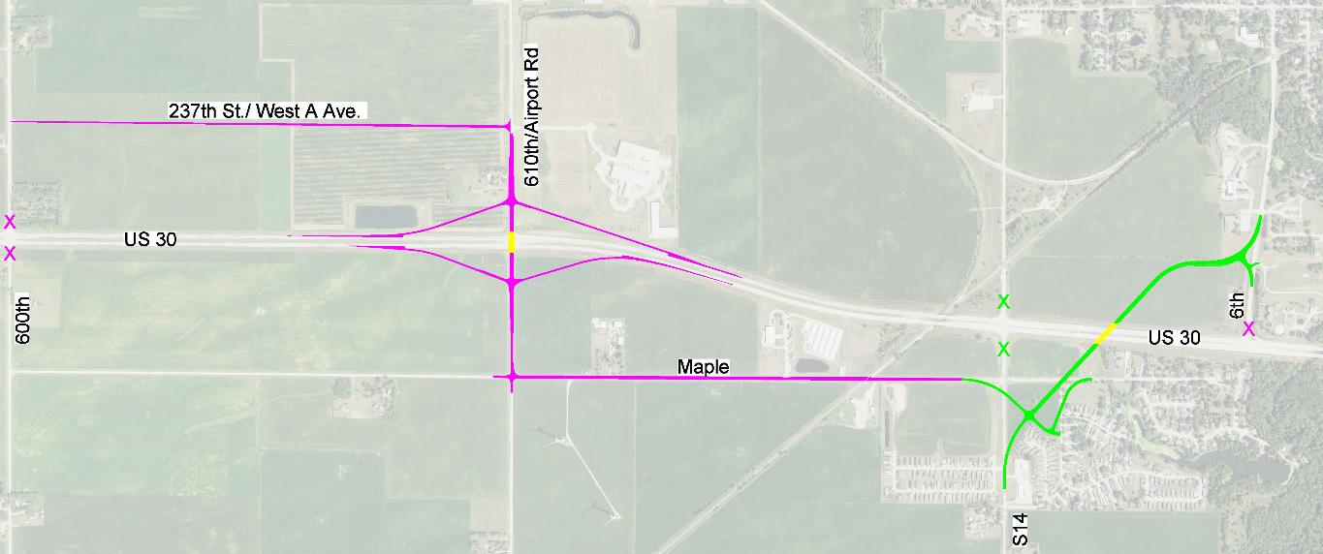
US 30/ 610th Ave in Nevada
New Interchange
2027/2028 ROW/Signs $10.1 Million
2029 Grade/Pave/Bridge $11 Million
2030 Pave/Signs/Lighting $10.4 Million
(Programmed)
Upcoming Projects

Slide 23
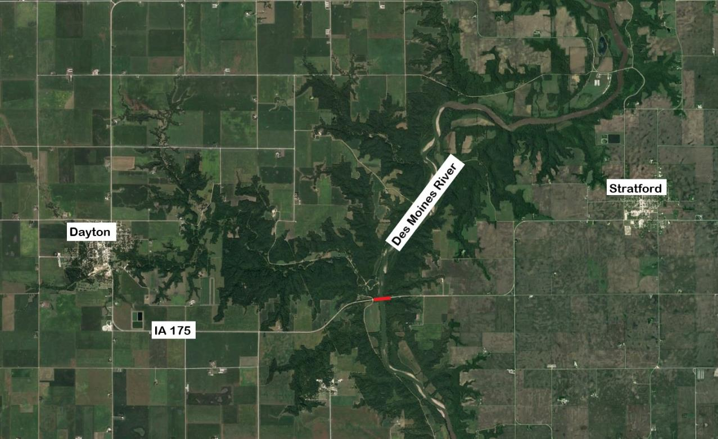
Webster IA 175
Des Moines River
Bridge Replacement
2028 $ 13.8 Million (Programmed)
Upcoming Projects

Slide 24
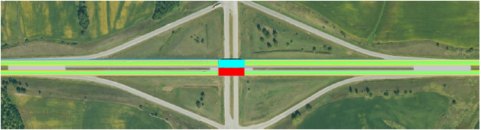


I-80 at US 63 in Poweshiek County
Interchange Reconstruction
2029 ROW $700,000
2029 New Bridge $14 Million
2030 New Bridge $14 Million
(Programmed)
Upcoming Projects

Slide 25
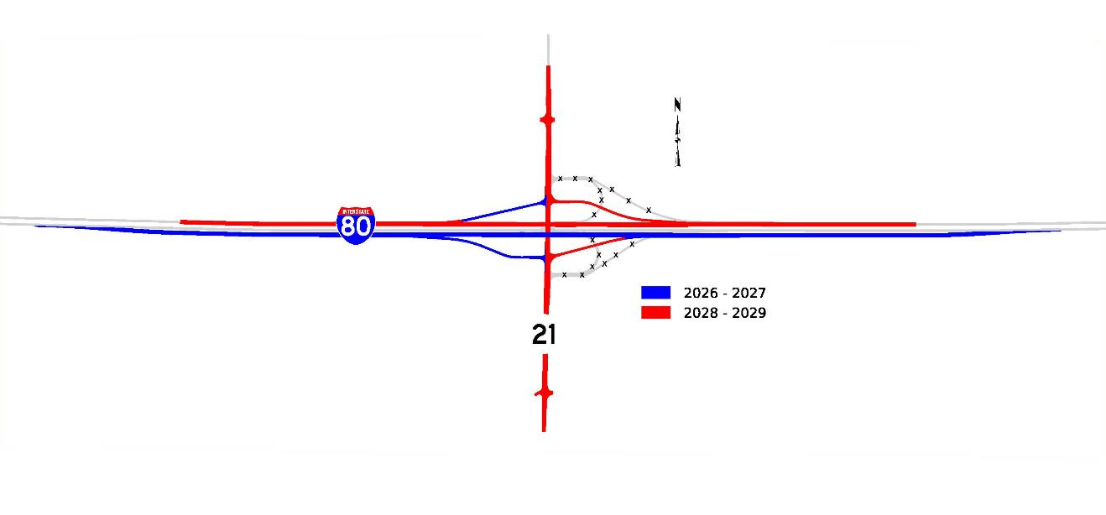
I-80 at IA 21 in Poweshiek County
Interchange Reconstruction
2026 Grade/Pave/Bridge $18.6 Million
2027 Signs/Lighting $0.4 Million
2028 Grade/Pave/Bridge $20.4 Million
(Programmed)
Upcoming Projects

Slide 26
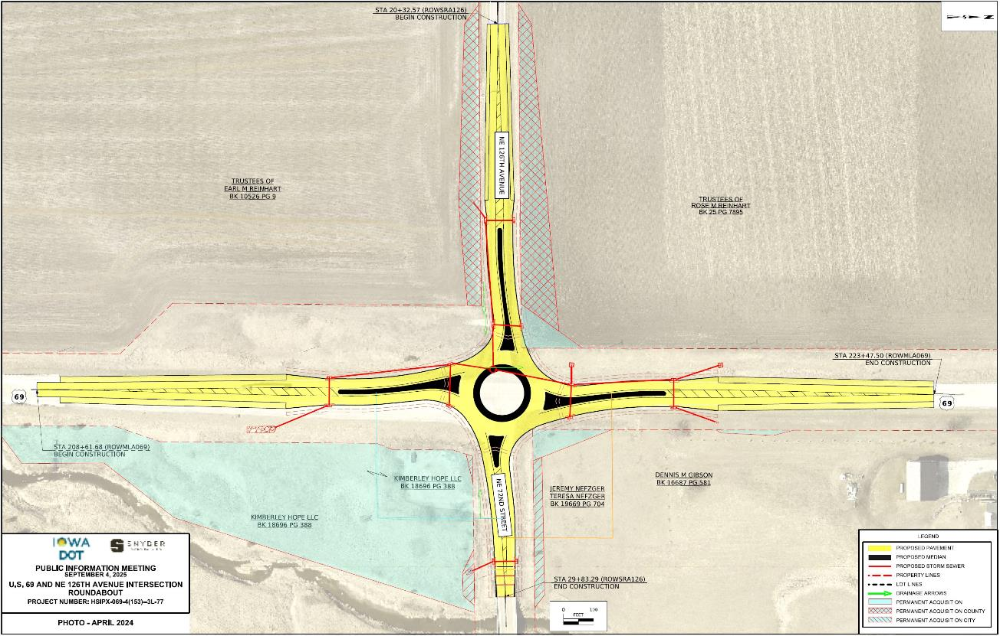
US 69 in Polk/Story County
Roundabout Projects at
NE 126th Ave and Iowa 210
2027 Paving $2.1 Million (Polk)
2028 Paving $2.2 Million (Story)
(Unprogrammed)
Upcoming Projects

Slide 27
US 69 in Huxley
Roundabout Project at Ia 210
2028 Grade/Paving (Tenative)
Safety
Notes:
Amount updated

Slide 28
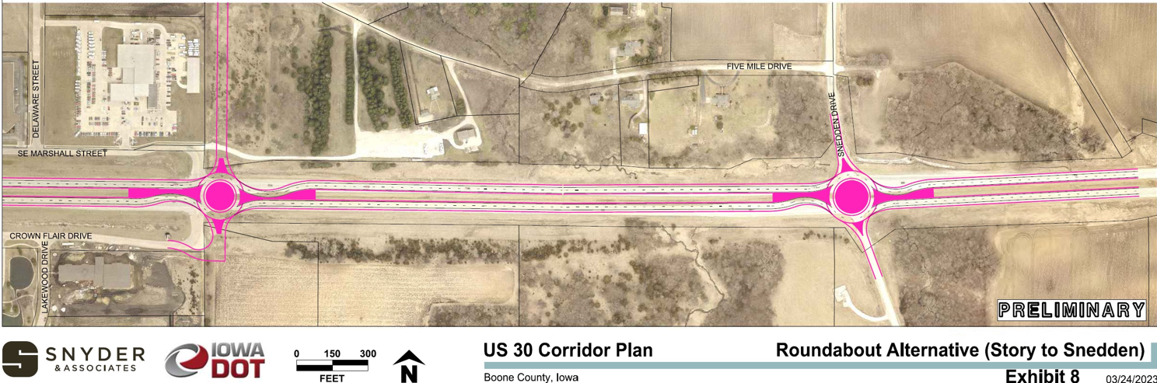
US 30 in Boone County
Roundabout Projects at Marshall St and Snedden Dr
2027 Paving $3 Million (Snedden)
(Programmed)
2027 Paving $2.9 Million (Marshall)
(Unprogrammed)
Upcoming Projects

Slide 29
Questions?
JEREMEY VORTHERMS
515-233-7851
Jeremey.Vortherms@iowadot.us
iowadot.gov

