Slide 1
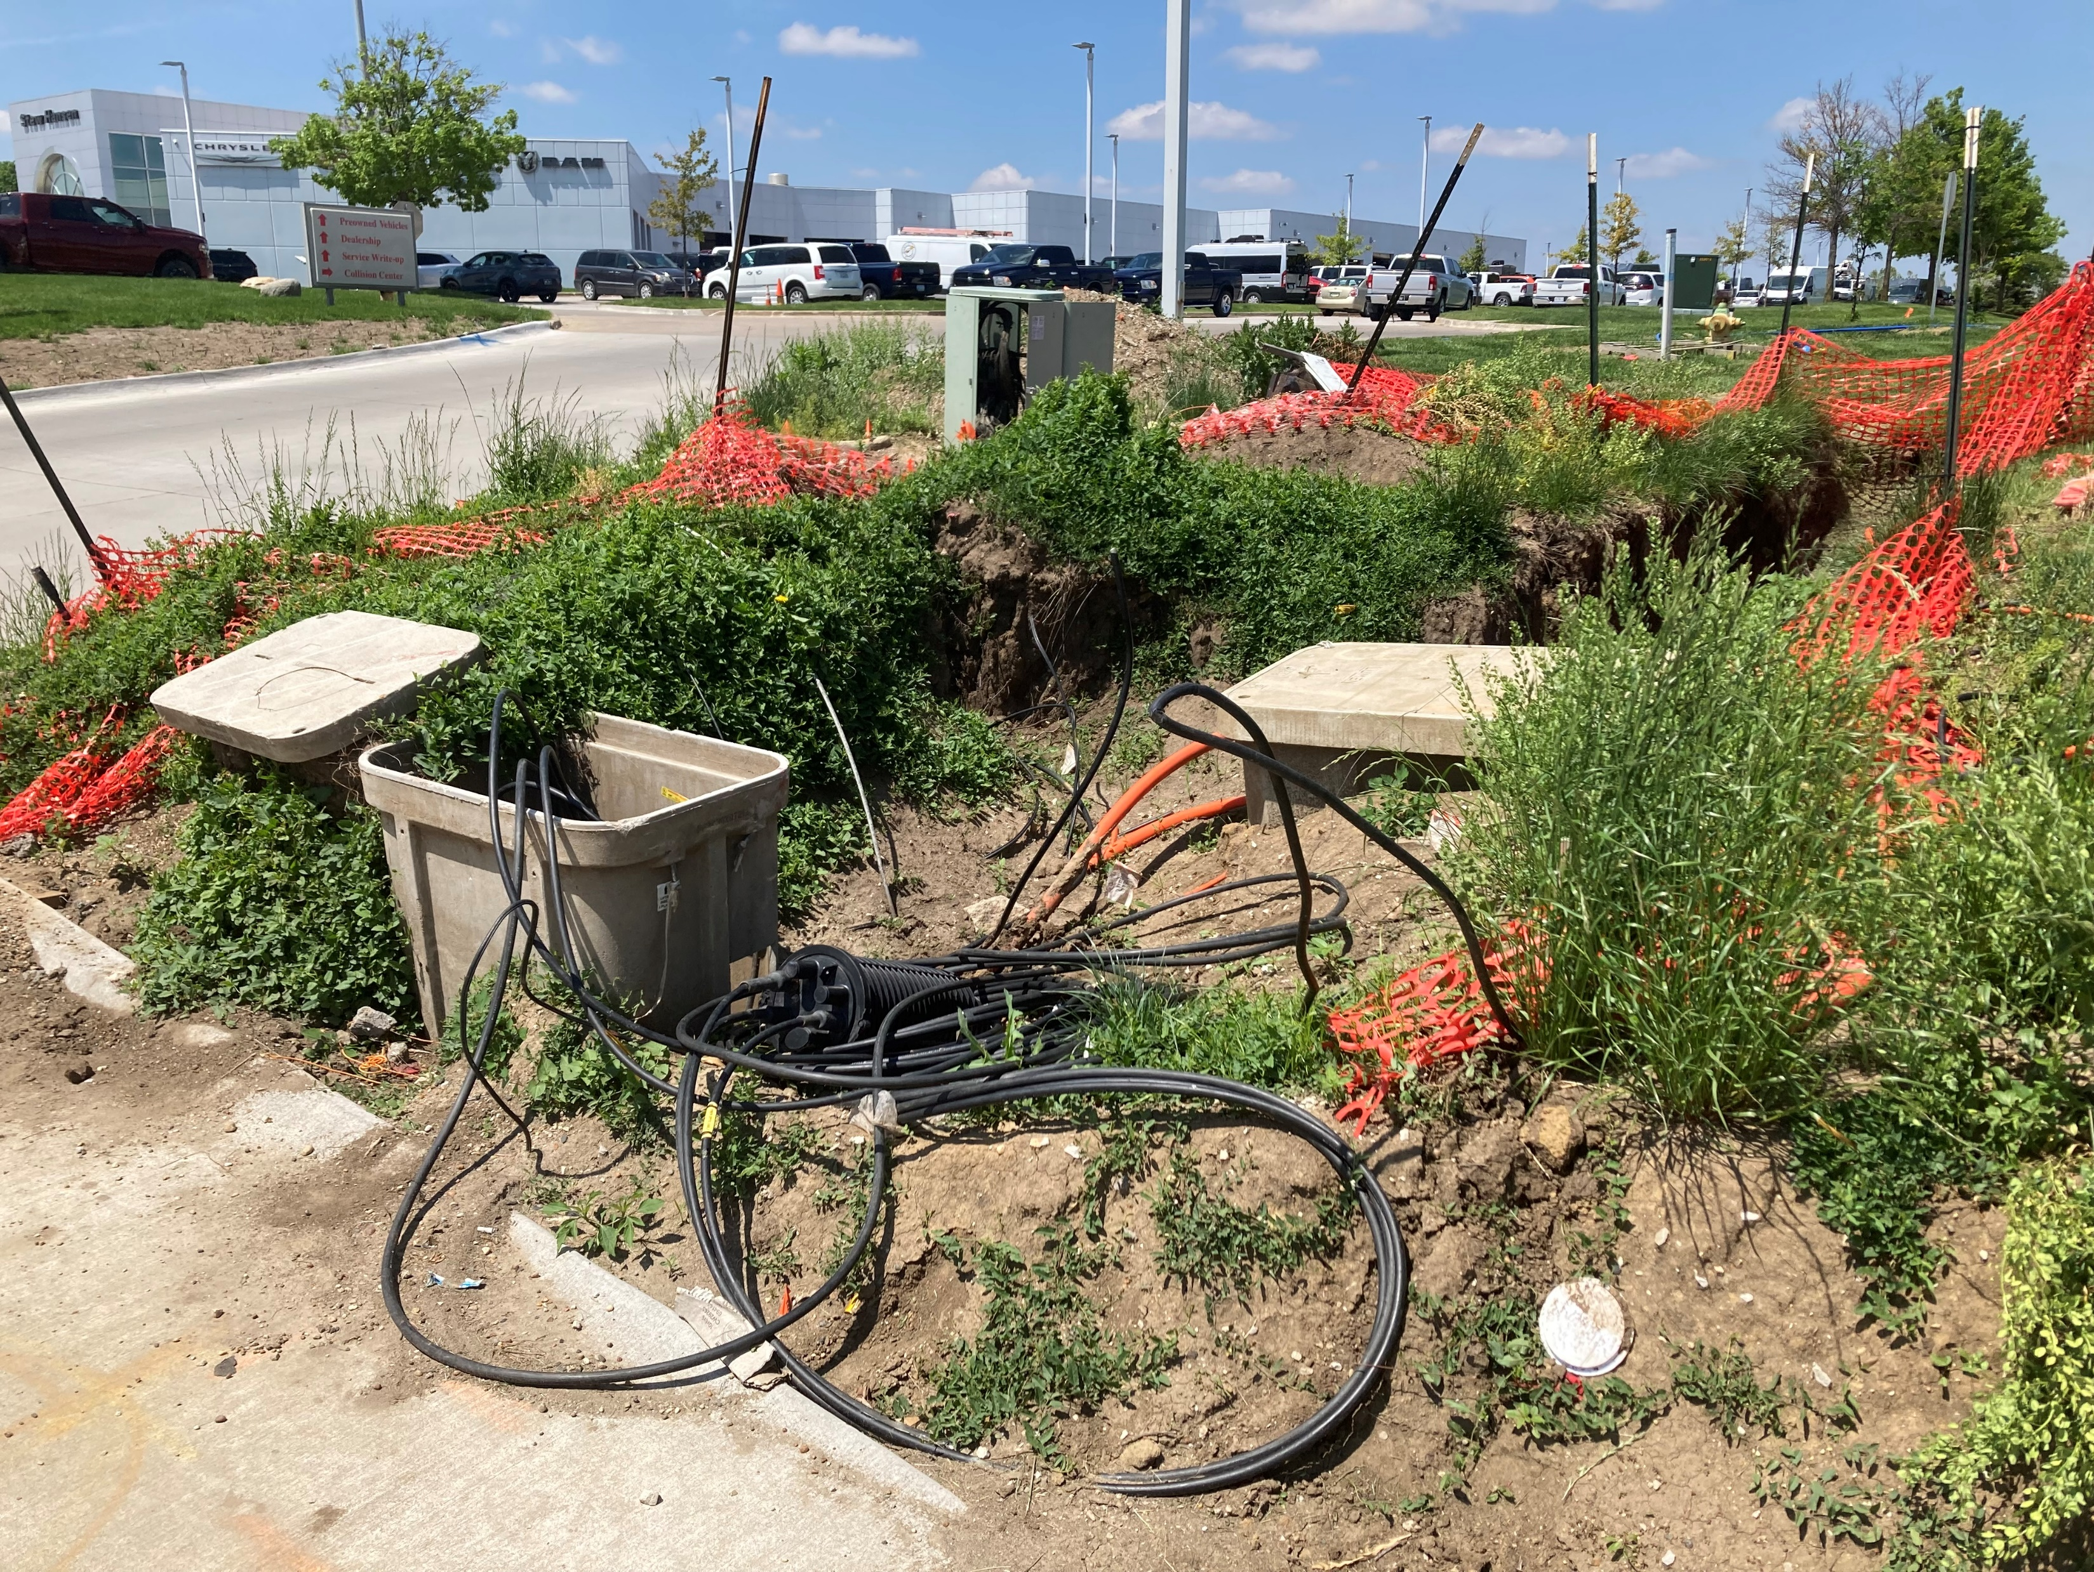


Construction & Utility Coordination
Caleb Wright, EIT
Transportation Engineer Associate
March 2026

Slide 2
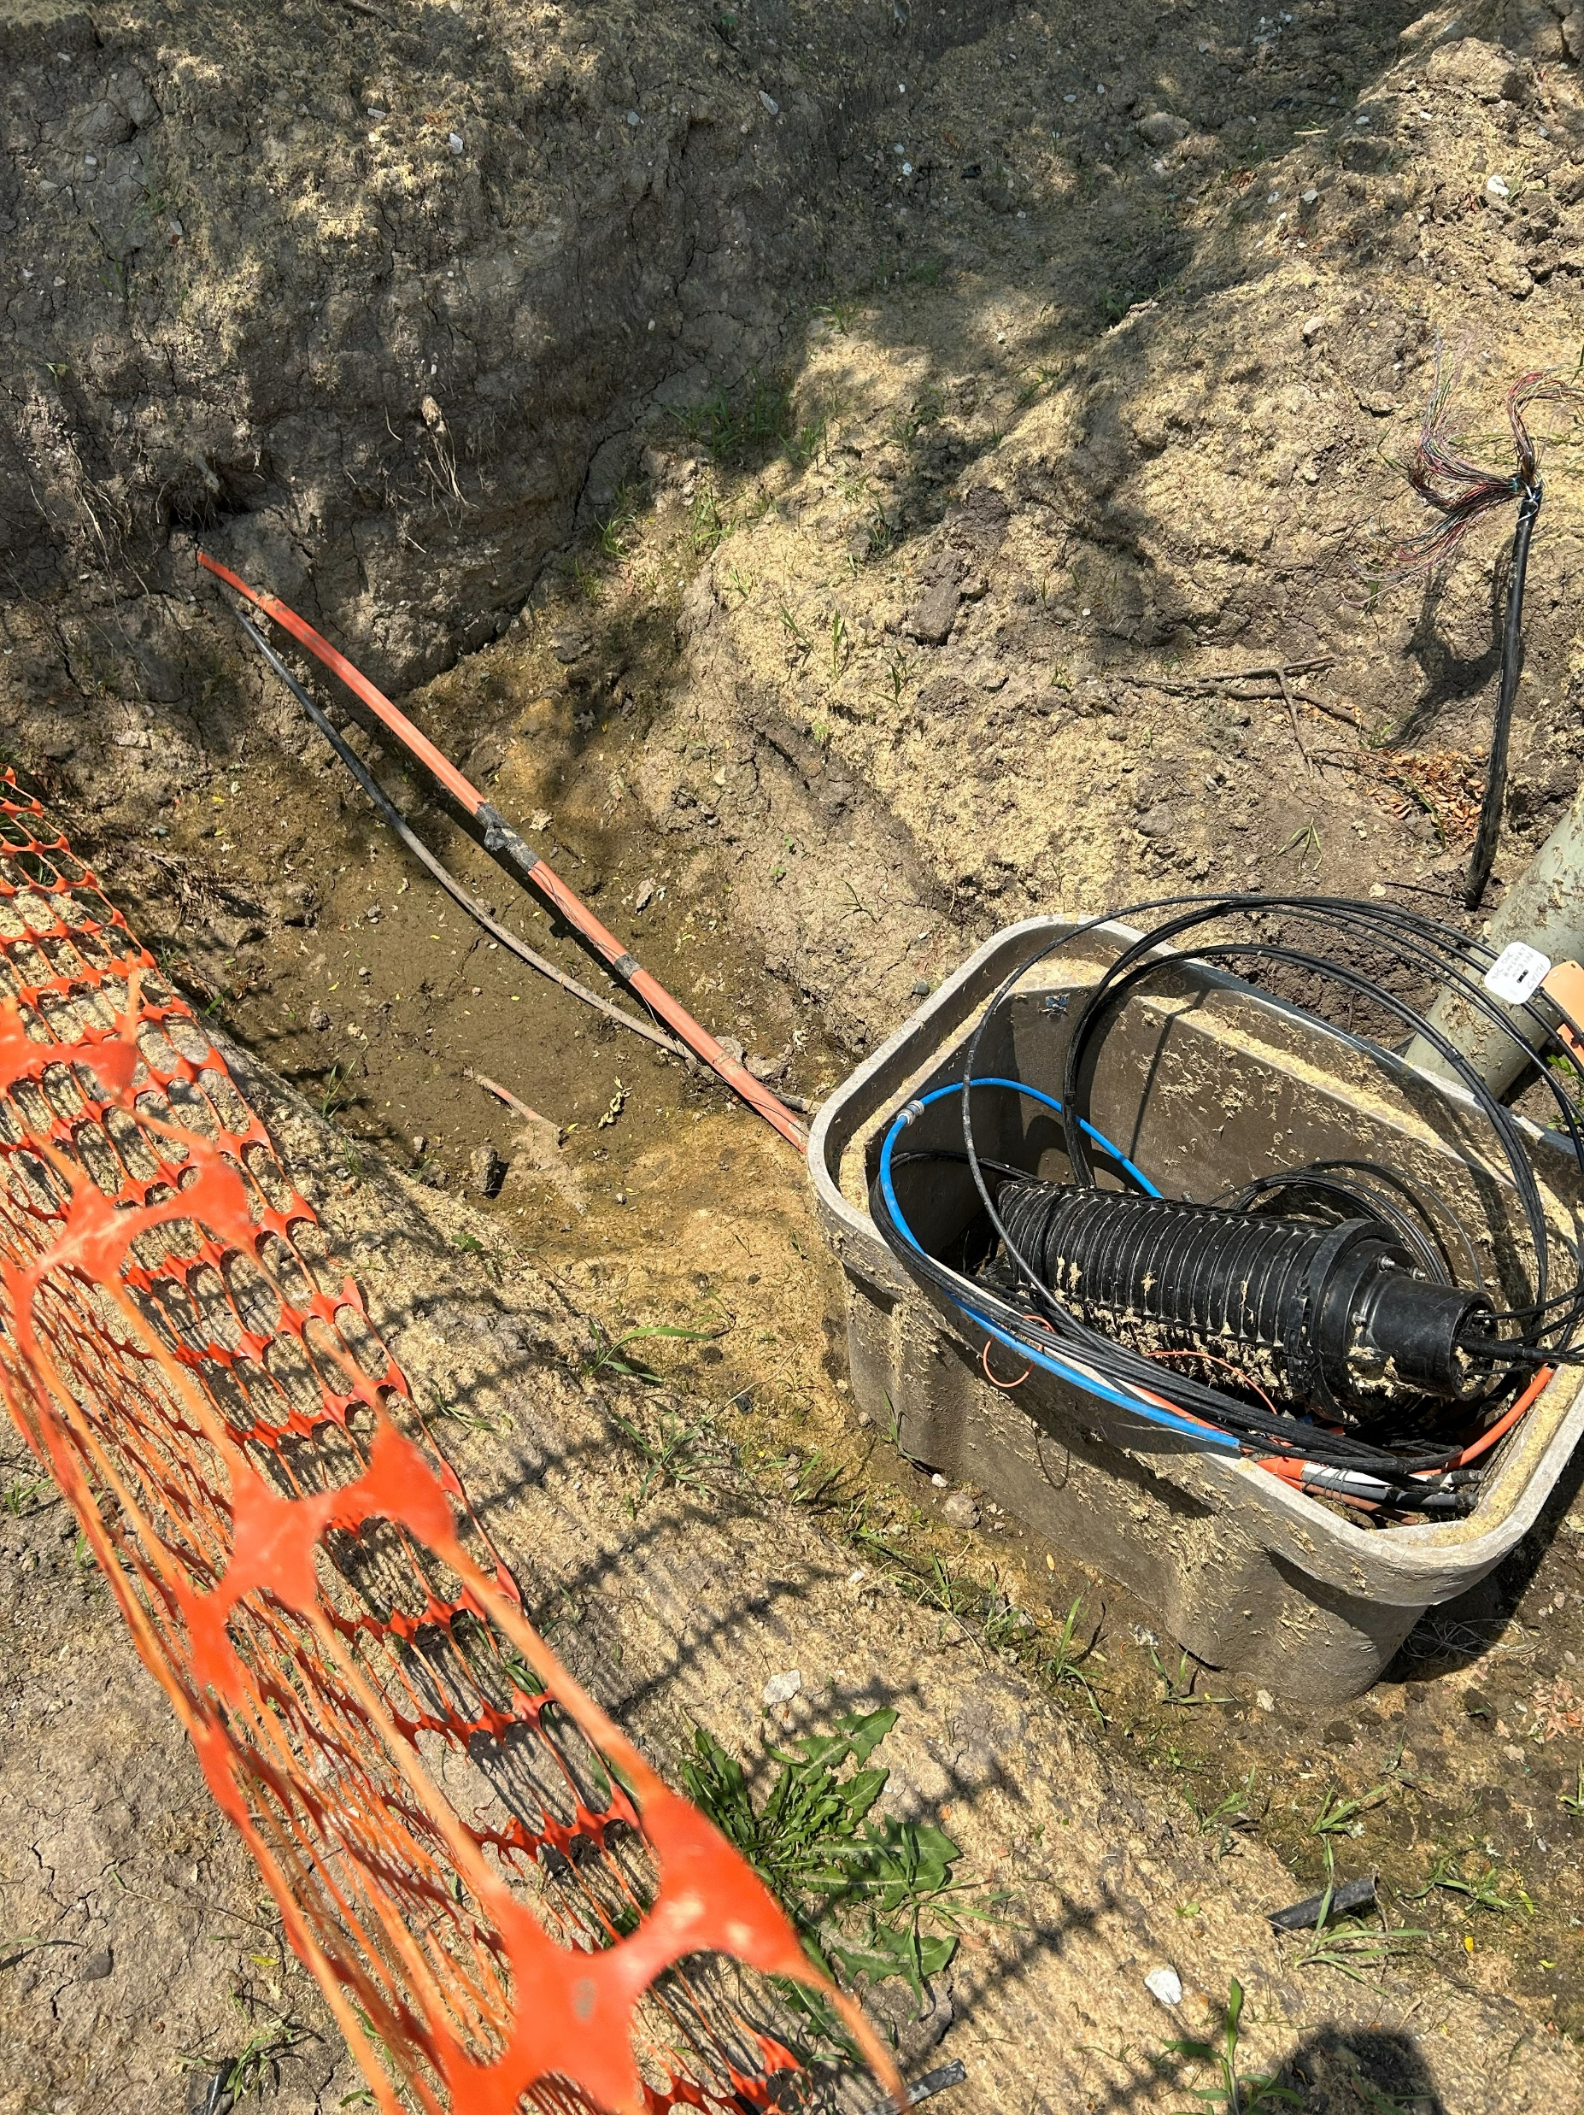

Overview
Bonding Process & Conflict Resolution
Coordination Efforts
Causes of Conflict

Slide 3
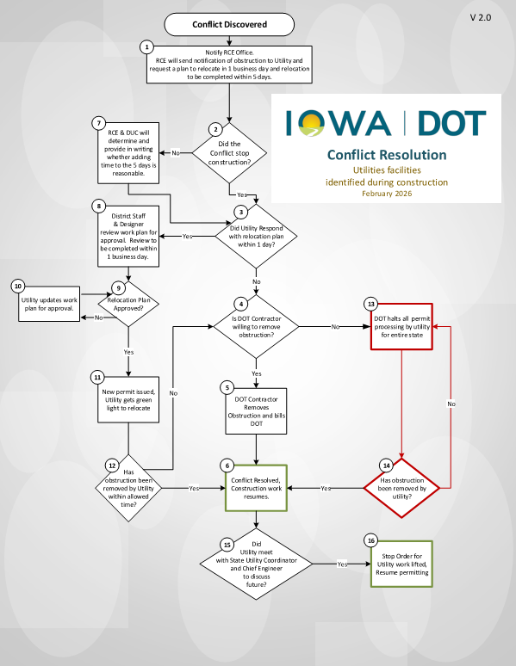
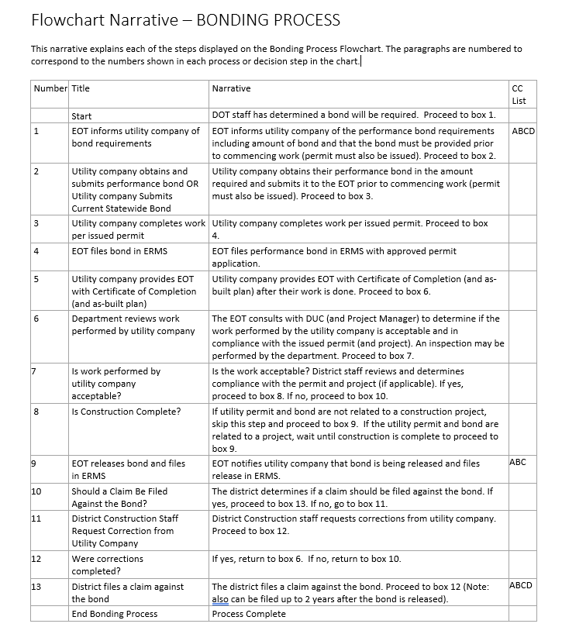
Photo Slide

Slide 4
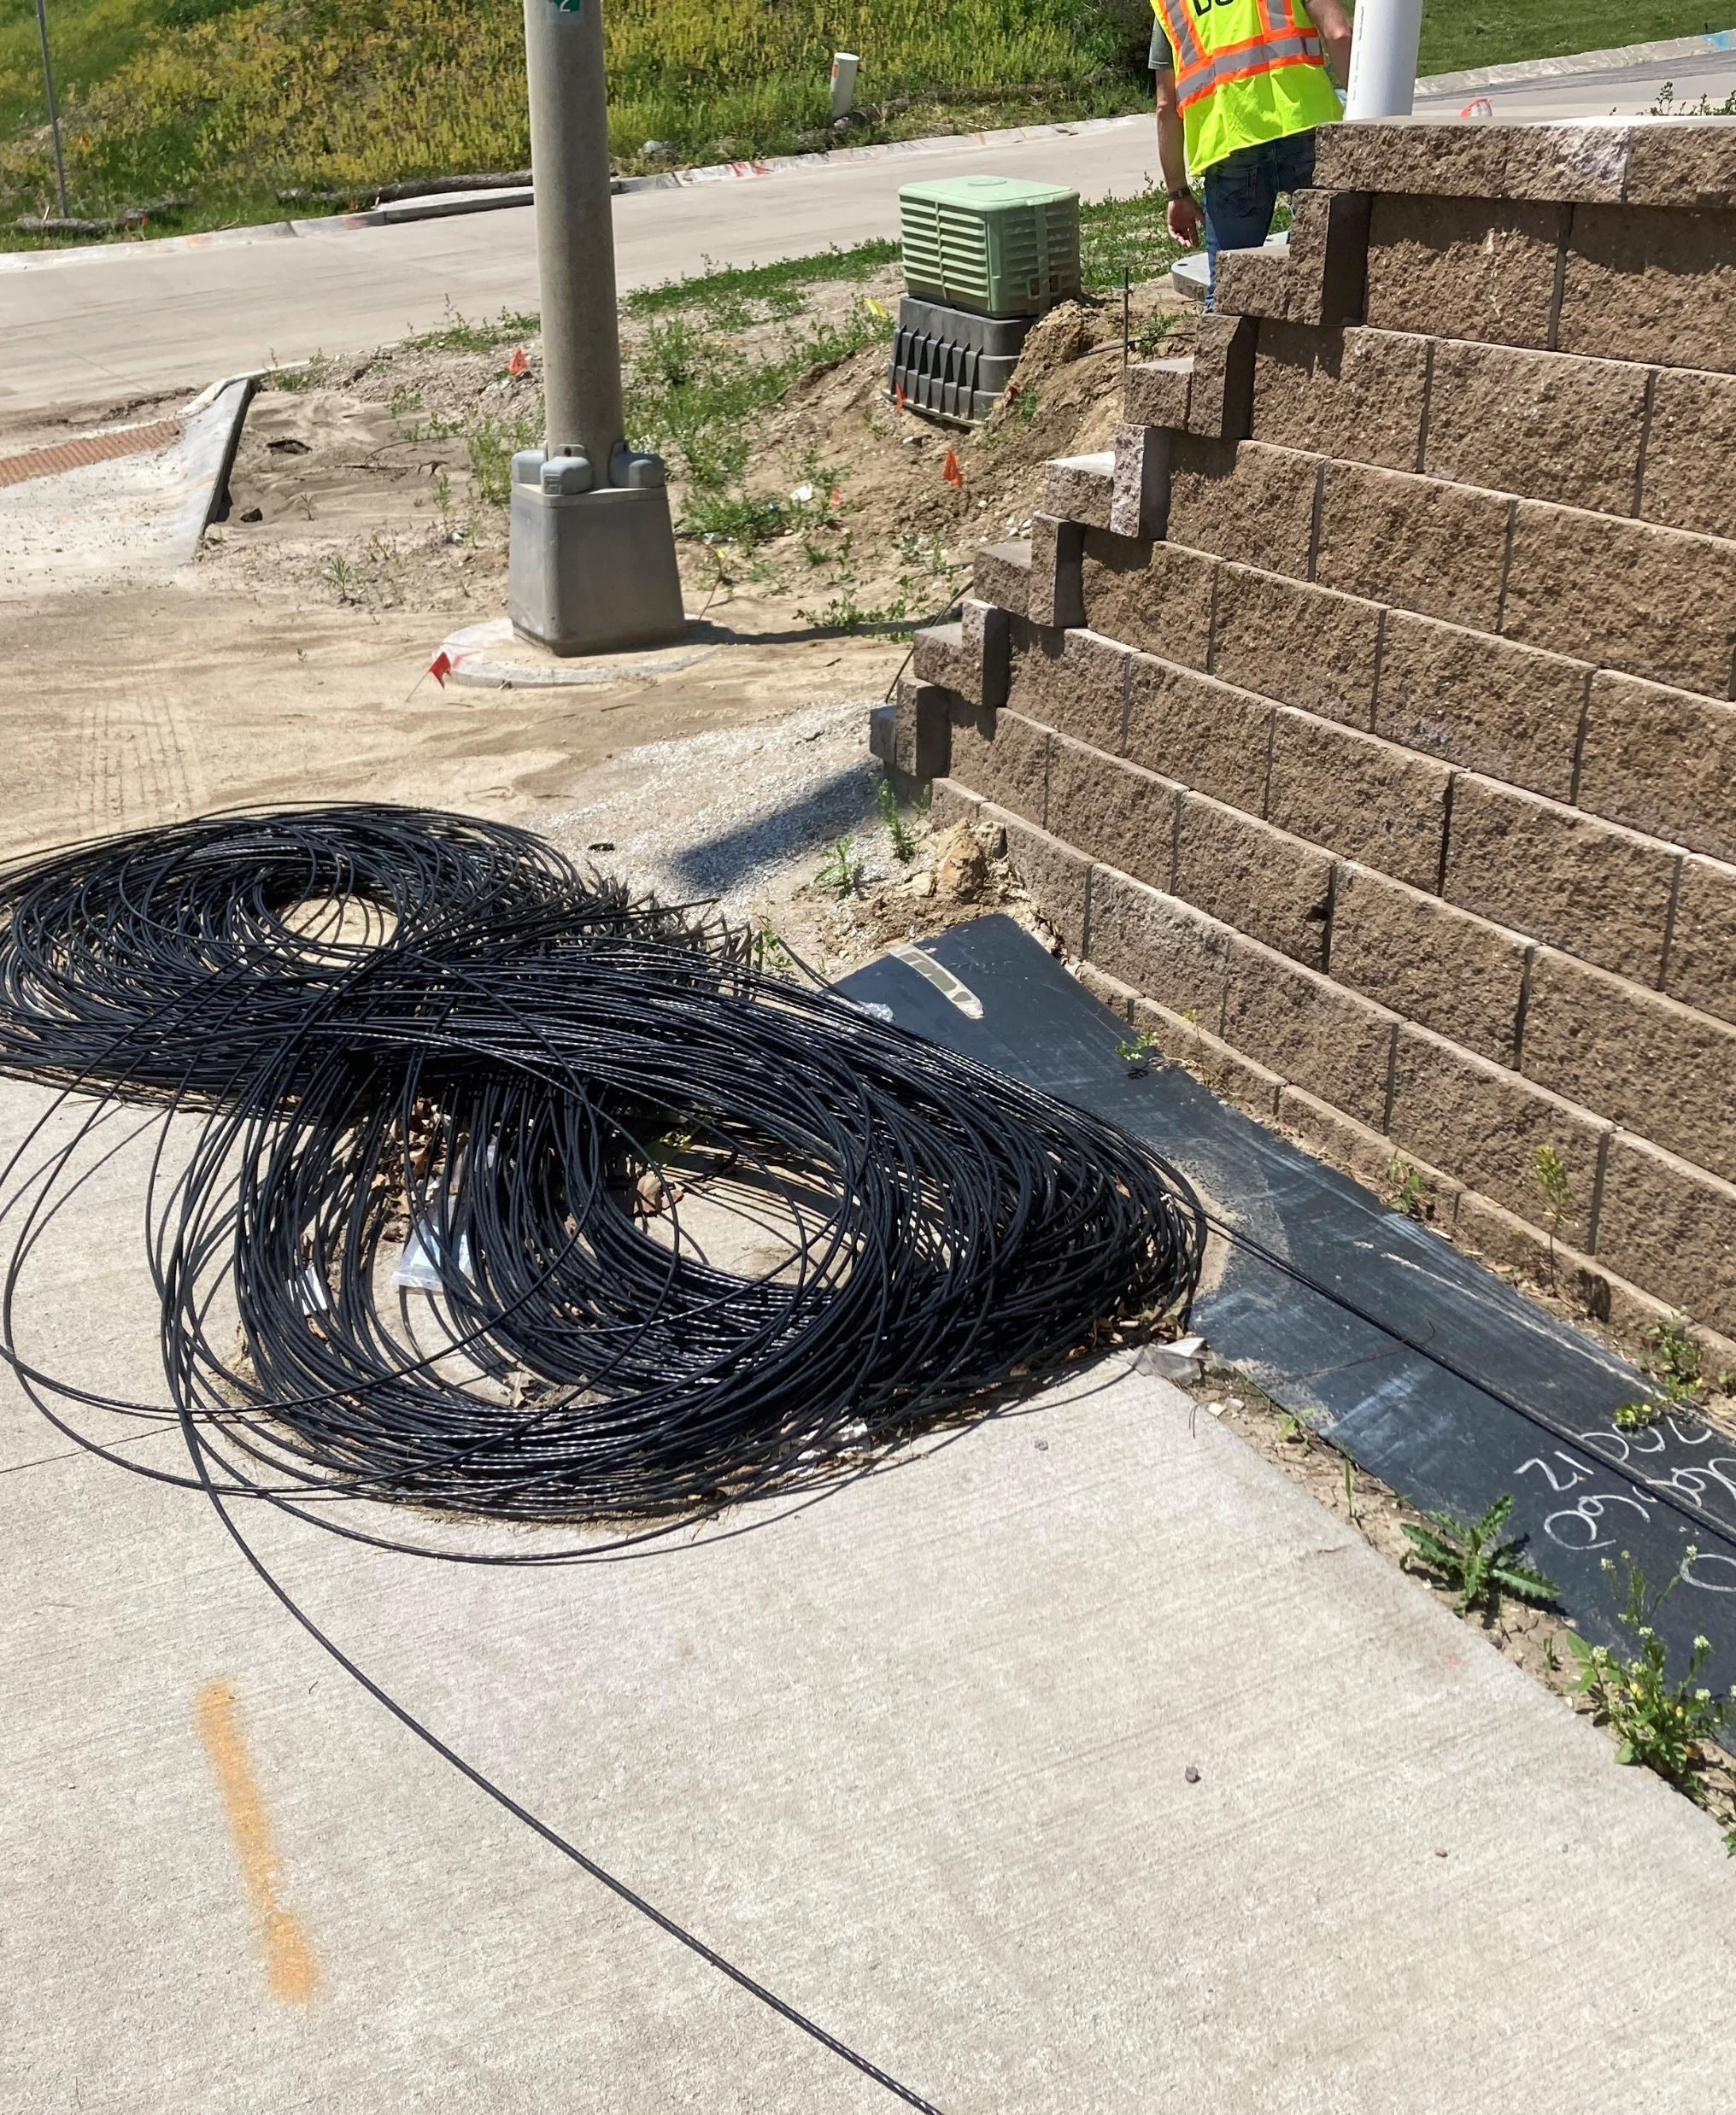
Construction Coordination

Slide 5
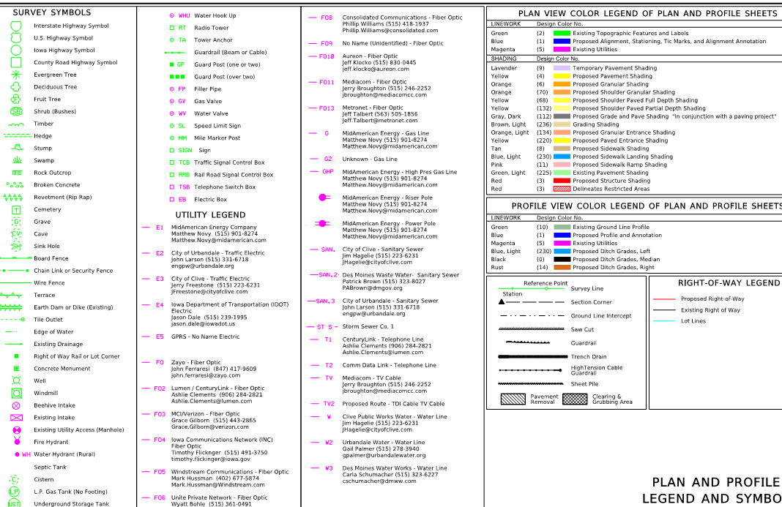
Photo Slide

Slide 6
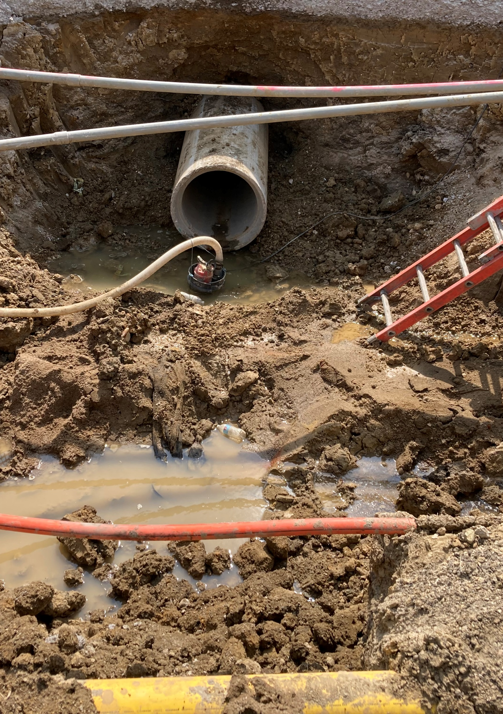




Prior to Construction
Review Plans
Call in Locates
Pothole
Contact Company

Slide 7
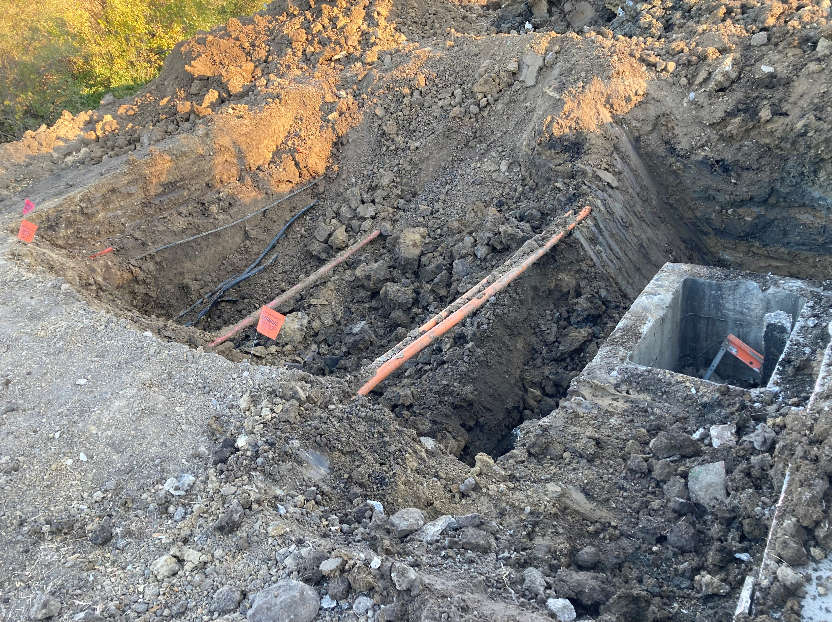
Photo Slide

Slide 8
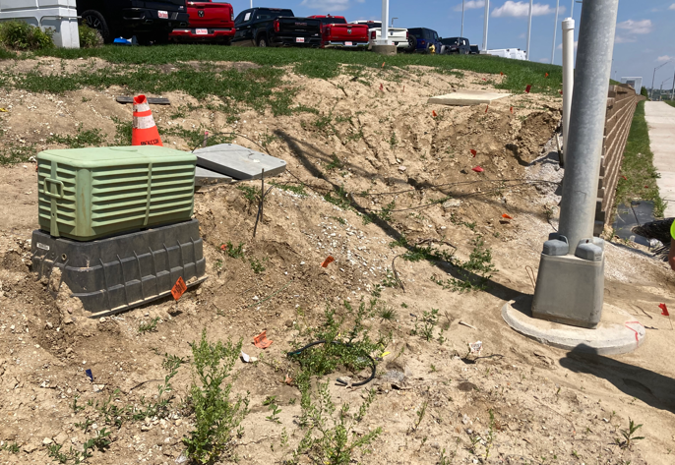
Photo Slide

Slide 9
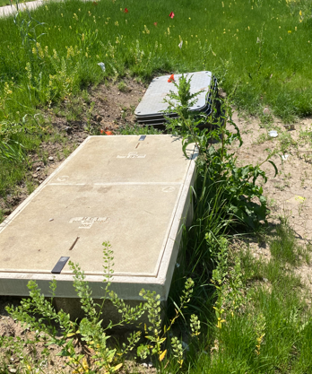
Main Causes of Conflict
Incorrect depth of installation
Installation differs from approved permit
Unknown Installation
Existing installation requiring adjusted

Slide 10
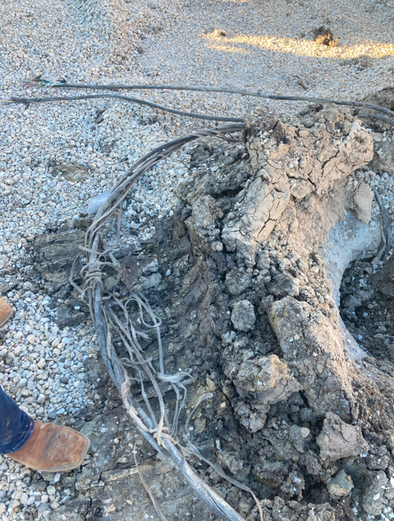
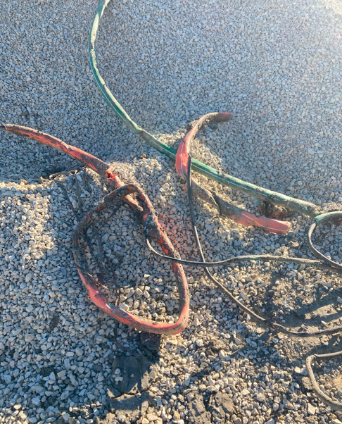
Photo Slide

Slide 11
Questions?
Caleb Wright
515-357-0244
caleb.wright@iowadot.us​
iowadot.gov

