Slide 1
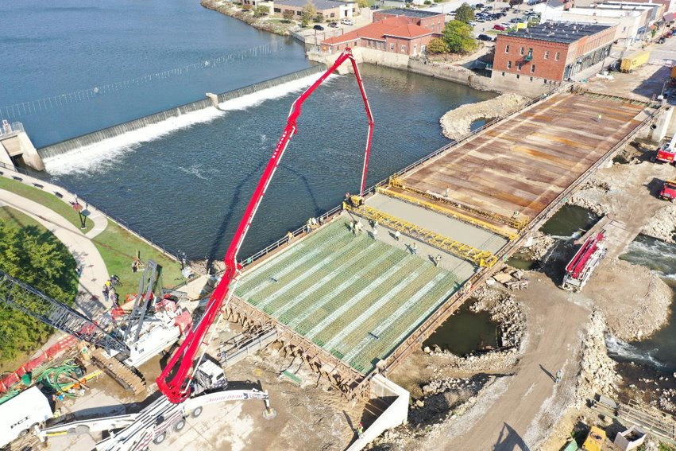


Upcoming Projects
District 2
Mary Kelly
District 2 Assistant District Engineer
March 2, 2026
Mason City
3/2/2023

Slide 2
Iowa Department of Transportation
Mission Statement
Making Lives Better Through
Transportation

Slide 3




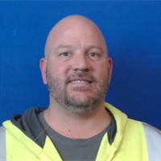
Nick Humpal
District Engineer
641-422-9446
Mary Kelly
Assistant District Engineer
641-422-9442
Daryl Erickson
District Utility Coordinator
641-422-9449
Nick Sorenson
Eastside Permitting
641-394-3161
Mark Nel
Westside Permitting
641-422-9476

Slide 4
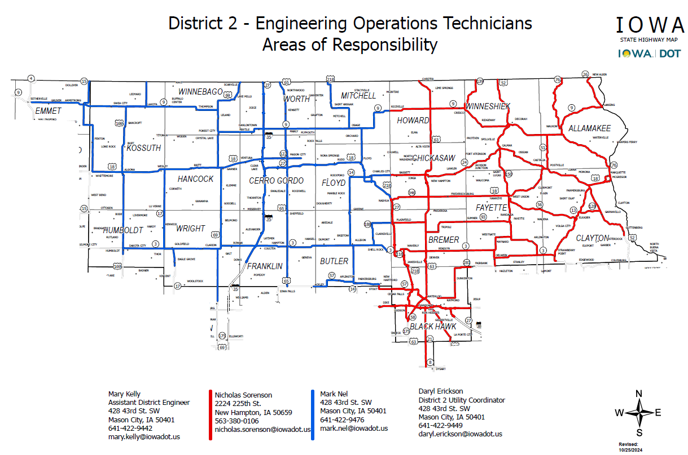

Slide 5





Mason City Construction
New Hampton Construction
Andrew Olson
Resident Construction Engineer
Ron Loecher
Resident Construction Engineer
Roy Gelhaus
District Construction Engineer
Jason Ruter
Construction Supervisor
Tyler Kubik
Construction Supervisor

Slide 6
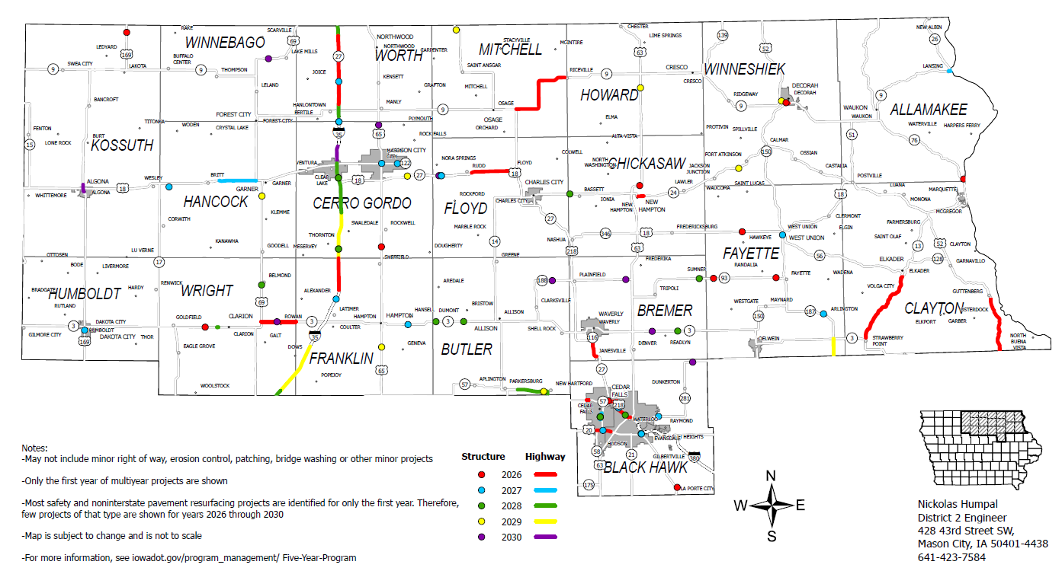
2026-2030 Iowa Highway Program

Slide 7
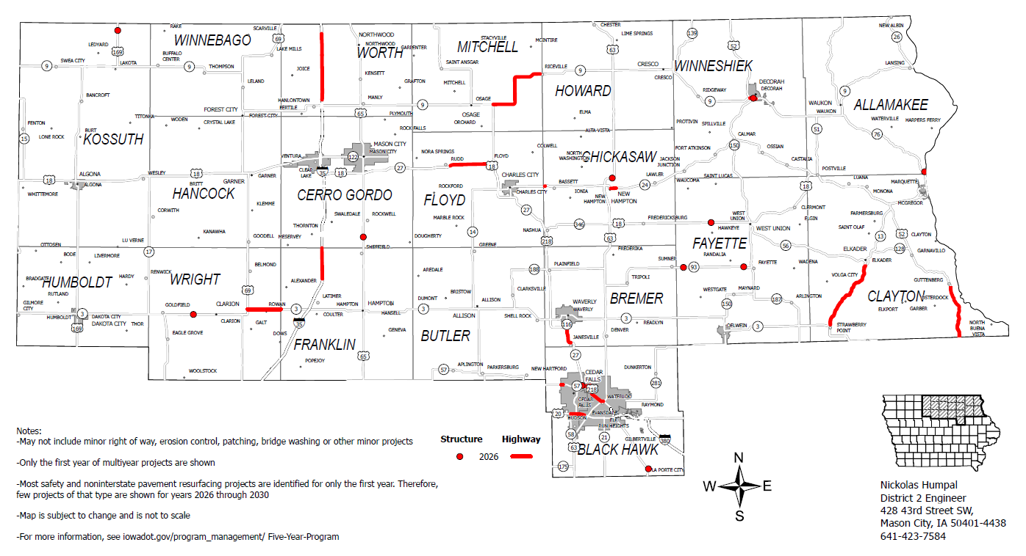
2026 Iowa Highway Program

Slide 8
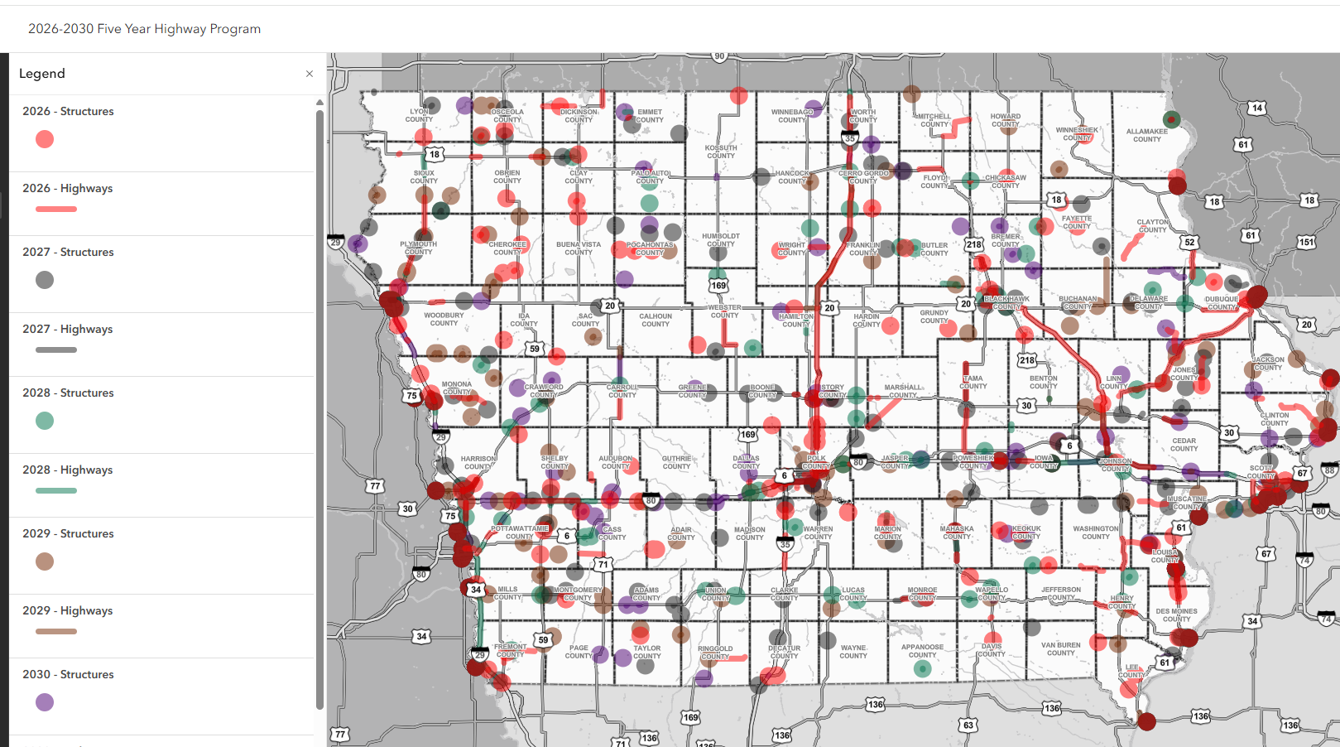
5-Year Highway Program Interactive Map
Link to the interactive 5-year program map:
https://iowadot.gov/transportation-development/future-programs/five-year-highway-program

Slide 9
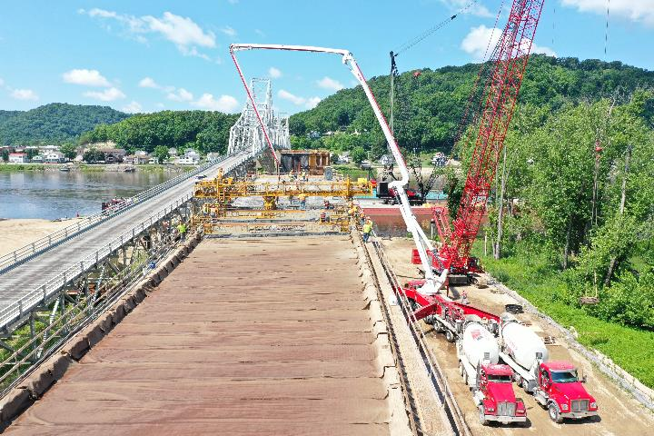
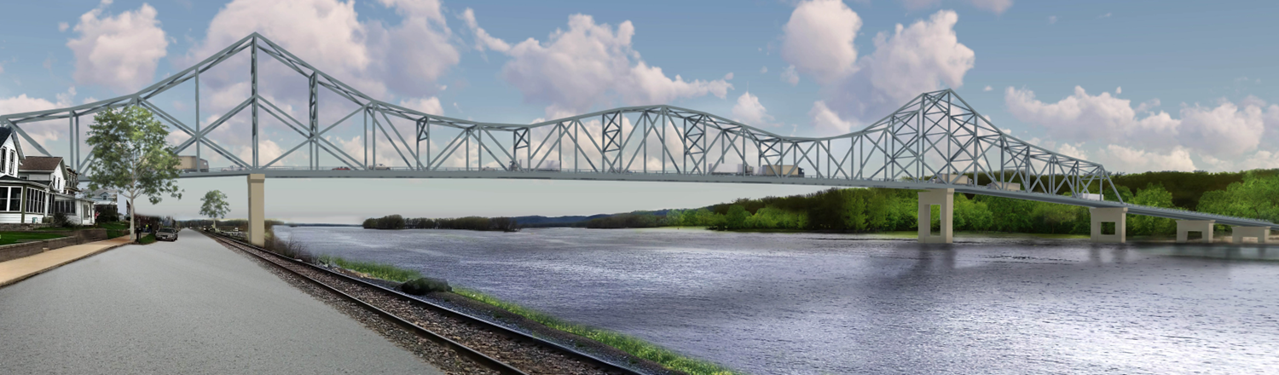
Mississippi River Bridge at Lansing
Bridge Replacement
Let for $124.3 million
Split 50/50 between Iowa and Wisconsin
Bridge closed October 20
Currently being dismantled
Scheduled to open in Spring of 2027
https://iowadot.gov/lansingbridge/Home

Slide 10
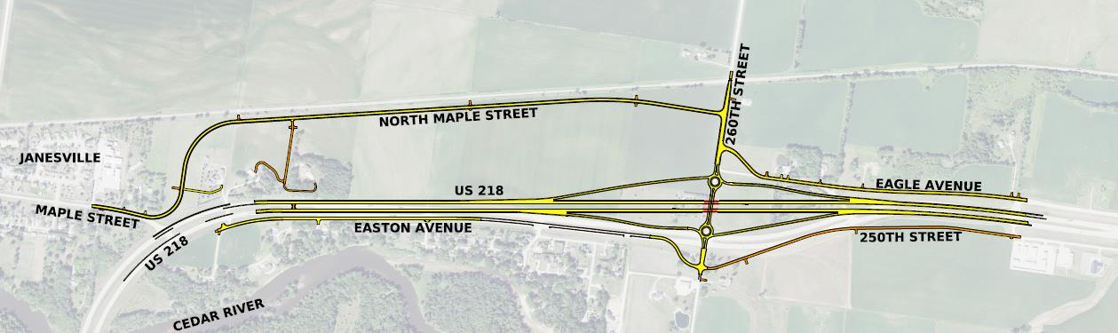
U.S. 218-Bremer County
Reconstruction
Grading project let for $10.1 million (2024)(Completed)
Current grading/paving let for $14.9 million (2026)
Cedar River to IA 116 in Waverly
Currently Under Construction

Slide 11
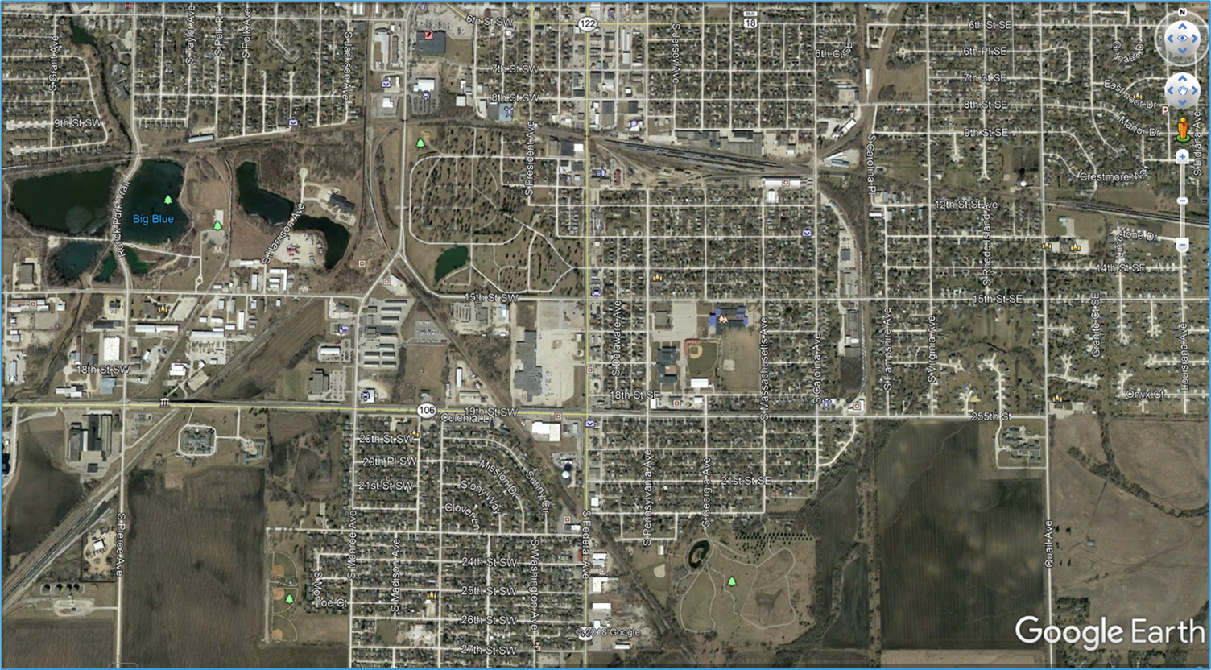






U.S. 65-Mason City
Reconstruction
Let for $13.8 million
0.1 miles S. of 27th St. SW to 6th St. S.
2024-Completed 17th St. S. to 20th St. S.
2025-Completed 6th St. S. to 17th St. S.
2026-20th St. S. to 27th St. S.

Slide 12
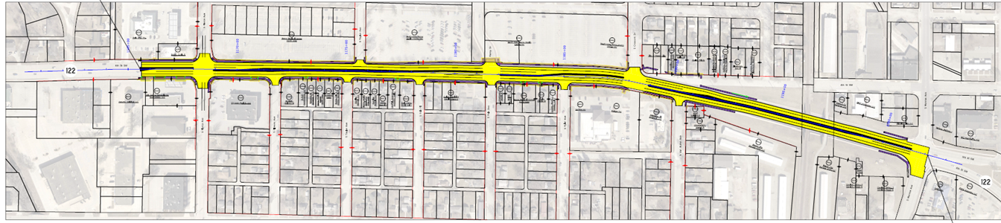


IA 122-Mason City
Pierce Avenue to Monroe Avenue
Reconstruction
Westbound lanes near completion
Eastbound lanes in 2026
Let for $12.5 million

Slide 13
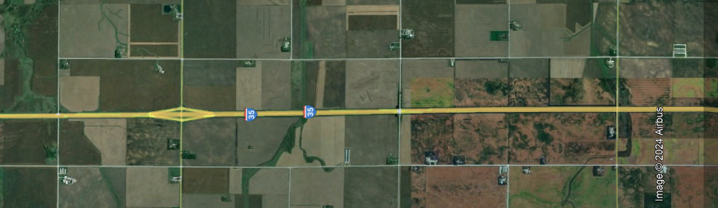

I-35-Franklin County
North
0.5 miles south of County Road C23 to Cerro Gordo County line
Reconstruction in 2026
Let for $14M

Slide 14
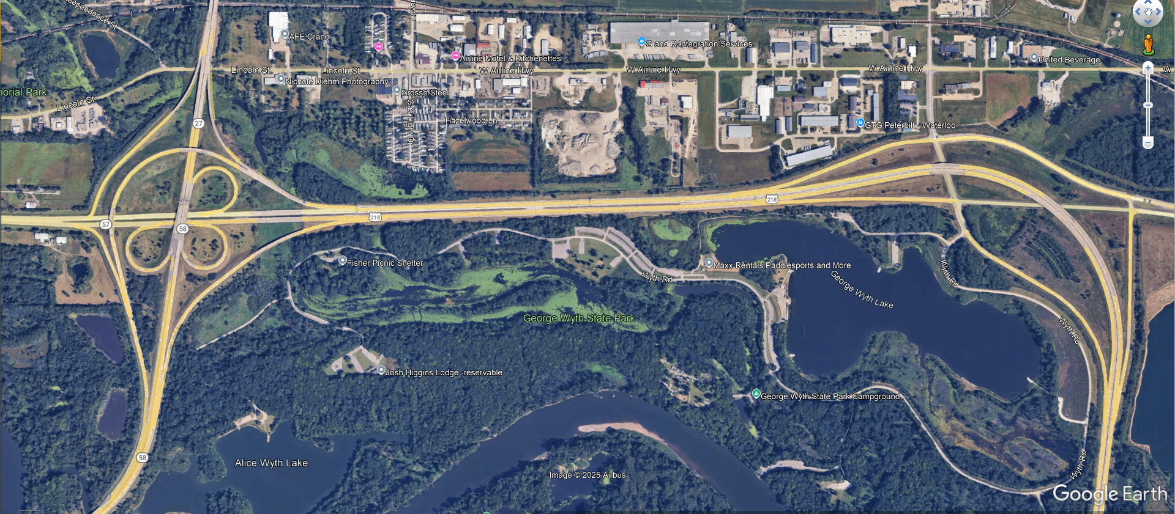




U.S. 218-Waterloo
U.S. 218 from George Wythe State Park to the IA 27/IA 57/IA 58 Interchange (SB)
6.9 miles
2027 Reconstruction
Programmed for $6.9 million

Slide 15
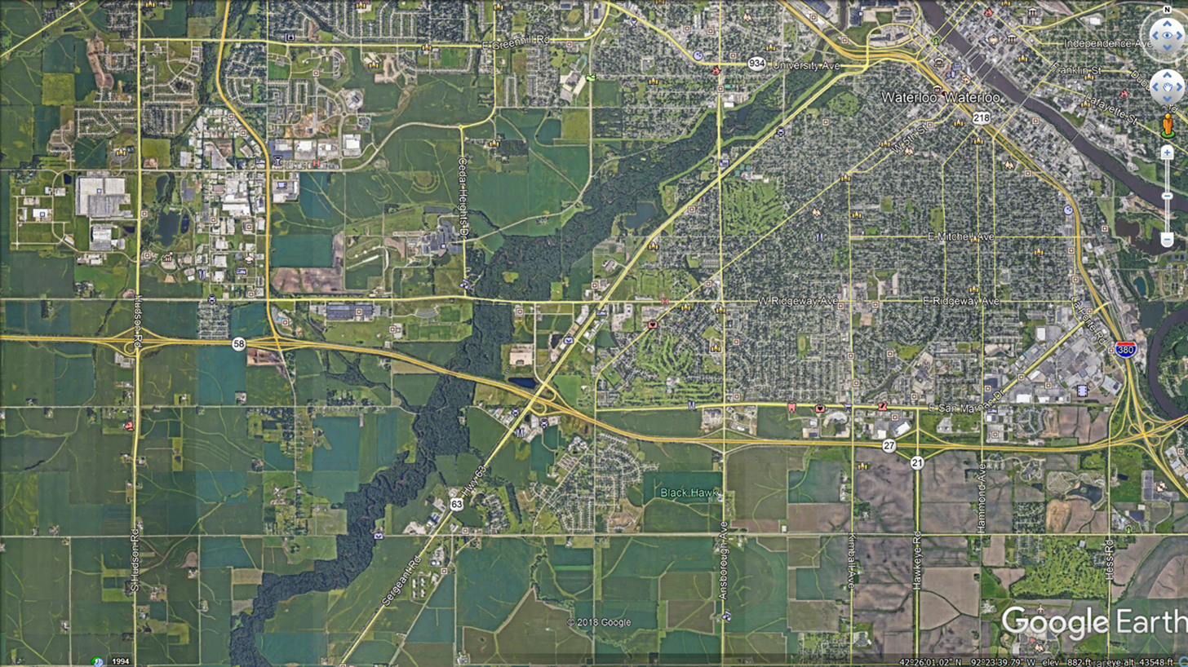
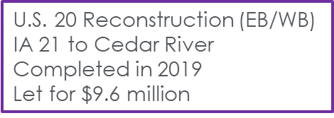






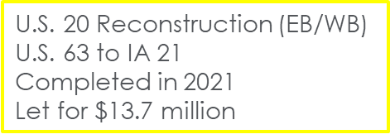
U.S. 20-Waterloo/Cedar Falls
U.S. 20 Reconstruction (EB/WB)
Hudson Rd. to U.S. 63
Constrution in 2026
Let for $21.4 million

Slide 16
IA 57/Union Rd-Cedar Falls
Roundabout
Construction in 2026
$1.8 million (State Share)

Slide 17
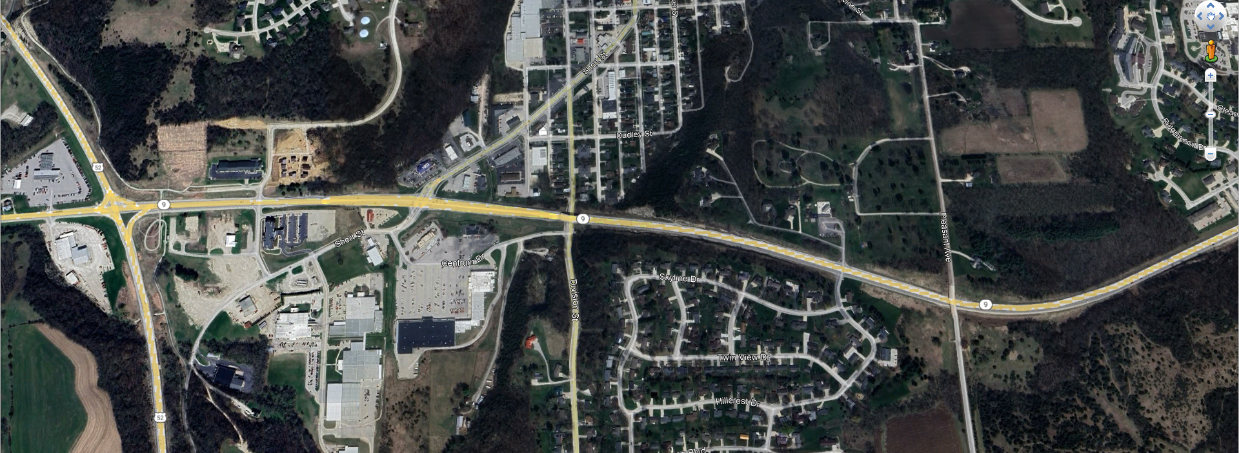
IA 9-Decorah
Reconstruction
U.S. 52 to east of Pleasant Ave.
Construction in 2026
Let for $11.8M

Slide 18
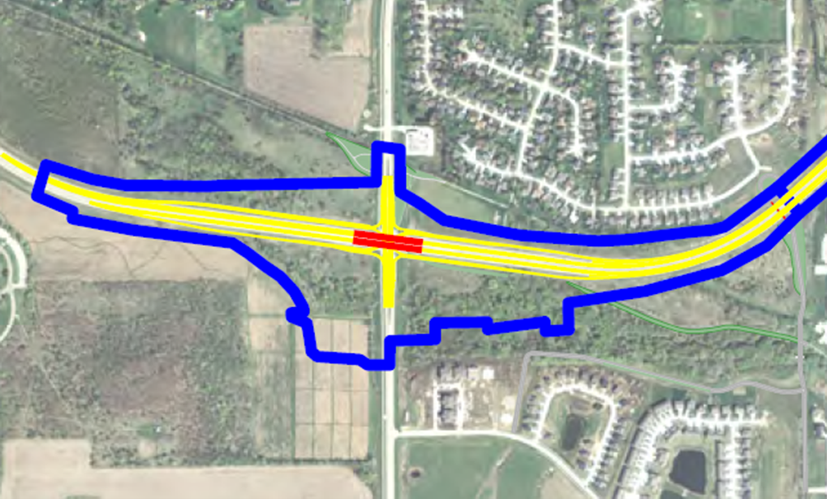
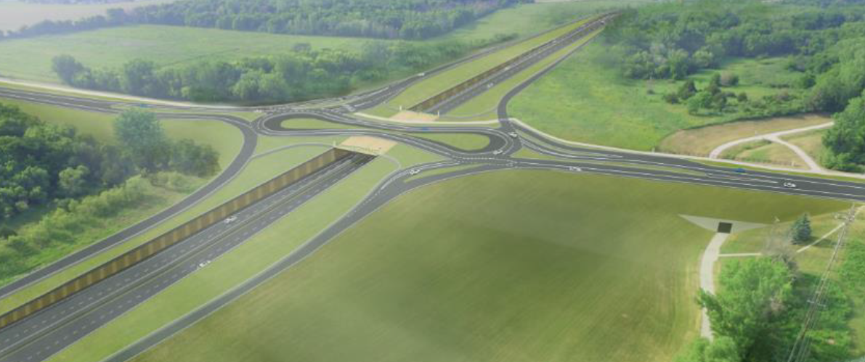
IA 58/Greenhill Rd-Cedar Falls
IA 58/Greenhill Rd Interchange
Estimated at $73M, Underfunded
2028 Letting

Slide 19
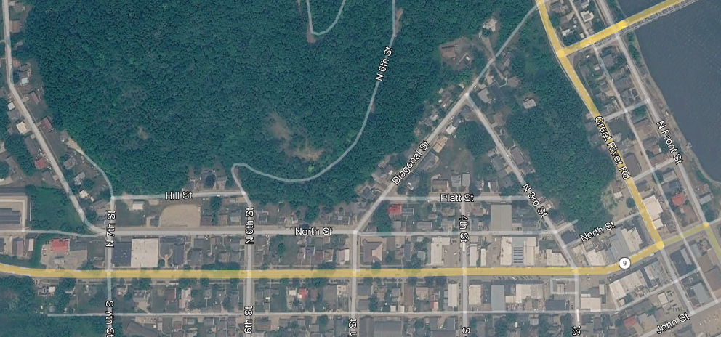
IA 9-Lansing
Reconstruction
N 7th St to near Hale St
Programmed in 2028 for $3.4M

Slide 20
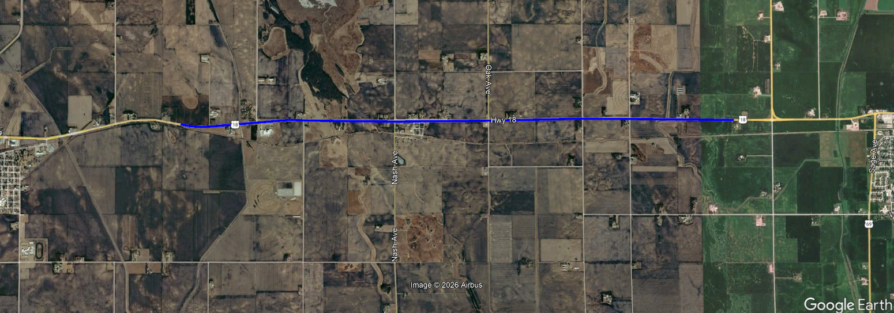
US 18–Super 2
HMA Resurfacing,
Passing and Turn Lanes
2 mi E of Co Rd R35 to W Jct of US 69
Proposed in 2027 for $6.6M

Slide 21
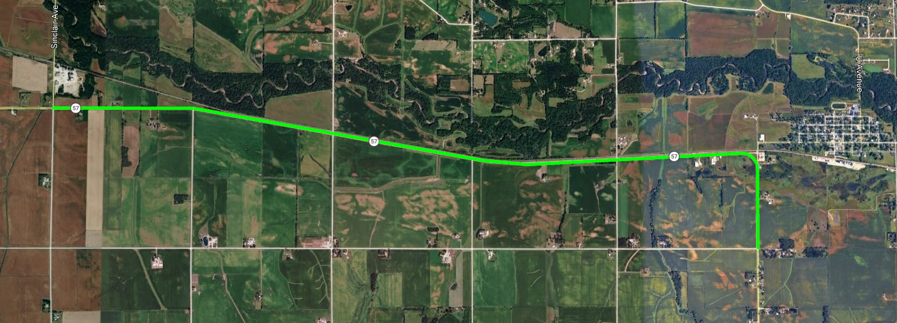
IA 57-Butler County
Reconstruction
From Co Rd T47 to New Hartford Programmed in 2028 for $12.6M

Slide 22
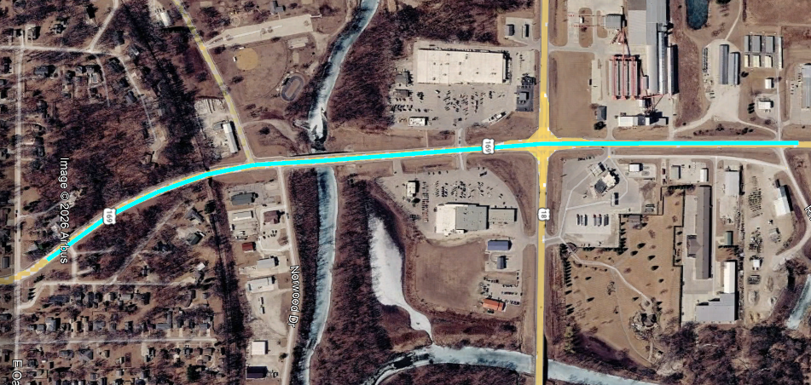
US 169–Algona
North
Reconstruction
South of Maple St. to 0.6 mi north of US 18
Programmed in 2031 for $6.9M

Slide 23
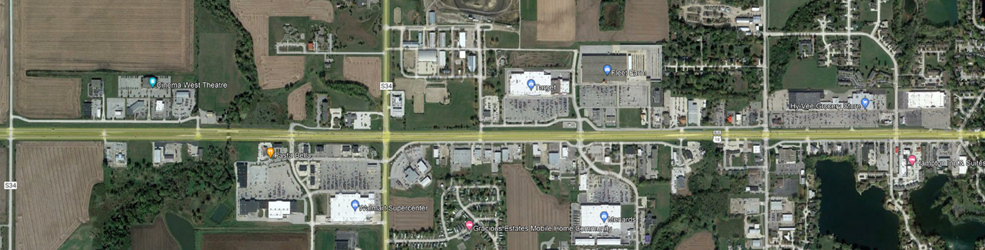





IA 122-Mason City
Lark Avenue to Cerro Gordo/Winnebago Way
Reconstruction
Possibly Adding Roundabouts at 5 Intersections
Estimated Cost of $49 million
Not Currently Programmed

Slide 24
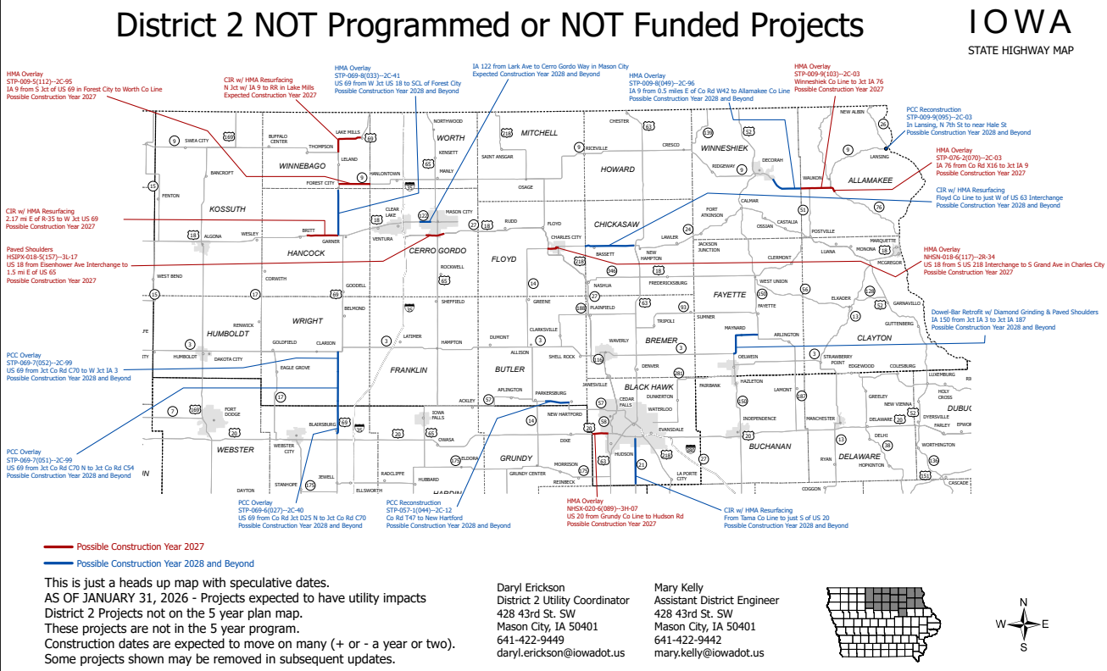

Slide 25
Questions?
Mary Kelly, P.E.
641-422-9442
mary.kelly@iowadot.us
iowadot.gov

