Slide 1



Annual Utility Meeting
District 4 Update
3/2/2023
Wes Mayberry, P.E.
Assistant District Engineer
February 26, 2026

Slide 2

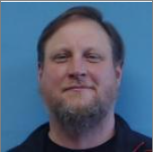
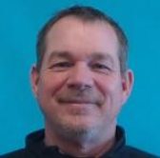
District 4 Staff
Scott Schram
Wes Mayberry
Scott Suhr
Orest Lechnowsky, PE
West Staff Engineer
District Engineer
Assistant Engineer
District Planner

Slide 3
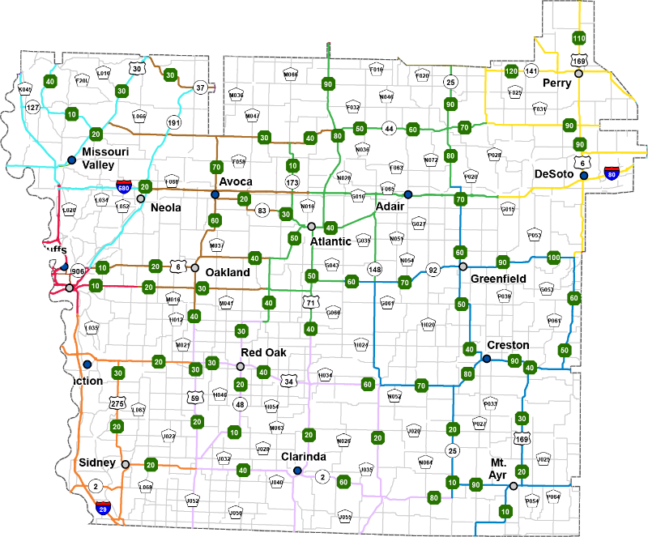
District 4
17 Counties
703 Bridges
3,792 Lane Miles
17 Maintenance Garages
2 Construction Residencies

Slide 4
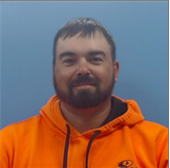

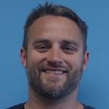
District 4 Utility Staff
assistant district engineer
Nate Epperson
Nick Mocha
Blake Asberry
Engineering Operations Technician
Permits for:
Harrison, Shelby, Pottawattamie, Mills, Montgomery, Fremont, Page
Mike Frank
district engineer
Engineering Operations Technician
Permits for:
Audubon, Guthrie, Dallas, Cass, Adair, Madison, Union, Taylor, Ringgold
District Utility Coordinator

Slide 5
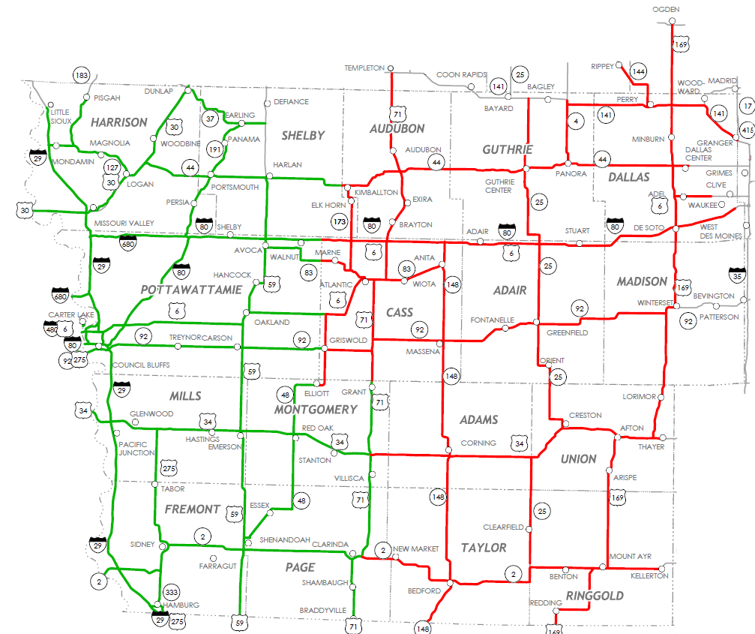
EOT Areas of Responsibilities

Slide 6
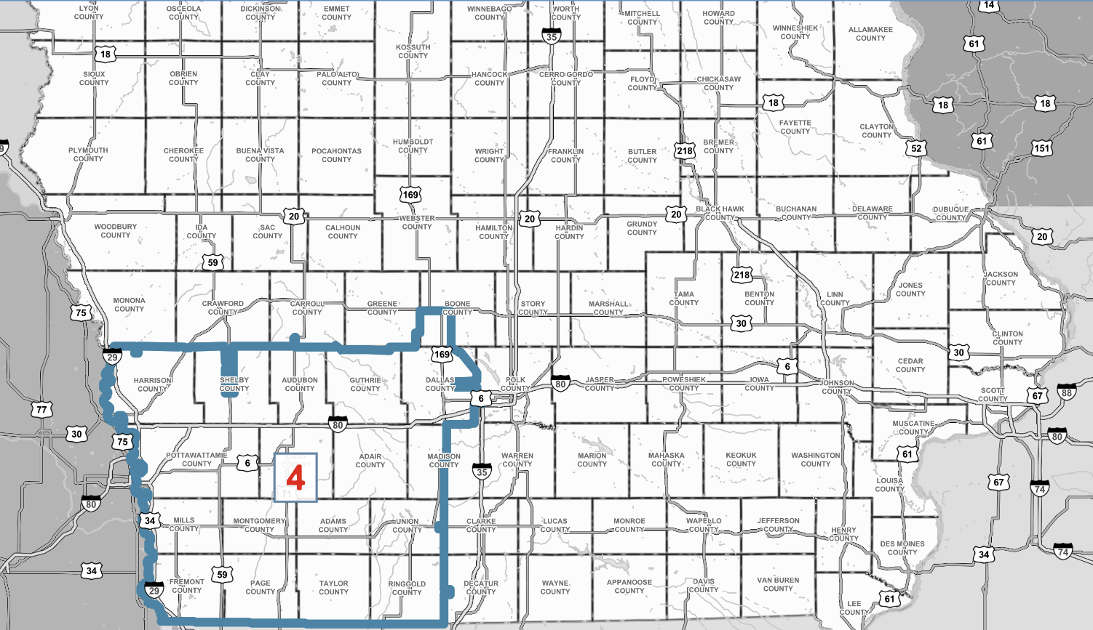
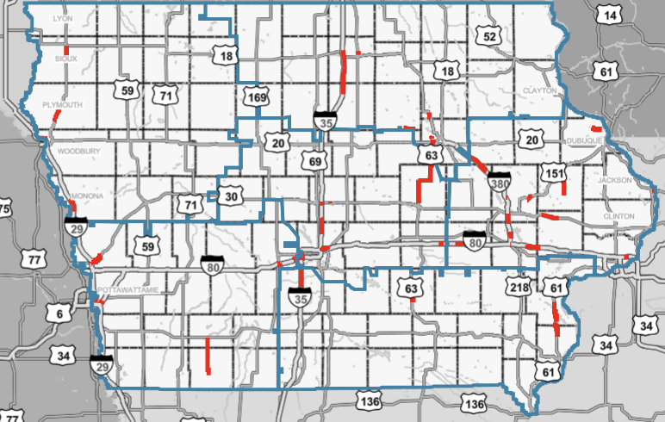
District 4

Slide 7
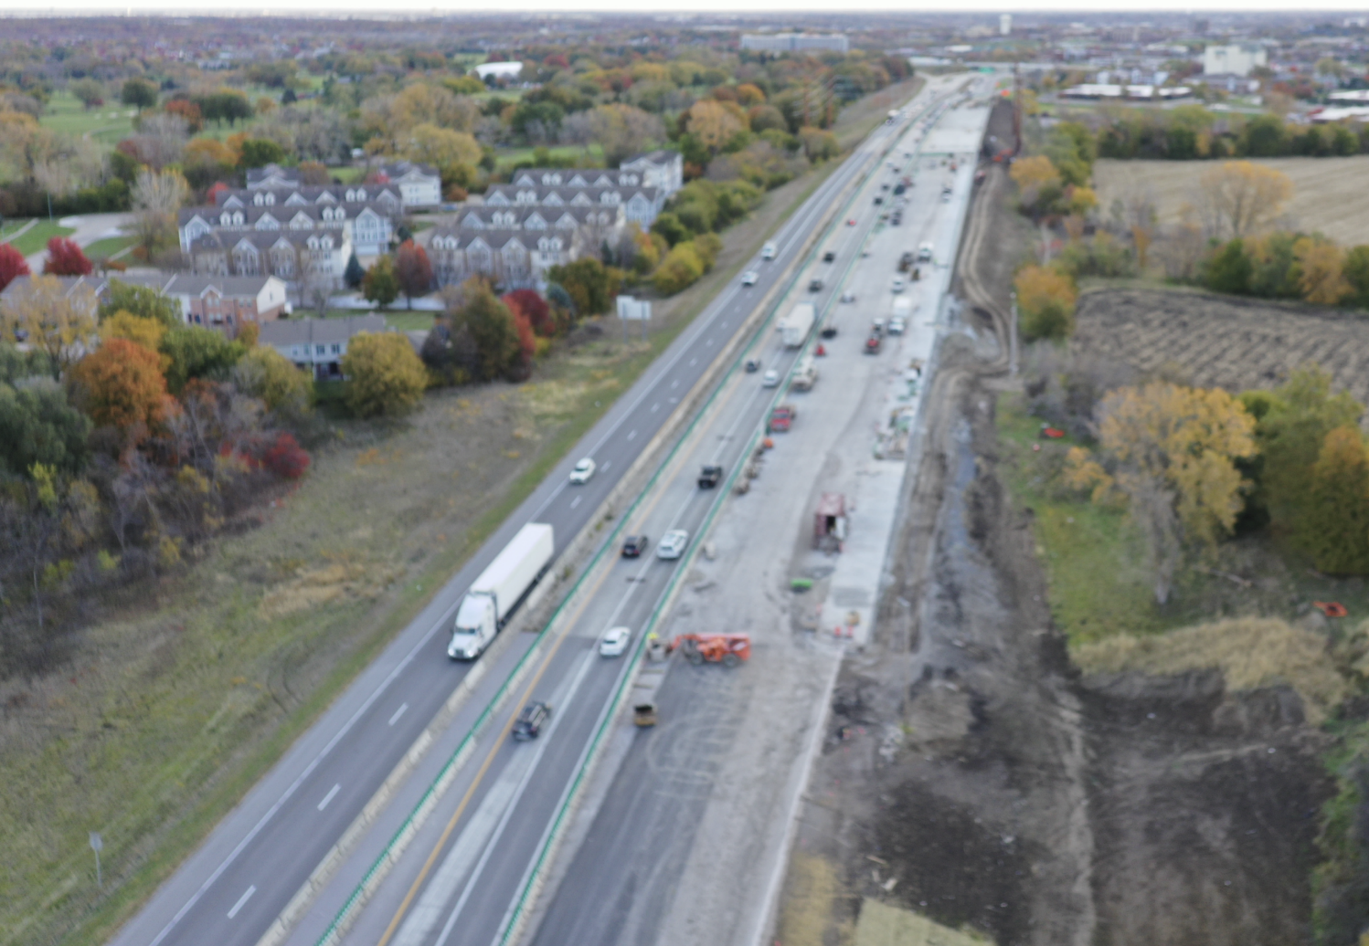
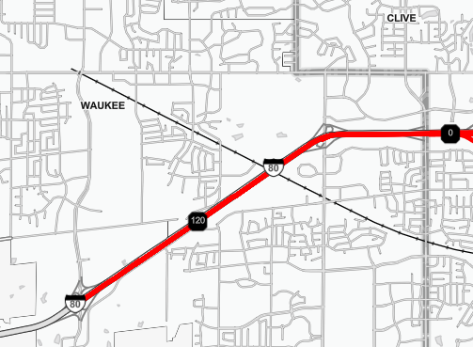
Major
Projects
District 4
I 80 Dallas County Grand Prairie to Jordan Creek
EB:
Intermediate lift of HMA is finished.
Open to Traffic
Final surface lift placed Spring 2026
WB
Let 1/21/2026
1/21/2026 Letting
I 80 Dallas County Grand Prairie to Jordan Creek
Grand Prairie Parkway to Jordan Creek
Bridges/Grade/Pave
2024 - $20M Bridge COMPLETE
2025 - $24.2M Bridge/Paving COMPLETE
2026 - $24.2M Bridge/Paving

Slide 8
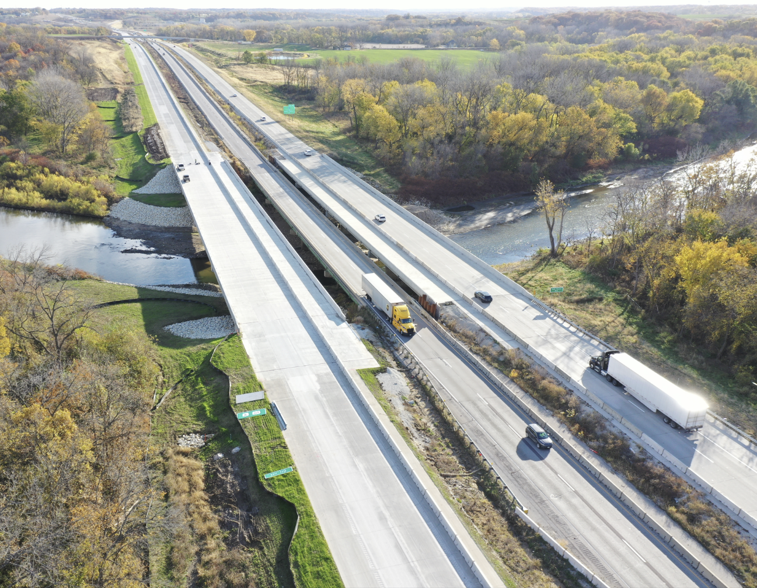
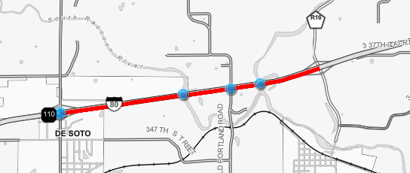
Major
Projects
District 4
I 80 Dallas County Racoon River Bridges
US 6/US 169 in DeSoto to Co Rd R16
Widening and Bridge Replacement at the South and North Raccoon Rivers
All Lanes Open 11/19/2025
Remove old EB pavement in 2026

Slide 9
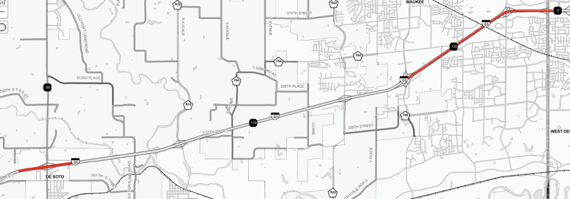
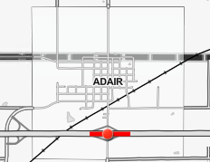
Major
Projects
District 4
I 80 Dallas County
Grand Prairie Parkway to Jordan Creek
Widen to 6 Lanes
FY26: $24.2 WB Bridges and Paving
I 80 Dallas County
US 6 / US 169 Desoto Interchange
I-80 Bridge Replacements
FY27 – ROW/Structures
$25.9M
Adair I 80
Adair Interchange
2029 – ROW
2030 – Bridge Replacement
$3.955 M
Notes:
Updated Adair 2028 to 2029/2030

Slide 10
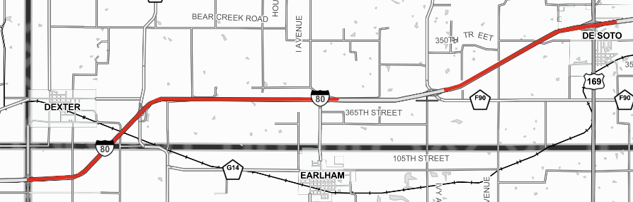
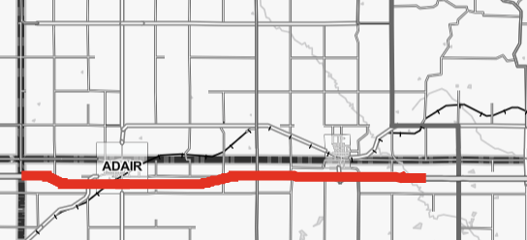
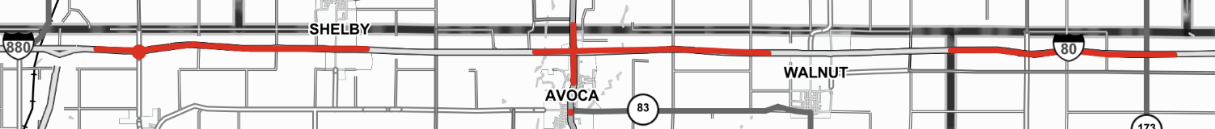
Adair I 80
Cass Co to IA 25 (WB)
2025 Resurfacing
$4 M
COMPLETE
Major
Projects
District 4
I 80 Dallas County
E of Co Rd P58 to 0.5 mi E of US 169 (WB)
2030 Resurfacing
$3.778M
I 80 Dallas County
CO RD P48 TO DALLAS CO (EB)
FY30 HMA Resurfacing ($2.43M)
I 80 Dallas County
MADISON CO TO 0.7 MI E OF CO RD P53 (WB)
FY30 HMA Resurfacing ($2.07M)
I 80 Pottawattamie County
CO RD L66 Interchange
FY30 Bridge New ($12.1M)
I 80 Pottawattamie County
0.4 mi E of I-880 to 0.1 mi W of Silver Creek Bridge (WB)
2026 Patching
$1.4M
I 80 Pottawattamie County
W Nishnabotna River to 0.7 mi E of Rest Area (EB)
2028 Resurfacing
$5.1M
I 80 Cass County
Pottawattamie Co to E of IA 173 (EB)
2028 Resurfacing
$2.5M
I 80 Pottawattamie County
In Avoca, Pershing St to S of Co Rd F66
FY27 Grade & Pave ($13.42M)

Slide 11
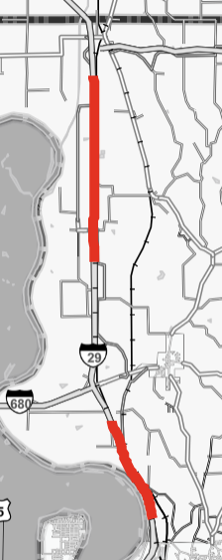
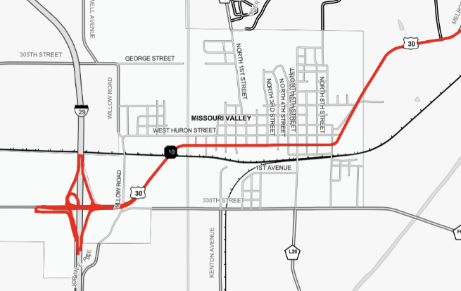
Major
Projects
District 4
I 29 Pottawattamie County
0.9 mi S of Co Rd L19 to S of I-880 (SB)
2026 PCC Overlay
$6.5M
US 30 Harrison County
Missouri Valley Bypass
$35M Bridges and Grading 7/20/2027
$29M Paving 7/17/2029
I 29 Pottawattamie County
0.6 mi N of NCL Council Bluffs to 1.1 mi S of I-680 (SB)
FY30 HMA Resurfacing ($2.49M)
I 29 Pottawattamie County
AT THE IA 192 INTERCHANGE IN COUNCIL BLUFFS (NB)
FY27 Bridge Replacement ($9.062M)
Notes:
Added PCC Overlay in 2026 and bridge replacement in FY27

Slide 12
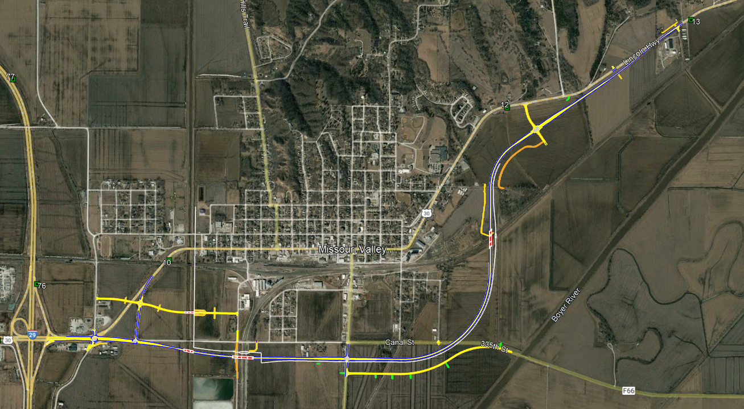
Highway 30
Missouri Valley by-pass
FY 26 Right of way programmed
FY 28 grading and culverts
FY 30 Paving

Slide 13
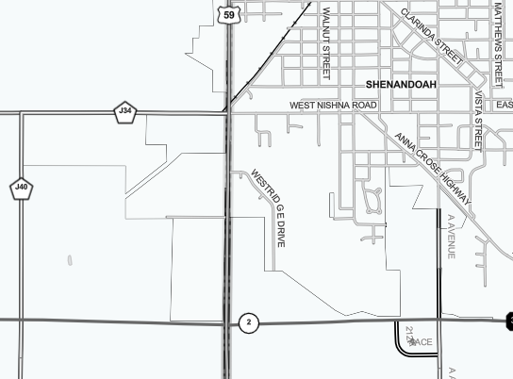
Major
Projects
District 4
*Safety Project * US 59 Page County
IA 2 Intersection
FY27 Grade & Pave ($2.58M)
Roundabout
Notes:
There are 3 Fremont County Bridges, but one is a small $500K deck overlay, not considered a major project..

Slide 14
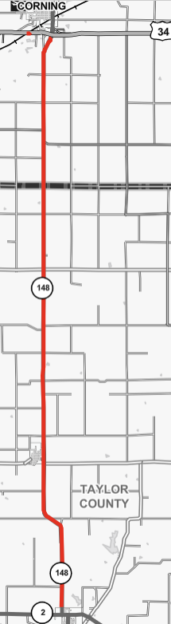
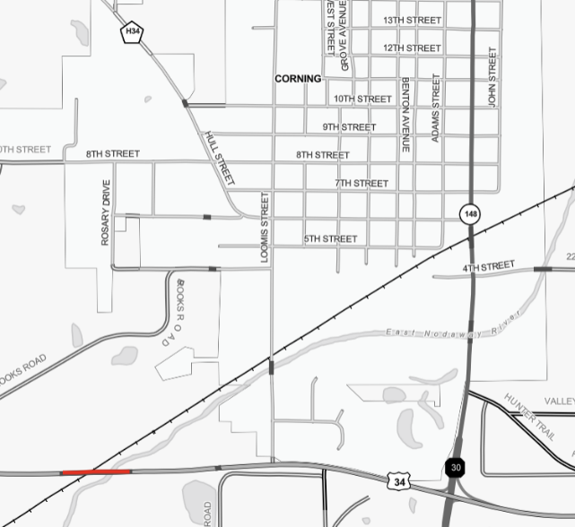
Major
Projects
District 4
Adams US 34
West of Corning
2028 – ROW / Structures
$16.4 M
Taylor IA 148
NCL Bedford to US 34
Pavement Rehab
$12.3M
COMPLETE

Slide 15
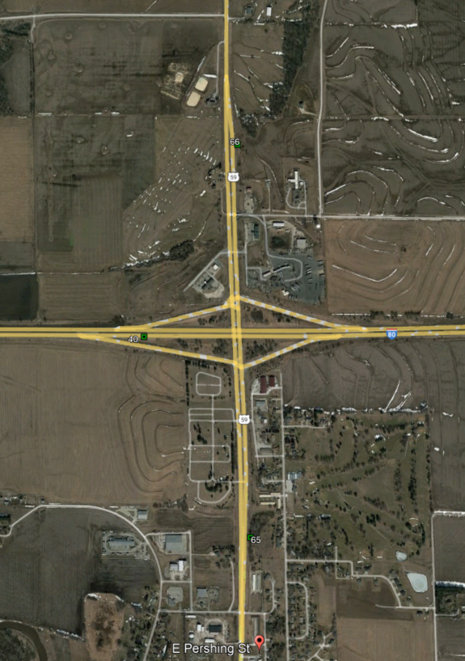
Hwy 59 – City of Avoca (Rural Section)
Programmed FY 28

Slide 16
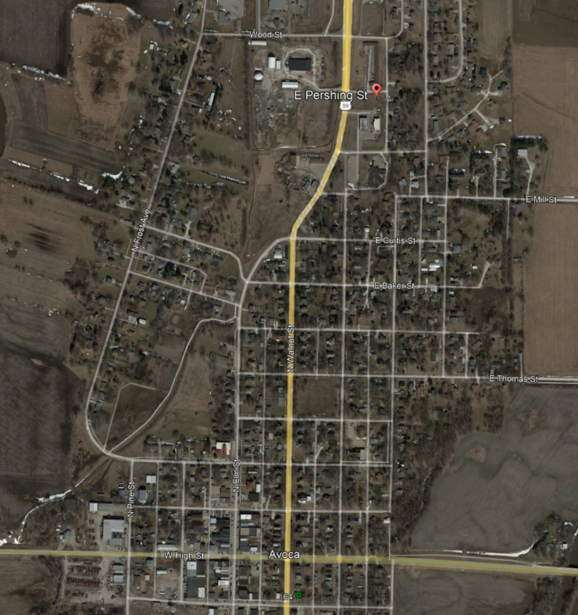
Hwy 59 – City of Avoca (Urban Section)
Programmed FY 29

Slide 17
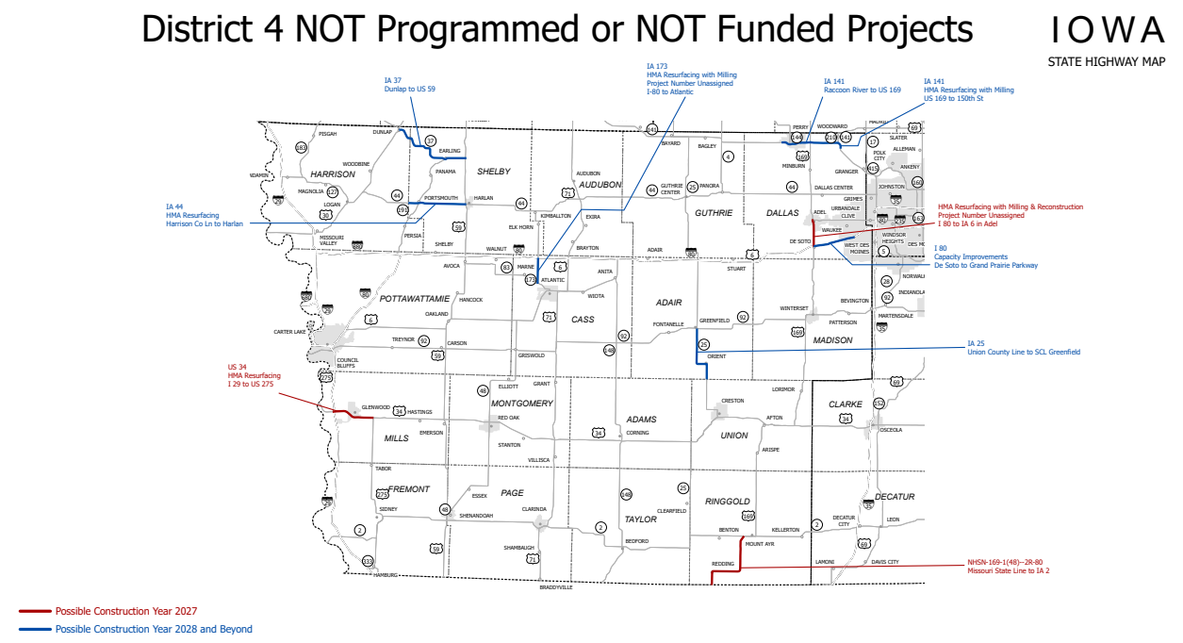

Slide 18
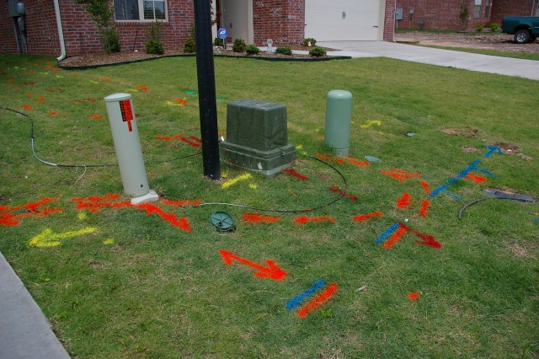
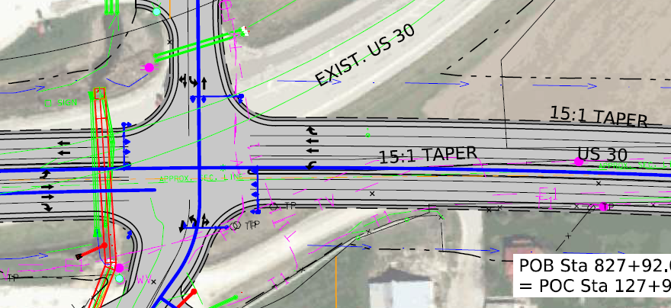

Survey – Utility Locates
One call locates vs private locates
Survey

Slide 19
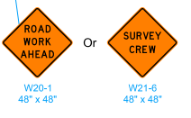
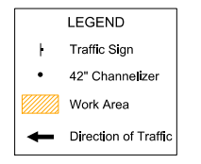
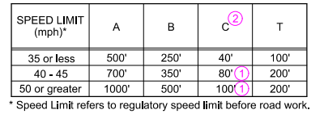
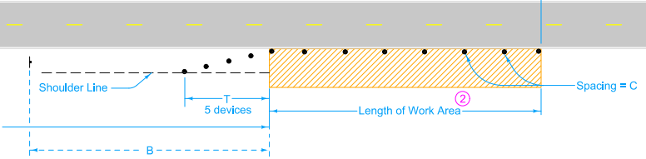
Traffic Control Standard Road Plans
Sign Sizes
Channelizers
Spacing

Slide 20
Questions?
Wes Mayberry, P.E.
712-250-0496 (cell)
Wes.mayberry@iowadot.us​
iowadot.gov

